Slide 1
Project Uno
Nicole Nanton, Clinton Waters, Kasa Ftwi, Jorge Torres, Nell Meier

Slide 2


Initial Attempt: Netflix Vs. Hulu
Which streaming service provider is top dog?
Who has the biggest subscriber base?
Who has the biggest offering?
Who has the most original content?
How do the genres compare between both services?
What service is worth the subscription cost with a cost matrix?
However…
API info for these services is not readily available.
Lots of 3rd party methods but did not find anything direct.
Data posted online was incomplete and missing attributes.
We questioned the data sources. Yes, we Kaggle too..

Slide 3
We had to look for an Alternative
We knew as a group we had to achieve the following:
Interact with an API
Incorporate data frames
Cleansing data, even for a little transformation/cleaning.
Create a CSV
Use a CSV or API for data frames
Create charts
Pie
Bar
Gmaps
Learn a fact about places

Slide 4


Project Uno: Re-Do
Yelp is a business directory service and crowd-sourced review forum, and a public company of the same name that is headquartered in San Francisco, California. The company develops, hosts and markets the Yelp.com website and the Yelp mobile app, which publish crowd-sourced reviews about businesses.
Yelp operates an online reservation service called Yelp Reservations.
Yelp has data that is available to the public.
Yelp has an API that can be used by new users.

Slide 5
Project Uno:
Yelp API – Limitations/Considerations
There is a limitation of 5,000 calls a day.
Requires authentication with a Bearer token, which is different from how we learned to construct URL’s in class.
Can only return up to 50 businesses in each search
Yelp’s open data was over 3GB, not a work around.
No command of yelp API details
We leverage a 3rd party application to understand how to use the API:
Application: Postman
Bearer Token
Response Data

Slide 6
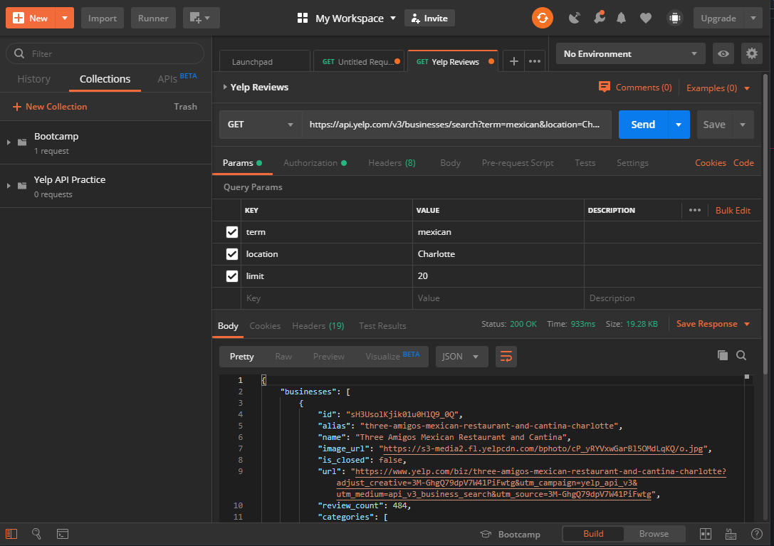
Postman:
Had to learn how to interact with the API
Provided confidence that we can proceed with the new idea
Validated that we had enough business attributes to develop a point of view
Can play with the API to allow our creativity in approach.

Slide 7
Yelp Questions:
How often do chain restaurants show up?
Which city has the highest concentration of popular chain restaurants?
What is the relationship between average review and review count?
What are the top 5 popular foods based on number of reviews?
What are the top 5 least popular foods based on number of reviews?
What is the most popular cuisine based on ratings by individual city?
Which region has the most expensive restaurant, what does it look like visualized.
Where are the following located using maps:
5-star restaurants
4-star restaurants
3-star restaurants

Slide 8
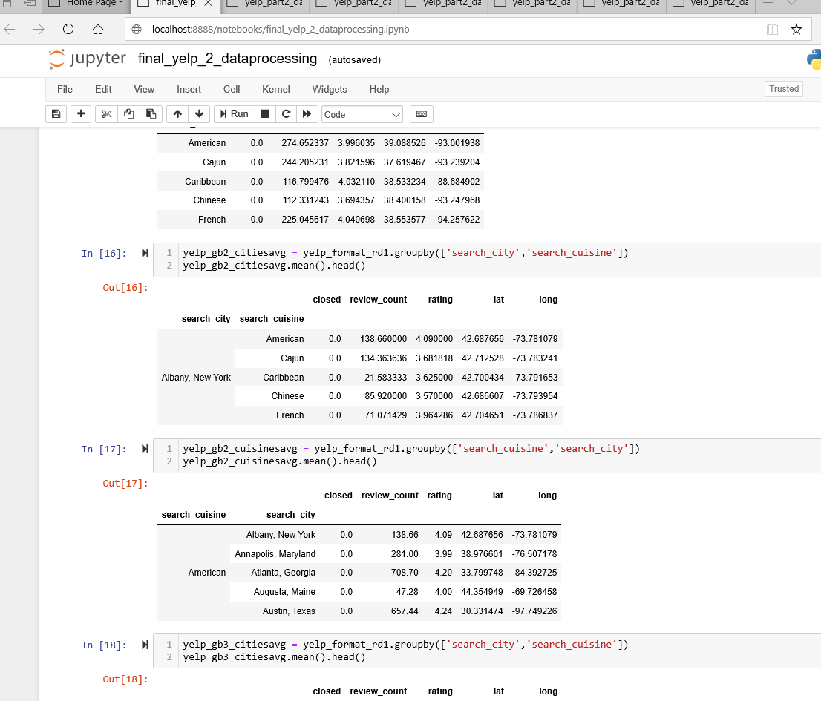
Libraries/Modules used in Project Uno
CSV
To manage our exports and imports
Request
To contact Yelp using their API
MatPlotLib
To get our chart game on
Gmaps
To apply a little heat
Pandas
Clean and filter
OS
To work with best practices for file paths, limited use, but used.

Slide 9

Scope of Data Extract from API
Cities (50 were used)
US State Capitals: Internet Search https://www.google.com
Cuisines (20 were used):
Popular cuisines/food types per https://www.herinterest.com/types-of-cuisine/
API Calls (50 cities x 20 cuisines) = 1000 calls
Over 27,000 records of data via just API extract

Slide 10
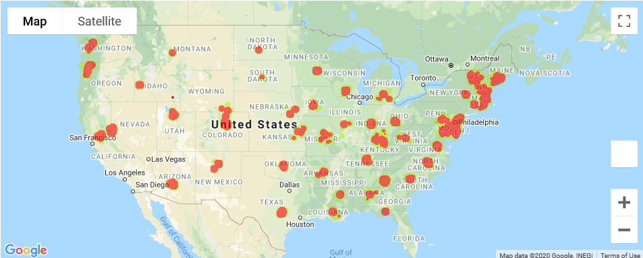
US Capitals Used for Data Capture
Heat map of over 27,000 locations using their rating count for the Heat

Slide 11
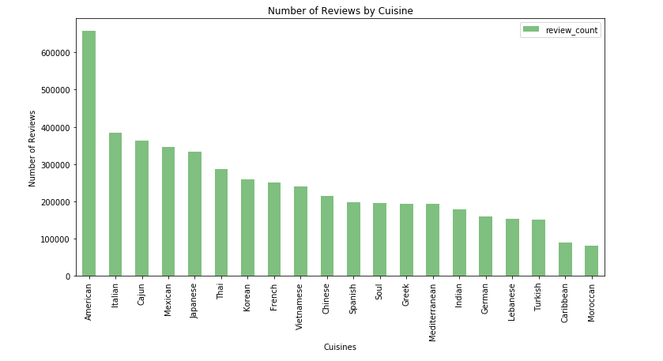
Number of Reviews for Each Cuisine - Count

Slide 12
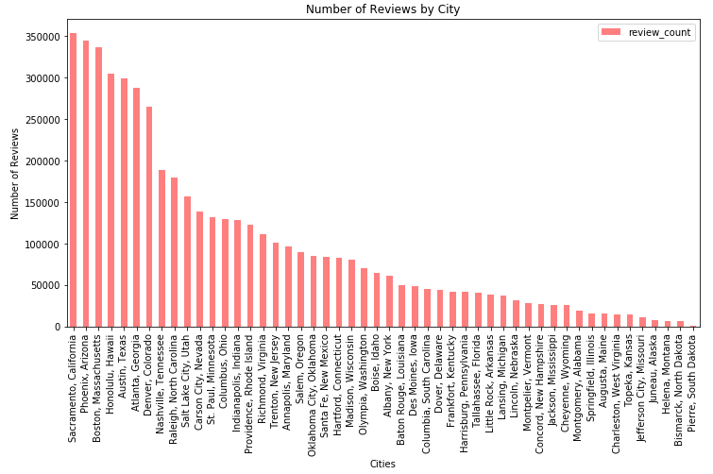
Number of Reviews per City

Slide 13
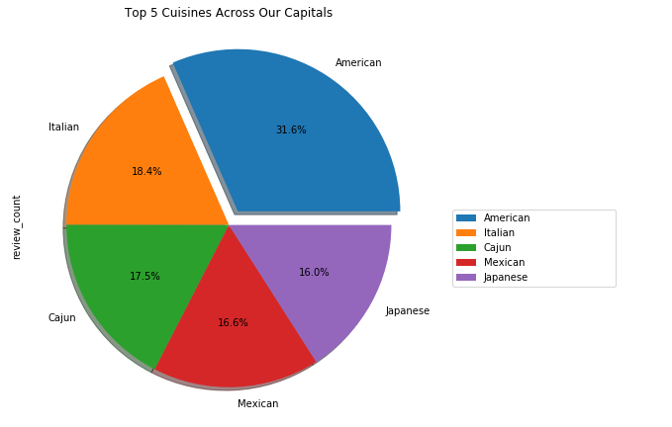
Top 5 Cuisines Across Capitals
We wanted to know which types of cuisines had the highest count of reviews
In the capitals, American cuisine led at 31.6%.
The next highest percentages were all in the teens

Slide 14
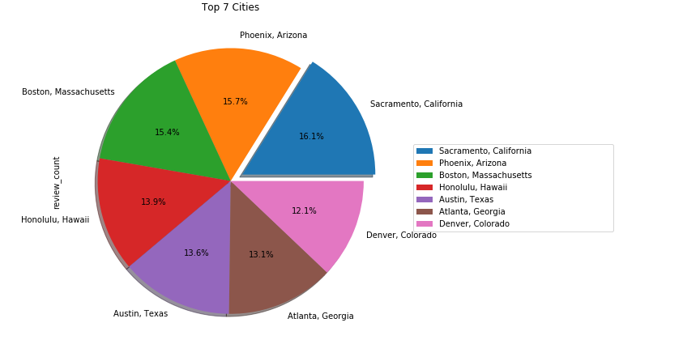
Top 7 Cities with the most Reviews
We wanted to know which cities had the highest count of reviews
We narrowed it down to the top 7- after the top 7, the review count dipped sharply

Slide 15
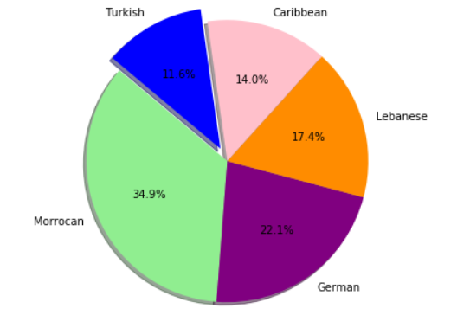
Least 5 Popular Cuisines
Based on the data, these were the five cuisines with the lowest number of reviews

Slide 16
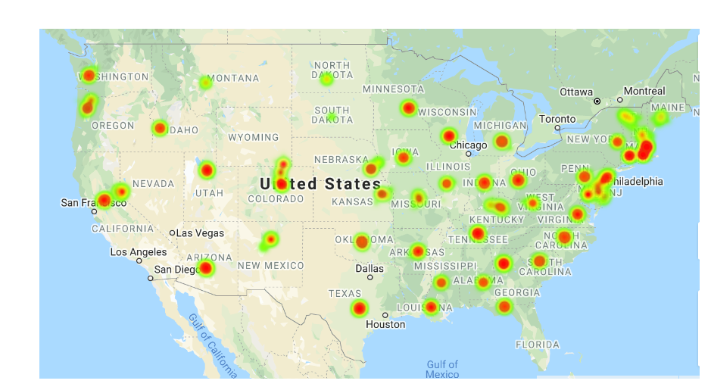
Heat Map Based on Price (Level 1)

Slide 17
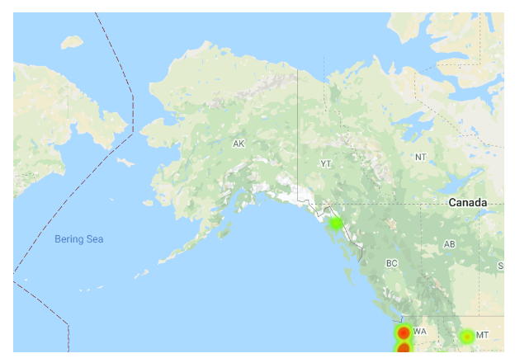
Heat Map of Alaska (Level 1)

Slide 18
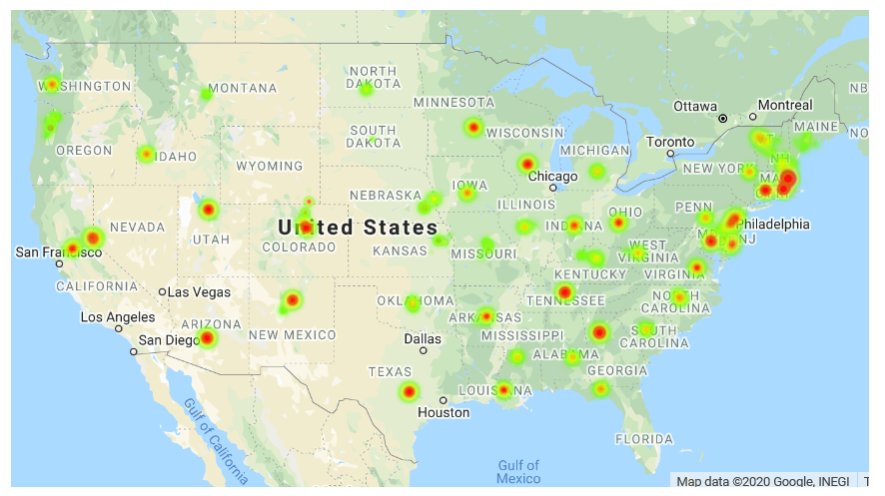
Heat Map Based on Price (Level 3)

Slide 19
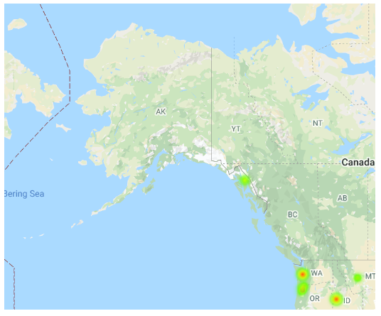
Heat Map of Alaska (Level 3)

Slide 20
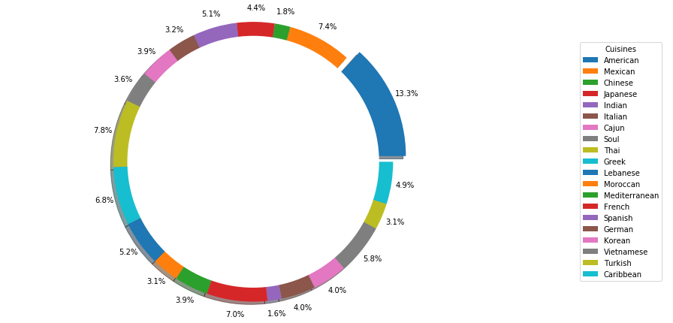
Which cuisine had the highest number of reviews?

Slide 21
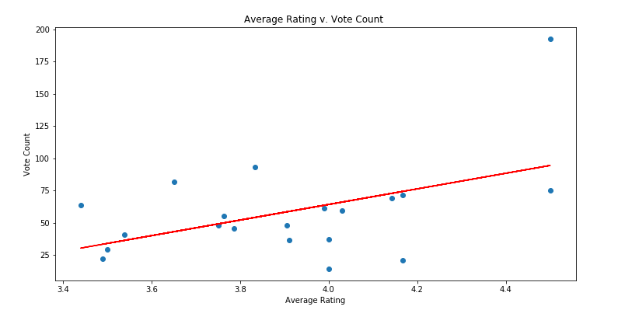
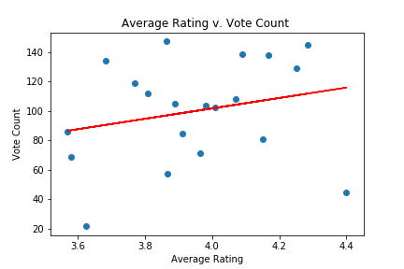
Correlation Between Count of Votes and Average Rating
New York
Alabama

Slide 22
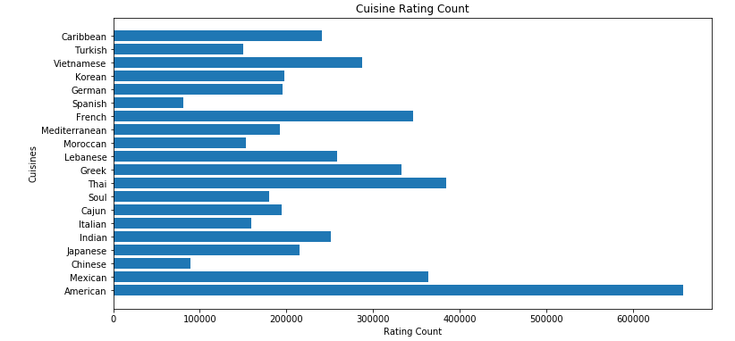
Horizontal Bar Chart Showing Number of Reviews vs. Cuisines

Slide 23
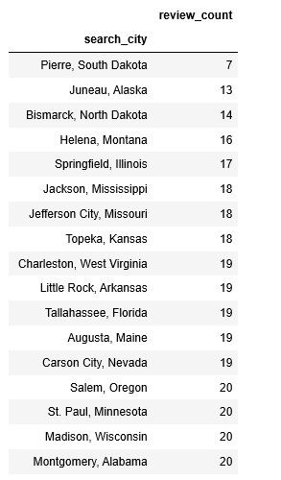
Number of Successful API Calls with Results
For each city we made 20 different cuisine calls.
South Dakota only 7
Alaska only 13
And so on…

Slide 24
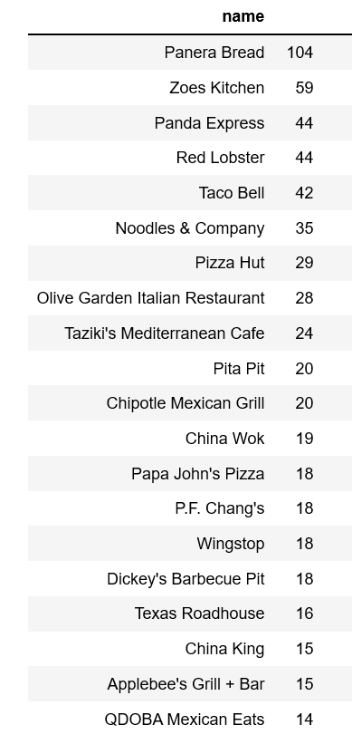
Chain Restaurant Concentration

Slide 25
Top Observations
We have the potential of doing a larger play on linear regression for ratings vs review counts.
Based on the reviewing different states, like the Alabama example.
Hypothesized that larger review count can correlate to higher ratings
Increase scope for a larger data set and possibly focus on a specific region vs large scope.
A lot of variability when looking at 1 city of every state.
Metro areas or larger cities have more offerings, project limited by API.
Not all cities have all the 20 cuisines in our test, shocker for review of our capitals.

Slide 26
Jump Into The Notebooks

