Slide 1
Accelerating Information Experts
Through Compiler Design
Aaron W. Hsu <awhsu@indiana.edu>
Indiana University
ARRAY '15, Portland, OR
This research is funded by Dyalog, Ltd.

Slide 2
A Tale of Two Cities/Jekyll and Hyde
Build a high-performance APL Compiler
  Target the information expert
  Target multiple modern platforms (GPU, Xeon Phi, &c.)
  Scalable language suitable for the APLer
Do it with flare
  Eat your own dog food
  Fully data parallel compiler
    No looping
    No Recursion
    No Branching

Slide 3
Straight to the Demo
Integrating a compiler with Dyalog APL
Make it easy to leverage Dyalog APL
Make it easy to leverage GPUs and Parallelism

Slide 4
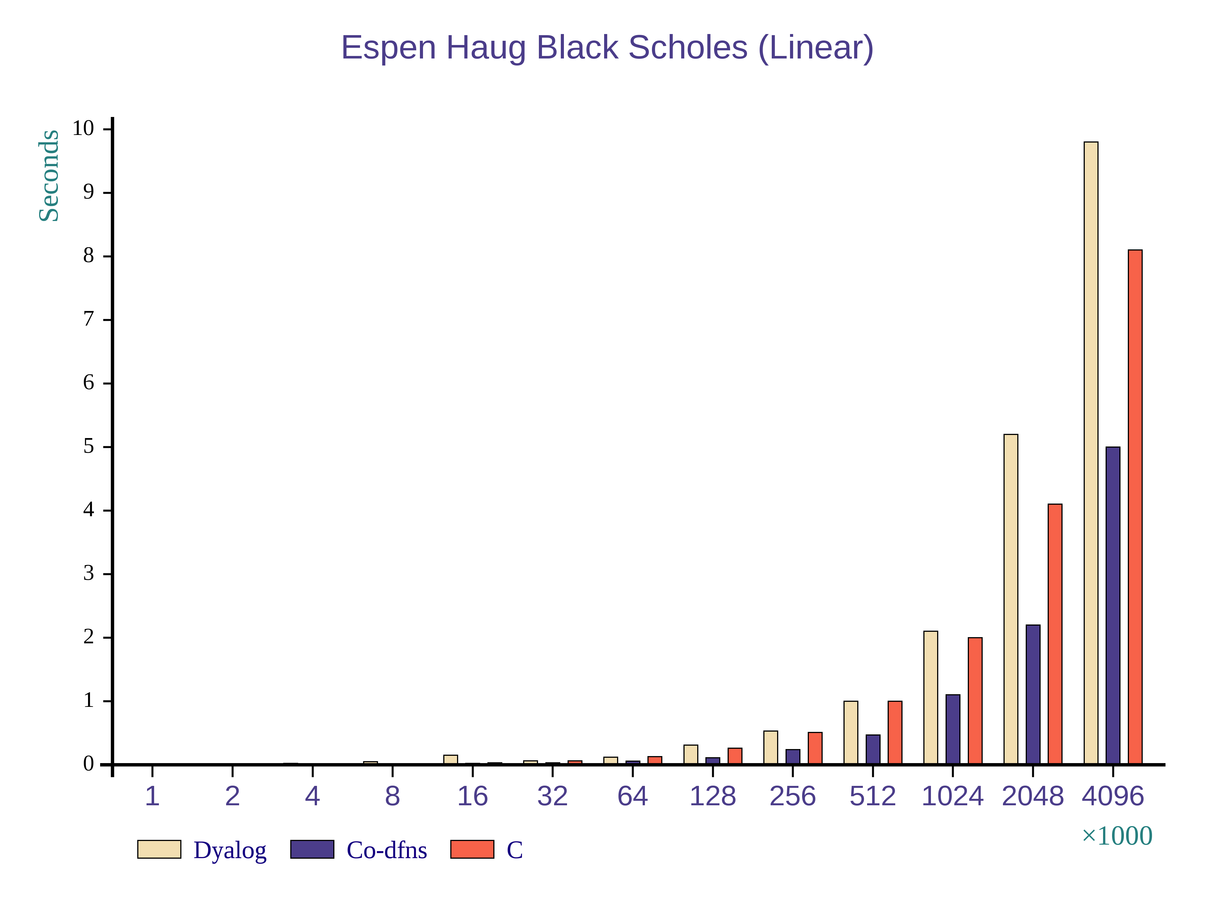
Performance

Slide 5
GPU (Demo)
Preliminary GPU Support
Still Fragile
Tweaking helps
Demo...

Slide 6
Compiler Design/Other Side of the Coin
Complete Compiler without
  Recursion
  Explicit Looping
  Branching or Dispatch
Points-free (Trains) Programming Style
Nanopass inspired architecture
Demonstrates a complete, concise compiler
Pushes the “acceptable” domain of Array programs
Demo...

Slide 7
Roadmap/Future Work
V0.4 – Shrink Locality Issues through Fusion/GPU
  Completed
V0.5 – Complete Runtime (Primitives, &c.)
V0.6 – Stable, scalable performance improvements
V??? – Self-hosting compiler on the GPU
Proof of the generality of the technique
Optimizations to enable self-hosting at speed

Slide 8
Thank You
http://www.sacrideo.us
http://arcfide.github.io/Co-dfns
awhsu@indiana.edu

