Slide 1
Lessons for the Masses from the Trenches of Co-dfns

Slide 2
Aaron W. Hsu, Dyalog 2019
Elsinore, DK

Slide 3
Co-dfns, why care?

Slide 4
Impossible

Slide 5
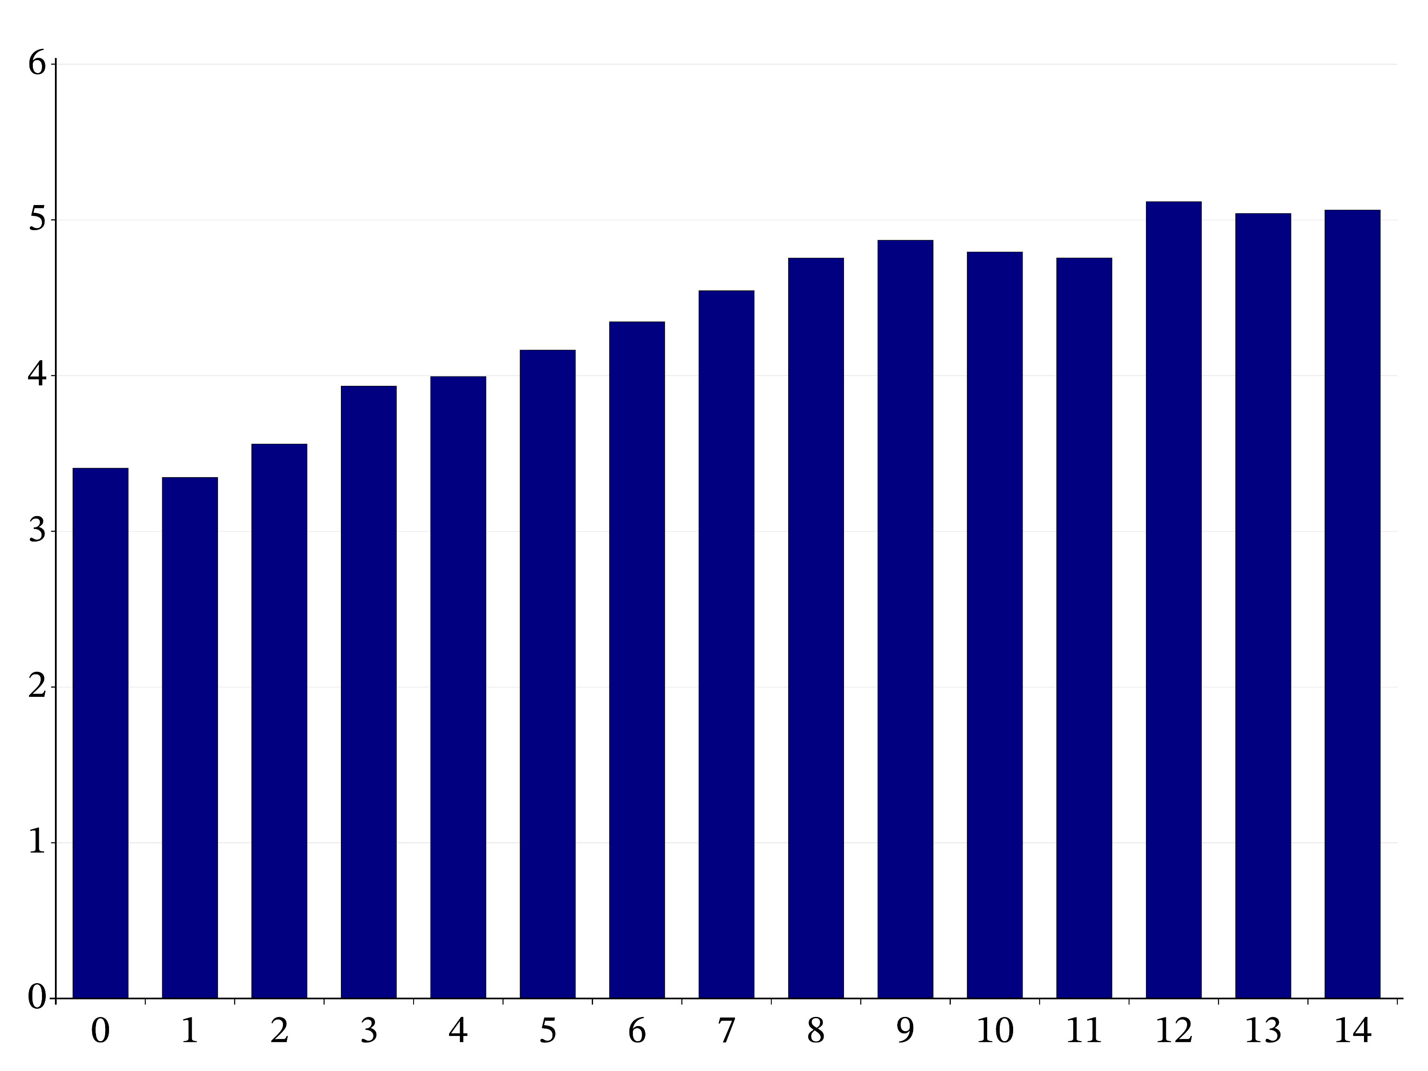

Slide 6
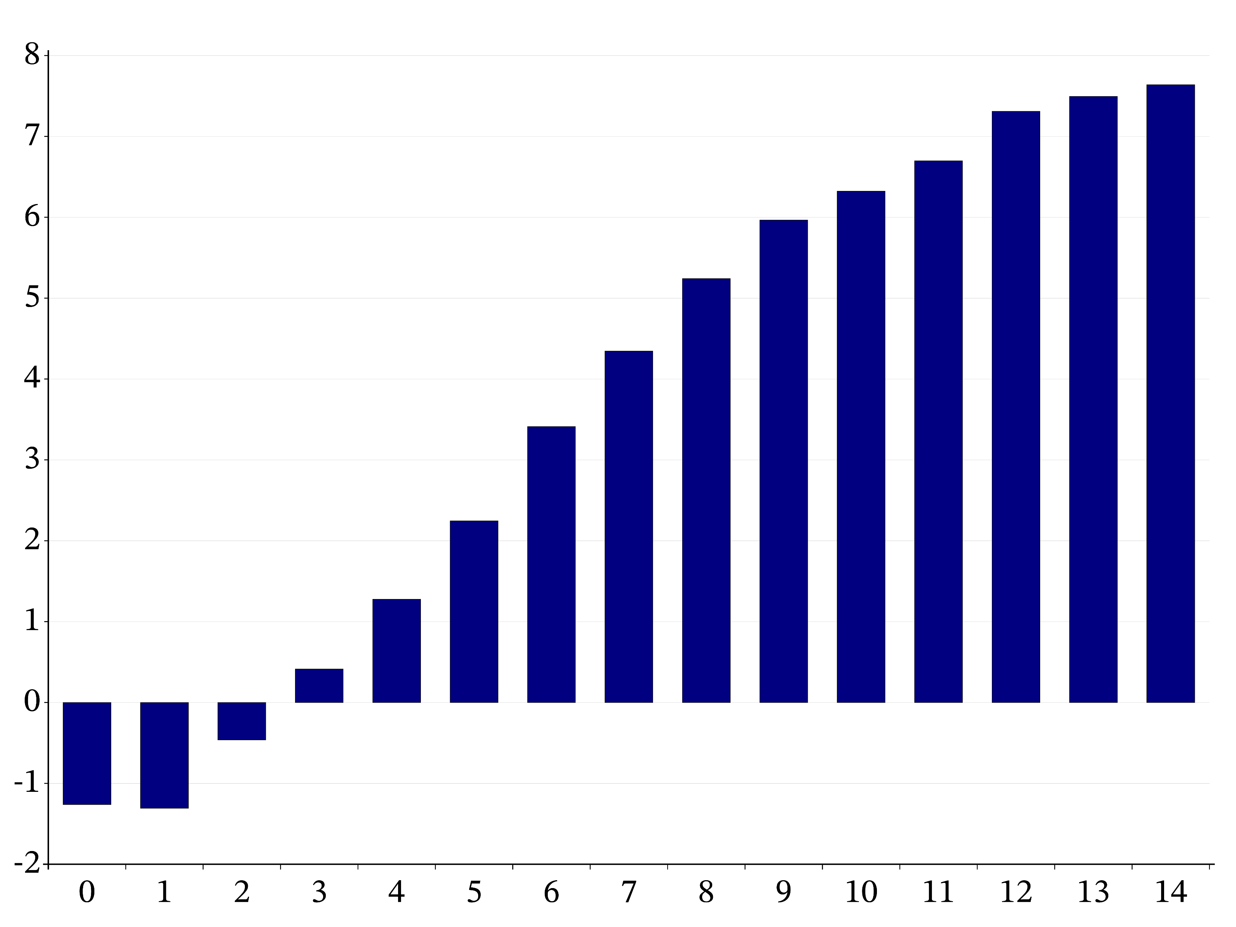

Slide 7
63MB

Slide 8
1.4GB

Slide 9
Software Design

Slide 10
T-shirt

Slide 11
⍝ A B E F G L M N O P V Z
⍝ 0 1 2 3 4 5 6 7 8 9 10 11
tt←{⍞←'C' ⋄ ((d t k n)exp sym)←⍵ ⋄ I←{(⊂⍵)⌷⍺}
r←I@{t[⍵]≠3}⍣≡⍨p⊣2{p[⍵]←⍺[⍺⍸⍵]}⌿⊢∘⊂⌸d⊣p←⍳≢d ⍝ PV
p,←n[i]←(≢p)+⍳≢i←⍸(t=3)∧p≠⍳≢p ⋄ t k n r,←3 1 0(r[i])⍴⍨¨≢i ⍝ LF
p r I⍨←⊂n[i]@i⊢⍳≢p ⋄ t k(⊣@i⍨)←10 1
i←(⍸(~t∊3 4)∧t[p]=3),{⍵⌿⍨2|⍳≢⍵}⍸t[p]=4 ⋄ p t k n r⌿⍨←⊂m←2@i⊢1⍴⍨≢p ⍝ WX
p r i I⍨←⊂j←(+⍀m)-1 ⋄ n←j I@(0≤⊢)n ⋄ p[i]←j←i-1
k[j]←-(k[r[j]]=0)∨0@({⊃⌽⍵}⌸p[j])⊢t[j]=1 ⋄ t[j]←2
p[i]←p[x←¯1+i←{⍵⌿⍨~2|⍳≢⍵}⍸t[p]=4] ⋄ t[i,x]←t[x,i] ⋄ k[i,x]←k[x,i] ⍝ LG
n[x]←n[i] ⋄ p←((x,i)@(i,x)⊢⍳≢p)[p]
n[p⌿⍨(t[p]=2)∧k[p]=3]+←1 ⍝ CI
p[i]←p[x←p I@{~t[p[⍵]]∊3 4}⍣≡i←⍸t∊4,(⍳3),8+⍳3] ⋄ j←(⌽i)[⍋⌽x] ⍝ LX
p t k n r{⍺[⍵]@i⊢⍺}←⊂j ⋄ p←(i@j⊢⍳≢p)[p]
s←¯1,⍨∊⍳¨n[∪x]←⊢∘≢⌸x←0⌷⍉e←∪I∘⍋⍨rn←r[b],⍪n[b←⍸t=1] ⍝ SL
d←(≢p)↑d ⋄ d[i←⍸t=3]←0 ⋄ _←{z⊣d[i]+←⍵≠z←r[⍵]}⍣≡i ⋄ f←d[0⌷⍉e],¯1 ⍝ FR
xn←n⌿⍨(t=1)∧k[r]=0 ⍝ XN
v←⍸(t=10)∧n<¯4 ⋄ x←n[y←v,b] ⋄ n[b]←s[e⍳rn] ⋄ i←(≢x)⍴c←≢e ⍝ AV
_←{z/⍨c=i[1⌷z]←e⍳⍉x I@1⊢z←r I@0⊢⍵}⍣≡(v,r[b])⍪⍉⍪⍳≢x
f s←(f s I¨⊂i)⊣@y¨⊂¯1⍴⍨≢r ⋄ p t k n f s r d xn sym}

Slide 12
4,695,803 ++
4,384,445 --

Slide 13
66,000

Slide 14
6920

Slide 15
400+

Slide 16
Lessons

Slide 17
Good enough is the enemy of the future.

Slide 18
Simplicity is not optional, nor complexity required.

Slide 19
Speed is not a luxury.

Slide 20
Manage your memory.

Slide 21
Pointers are the refined sugar of programming.

Slide 22
Prefer parallelism, serialize only at great need.

Slide 23
Value the human, command the machine.

Slide 24
Embrace suffering in ascetical programming.

Slide 25
Competency trumps safety.

Slide 26
Beauty and Truth are intimately connected.

Slide 27
Thank you.

