Slide 1
My Favorite Verbose Programming Technique
Aaron W. Hsu aaron@dyalog.com, Dyalog, Ltd.
LambdaConf 2025, Estes Park, CO

Slide 2
I have an extreme preference
for brutally simple, concise code.

Slide 3
“You can’t do X with Y.”

Slide 4
I can, I will.

Slide 5
Needs to be practical.

Slide 6
Needs to be a good experience,
result in better code.

Slide 7
My compiler became an answer to
“You can’t do tree manipulation naturally in APL.”

Slide 8
APL can pretty much directly express solutions
to all the problems addressed by traditional computer science
Except…

Slide 9
APL can pretty much directly express solutions
to all the problems addressed by traditional computer science
Except…
Event-driven Reactive Behaviors

Slide 10
What makes event-driven problems a bad fit?

Slide 11
What makes event-driven problems a bad fit?
Non-deterministic event arrival

Slide 12
What makes event-driven problems a bad fit?
Non-deterministic event arrival
Potential need to respond “immediately”

Slide 13
Open Question for a Long Time

Slide 14
I want a “good” solution!

Slide 15
What makes a good solution?

Slide 16
What makes a good solution?
Inexpensive/Low-overhead

Slide 17
What makes a good solution?
Inexpensive/Low-overhead
Low Abstraction

Slide 18
What makes a good solution?
Inexpensive/Low-overhead
Low Abstraction
High Level

Slide 19
What makes a good solution?
Inexpensive/Low-overhead
Low Abstraction
High Level
Domain-centric

Slide 20
What makes a good solution?
Inexpensive/Low-overhead
Low Abstraction
High Level
Domain-centric
Concise

Slide 21
What makes a good solution?
Inexpensive/Low-overhead
Low Abstraction
High Level
Domain-centric
Concise
Mathematical

Slide 22
What makes a good solution?
Inexpensive/Low-overhead
Low Abstraction
High Level
Domain-centric
Concise
Mathematical
Easy proofs of correctness

Slide 23
What makes a good solution?
Inexpensive/Low-overhead
Low Abstraction
High Level
Domain-centric
Concise
Mathematical
Easy proofs of correctness
“Pen and Paper” friendly

Slide 24
Why those requirements?

Slide 25
APL as a specification language

Slide 26
User Requirements
→
Specification
→
Implementation
→
Testing

Slide 27
User Requirements are human language expressions of behavior

Slide 28
Specifications are formal definitions of user requirements

Slide 29
Programs are typically an implementation
of an (implied) specification

Slide 30
Formal Specifications cannot be Mechanically Verified

Slide 31
Formal Specifications cannot be Mechanically Verified
A human is the only source of
“the right thing”

Slide 32
Specification
→
Implementation

Slide 33
Specification
→ [Types]
Haskell/Scala/Scheme/JavaScript

Slide 34
Specification
→
APL

Slide 35
Specification
+
Implementation

Slide 36
APL = Specification + Implementation

Slide 37
Where do existing solutions fail?

Slide 38
Where do existing solutions fail?
Functional Reactive Programming
Callback Handlers
Event Loop over switch(event)

Slide 39
Where do existing solutions fail?
Assume the presence of an understood, correct specification

Slide 40
Where do existing solutions fail?
Assume the presence of an understood, correct specification
Rely on ad hoc assurance of completeness

Slide 41
Where do existing solutions fail?
Assume the presence of an understood, correct specification
Rely on ad hoc assurance of completeness
Still depend heavily on human verification

Slide 42
Where do existing solutions fail?
Assume the presence of an understood, correct specification
Rely on ad hoc assurance of completeness
Still depend heavily on human verification
Types have all these same issues

Slide 43
What am I afraid of?

Slide 44
What am I afraid of?
“Have I forgotten anything?”

Slide 45
What am I afraid of?
“Have I forgotten anything?”
“Have I done anything silly?”

Slide 46
What am I afraid of?
“Have I forgotten anything?”
“Have I done anything silly?”
“Are we sure this is the right thing?”

Slide 47
Time to go looking for inspiration…

Slide 48
I’m in APL, it’s a math notation,
what do the mathematicians do?

Slide 49
I’m in APL, it’s a math notation,
what do the mathematicians do?
Basically, state machines.

Slide 50
What prior art exists around this sort of thing in Iverson-land?

Slide 51
What prior art exists around this sort of thing in Iverson-land?
J has a built-in state machine operator!
Documentation explicitly discusses this problem.

Slide 52
That’s two votes for state machines.

Slide 53
But they still have these issues:
Are we correct?
Did we miss anything?
Did we do something silly?

Slide 54
Enter Cleanroom Software Engineering…

Slide 55
Famous for making developers prove their code,
without being allowed to run it.
“Write bug-free code.”

Slide 56
Cleanroom also taught a method of functional specification
as state machines!

Slide 57
The emphasis was:
Correct – Am I doing the right thing?
Complete – Am I missing something?
Consistent – Am I doing something silly?

Slide 58
Sequence-based Enumeration

Slide 59
Sequence-based Enumeration
A specific process for modeling system behavior
by building a correct, consistent, and complete
state machine based on human-language requirements

Slide 60
System behavior
≡
f(seq-hist, stimulus) → response

Slide 61
f(seq-hist, stimulus) → response
Systematically define f by:

Slide 62
f(seq-hist, stimulus) → response
Systematically define f by:
Defining the sets of stimuli and responses

Slide 63
f(seq-hist, stimulus) → response
Systematically define f by:
Defining the sets of stimuli and responses
Begin systematically enumerating all possible sequence histories

Slide 64
For each history, consider
for each stimuli:

Slide 65
For each history, consider
for each stimuli:
What is the response?

Slide 66
For each history, consider
for each stimuli:
What is the response?
What is the “equivalent sequence?”

Slide 67
For each history, consider
for each stimuli:
What is the response?
What is the “equivalent sequence?”
If no equivalent, then this is a canonical sequence

Slide 68
For each history, consider
for each stimuli:
What is the response?
What is the “equivalent sequence?”
If no equivalent, then this is a canonical sequence
→
new state in the machine.

Slide 69
Example from Cleanroom Book: Security Alarm

Slide 70
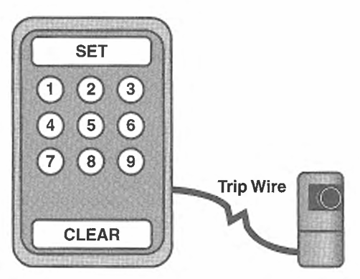

Slide 71
Process → Specification evolution:
Stimuli Abstraction
Response Refinement

Slide 72
The key emphasis:
The systematic, human, exploratory process
over the entire state space.

Slide 73
The primary benefit
You must confront every possible state
and make an explicit decision about your system

Slide 74
The primary benefit
You must confront every possible state
and make an explicit decision about your system
Pretty much eliminates your ability to have unexpected behavior

Slide 75
The primary benefit
You must confront every possible state
and make an explicit decision about your system
Pretty much eliminates your ability to have unexpected behavior
Model checkers and the like can prove nice temporal properties

Slide 76
Secondary Benefits

Slide 77
Secondary Benefits
Very low overhead

Slide 78
Secondary Benefits
Very low overhead
Low abstraction

Slide 79
Secondary Benefits
Very low overhead
Low abstraction
Flexible and general

Slide 80
Secondary Benefits
Very low overhead
Low abstraction
Flexible and general
[It’s just computed goto!]

Slide 81
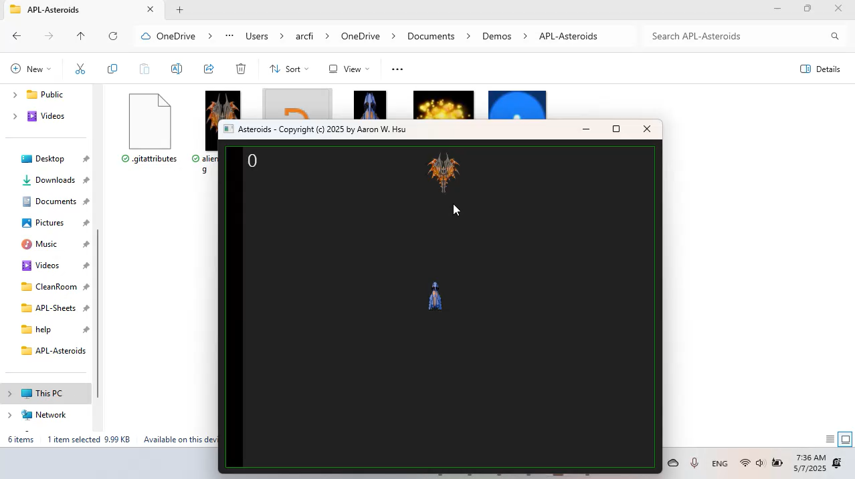
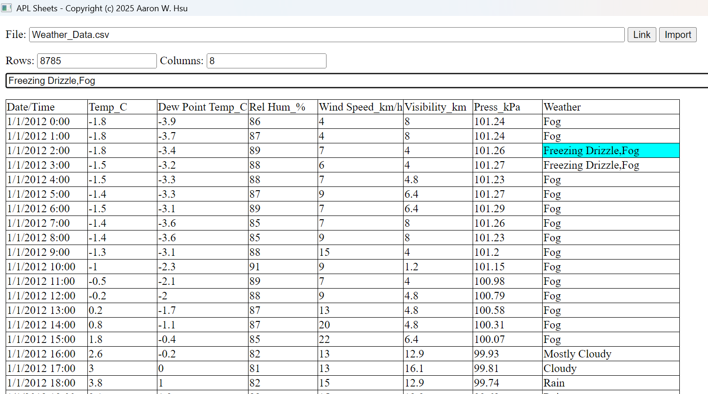

Slide 82
Conclusion
arcfide@sacrideo.us
Sequence-based enumeration can be used as a foundation for defining an executable specification of event-driven behavior.
https://www.sacrideo.us/last-minute-discount-for-apl-workshop/

