Slide 1
Do Programming Language Features Deliver on their Promises?
Aaron W. Hsu aaron@dyalog.com, Dyalog, Ltd.
LambdaConf 2025, Estes Park, CO

Slide 2
I am Biased

Slide 3
I am Biased
Ascetical Programming

Slide 4
I am Biased
Ascetical Programming
Seen and been near legacy, work in greenfield research

Slide 5
I am Biased
Ascetical Programming
Seen and been near legacy, work in greenfield research
Spent time in a variety of programming communities

Slide 6
I am Biased
Ascetical Programming
Seen and been near legacy, work in greenfield research
Spent time in a variety of programming communities
Unique Perspective

Slide 7
“Design” part of programming languages

Slide 8
“Design” part of programming languages
Developer Experience
Path of Least Resistance
Path of Feel Goodiness

Slide 9
Exploratory, not Dogmatic.
And mostly meant to be fun and comedic.

Slide 10
Exploratory, not Dogmatic.
And mostly meant to be fun and comedic.
But the best comics speak the truth, no?

Slide 11
Rich Hickey. 2011. “Simple Made Easy”. StrangeLoop.

Slide 12
Rich Hickey. 2011. “Simple Made Easy”. StrangeLoop.
Simple vs. Complex ≡ Disentangled vs. Entangled
“Simplicity is prerequisite for reliability.” – Edsger Dijkstra
Simple, not Easy.

Slide 13
Ultimate Goal: Simplicity

Slide 14
Traditional Software Crisis ≡ “Unmanaged complexity”

Slide 15
Traditional Software Crisis ≡ “Unmanaged complexity”
Modern Software Crisis ≡ “Readily accessible complexity”

Slide 16
What are the promises?
Did it meet those promises?
What were the unintended effects?
Does it tend towards encouraging incidental complexity?
Can we reframe its use to encourage simplicity?

Slide 17
Development Methods, Praxis, Architecture:
Unit Testing
Microservices
Test-driven Development
REST API

Slide 18
Low-hanging Fruit:
Object-orientation
Inheritance
Encapsulation

Slide 19
Rage bait:
Many functional programmers are championing
Object-oriented Programming under the guise of FP.
Encapsulation, Inheritance, Indirection and Abstraction.

Slide 20
“The lie is that if something is object-oriented,
it will be easier for someone to integrate,
because it is all encapsulated.
But the truth is the opposite.”
-- Casey Muratori, Wookash Podcast, Sep 22, 2024. YT

Slide 21
“I also must confess to a strong bias against the fashion for reusable code. To me, "re-editable code" is much, much better than an untouchable black box or toolkit. I could go on and on about this. If you’re totally convinced that reusable code is wonderful, I probably won’t be able to sway you anyway, but you’ll never convince me that reusable code isn’t mostly a menace.”
-- Donald Knuth, InformIT Interview. Apr 25, 2008.

Slide 22
Token AI Slide:
Natural Language Programming

Slide 23
Token AI Slide:
Natural Language Programming
Present-day AI is very good at writing code that never should have been written in the first place.

Slide 24
Token AI Slide:
Natural Language Programming
Present-day AI is very good at writing code that never should have been written in the first place.
The value of AI for writing code is inversely proportional to the quality of the programming language.

Slide 25
Just joking! But not really.

Slide 27
Tacit/Points-free Programming

Slide 28
What’s the promise?
[T]he strict use of composition results in programs that are well adapted for equational reasoning. … The lack of argument naming gives point-free style a reputation of being unnecessarily obscure, hence the epithet "pointless style".
-- Tacit programming - Wikipedia

Slide 29

“The sum of a collection of numbers divided by the count of numbers in the collection.”
(/ (fold-right + 0 elems) (length elems))
+⌿÷≢

Slide 30
More concise!
Removes unnecessary names
More compositional
Less boilerplate
“Simpler expressions”

Slide 31
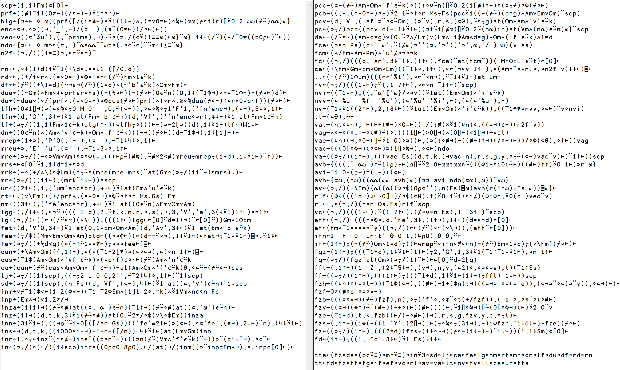

Slide 32
More concise! →
Removes unnecessary names →
More compositional →
Less boilerplate →
“Simpler expressions” →

Slide 33
More concise! → But caused duplication
Removes unnecessary names →
More compositional →
Less boilerplate →
“Simpler expressions” →

Slide 34
More concise! → But caused duplication
Removes unnecessary names → But introduced new ones
More compositional →
Less boilerplate →
“Simpler expressions” →

Slide 35
More concise! → But caused duplication
Removes unnecessary names → But introduced new ones
More compositional → For compositions of one
Less boilerplate →
“Simpler expressions” →

Slide 36
More concise! → But caused duplication
Removes unnecessary names → But introduced new ones
More compositional → For compositions of one
Less boilerplate → With more control flow
“Simpler expressions” →

Slide 37
More concise! → But caused duplication
Removes unnecessary names → But introduced new ones
More compositional → For compositions of one
Less boilerplate → With more control flow
“Simpler expressions” → Substituted complexity

Slide 38
Incidental Complexity:
Encourages introducing more names,
just what it was supposed to reduce!

Slide 39
Incidental Complexity:
Encourages introducing more names,
just what it was supposed to reduce!
Reframing:
A valuable syntax for reducing total points of the system,
but not at the expense of introducing new names.

Slide 40
At scale, points-free by de-naming
⍝ Lift Lambdas to the top-level
p,←n[i]←(≢p)+⍳≢i←⍸(t=F)∧p≠⍳≢p ⍝ New nodes at top-level
t k n lx mu pos end r(⊣,I)←⊂I ⍝ Copy data to new nodes
p r I⍨←⊂n[i]@i⊢⍳≢p ⍝ Point fn bodies @ top nodes
t[i]←V ⍝ Old nodes become variables
k[i]←3+5 11⍸k[i] ⍝ …that point to lifted fns

Slide 41
At scale, points-free by de-naming
⍝ Lift Lambdas to the top-level
p,←n[i]←(≢p)+⍳≢i←⍸(t=F)∧p≠⍳≢p ⍝ New nodes at top-level
t k n lx mu pos end r(⊣,I)←⊂I ⍝ Copy data to new nodes
p r I⍨←⊂n[i]@i⊢⍳≢p ⍝ Point fn bodies @ top nodes
t[i]←V ⍝ Old nodes become variables
k[i]←3+5 11⍸k[i] ⍝ …that point to lifted fns
You can reduce names without needing special syntax!

Slide 43
DSLs/Syntactic Abstraction

Slide 44
Programming Languages are not a good fit for our domain
→
Write specialized domain knowledge behind a DSL
→
Profit…?

Slide 45
Non-programmers won’t need programming!

Slide 46
Non-programmers won’t need programming!
Declarative solutions! Bespoke?

Slide 47
Non-programmers won’t need programming!
Declarative solutions! Bespoke?
The tool is always ideally suited to the job!

Slide 48
Non-programmers won’t need programming!
Declarative solutions! Bespoke?
The tool is always ideally suited to the job!
“Right tool for the right job” is now a reality.

Slide 49
Non-programmers won’t need programming!
Declarative solutions! Bespoke?
The tool is always ideally suited to the job!
“Right tool for the right job” is now a reality.
There’s a library for that….

Slide 50
PyTorch
NumPy
BLAS
SQL
ORMs
HTML
SAP
Excel
Leftpad

Slide 51
Leftpad

Slide 52
Leftpad
(⊃⍛⌊∘≢)↓(⊃⍴⌿)⍛⍪

Slide 53
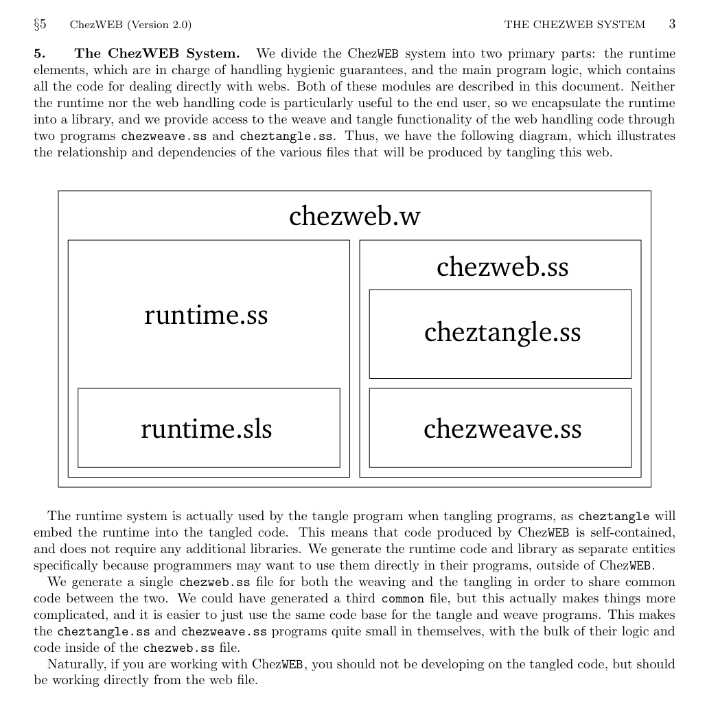
Hygienic Literate Programming. ChezWEB. Scheme Workshop 2011.

Slide 54
Scheme, the language for writing DSLs
→

Slide 55
Scheme, the language for writing DSLs
→
No one speaks the same language.

Slide 56
Scheme, the language for writing DSLs
→
No one speaks the same language.
Every sufficiently popular DSL becomes a poorly designed
general purpose programming language (c.f. TeX)

Slide 57
Lesson: Tower of Babel

Slide 58
Lesson: Tower of Babel
Collaboration and Focused Effort should transfer, not isolate

Slide 59
Lesson: Tower of Babel
Collaboration and Focused Effort should transfer, not isolate
DSLs are an appeal to Jargon’s advantage,
ignoring its disadvantages

Slide 60
Lesson: Tower of Babel
Collaboration and Focused Effort should transfer, not isolate
DSLs are an appeal to Jargon’s advantage,
ignoring its disadvantages
Jargon obscures common knowledge transfer more than we realized

Slide 61
Lesson: Tower of Babel
Collaboration and Focused Effort should transfer, not isolate
DSLs are an appeal to Jargon’s advantage,
ignoring its disadvantages
Jargon obscures common knowledge transfer more than we realized
The user is always limited by and held hostage by the implementor

Slide 62
Back to the beginning, what was the justification?

Slide 63
Back to the beginning, what was the justification?
Language/Domain Mismatch

Slide 64
Back to the beginning, what was the justification?
Language/Domain Mismatch
Design languages to address problems
concisely, directly, and simply.

Slide 65
Back to the beginning, what was the justification?
Language/Domain Mismatch
Design languages to address problems
concisely, directly, and simply.
Focus on holistic economy of expression as a metric.

Slide 66
Back to the beginning, what was the justification?
Language/Domain Mismatch
Design languages to address problems
concisely, directly, and simply.
Focus on holistic economy of expression as a metric.
Stop trying to hide the magic, reframe your core concepts/constructs.

Slide 67
Example:
Parallel programming hard.

Slide 68
Example:
Parallel programming hard.
Introduce iteration combinators (map, fold, scan) and a data-flow style of programming as the “first language”.

Slide 69
Example:
Parallel programming hard.
Introduce iteration combinators (map, fold, scan) and a data-flow style of programming as the “first language”.
Result: Parallel programming easy.
c.f. – CMU’s experiments with 1st year programming education

Slide 70
Caveat: I still really love syntactic abstraction,
I just can’t really justify it most places.

Slide 71
Dynamic Languages + Reflection
(Thanks Steven W.)

Slide 72
Superior Tooling Support
Monkey patching
Meta Programming
Agility/Adaptation
Richer behaviors

Slide 73
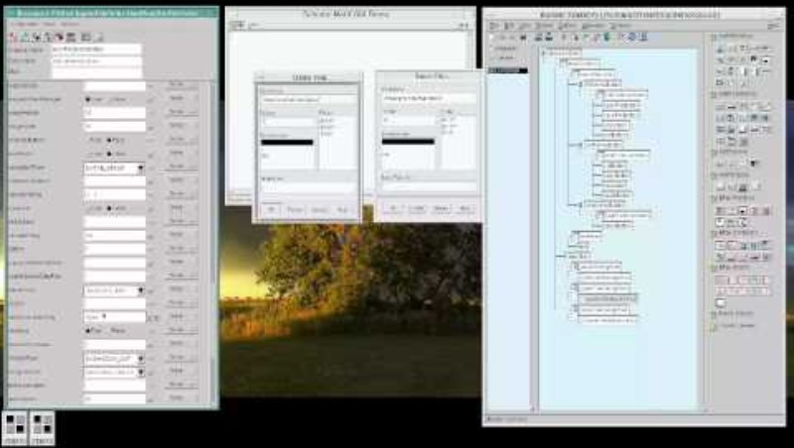

Slide 74
Ruby Compiler
→

Slide 75
Ruby Compiler
→
Pain, tears, and abandonment
Endless and intractable uses of reflection

Slide 76
SATAN: Static Analysis Tool for APL Notation
(Brandon Wilson)

Slide 77
SATAN: Static Analysis Tool for APL Notation
(Brandon Wilson)
APL is highly dynamic:
Type-sensitive parsing, dynamic/lexical scope, eval-everywhere

Slide 78
SATAN: Static Analysis Tool for APL Notation
(Brandon Wilson)
APL is highly dynamic:
Type-sensitive parsing, dynamic/lexical scope, eval-everywhere
Real World APL code is “statically dynamic”.

Slide 79
Reflection often encourages Indirection/Abstraction
Nothing is ever where you think it is
(paraphrasing Ed Amsden)

Slide 80
Most of the time, you don’t want it, you don’t need it, you shouldn’t use it.
But…

Slide 81
I can’t fully dismiss the value of tools and introspection.
Read-only introspection is hugely useful.

Slide 82
I can’t fully dismiss the value of tools and introspection.
Read-only introspection is hugely useful.
Mutable reflection is highly questionable.

Slide 83
I can’t fully dismiss the value of tools and introspection.
Read-only introspection is hugely useful.
Mutable reflection is highly questionable.
There is often a spiritually static way to leverage dynamic features.
Avoid indirection.

Slide 84
One of my favorite tools:
The computed goto.
Sorry, not sorry.

Slide 86
New Feature:

Slide 87
New Feature:
24× more memory

Slide 88
New Feature:
24× more memory
59× more code

Slide 89
New Feature:
24× more memory
59× more code
3× more concepts to learn

Slide 90
New Feature:
24× more memory
59× more code
3× more concepts to learn
9× slower on the CPU

Slide 91
New Feature:
24× more memory
59× more code
3× more concepts to learn
9× slower on the CPU
56x slower on the GPU

Slide 92
New Feature:
24× more memory
59× more code
3× more concepts to learn
9× slower on the CPU
56x slower on the GPU
(Actually, you can’t run your code on the GPU with this new feature. So, the slowdown is infinite.)

Slide 93
Hooray!
Generalized Pointers/Garbage Collection

Slide 94
C pointers have a nice connection with array indexing.

Slide 95
C pointers have a nice connection with array indexing.
→
Higher level languages abstracted pointers into opaque references,
uncomputable things that encouraged data-abstraction via structures of pointers

Slide 96
Singular object management with malloc/free was error-prone.

Slide 97
Singular object management with malloc/free was error-prone.
GC is framed as a solution to this problem.

Slide 98
Singular object management with malloc/free was error-prone.
GC is framed as a solution to this problem.
We already have good solutions to this without GC!

Slide 99
GC is actually the story of

Slide 100
GC is actually the story of
Generalized Pointers + Infinite Lifetimes

Slide 101
First-class Procedures + Structured Programming
←→
Generalized Pointers + Infinite Lifetimes

Slide 102
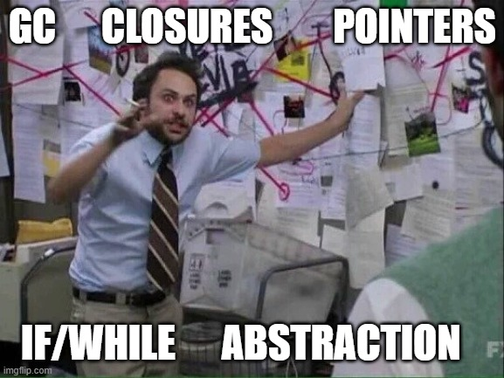

Slide 103
Am I crazy?

Slide 104
Am I crazy?
“Nodejs memory leak”

Slide 105
Am I crazy?
“Nodejs memory leak”
Stop Node.js Memory Leaks - End-to-end Tracing + Logging Ad
Preventing and Debugging Memory Leaks in Node.js
node.js - Detecting memory leaks in nodejs - Stack Overflow
Advanced Techniques for Detecting Memory Leaks in Node.js ...
Finding And Fixing Node.js Memory Leaks: A Practical Guide - Marmelab

Slide 106
Stop relying on indefinite extent
Stop using constructors of boxed data
Stop defaulting to encapsulation and closures

Slide 107
Stop relying on indefinite extent
Stop using constructors of boxed data
Stop defaulting to encapsulation and closures
Make (app/biz/logic) state global and highly controlled
Manual memory management is easy in a high-level language

Slide 108
Stop relying on indefinite extent
Stop using constructors of boxed data
Stop defaulting to encapsulation and closures
Make (app/biz/logic) state global and highly controlled
Manual memory management is easy in a high-level language
Favor relational, table, entity-component,
collection-based data organization
using Struct of Arrays encodings (APL’s Inverted Table)

Slide 110
Sophisticated Control Flow
Recursion
Polymorphic dispatch
Callback-driven event systems
Agent-features
AKA – Structured Programming and its evil spawn.

Slide 111
“Goto considered harmful.”

Slide 112
“Goto considered harmful.”
No more spaghetti code.

Slide 113
“Goto considered harmful.”
No more spaghetti code.
Simpler code – it even has less arbitrary labels!

Slide 114
“Goto considered harmful.”
No more spaghetti code.
Simpler code – it even has less arbitrary labels!
So foundational, people don’t even consider whether it should exist or not.

Slide 115
“All problems in computer science
can be solved by another level of indirection,
except for the problem of too many layers of indirection.”
– David J. Wheeler
“It is easier to move a problem around…
than it is to solve it.”
-- RFC 1925

Slide 116
+/⍳n
+/⌽⍳n + is associative and commutative
((+/⍳n)+(+/⌽⍳n))÷2 (x+x)÷2←→x
(+/((⍳n)+(⌽⍳n)))÷2 + is associative and commutative
(+/((n+1)⍴n))÷2 Lemma
((n+1)×n)÷2 Definition of ×
-- Notation as a Tool of Thought,
Ken Iverson, ACM Turing Award Lecture

Slide 117
Compare proof logics (c.f. Dijkstra) for structured programs
Recursive programs (ACL2)
Higher-order dependently typed programs
These are all fundamentally more complex.

Slide 118
Branching is responsible for CPUs having branch predictors,
undermining some of the most elegant CPU designs
Every branch, jump, and indirect dispatch
introduces more edges into an increasingly complex graph

Slide 119
In EWD249, Dijkstra especially points out the value
of constraining and disciplining control flow.
The whole model of structured programming was intended
to reduce control flow complexity.

Slide 120
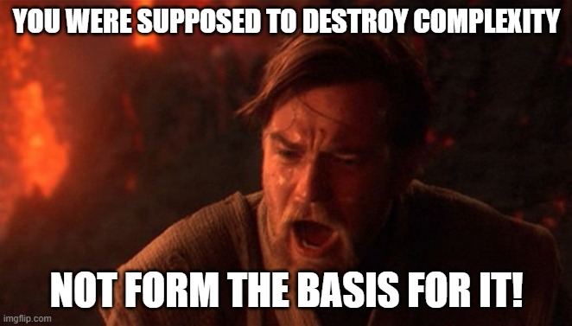

Slide 121
Structured programming encourages single-item thinking

Slide 122
Structured programming encourages single-item thinking
Single-item thinking encourages casing, specialization (types)

Slide 123
Structured programming encourages single-item thinking
Single-item thinking encourages casing, specialization (types)
This incentivizes all the high-level branch and dispatch

Slide 124
Structured programming encourages single-item thinking
Single-item thinking encourages casing, specialization (types)
This incentivizes all the high-level branch and dispatch
Which is just fancier goto programming that Dijkstra was avoiding!

Slide 125
Dynamically paged, eval-dependent, goto-driven APL
developed over the course of 30+ years

Slide 126
Eliminate non-linear, irregular control flow

Slide 127
Eliminate non-linear, irregular control flow
Combinators (map, fold, scan, key, stencil, etc.)

Slide 128
Eliminate non-linear, irregular control flow
Combinators (map, fold, scan, key, stencil, etc.)
Data-parallel programming

Slide 129
Eliminate non-linear, irregular control flow
Combinators (map, fold, scan, key, stencil, etc.)
Data-parallel programming
Data-driven, data-oriented design

Slide 130
Eliminate non-linear, irregular control flow
Combinators (map, fold, scan, key, stencil, etc.)
Data-parallel programming
Data-driven, data-oriented design
Compute over collections/sets/arrays, not individual items

Slide 131
Eliminate non-linear, irregular control flow
Combinators (map, fold, scan, key, stencil, etc.)
Data-parallel programming
Data-driven, data-oriented design
Compute over collections/sets/arrays, not individual items
Avoid traditional type abstraction

Slide 132
See tomorrow’s talk for my favorite approach to handling
inherently branchy, event-driven code

Slide 134
Static Typing

Slide 135
Static typing gets a pass…

Slide 136
Static typing gets a pass…
Because I already ranted about it for a whole talk:
Does APL Need a Type System? at #FnConf18

Slide 137
Static typing gets a pass…
Because I already ranted about it for a whole talk:
Does APL Need a Type System? at #FnConf18
But…maybe just a taste?

Slide 138
Static typing as I’ve heard it
has sometimes claimed elegance, but never brutal simplicity.

Slide 139
Static typing as I’ve heard it
has sometimes claimed elegance, but never brutal simplicity.
The story I’ve always heard is…
“We’ll make things harder on you initially,
so the machine can help you in the future.”

Slide 140
Static typing as I’ve heard it
has sometimes claimed elegance, but never brutal simplicity.
The story I’ve always heard is…
“We’ll make things harder on you initially,
so the machine can help you in the future.”
The code has always been more complex.

Slide 141
“Scrap your boilerplate”
Ralf Lammel and Simon Peyton Jones
+
Multiple follow-up papers

Slide 142
But…static typing has mostly delivered
on its technical promises.

Slide 143
But…static typing has mostly delivered
on its technical promises.
It has failed to show that the trade-off is the right direction.

Slide 144
But…static typing has mostly delivered
on its technical promises.
It has failed to show that the trade-off is the right direction.
Conspiracy Theory: Types are a great way to make money off of PL,
particularly if you want to make money off of research grants.

Slide 145
Static type annotations have a generally complecting influence.

Slide 146
Static type annotations have a generally complecting influence.
Rigorous proof systems and implicit type inference don’t suffer the same hinderances to the code quality (simplicity).

Slide 147
Static type annotations have a generally complecting influence.
Rigorous proof systems and implicit type inference don’t suffer the same hinderances to the code quality (simplicity).
But…systems like Rust have had a positive impact
on people willing to take more control over their own code again.

Slide 148
Think about the types, but design your system to make them
obvious architecturally and in your code

Slide 149
Think about the types, but design your system to make them
obvious architecturally and in your code
Don’t obscure code with static type annotations

Slide 150
Think about the types, but design your system to make them
obvious architecturally and in your code
Don’t obscure code with static type annotations
Stop doing excessive type abstraction and attempting to hide implementation details
(Yes, that includes you, dynamically typed folks)

Slide 151
Not Yet Ripe:
Formal Methods

Slide 152
“80% of development is spent on plumbing”
(Isaac Shapira quoting someone else)

Slide 153
Irony:

Slide 154
Irony:
I avoid using all the features designed to avoid the plumbing.

Slide 155
Irony:
I avoid using all the features designed to avoid the plumbing.
But I end up writing no plumbing.

Slide 156
Example at “scale”

Slide 157
Example at “scale”
Compiler building frameworks vs Co-dfns:

Slide 158
Example at “scale”
Compiler building frameworks vs Co-dfns:
A data parallel compiler hosted on the GPU.
Aaron Hsu. 2019. Indiana University.

Slide 159
Example at “scale”
Compiler building frameworks vs Co-dfns:
A data parallel compiler hosted on the GPU.
Aaron Hsu. 2019. Indiana University.
A near-zero abstraction compiler written in APL for APL.

Slide 160
Example at “scale”
Compiler building frameworks vs Co-dfns:
A data parallel compiler hosted on the GPU.
Aaron Hsu. 2019. Indiana University.
A near-zero abstraction compiler written in APL for APL.
Now also does (context-sensitive, type-dependent) parsing
in the same style.

Slide 161
1500 vs. (50,000 – 100,000)

Slide 162
1500 vs. (50,000 – 100,000)
“[O]ne of my central themes will be that any two things that differ in some respect by a factor of already a hundred or more,
are utterly incomparable.”
-- Edsger Dijkstra, EWD249

Slide 163
Conclusion
arcfide@sacrideo.us
Featuritis is a real thing in language design
Avoid language features that inherently introduce complexity
The use of language features is often a crutch
to avoid simplification or tackling harder root problems
https://www.sacrideo.us/last-minute-discount-for-apl-workshop/

