Slide 1
U-Net CNN in APL
Aaron W. Hsu and Rodrigo Girão Serrão (ARRAY ‘23)

Slide 2
INTRODUCTION
What would happen if we tried to implement a complete, non-trivial Convolutional Neural Network in pure APL, from scratch, without using any libraries or frameworks?

Slide 3
AGENDA
What do we know?
What do we want to know?
What do we do?
Thoughts and Future Work
Conclusion

Slide 4
What do we know?
State of the CNN development space

Slide 5


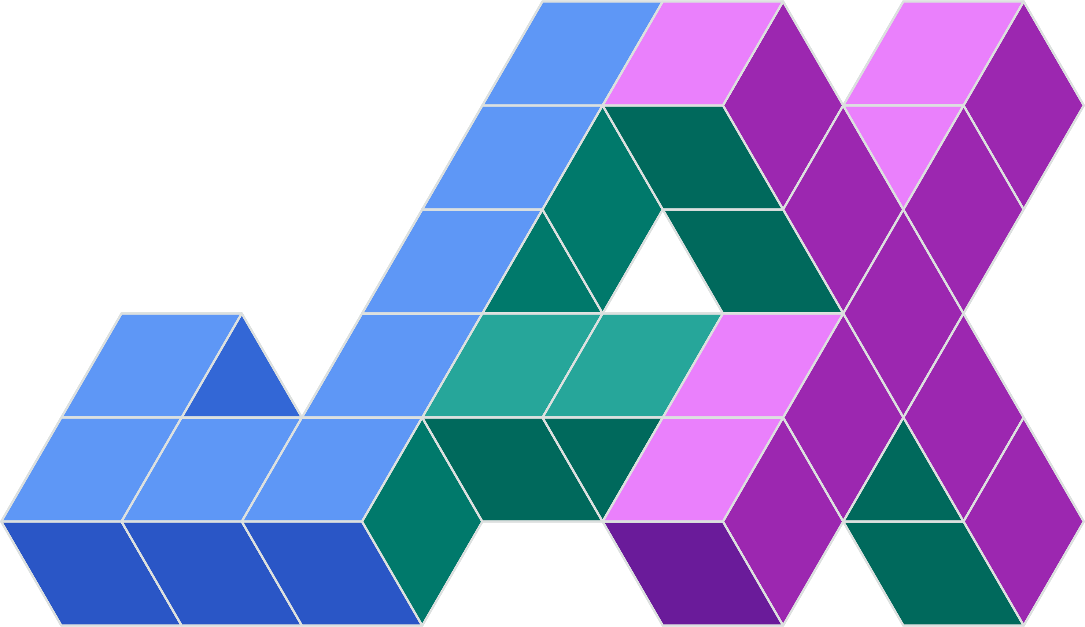


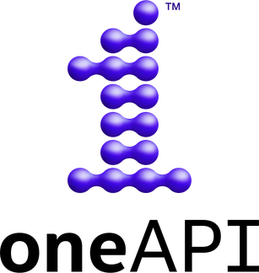
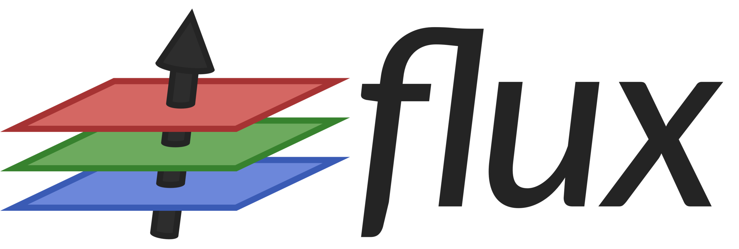

Deep Learning ≡ Frameworks

Slide 6
Frameworks dominate…
Difficulty
Implementing neural network algorithms from scratch seems to be challenging and tedious.
Performance
Most of the time, when you do a from scratch implementation, it ends up being slow.
Education
Many data science paths focus on becoming specialists in framework-specific knowledge or “high-level” application of frameworks.
Lack of Insight
People can get quite far by just “knob-turning” and “button mashing,” but at what cost?

Slide 7
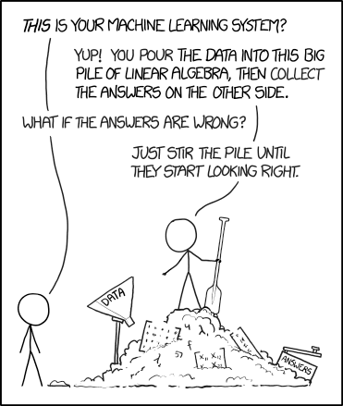

Slide 8
When everyone is doing the same thing, that signals a potential opportunity.​

Slide 9
Frameworks limit vertical agility
Black box frameworks are hard to modify and hard to compose with other domain knowledge.
You are limited to the expressivity of the framework.
It is easy to “get by” without really understanding.

Slide 10
What do we want to know?
Trying something different…

Slide 11
What if we use APL?
In the past…
From scratch…
Compilation…
APL was a prominent feature in the original wave of neural network research, but…
Performance costs were too high.
Would the unique features of APL make a from scratch implementation practical?
How hard is it?
With current APL compilers, what is the performance of a naïve implementation?
What is needed to be competitive?

Slide 12
What do we do?
Go vroom, vroom!

Slide 13
U-net in APL
U-Net
A non-trivial but self-contained neural network used for image segmentation. Well studied and common.
Simple
Implemented a naïve implementation using pure APL in a single module from scratch in pure APL.
Co-dfns
Compiled and benchmarked using the Co-dfns APL compiler.
vs. PyTorch
Implemented the same net in PyTorch and compared performance and code style/complexity.

Slide 14
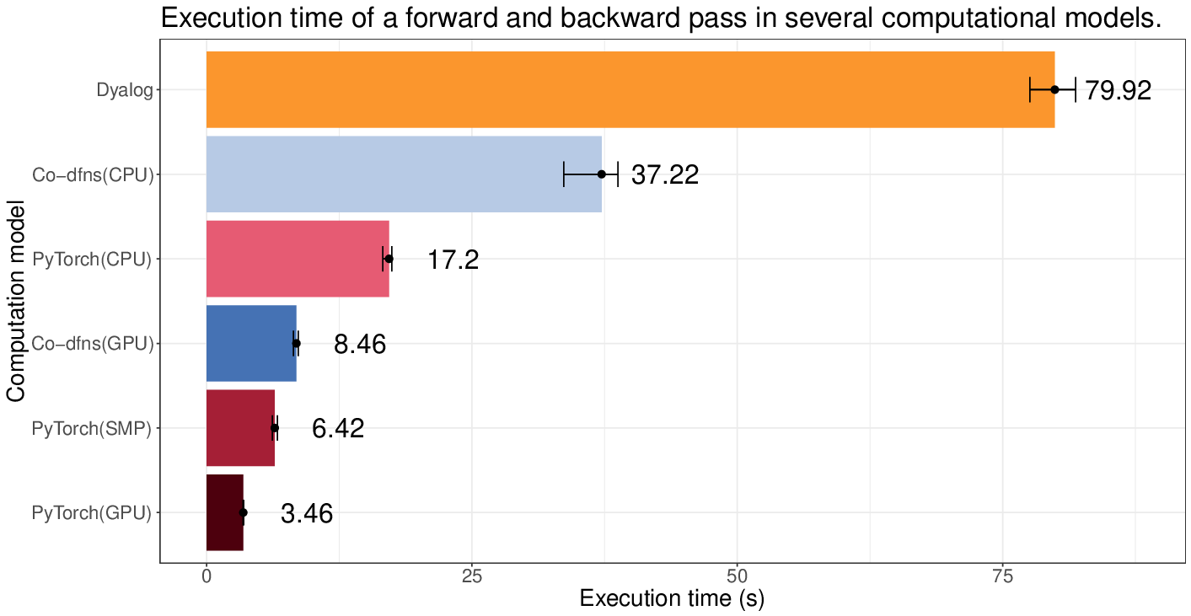
Performance

Slide 15
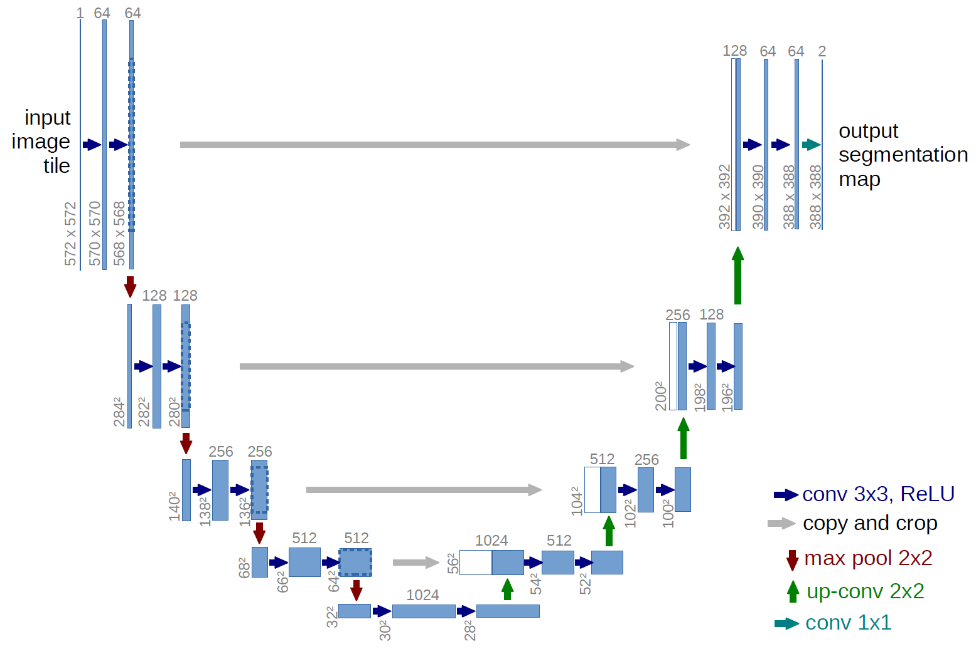
U-Net CNN

Slide 16
Comparing the Code
APL (23 LoC)
PyTorch (~95 LoC)
CV←{0⌈(,⍤3⊢3 3⌺⍵)+.×,[⍳3]⍺}
∆CV←{w←⊖⌽[1]0 1 3 2⍉⍺
∆z←⍵×0<a
∆w←3 0 1 2⍉(⍉,[⍳2]∆z)+.×,[⍳2]3 3⌺x
∆Z←¯2⊖¯2⌽[1](4+2↑⍴∆z)↑∆z
∆x←(,⍤3⊢3 3⌺∆Z)+.×,[⍳3]w
}
nn.Sequential(
nn.Conv2d(
in_channels, out_channels,
kernel_size=(3, 3),
bias=False),
nn.ReLU(inplace=True),
)

Slide 17
Thoughts
What next?

Slide 18
Usability/Speed
Complexity
The APL code can get close to PyTorch in raw structural complexity, but it’s still a learning jump from just calling library functions. But transparent code is much easier to debug with proper tooling.
Education/Insight
The APL code has a clear advantage of giving full access and control over the algorithm, allowing for implementation insights to be applied from domain knowledge more easily. (c.f. – CV vs. C1)
Generality
The APL code was more network agnostic than the PyTorch code, especially in gluing the network together. It’s not clear how much this affected performance.
Performance
There are clear areas for performance improvement both in how we write the code as well as how we compile the code. This suggests that performance parity with frameworks is a real possibility.

Slide 19
Big Questions
Auto-differentiation
Performance Tuning
Integration/Tooling
How much does this matter?
How feasible is this?
Can this scale beyond ML?
How to leverage data widths?
Multi-node, distributed code?
Predictability?
Which optimizations?
How to mix with existing code?
Monitoring/visualization tools?
Composition with other domains?
Education, teaching…

Slide 20
Conclusion
The APL language/ecosystem is a candidate for exploring alternative approaches to ML implementation that can increase transparency, compositionality, and general domain insight; even with current limits, it can be used to enable better modeling of ML algorithms for education and professional development.

Slide 21
THANK YOU
Aaron W. Hsu – aaron@dyalog.com
Rodrigo Girão Serrão – rodrigo@dyalog.com

Slide 22
W←⍬ ⋄ V←⍬ ⋄ Z←⍬ ⋄ LR←1e¯9 ⋄ MO←0.99
FWD←{Z⊢←(≢W)⍴⊂⍬
CV←{0⌈z⊣Z[⍺]←⊂Z[⍺],⊂z←(,[2+⍳3]3 3 SF⊃Z[⍺]←⊂⍵)+.×,[⍳3]⍺⊃W}
CC←{⍵,⍨(⌊p)↓(-⌈p)↓(⍺⊃Z)⊣p←2÷⍨(⍴⍺⊃Z)-⍴⍵}
MX←{⌈⌿[2],[2 3](2 2⍴2)SF⊃Z[⍺]←⊂⍵}
UP←{((2×¯1↓⍴⍵),¯1↑⍴⍺⊃W)⍴0 2 1 3 4⍉⍵+.×⍺⊃W⊣Z[⍺]←⊂⍵}
C1←{1E¯8+z÷[⍳2]+/z←*z-[⍳2]⌈/z←⍵+.×⍺⊃W⊣Z[⍺]←⊂⍵}
LA←{⍺≥≢Z:⍵ ⋄ (⍺+2)CC(⍺+5)UP(⍺+4)CV(⍺+3)CV(⍺+6)∇(⍺+2)MX(⍺+1)CV(⍺+0)CV ⍵}
2 C1 1 CV 0 CV 3 LA ⍵⍴⍨3↑1,⍨⍴⍵}
BCK←{Y←⍺ ⋄ Y∆←⍵ ⋄ ∆←{0⊣W[⍺]←⊂(⍺⊃W)-LR×⊃V[⍺]←⊂⍵+MO×(⍴⍵)⍴⍺⊃V}
∆CV←{w←,[⍳3]⊖⌽[1]0 1 3 2⍉⍺⊃W ⋄ x←⊃⍺⊃Z ⋄ ∆z←⍵×0<1⊃⍺⊃Z ⋄ ∆Z←¯2⊖¯2⌽[1](4+2↑⍴∆z)↑∆z
_←⍺ ∆ 3 0 1 2⍉(⍉,[⍳2]∆z)+.×,[⍳2]3 3 SF x ⋄ w+.×⍨,[2+⍳3]3 3 SF ∆Z}
∆CC←{x←⍺⊃Z ⋄ ∆z←⍵ ⋄ d←-⌊2÷⍨2↑(⍴x)-⍴∆z ⋄ (⊃d)⊖(1⊃d)⌽[1](⍴x)↑∆z}
∆MX←{x←⍺⊃Z ⋄ ∆z←⍵ ⋄ y×x=y←(⍴x)↑2⌿2/[1]∆z}
∆UP←{w←⍺⊃W ⋄ x←⍺⊃Z ⋄ ∆z←⍵ ⋄ cz←(2 2⍴2)SF ∆z
_←⍺ ∆(⍉,[⍳2]x)+.×,[⍳2]cz ⋄ (,[2+⍳3]cz)+.×⍉⍪w}
∆C1←{w←⍺⊃W ⋄ x←⍺⊃Z ⋄ ∆z←⍵ ⋄ _←⍺ ∆(⍉,[⍳2]x)+.×,[⍳2]∆z ⋄ ∆z+.×⍉w}
∆LA←{⍺≥≢Z:⍵ ⋄ (⍺+0)∆CV(⍺+1)∆CV(⍵ ∆CC⍨⍺+2)+(⍺+2)∆MX(⍺+6)∇(⍺+3)∆CV(⍺+4)∆CV(⍺+5)∆UP ⍵↑[2]⍨-2÷⍨⊃⌽⍴⍵}
3 ∆LA 0 ∆CV 1 ∆CV 2 ∆C1 Y∆-(~Y),[1.5]Y}

Slide 23
E←{-+⌿,⍟(⍺×⍵[;;1])+(~⍺)×⍵[;;0]}
RUN←{Y Y∆(Y E Y∆)⊣(Y←⌊0.5+nm↑⍵↓⍨2÷⍨(⍴⍵)-nm←2↑⍴Y∆)BCK⊢Y∆←FWD ⍺}
init_wv←{W⊢←(,1⊃⍵),,0⊃⍵ ⋄ V⊢←(≢W)⍴⊂⍬ ⋄ ≢W} ⋄ get_w←{W}
SF1←{R←≢W←⍺ ⋄ A←⍵ ⋄ S←1+(R↑⍴A)-W ⋄ ST←(×⌿S),×⌿Ts←R↓⍴A
(S,W,Ts)⍴1 0 2⍉{ST⍴S↑⍵↓A}⍤1⊢⍉W⊤⍳×⌿W}
SF2←{R←≢W←0⌷⍺ ⋄ S←1⌷⍺ ⋄ A←⍵ ⋄ P←⌈S÷⍨(R↑⍴A)-W-1 ⋄ ST←(×⌿P),×⌿Ts←R↓⍴A
I←S×⍳¨P ⋄ (P,W,Ts)⍴1 0 2⍉{ST⍴(I+⍵)⌷A}⍤1⊢⍉W⊤⍳×⌿W}
SW←{R←≢W←0⌷⍺ ⋄ S←1⌷⍺ ⋄ A←⍵ ⋄ P←⌈S÷⍨(R↑⍴A)-W-1 ⋄ Ts←R↓⍴A
(I,(⍳≢Ts)+≢I←,I,⍪R+I←⍳R)⍉(Ts,⍨,P,⍪S)⍴(P×S)↑⍵}
SF←{1≥≢⍴⍺:⍺ SF1 ⍵ ⋄ ⍺ SW ⍵ ⋄ ⍺ SF2 ⍵}

Slide 24
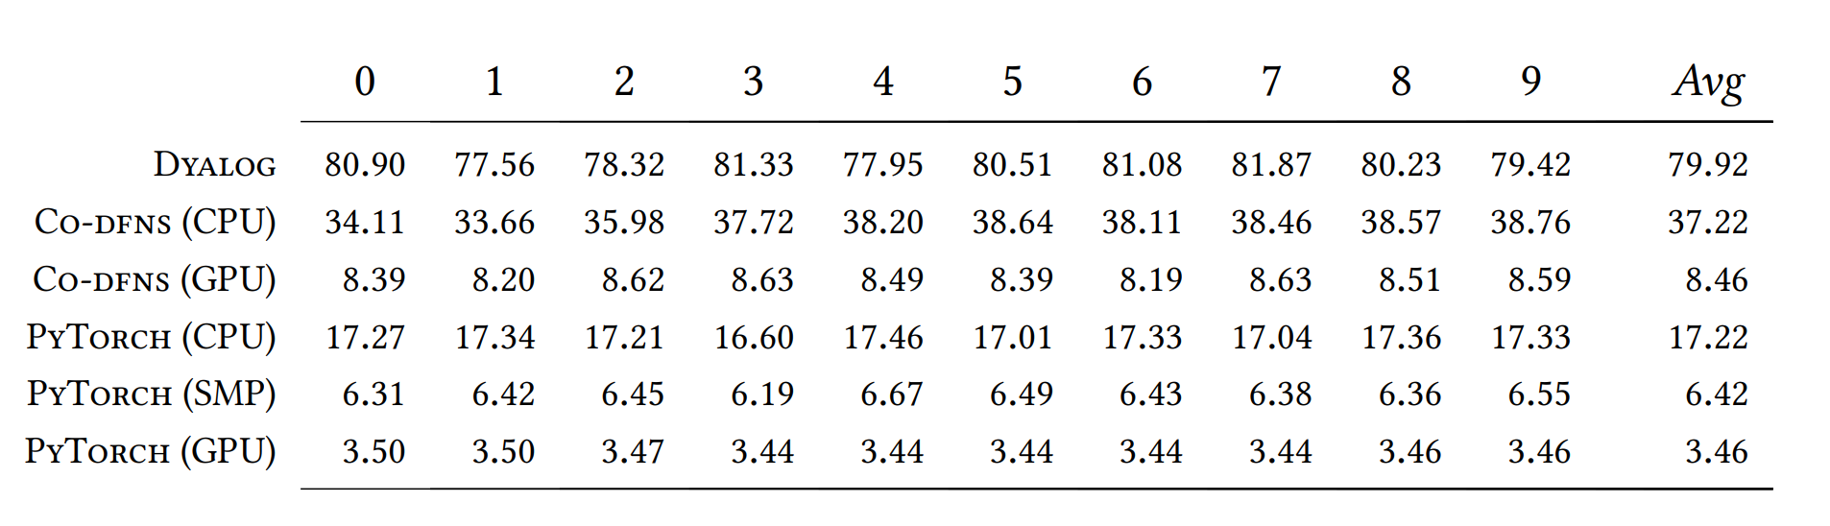

Slide 25
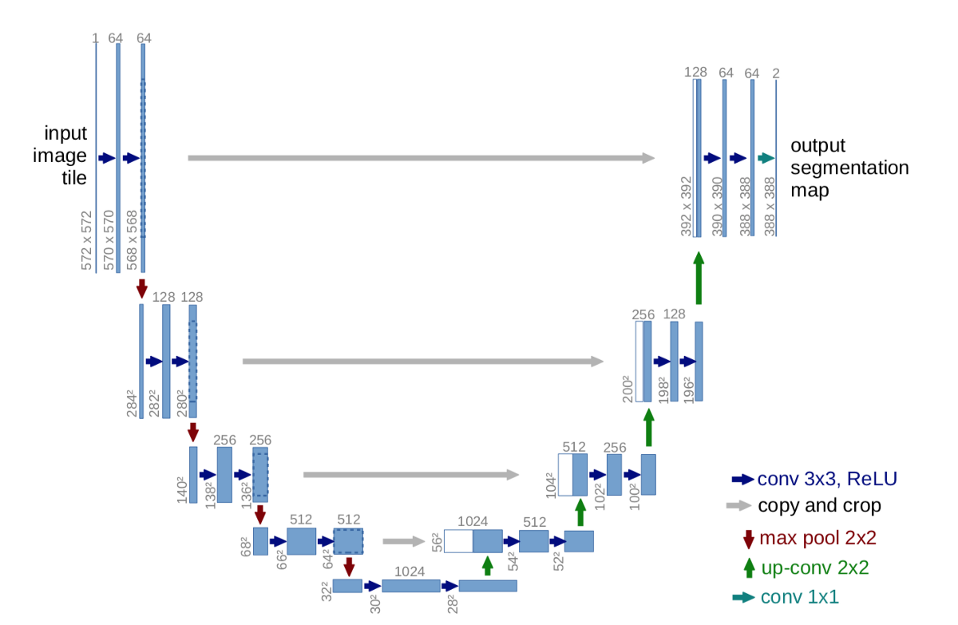
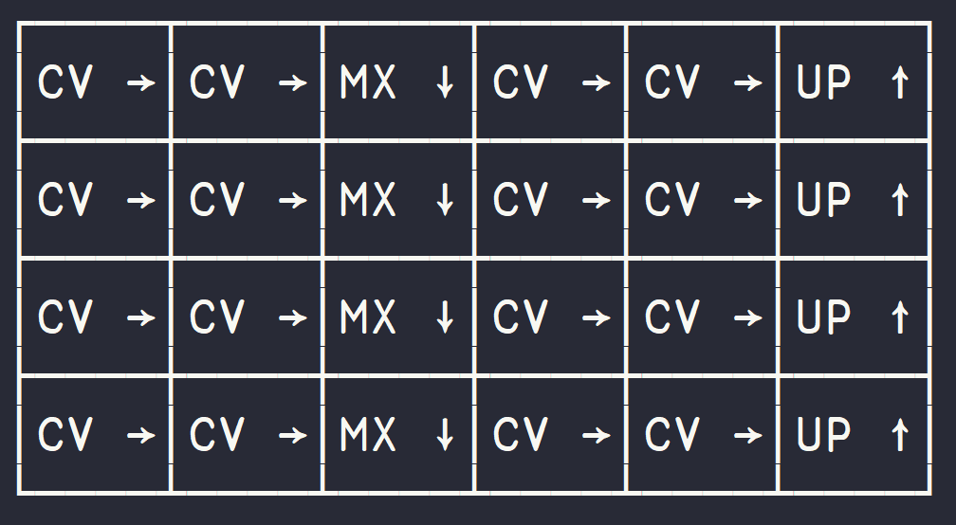
Wiring

Slide 28
