Slide 1
Computer Architecture
Lecture 6: Assembler
Lector: Konstantin Chaika
Based on
- David Harris, Sarah L. Harris, Digital Design and Computer Architecture
- Nand to Tetris / www.nand2tetris.org
Constructor University Bremen Spring 2025

Slide 2

Tell me when you're tired

Slide 3
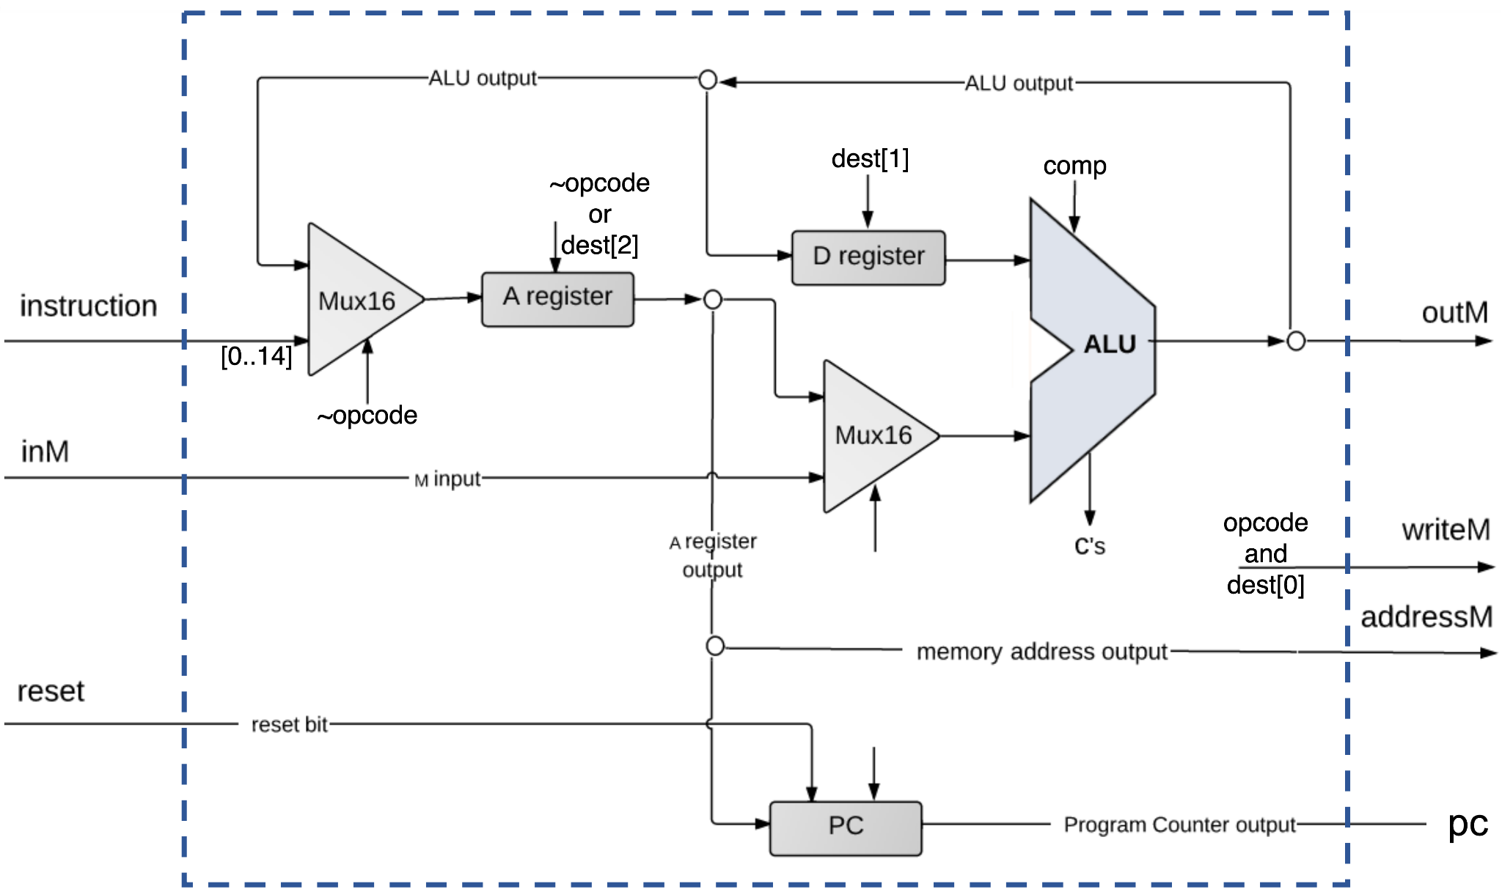
We build the computer!
Fetch-decode-execute cycle
Data path

Slide 4
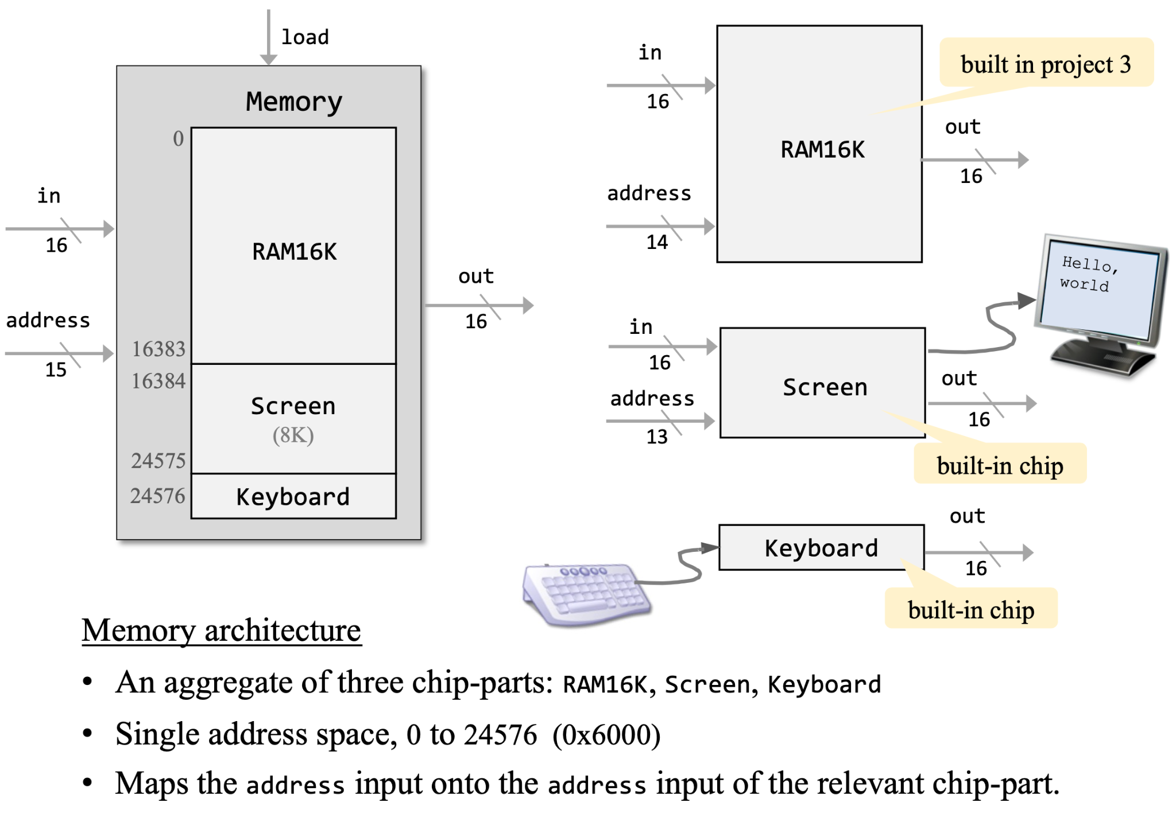
Memory mapped I/O

Slide 5
What next?
It’s time to program it!
Program translation
Hack assembler architecture
Symbol table

Slide 6
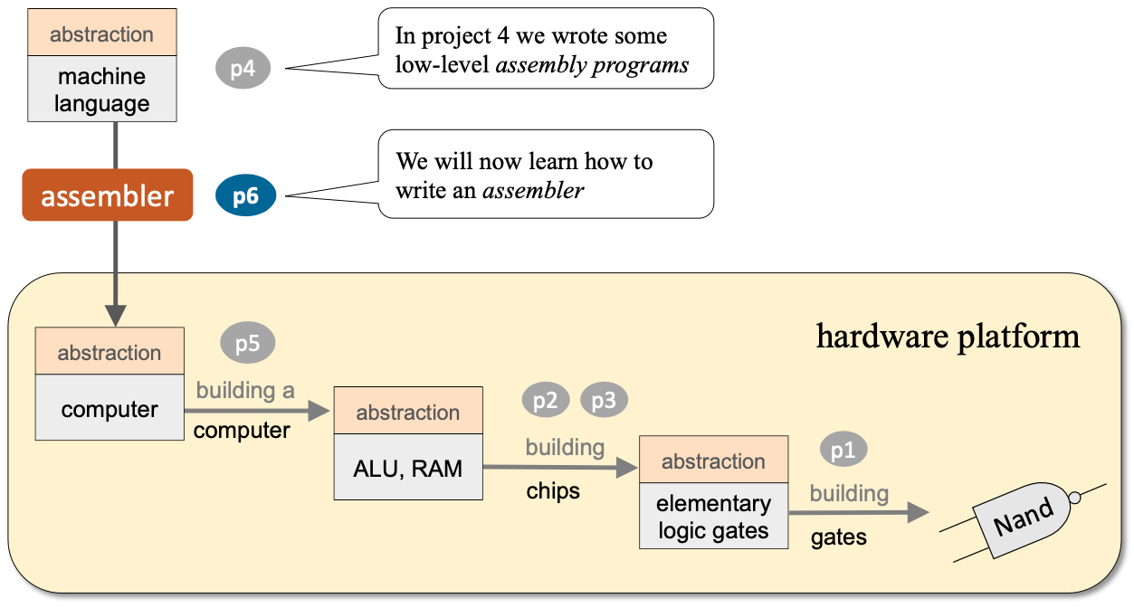
Roadmap

Slide 7
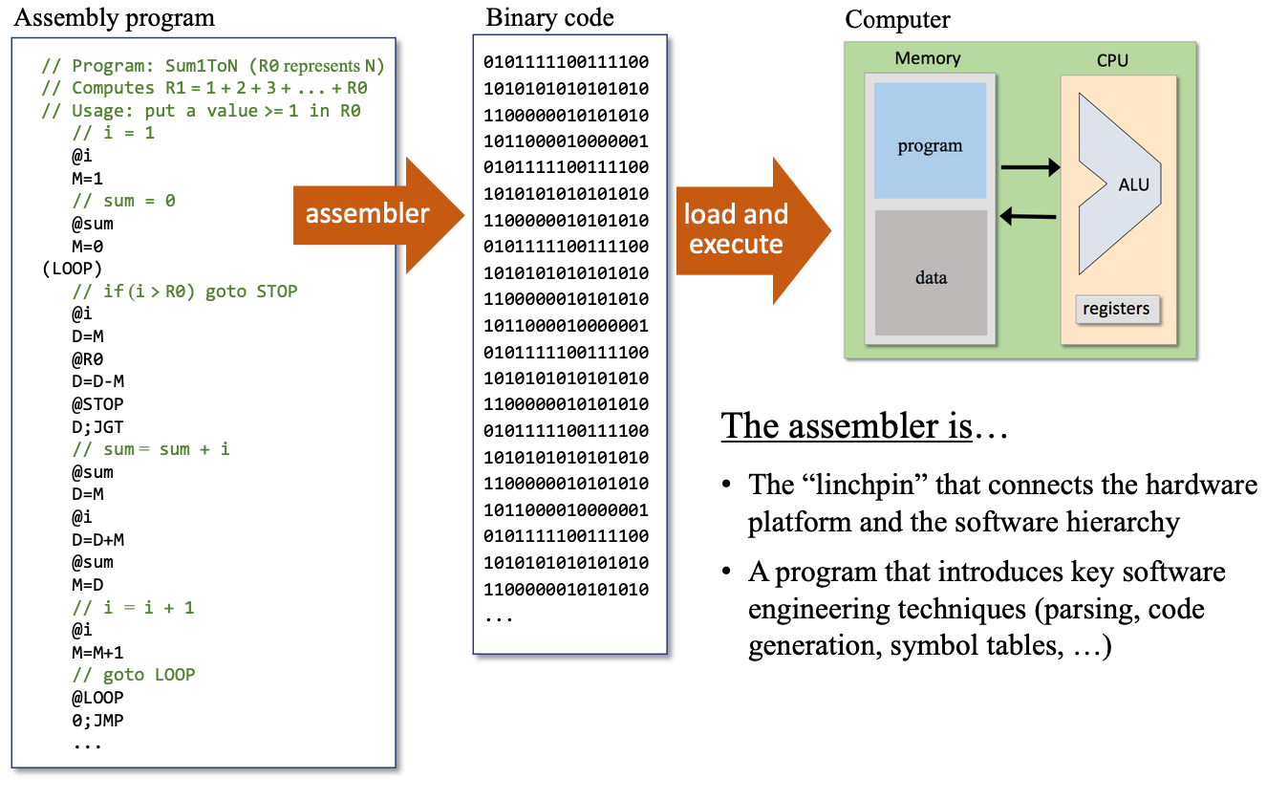
Program translation

Slide 8
Translating instructions
A-instructions
C-instructions
Notes:
Now learning how to translate the instructions whose support we design.

Slide 9
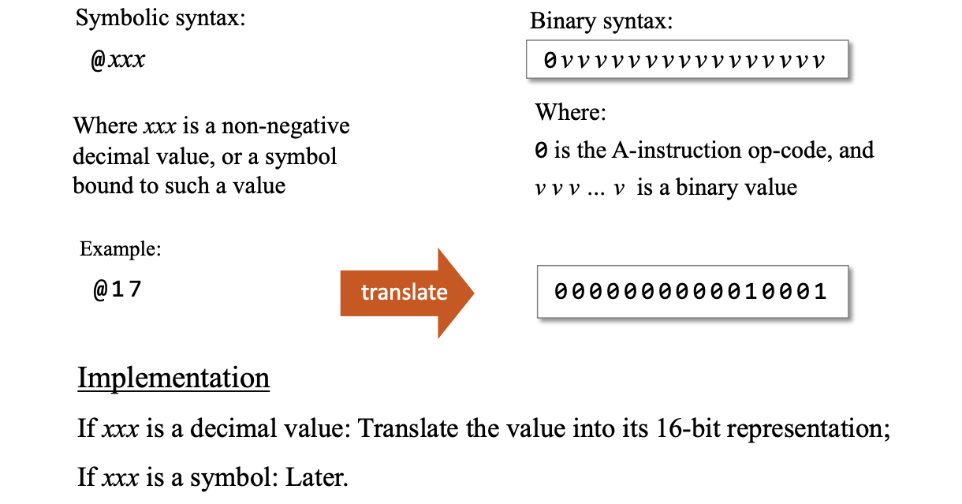

Translating A-instructions

Slide 10
Translating A-instructions

Slide 11
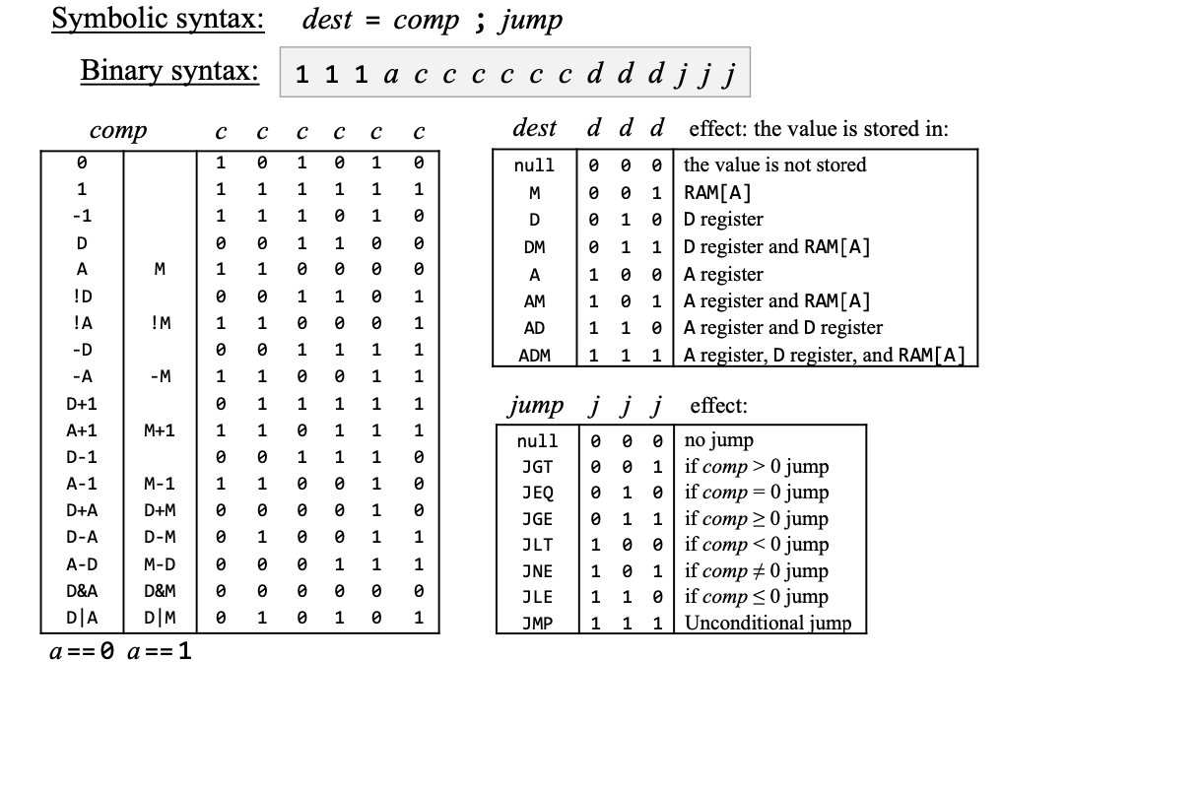
Translating C-instructions

Slide 12
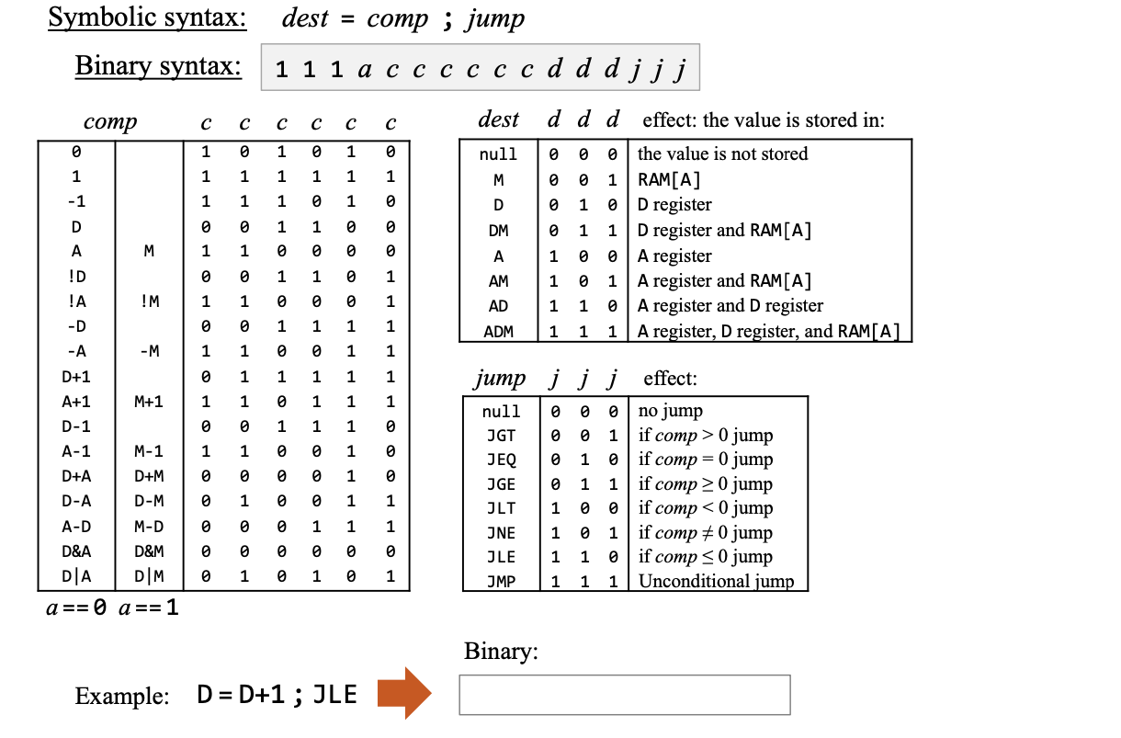
Translating C-instructions

Slide 13
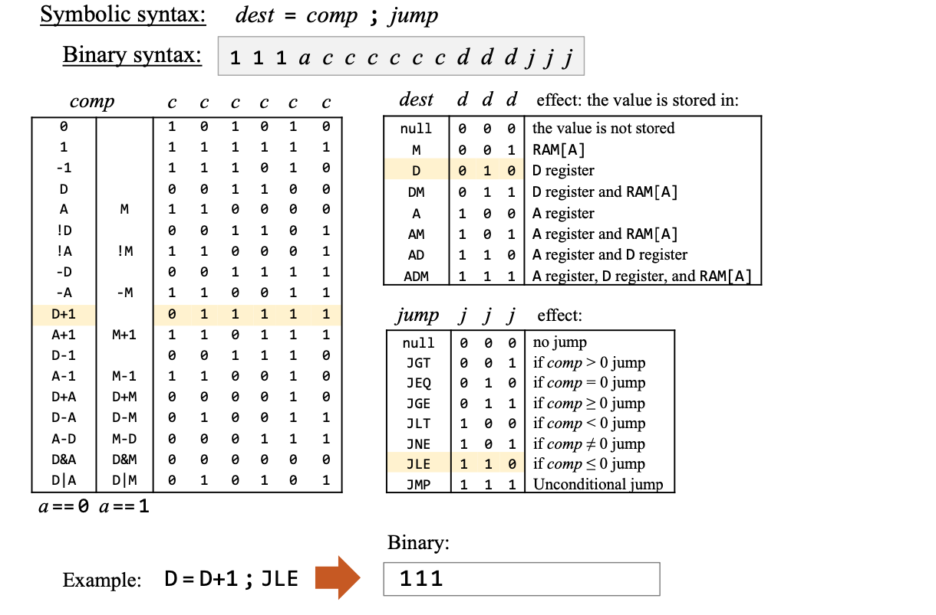
Translating C-instructions

Slide 14
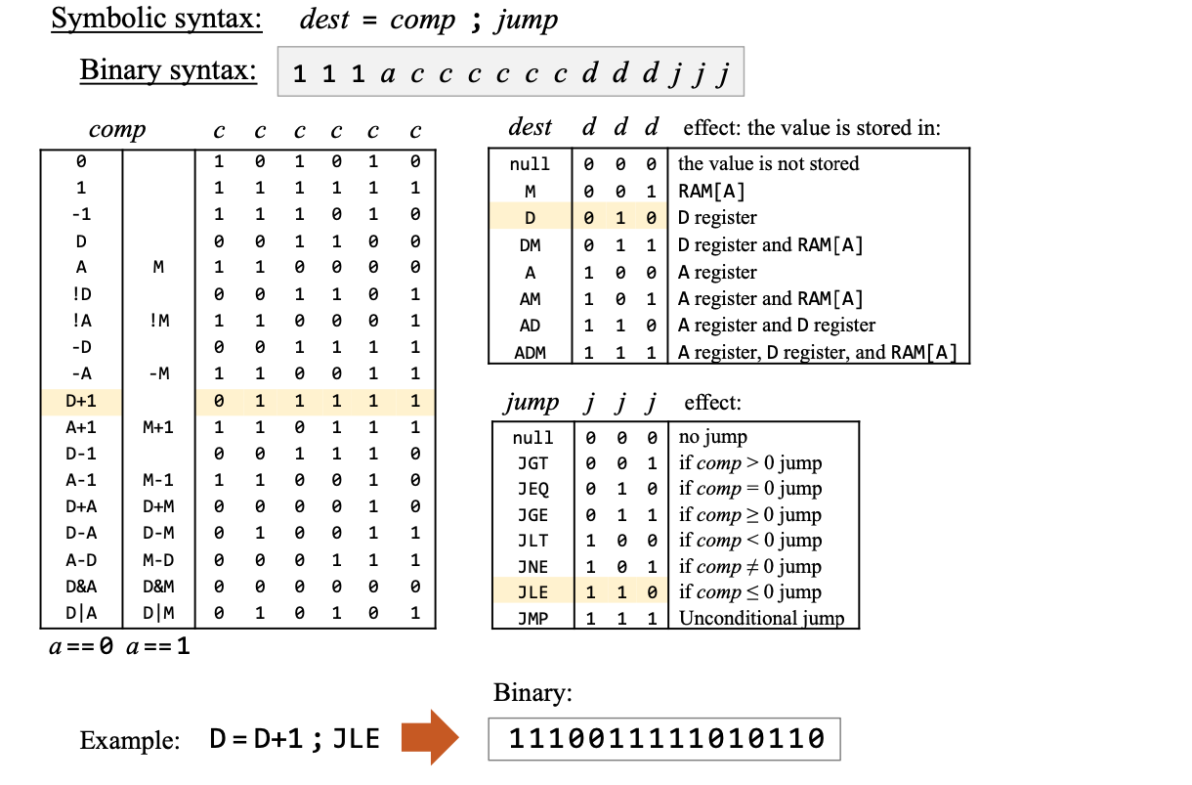
Translating C-instructions

Slide 15
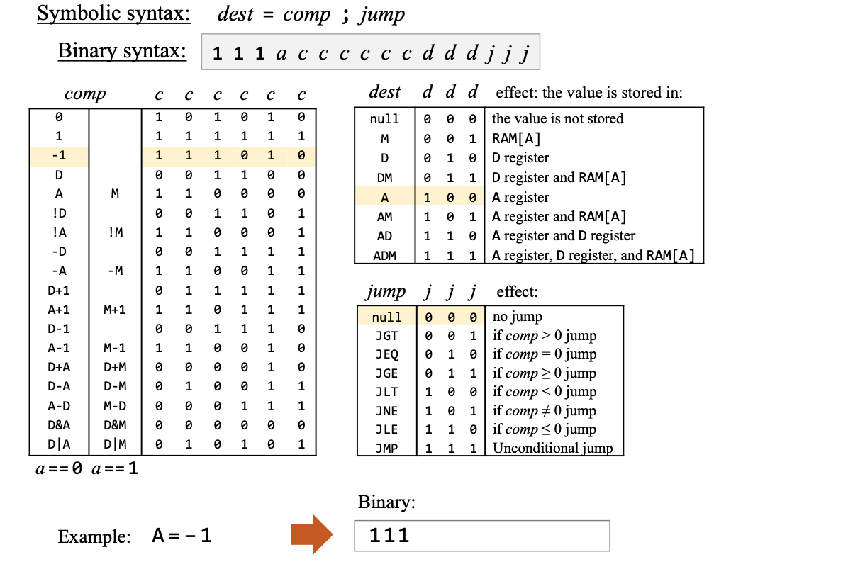
Translating C-instructions

Slide 16
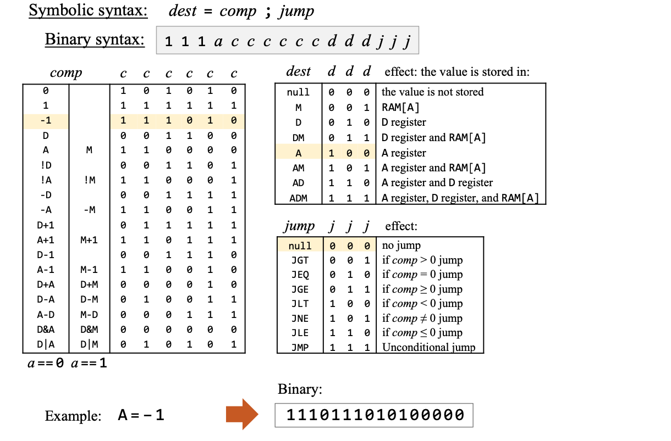
Translating C-instructions

Slide 17
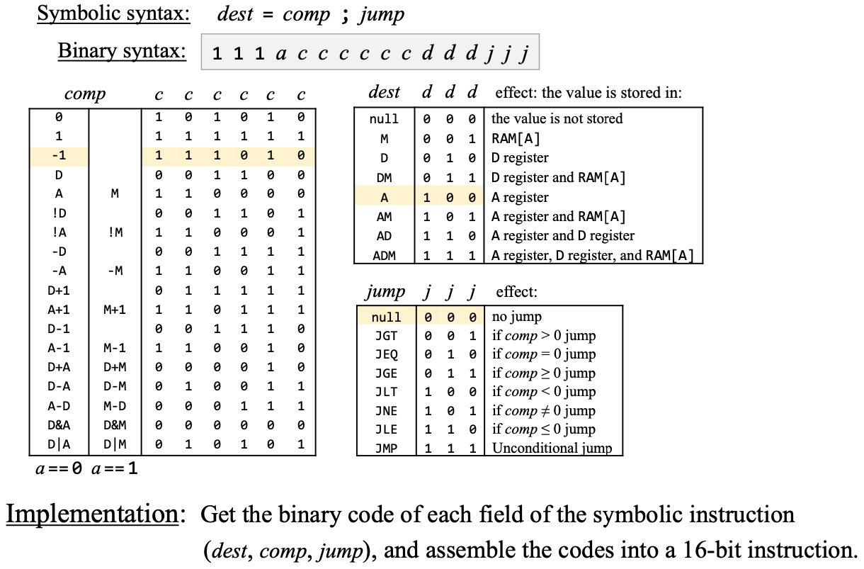
Translating C-instructions

Slide 18
Translating programs
What else should we take into account?
What else besides instructions translating?

Slide 19
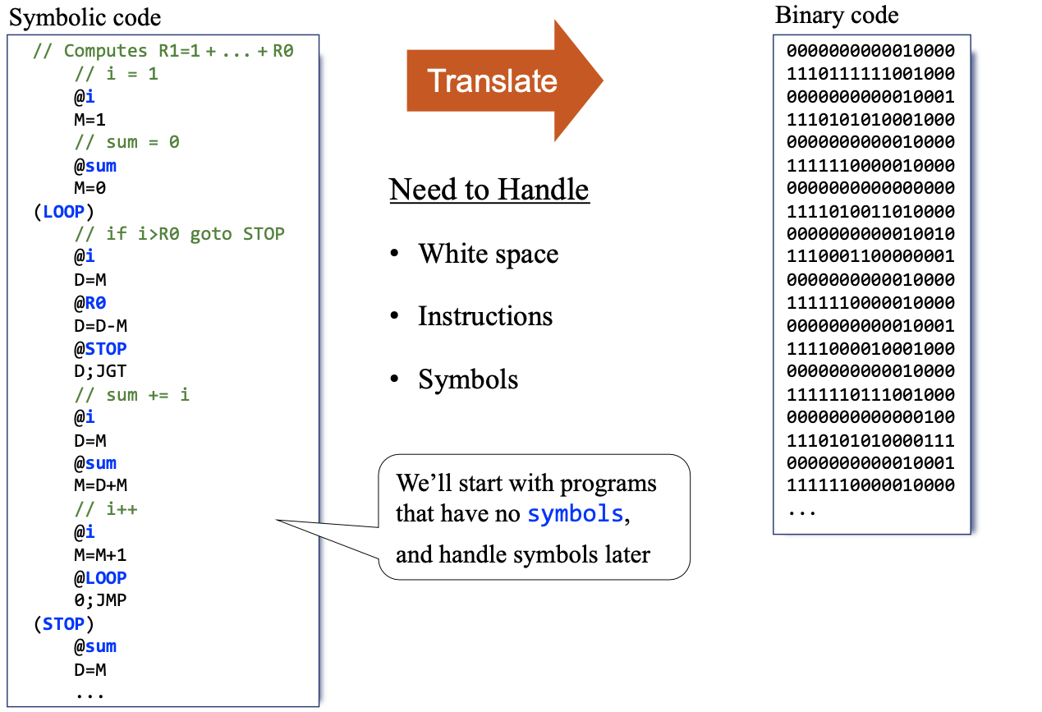
Translating programs

Slide 20
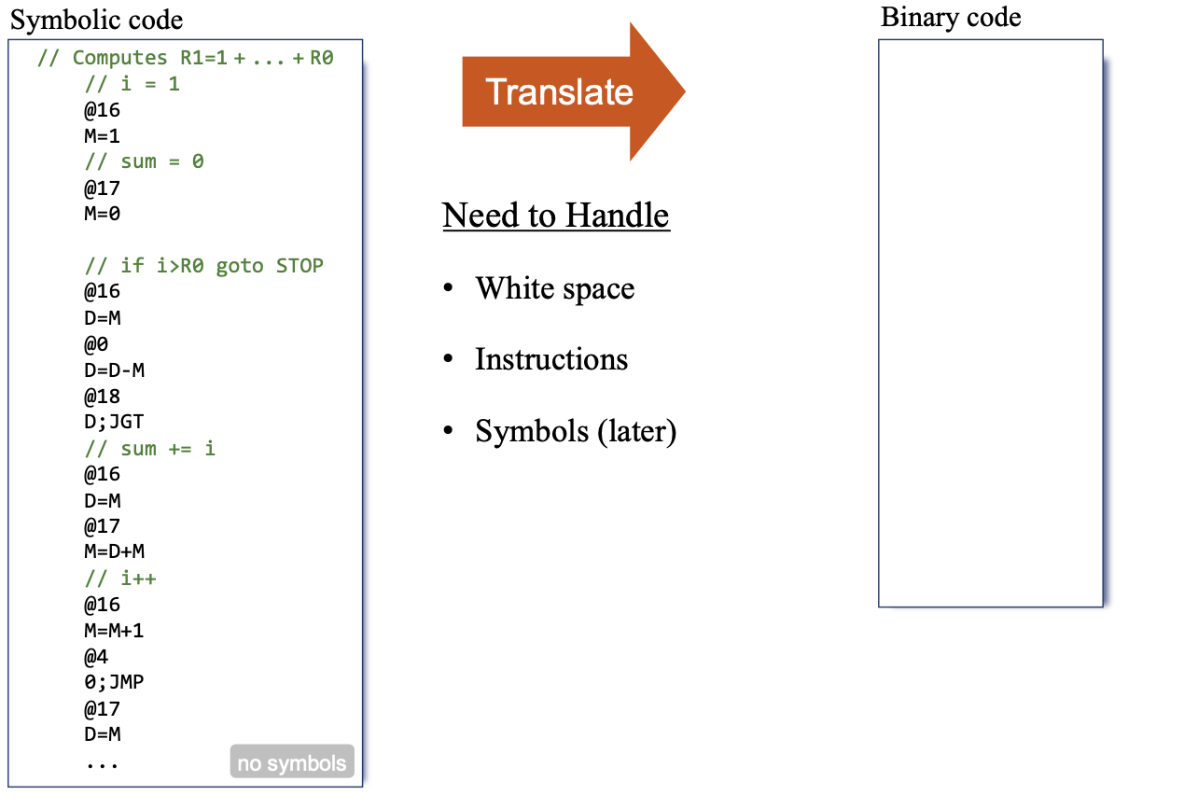
Translating programs

Slide 21
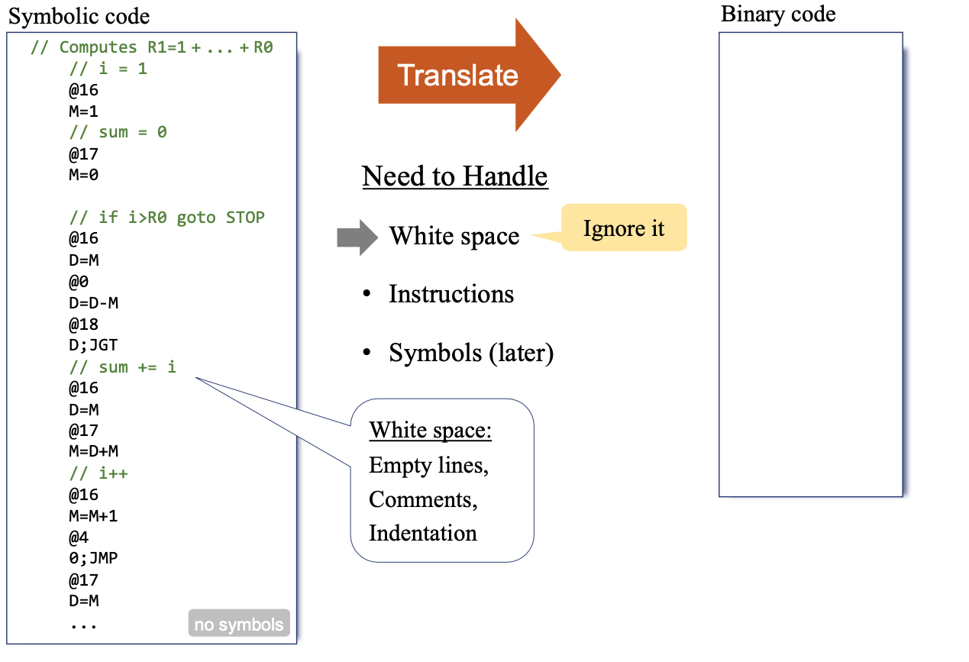
Translating programs

Slide 22
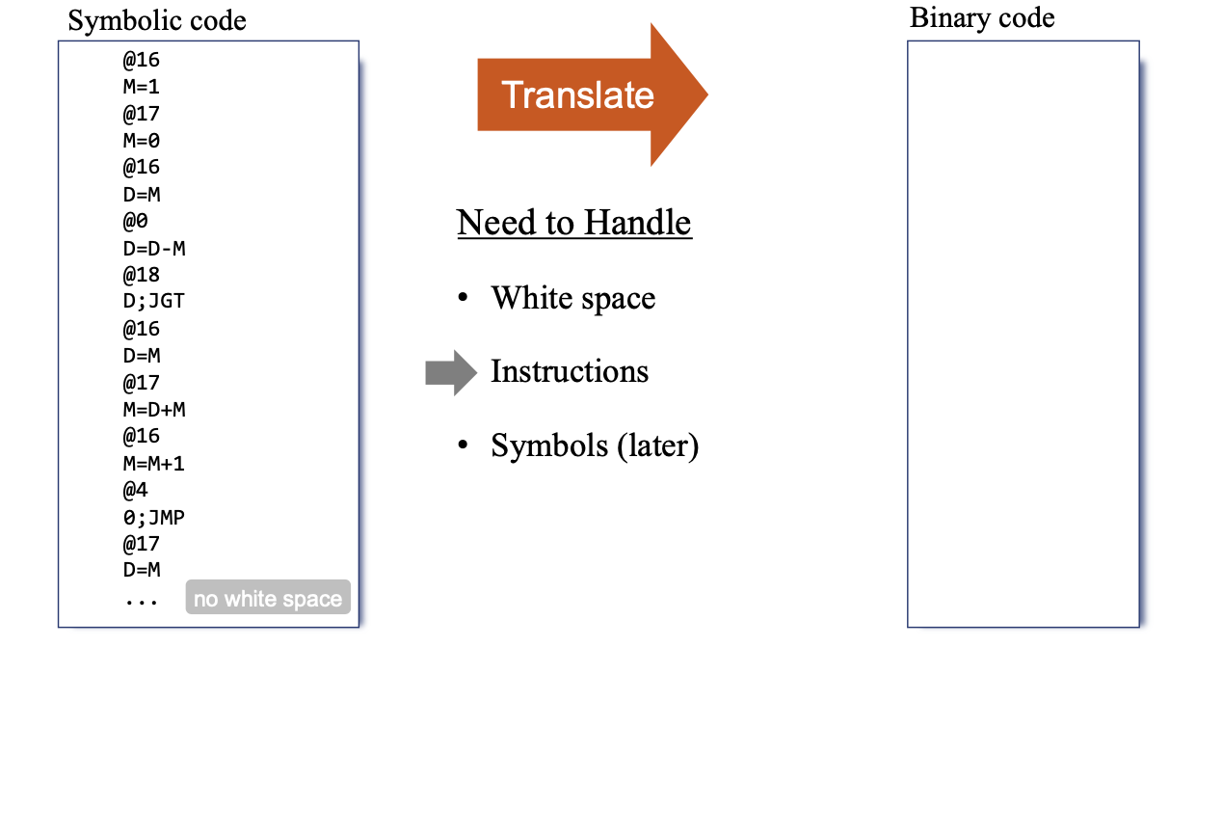
Translating programs

Slide 23
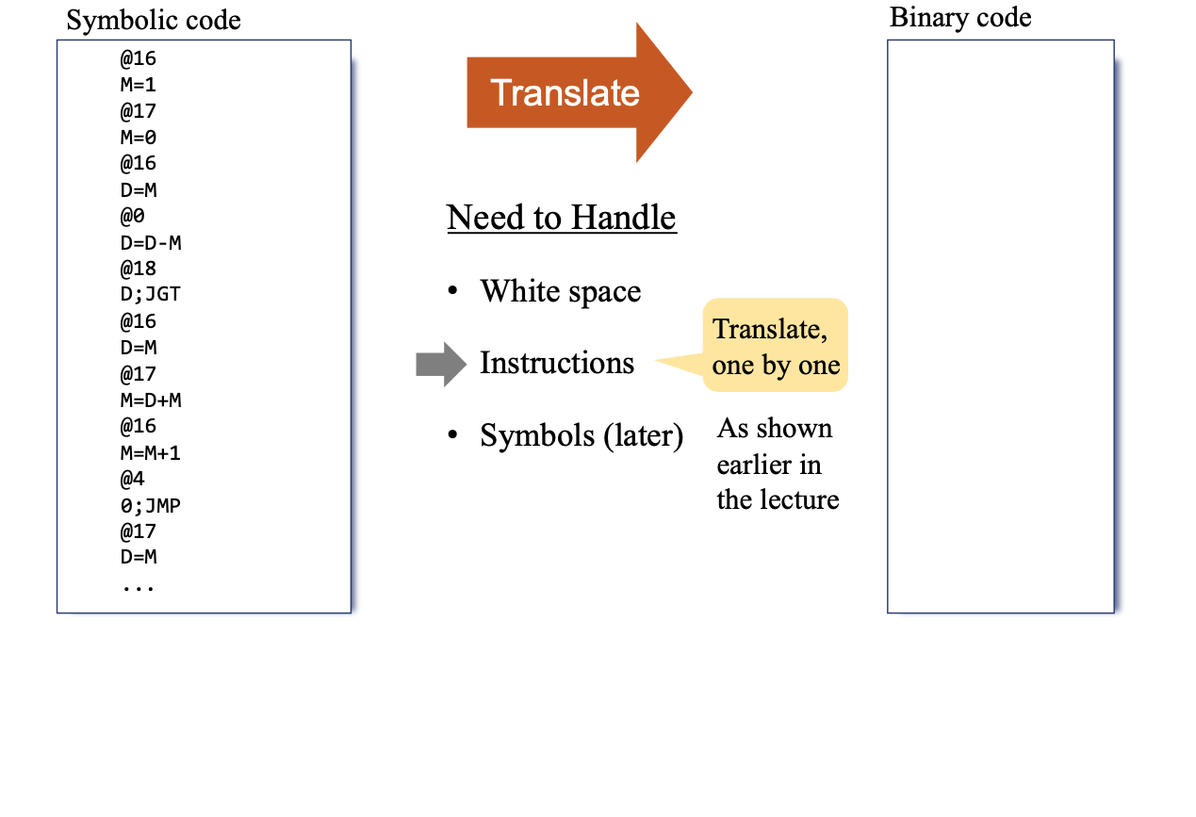
Translating programs

Slide 24
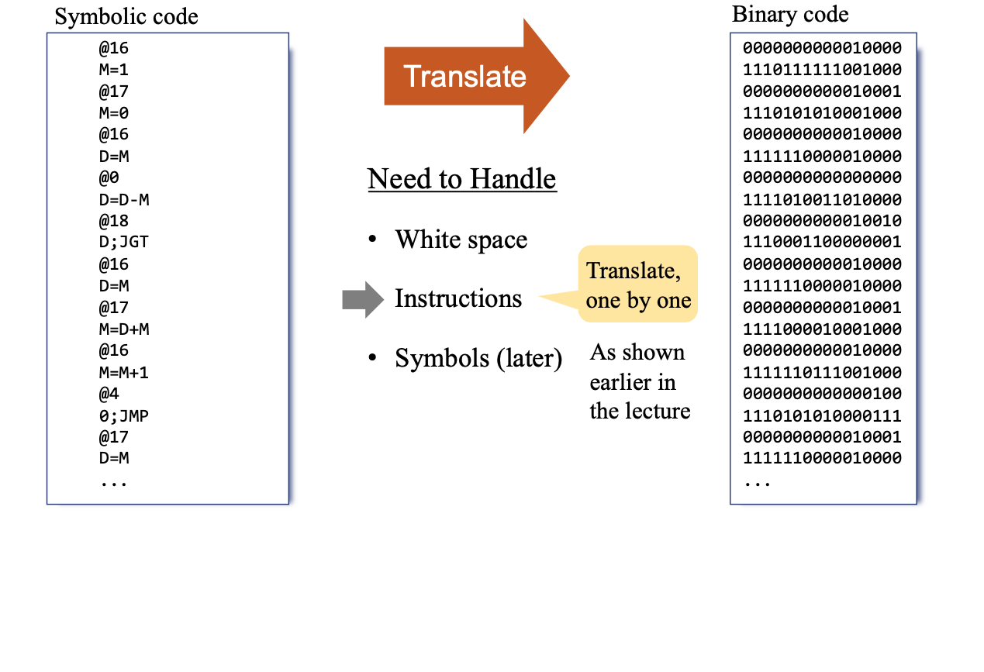
Translating programs

Slide 25
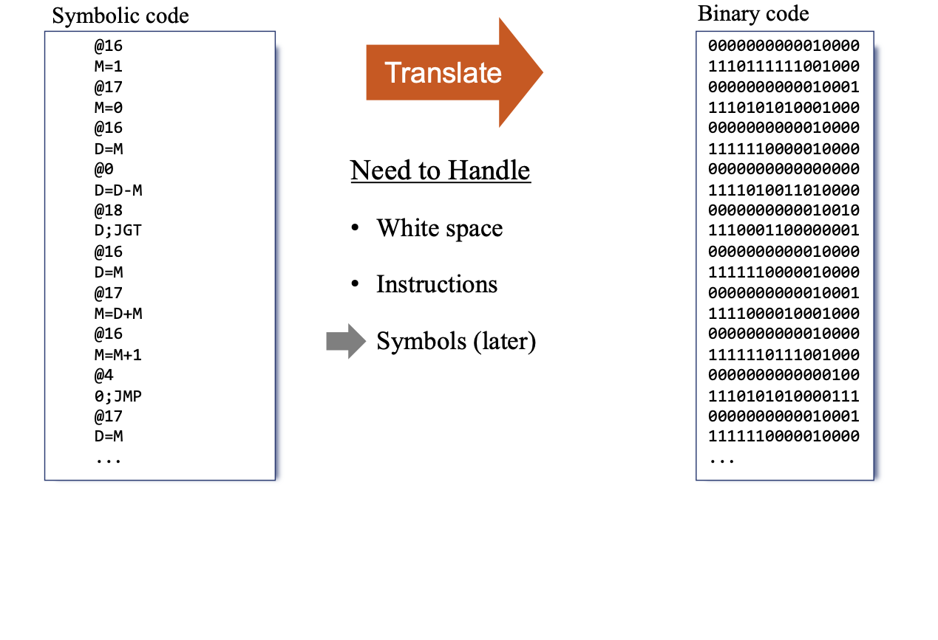
Translating programs

Slide 26
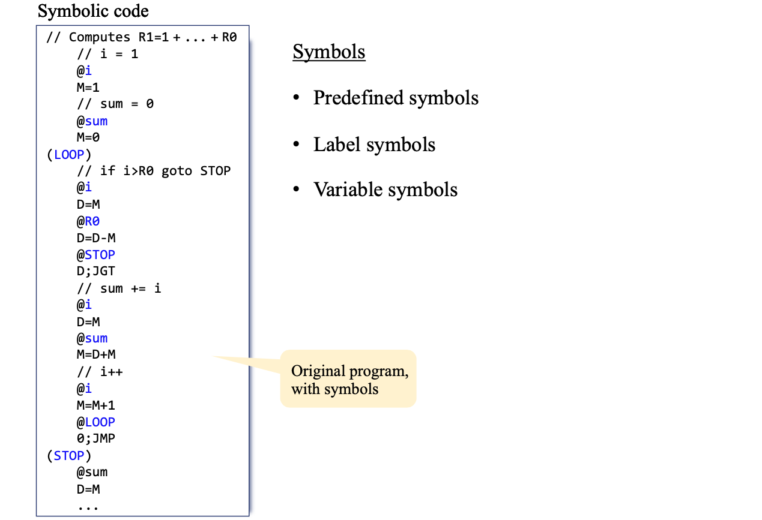
Translating programs

Slide 27
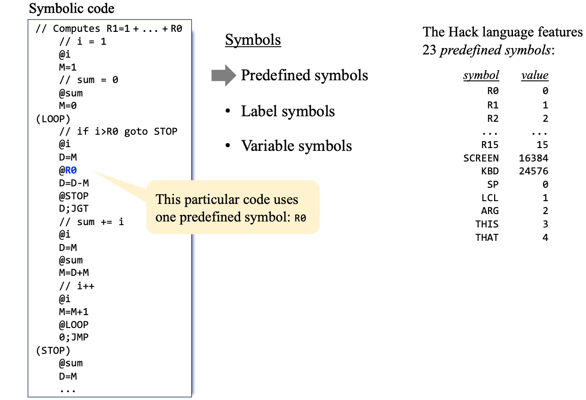
Translating programs

Slide 28
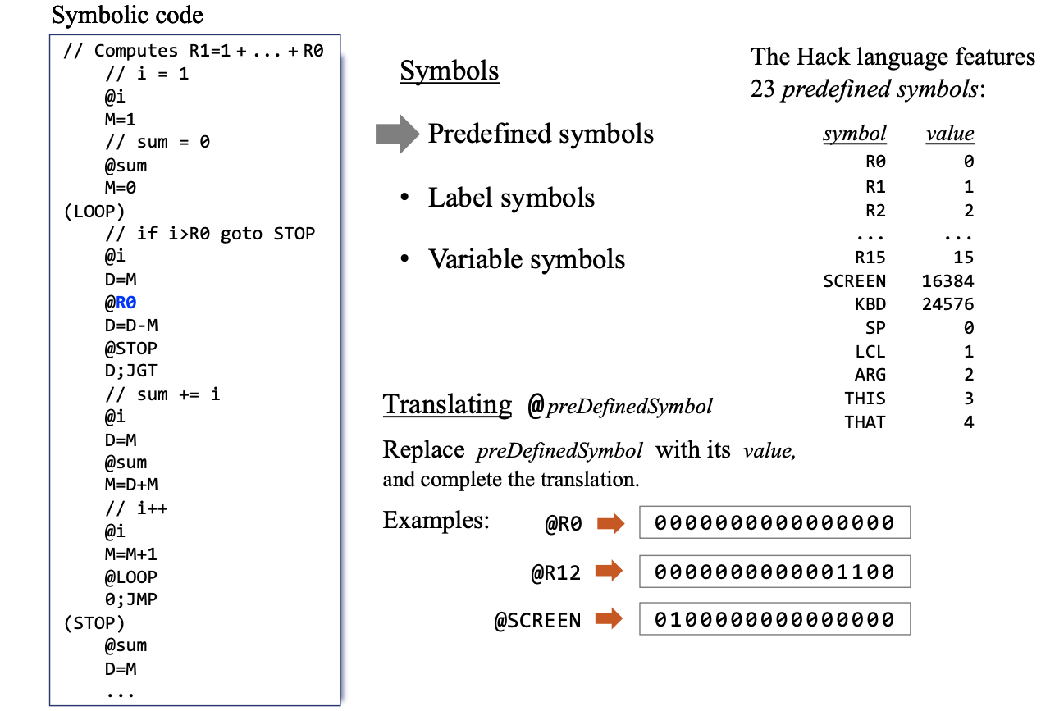
Translating programs

Slide 29
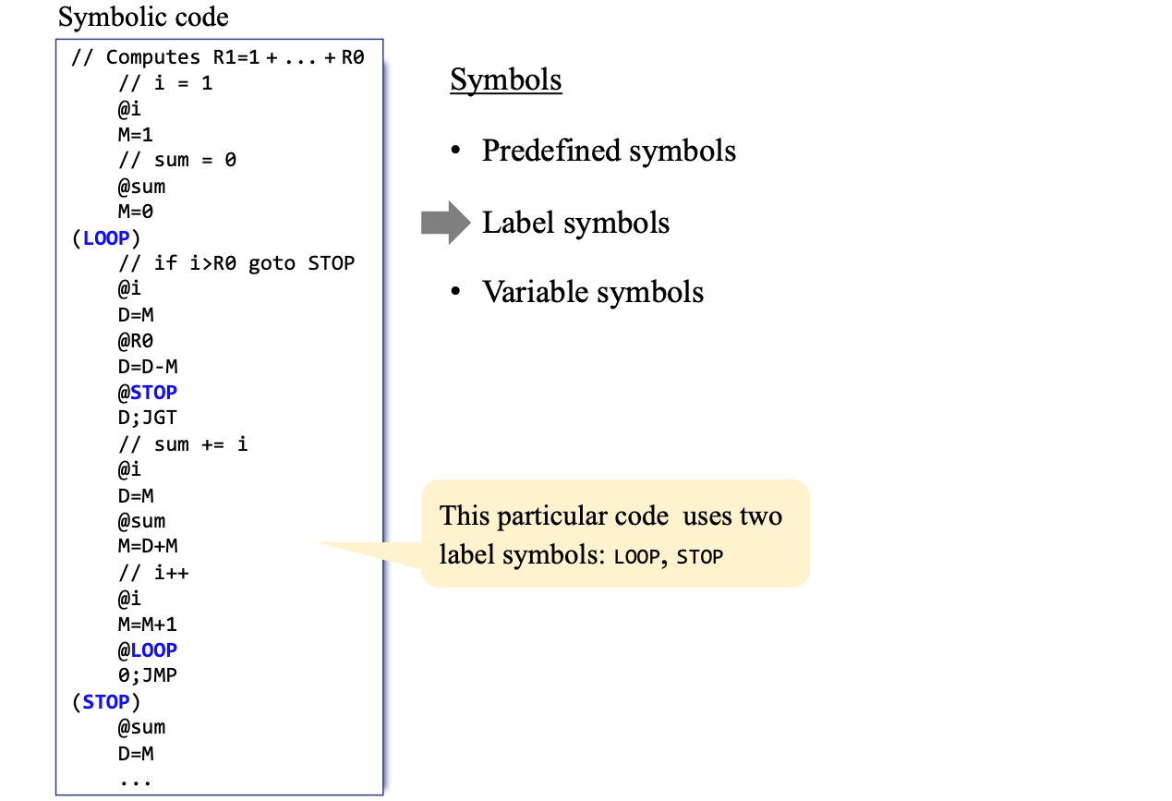
Translating programs

Slide 30
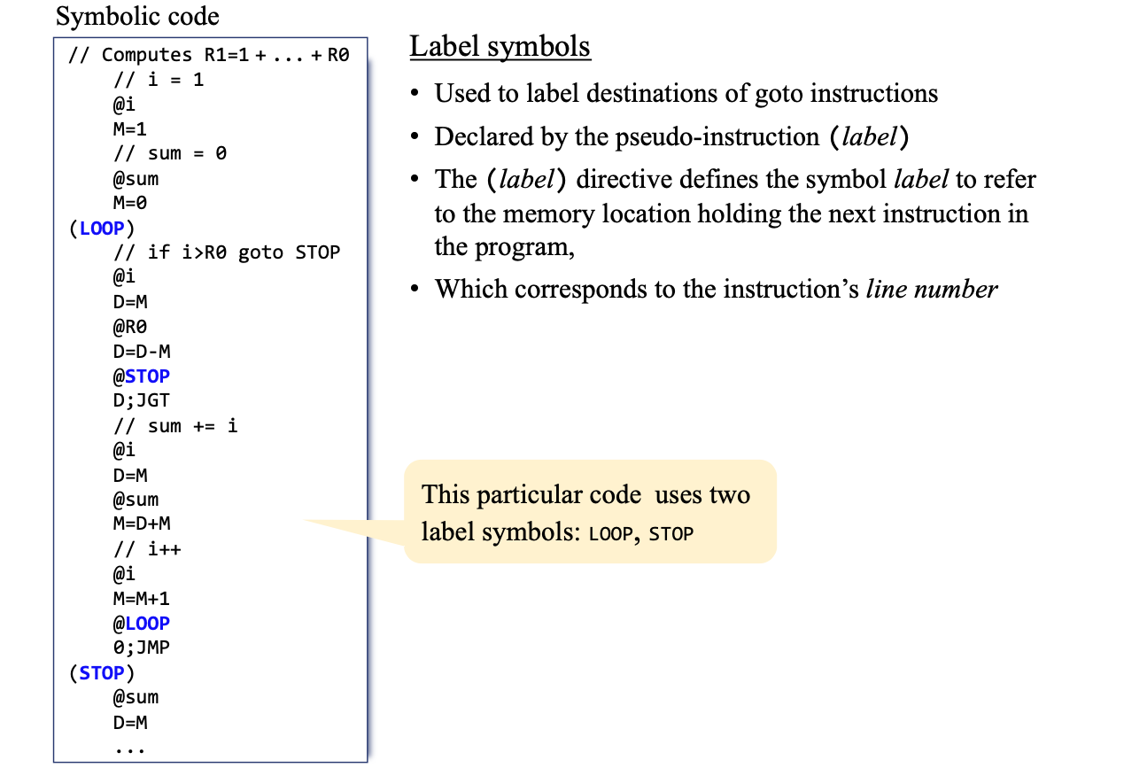
Translating programs

Slide 31
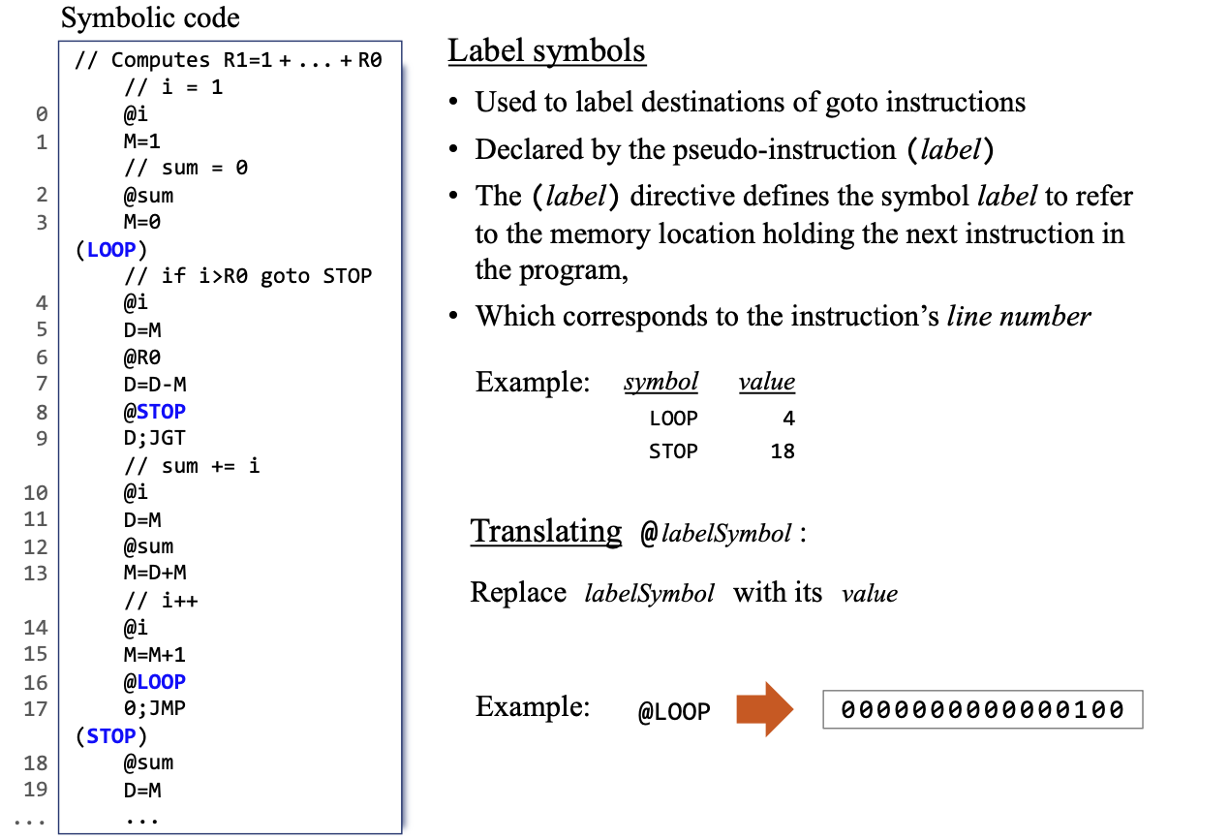
Translating programs

Slide 32
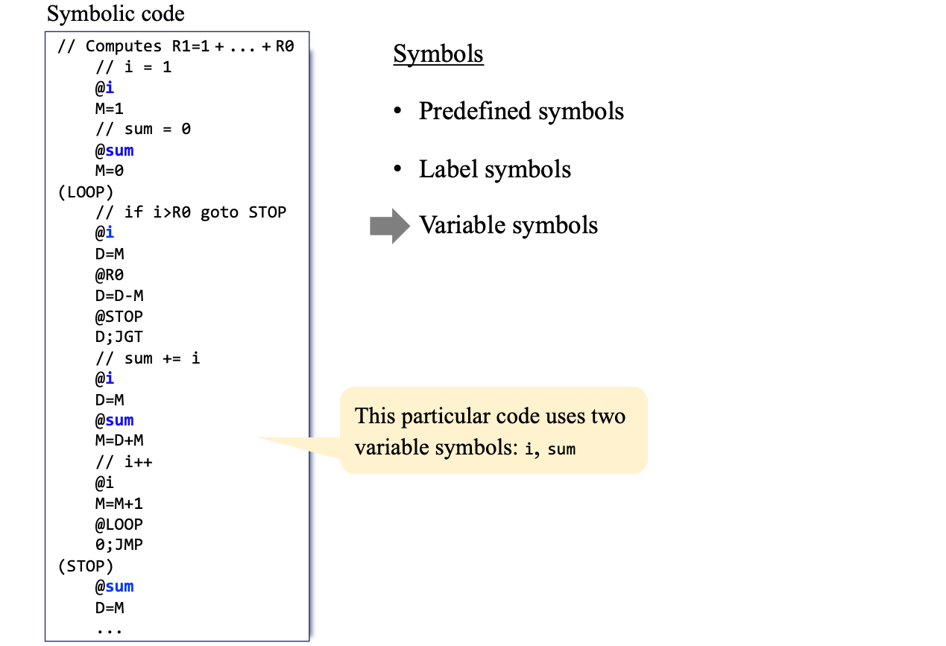
Translating programs

Slide 33
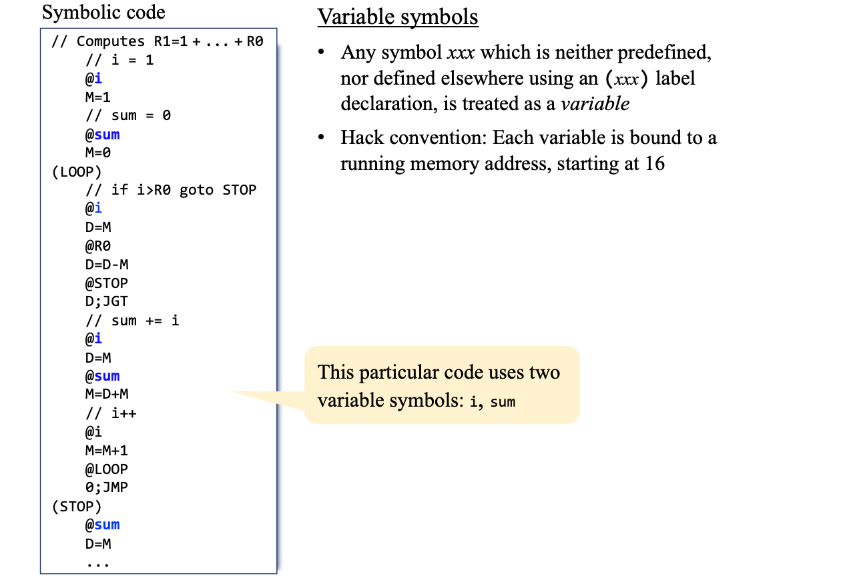
Translating programs

Slide 34
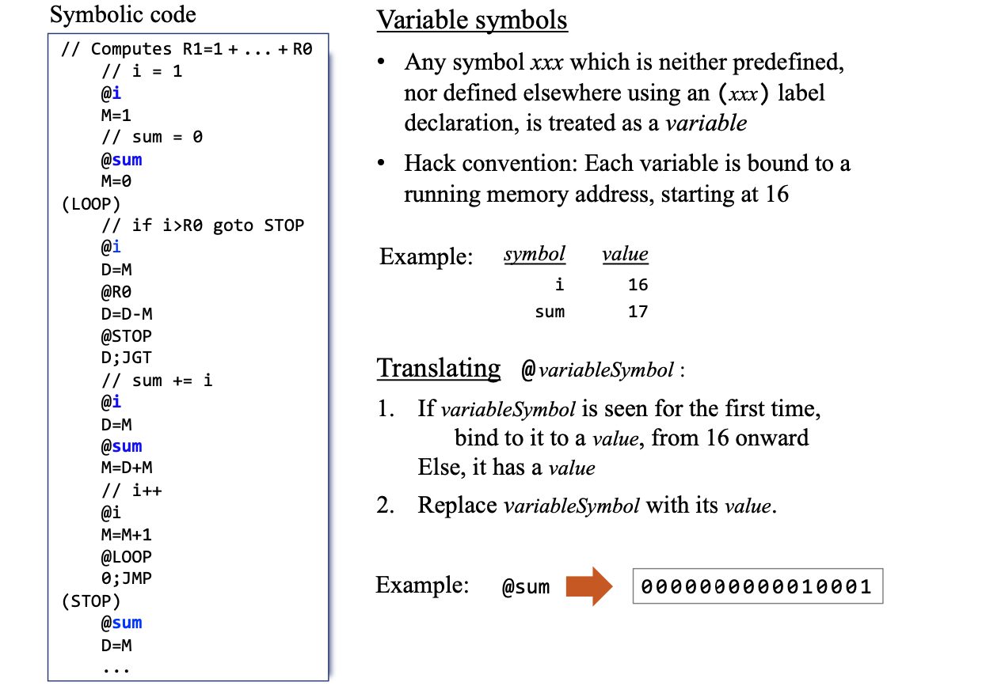
Translating programs

Slide 35
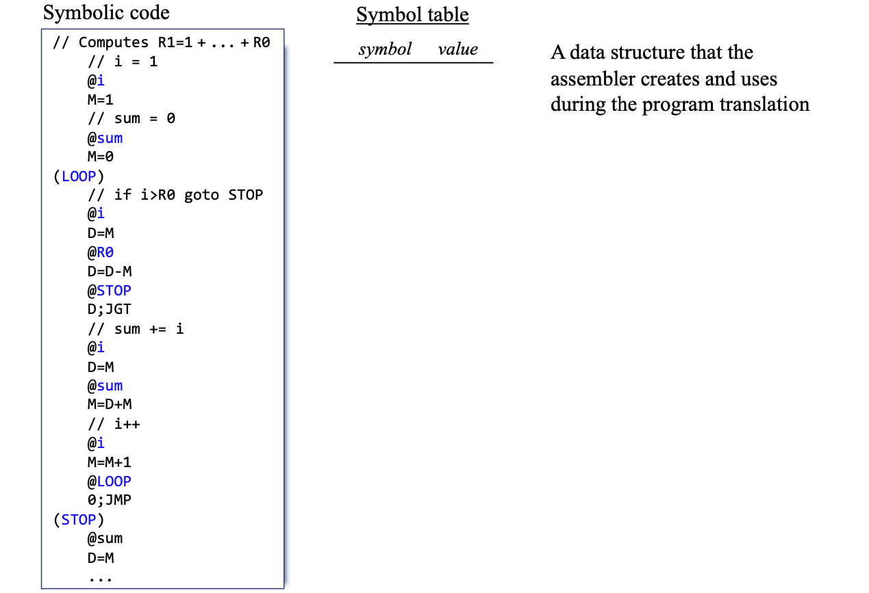
Translating programs

Slide 36
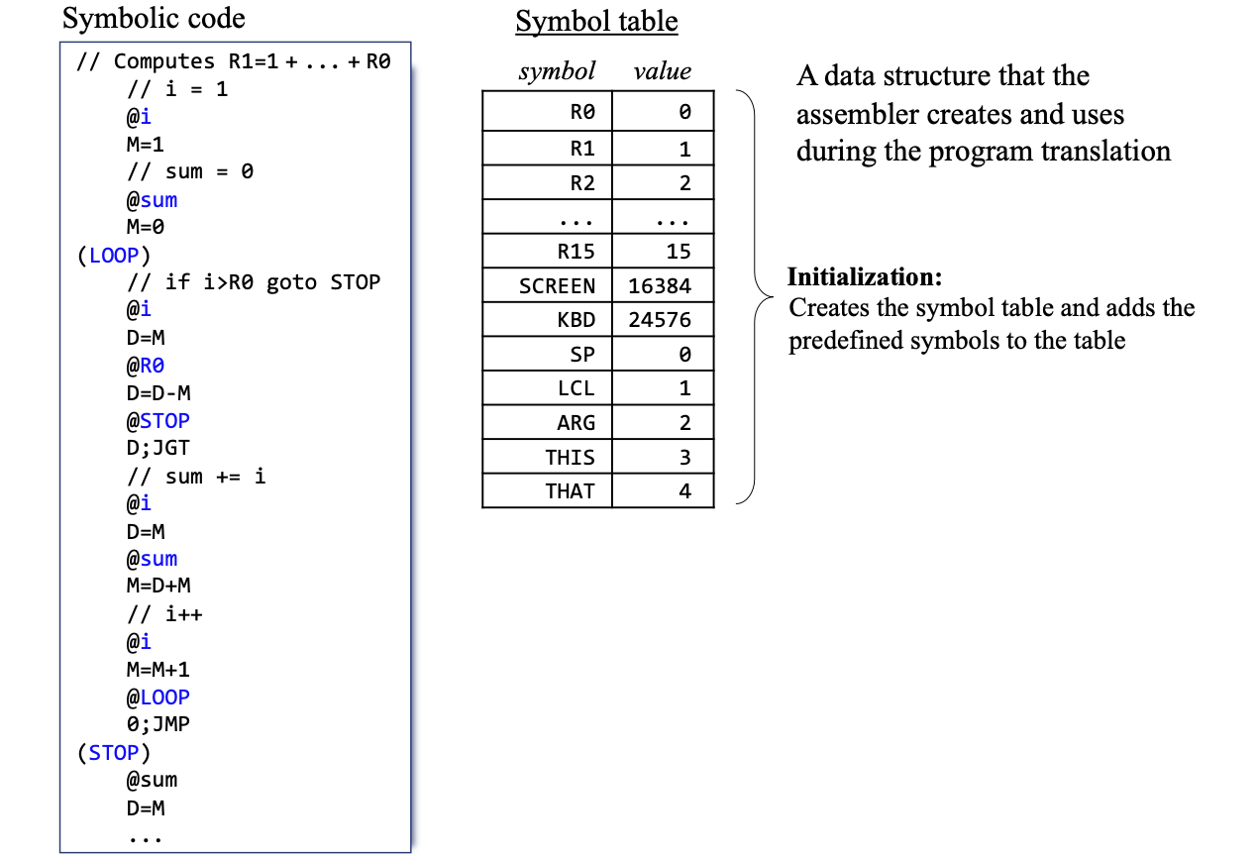
Translating programs

Slide 37
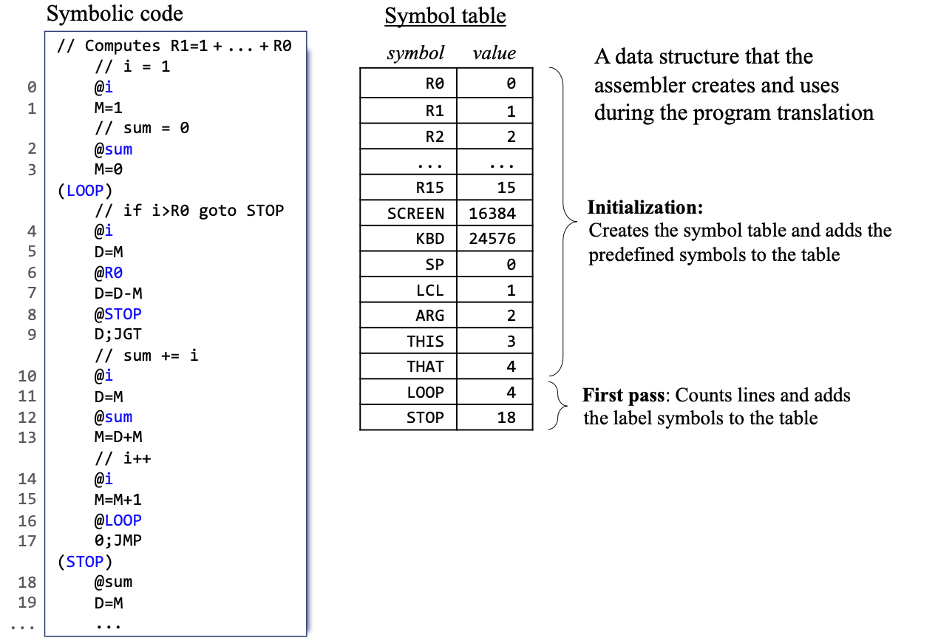
Translating programs

Slide 38
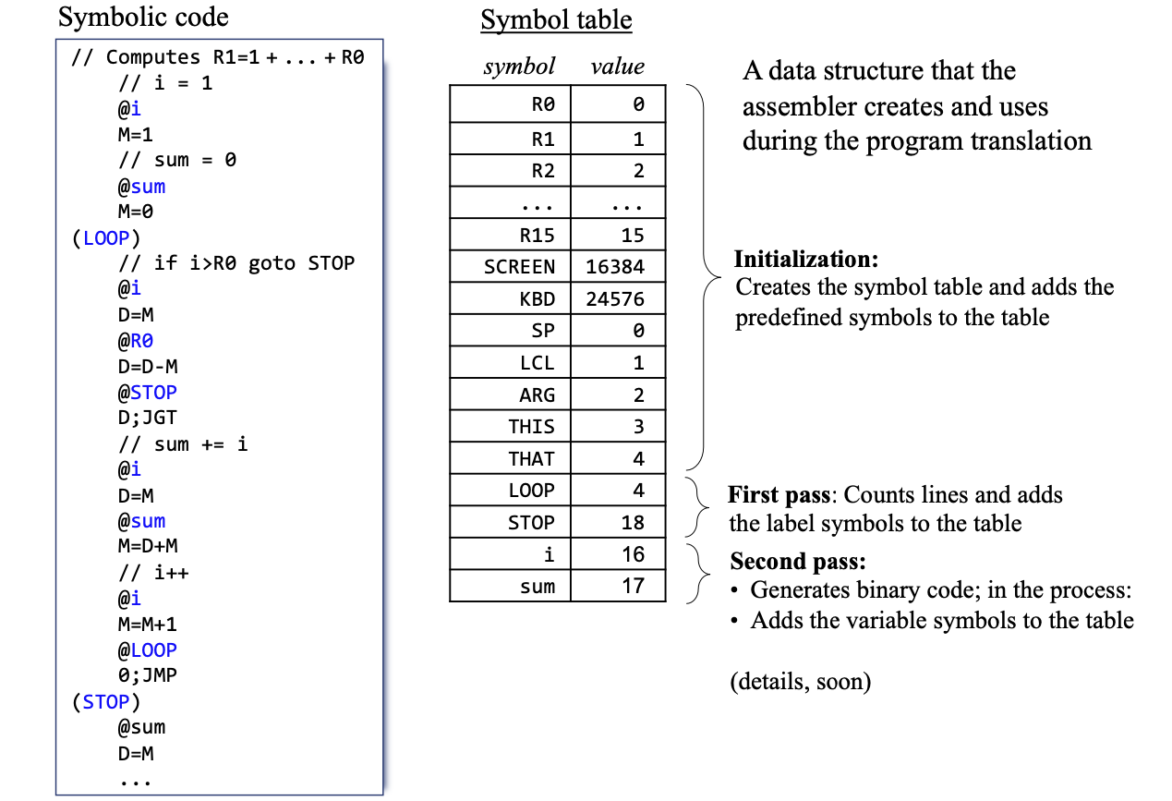
Translating programs

Slide 39
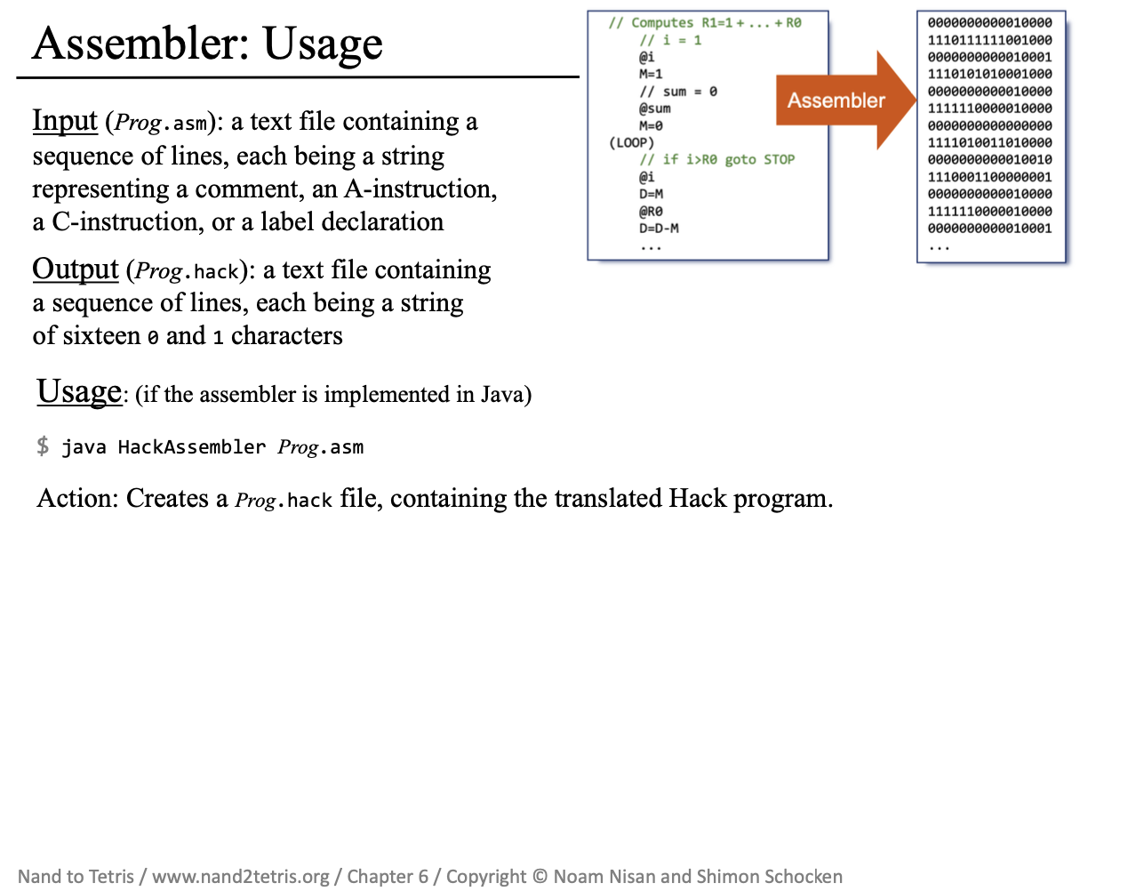

Slide 40
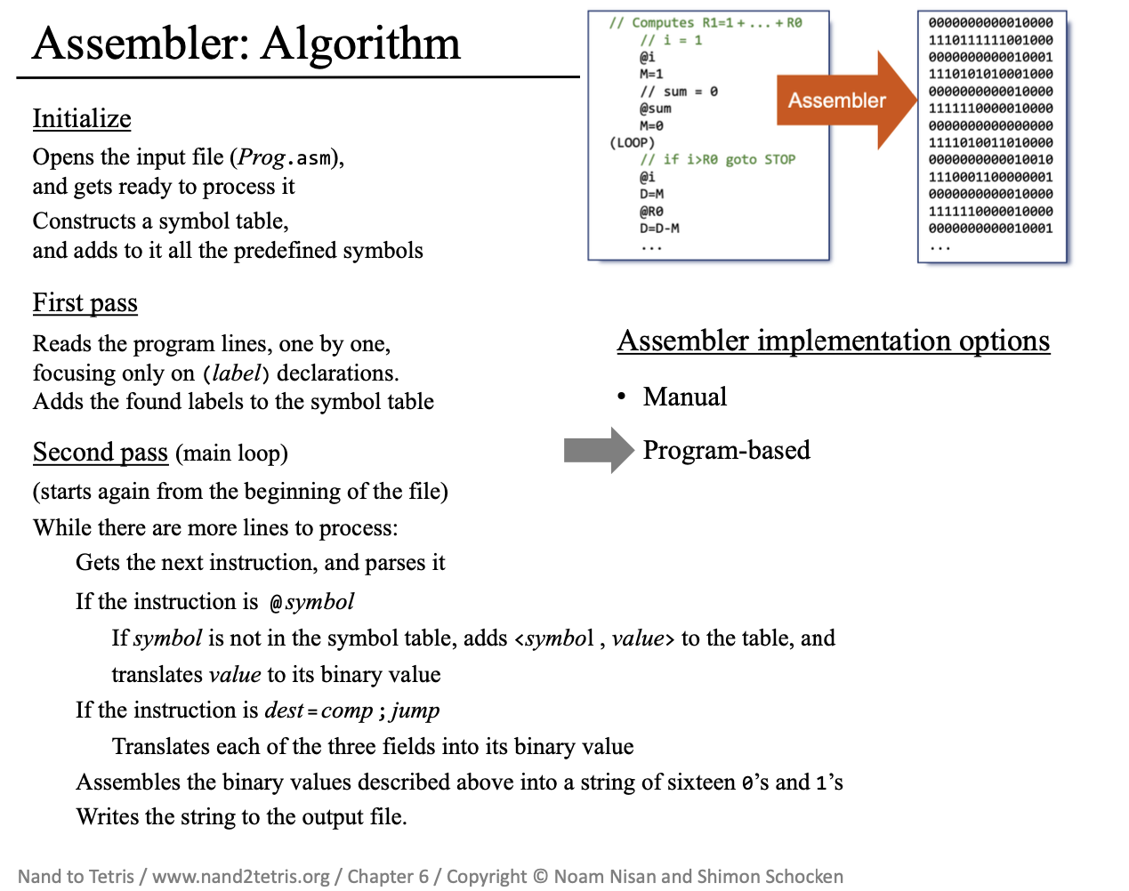

Slide 41
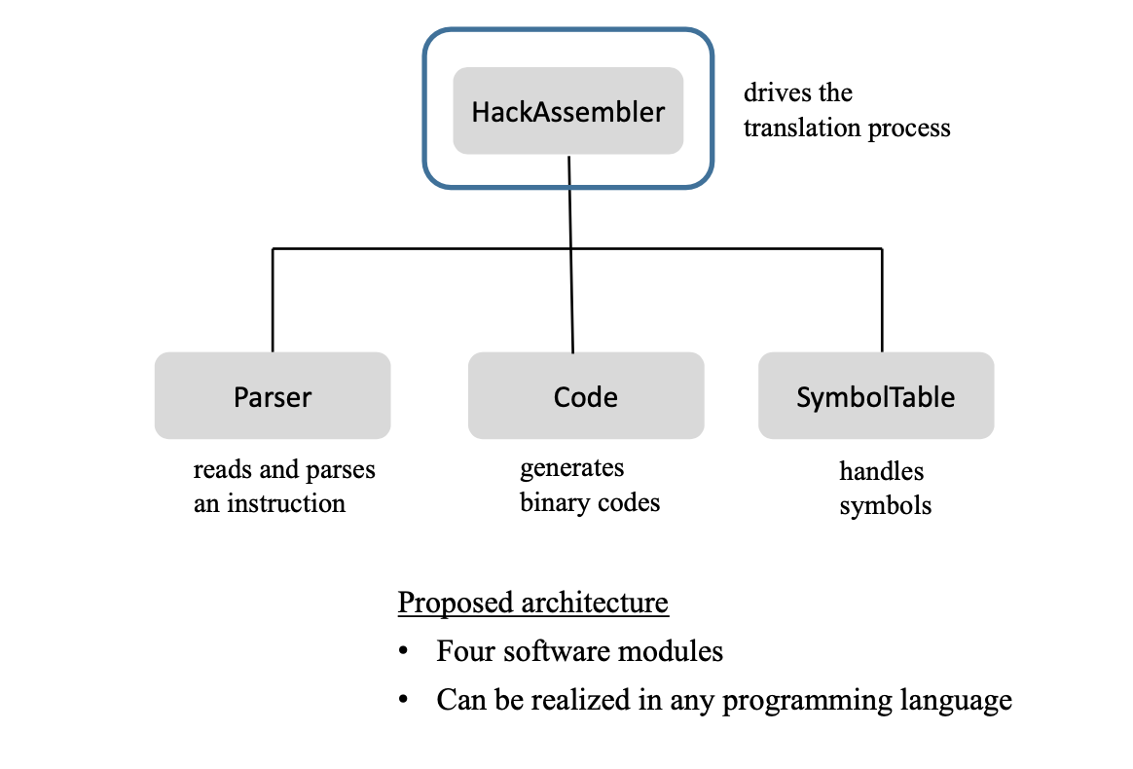
Assembler: Architecture

Slide 42
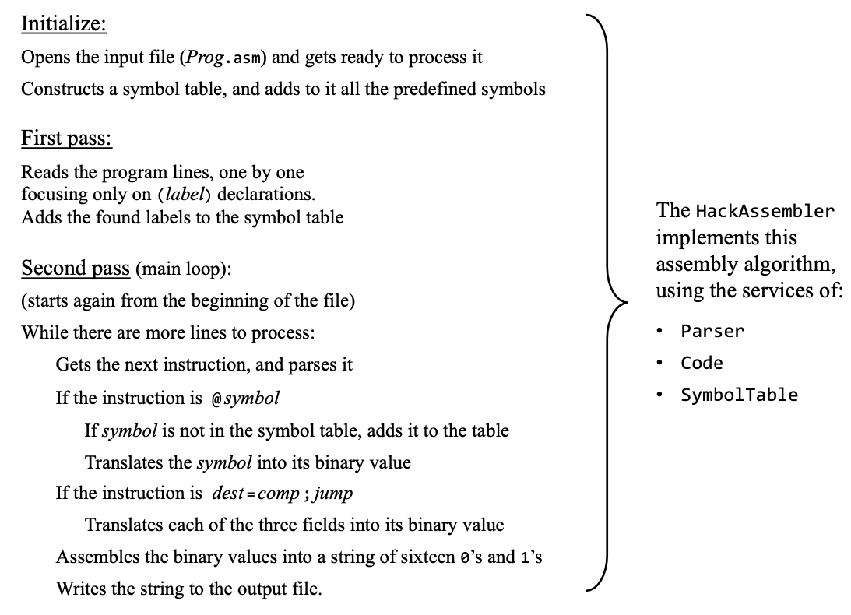
HackAssembler

Slide 43
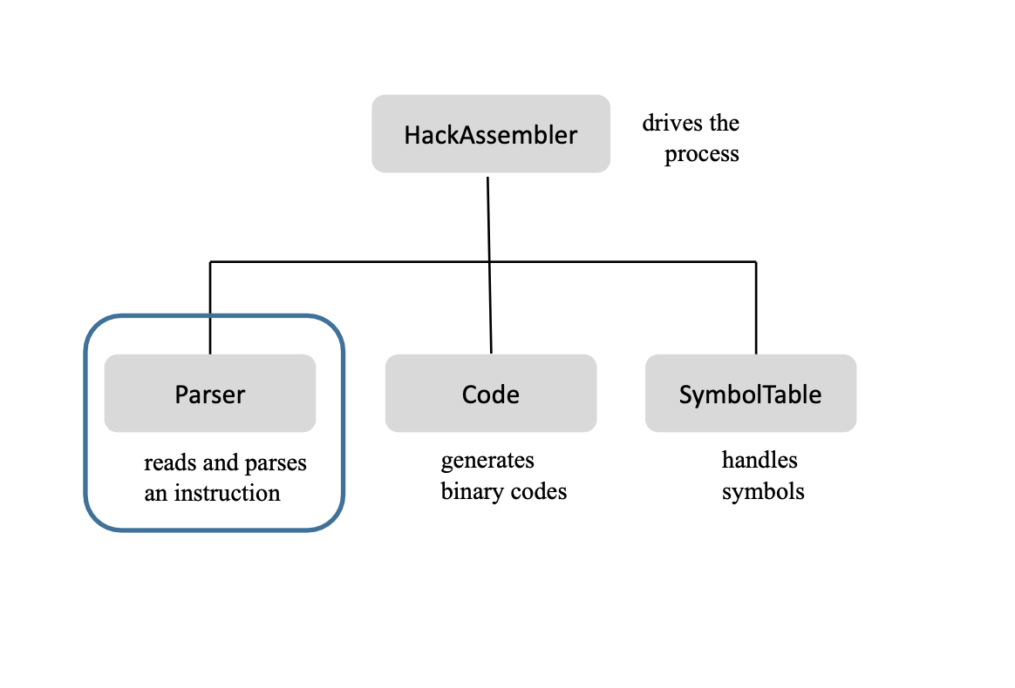
Assembler: Architecture

Slide 44
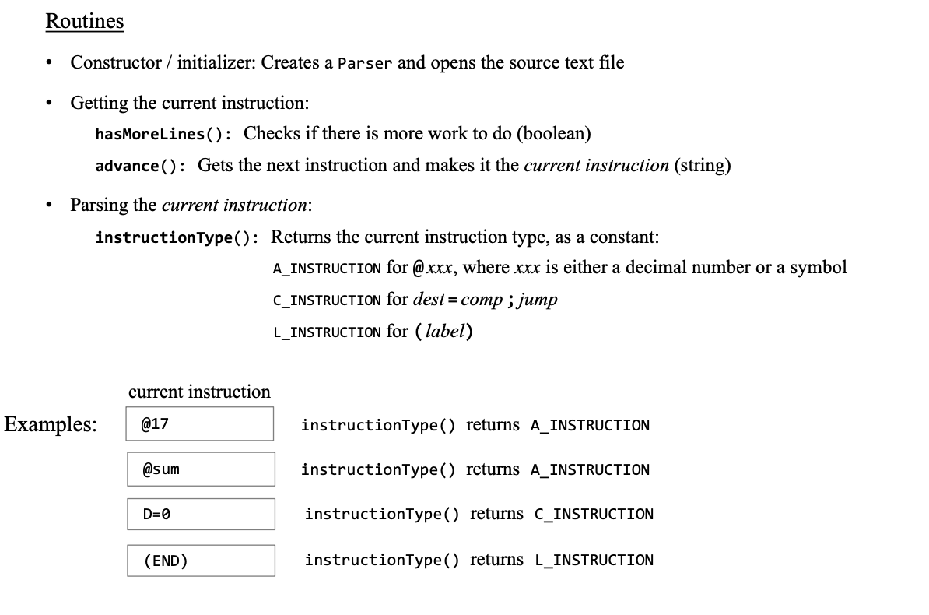
Parser API

Slide 45
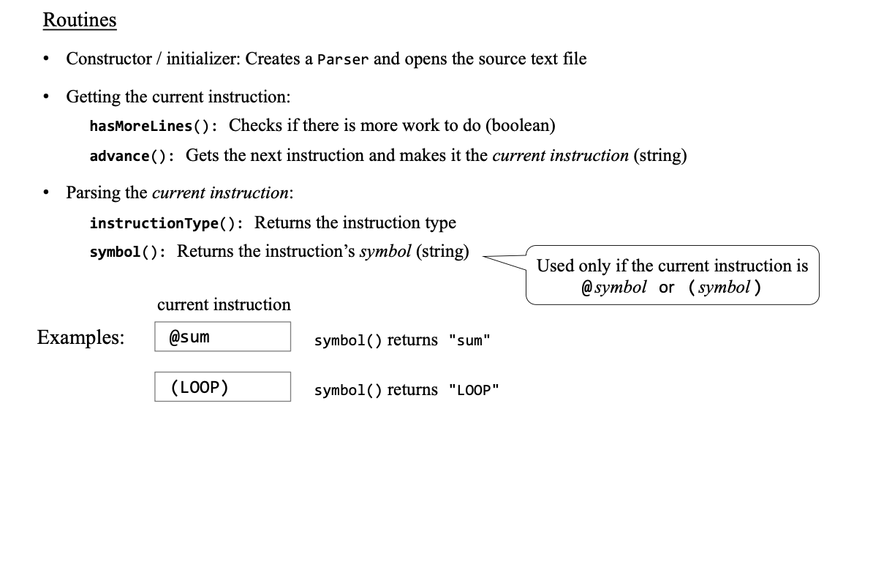
Parser API

Slide 46
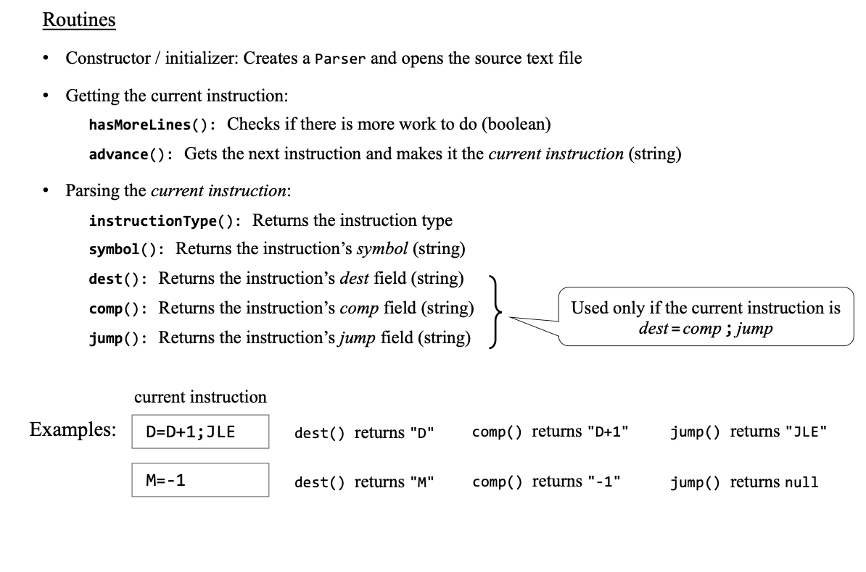
Parser API

Slide 47
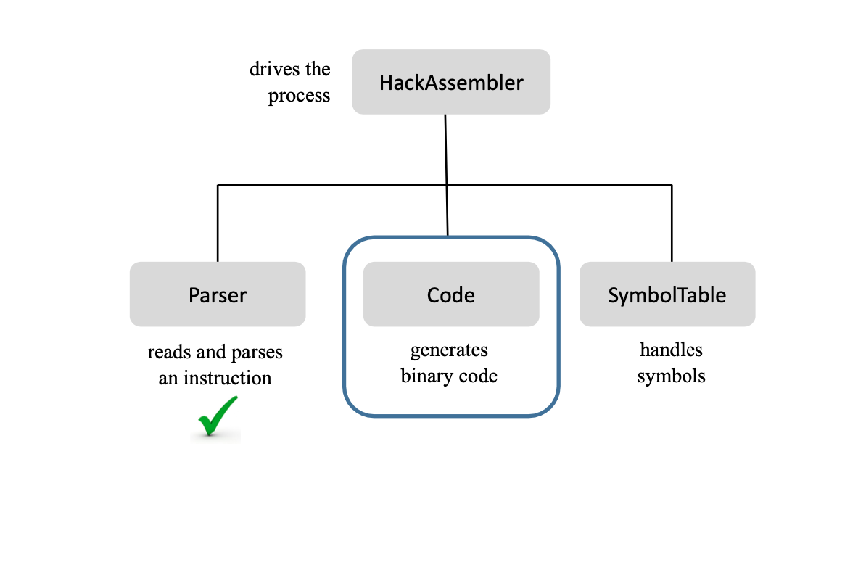
Assembler: Architecture

Slide 48
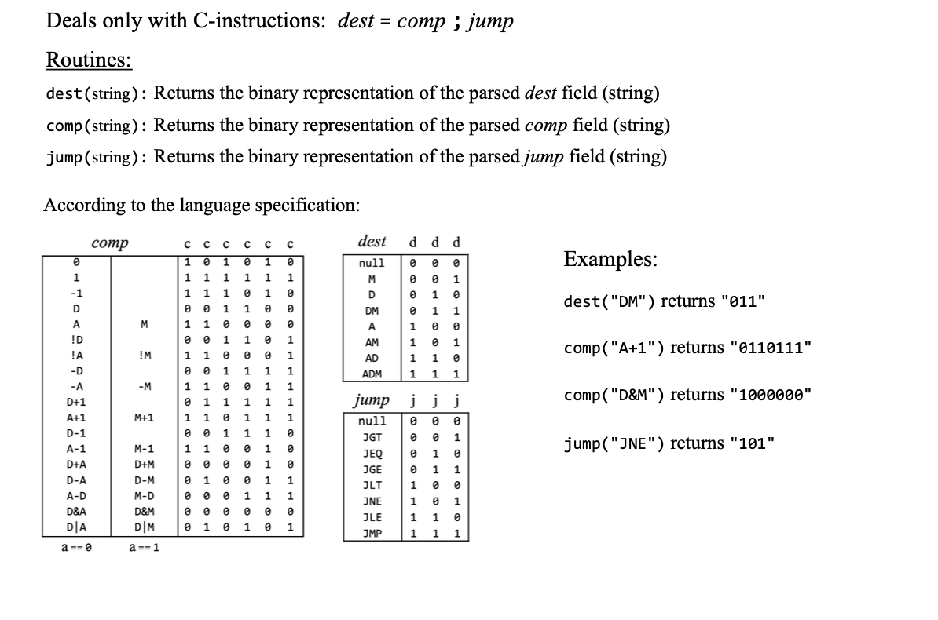
Code API

Slide 49
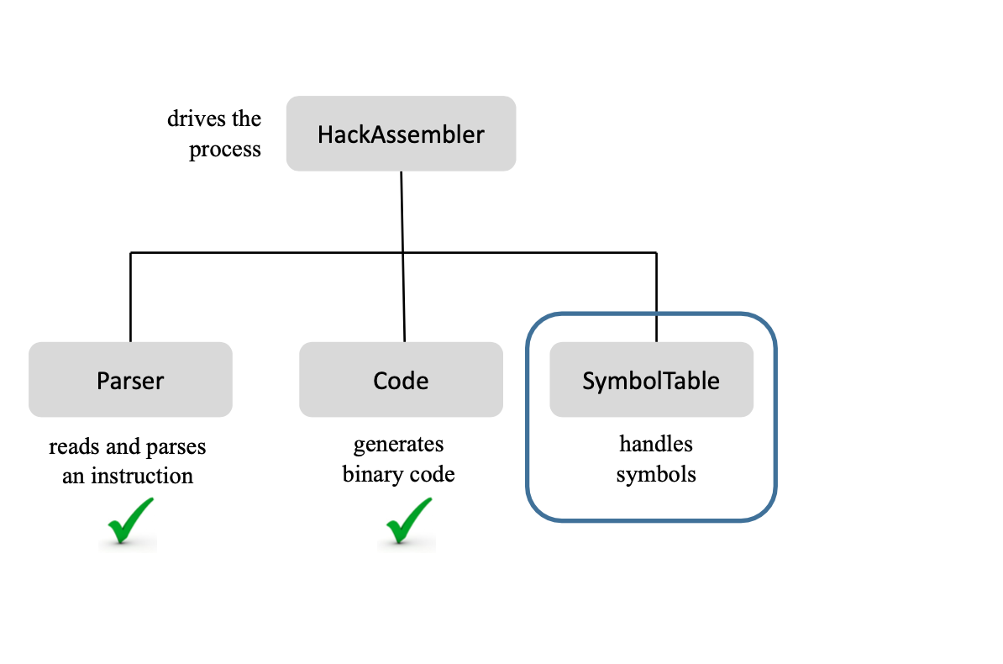
Assembler: Architecture

Slide 50
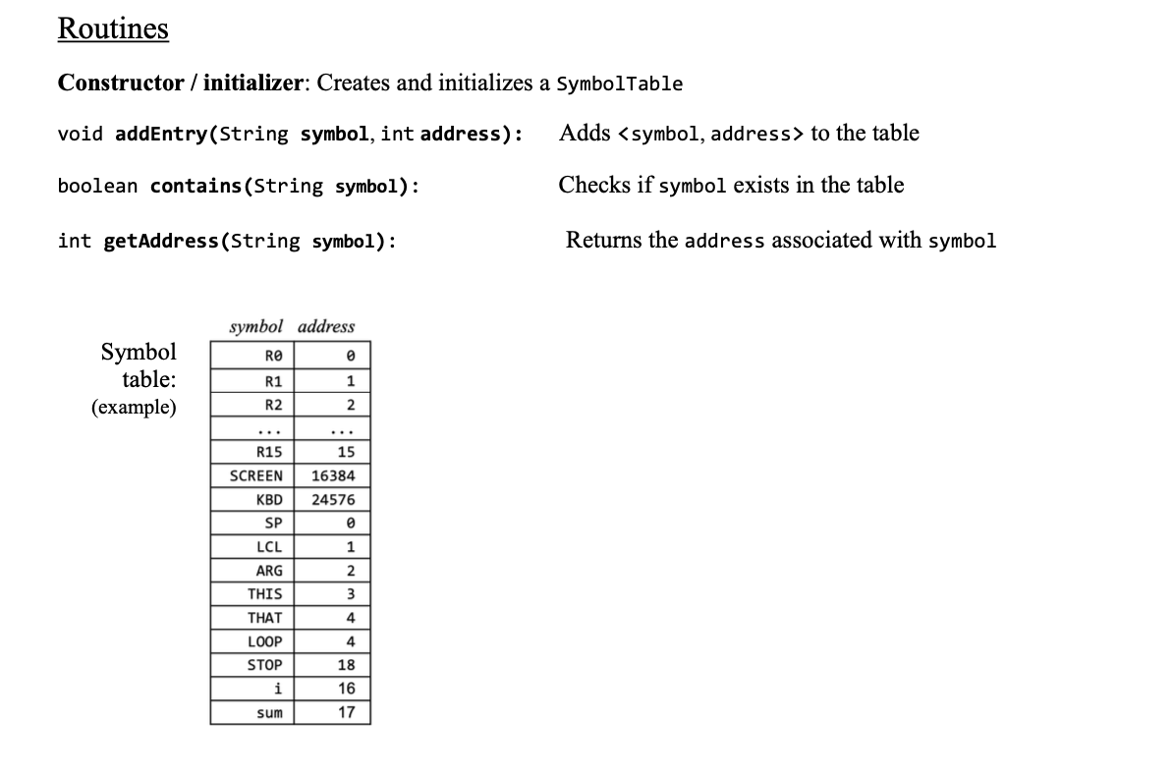
SymbolTable API

Slide 51
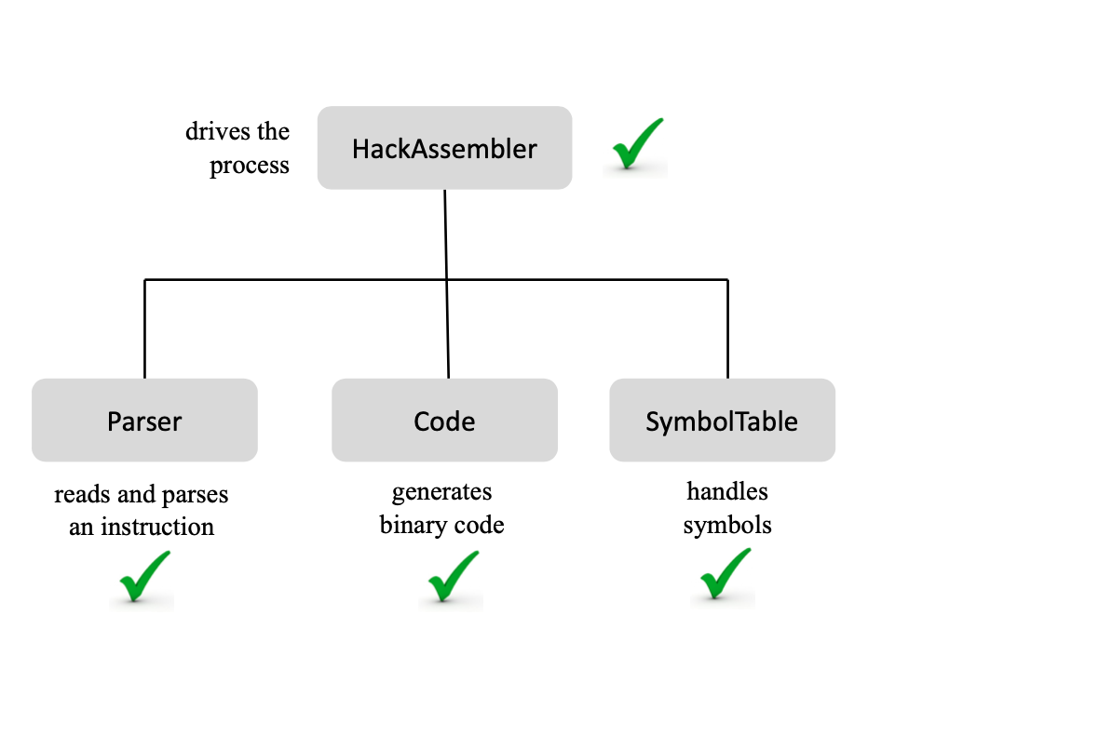
Assembler: Architecture

Slide 52
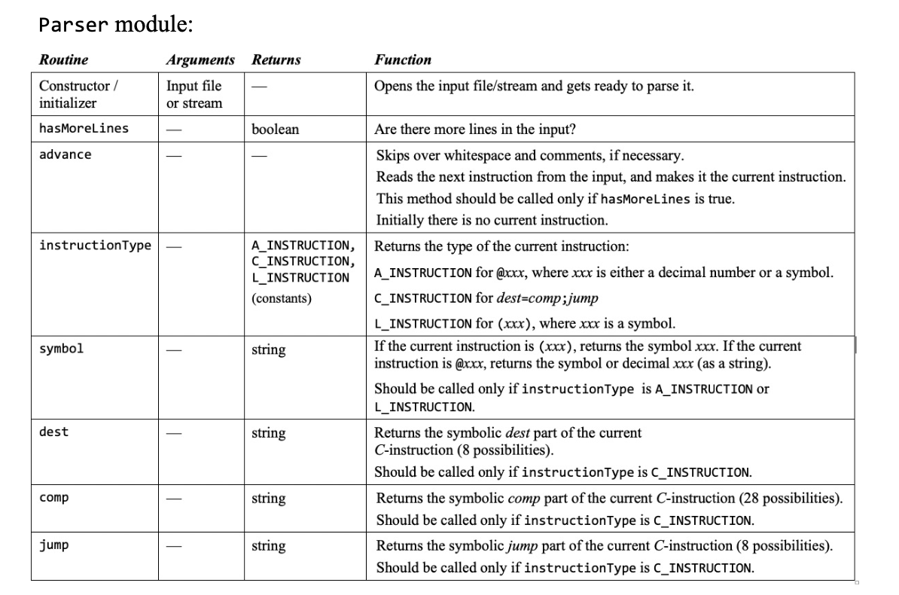
Assembler API (detailed)

Slide 53
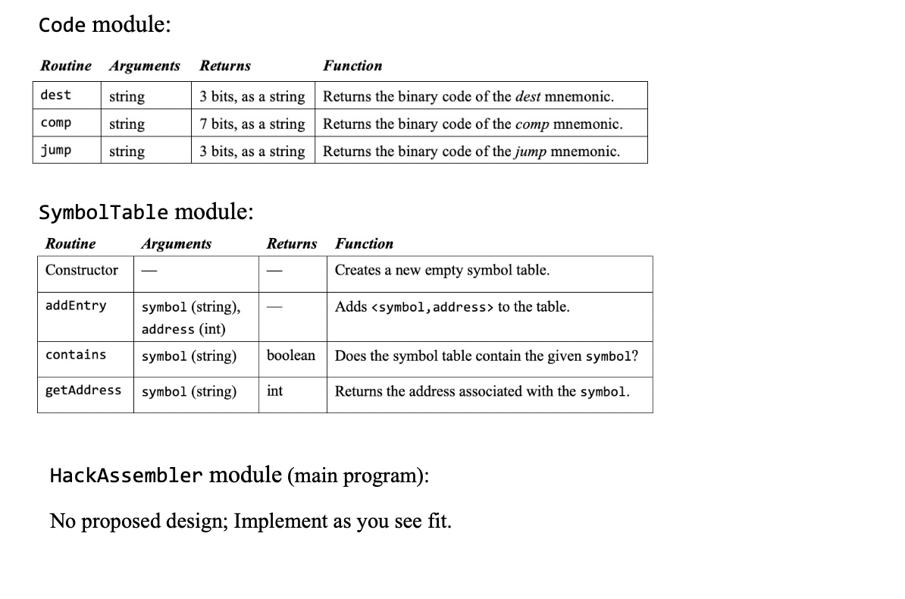
Assembler API (detailed)

Slide 54
Practice!

Slide 55
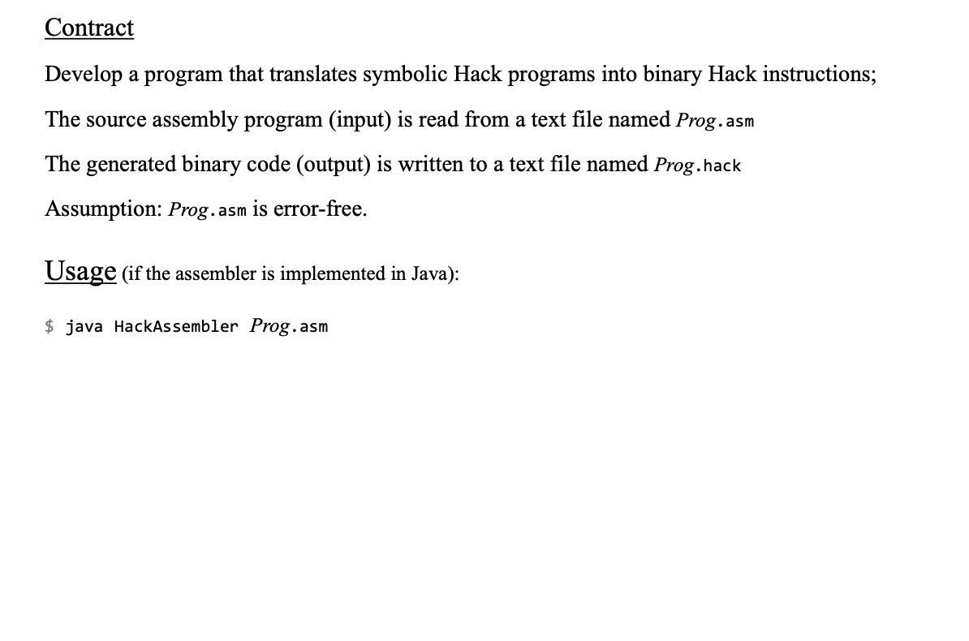
Developing a Hack Assembler

Slide 56
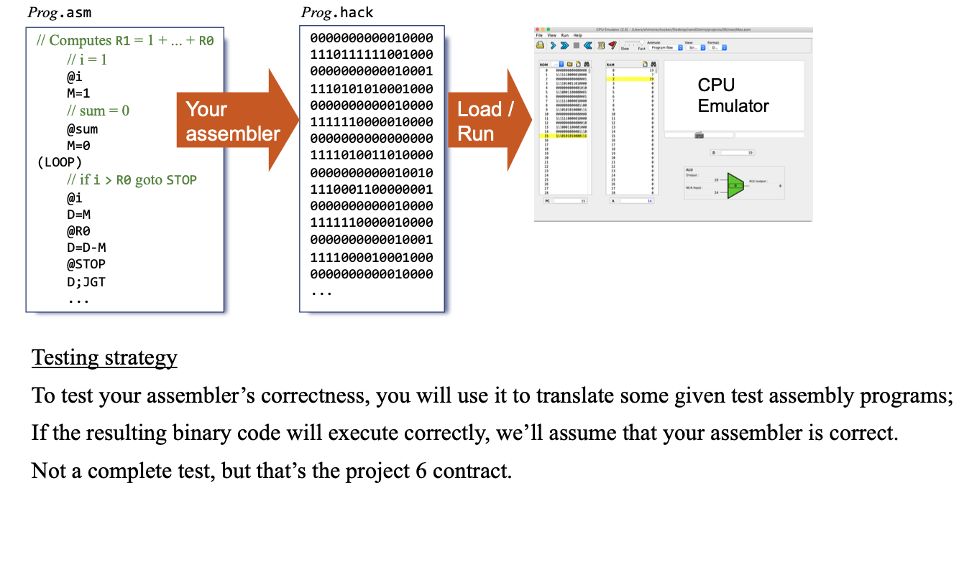
Testing
Notes:
https://nand2tetris.github.io/web-ide/asm

Slide 57
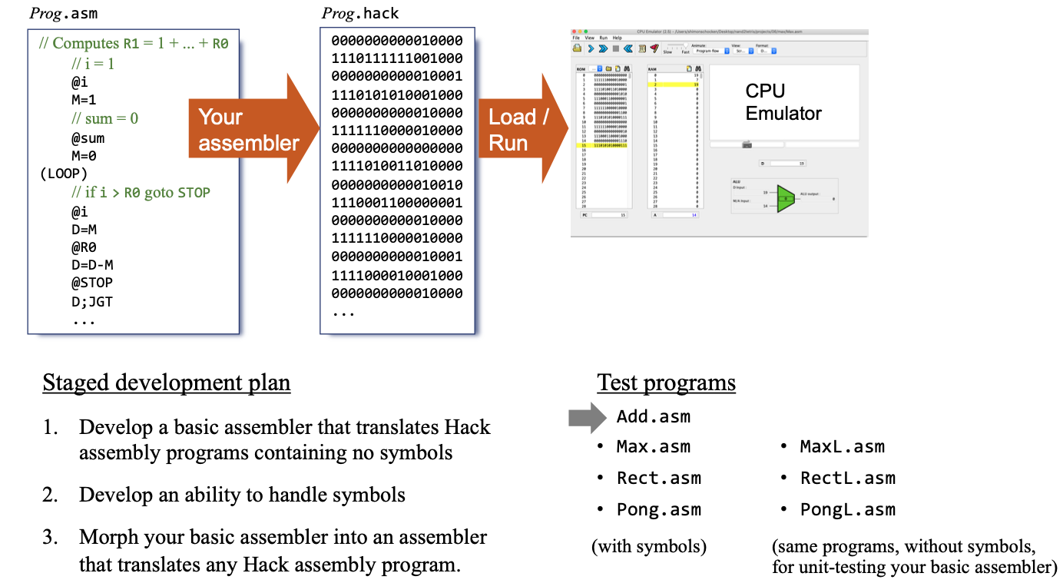
Testing (2)
Notes:
https://nand2tetris.github.io/web-ide/asm

Slide 58
Homework
Four files:
Add.hack
Max.hack
Rect.hack
Pong.hack

Slide 59

Ready for a homework?

