Slide 1
Computer Architecture
Lecture 10: HDD, Virtual memory
Lector: Konstantin Chaika
Based on
- David Harris, Sarah L. Harris, Digital Design and Computer Architecture
Constructor University Spring 2025

Slide 2
VIRTUAL MEMORY
H&H 8.4

Slide 3
Can there be misses in RAM?
If they can, then when?

Slide 4
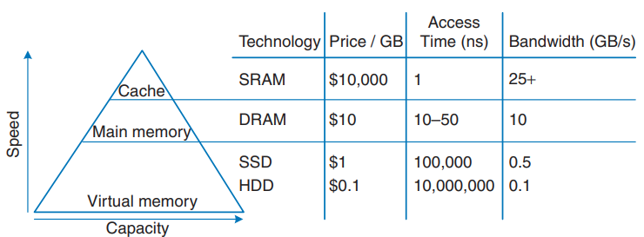
One more time about HDD/SDD

Slide 5
Virtual memory
Virtual memory is a memory management technique (in OS) where secondary memory (HDD/SSD) can be used as if it were a part of the main memory (RAM)

Slide 6
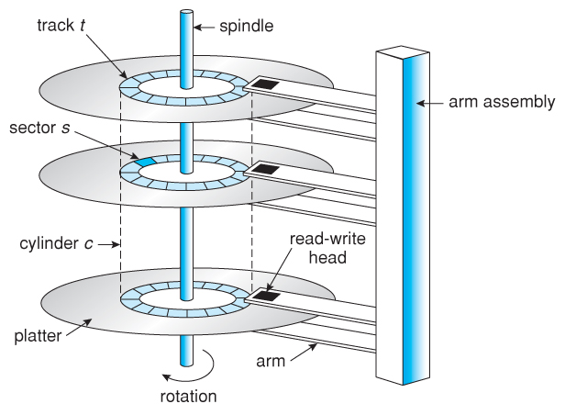
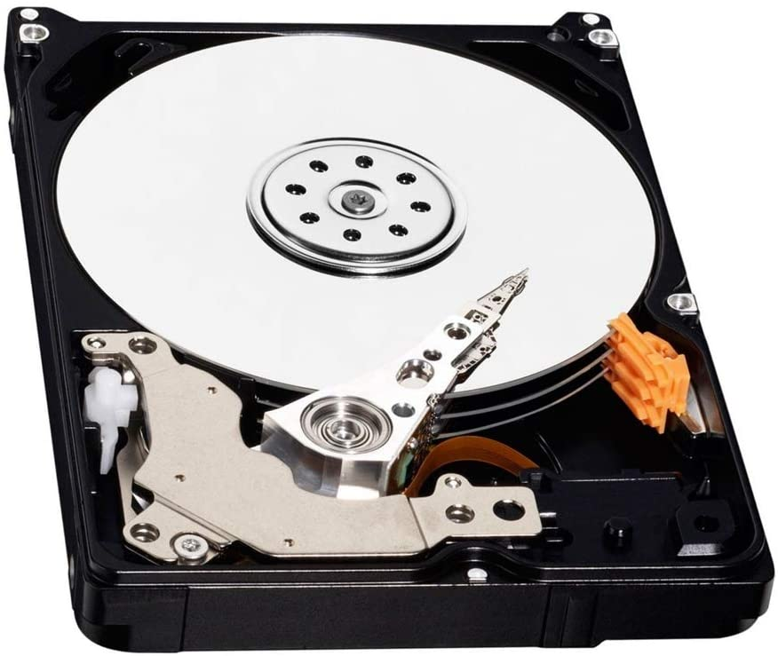
HDD

Slide 7
Interfaces
“Old School” :
Cylinder
Head
Sector
Logical block addressing (LBA)

Slide 8
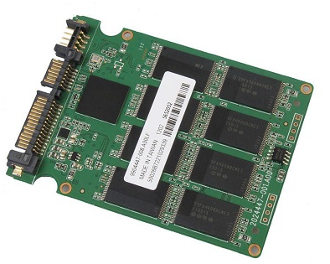
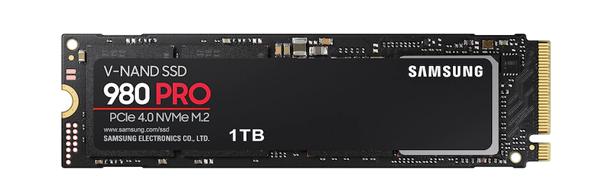
SSD + NVMe

Slide 9
How it is appeared?
In the early days of computers, memories were small and expensive
Program using the better algorithm could not be squeezed into the computer’s memory

Slide 10
How to solve this problem?
The traditional solution to this problem was the use of secondary memory, such as disk. The programmer divided the program up into a number of pieces, called overlays, each of which could fit in the memory.
The programmer was responsible for managing the whole overlay process without any help from the computer.
In 1961 a group of researchers in Manchester, England, proposed a method for performing the overlay process automatically, without the programmer even knowing that it was happening -- virtual memory
By the early 1970s virtual memory had become available on most computers.

Slide 11
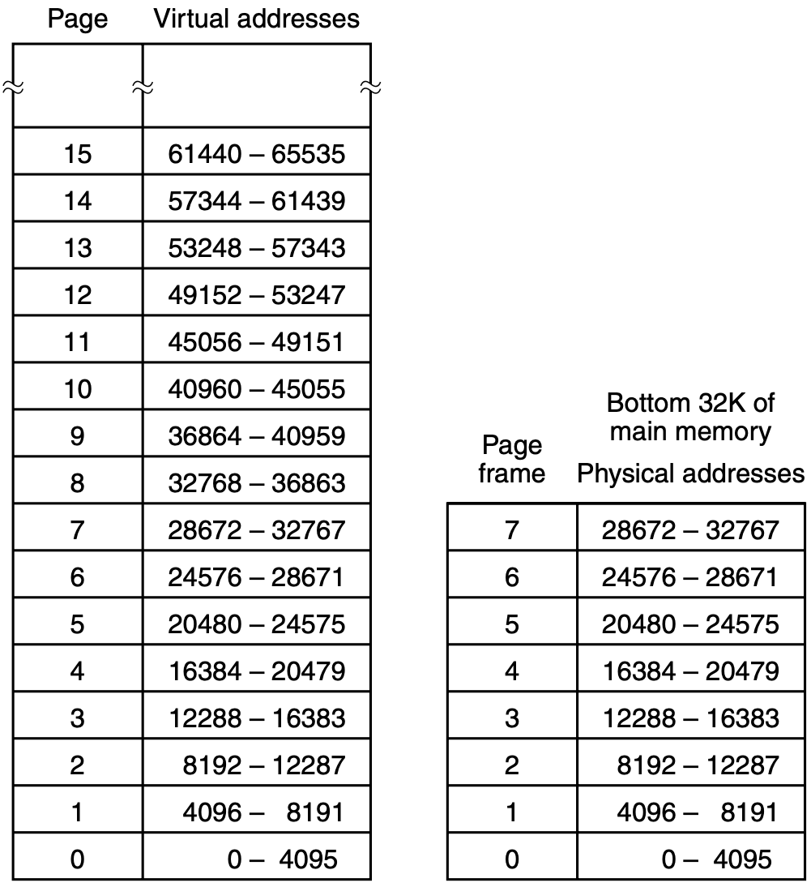
Paging

Slide 12
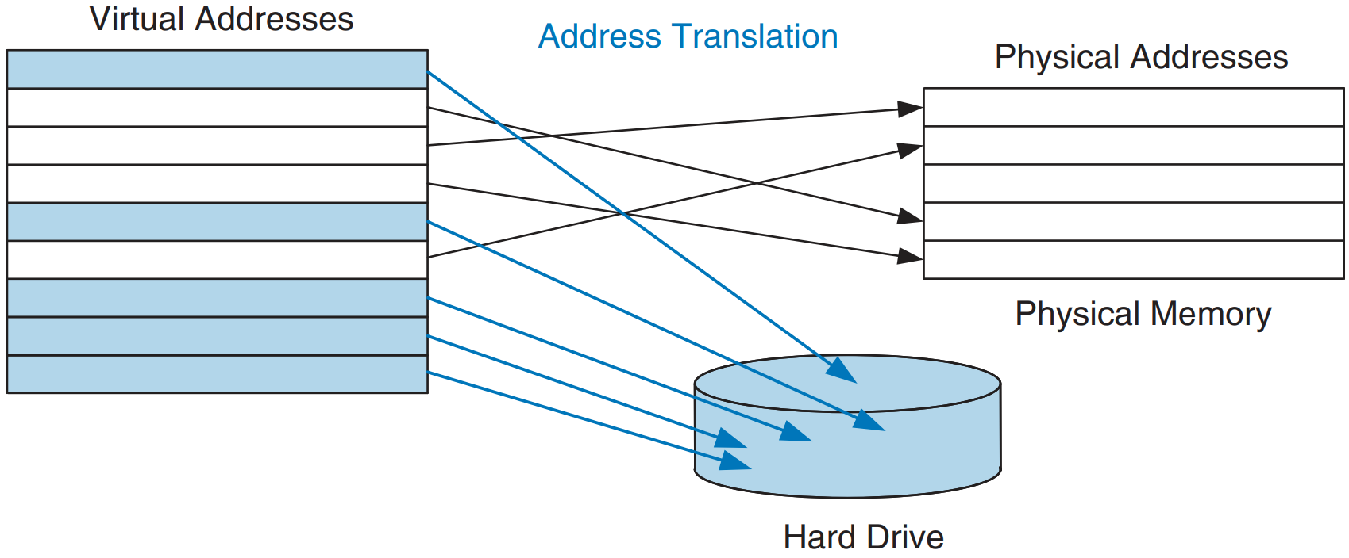
Virtual and physical pages
To avoid page faults caused by conflicts, any virtual page can map to any physical page.
In other words, physical memory behaves as a fully associative cache for virtual memory.

Slide 13
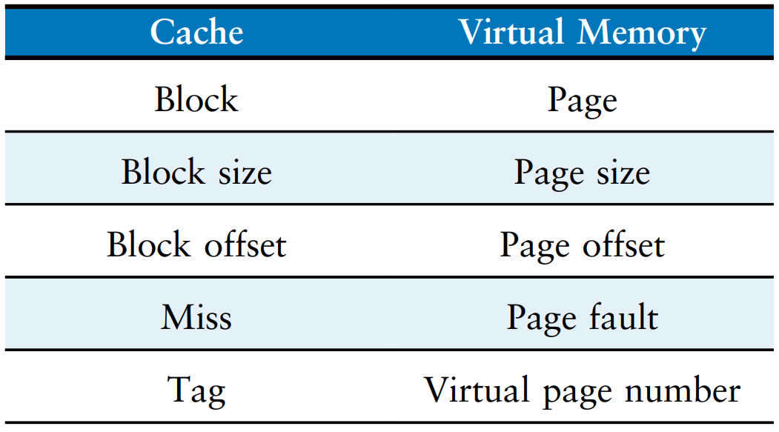
Analogous cache and virtual memory terms
Virtual memory is divided into virtual pages, typically 4 KB in size.
Physical memory is likewise divided into physical pages of the same size.
A virtual page may be located in physical memory (DRAM) or on the hard drive

Slide 14
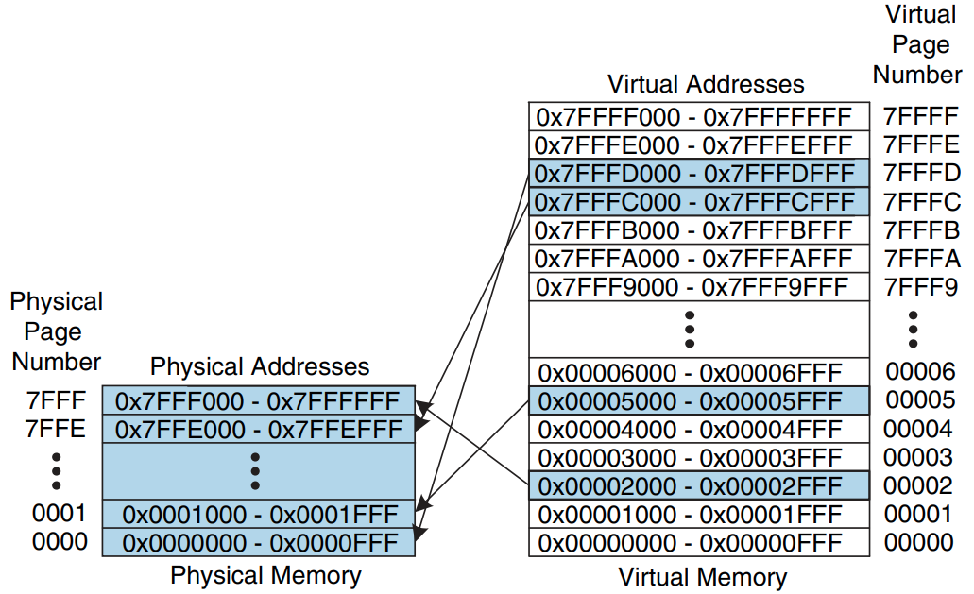
Physical and virtual pages
2 GB of virtual memory and 128 MB of physical memory divided into 4-KB pages

Slide 15
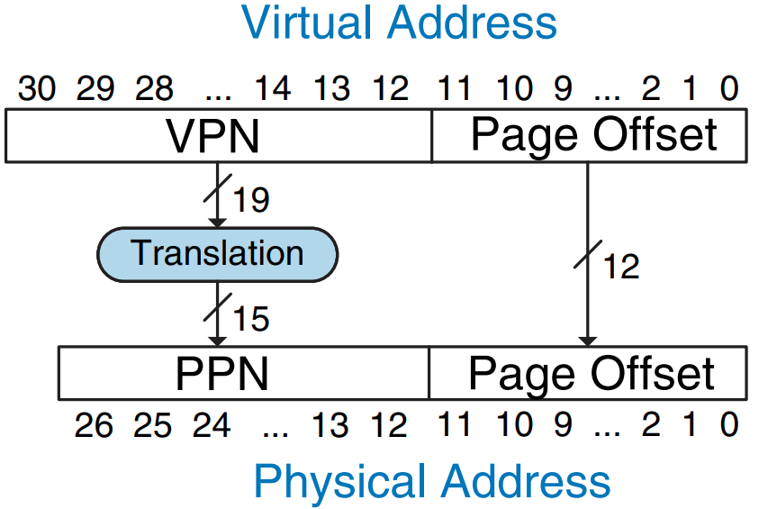
Translation from virtual address to physical address

Slide 16
Page table
Do we need a comparator to determine whether the virtual page maps to that physical page? It would be excessively expensive.
Virtual memory system uses a page table to perform address translation.
A page table contains an entry for each virtual page, indicating its location in physical memory or that it is on the hard drive.
Each load or store instruction requires a page table access followed by a physical memory access. The physical address is then used to actually read or write the data.
Notes:
Excessively -- чрезмерно

Slide 17
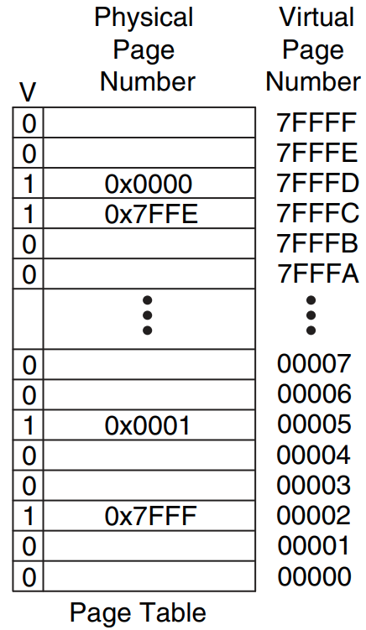
Page table example

Slide 18
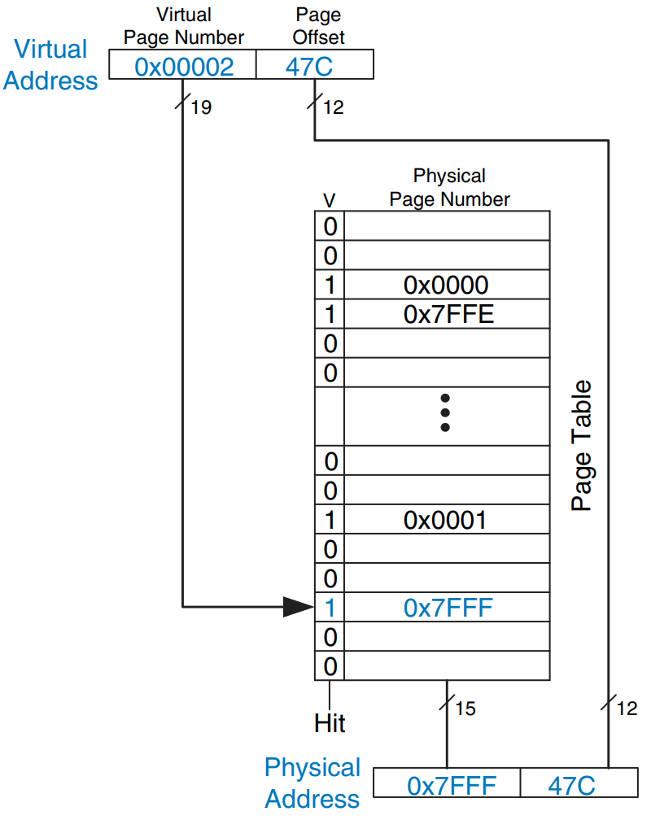
Address translation using the page table

Slide 19
TLB - translation lookaside buffer
The page table is usually so large that it is located in physical memory.
Each load or store involves two physical memory accesses: a page table access, and a data access.
To speed up address translation, a Translation Lookaside Buffer (TLB) caches the most commonly used page table entries
TLB is organized as a fully associative cache

Slide 20
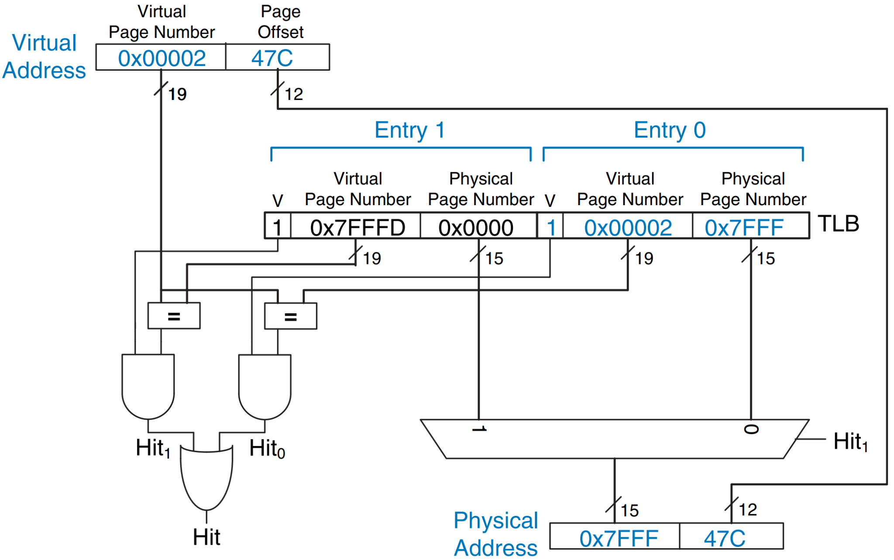
Address translation using a two-entry TLB

Slide 21
Replacement Policies
Write-back only
Writing the physical page back to the hard drive and reloading it with a different virtual page is called paging, and the hard drive space for a virtual memory is called swap space
Dirty bit D
Use bit U (periodically resetting)
LRU (Least Recently Used)
FIFO (First-In First-Out)

Slide 22
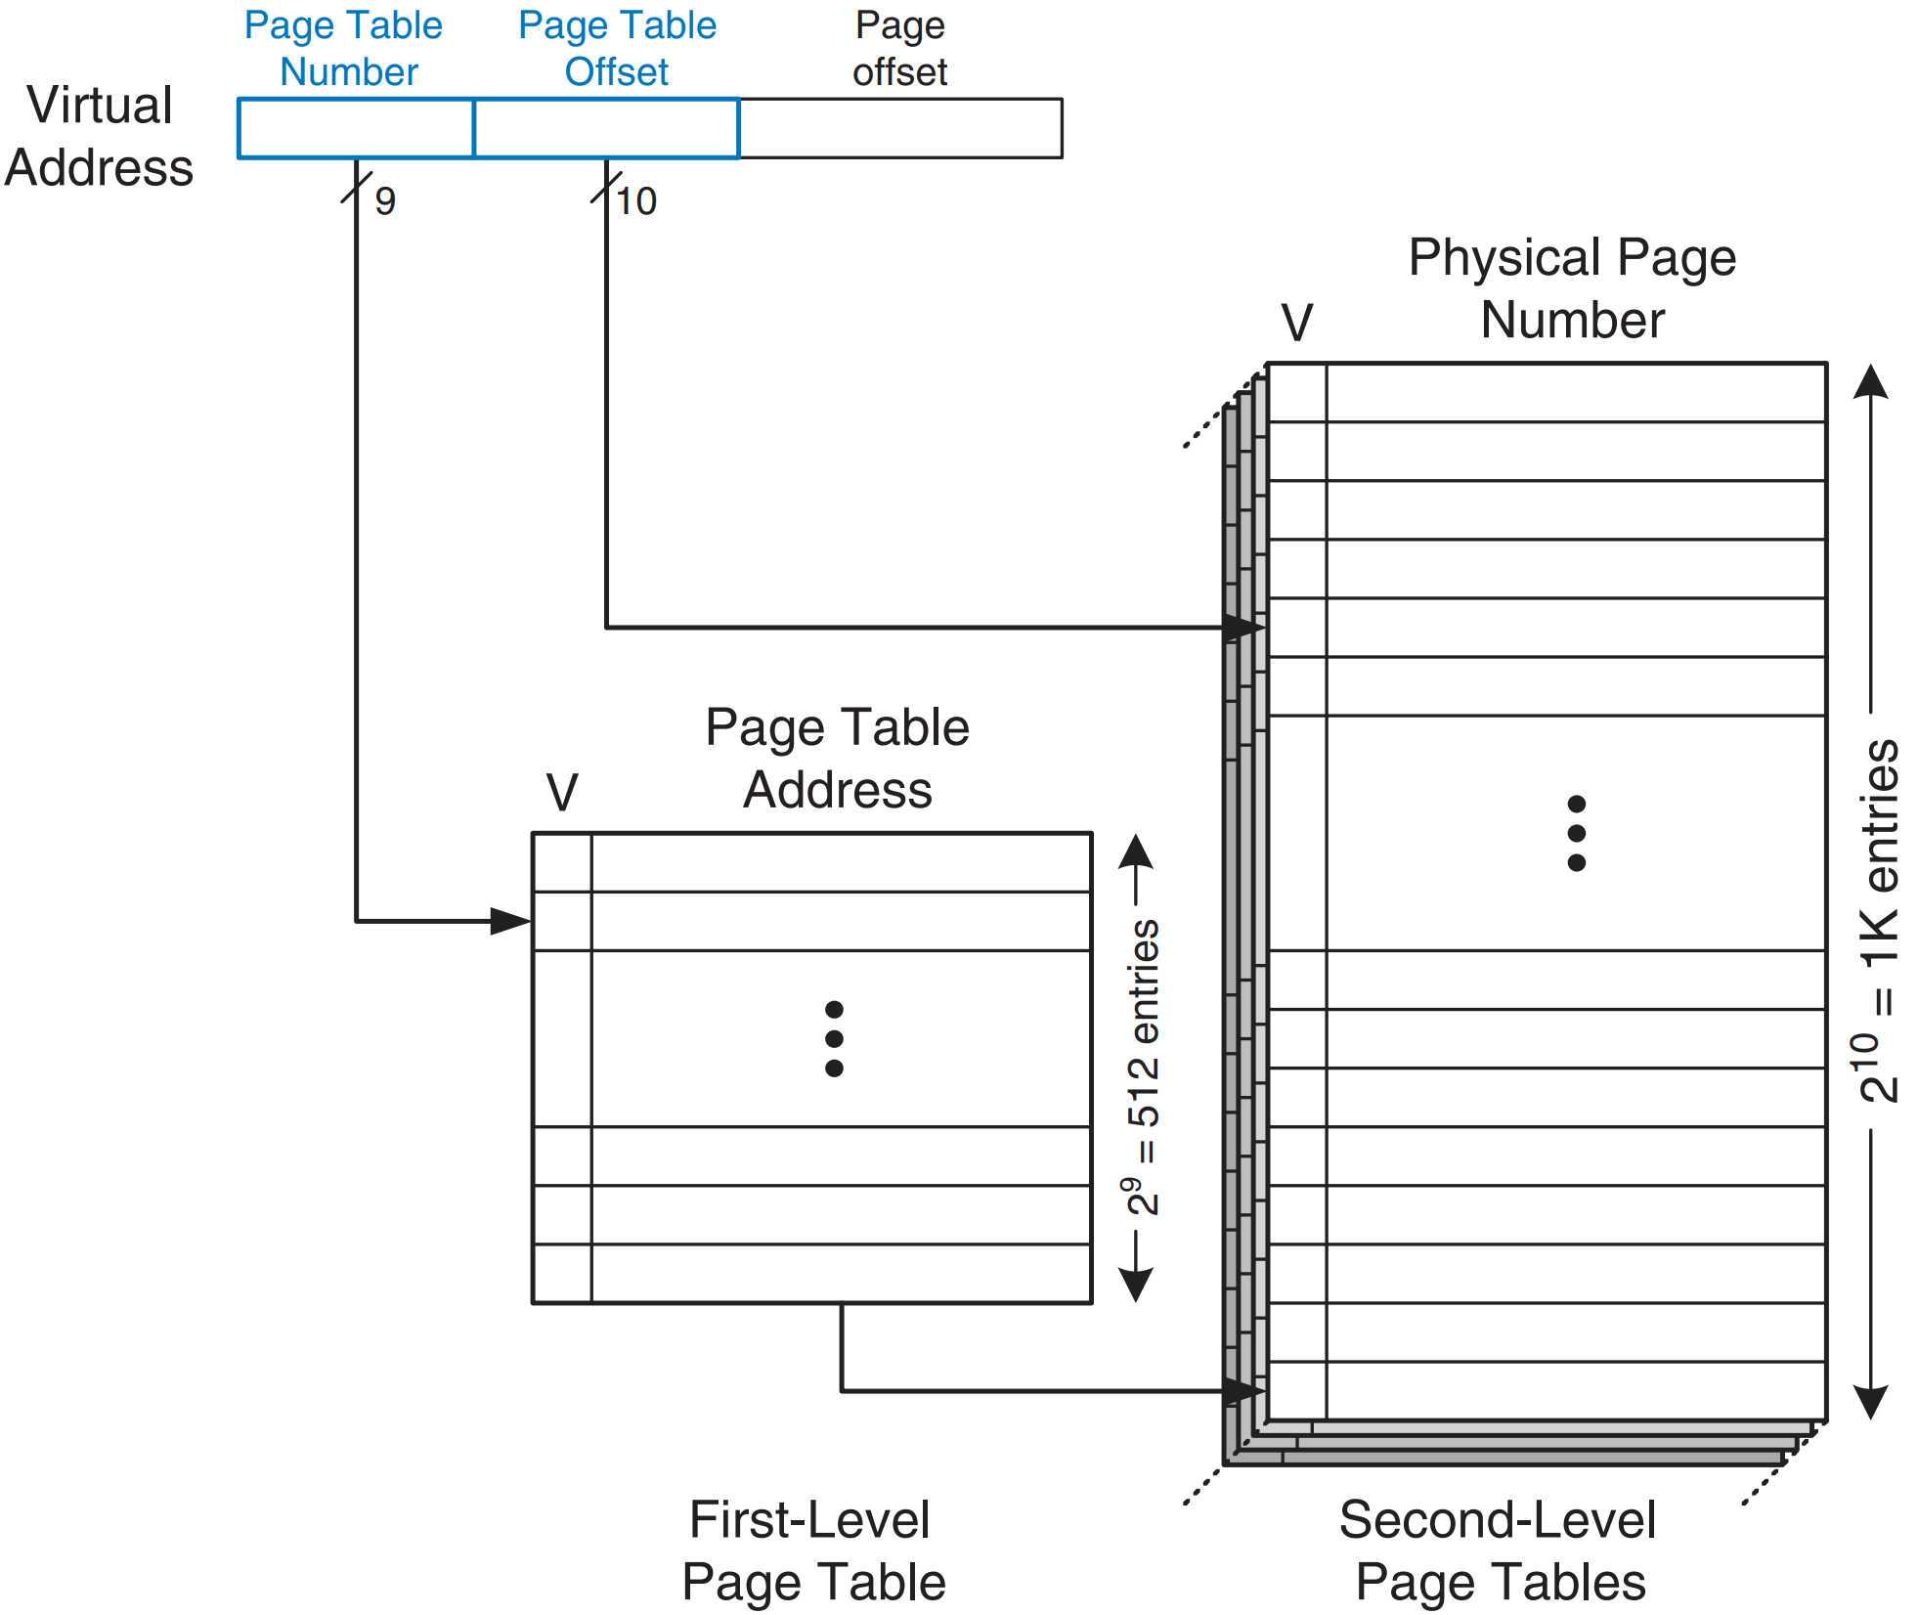
Multilevel Page Tables
2 GB virtual memory with 4 KB pages would need 2¹⁹ entries. If each entry is 4 bytes, the page table is 2 MB.
Yet another memory access when TLB misses

Slide 23
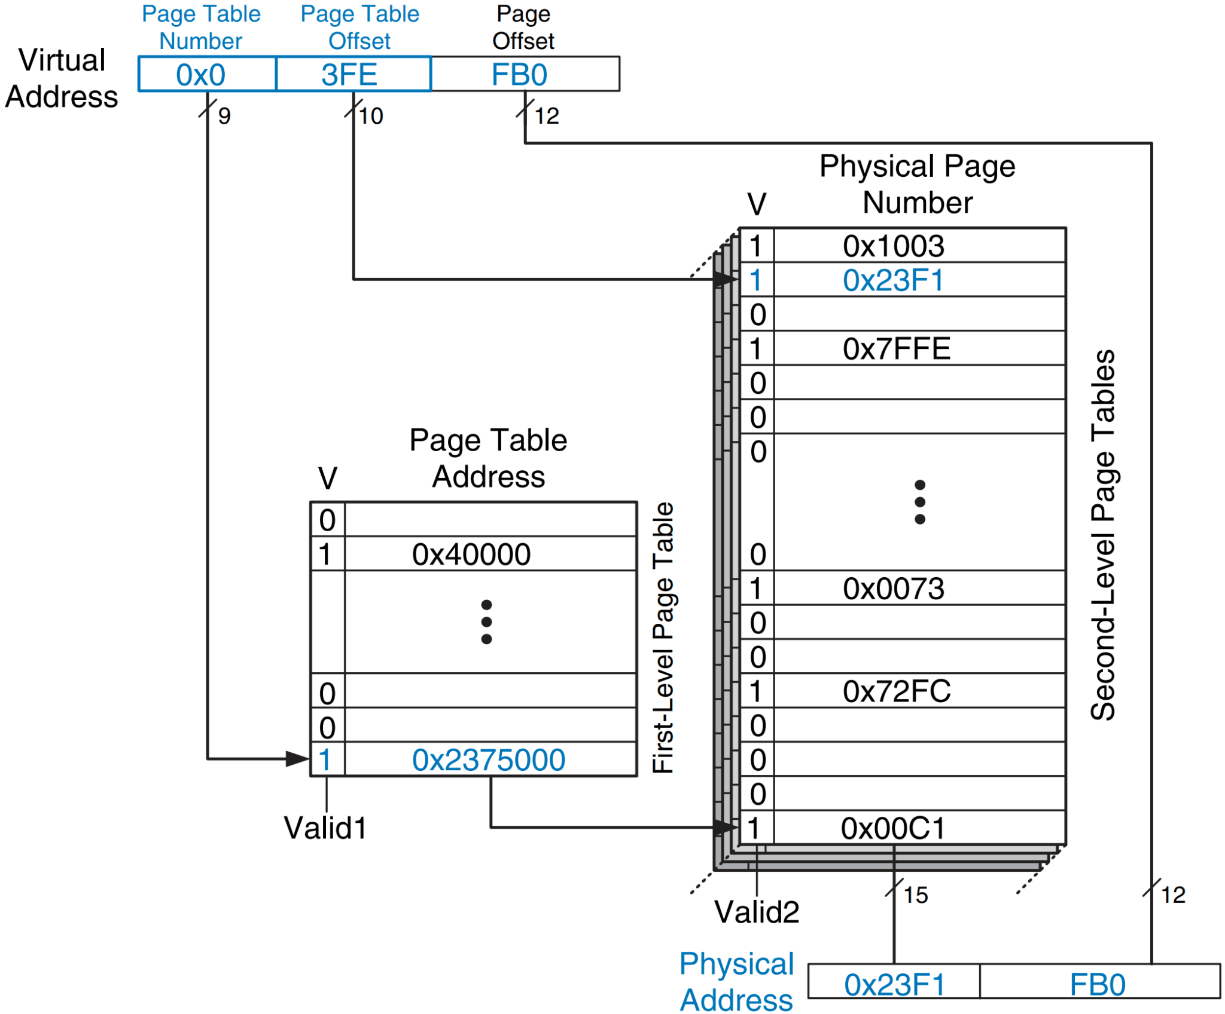
Address translation using a two-level page table

Slide 24
Segmentation
Virtual memory discussed above is one-dimensional because the virtual addresses go from 0 to some maximum address, one address after another.
For many problems, having two or more separate virtual address spaces may be much better than having only one.

Slide 25
Example
Compiler might have many tables that are built up as compilation proceeds, including
1. The symbol table, containing the names and attributes of variables.
2. The source text being saved for the printed listing.
3. A table containing all the integer and floating-point constants used.
4. The parse tree, containing the syntactic analysis of the program.
5. The stack used for procedure calls within the compiler.

Slide 26
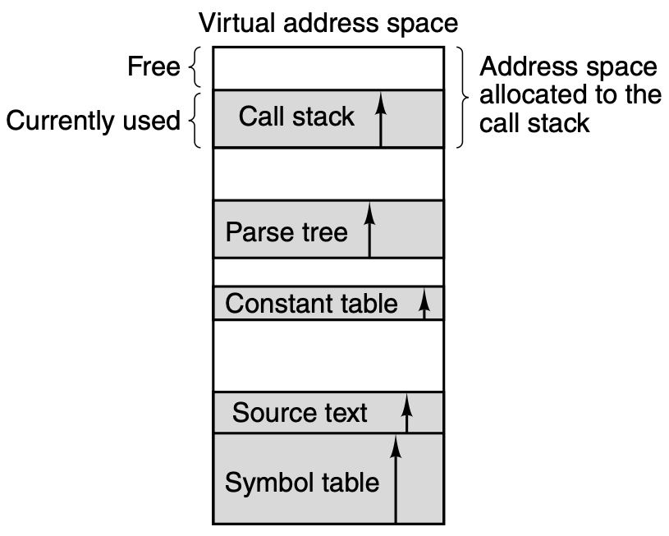
What is the problem?

Slide 27
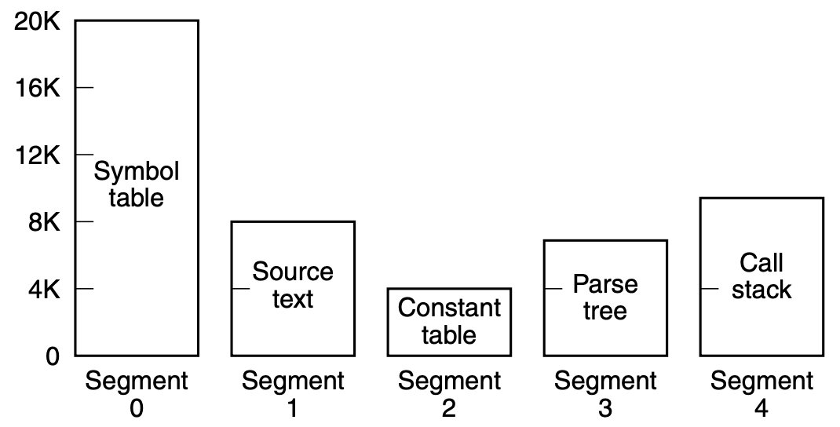
Solution
A straightforward solution is to provide many completely independent address spaces, called segments. Each segment consists of a linear sequence of addresses, from 0 to some maximum.
To specify an address in this segmented or two-dimensional memory, the program must supply a two-part address: a segment number, and an address within the segment.

Slide 28
Programmers know…
We emphasize that a segment is a logical entity, which the programmer is aware of and uses as a single logical entity.

Slide 29
How to share library? :)
If we make each procedure a separate segment, they can be shared easily, thus eliminating the need for more than one physical copy of any shared procedure to be in main memory

Slide 30
Extra protection
Because each segment forms a logical entity of which the programmer is aware, such as a procedure, or an array, or a stack, different segments can have different kinds of protection.
A procedure segment could be specified as execute only, prohibiting attempts to read from it or store into it.
A floating-point array could be specified as read/write but not execute, and attempts to branch to it would be caught.
Errors/attacks protection.

Slide 31
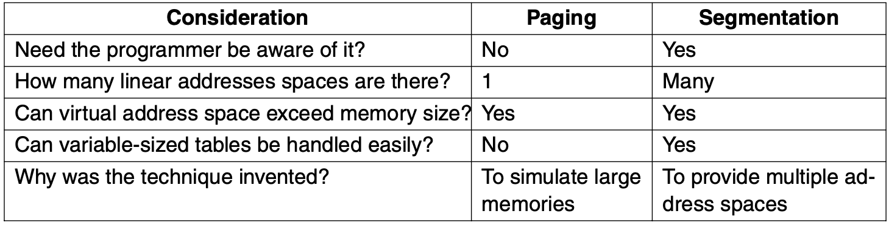
Comparison of paging and segmentation

Slide 32
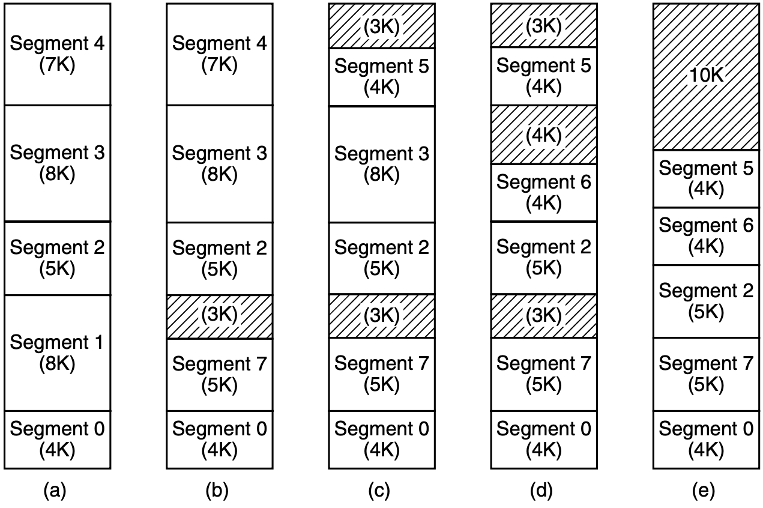
Physical memory fragmentation (swapping)

Slide 33
Space management
best fit
first fit
First fit is also a better algorithm in terms of overall performance than best fit, because the latter tends to generate a great many small, totally useless space

Slide 34
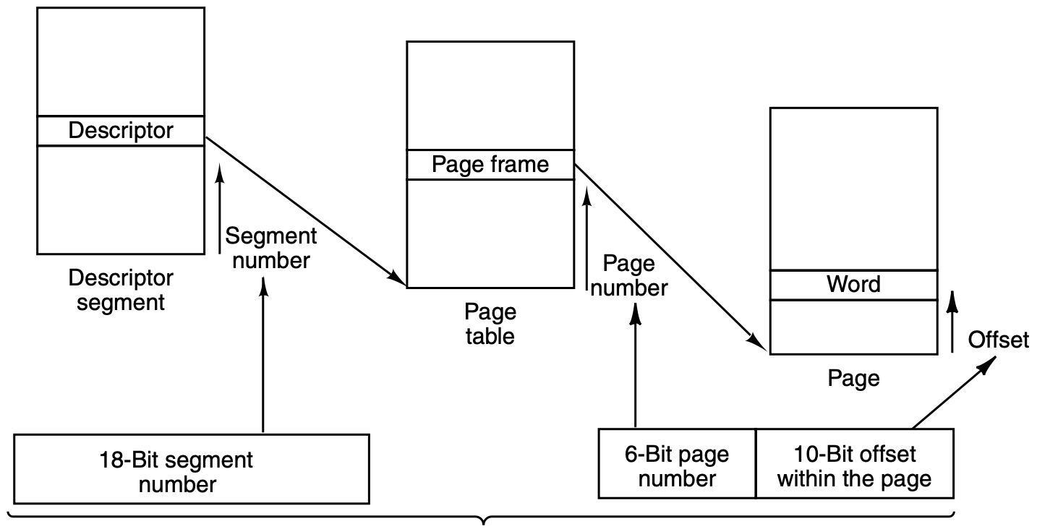
Paging
Other way to implement segmentation is by dividing each segment up into fixed-size pages and demand paging them
In this scheme, some of the pages of a segment may be in memory and some may be on disk

Slide 35
Virtual Memory on the Core i7

Slide 36
i7 virtual memory system
The Core i7 has a sophisticated virtual memory system that supports demand paging, pure segmentation, and segmentation with paging
Core i7 virtual memory consists of two tables:
LDT (Local Descriptor Table)
GDT (Global Descriptor Table).
Each program has its own LDT, but a single GDT is shared by all the programs on the computer.
The LDT describes segments local to each program, including its code, data, stack, and so on, whereas the GDT describes system segments, including the operating system itself.

Slide 37
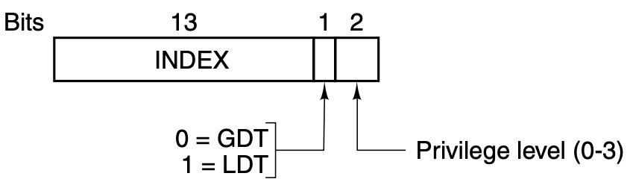
Segment registers
To access a segment, a Core i7 program first loads a selector for that segment into one of the segment registers. CS holds the selector for the code segment, DS holds the selector for the data segment, and so on.
Each selector is a 16-bit number. Descriptor 0 is invalid and causes a trap if used.

Slide 38
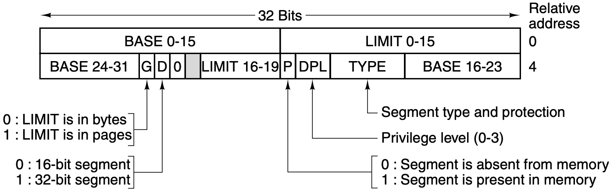
Core i7 code segment descriptor
Notes:
- BASE Field: This field contains the starting address of the memory segment. That is, it points to the location in memory where the segment begins.
- LIMIT Field: This field contains the size of the memory segment, or how far from the base address the segment extends.

Slide 39
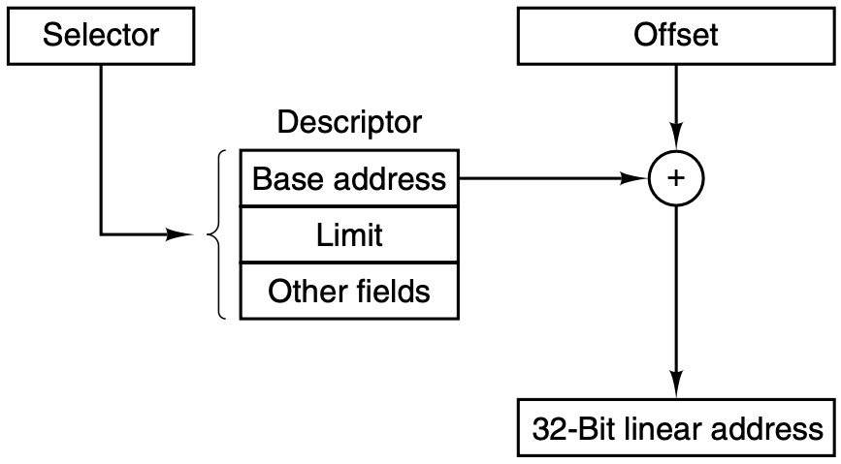
Conversion of a (selector, offset) pair to a linear address

Slide 40
What is Linear address?
If paging is disabled (by a bit in a global control register), the linear address is interpreted as the physical address and sent to the memory for the read or write
If paging is enabled, the linear address is interpreted as a virtual address and mapped onto the physical address using page tables, pretty much as in our examples.
The only complication is that with a 32-bit virtual address and a 4-KB page, a segment might contain 1 million pages, so a two-level mapping is used to reduce the page-table size for small segments

Slide 41
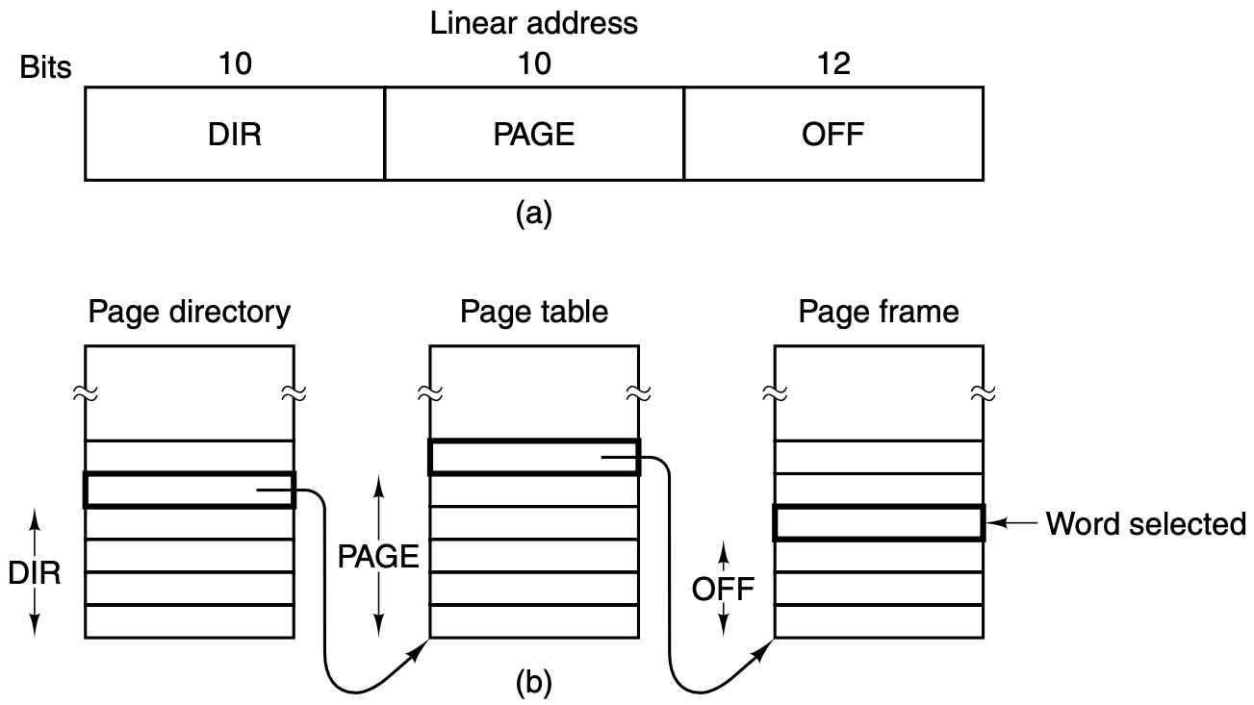
Mapping of a linear address onto a physical address
Core i7 MMU has special hardware support to look up the most recently used DIR − PAGE

Slide 42
How to “disable” segmentation?
BASE = 0 and LIMIT set to the maximum.
The instruction offset will then be the linear address, with only a single address space used—in effect, traditional paging

Slide 43
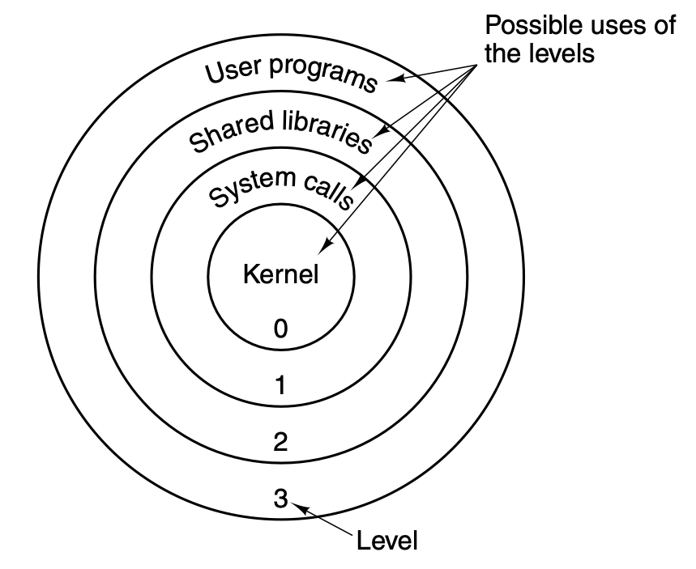
Protection on the Core i7
Attempts to access data at a higher level are permitted. Attempts to access data at a lower level are illegal and cause traps.
In order to make an interlevel call, the CALL instruction must contain a selector instead of an address.
This selector designates a descriptor called a call gate, which gives the address of the procedure to be called

Slide 44
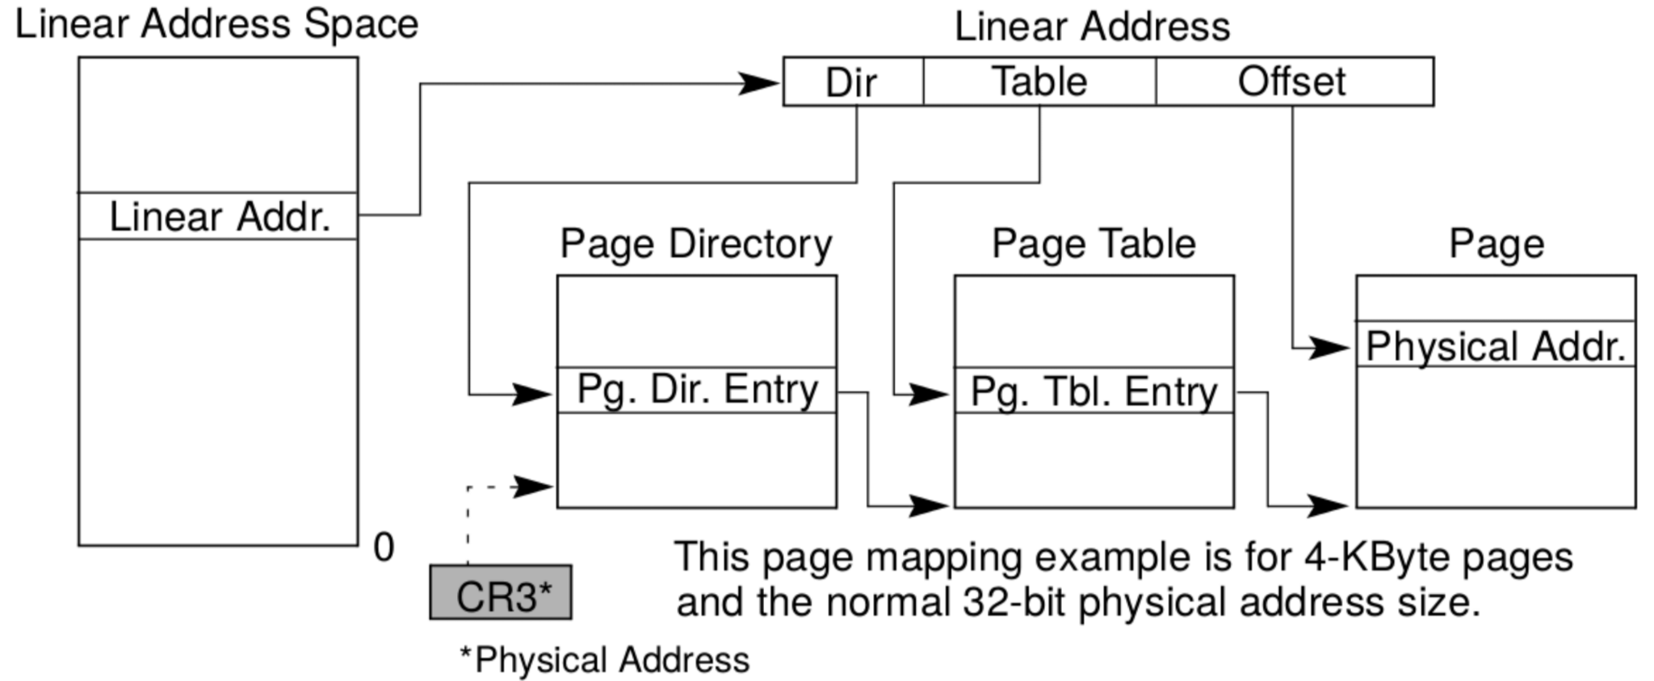
Intel X86

