Slide 1
Computer Architecture
Lecture 7:Multi-cycle processor: data path, control unit
Lector: Konstantin Chaika
Based on
- David Harris, Sarah L. Harris, Digital Design and Computer Architecture
Constructor University Bremen Spring 2025

Slide 2
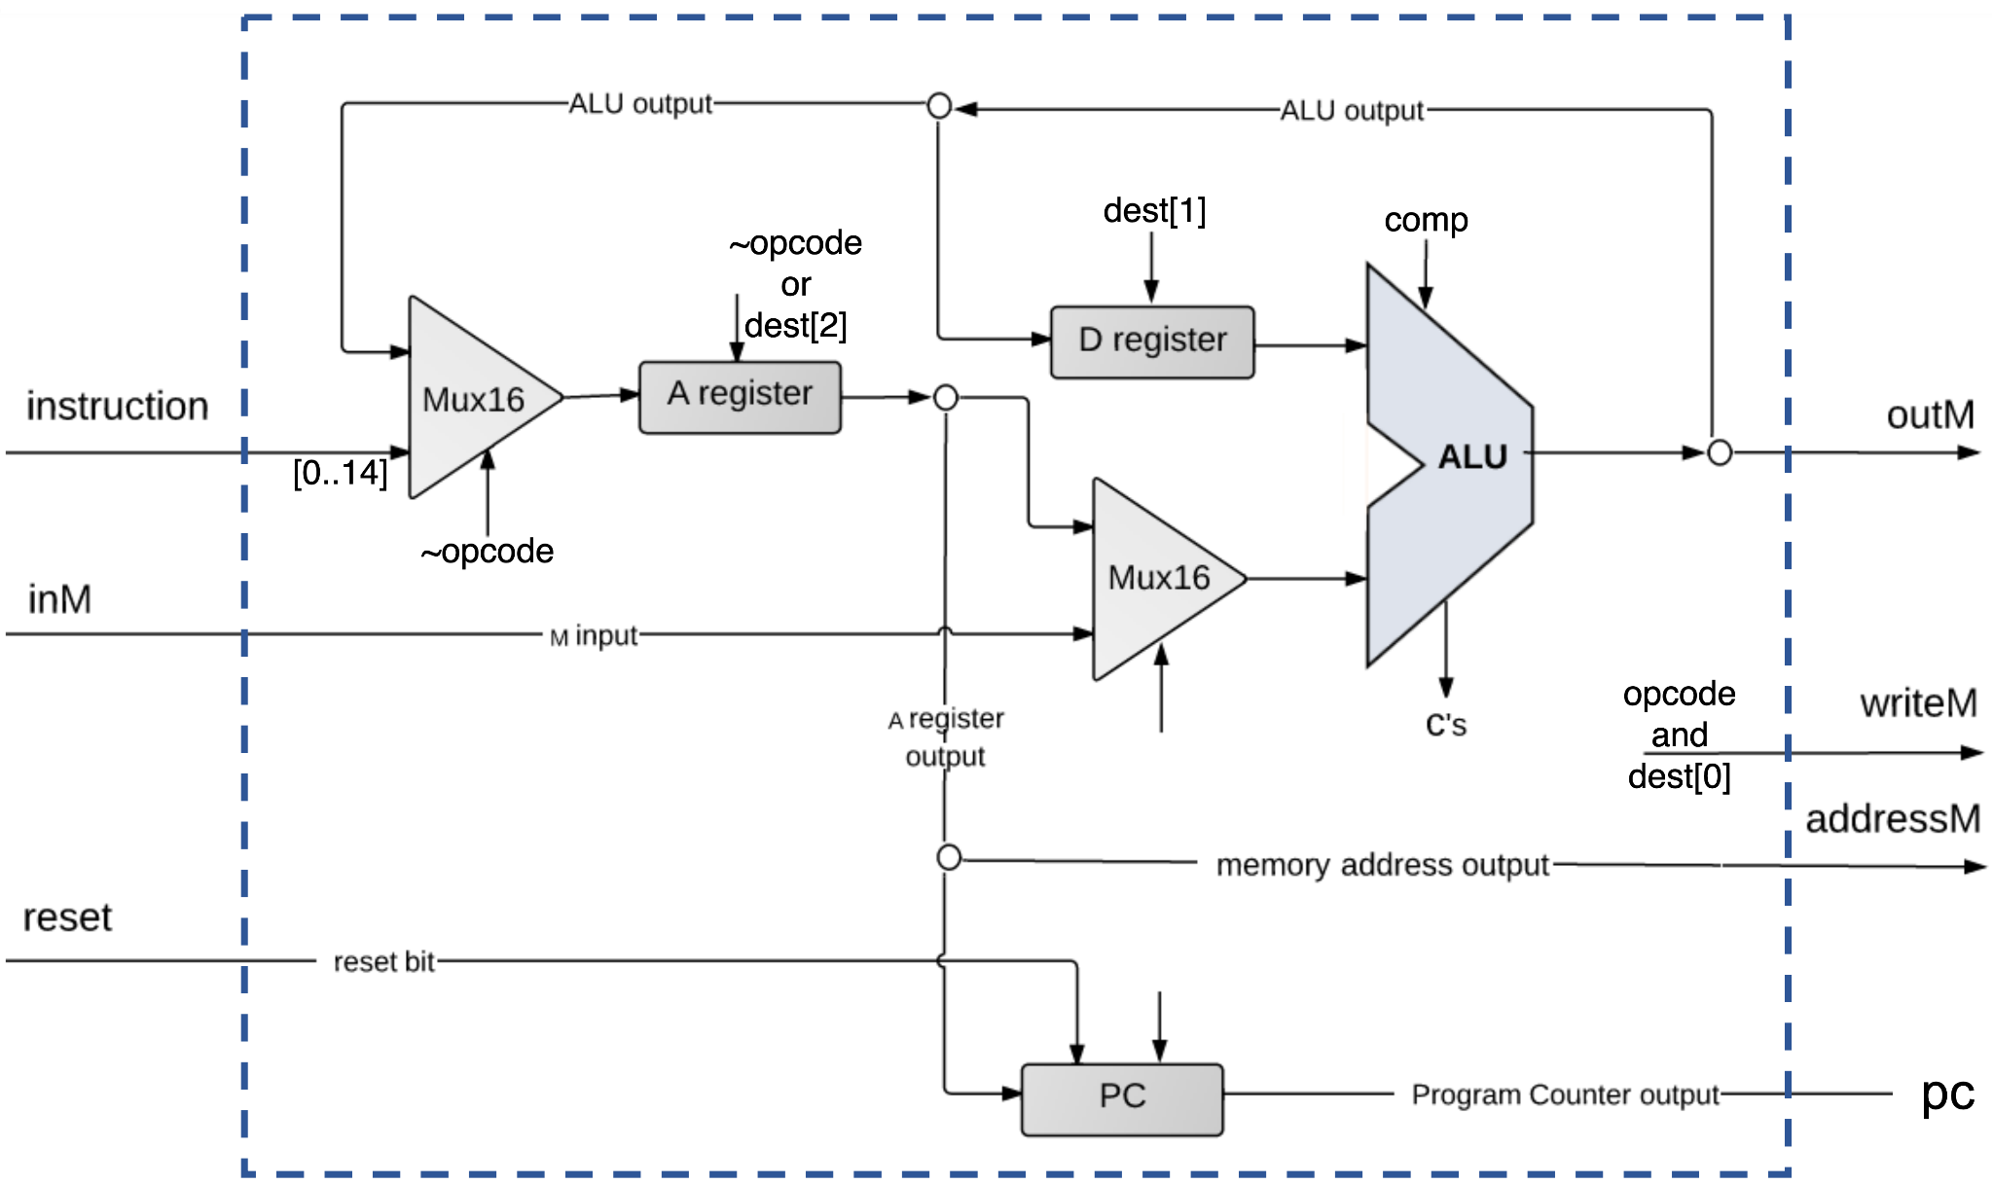
In previous episodes
Complete single-cycle processor
Commands executing in hardware
Fetch instruction from memory
Read source operand from register
Compute memory address
Write data back to register
What disadvantages do you see?

Slide 3
Single-cycle processor problems
Requires a clock cycle long enough to support the slowest instruction, even though most instructions are faster
Requires extra adders: in the ALU and for the PC logic (adders are relatively expensive circuits, especially if they must be fast)
It has separate instruction and data memories, which may not be realistic
What is the solution?

Slide 4
MIPS architecture

Slide 5
Instruction types
R(register)-type (instructions operate on three registers)
I(immediate)-type (instructions operate on two registers and a 16-bit immediate)
J(jump)-type (instructions operate on one 26-bit immediate)
Immediates == constants which values are immediately available from the instruction and do not require a register or memory access

Slide 6
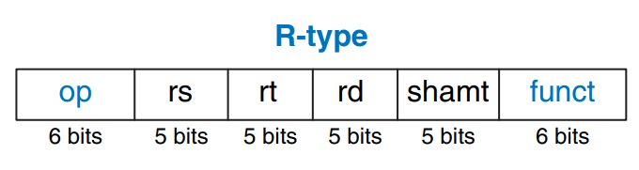
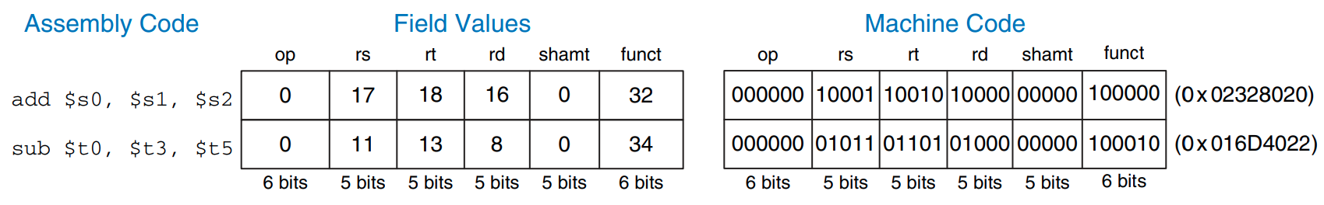
R-type commands
Shift amount
0 for R-type
For ALU

Slide 7
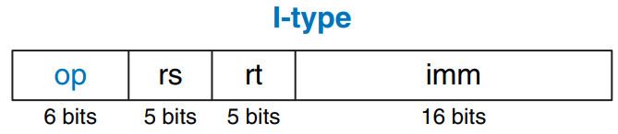
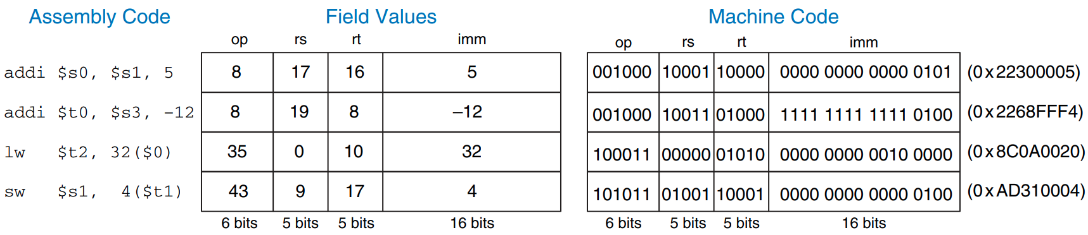
I-type commands

Slide 8
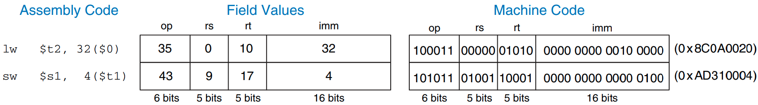
LW (Load word)
Base address
Offset
26
21
16
0
Destination

Slide 9
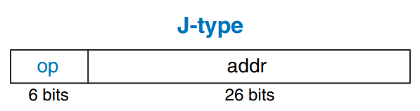
J-type commands
Jump to address: XXXXX
Jump to address: +10 commands from current
When it’s possible?

Slide 10
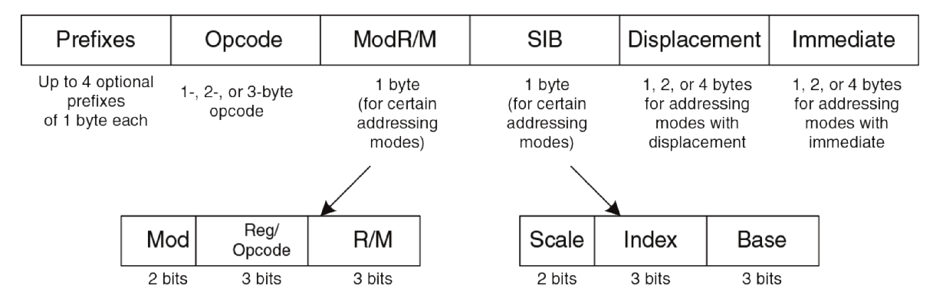
x86 instructions encoding (Interesting to see)
We can't even read the instruction in one cycle. Interpret even more

Slide 11
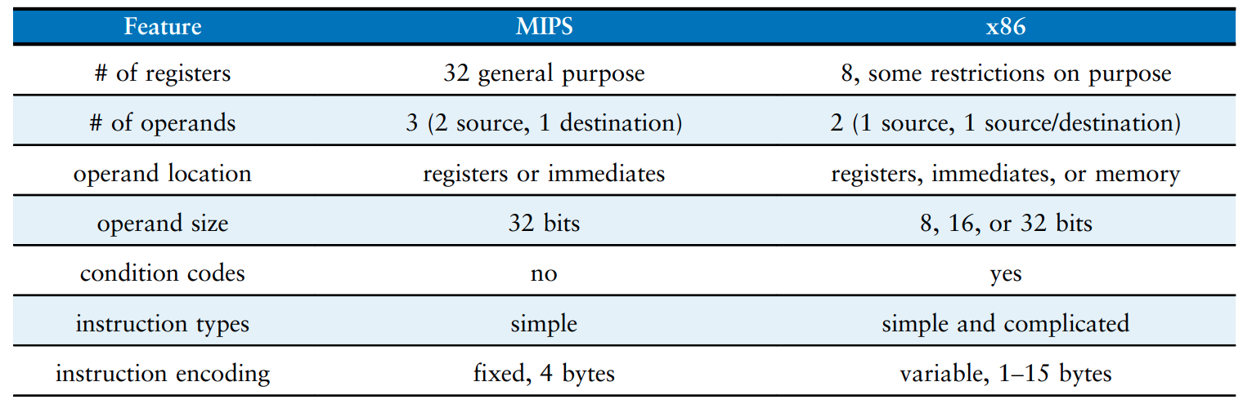
Major differences between MIPS and x86

Slide 12
MIPS addressing modes
Register-Only Addressing
Immediate Addressing
Base Addressing
PC-Relative Addressing
Pseudo-Direct Addressing

Slide 13
Register-Only Addressing
All R-type instructions use register-only addressing

Slide 14
Immediate Addressing
Immediate addressing uses the 16-bit immediate along with registers as operands.
Some I-type instructions, such as add immediate (addi) and load upper immediate (lui), use immediate addressing

Slide 15
Base Addressing
Adding the base address in register rs to the sign-extended 16-bit offset found in the immediate field. Commands: lw, sw
Base address
Offset
26
21
16
0
Destination

Slide 16
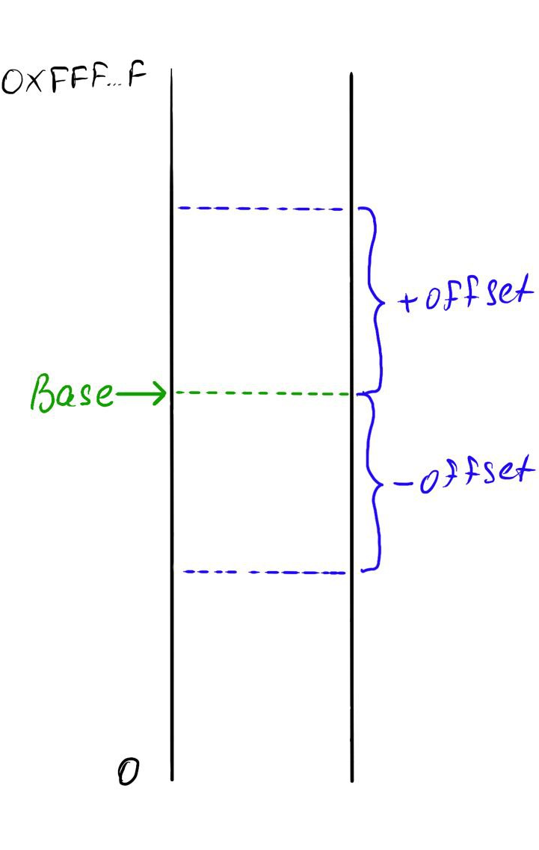
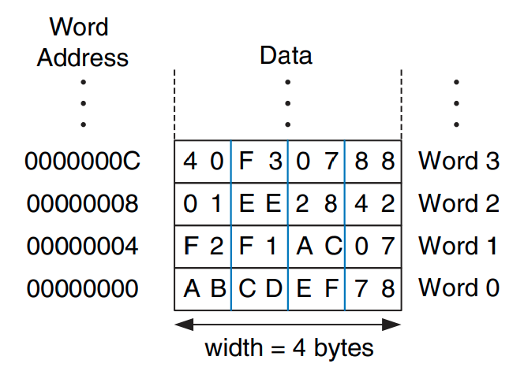
Byte-addressable / Word-addressable memory

Slide 17
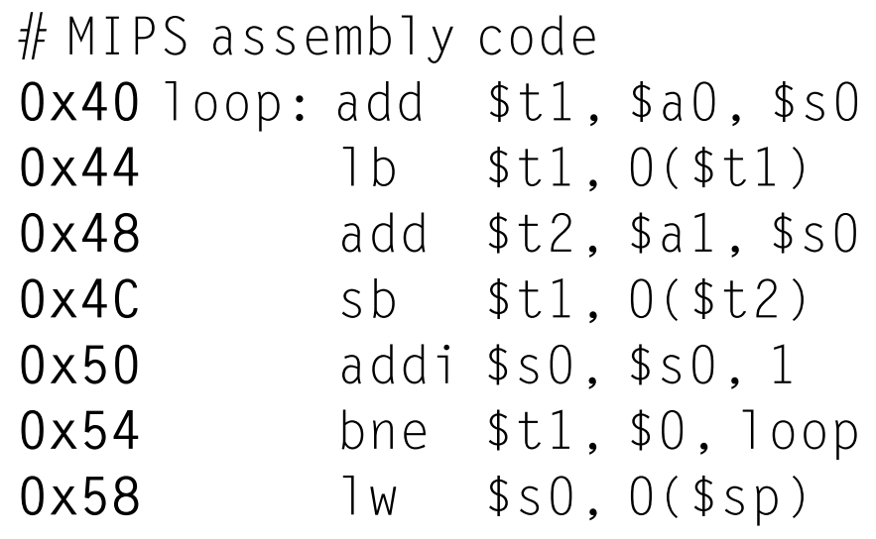
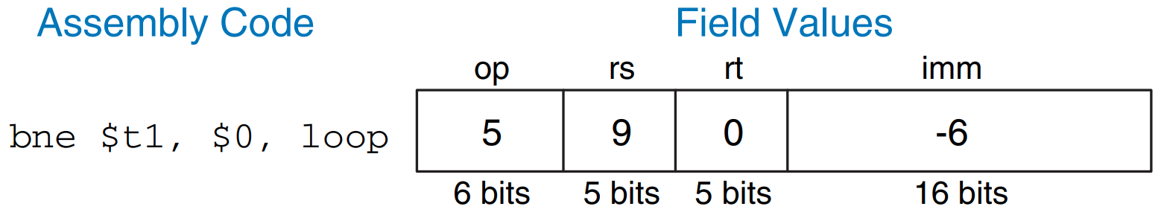
PC-Relative Addressing
PC-relative addressing to specify the new value of the PC if the branch is taken. The signed offset in the immediate field is added to the PC to obtain the new PC; hence, the branch destination address is said to be relative to the current PC

Slide 18
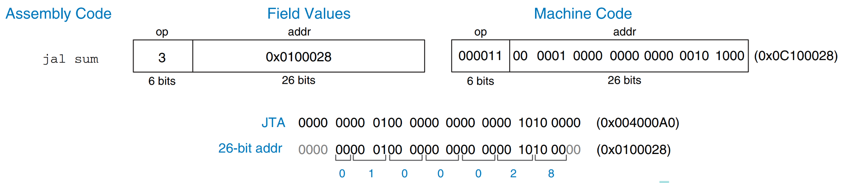
Pseudo-Direct Addressing
In direct addressing, an address is specified in the instruction. Ideally jump instructions would use direct addressing to specify a 32-bit jump target address (JTA) to indicate the instruction address to execute next.
Where to get it?

Slide 19
Single cycle MIPS datapath

Slide 20
(H&H 7.3)

Slide 21
Instruction types

Slide 22
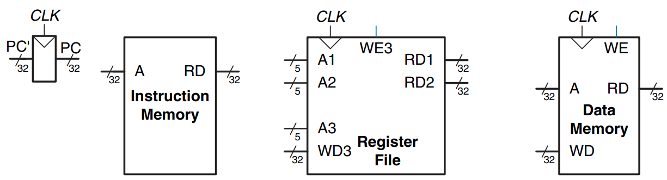
State elements of MIPS processor (Data path)
We need:
Data path
Control unit

Slide 23
LW (Load word)
Base address
Offset
26
21
16
0
Destination

Slide 24
LW instruction execution stages
Fetch LW instruction from memory
Read source operand from register file
Sign-extend the immediate
Compute memory address
Write data back to register file

Slide 25
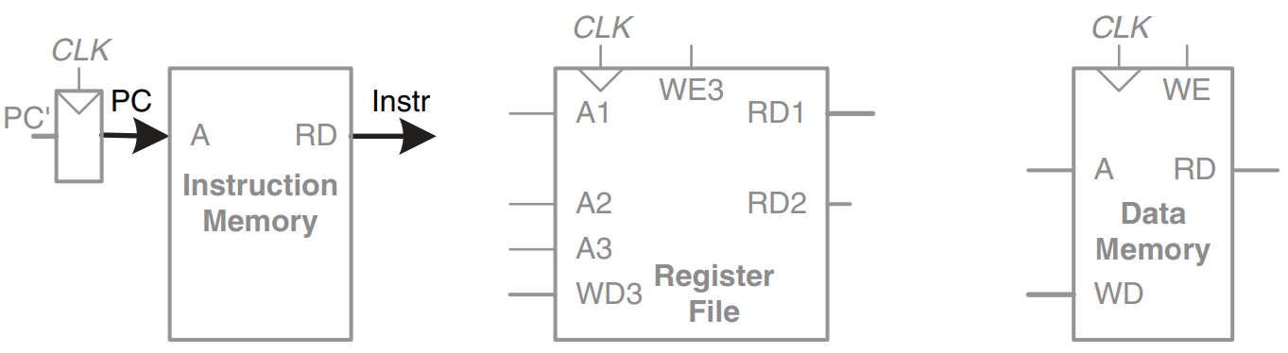
1. Fetch LW instruction from memory
Fetch LW instruction from memory
Read source operand from register file
Sign-extend the immediate
Compute memory address
Write data back to register file

Slide 26
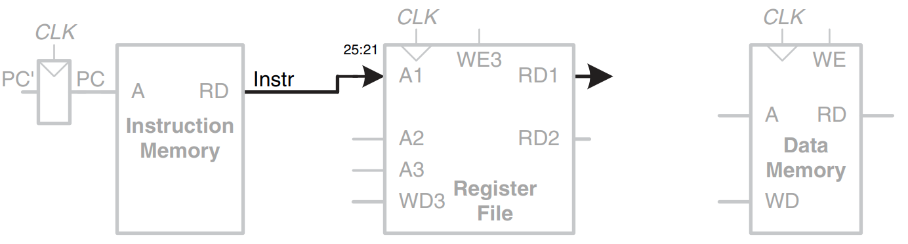
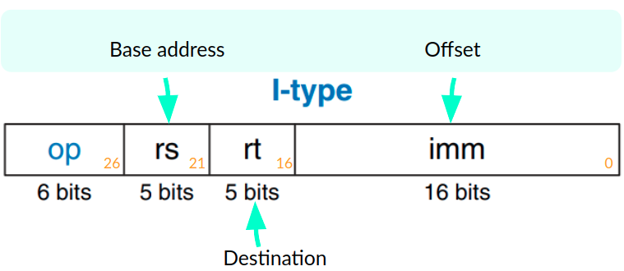
2. Read source operand from register file
Fetch LW instruction from memory
Read source operand from register file
Sign-extend the immediate
Compute memory address
Write data back to register file
??

Slide 27
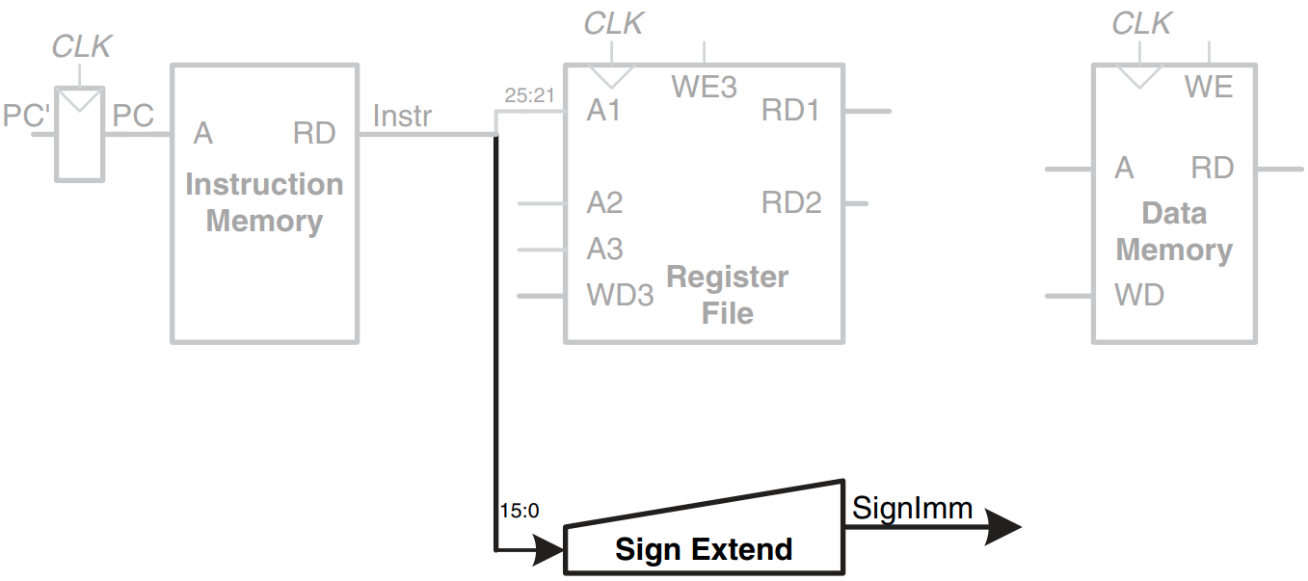
3. Sign-extend the immediate
Fetch LW instruction from memory
Read source operand from register file
Sign-extend the immediate
Compute memory address
Write data back to register file

Slide 28
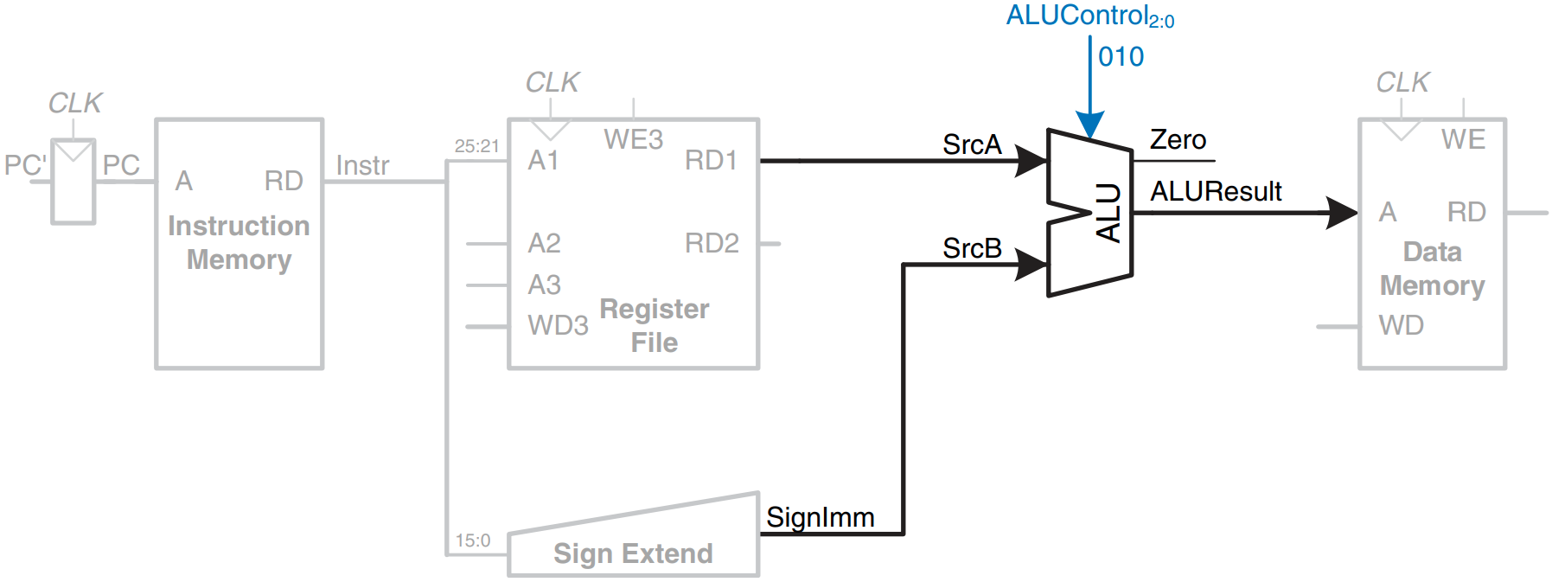
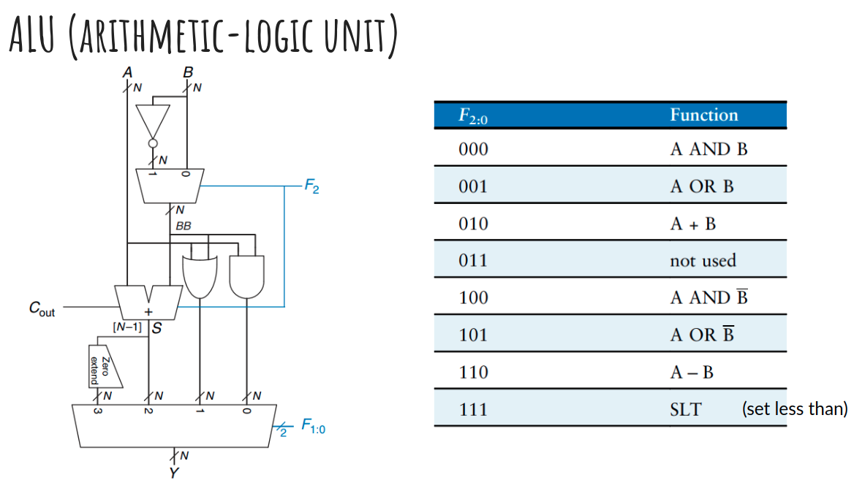
4. Compute memory address
Fetch LW instruction from memory
Read source operand from register file
Sign-extend the immediate
Compute memory address
Write data back to register file
We need control signals

Slide 29

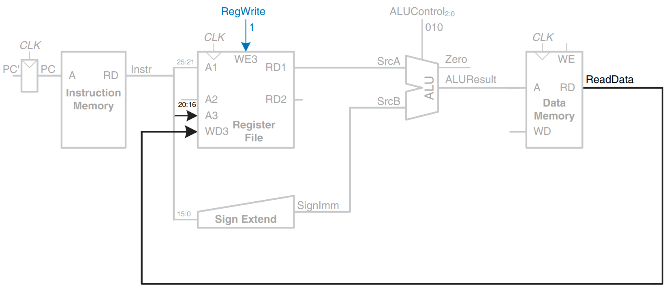
5. Write data back to register file
Fetch LW instruction from memory
Read source operand from register file
Sign-extend the immediate
Compute memory address
Write data back to register file
We need control signals (2)

Slide 30
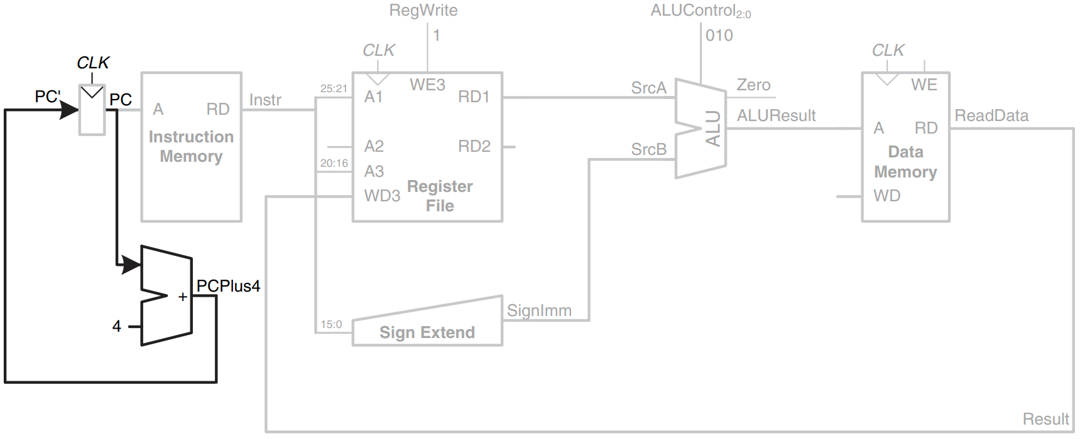
Determine address of next instruction for PC

Slide 31
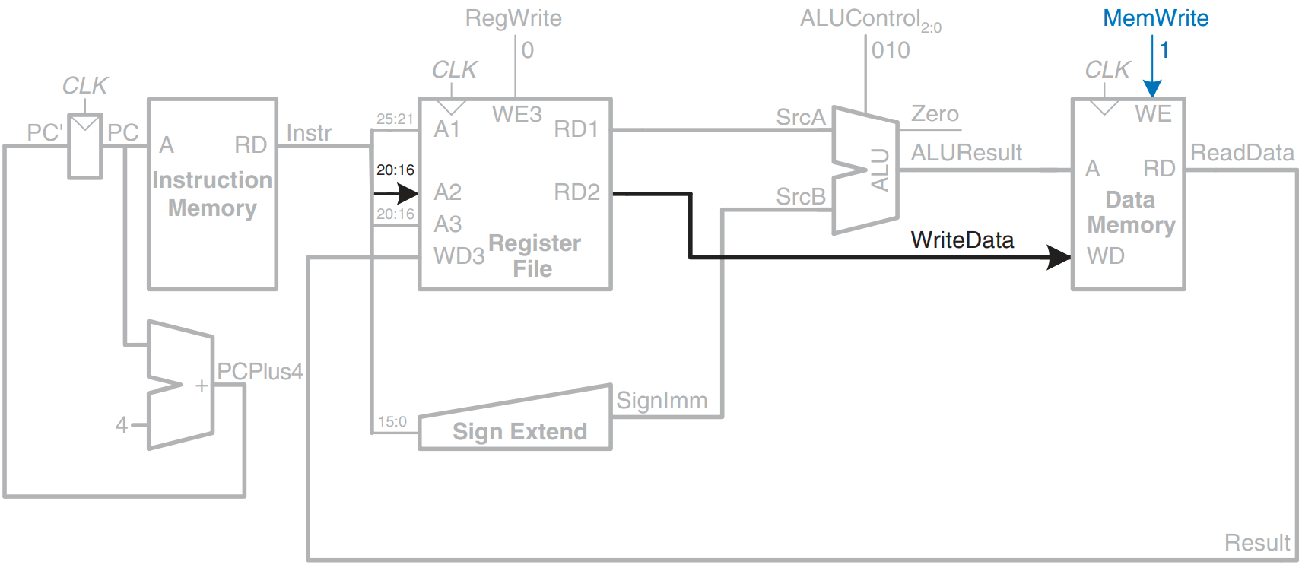
Write data to memory for SW instruction

Slide 32
R-type commands
Shift amount Not used in R-types commands
26
21
16
11
6
0
0 for R-type
For ALU

Slide 33
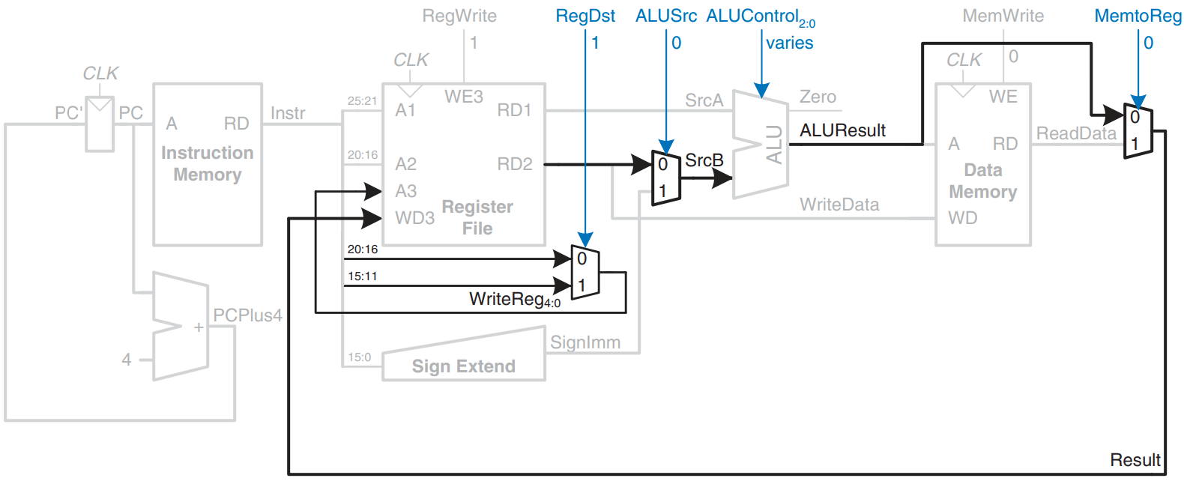
Datapath enhancements for R-type instruction

Slide 34
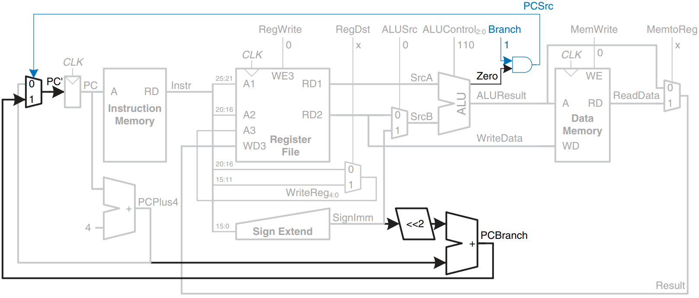
Datapath enhancements for beq instruction

Slide 35
We need control signals!

Slide 36
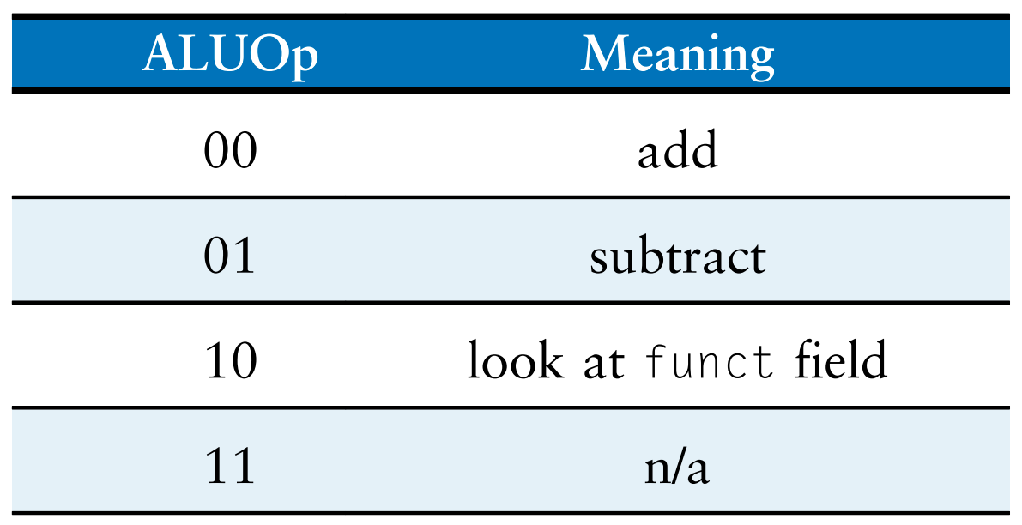
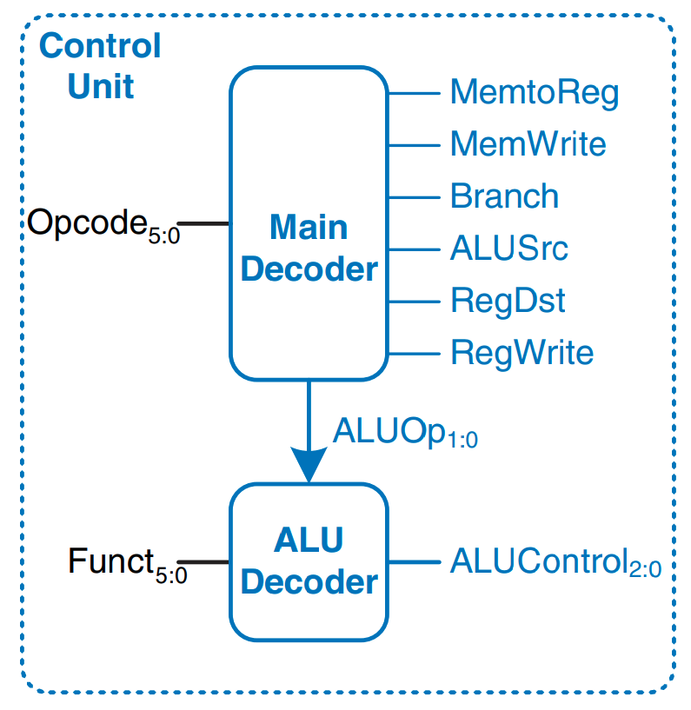
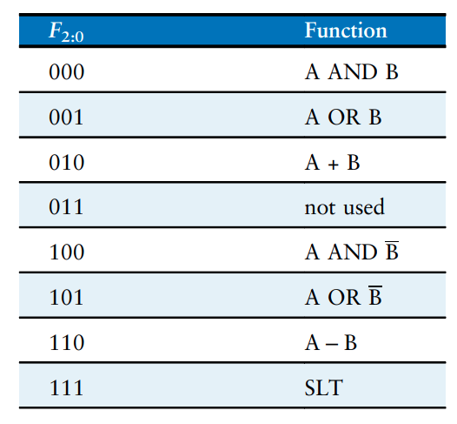
Control unit internal structure
!!!

Slide 37
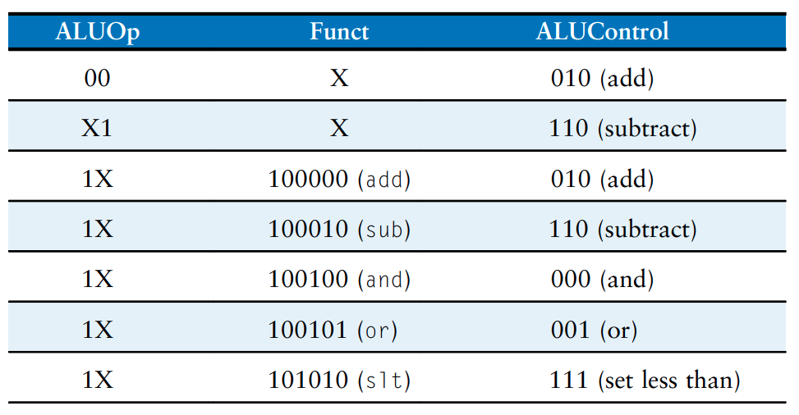
ALU decoder truth table

Slide 38
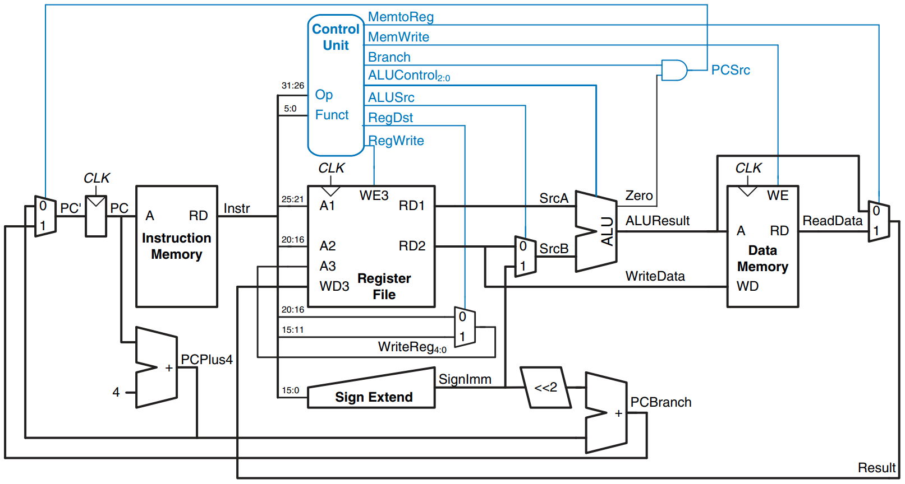
Complete single-cycle MIPS processor

Slide 39
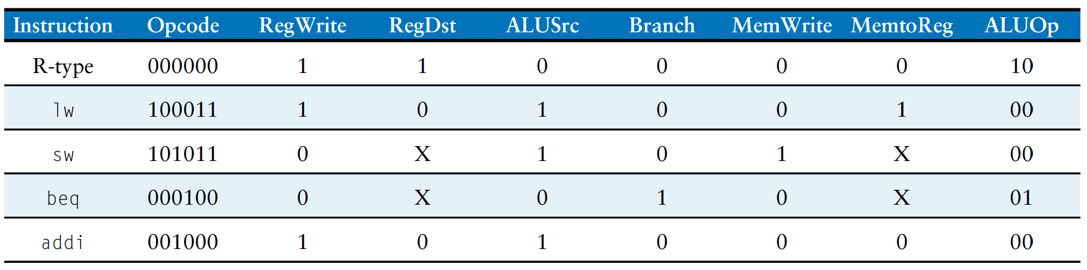
Main decoder truth table

Slide 40
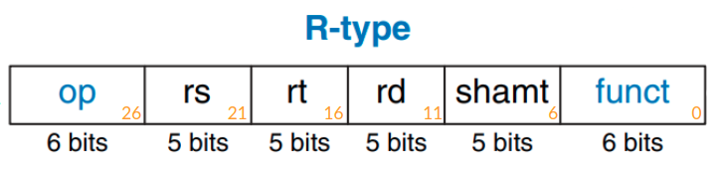
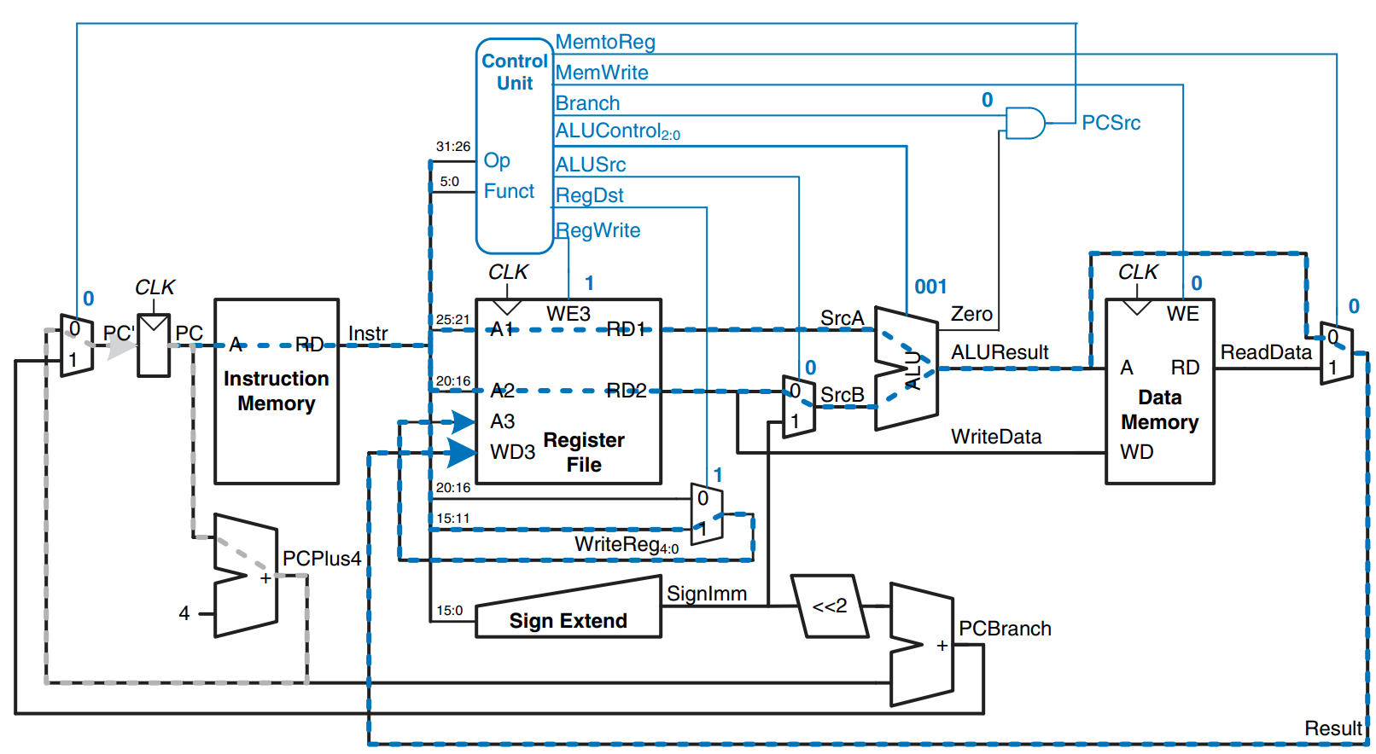
Executing or instruction

Slide 41
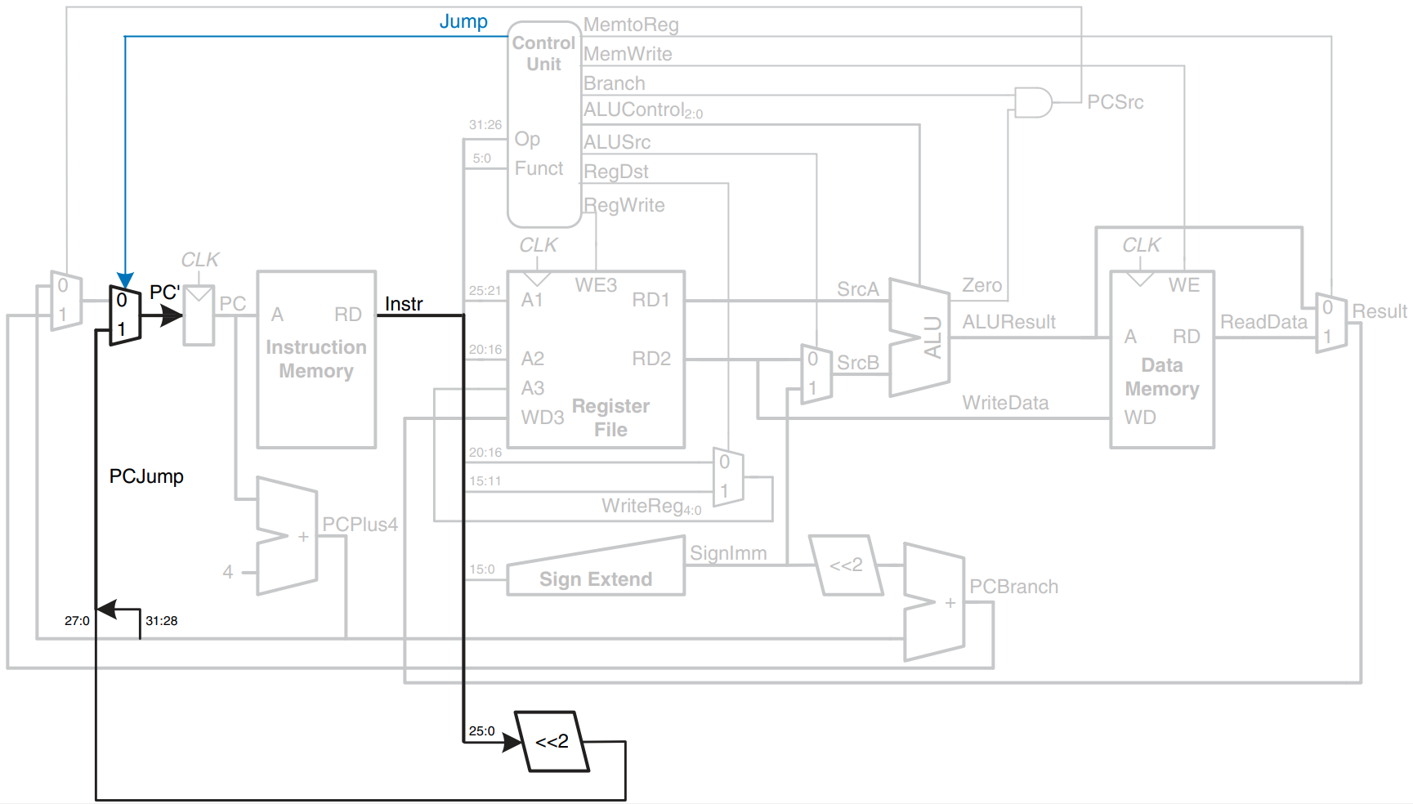
Datapath enhanced to support the J instruction

Slide 42
Multicycle Datapath
(LW first)

Slide 43
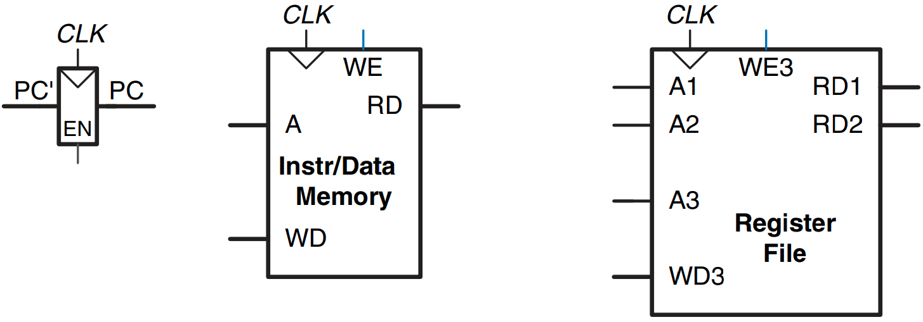
State elements with unified instruction/data memory

Slide 44
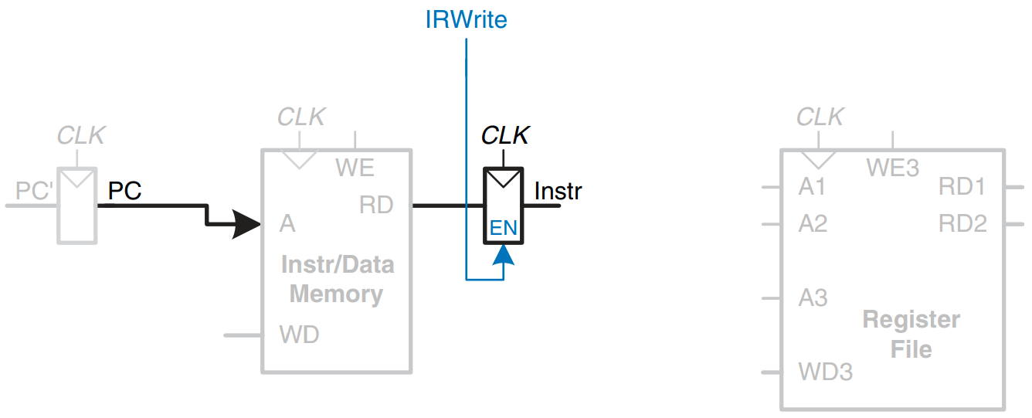
Fetch instruction from memory

Slide 45
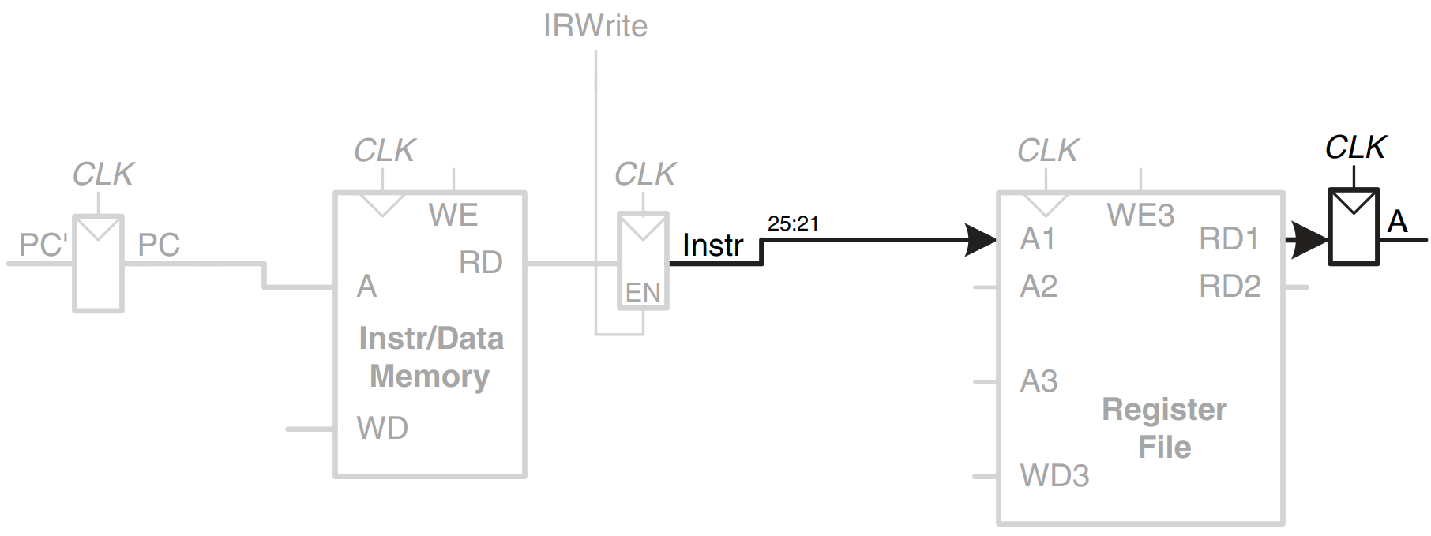
Read source operand from register file

Slide 46
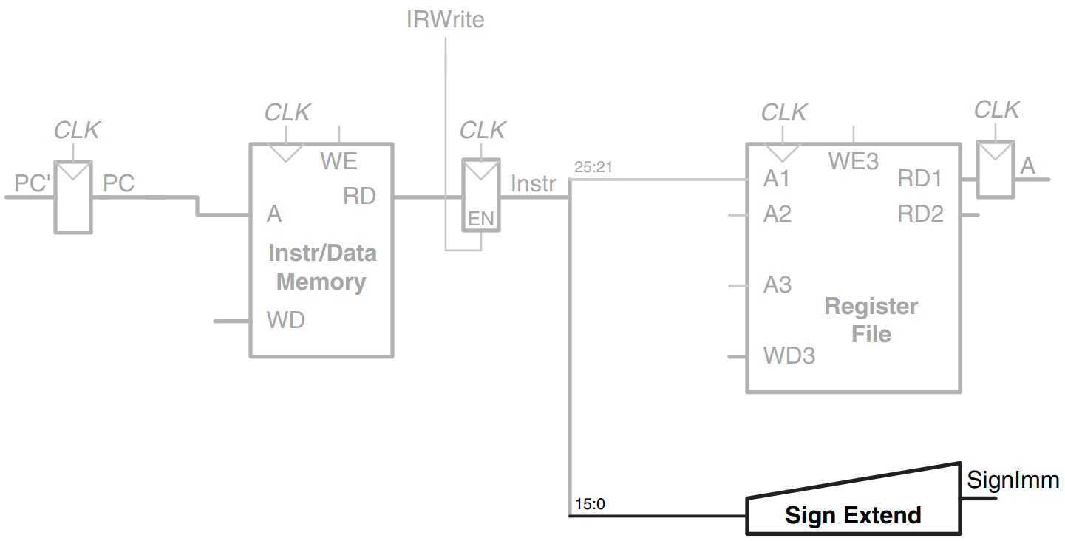
Sign-extend the immediate

Slide 47
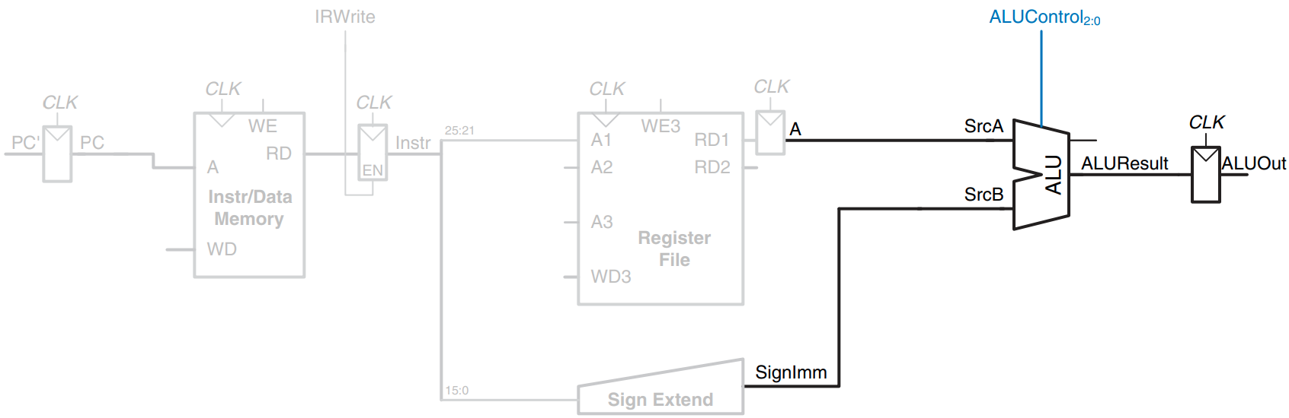
Add base address to offset

Slide 48
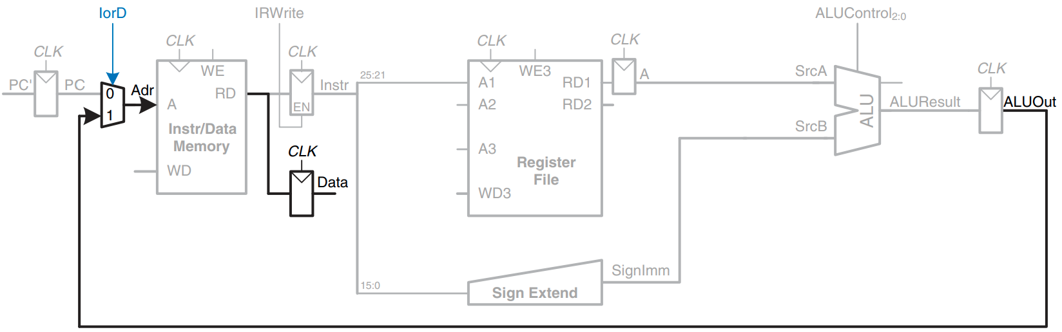
Load data from memory

Slide 49
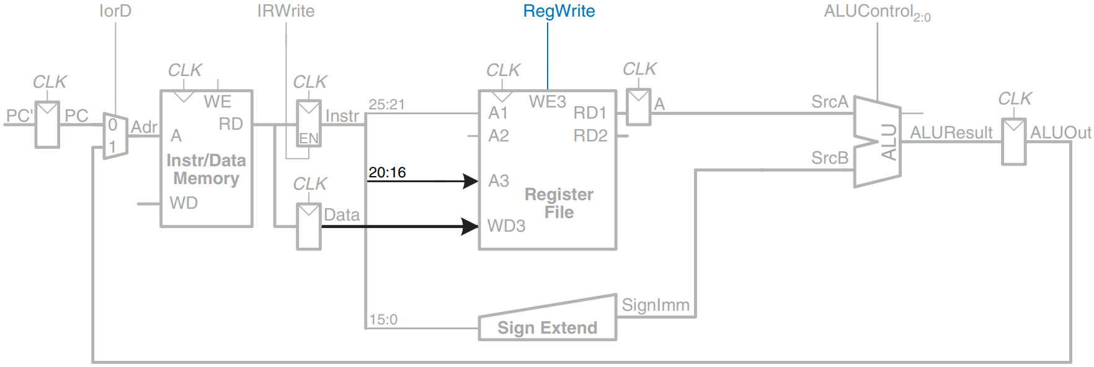
Write data back to register file

Slide 50
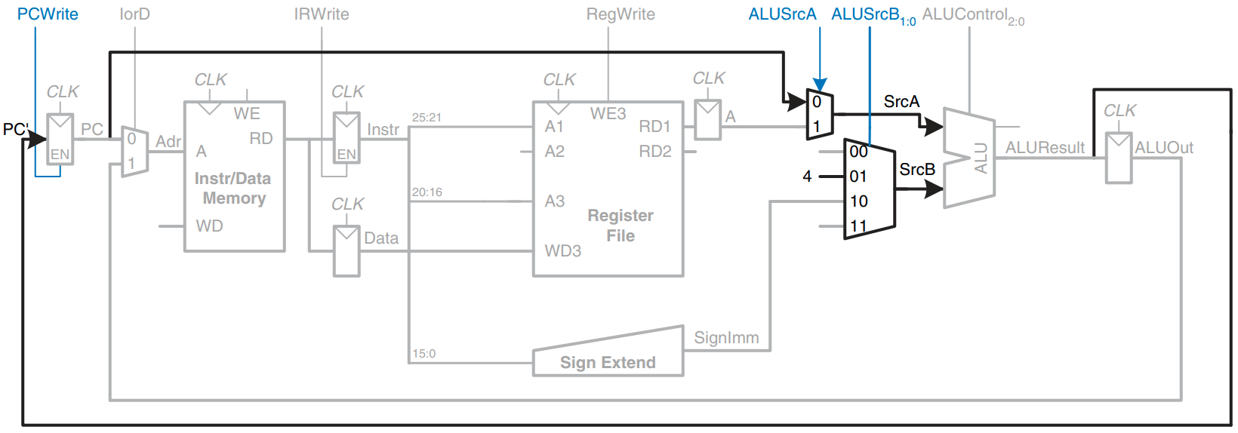
Increment PC by 4

Slide 51
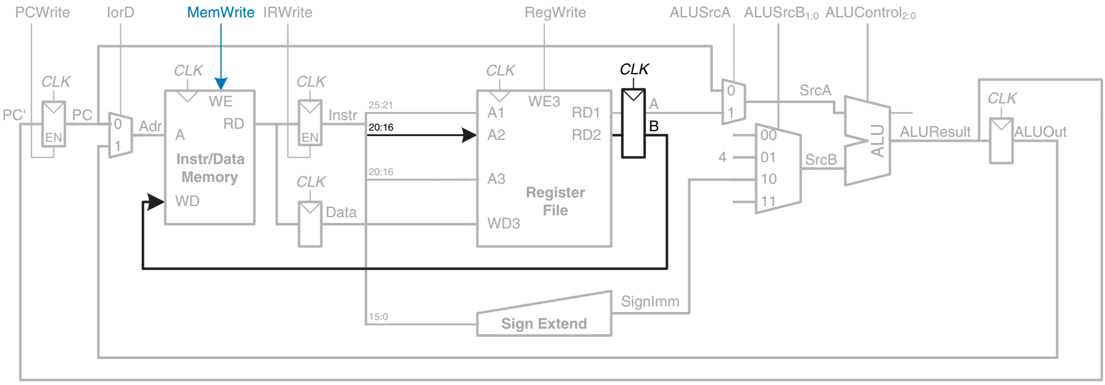
Enhanced datapath for SW instruction

Slide 52
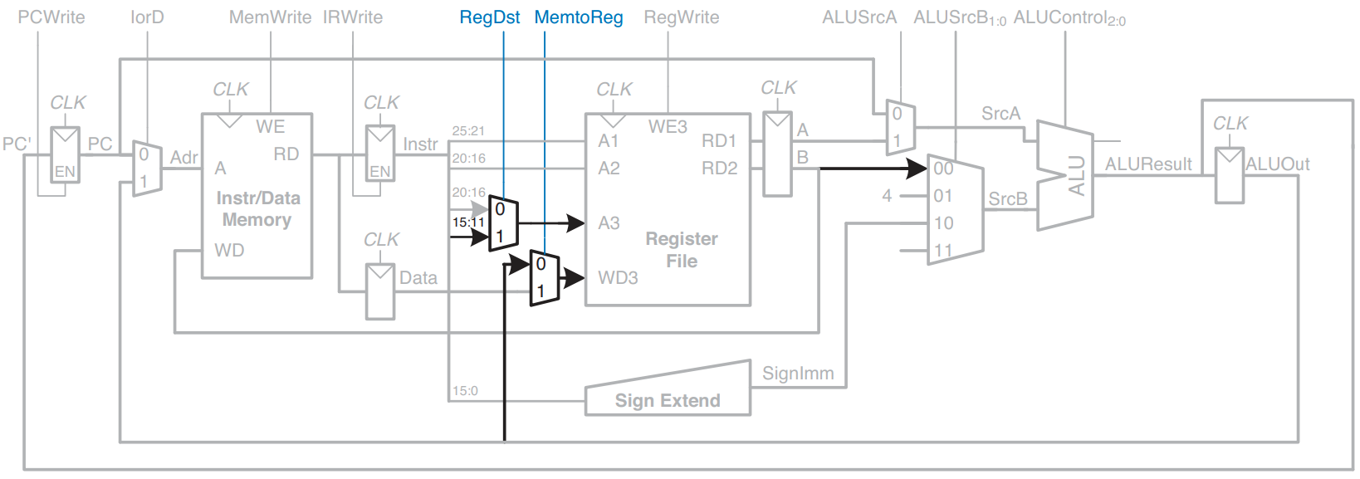
Enhanced datapath for R-type instructions

Slide 53
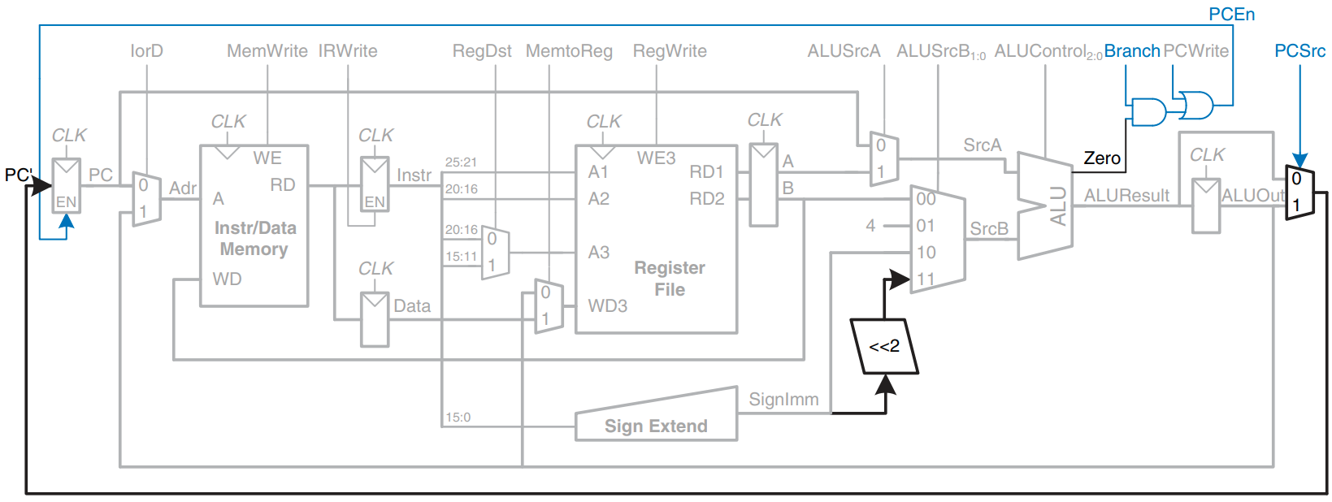
Enhanced datapath for beq instruction

Slide 54
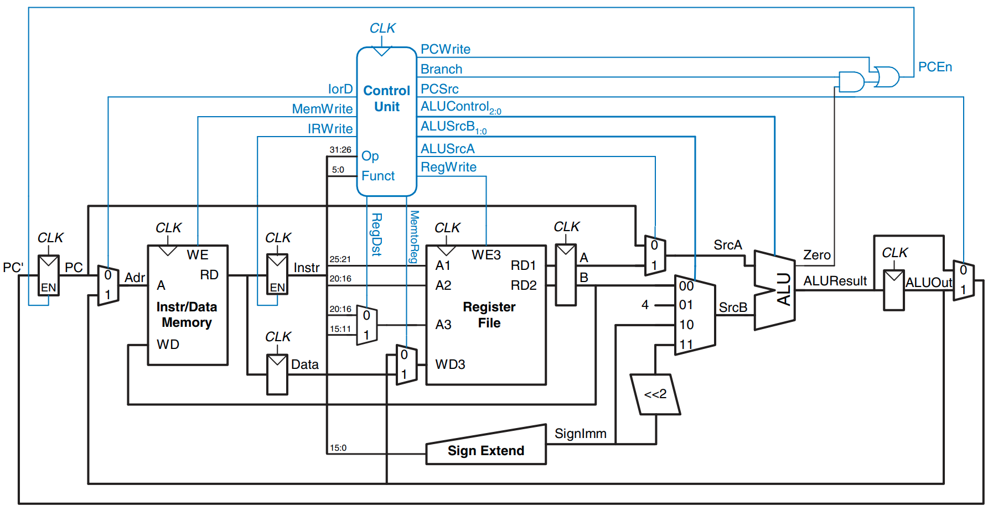
Complete multicycle MIPS processor

Slide 55
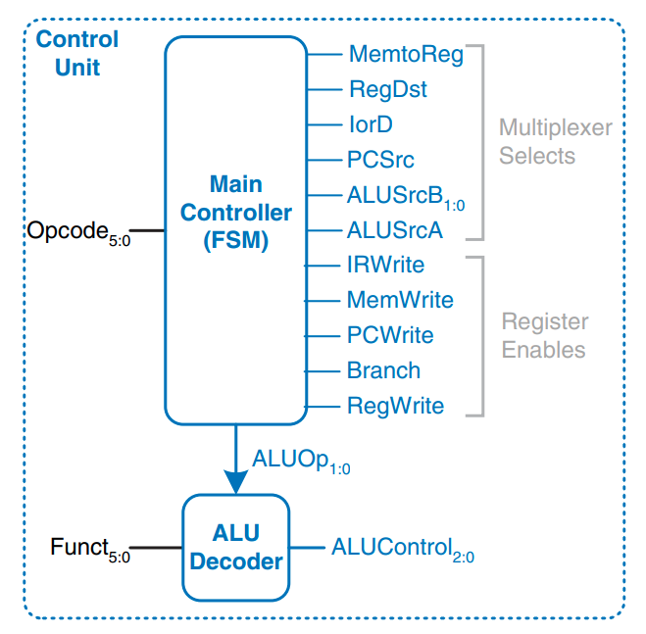
Control unit structure

Slide 56
How to implement FSM?

Slide 57

get some rest?

Slide 58
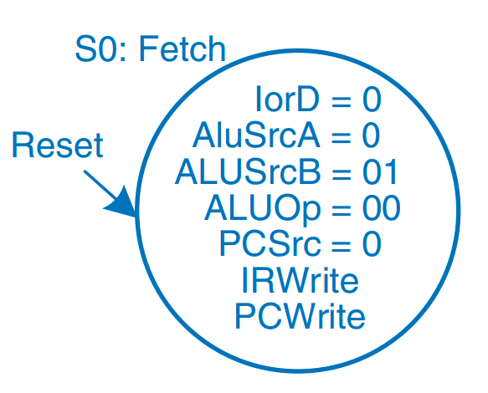
FSM: Fetch

Slide 59
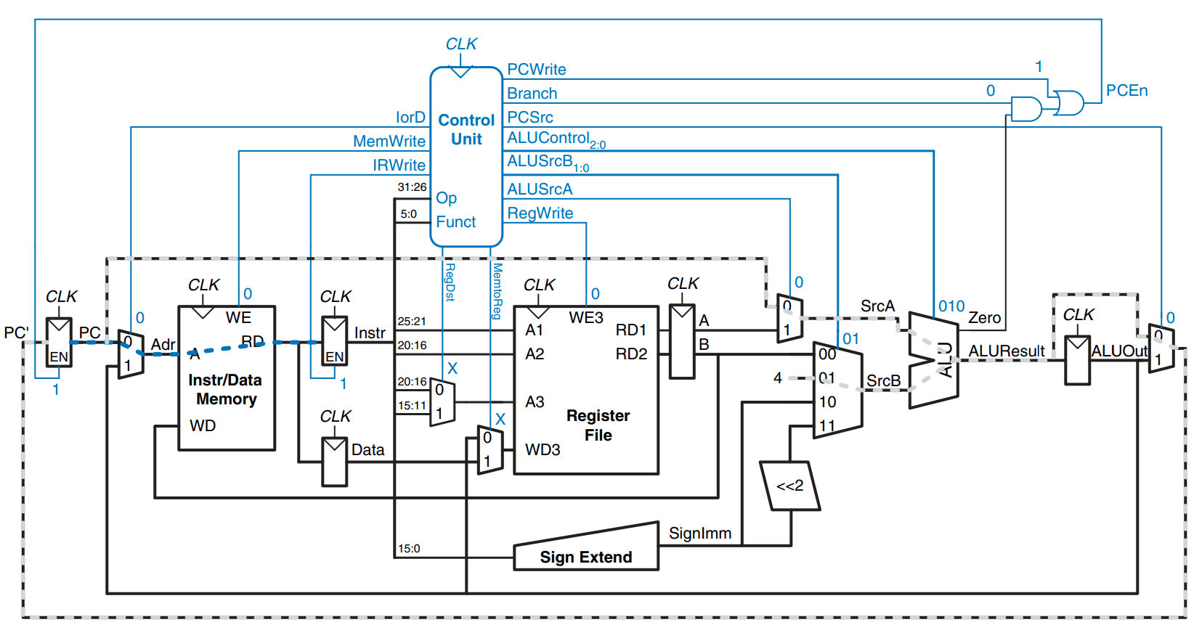
Data flow during the fetch step

Slide 60


Decode step

Slide 61

Memory address computation

Slide 62

Memory read

Slide 63
Memory read (2)
(2

Slide 64

Memory write

Slide 65

Memory write (2)

Slide 66

Execute R-type operation

Slide 67
Execute R-type operation (2)

Slide 68

Branch support

Slide 69
Branch support (2)

Slide 70

Main controller states for addi

Slide 71

Multicycle datapath enhanced to support the J instruction

Slide 72

Main controller state for J

Slide 73
Performance Analysis
Instruction execution time = number of cycles *cycle time
25% loads, 10% stores, 11% branches, 2% jumps, and 52% R-type instructions == Average CPI (Cycles Per Instruction) is 4.12
100 billion instructions
Multicycle processor = 133.9 seconds
Single-cycle processor = 92.5 seconds
Multicycle processor is likely to be less expensive:
+ Eliminates two adders and combines the instruction and data memories into a single unit
- However, require five nonarchitectural registers and additional multiplexers

