Slide 1
Computer Architecture
Lecture 5: Building a computer
Lector: Konstantin Chaika
Based on
- David Harris, Sarah L. Harris, Digital Design and Computer Architecture
- Nand to Tetris / www.nand2tetris.org
Constructor University Bremen Spring 2025

Slide 2
Extra materials
Added to CompArch Spring 2025

Slide 3
Course topics
Course topics
All this files are in the [Public] CompArch Constructor Spring 2025 folder

Slide 4
Like to watch streaming?
nand2tetris - YouTube

Slide 5
One more week for deadlines
CompArch Spring 2025

Slide 6

Tell me when you're tired

Slide 7
Machine language is done!
What's next?
What do we need to implement now?

Slide 8
What we're going to learn today
Fetch-decode-execute cycle
Two-cycle + one-memory machine VS Single cycle + two-memory machine
CPU interface
Creating data path
I/O devices wrap for memory
Reset
HW & GH discussion
As a result: a CPU that can execute the programs we learned how to write in the last lecture!

Slide 9
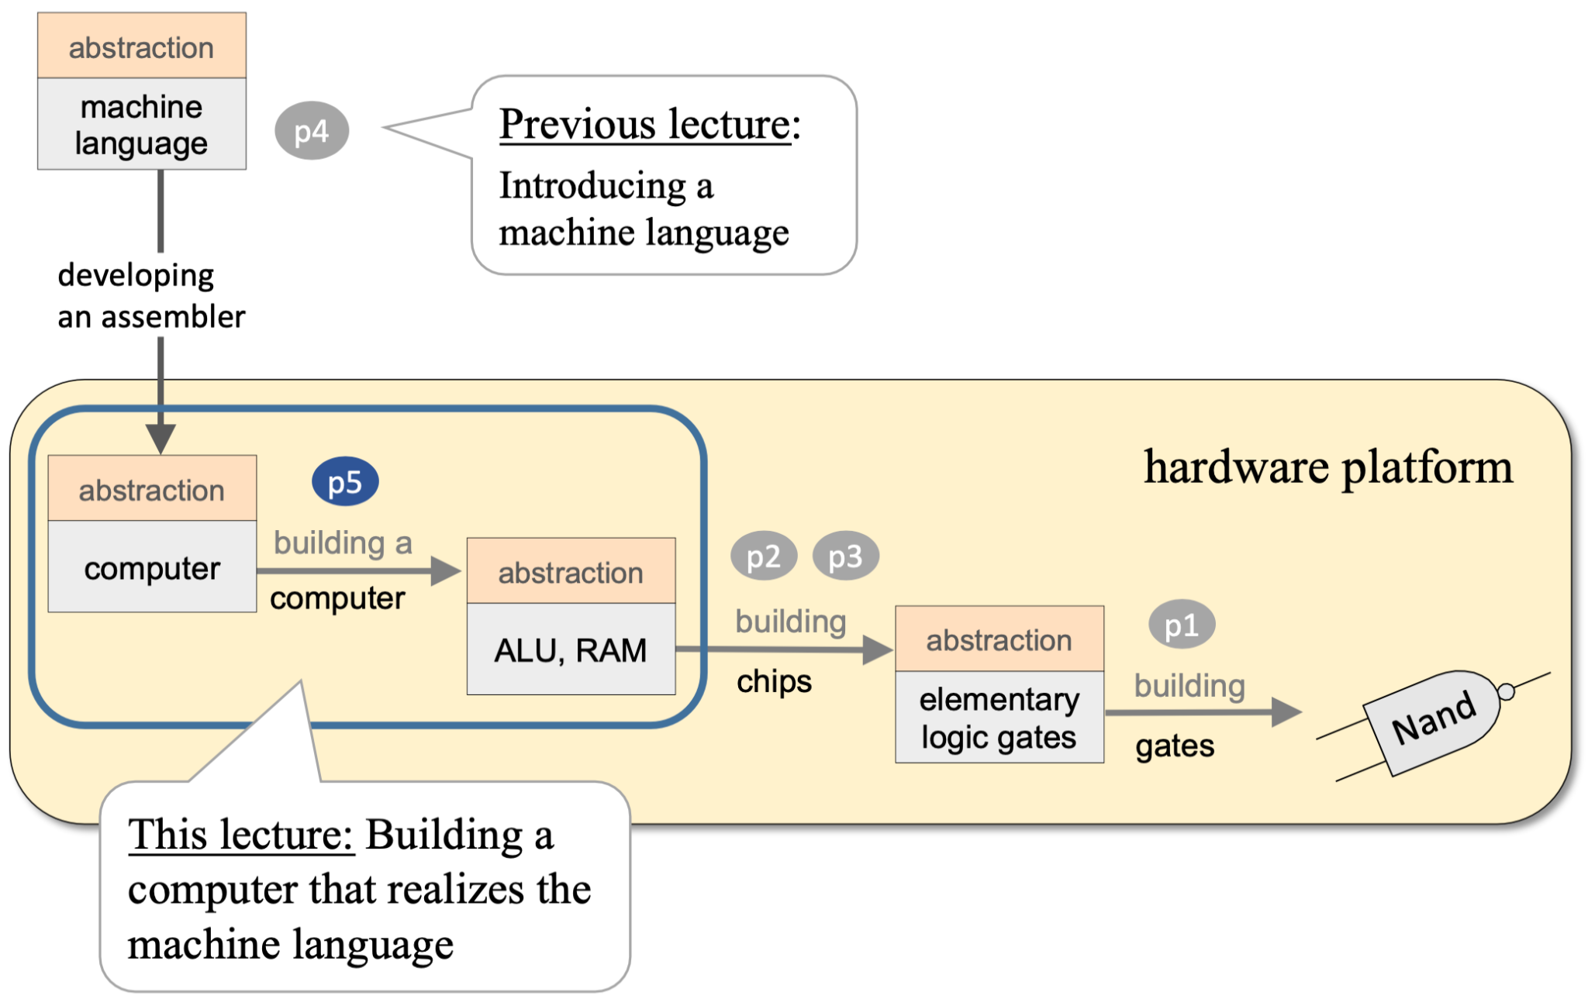
A processor that executes commands

Slide 10
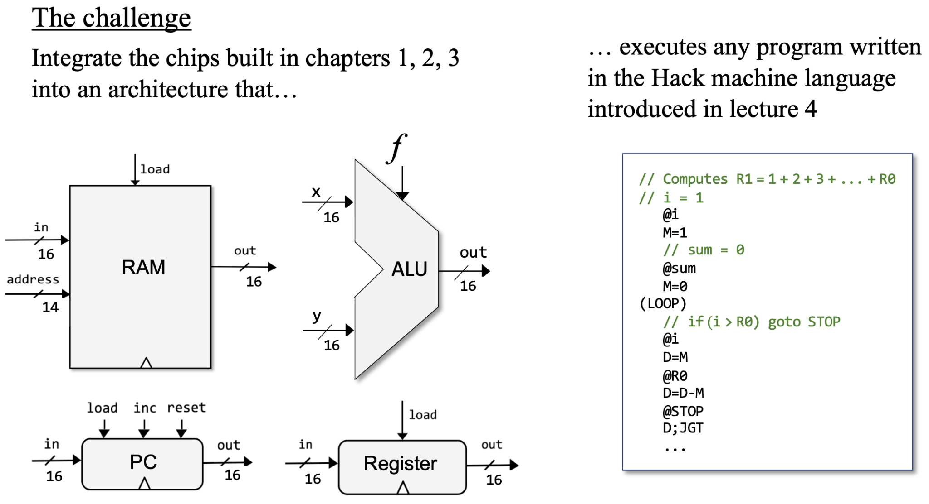
What we have vs What we need

Slide 11
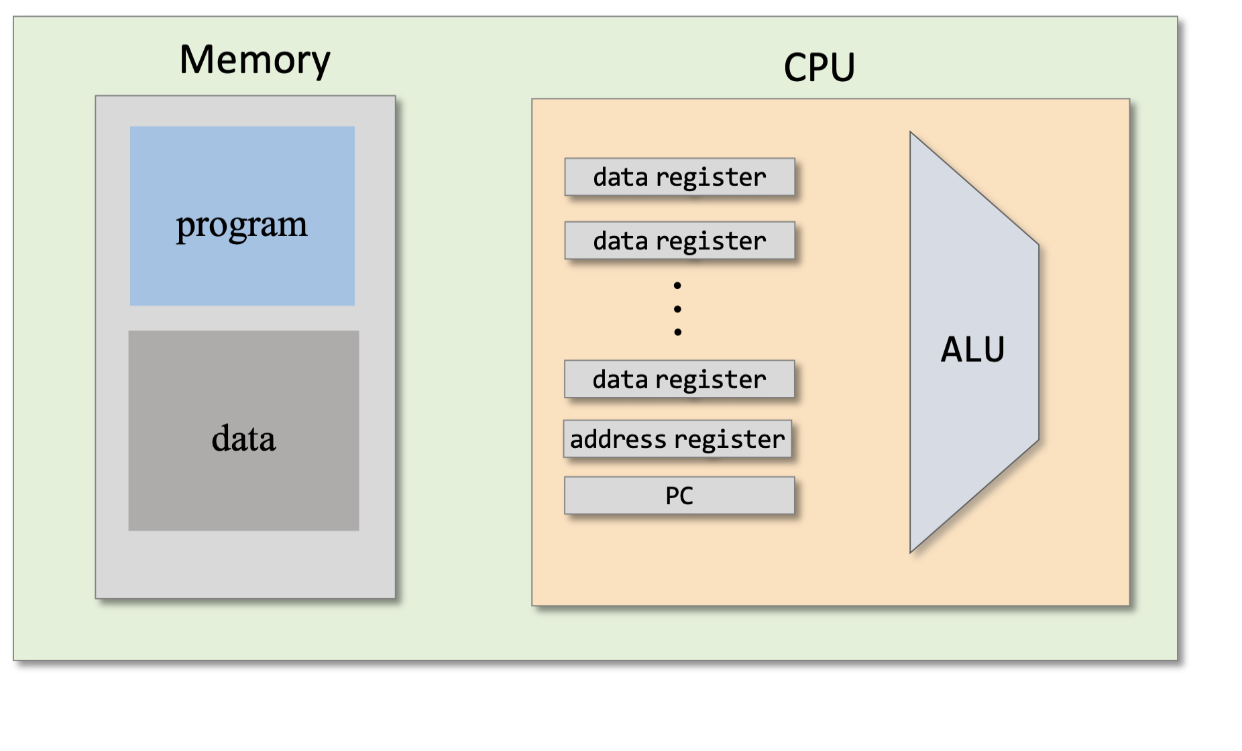
What does the execution of a command consist of?
Where do we get the instructions for execution from?
What should we do with it?

Slide 12
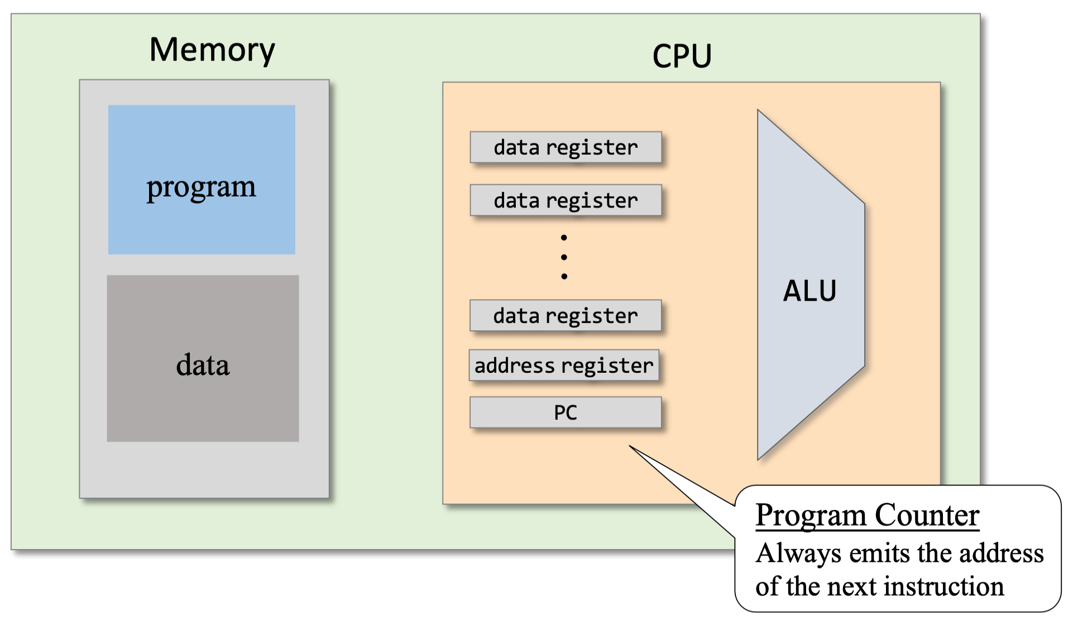
Determine the address of the next instruction

Slide 13
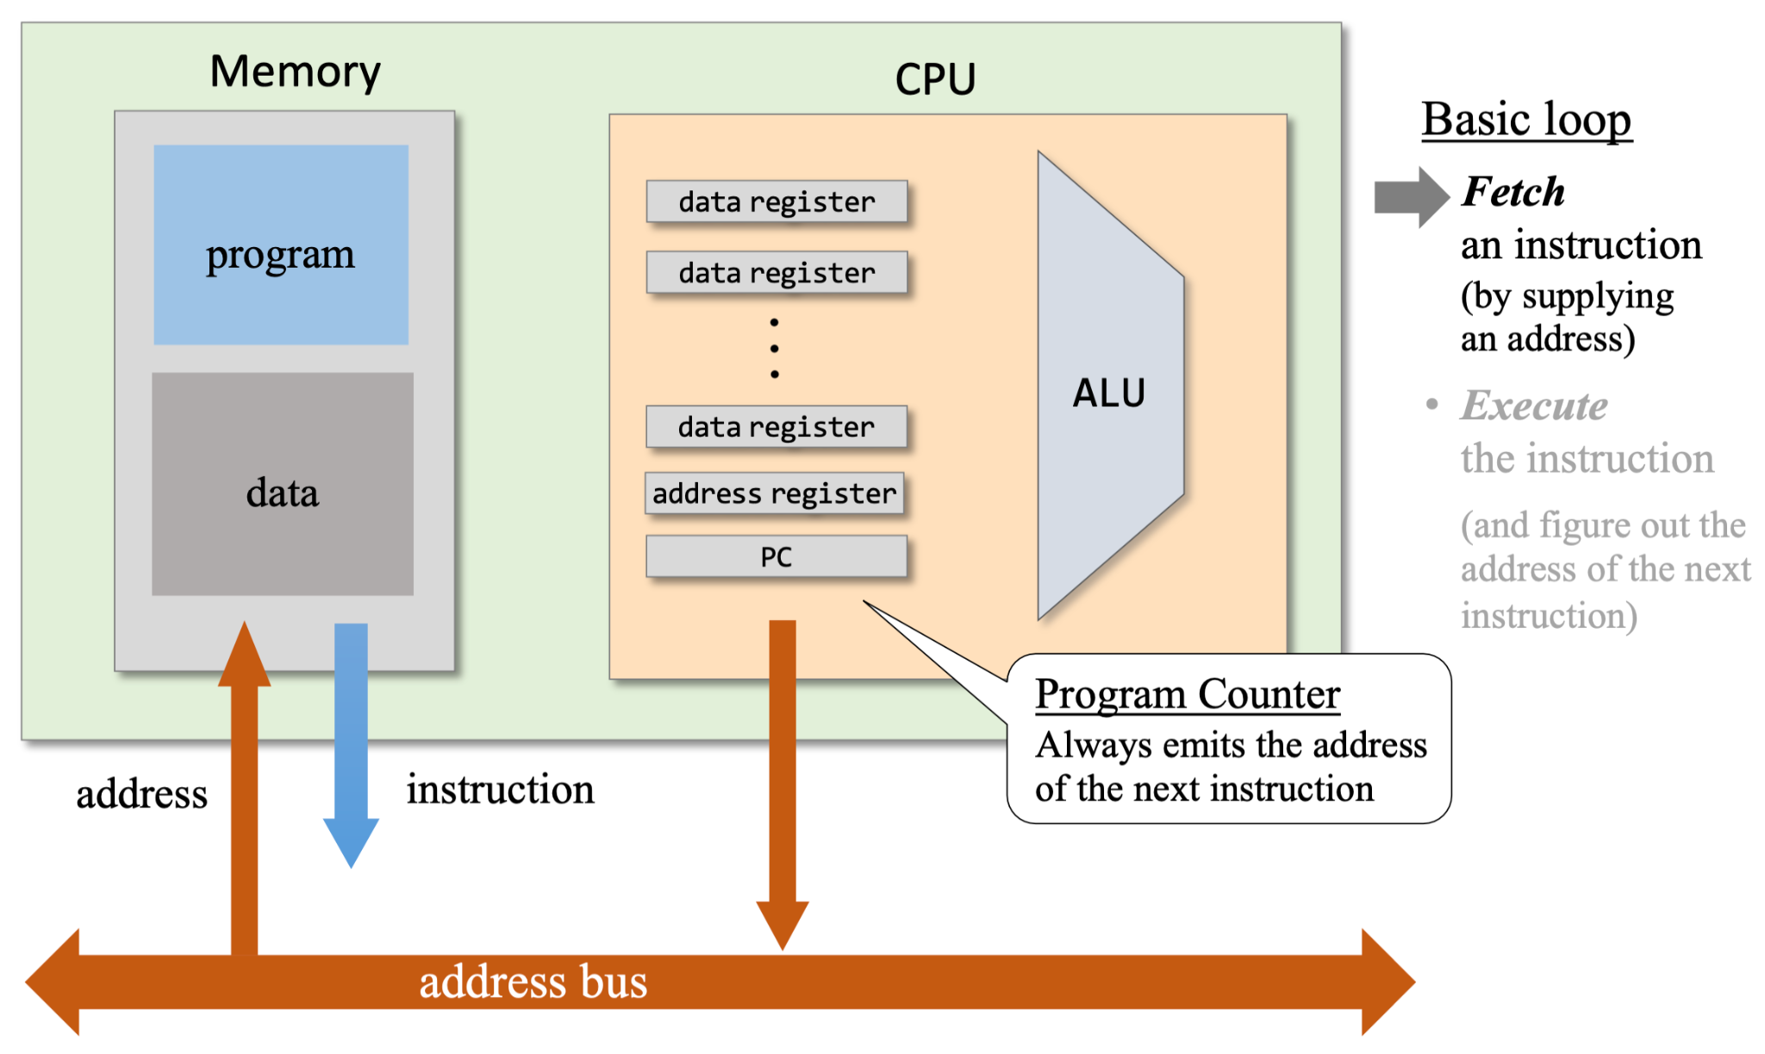
Fetching an instruction
Where should it go?
Notes:
What is the bus?

Slide 14
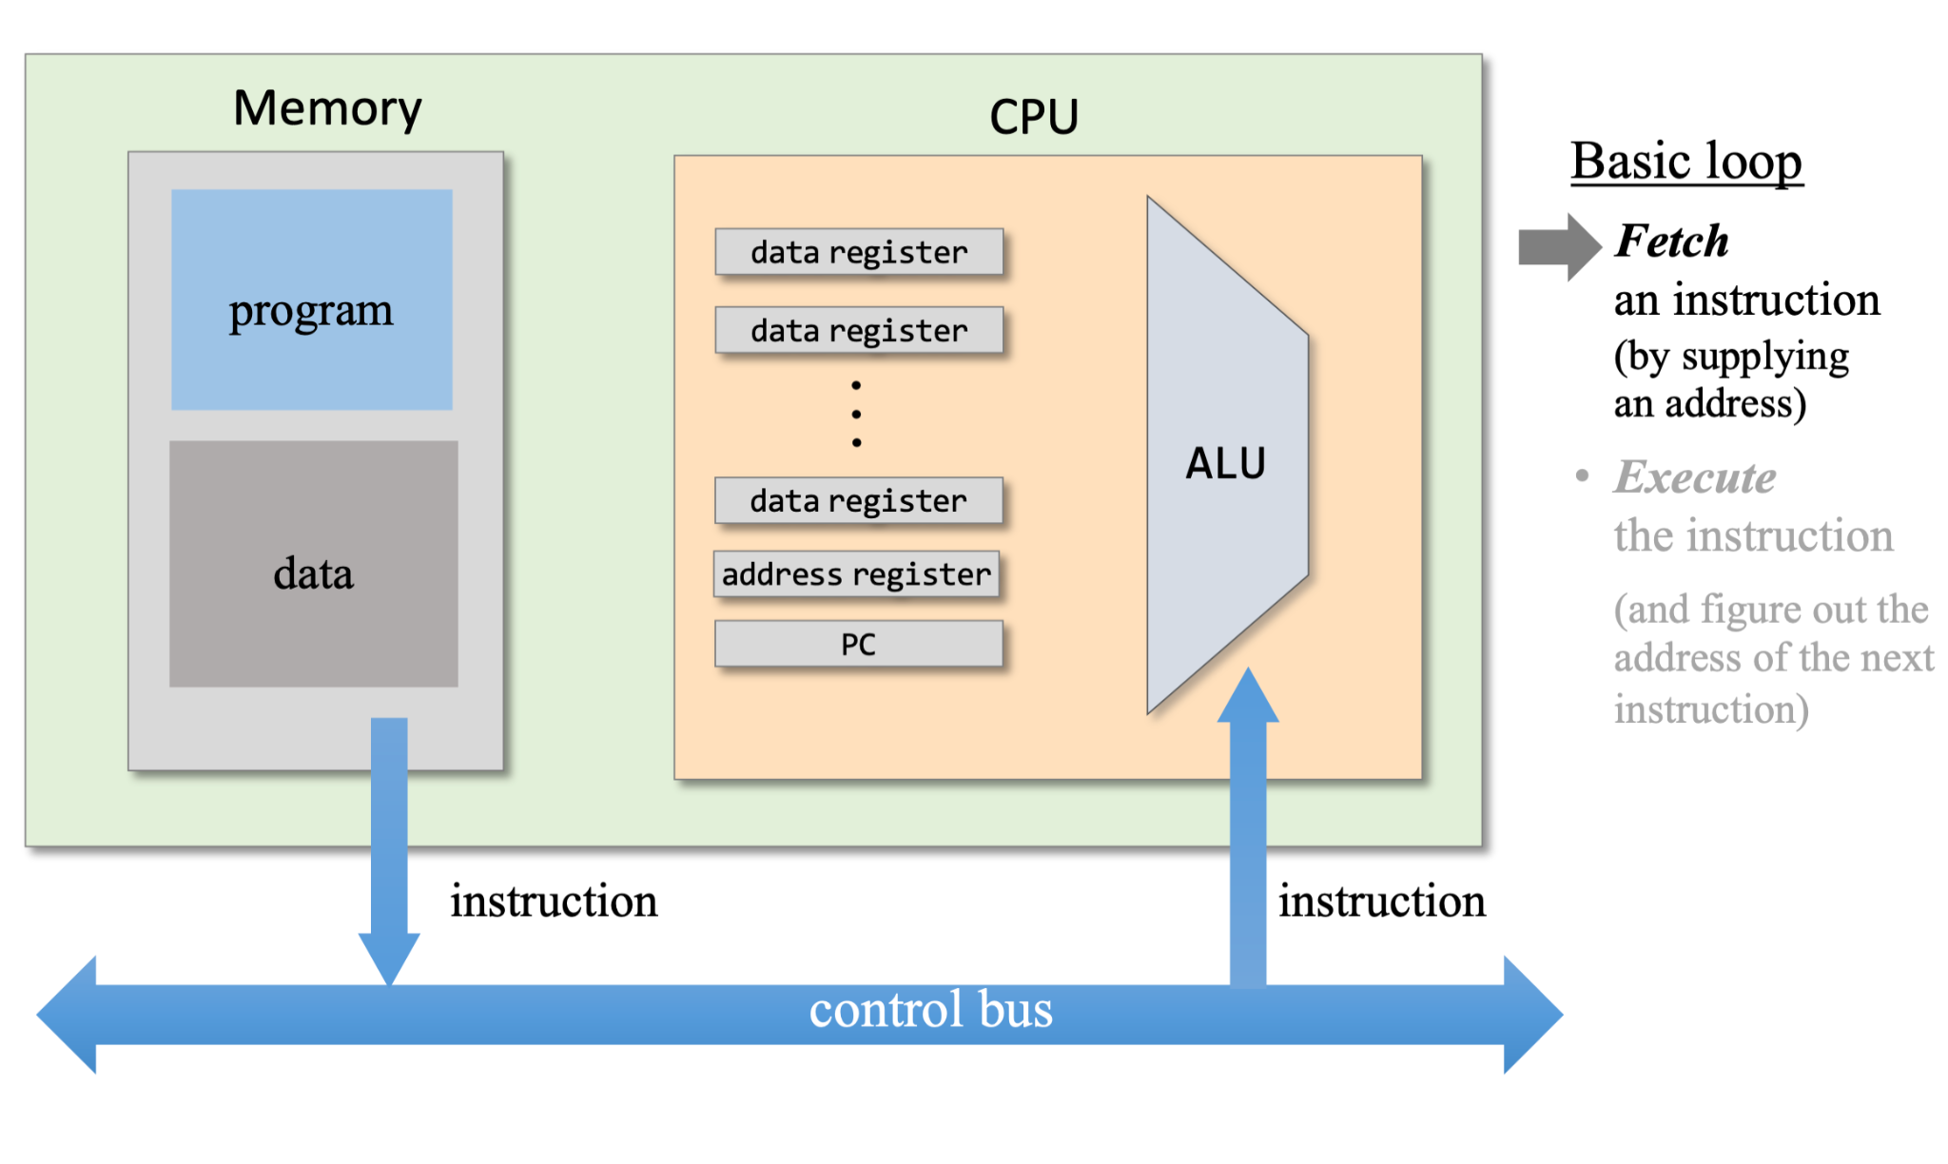
Fetching an instruction (2)

Slide 15
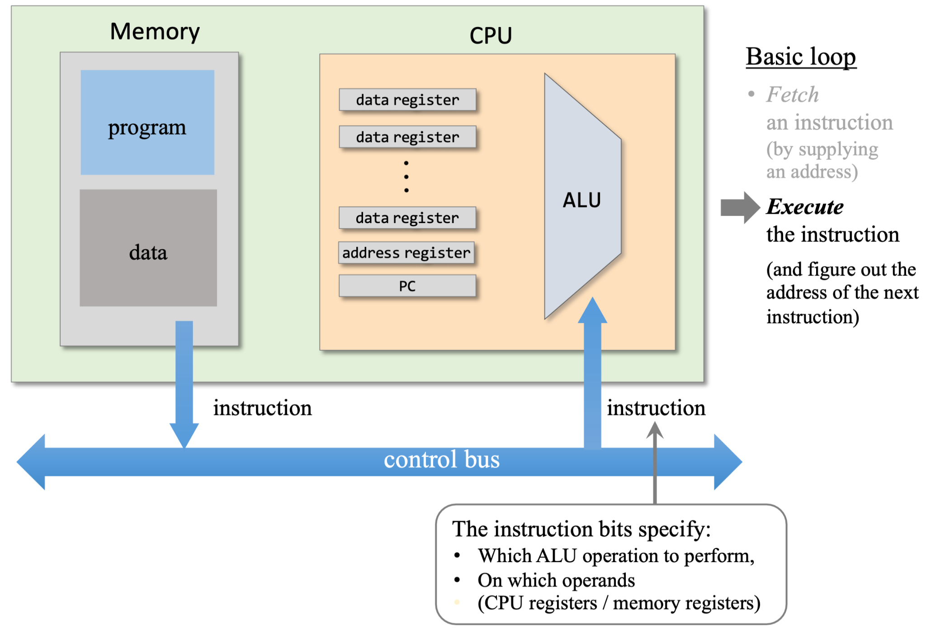
Control signals

Slide 16
What did we miss?
It's all very nice.
But what did we miss?
Do we have enough of everything to execute the command?

Slide 17
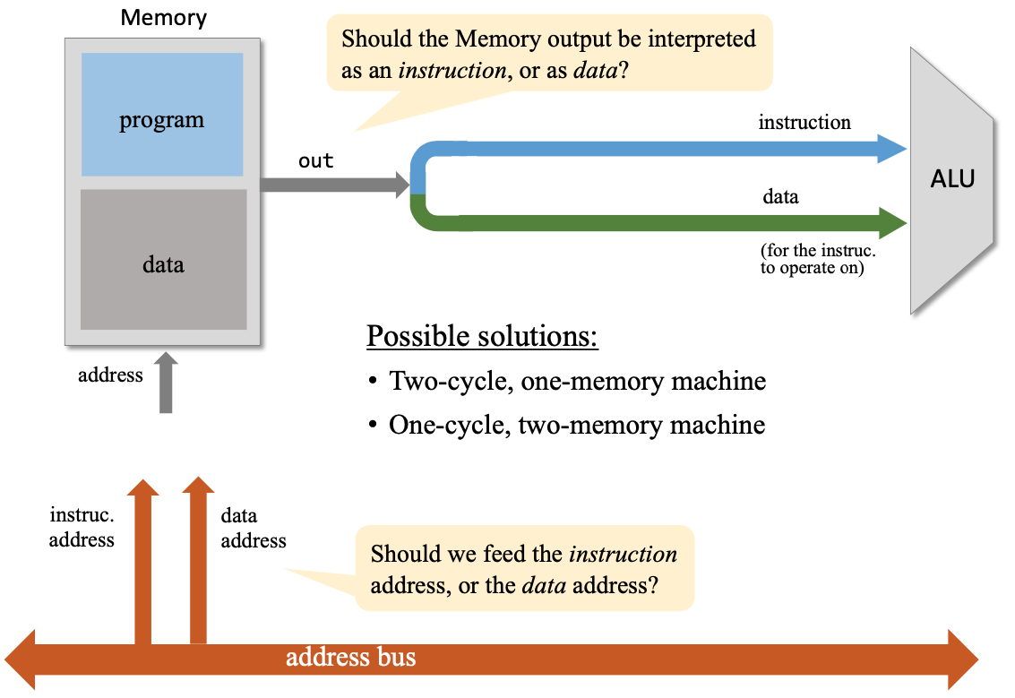
Fetch – Execute issues

Slide 18
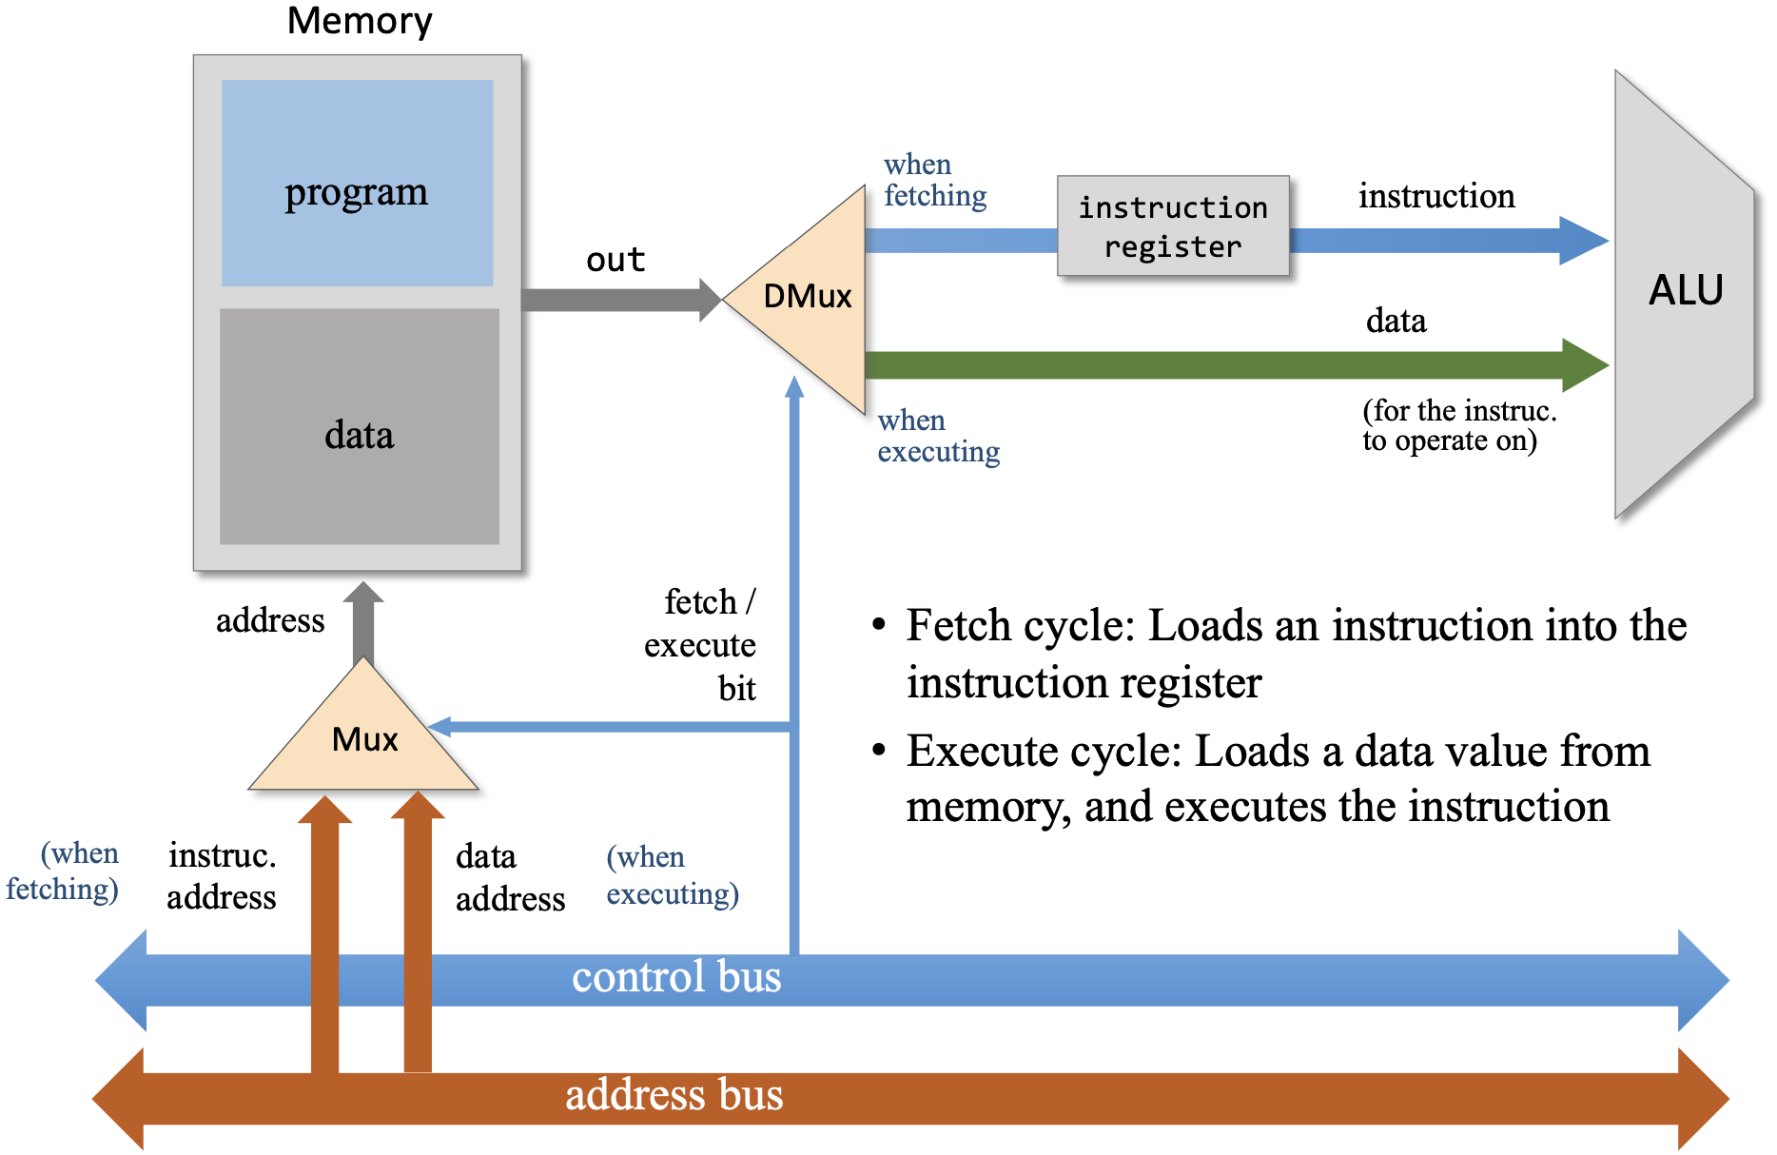
Two-cycle, one-memory machine

Slide 19
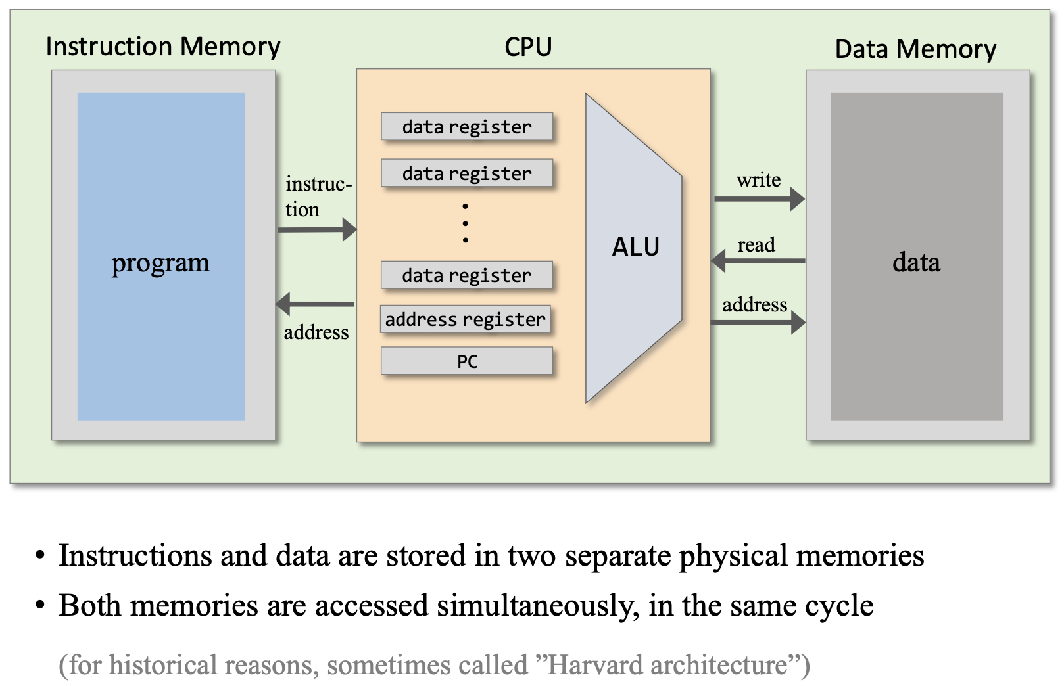
Single cycle, two-memory machine

Slide 20
Advantages and Disadvantages
Your ideas?
Guess which architecture we will choose?

Slide 21
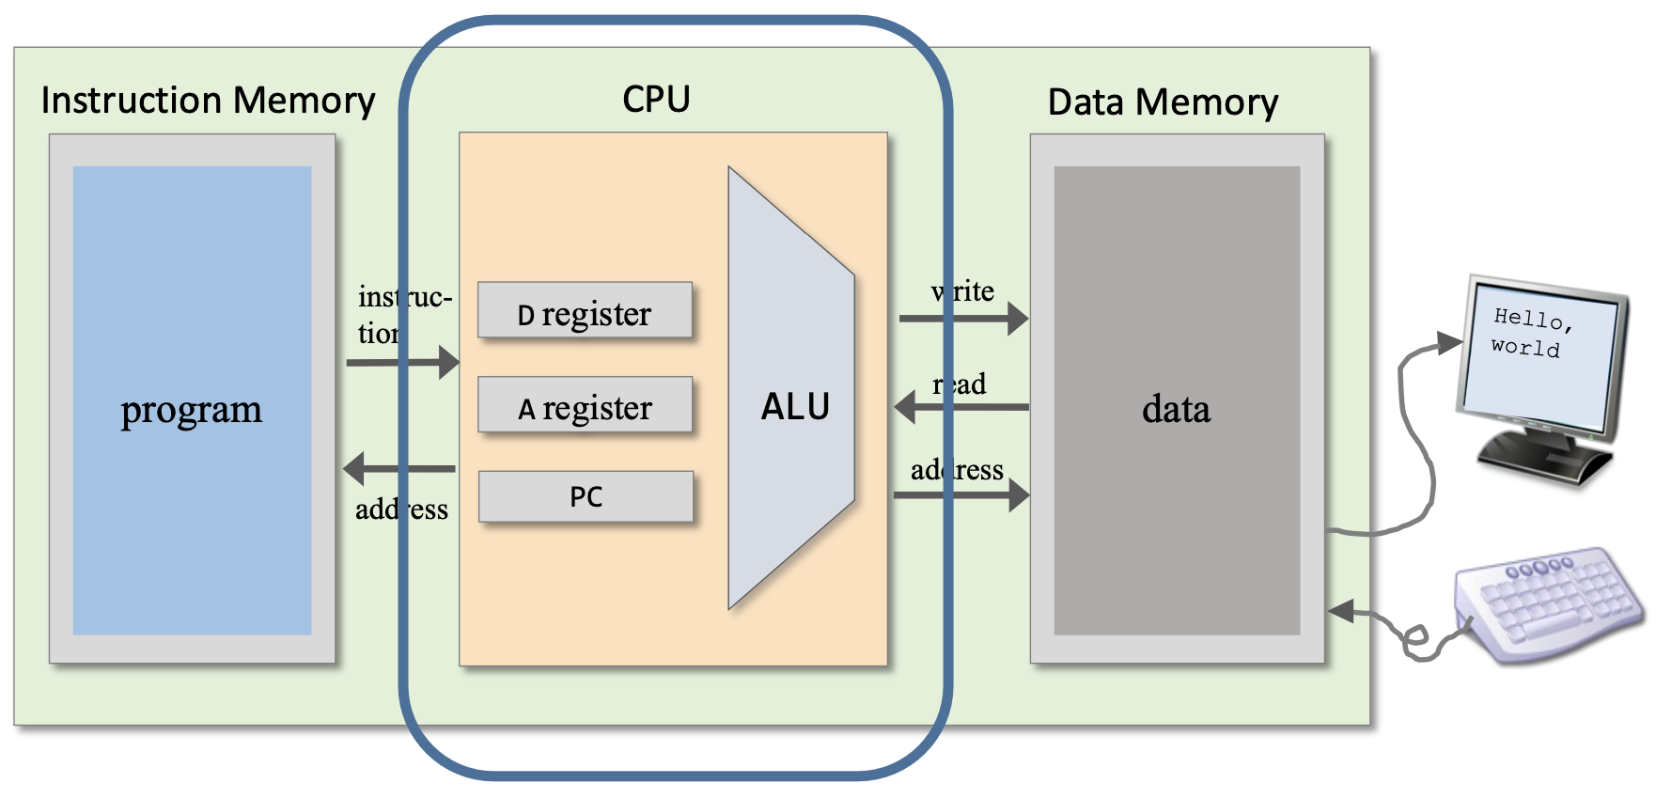
The Hack computer

Slide 22
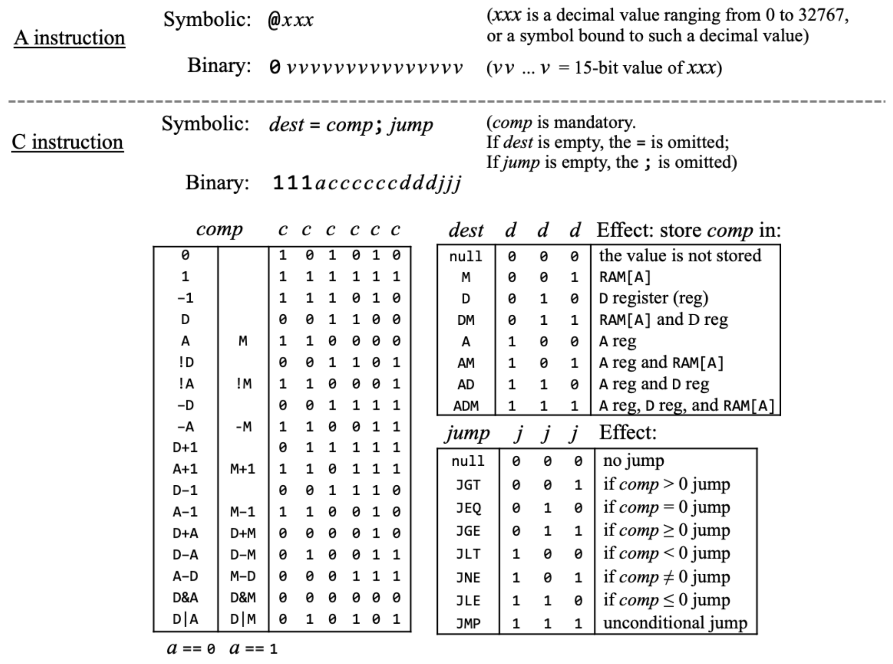
It's time to get down to the action!

Slide 23
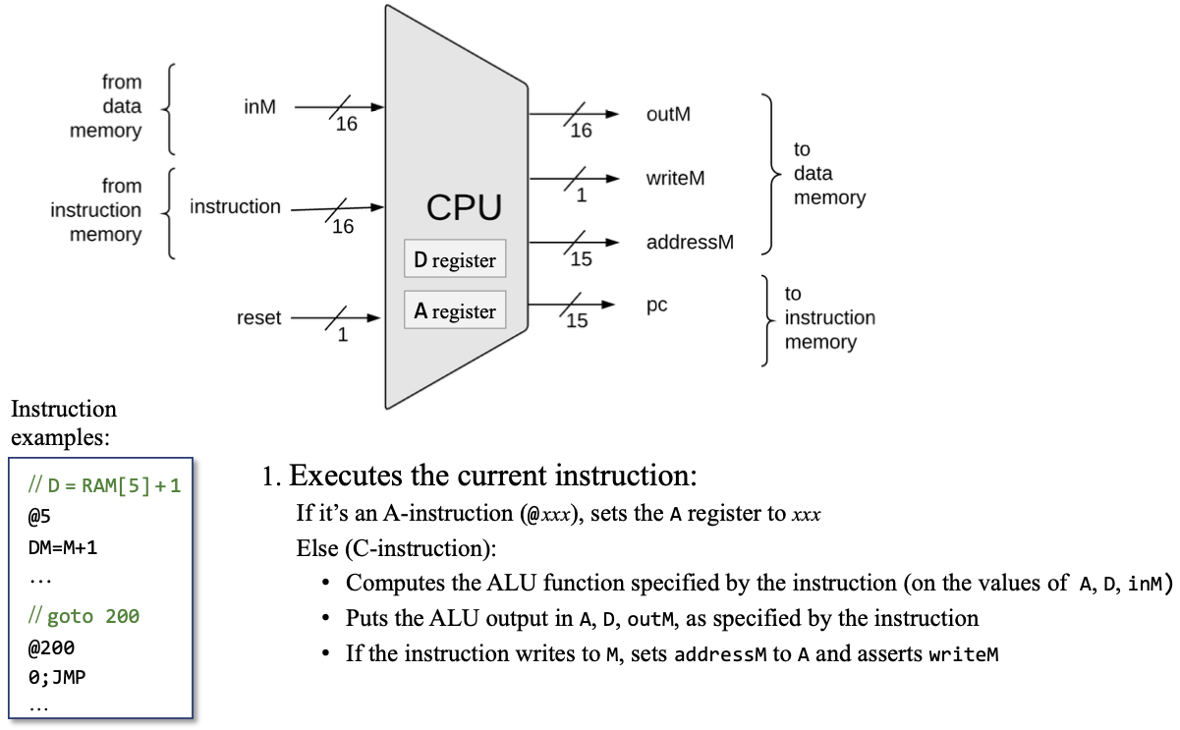
CPU abstraction: guess

Slide 24
CPU abstraction

Slide 25
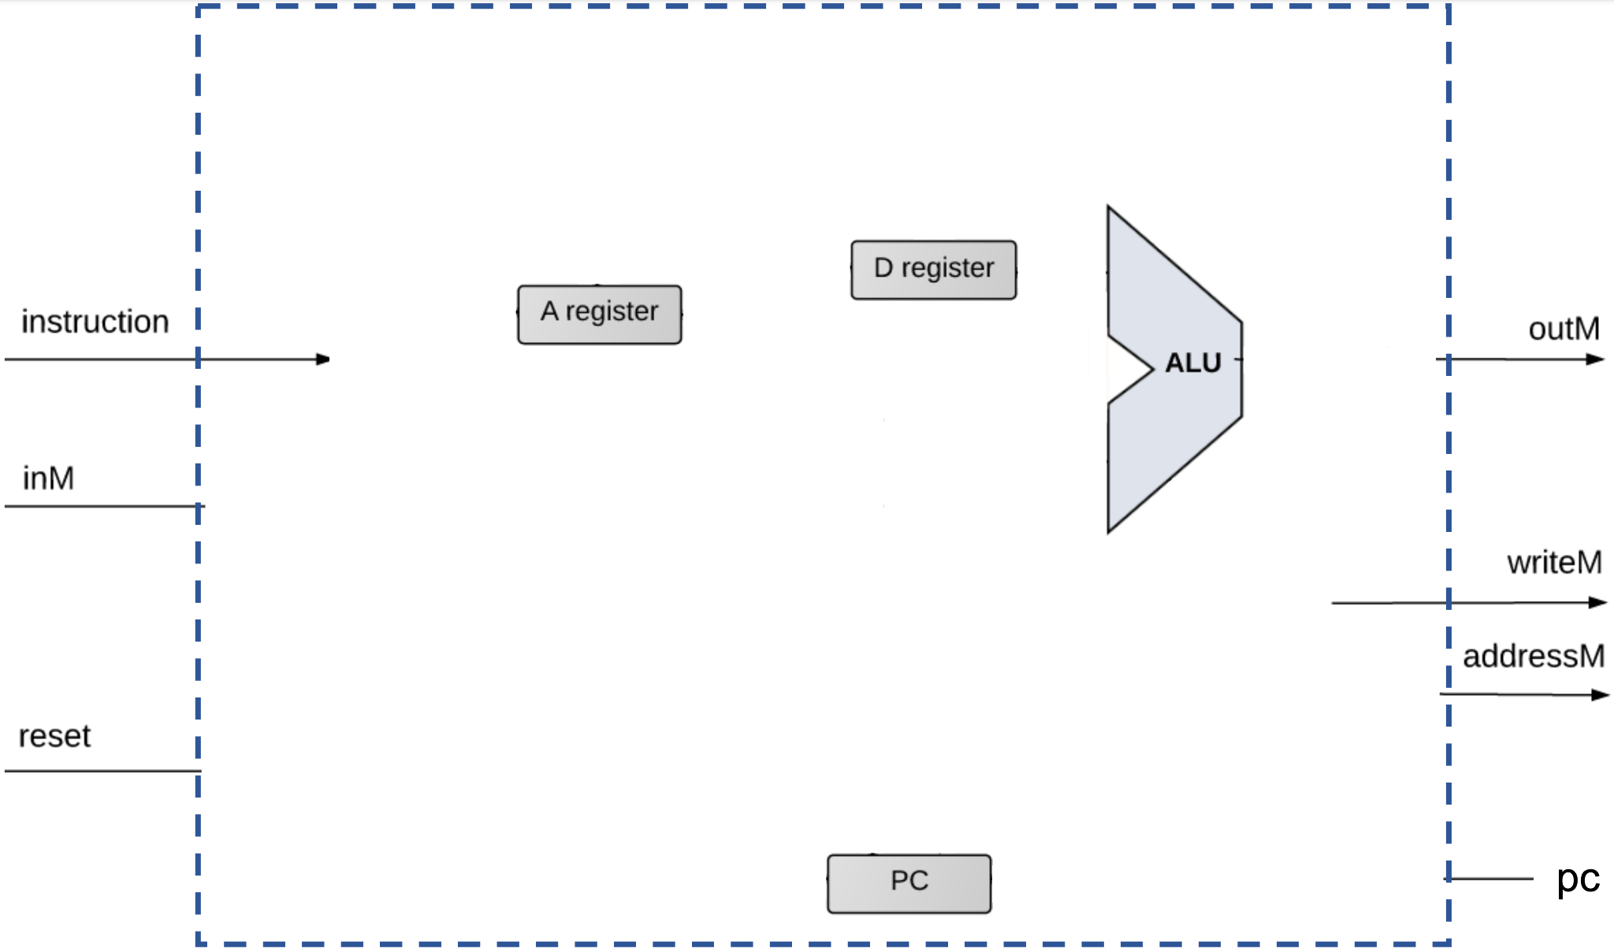

All what we need

Slide 26
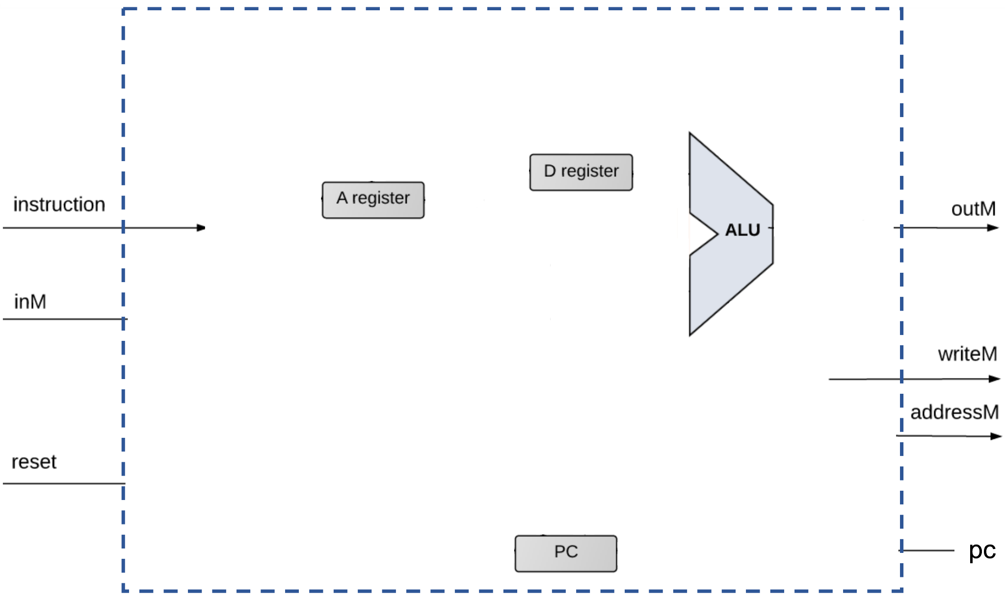

Where to add A-instruction?

Slide 27

When trigger A-register load?

Slide 28
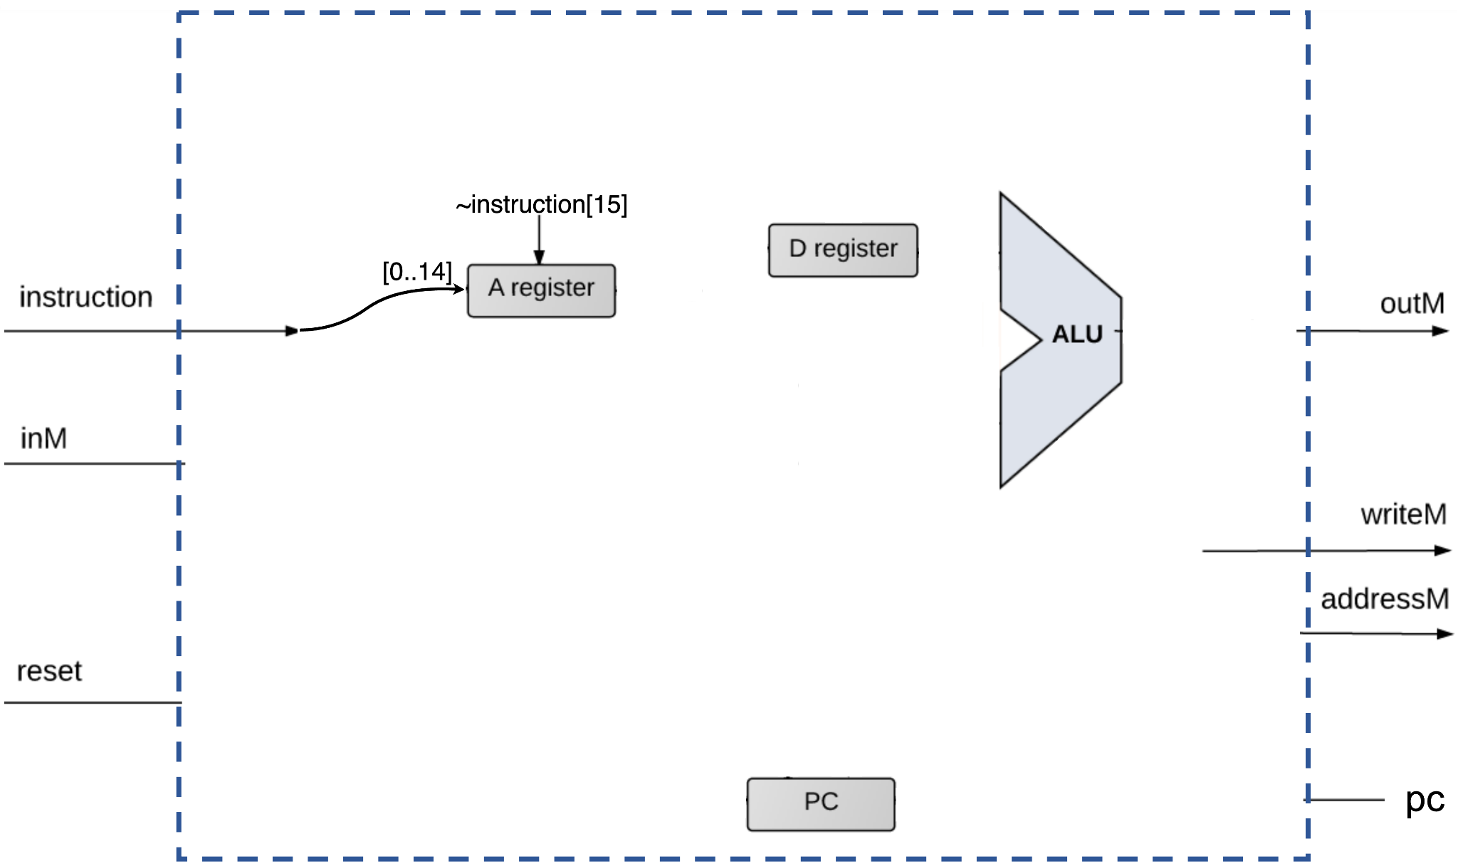
Let’s pause with A-command

Slide 29
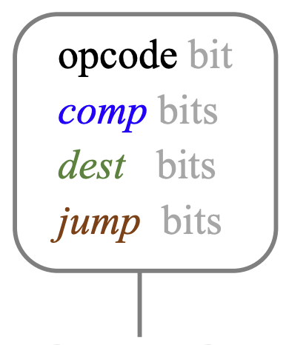
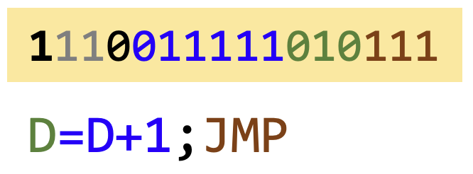
C-instruction handling
Each instruction field (opcode, comp, dest, and jump bits) is handled separately
Each group of bits is used to ”tell” a CPU chip-part what to do
opcode == instruction[15]

Slide 30
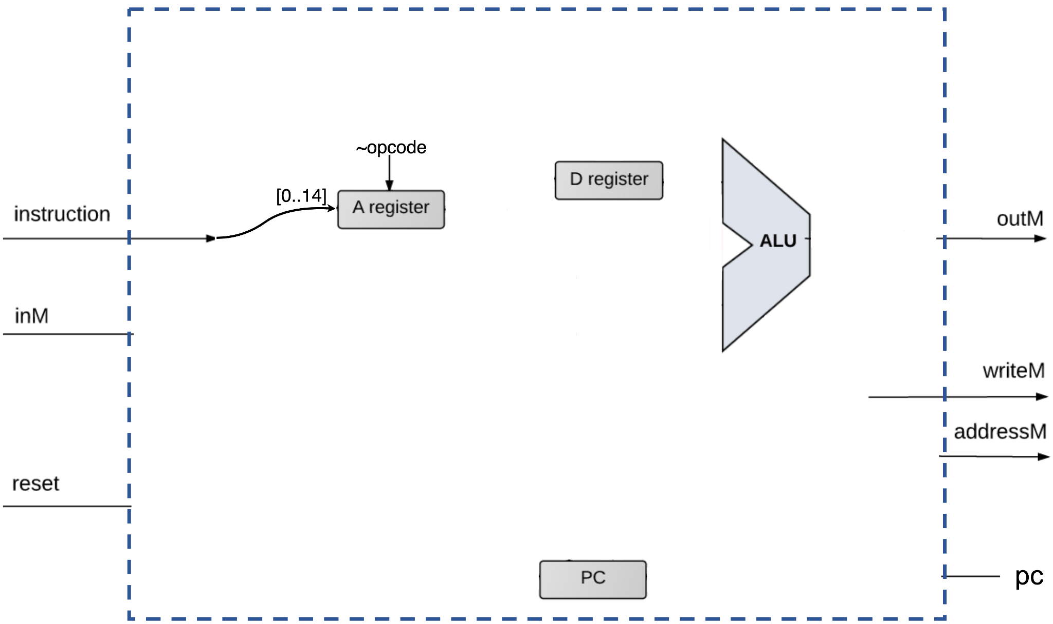
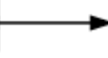
Where we need comp?

Slide 31

What should we do with a result? (dest)

Slide 32
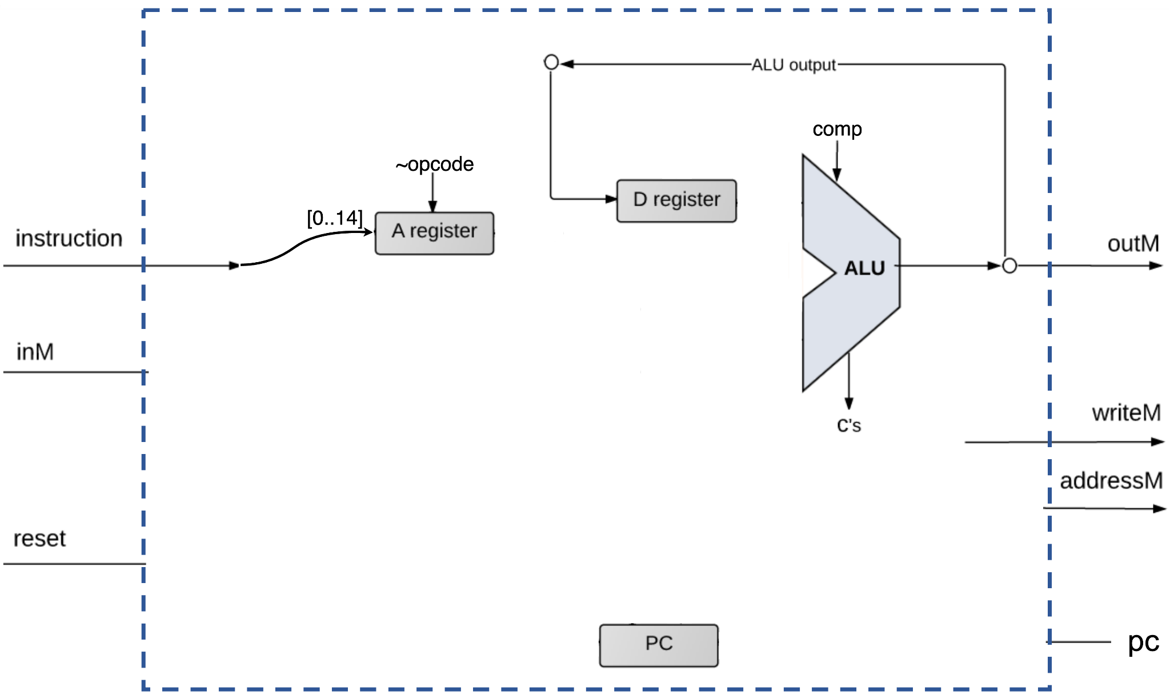
Nice!

Slide 33
When trigger D-register load?

Slide 34
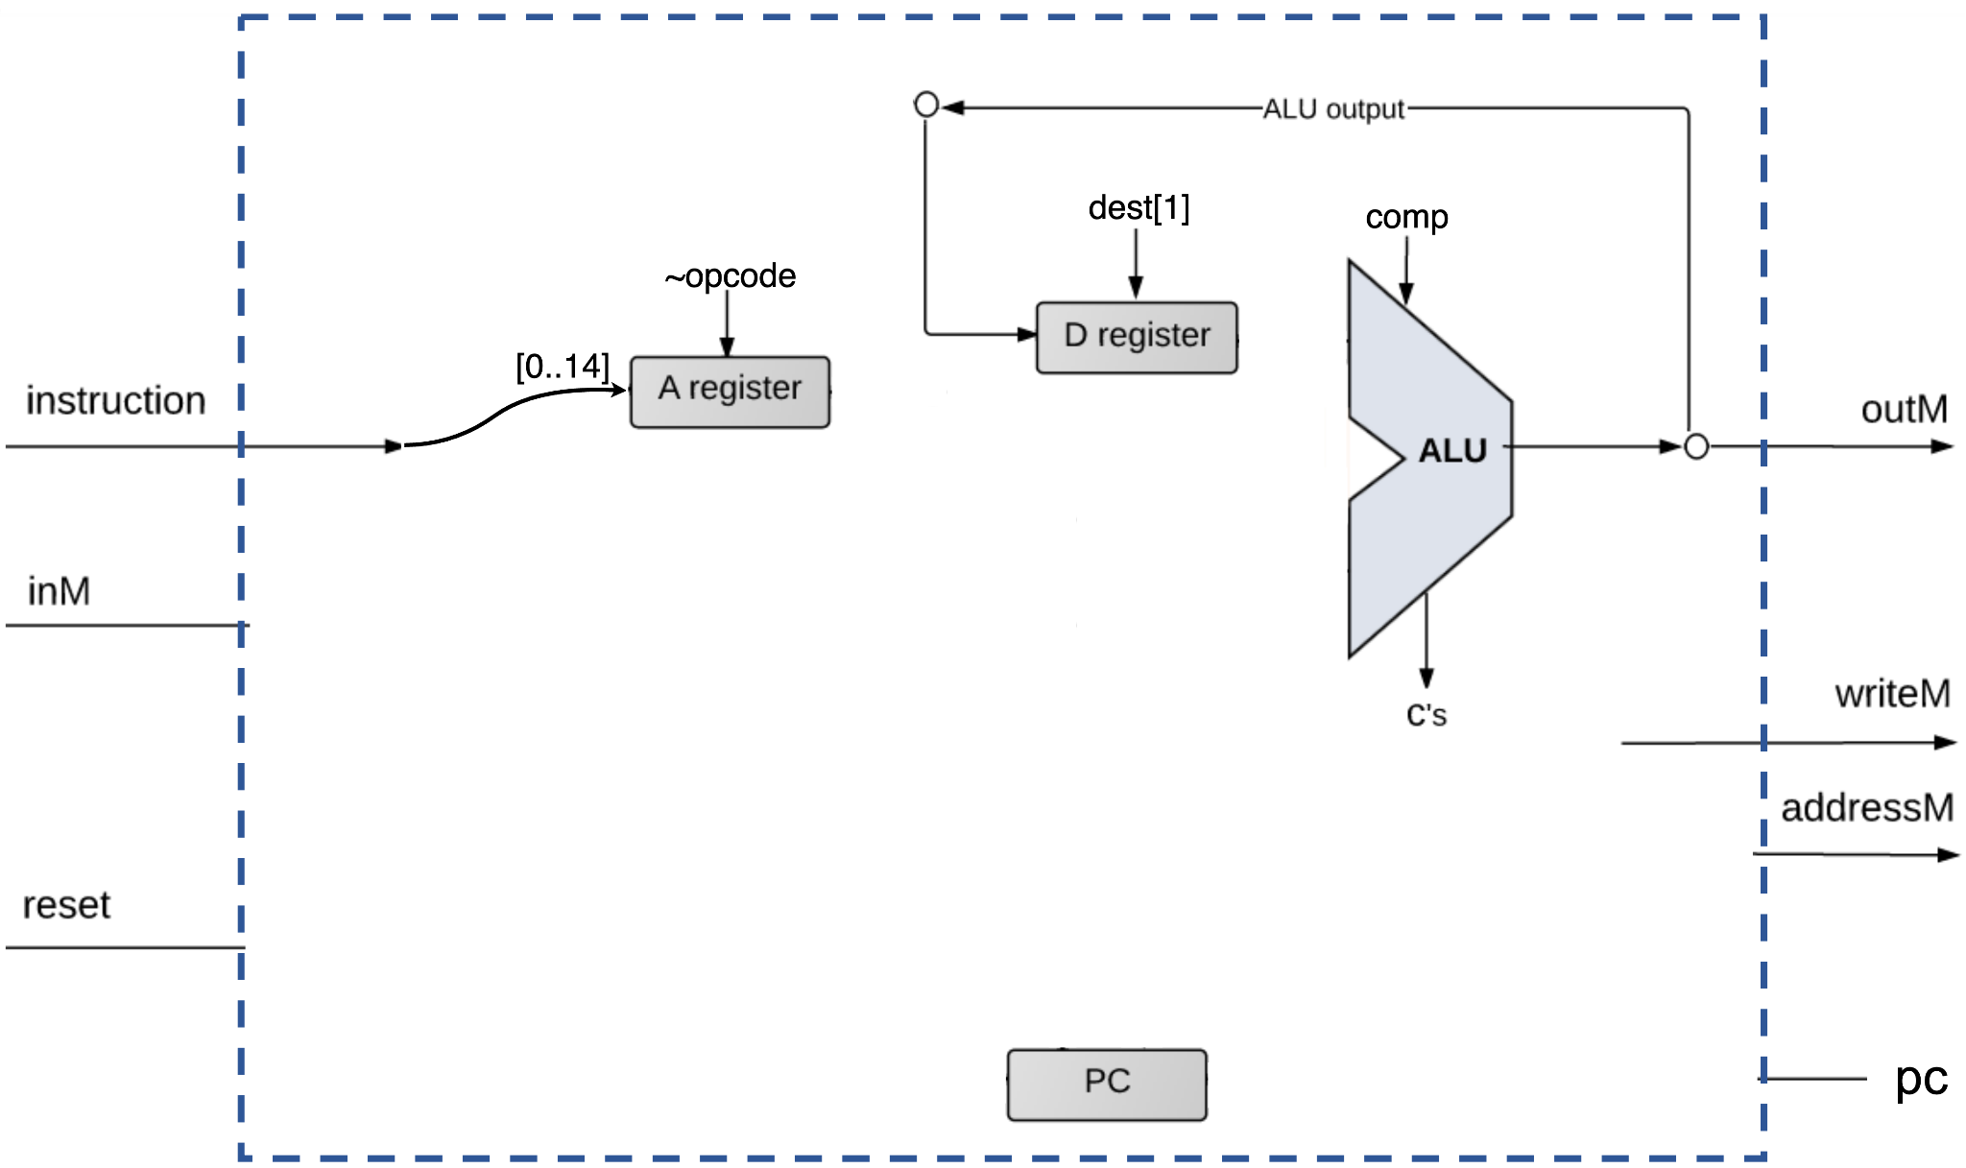
Nice!

Slide 35
What if the destination is A-register?

Slide 36
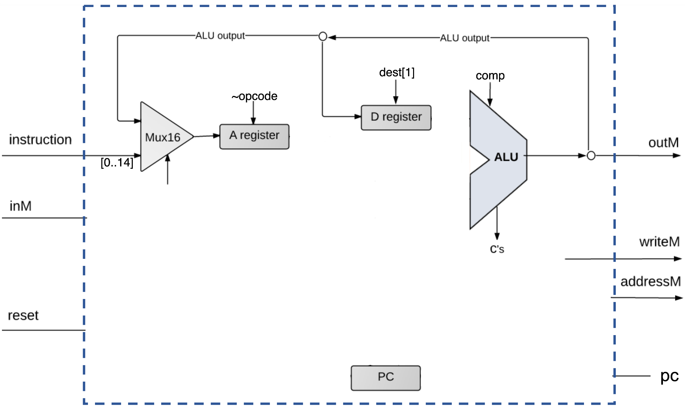
How to control this multiplexer?

Slide 37
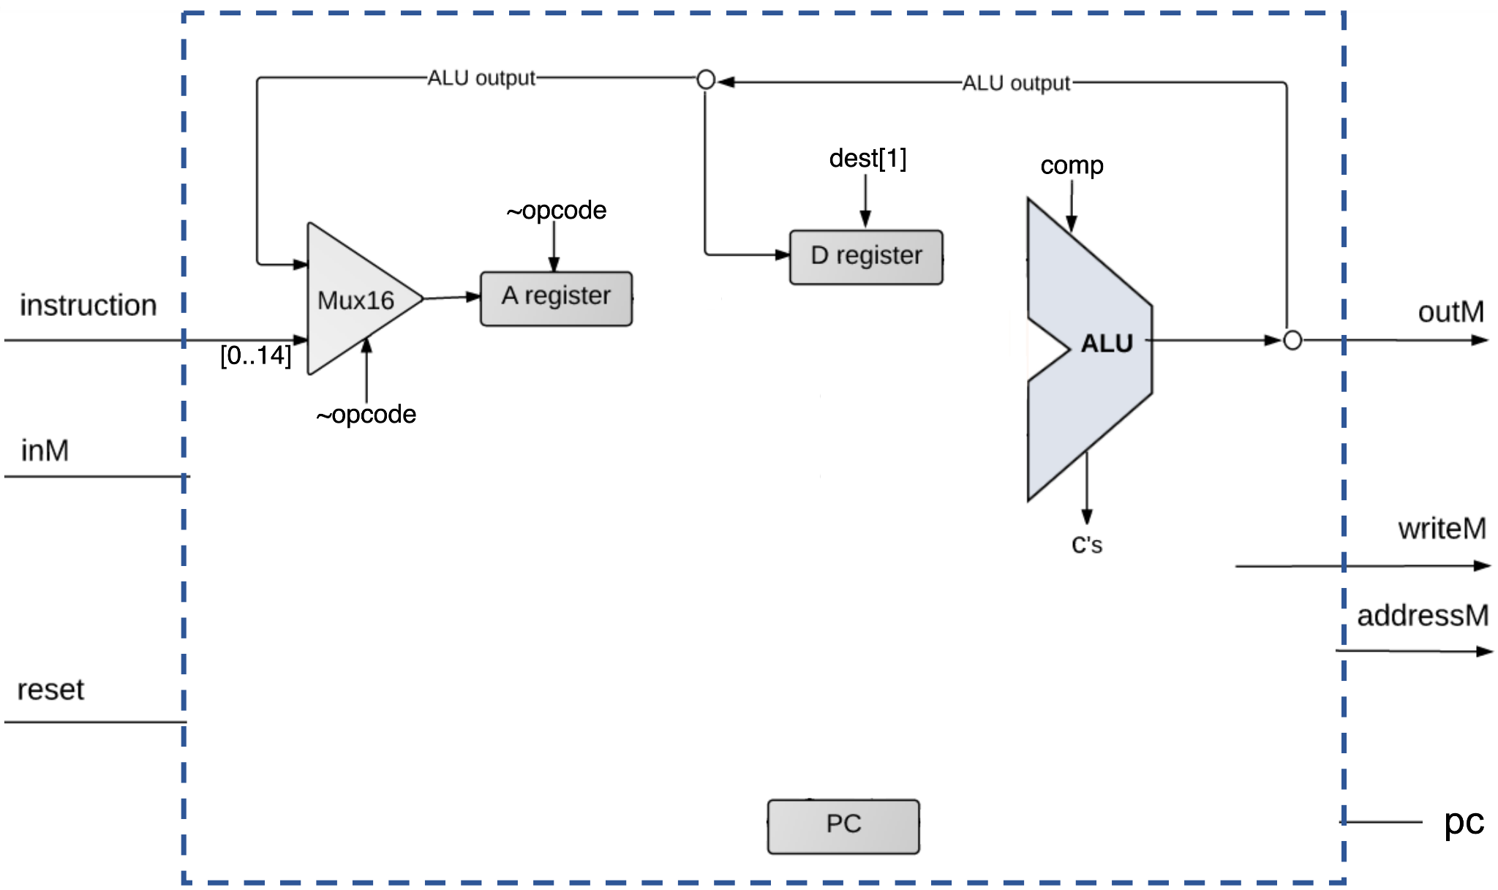
Is A-register control still correct?

Slide 38

What about write to the memory?
Notes:
OR!!!!

Slide 39
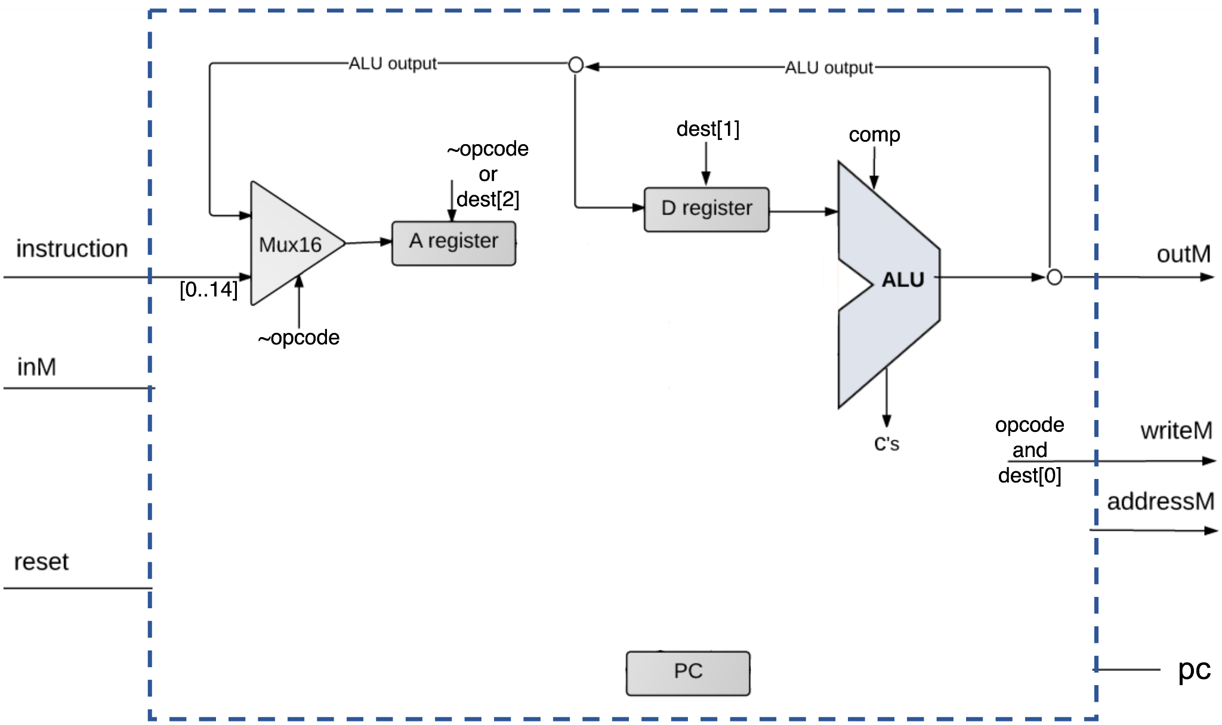
What about write to the memory?
Notes:
opcode!!!

Slide 40
Nice! But what about D+A?

Slide 41
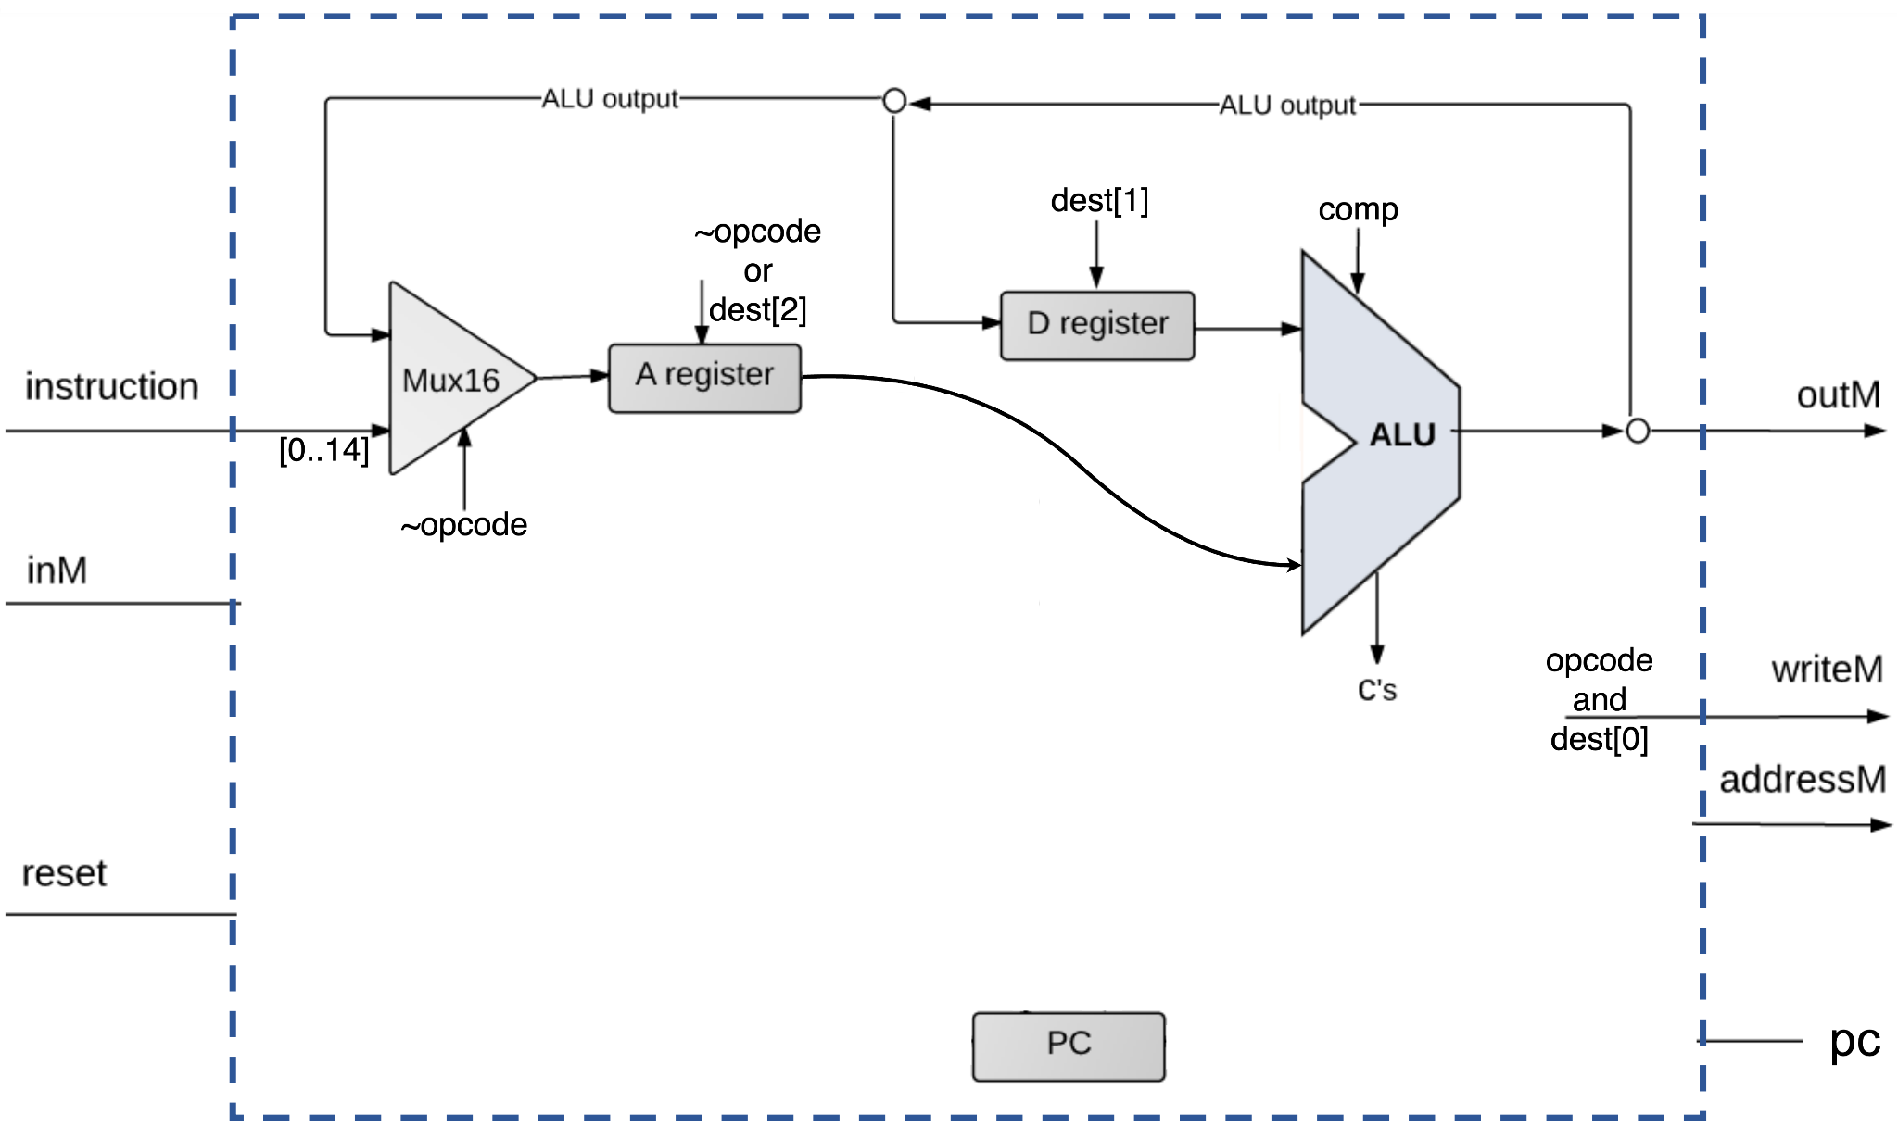
Easy! D+M?

Slide 42
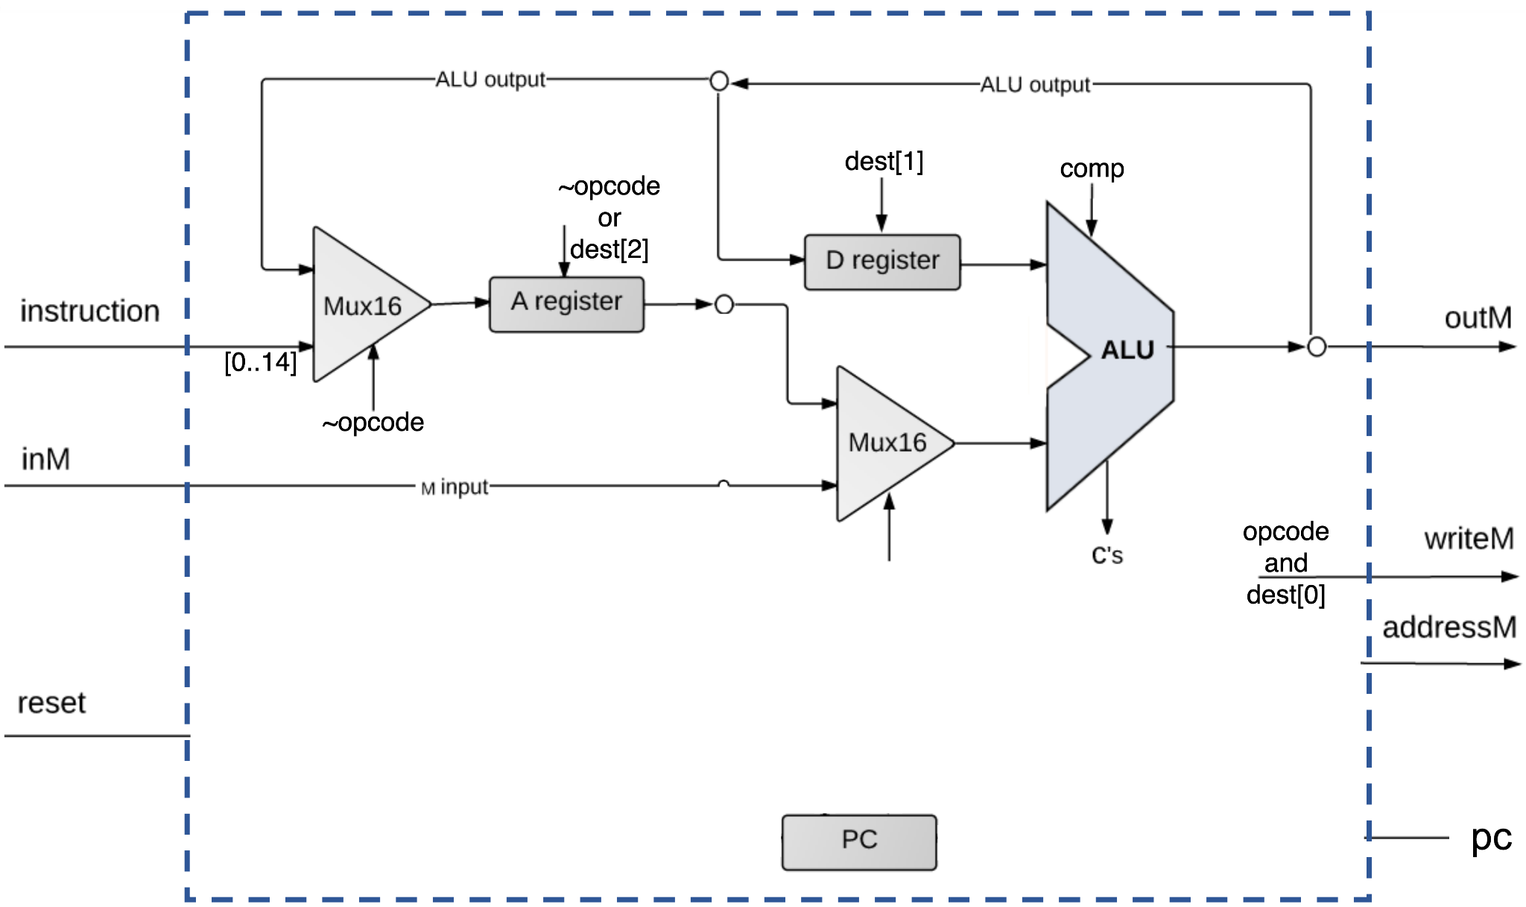
Nice! Let’s connect addresM!

Slide 43
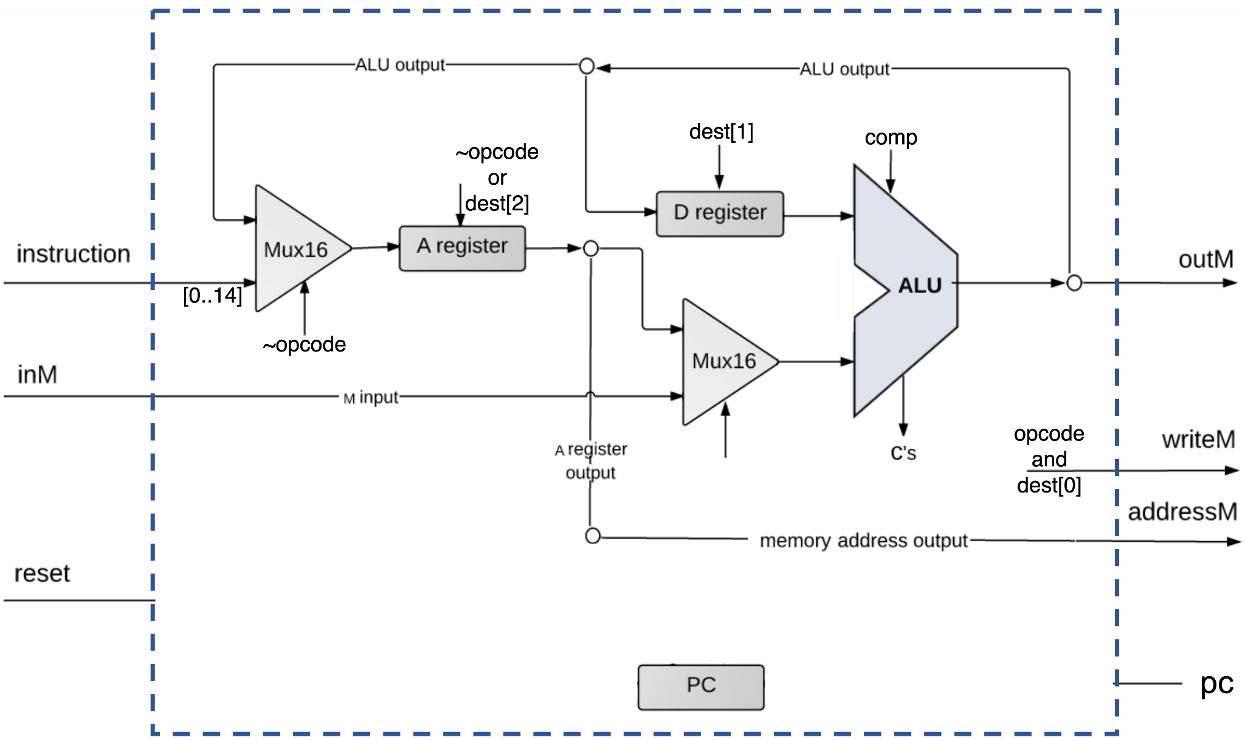
Cool!

Slide 44
Now let’s talk about jumps!

Slide 45
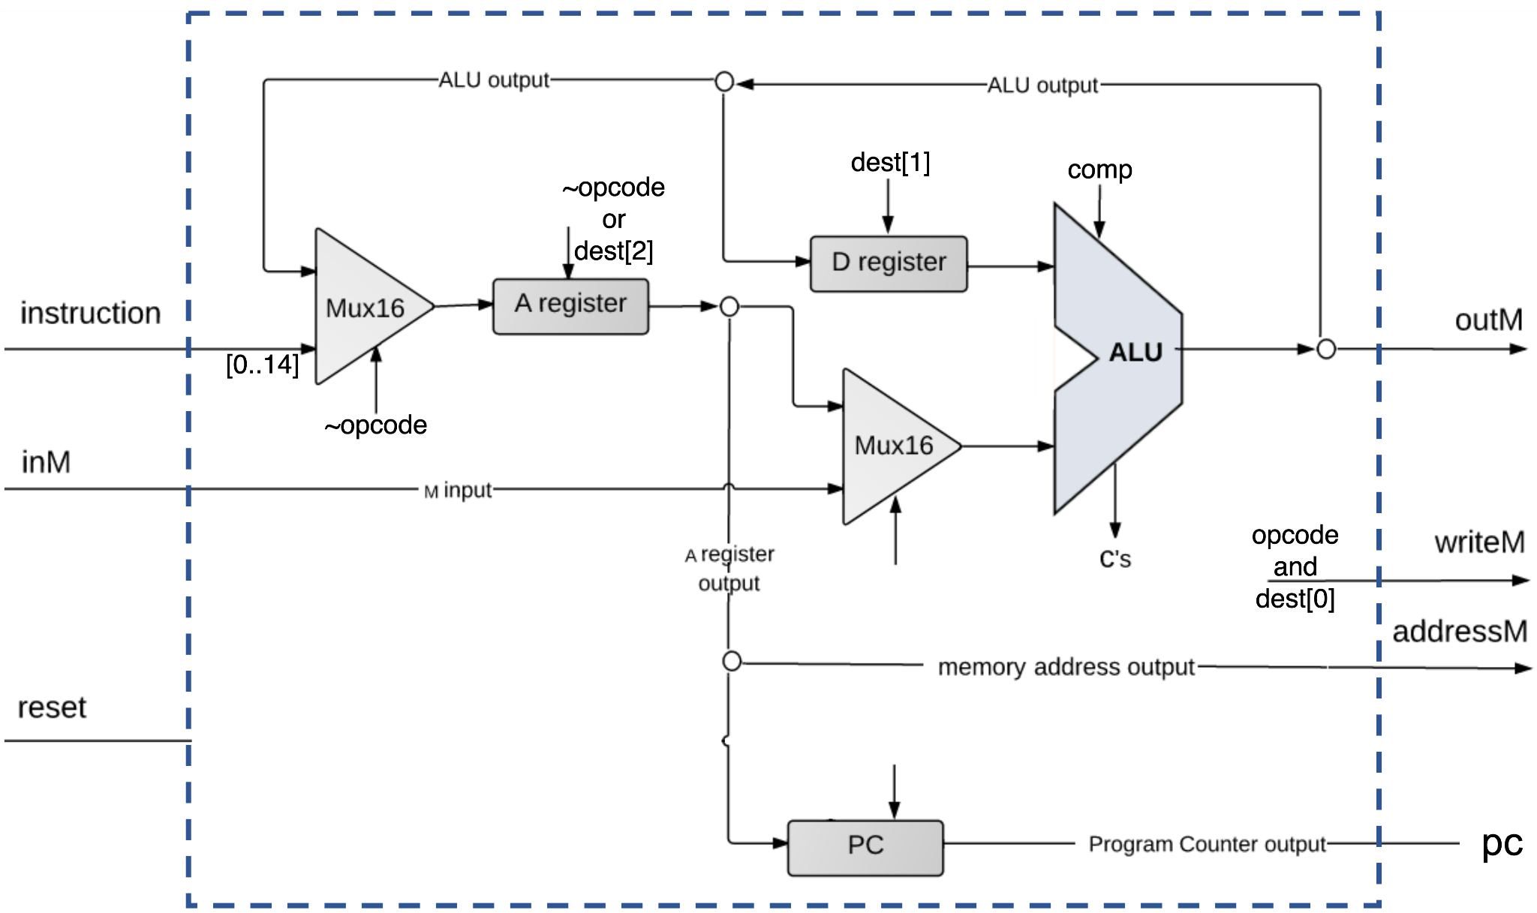
How to reset our processor?

Slide 46

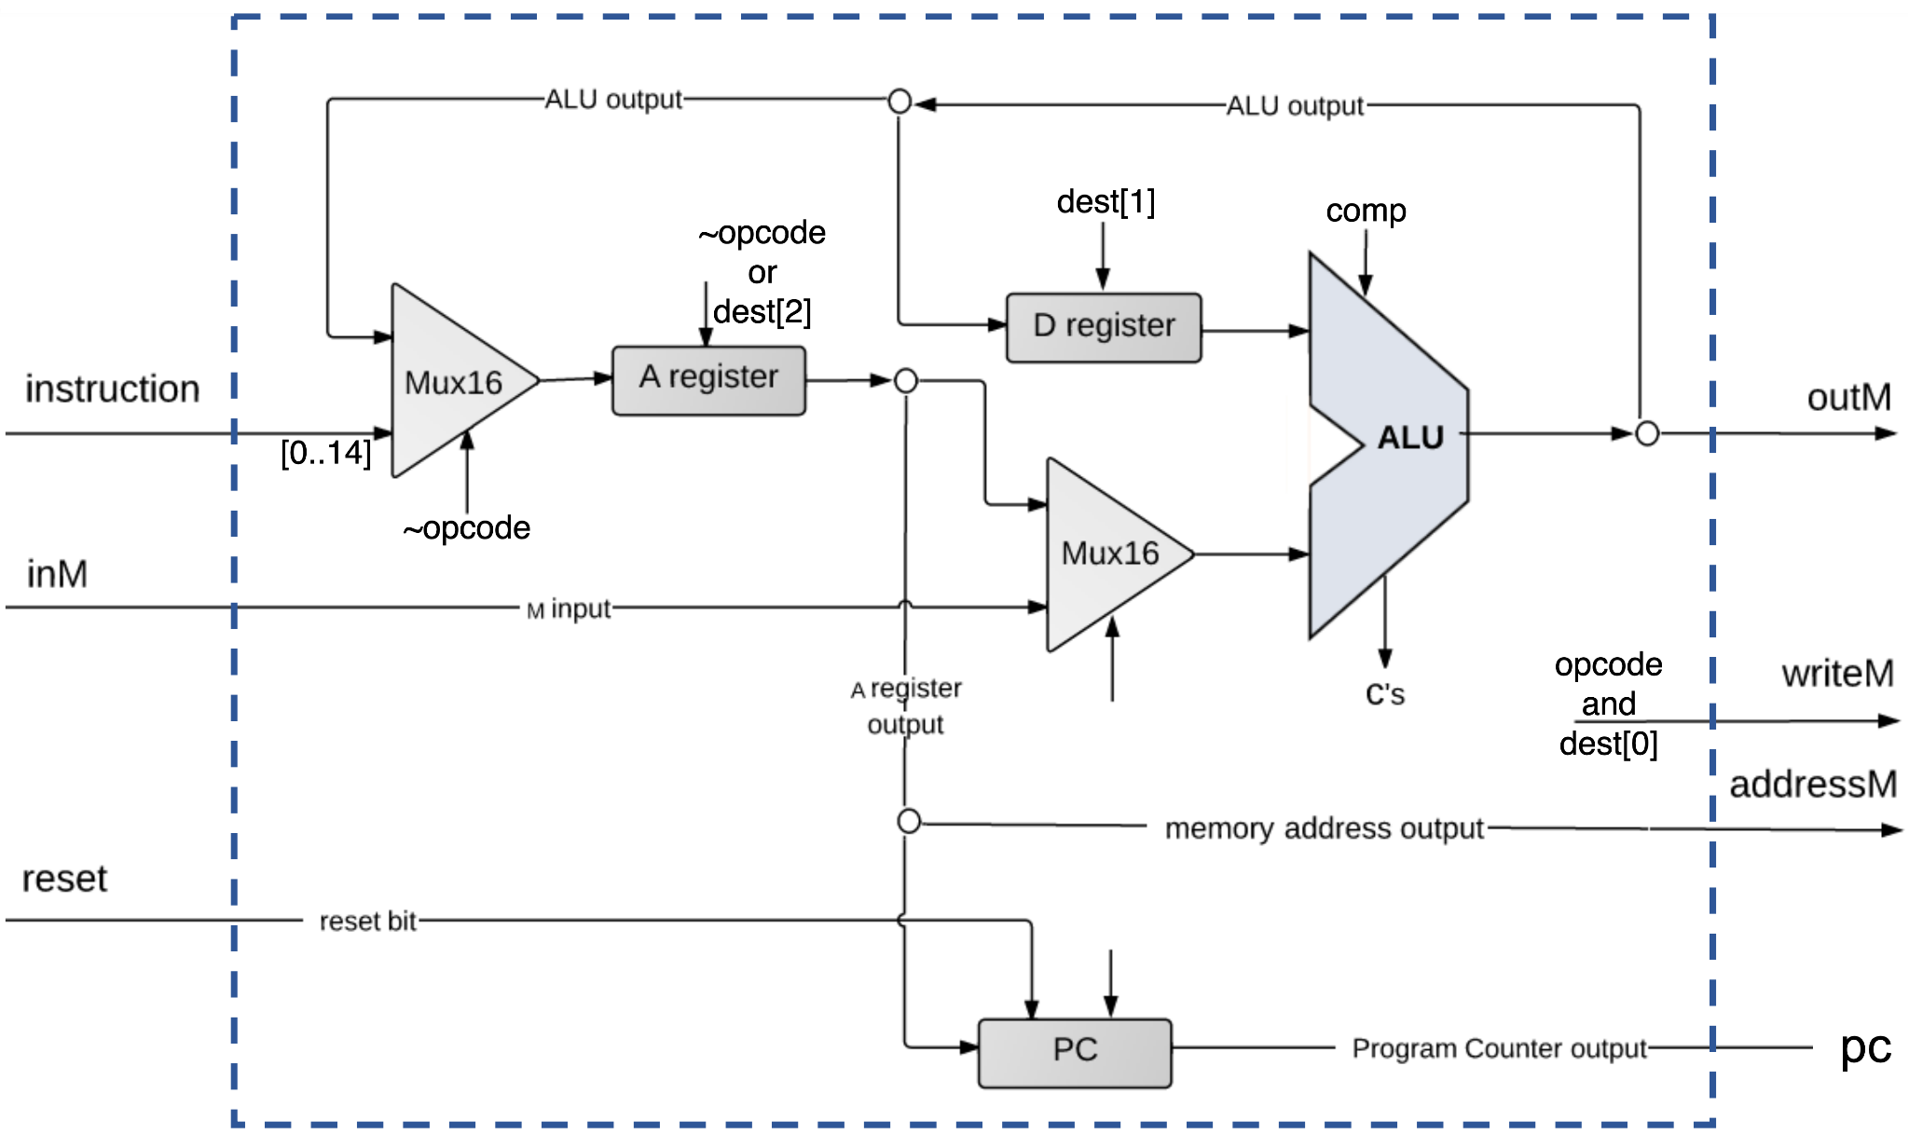
TADA!!!!

Slide 47
Data path design finished!

Slide 48
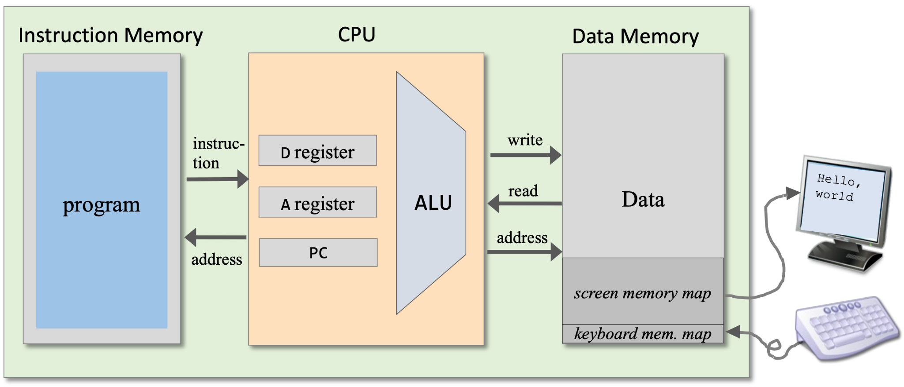
I/O devices

Slide 49
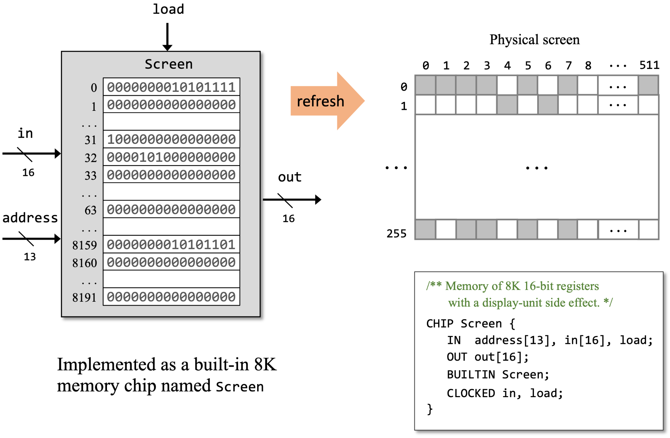
Screen

Slide 50
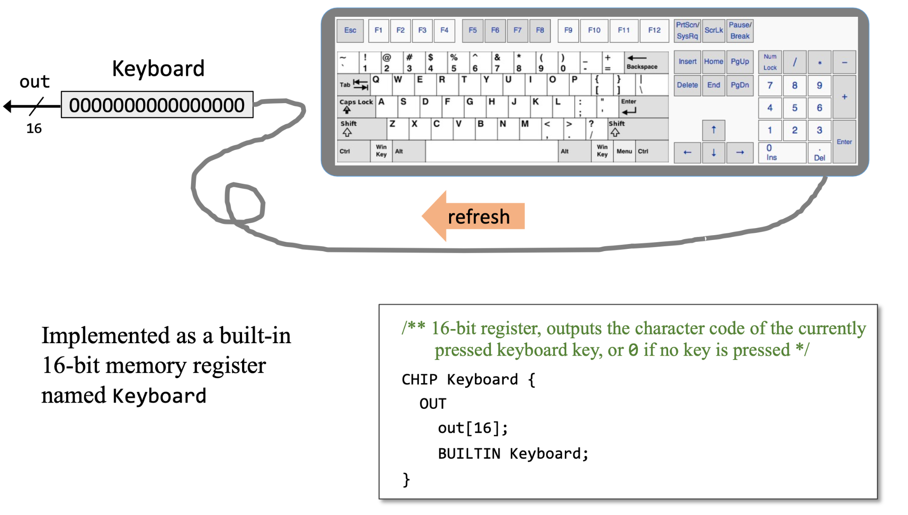
Keyboard

Slide 51
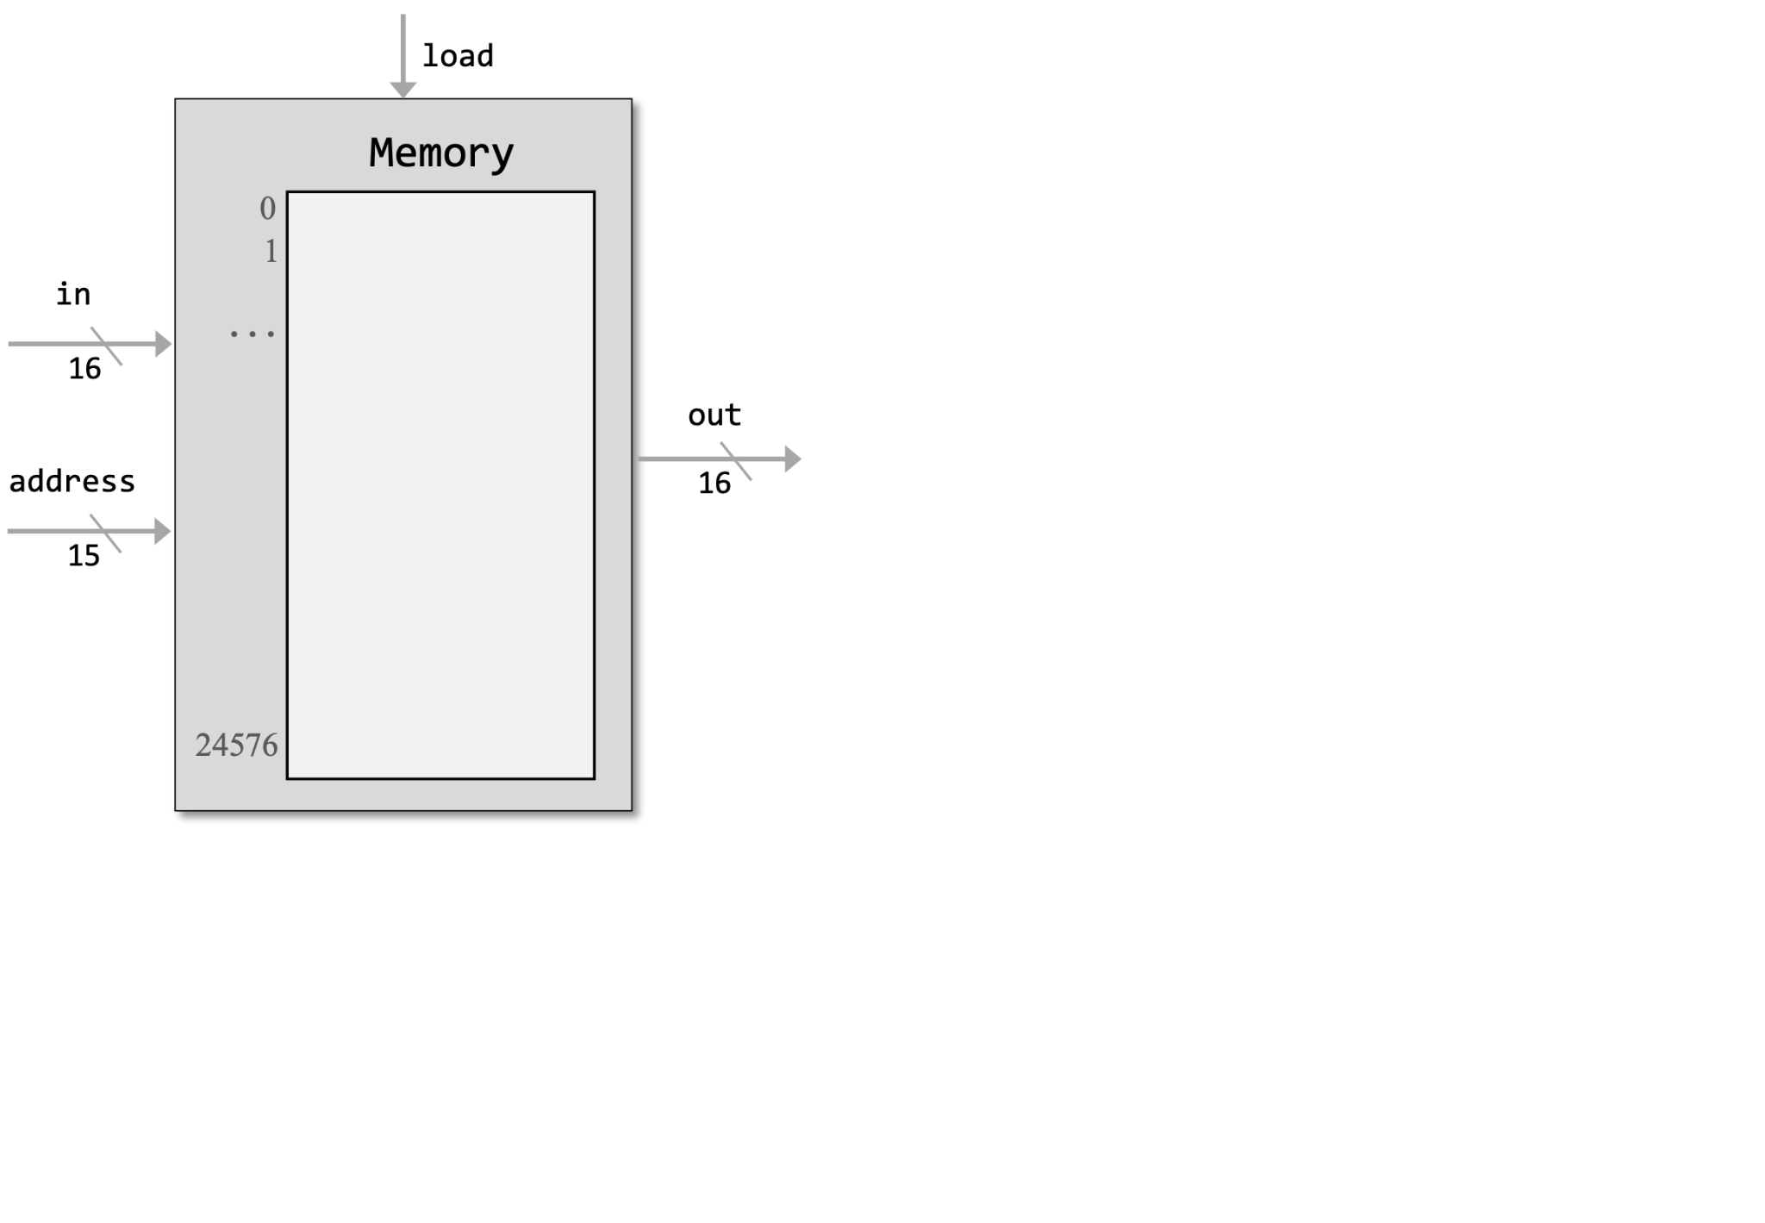
How to implement memory?

Slide 52
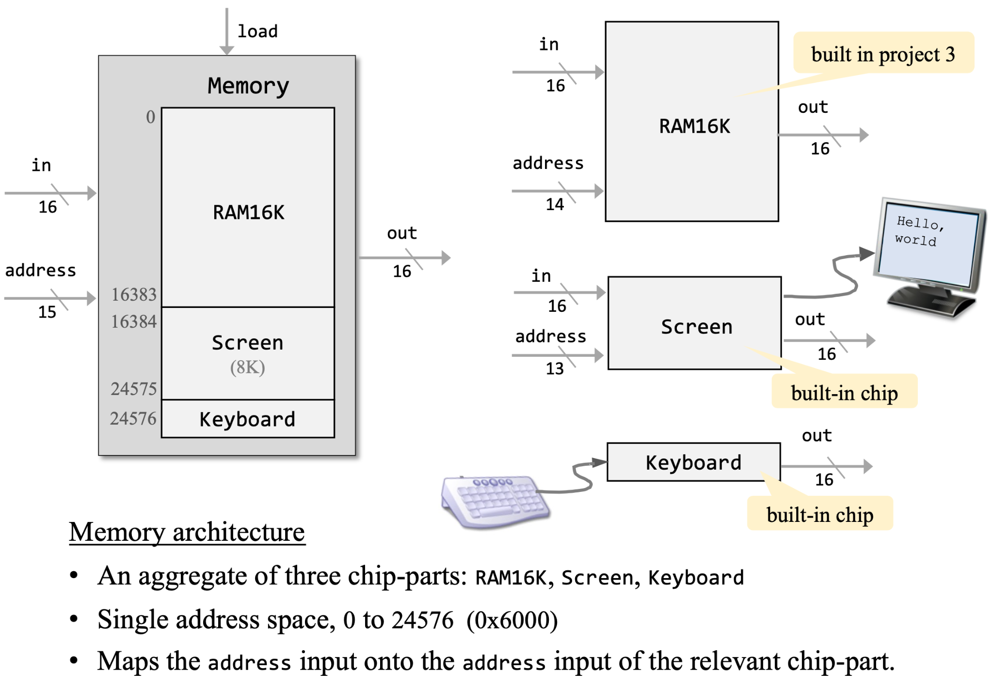
Now the memory has a wrap

Slide 53
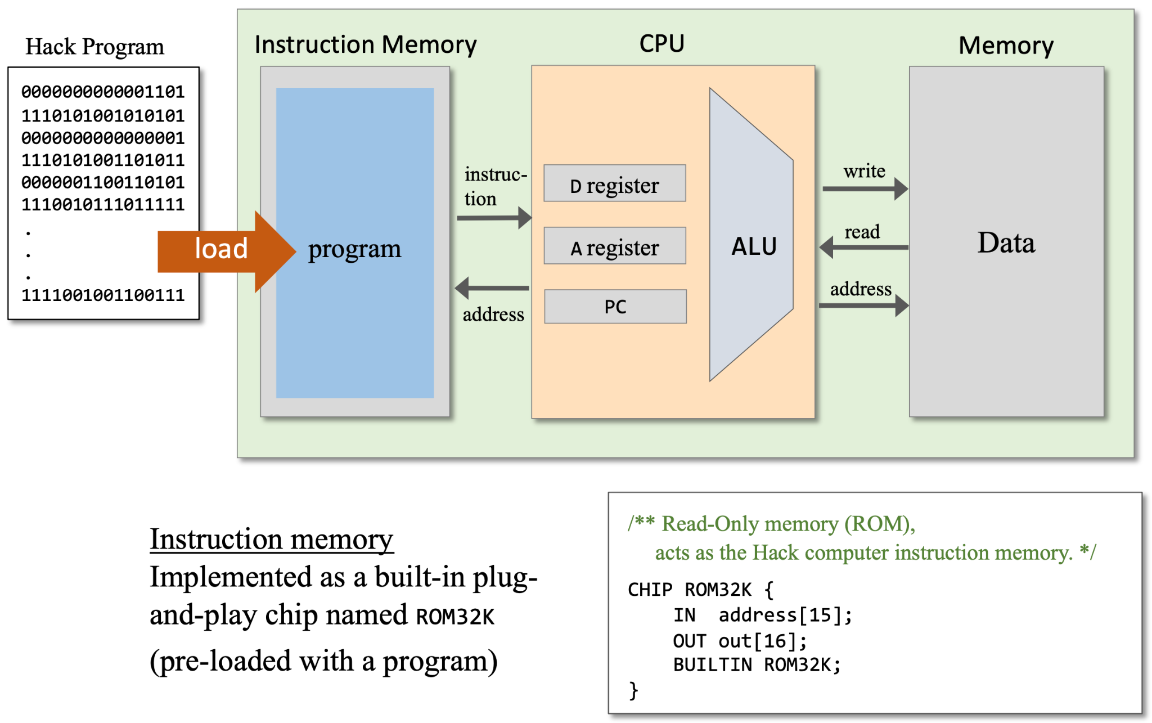
Instruction memory

Slide 54
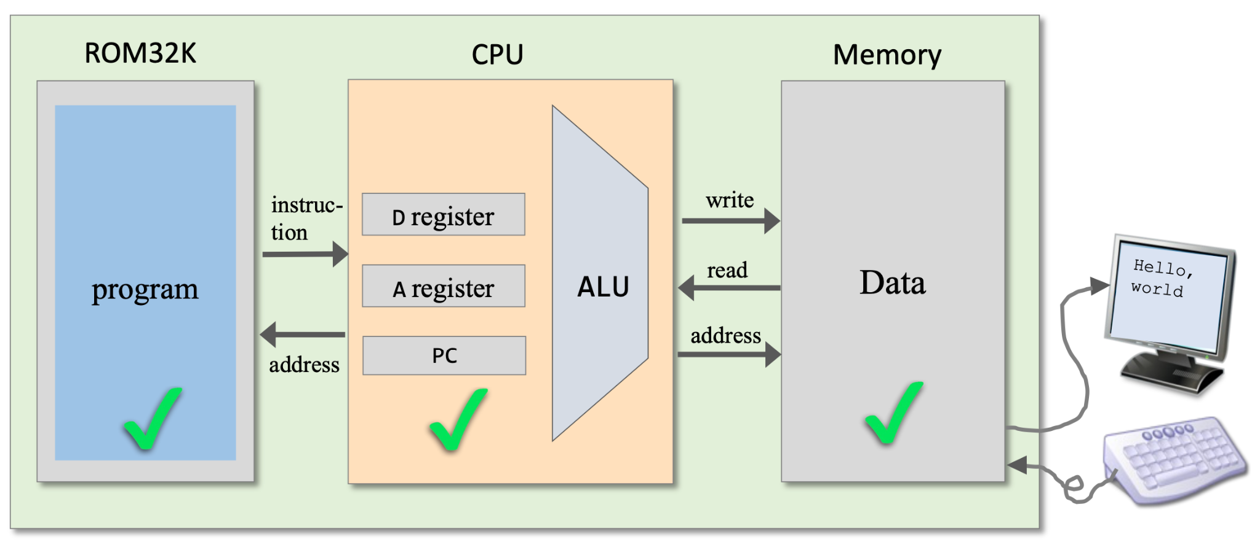
Integrate everything into a single chip, named Computer!

Slide 55
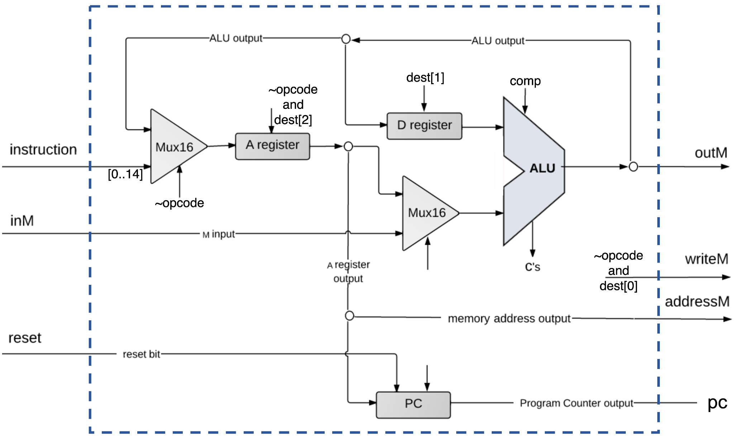
Reset?
How is reset used to control a computer?
What happens when it is 1?
What happens when it is 0?

Slide 56
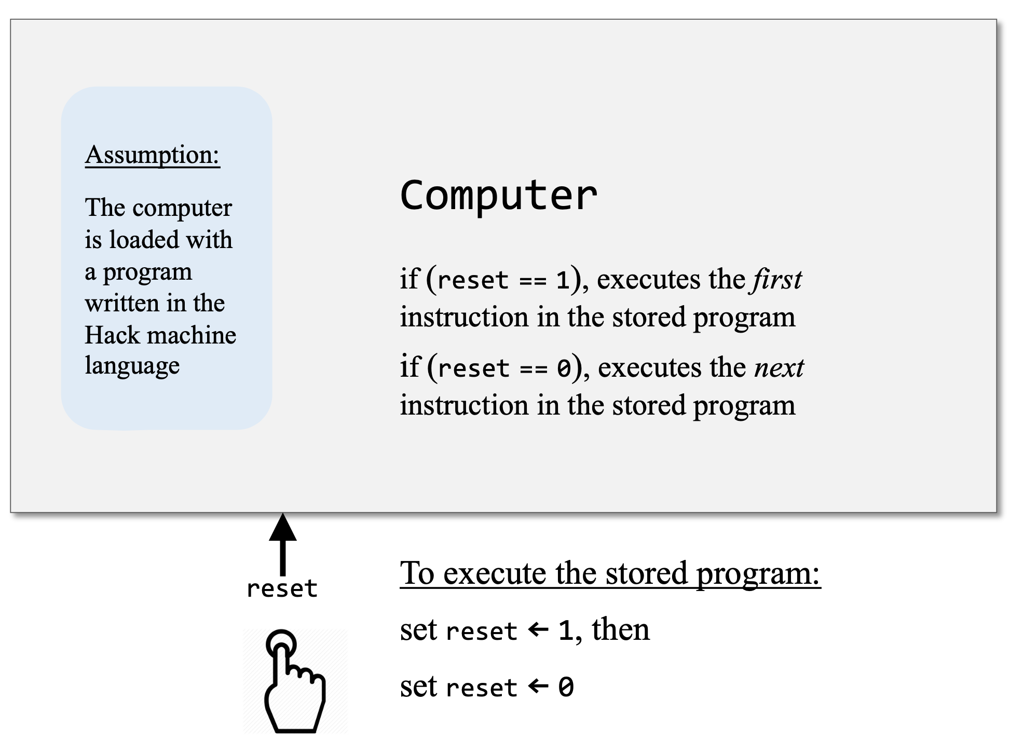
Reset!

Slide 57
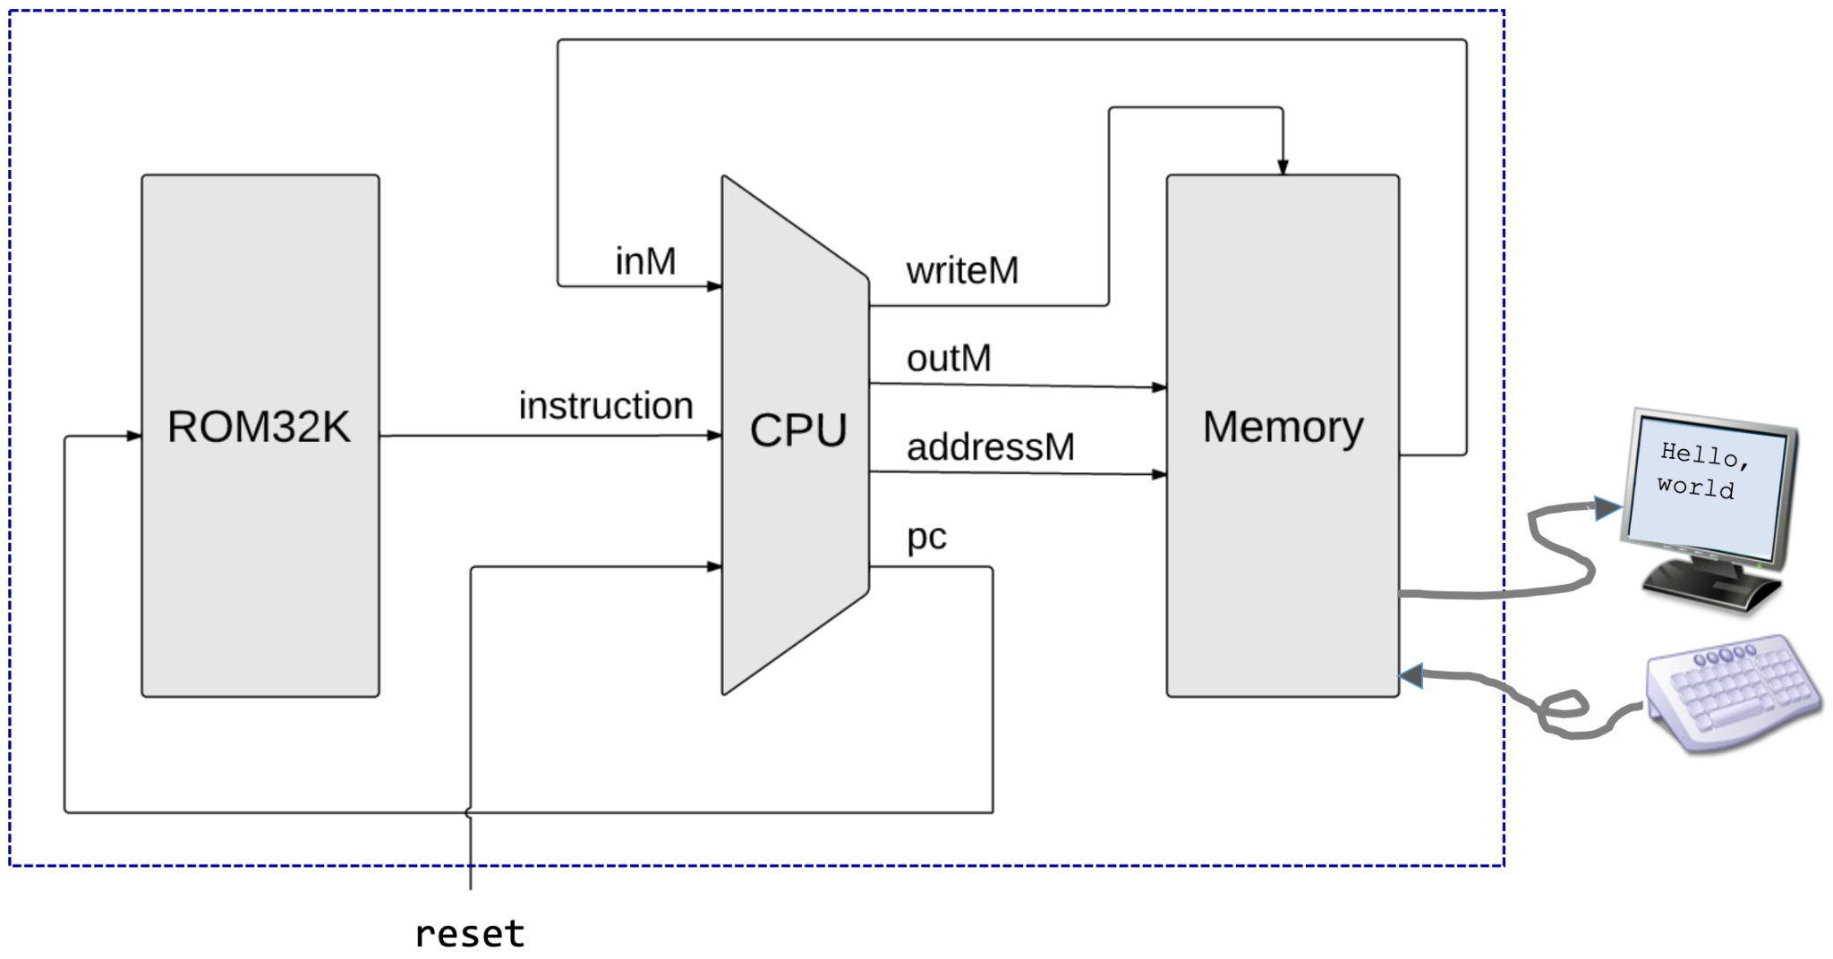
Computer!

Slide 58
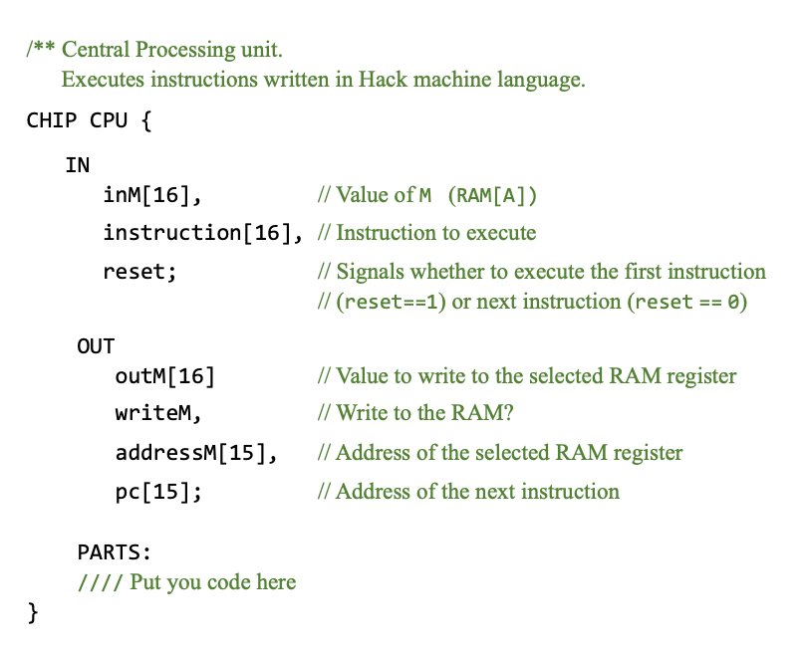
CPU
All the chip-parts seen here were built in projects 1, 2, 3;
But: Use their built-in versions
Use HDL to isolate, and connect instruction bits, to the control bits of chip-parts
Use gate logic to compute the address of the next instruction.

Slide 59
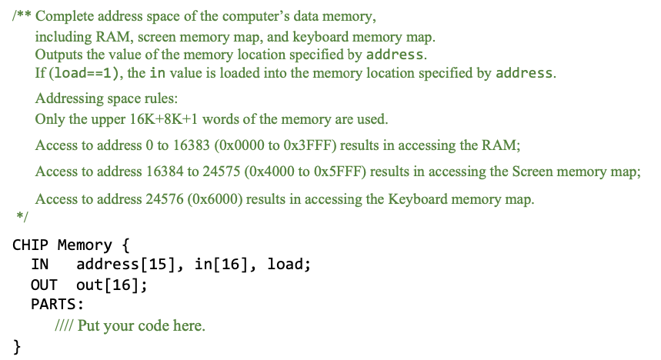
memory
Two bits in the address input can be used to determine the target memory-part (RAM16K, Screen, Keyboard)
The remaining bits of the address input are the address within the target memory-part
Do the read/write, and output the memory-part[address] value to the out output.
Use builtin memory-parts (RAM16K, Screen, Keyboard), and builtin logic gates, as needed.
Optional: Start by building a basic Memory chip that outputs two bits, say, loadRAM and loadScreen, indicating if the addressed memory-part is the RAM or the Screen
Then complete the final Memory chip, in which these two bits can become internal pins.

Slide 60
HomeWork 5

Slide 61
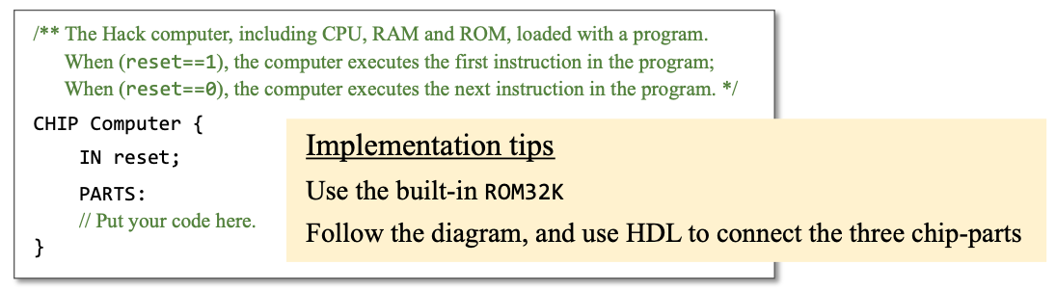
Computer

Slide 62
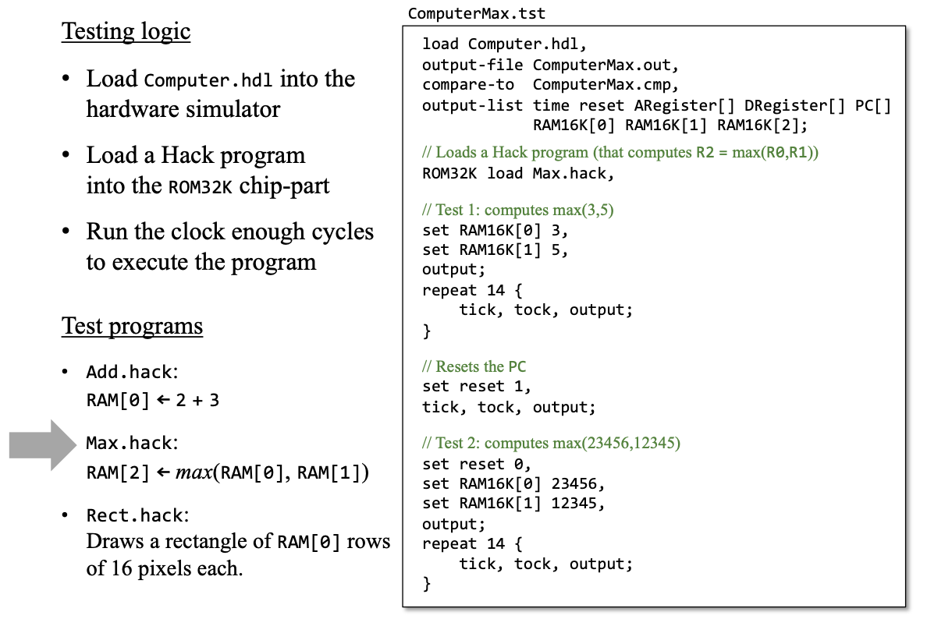
Testing

Slide 63
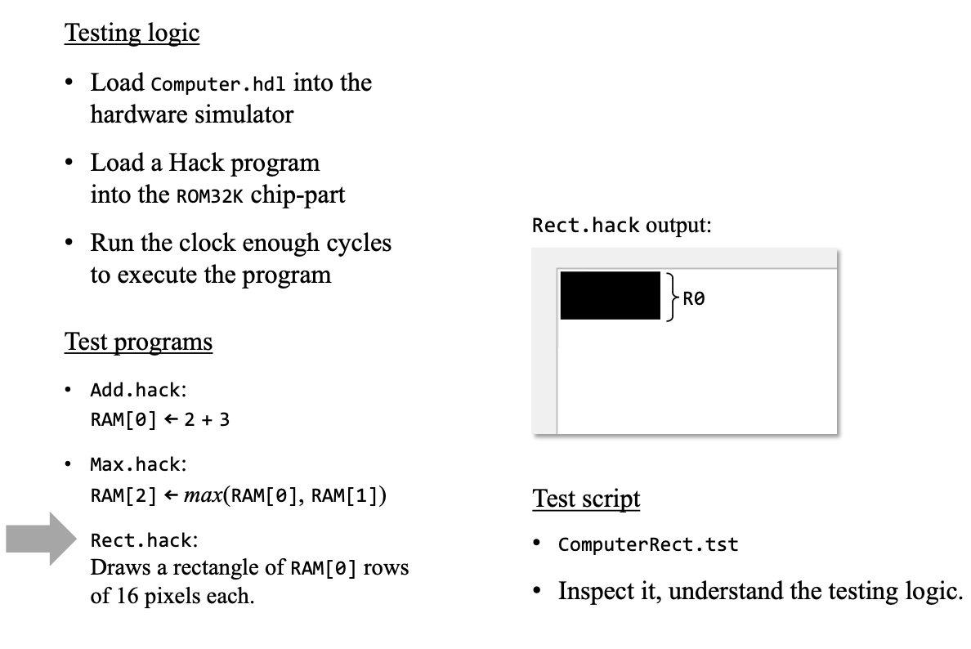
Testing(2)

Slide 64
Homework
Three files:
CPU.hdl
Memory.hdl
Computer.hdl

Slide 65
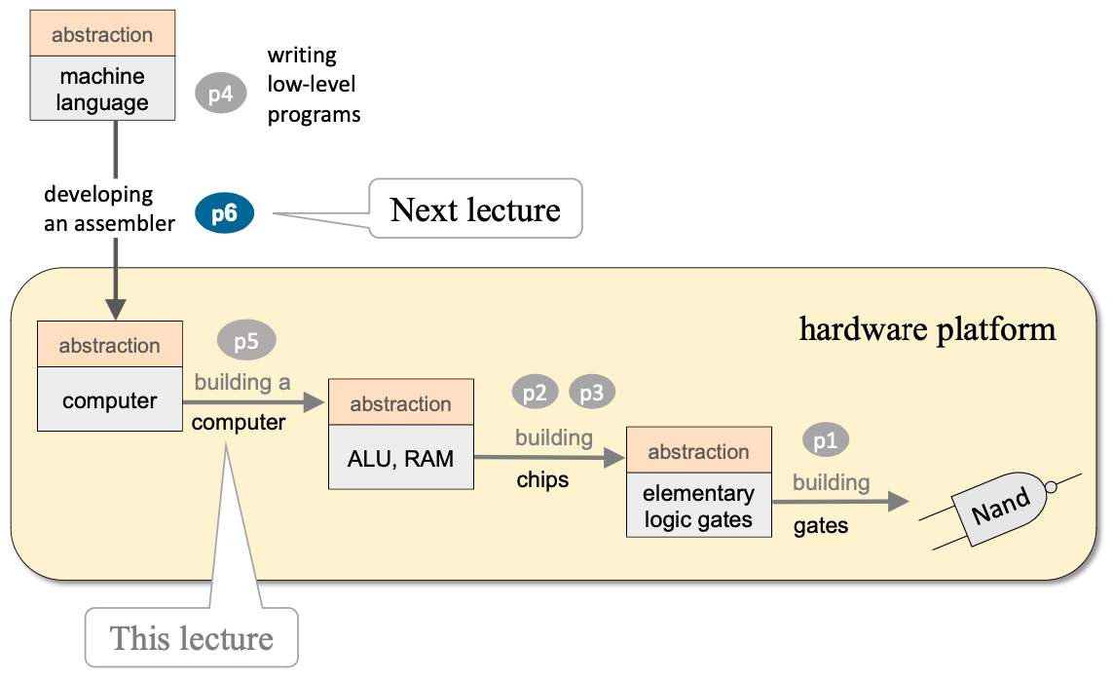
Roadmap

Slide 66
Once again about HWs

Slide 67
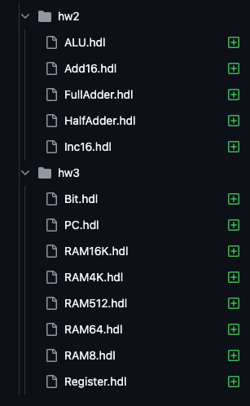
🤨

Slide 68
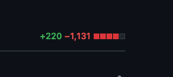
😑

Slide 69
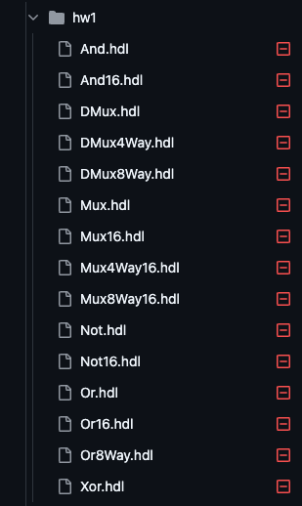
😕

Slide 70

🤯

Slide 71
Sync your forks
Accidentally added submodule was removed

Slide 72
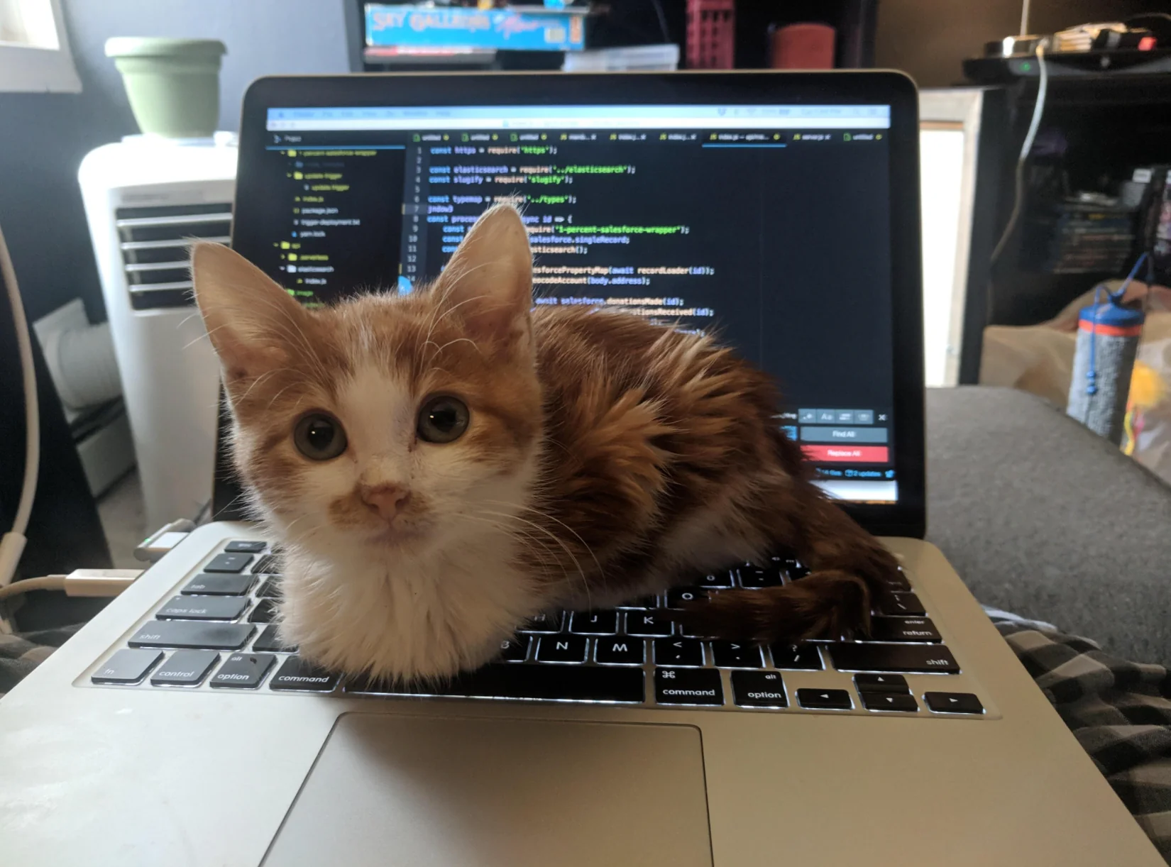
Ready for a homework?

