Slide 1
Computer Architecture
Lecture 3: Memory
Lector: Konstantin Chaika
Based on
- David Harris, Sarah L. Harris, Digital Design and Computer Architecture
- Nand to Tetris / www.nand2tetris.org
Constructor University Bremen Spring 2025

Slide 2
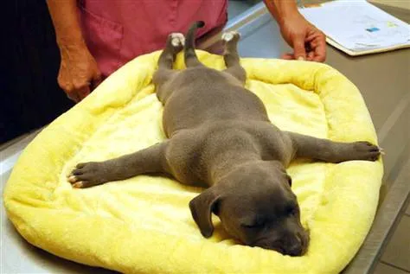
Tell me when you're tired

Slide 3


Slide 4
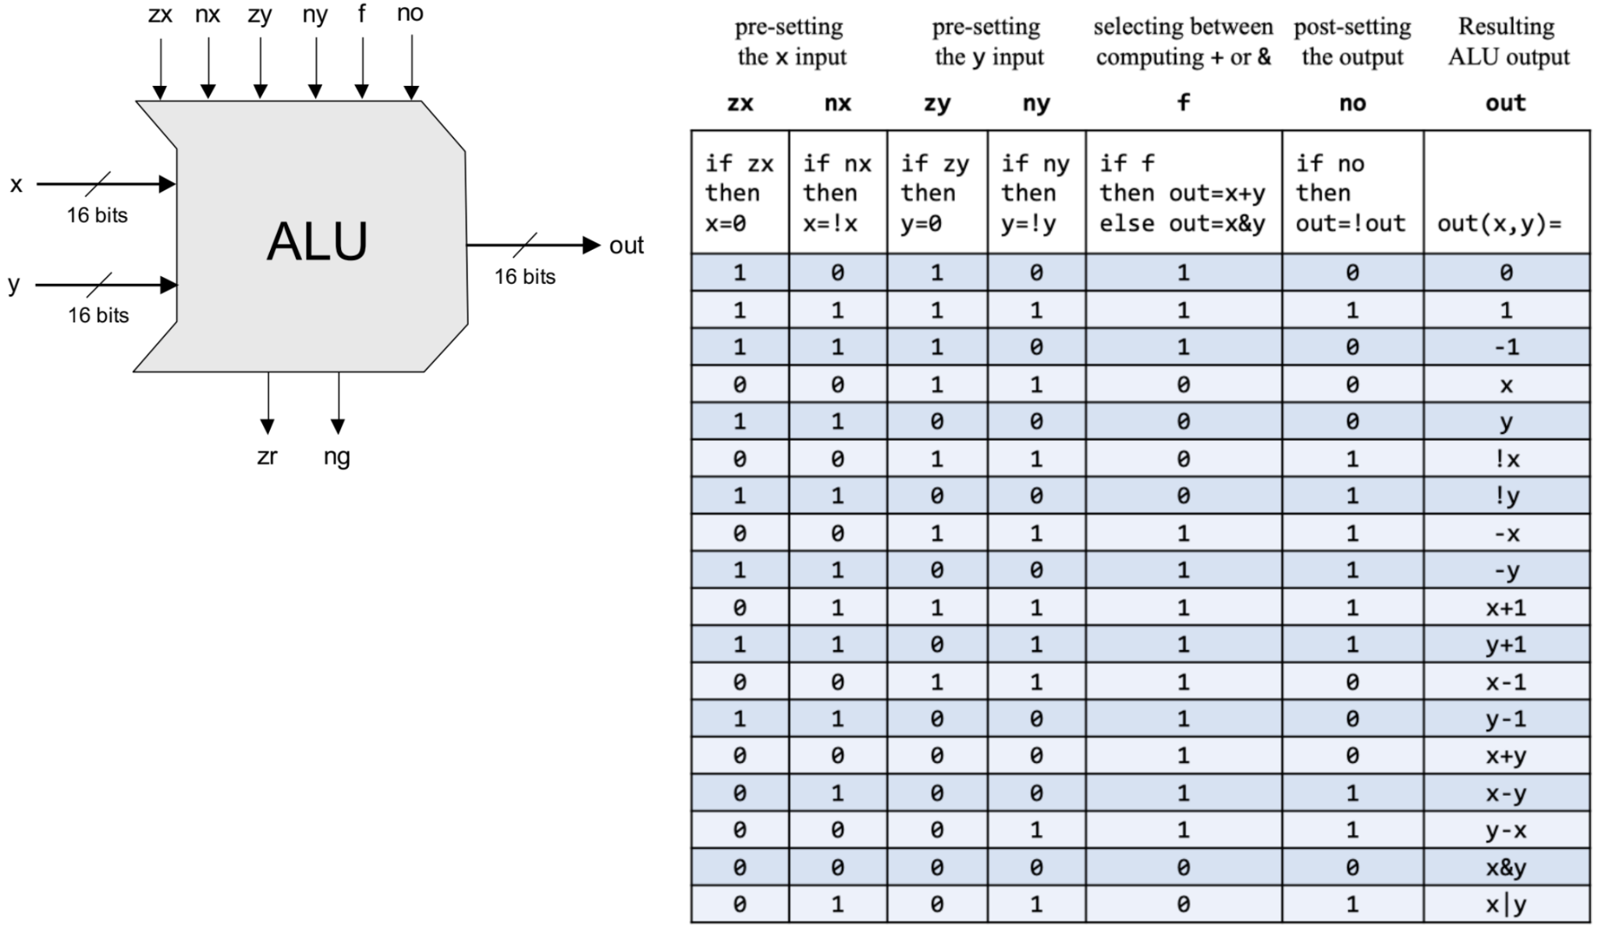
ALU is done?
Have we built a computer yet?

Slide 5
ALU is done??
Have we built a computer yet?
What are we missing now?

Slide 6
ALU is done?!?!
Have we built a computer yet?
What are we missing now?
Where do we get the data for the ALU?

Slide 7
So, we need a memory!
What special feature does the memory have that our previous circuits did not have? (adder, ALU, …)?

Slide 8

Combinational VS Sequential Logic
So, what is the difference?
What type of logic does memory belong to?

Slide 9
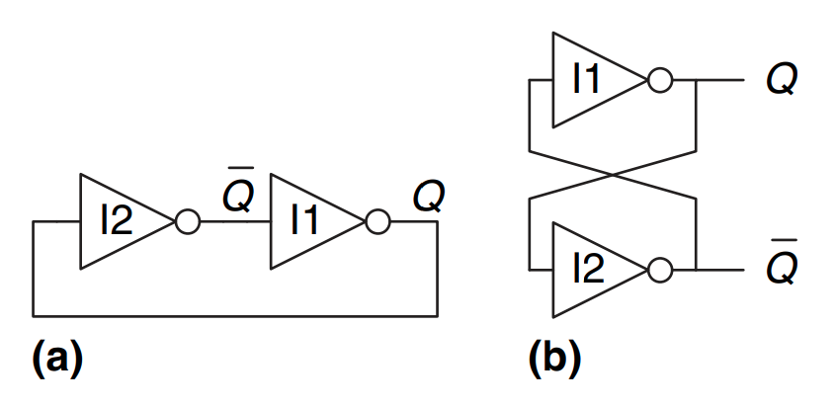
Cross-coupled inverter pair
How does it work?

Slide 10
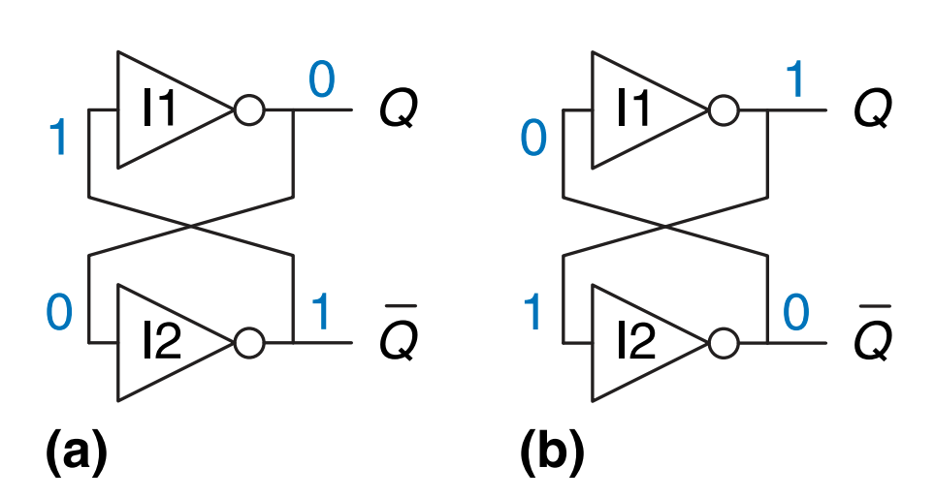
Stable states
Notes:
What's missing?

Slide 11
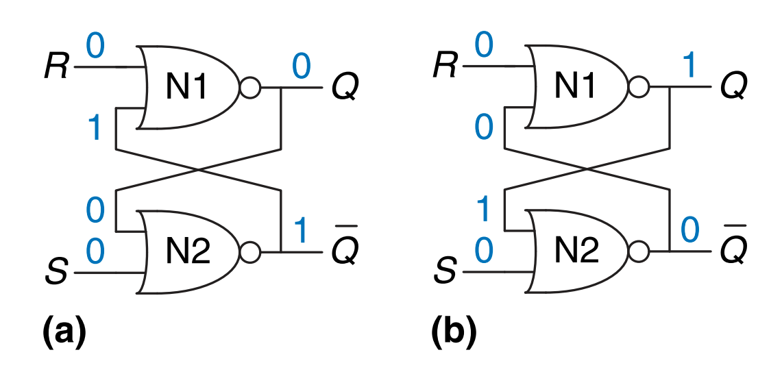
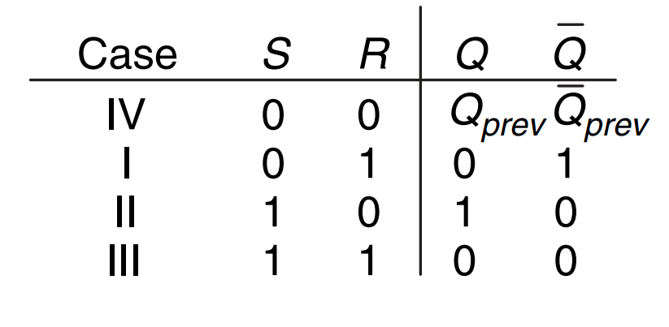
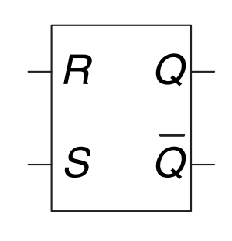

SR(RS)-Latch
Demo time
Notes:
https://everycircuit.com/circuit/5202013106995200

Slide 12
Do SR(RS)-Latch have disadvantages?

Slide 13
SR(RS)-Latch disadvantage
What do we write?
When do we write?

Slide 14
Everything has a processing time
Demo time
Notes:
https://everycircuit.com/circuit/6045634936963072

Slide 15
A few words about Clock
Different components, different speed?
How to synchronize the work of components?

Slide 16
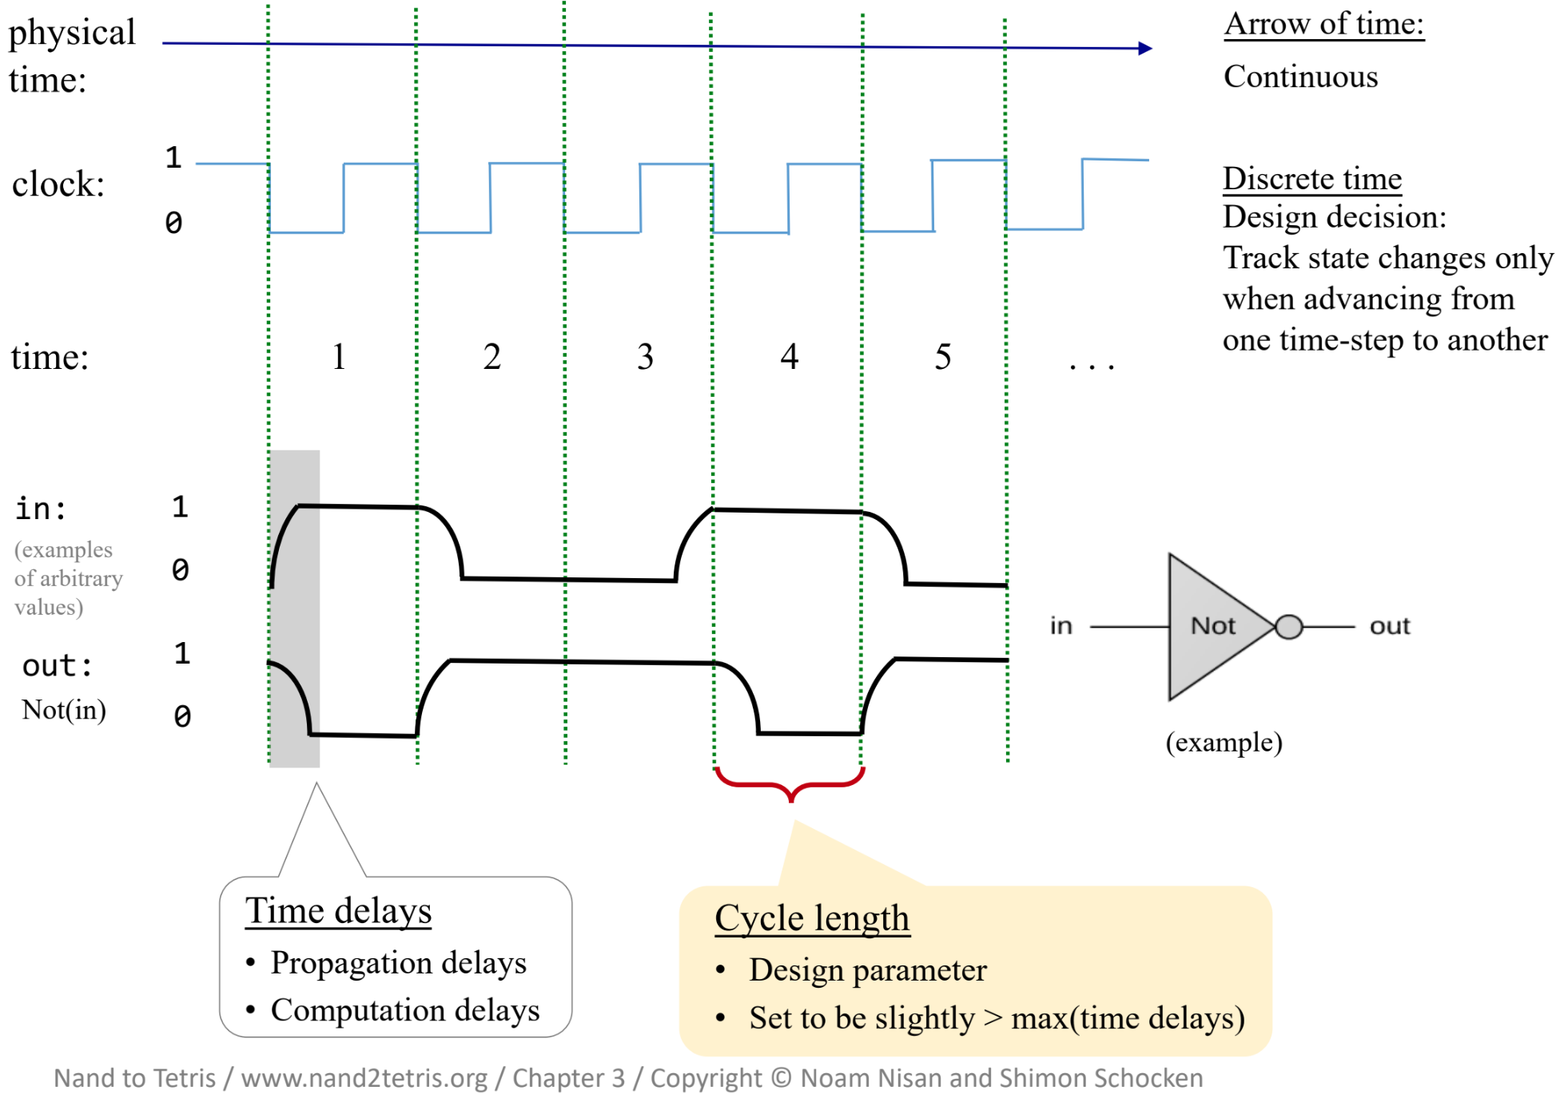
Chip behavior over time

Slide 17
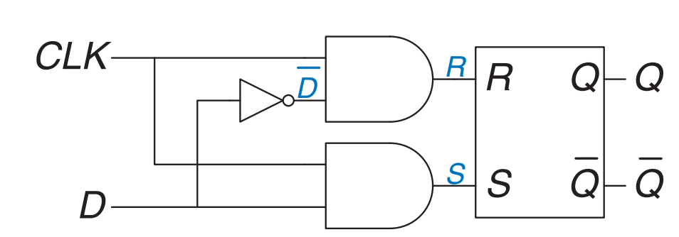
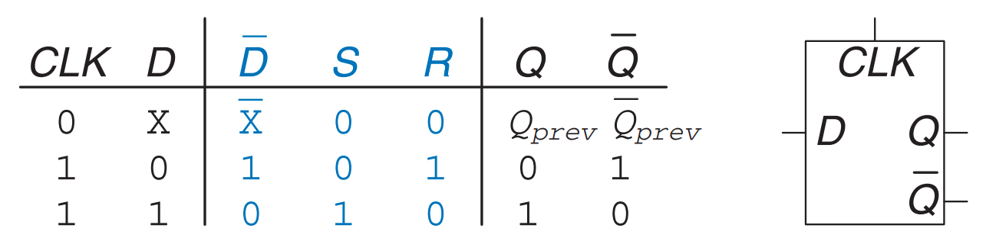
D-Latch
Demo time
Notes:
https://everycircuit.com/circuit/4874096380477440

Slide 18
D-Latch disadvantage
When does the state of the outputs change?
Demo time
Notes:
https://everycircuit.com/circuit/4874096380477440

Slide 19
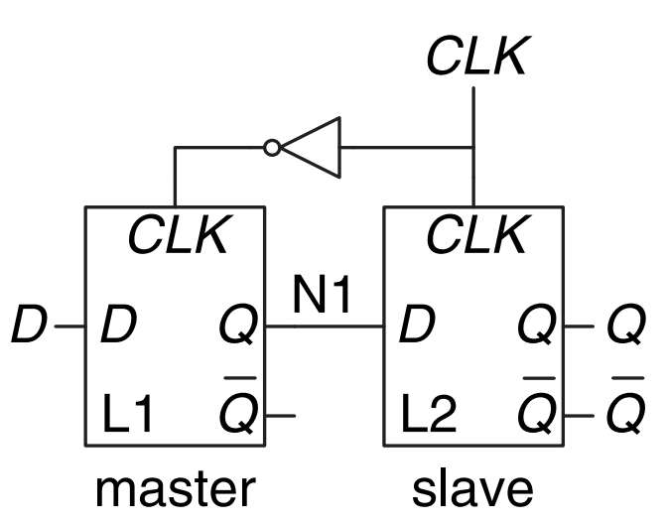
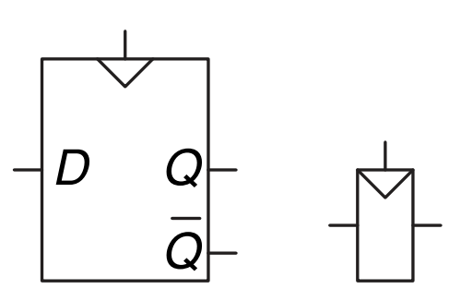
D-flip-flop (D-trigger)
How does it work?

Slide 20
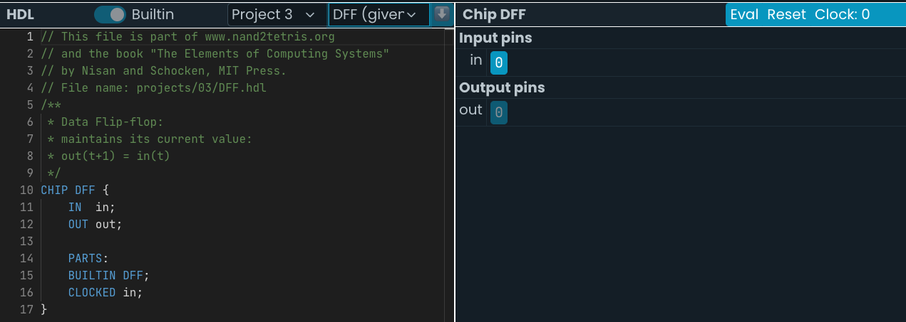
D-flip-flop is given
DFF is given in your home work and you will use it as a base building block for another components.
Notes:
https://nand2tetris.github.io/web-ide/chip/

Slide 21
What disadvantage you can see here?
We always want to control everything.
We want to know when each signal will change
Notes:
Not every cycle

Slide 22
1-bit registers
What’s the load signal?
How to implement 1-bit register?

Slide 23
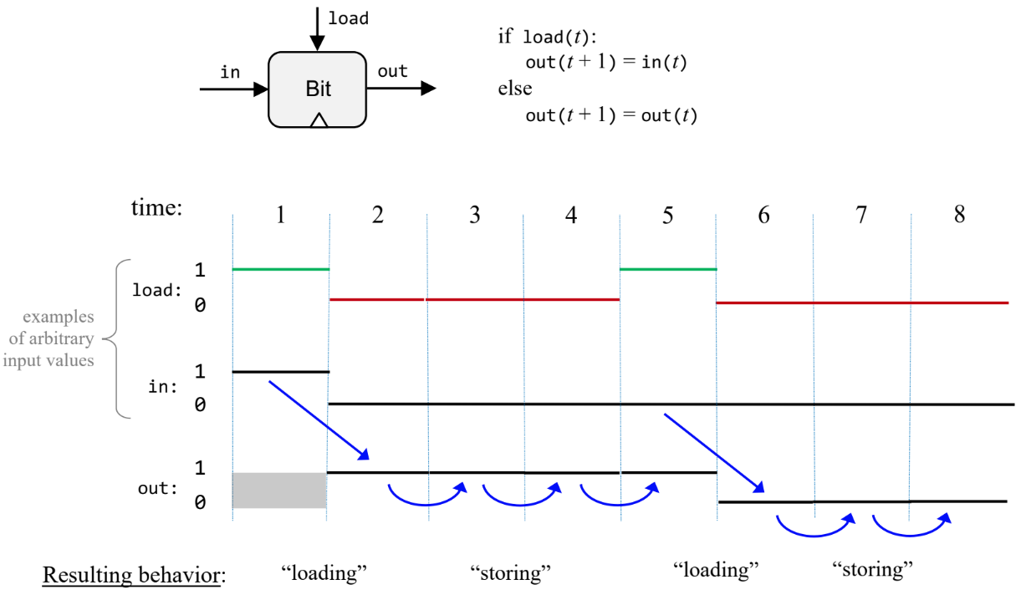
1-Bit register signal diagram

Slide 24
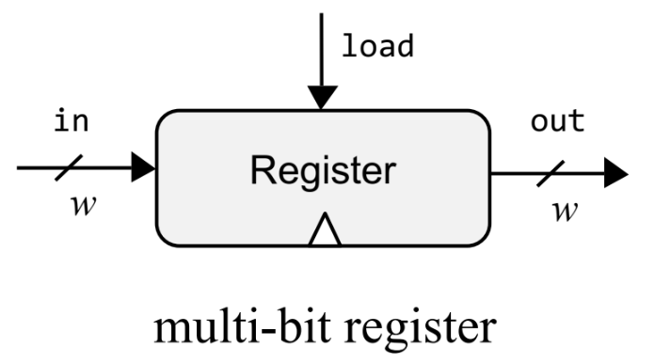
Multi-bit register
How to implement it?
How many bits we need in our CPU?

Slide 25
Memory
Register file
Inside CPU
Stores the data that the processor is currently working with
RAM
External storage (from the CPU's point of view)
Stores instructions and all other data
In reality, they have nothing in common in terms of hardware implementation.
There's common ground in terms of the interface.

Slide 26
Memory interface
What should it include?

Slide 27
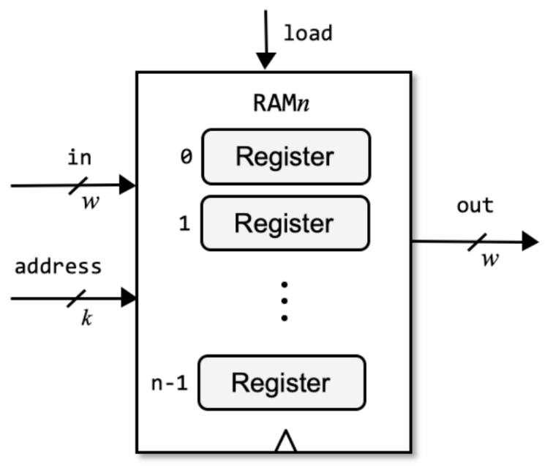
Memory abstraction
How to choose k?
How to choose n?

Slide 28
Which instruction to execute?
Imagine we're storing instructions in our memory.
We read one instruction and executed it. How do we know what the next one is?

Slide 29
PC -- Program Counter
What interface should it have?

Slide 30
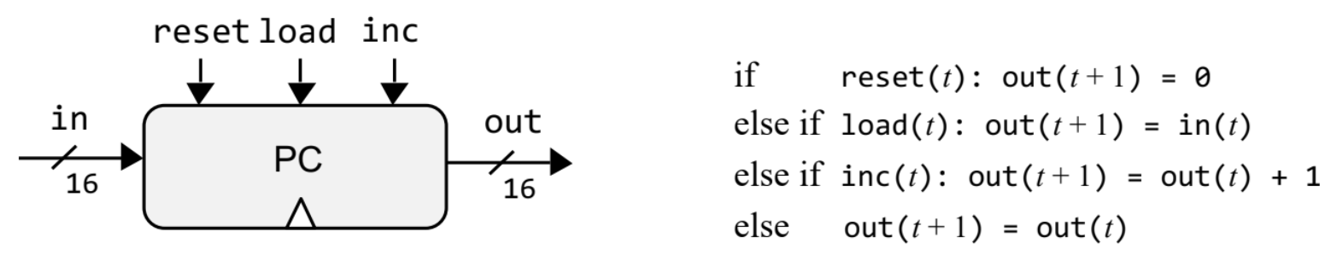
PC interface

Slide 31
Practice

Slide 32
Home Work
DFF (given)
Bit (1-bit register)
Register
RAM8
RAM64
RAM512
RAM4K
RAM16K
PC
Notes:
Talk about what each component is

Slide 33
Bit ?
DFF (given)
▶Bit (1-bit register)
Register
RAM8
RAM64
RAM512
RAM4K
RAM16K
PC
How to implement it?

Slide 34
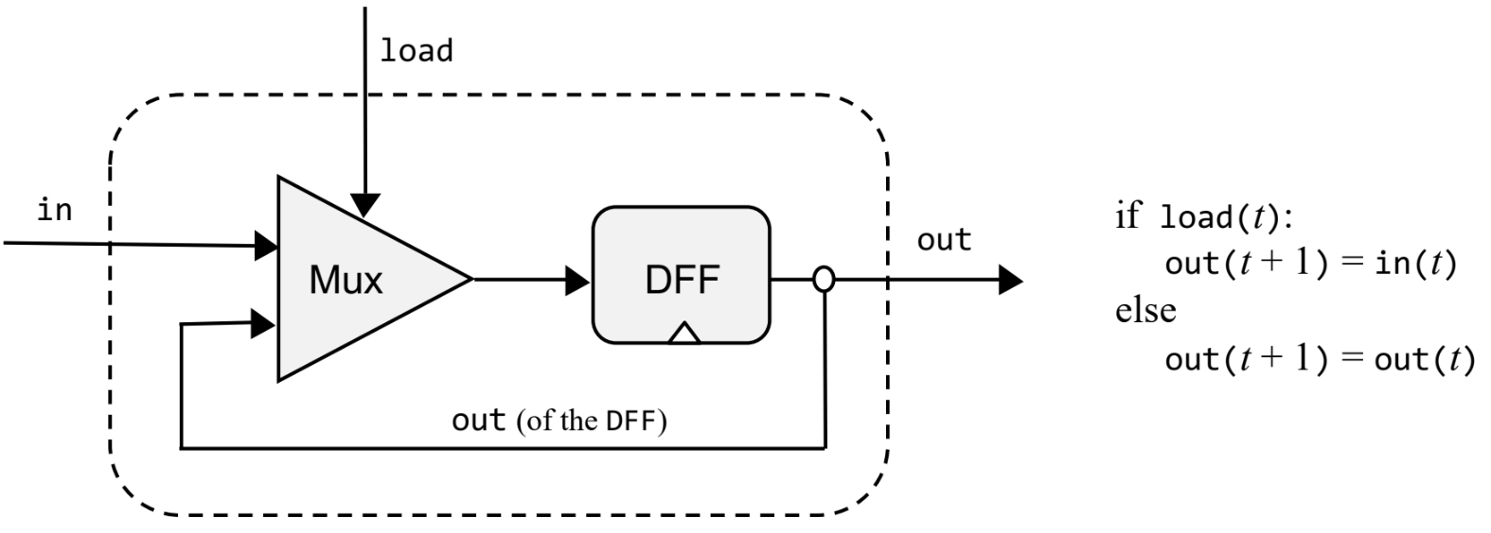
Bit !
DFF (given)
▶Bit (1-bit register)
Register
RAM8
RAM64
RAM512
RAM4K
RAM16K
PC

Slide 35

Register
DFF (given)
Bit (1-bit register)
▶Register
RAM8
RAM64
RAM512
RAM4K
RAM16K
PC
16-bit register

Slide 36
RAM8 ?
DFF (given)
Bit (1-bit register)
Register
▶RAM8
RAM64
RAM512
RAM4K
RAM16K
PC
Any ideas about implementation for n == 8?
Read
How to select which register output be used?
Write
How to select which register should be loaded?
How to send in signal to the input of the right register?

Slide 37
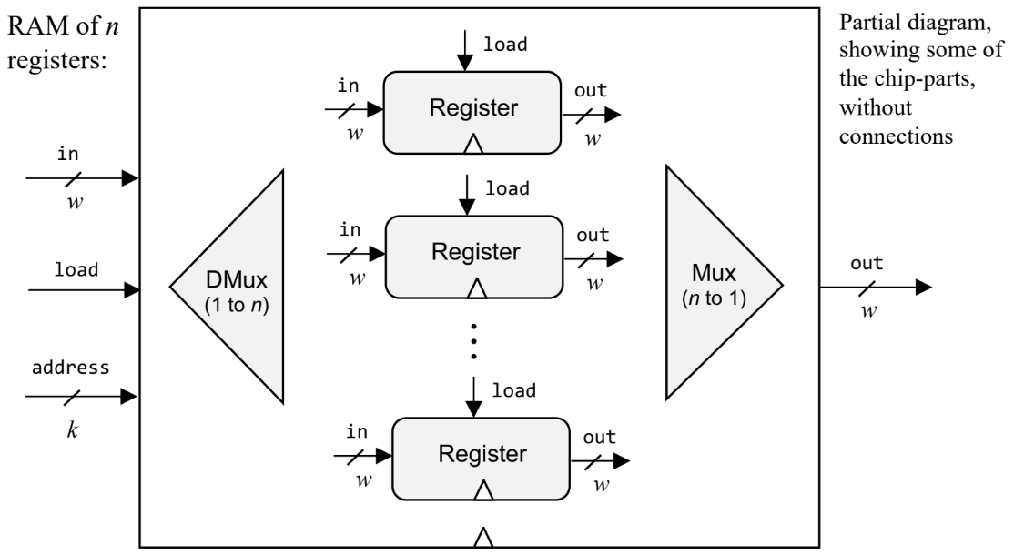
RAM8 !
DFF (given)
Bit (1-bit register)
Register
▶RAM8
RAM64
RAM512
RAM4K
RAM16K
PC

Slide 38
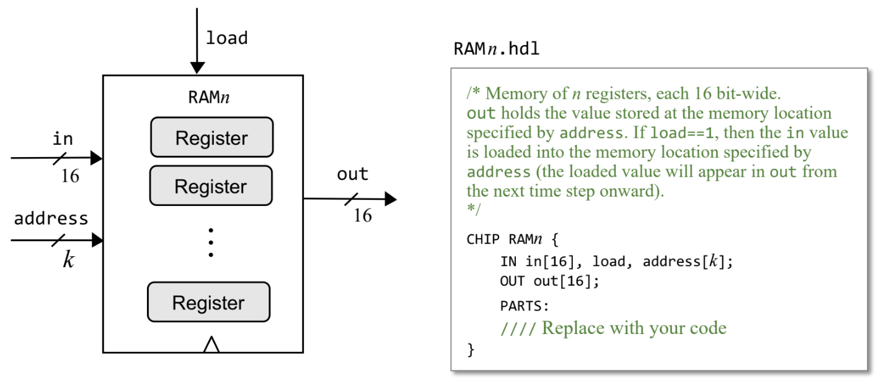
RAM64, 512, 4K, 16K ?
DFF (given)
Bit (1-bit register)
Register
RAM8
▶RAM64
▶RAM512
▶RAM4K
▶RAM16K
PC
Any ideas about realization?

Slide 39
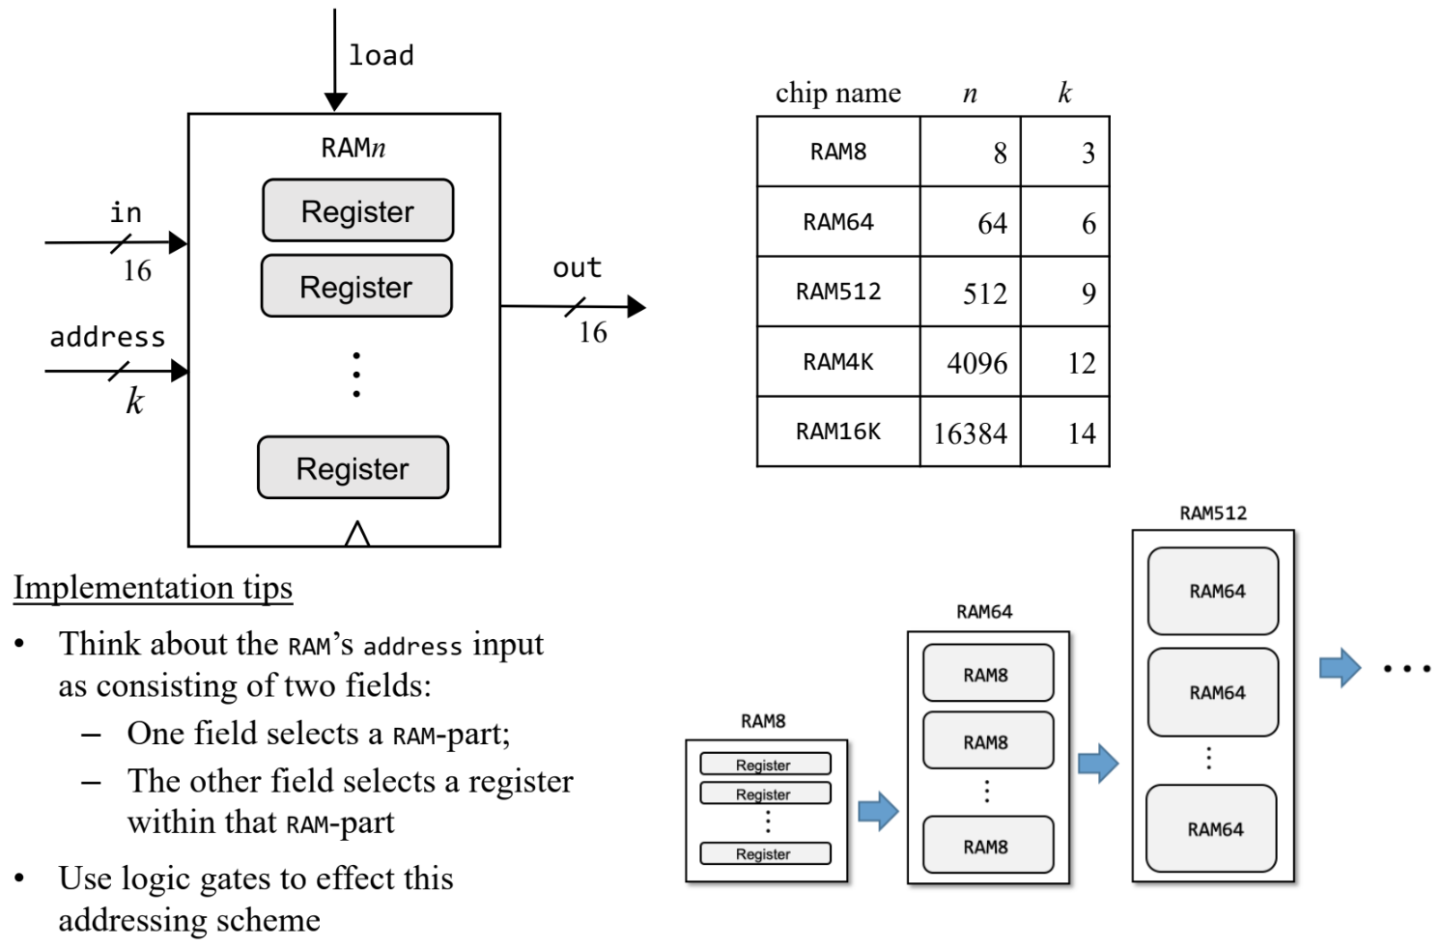
RAM64, 512, 4K, 16K !
DFF (given)
Bit (1-bit register)
Register
RAM8
▶RAM64
▶RAM512
▶RAM4K
▶RAM16K
PC

Slide 40
PC ?
DFF (given)
Bit (1-bit register)
Register
RAM8
RAM64
RAM512
RAM4K
RAM16K
▶PC
Any ideas about realization?

Slide 41
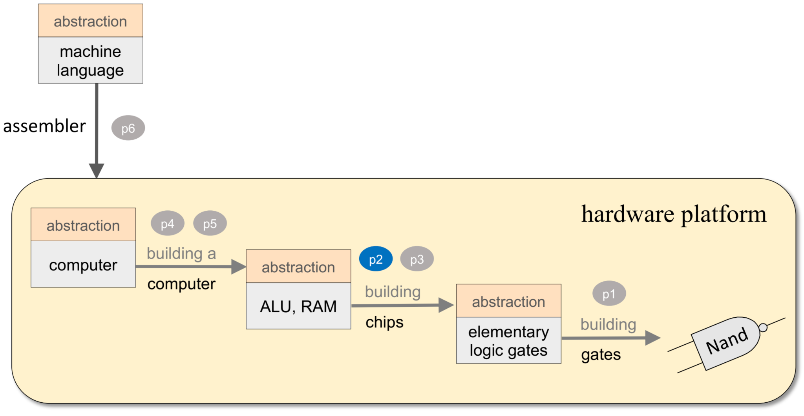
Previous HW

Slide 42
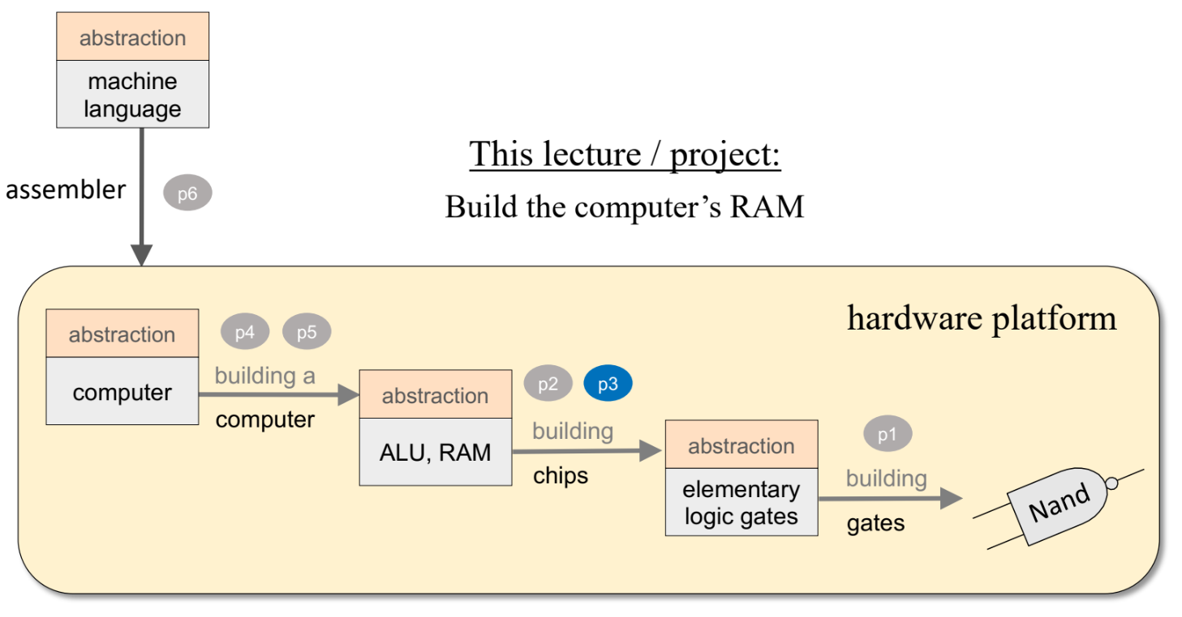
Current HW

Slide 43

Ready to do the homework?

