Slide 1
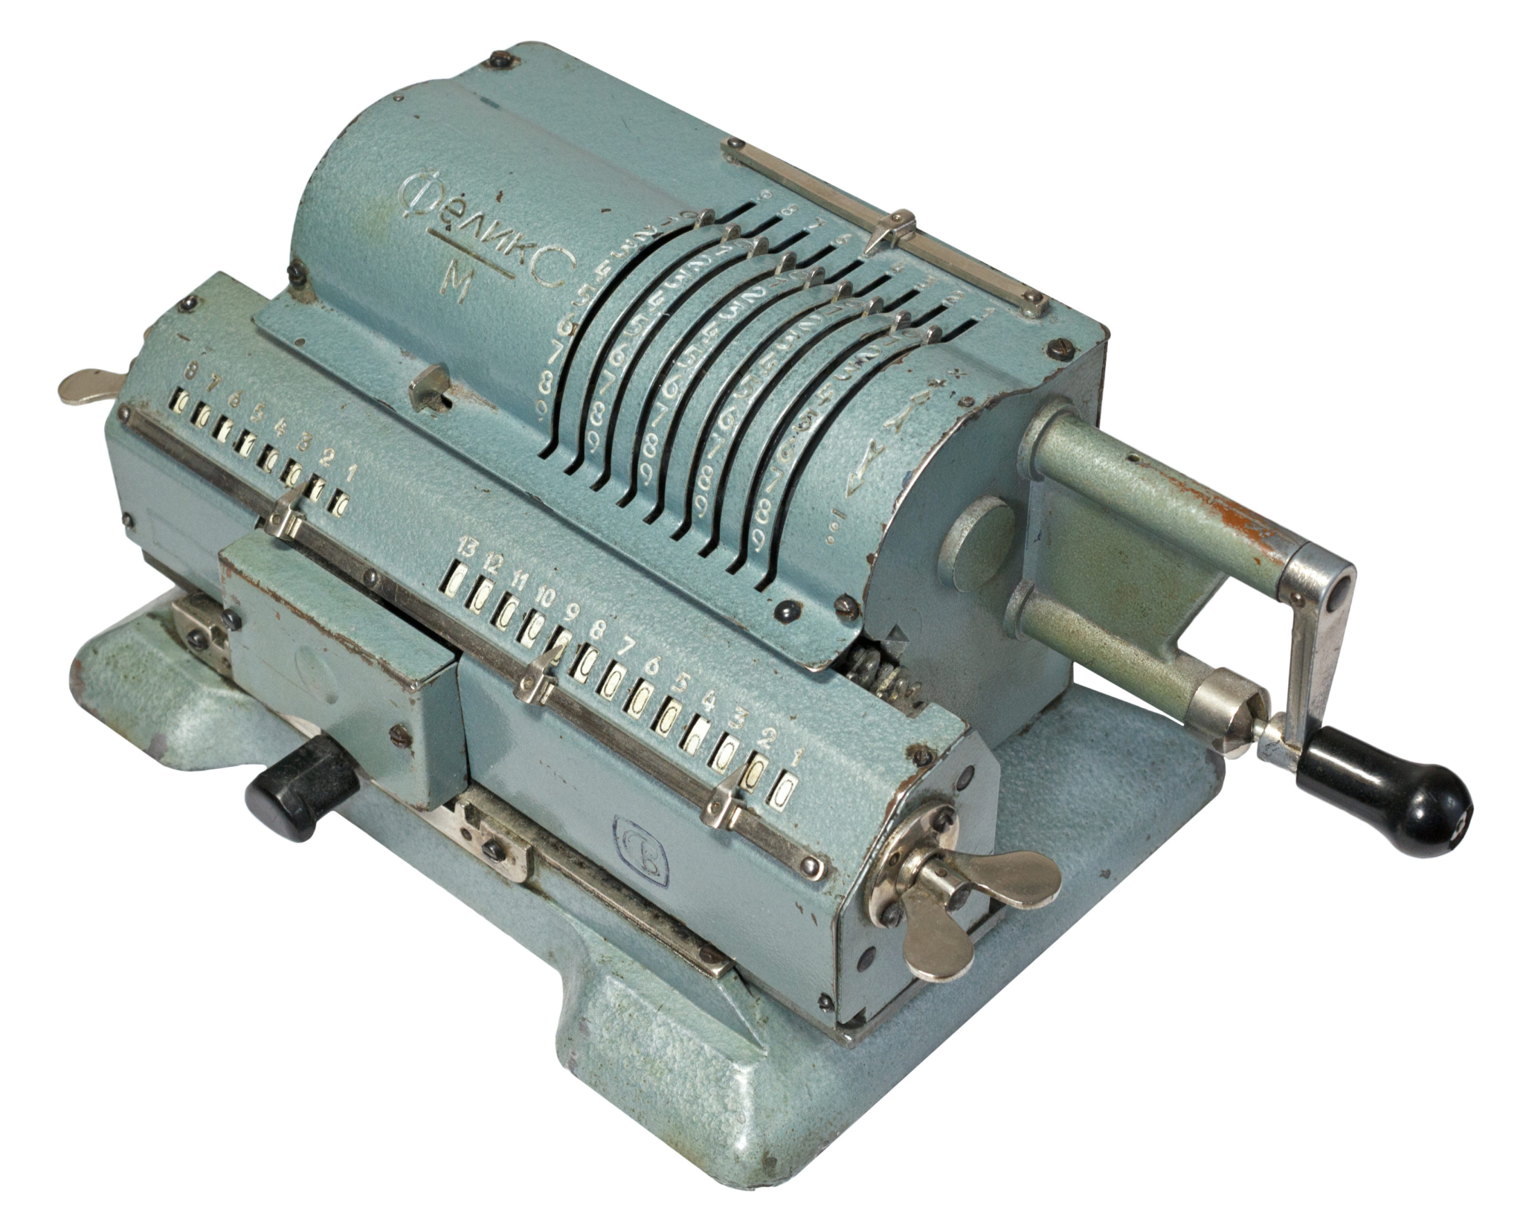
Let's get back to what's most important
What was the computer invented for? What did people want?

Slide 2
So, we need to learn how to perform arithmetic operations
What's the most basic one to start with?

Slide 3
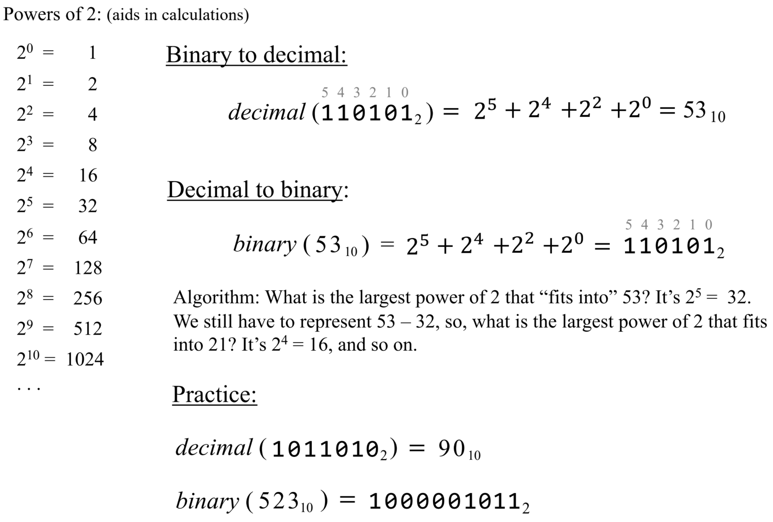
Decimal ↔ binary conversions

Slide 4
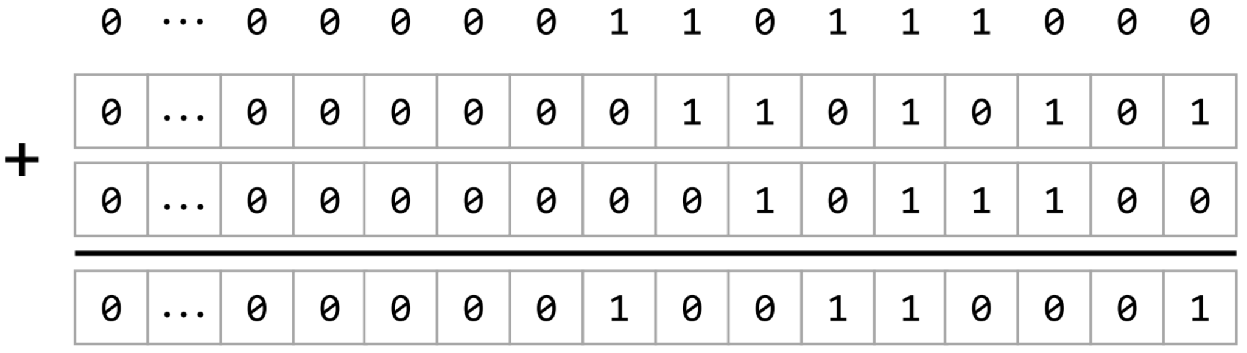
Addition
Computers represent integers using a fixed number of bits.

Slide 5
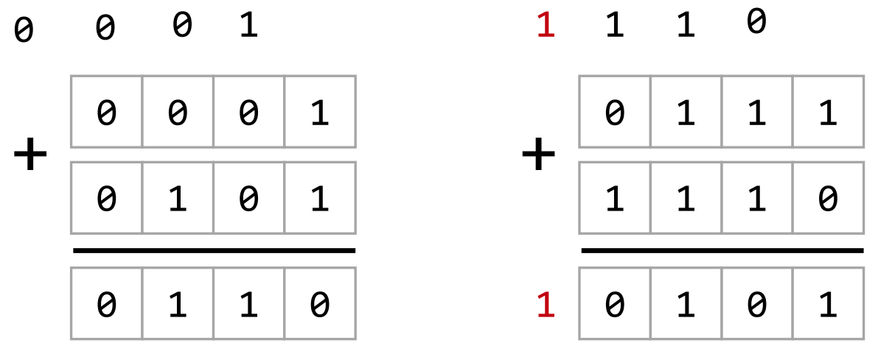
Overflow, Carry (out, in)
What should we do with overflow? Is it bad?

Slide 6
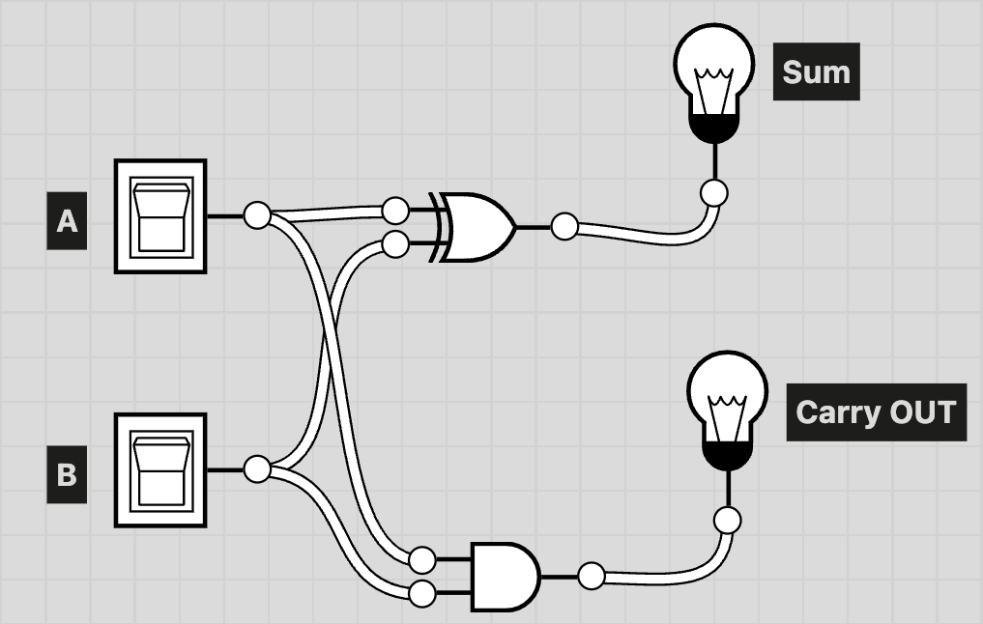
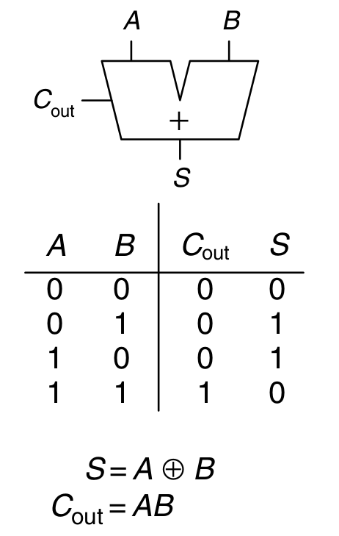
Half Adder
A+B == A OR B
AB == A AND B A⊕B == A XOR B
Why is it half adder?
What should be build next?

Slide 7
Let’s solve the problem one step by step
How do you find the sum of only two bits?
How to calculate whether the carry has occurred?
What logic gates do we need for it?
Let’s try: https://logic.ly/demo/

Slide 8
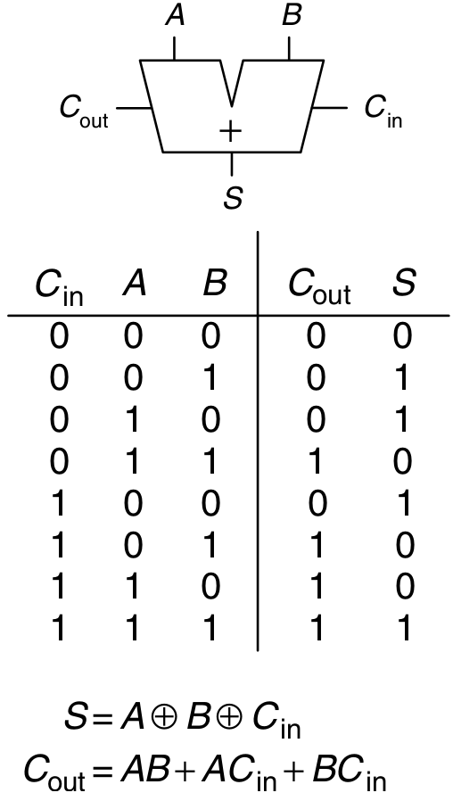
Full Adder!

Slide 9
Full Adder: can we reuse smth?
The formulas look good, but is there any way to reuse what we've already done?
Let’s try: https://logic.ly/demo/ ?

Slide 10
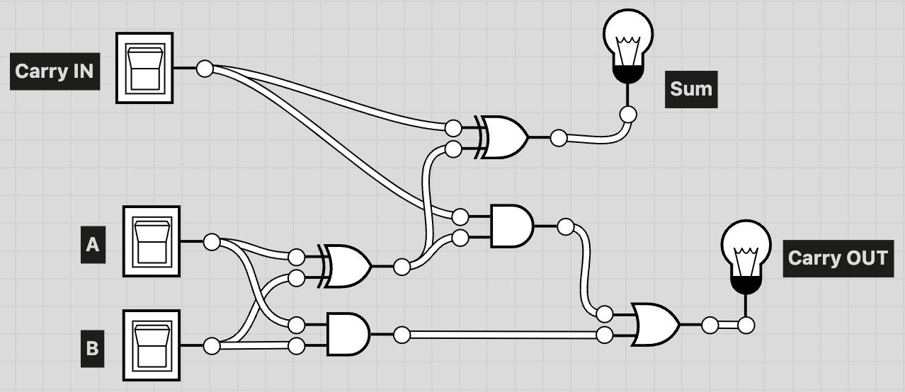
Full Adder scheme

Slide 11
What about the case of more bits?
How to sum numbers if they consist of more than one bit?
Numbers that are how many bits long should be summed by the processor? (machine word size)

Slide 12
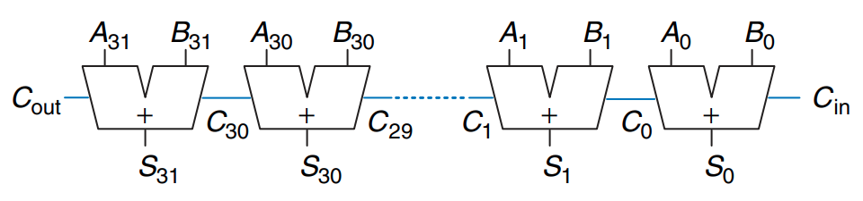
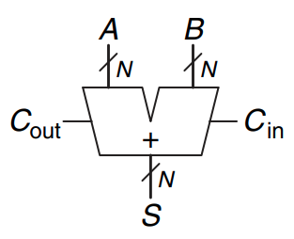
Carry propagate adder (Ripple-Carry Adder)
Who sees the problem?
Notes:
Arity is the number of arguments or operands taken by a function,

Slide 13
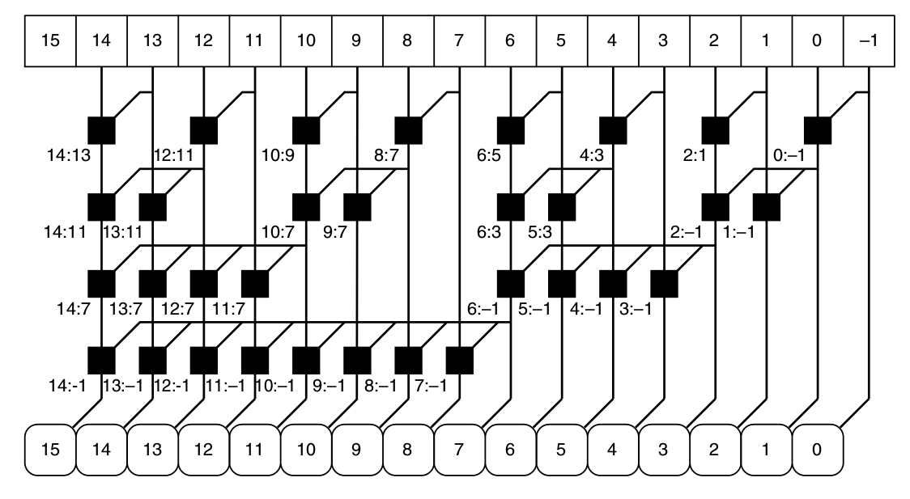
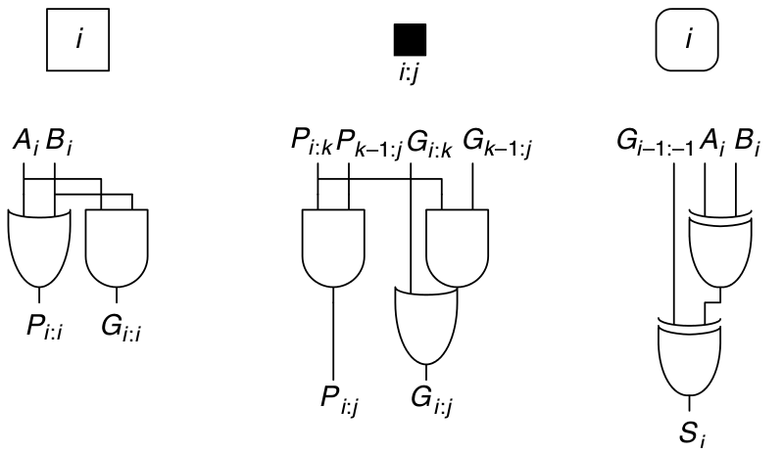
We're not going to die in optimisations!
But the engineers did 💪
Notes:
Prefix adder

Slide 14
Subtraction
Ok, carry propagate adder is fine for our first processor. But what about subtraction?
How would you store a negative number in binary form?

Slide 15
Two's complement
Bits | Unsigned value | Signed value (Two's complement)
0000 0000 | 0 | 0
0000 0001 | 1 | 1
0000 0010 | 2 | 2
0111 1110 | 126 | 126
0111 1111 | 127 | 127
1000 0000 | 128 | −128
1000 0001 | 129 | −127
1000 0010 | 130 | −126
1111 1110 | 254 | −2
1111 1111 | 255 | −1
How do make two's complement?

Slide 16
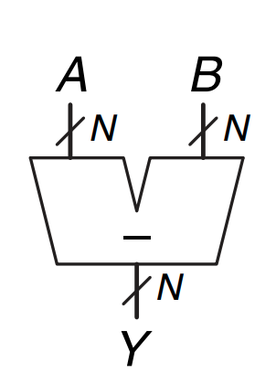
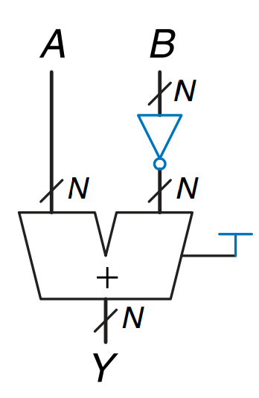
Subtractor

Slide 17
Multiplication and division
How to perform multiplication and division in a naive way? (We will not implement it in hardware)
How to perform comparison?

Slide 18
A bunch of stuff for addition, AND, OR, is cool…
But it can't be operated. We need to put everything into one module that will perform arithmetic-logic operations. ALU!
Let's assume the design of its interface:
What will be input? What will be output?

Slide 19
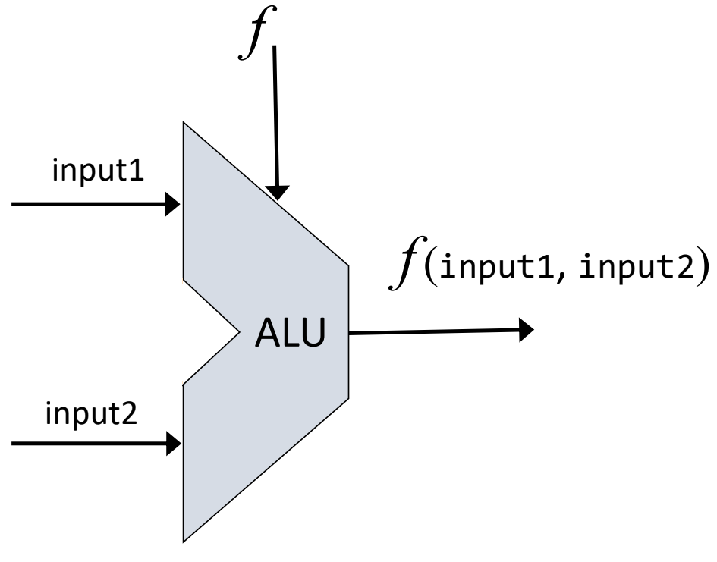
Expectation

Slide 20
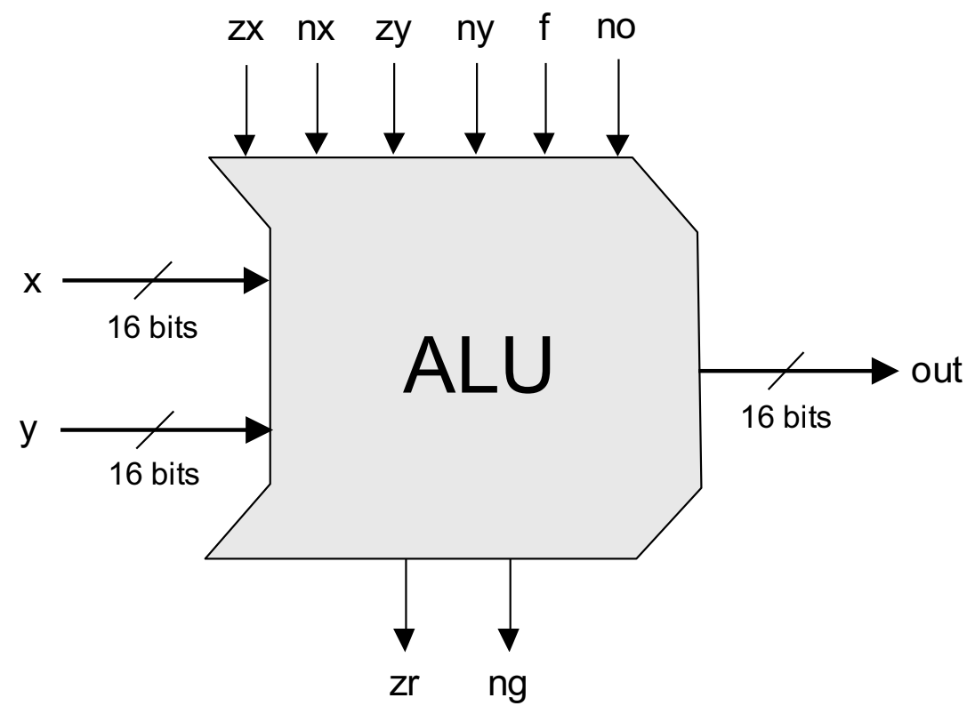
Reality
Your ideas:
What are these inputs?
What are these outputs?!

Slide 21
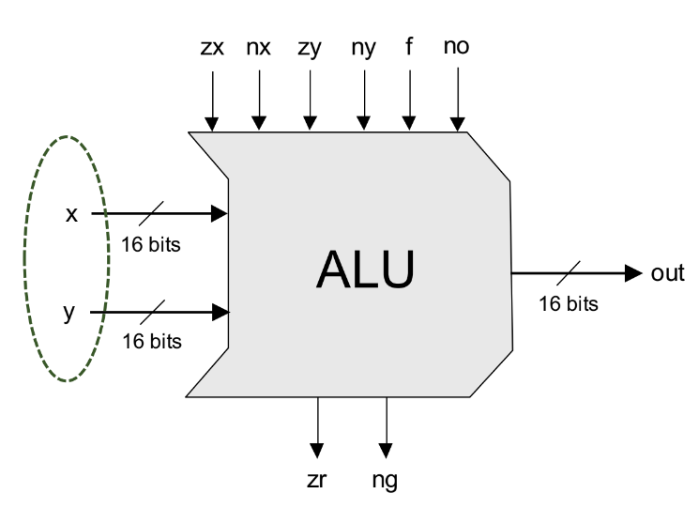
Input values

Slide 22
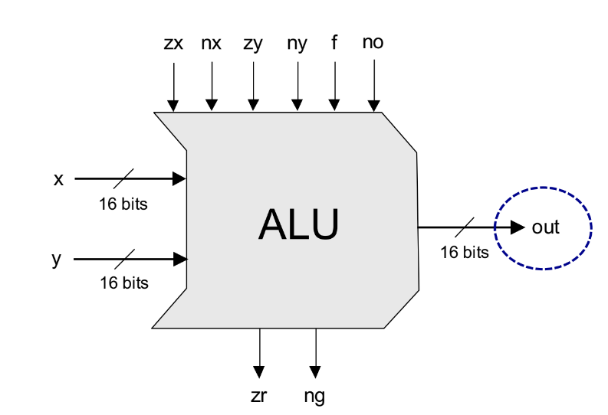
Output value

Slide 23
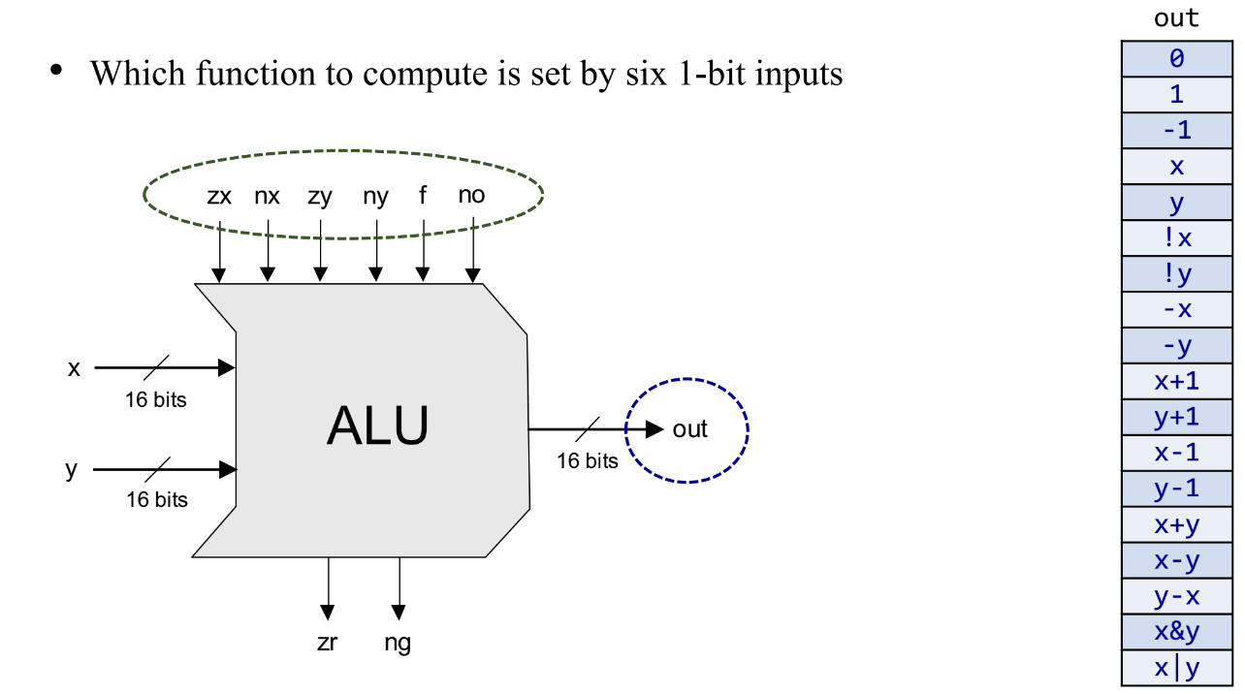
Control

Slide 24
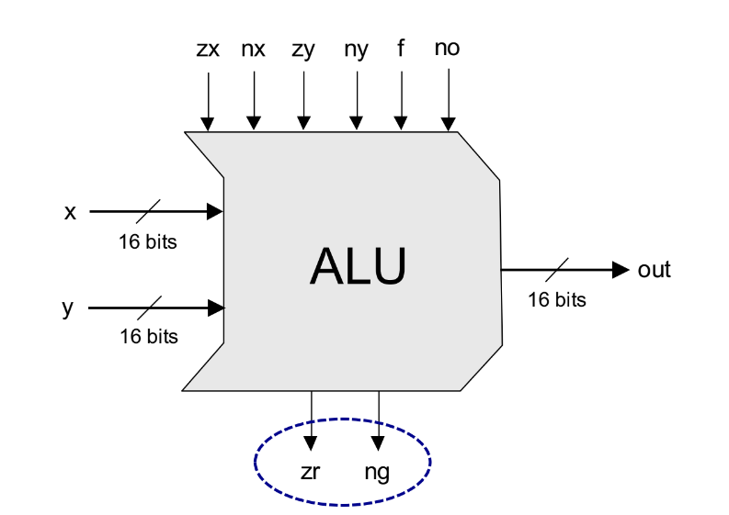
Flags
Notes:
ZeRo result
NeGative result

Slide 25
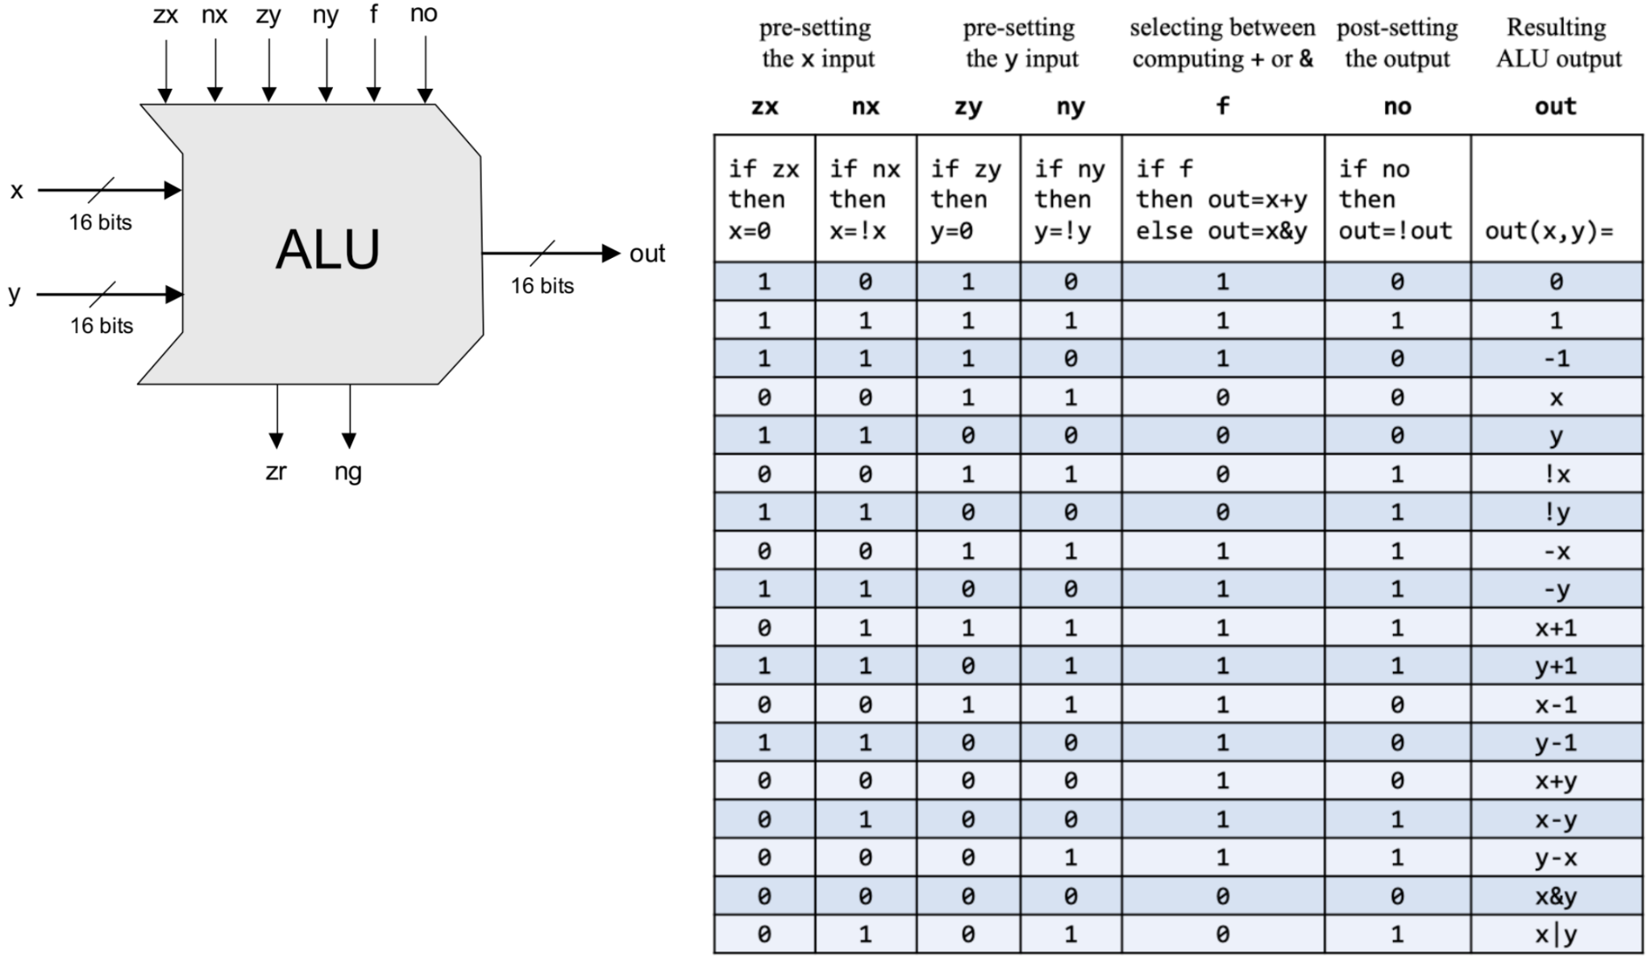
ALU control
inputs

Slide 26
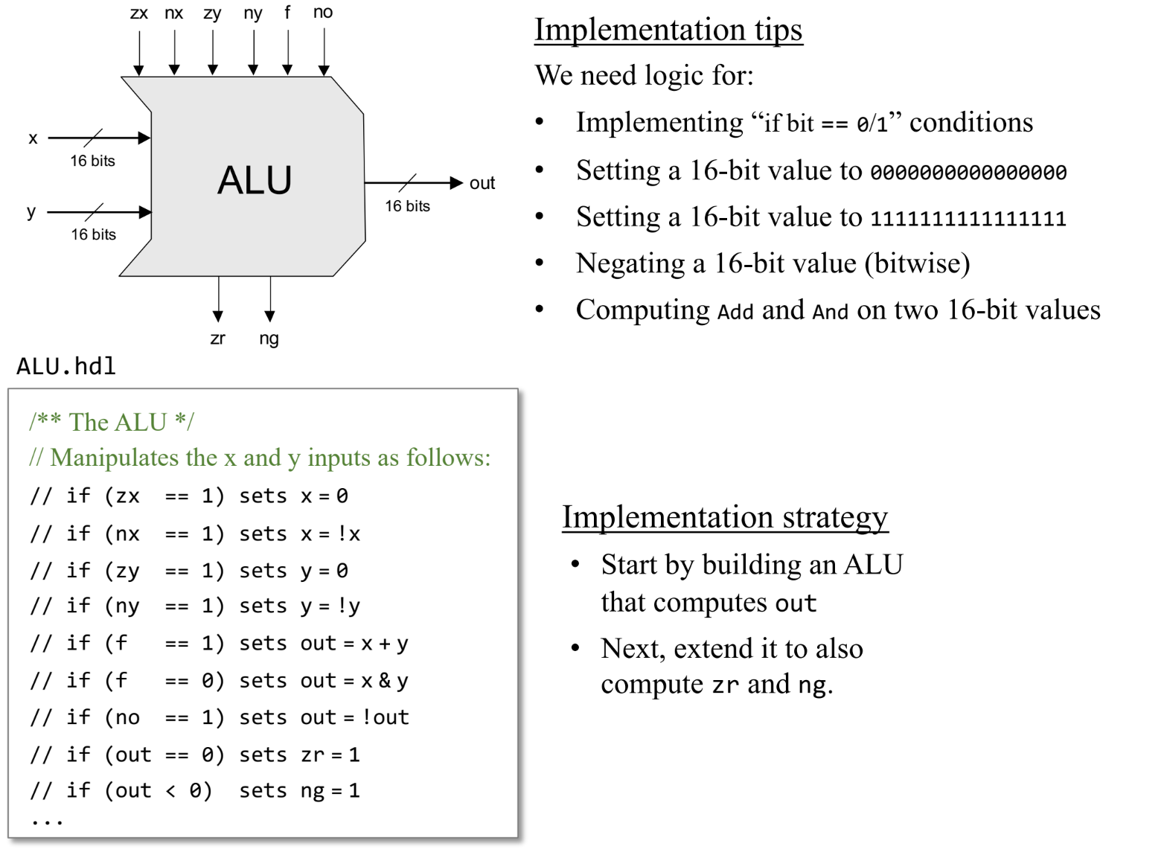
ALU
implementation

Slide 27
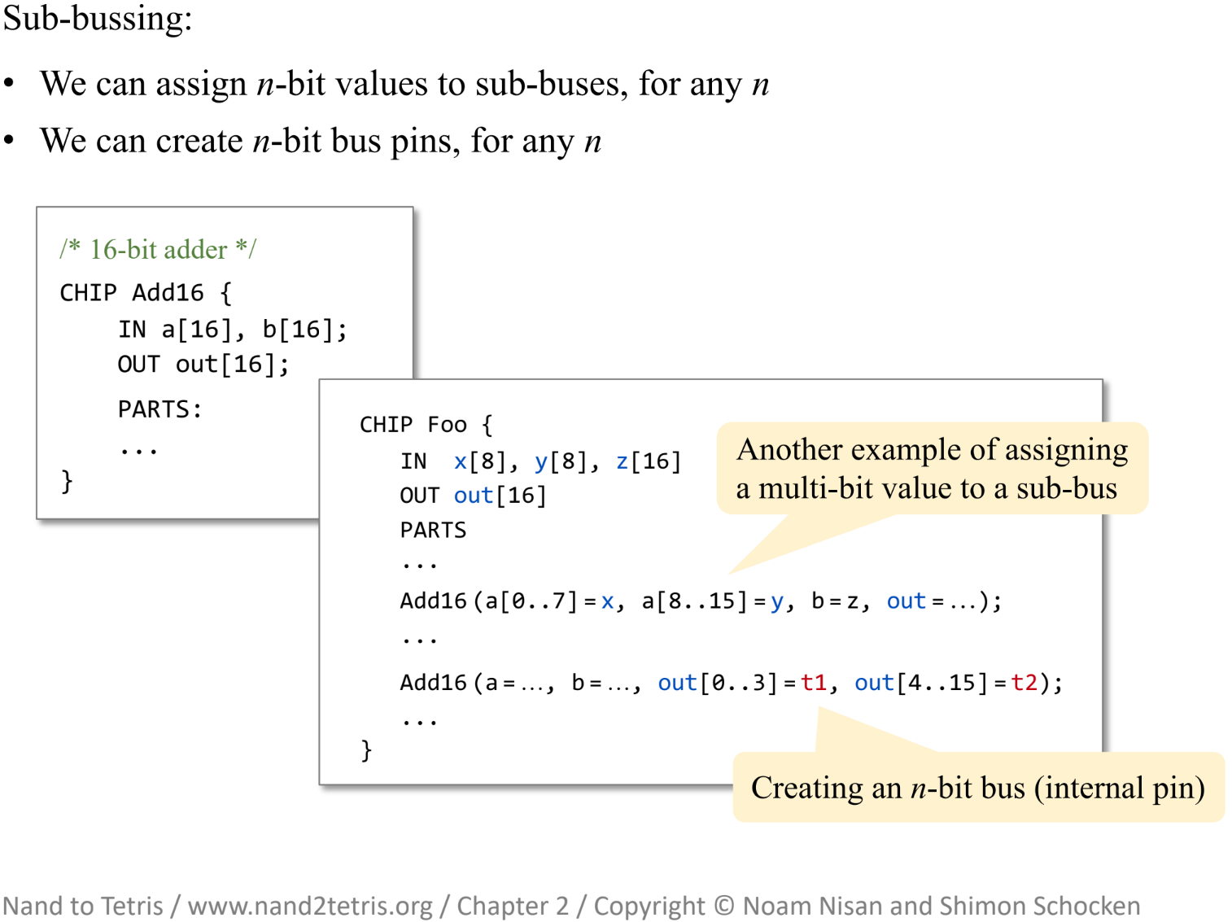
Useful bus tips (1)

Slide 28
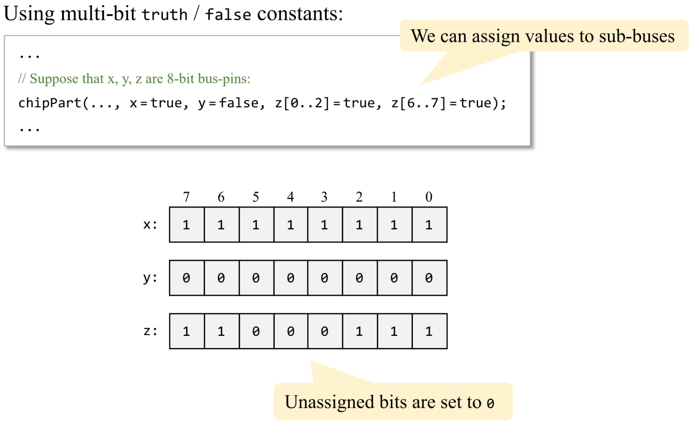
Useful bus tips (2)

