Slide 1


Introduction to High Performance Computing (HPC)
QLS 612 - 2022
Brent McPherson, PhD

Slide 2
The goals of this lecture are to:
Describe the structure of HPCs and how they differ from other traditional computers and common approaches.
Laptops / Desktops
Introduce the concepts of using High Performance Computers (HPCs).
How to begin effectively using HPCs in your work.
This will reference concepts covered in the “Introduction to the Terminal and Bash” and “Containerization” lectures.

Slide 3





Modern NeuroData Science Requires Computers
No part of our research can progress without access to useful computing resources.
Data is acquired and stored on computers.
Data preparation and curation is performed on computers.
Analysis and modeling require computers.
Visualization and reporting or results require computers.
The distribution and reporting of results require computers.
If at any point our work cannot continue in a digital space, it has effectively ended.
In order to maximize our ability to perform innovative work in a field dependent on modern computational advances, a useful understanding of these machines is necessary.

Slide 4
The Concepts of High Performance Computing (HPC)

Slide 5

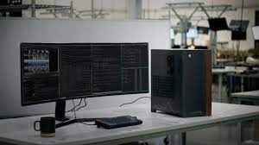
Concepts of HCP - Working on a personal computer (PC)
Everyone is familiar with this.
You’re using one now.
These machines are designed to facilitate the most common needs of the most people.
However, the limits of these machines can be easily reached when performing modern neuroscience analysis.
Notes:
ADD - table of approximate hardware specifications for a laptop / high end workstation

Slide 6
Personal Computer (PC)
Core
Core
Peripherals:
Screen
Keyboard
Mouse
etc.
Memory
(8 - 64GB)
Core
Core
Processor
(2 - 8 Cores)
Graphics Processing Unit*
(GPU)
WiFi /
Ethernet
1 GBit
Local Disk
(500 GB - 3 TB)
* not necessarily present in all systems (laptops)

Slide 7
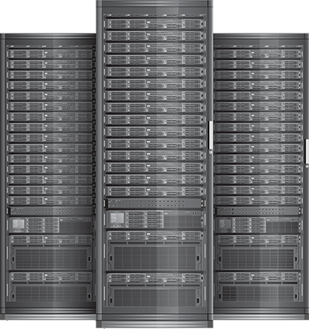
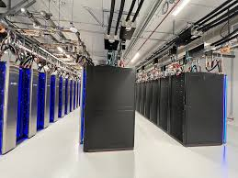
Working on an HPC
These are not “personal” systems, they are multi-user.
You do not interact with them directly, but over a network connection.
The interaction with your analysis amounts to transferring data / results and starting / stopping your analysis “job”.
Typically there is minimal “interactive” computing performed on a HPC
They almost exclusively run Linux

Slide 8
Compute Node
Core
Core
Peripherals:
None
Connects to the rest of the compute cluster.
Memory
(128 GB - 2TB)
Core
Core
Processor
(16 - 128 Cores)
Processing Accelerator(s)
(GPU, TPU, FPGA)
Infiniband
Ethernet
1 - 10 GBit
Local Disk*
(500 GB - 3 TB)
* it may be less and / or have higher access speed

Slide 9
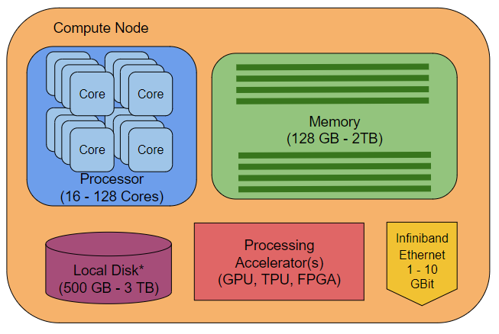
HPC Cluster
Login Node
Scheduler
Data Transfer
. . . . . .
Data Storage /
Archive

Slide 10
The Anatomy of a Computer
PCs
HPCs
1 CPU
2 - 8 cores
3.5 - 4.5 GHz
8 - 64 GB RAM
500 GB - 3 TB Storage
1 GPU
This may be built into the CPU
WiFi / 1 GBit Ethernet
Single-User System
Good for most general usage
This is likely where you will develop your analysis.
Multiple CPUs
16 - 128 cores per CPU
2.4 - 3.5 GHz
128 GB - 2 TB RAM
500 GB - 3 TB Storage
Not for long term storage
1 - 4 Processor Accelerators
GPUs w/ double precision CUDA
TPUs, FPGAs, Coprocessors, etc.
1 - 10 GBit Ethernet
Infiniband
Multi-User System
Good for high throughput / large models.
Notes:
Use figures

Slide 11



Working on the Cloud - An expensive middle ground
This is most often an option through dedicated research proposals.
The cloud system can be tailored to fit your specific analysis and data requirements.
A large virtual analysis computer
Your own dedicated cluster
The data may be distributed on the cloud already.
This will be very expensive for long term use.

Slide 12
The advantages of a HPC over a PC
The ability to handle larger datasets in a more time efficient manner.
The ability to “Scale Up” or “Scale Out” an analysis.
Scale Up: create a larger single instance of computing resources to run a larger model, estimation, or analysis.
Scale Out: the ability to analyze independent parts of a dataset simultaneously
Independent permutations / cross-validations / simulations.
Different subjects through the same preprocessing preparations.
“Embarrassingly Parallel”
We’ll be introducing you to “Scaling Out” your analysis in the example today.

Slide 13


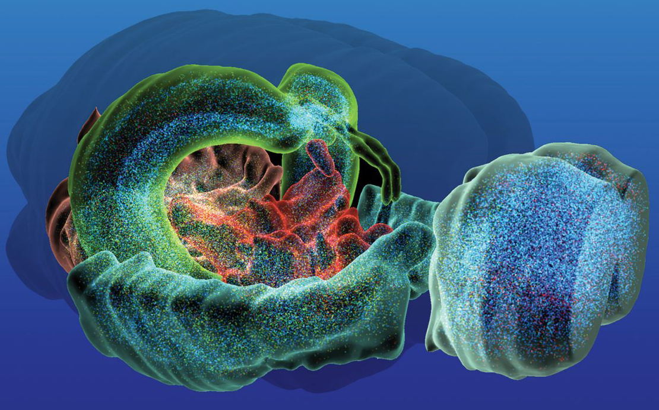
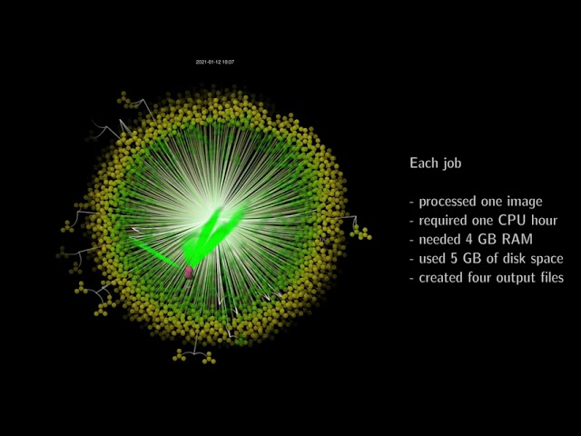
Scaling Up
Scaling Out
UKBB high-throughput replication of over 40K subjects

Slide 14
Beginning to use a Cluster Computer

Slide 15
Accessing the Cluster
This is done exclusively through a remote connection.
ssh, a remote desktop client, etc.
You will connect to the Login Node of the cluster.
The login in node manages the coordination of user processes on the cluster
It also reports the overall status of the system.
You will submit your jobs and query their status from the Login Node.
DO NOT run jobs or do work on the Login Node.

Slide 16
Connect to the cluster using SSH

Slide 17
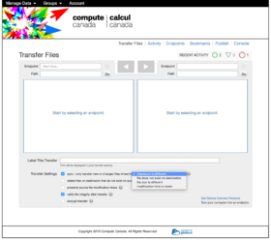
Getting your data on the cluster
I assume your data is on a computer not accessible by the cluster.
You will use a file transfer tool to move your data from where it is to the data server.
scp, sftp, rsync, FileZilla, mobaXterm, etc.
This data server will be accessible to the compute nodes
This may be done through the Login Node, but there may be a specific connection for moving data.
Check with the system administrators.

Slide 18
Getting your data on the cluster - Things to Remember
Be aware of the policies of this server!
Files are often automatically removed after a (potentially short) window of inactivity.
These servers are often not backed up.
Your home directory (~/) is probably backed up. However, it may not be a good location or have enough space to store data that will run on the cluster.
Once your analysis is complete you need to have a plan to securely store your data long term.

Slide 19
2. Copy over the example analysis scripts

Slide 20
Getting your software on the cluster
The cluster administrator(s) will likely need to install it.
If you are confident you know how the tools works, you may be able to set it up yourself.
Many tools will be readily available on the cluster through modules.
These are an efficient way to add and remove tools installed on the cluster to your session.
They also allow for easier management of different versions of the same tool.
Hopefully, most of the tools you need will already be installed.
Running your code in containers guarantees you have the tools you need to run your analysis.
You do have to a have (or be able to build) a working container of the tool.

Slide 21

Getting your software on the cluster - Modules
How most software is made available to users on a HPC.
A convenient way to set up basic development environments and change between versions.
> module avail
> module load python
> module load python/3.8.0
> module unload python
> module swap python/3.7.0

Slide 22
Running your analysis - Working with a Scheduler
With your data available you need to run your analysis.
You will do this by running your analysis as a Job.
Jobs are submitted to the Scheduler to be performed.
This deploys the analysis onto the compute nodes.
Your entire analysis will need to be scripted.
You cannot interact with or manually input information to a job when it’s running.
Much of what’s been covered in QLS 612 will prepare you for working this way.
Once your analysis script is complete, you create your job script for the analysis.
This script describes the resources needed to successfully run your analysis on the cluster.

Slide 23
Running your analysis - Creating Job Scripts
Your jobs will be defined with a job script to:
Define the system resources to run your job.
Launch and run your analysis on the data.
The job script will be submitted to the scheduler from the login node to be added to the queue.
The scheduler uses your resource requests and your priority to determine what runs when.
Your outputs, along with logs, will be created for each job you submit.
The example today will assume you are Scaling Out your analysis.
You want to run a common process across many subjects
i.e. fMRIPrep, FreeSurfer, etc.

Slide 24
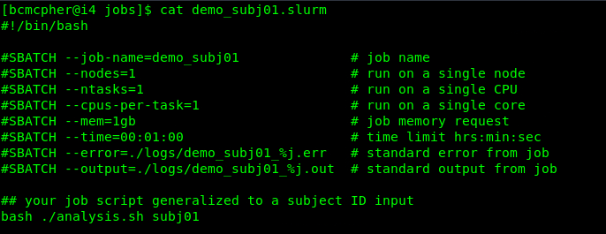
Notes:
Add content of example job script

Slide 25
Running your analysis - be efficient
For every job you run, you will have
The input data
Your analysis script
The job script and logs
Your result(s)
Just like your analysis, you should script as much of your cluster jobs as possible.
You should never be individually modifying job files for subjects.

Slide 26
The Example
The example today reports back a short log about the system status of the node before waiting.
This will let you see the different nodes your jobs ran on.
The analysis input wants a subject ID as an input
This is is likely how you would set up a symmetric analysis across your subjects.
The goal is to provide a basic working template for your job scripts that you can modify.

Slide 27
3. Make and submit your jobs
4. Monitor their status
5. Cancel a job
6. Explore the documentation and modify your resource requests.
7. Run the script in a container?

Slide 28
Commands
> ./mk_jobs
> find jobs -type f -name "*.slurm" | xargs -n 1 sbatch
> squeue -u USERNAME
> sacct
> seff
> scancel JOBID

Slide 29
Thanks

Slide 31
Evaluating Your Jobs
sacct - SLURM accounting
This function report back the usage of your job
Use this to evaluate
That you job is using all the cores you intended
That you have not over allocated memory or walltime
sacct -j JobID –format=JobID,JobName,ReqMem,MaxRSS,Elapsed
sstat
seff
Lot’s of things to explore here on your own!

