Slide 1
PITCHUP
WOMEN-FIRST CRICKET DEVELOPMENT
Her progress should
travel beyond
the scorecard.
THE PROBLEM TO VALIDATE
01 Fragmented progress
Practice records can get lost
between matches and messages.
02 Limited visibility
Turn everyday training into a personal record,
useful coach context and chosen moments of visibility.
Everyday effort deserves a story
beyond match-day statistics.
03 Control over sharing
BATTING
BOWLING
FIELDING
Women athletes should choose
what to share and with whom.
Presented by Vijaya Rupesh N
ICC × IGNYTE / BEYOND BOUNDARIES
01 / 04
Notes:
PitchUp is a women-first cricket development prototype. Our starting hypothesis is that grassroots women cricketers need a simple way to carry their practice history between sessions, make it useful to a coach, and choose which milestones others see. These are design hypotheses, not findings from completed user interviews. The current scope is batting, bowling and fielding. Presenter: Vijaya Rupesh N. Primary fit: Athlete Health, Performance & Inclusivity, through access and performance records; secondary fit: Sport Visibility & Engagement. We make no injury-prevention or performance-improvement claims. Official challenge: https://challenges.ignyte.ae/competition/1B9DF5DB-F9A0-F011-B3CD-002248CB5C1B

Slide 2
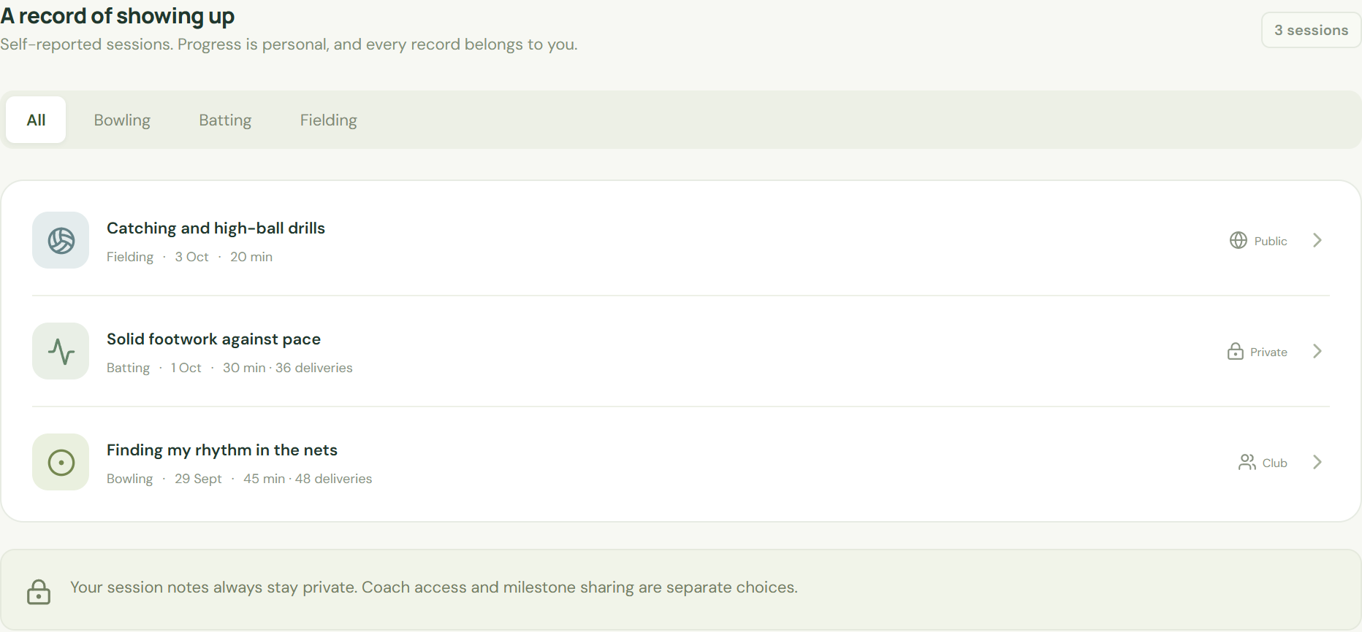
PITCHUP
SOLUTION / ATHLETE CONTROL
Record privately. Make progress visible.
A cricket-specific journey with separate choices for coach access and milestone sharing.
01
Record
Session type, duration, effort
and a private reflection.
02
Understand
Weekly history and comparison
with the athlete’s own plan.
03
Choose the audience
Keep private, share a milestone,
or allow coach access separately.
CURRENT PROTOTYPE • FICTIONAL RECORDS
ICC × IGNYTE / BEYOND BOUNDARIES
02 / 04
Notes:
Walk through the current prototype: record a batting, bowling or fielding session. Batting and bowling capture deliveries; fielding captures duration and notes. See the history and a factual weekly summary. Session notes stay outside the milestone shown in this demonstration, and coach access and the milestone audience are separate choices. The screenshot uses a fictional athlete and records. Our intended differentiation is the combination of cricket-specific training records and athlete-controlled visibility, not simply adding cricket to a generic tracker. Strava already supports cricket. Women-first means designing and testing around women athletes' control, access and visibility; it does not mean unsupported biological assumptions. The current demo simulates roles and audience behavior; production identity, authorization and storage remain planned. Competitor reference: https://press.strava.com/en-gb/articles/strava-adds-five-new-sports-to-enable-more-comprehensive-activity-tracking

Slide 3
PITCHUP
PROTOTYPE / FEASIBILITY & INNOVATION
A working core. A clear path to scale.
Simple inputs → transparent summaries → athlete-selected visibility
01 / WORKING TODAY
02 / RESPONSIBLE AI
03 / PRODUCTION PATH
Cricket records
Grounded guidance
Trust before rollout
React web prototype
Batting, bowling, fielding logs
Weekly history and goals
Rule-based explanations
Sharing and coach demo views
Current insights use rules.
Planned AI explains logged data
and helps draft milestones,
with athlete review before posting.
No injury-risk prediction.
Add sign-in and verified roles
Enforce consent on the server
Move to a managed database
Test access and data deletion
Adapt rules for other sports
Demo: local / browser persistence and simulated roles. No ICC data integration or live athlete pilot claimed.
ICC × IGNYTE / BEYOND BOUNDARIES
03 / 04
Notes:
The deployed app demonstrates the core journey with browser storage fallback; the local prototype also includes a Node API and domain rules. Today, explanations are deterministic comparisons against self-reported records and the user's own plan. There is no integrated machine-learning model. A future grounded language model could turn validated records into a plain-language summary or draft milestone, but an athlete must review content before sharing. The production gate is secure authentication, verified coach membership, server-enforced access, durable storage and consent testing. Simulated demo role switching is not production security. Data export and deletion are demonstrated locally. We do not claim medical readiness or injury prediction, nor access to proprietary ICC data. Cross-sport scale would reuse the consent and community layer while adapting and validating sport-specific activity rules.

Slide 4
PITCHUP
IMPACT / PILOT & SUSTAINABLE GROWTH
Start with women’s cricket.
Earn the right to scale.
VALIDATE WITH WOMEN ATHLETES
VALUE & VIABILITY
20 athletes · 4 weeks
Players: progress records. Coaches: chosen context.
Communities: athlete-approved milestones.
Proposed adult-player pilot; recruitment pending.
Start directly with players; no club deal required.
Planned model: free core player access; paid club tools.
Mobile web, no wearable needed; Hindi summary.
Small text records limit storage and compute needs.
Measure logging time, weekly return, sharing
comprehension and usefulness of progress records.
Ask: ICC / Ignyte introductions to women athletes
for interviews, usability testing and an opt-in pilot.
EXPLORE THE LIVE PROTOTYPE
ignyte-icc.vercel.app ↗
ICC × IGNYTE / BEYOND BOUNDARIES
04 / 04
Notes:
The proposed first validation is four weeks with twenty consenting adult women cricketers, recruited directly where possible. No participants or clubs are currently confirmed, and these numbers are a proposed plan, not traction. Before recruiting, complete the production trust work or use moderated usability sessions with fictional data. Measure time to log, weekly return, comprehension of sharing controls and perceived usefulness; use interviews to decide whether coach access solves a real need. Later, willing coaches can test the review workflow. We propose keeping basic player access free and testing paid tools for clubs and academies; no pricing or revenue has been validated. Mobile web and no required wearable reduce hardware barriers. The current Hindi feature is a short summary, not a fully translated app. Text-first records avoid routine video processing, but no environmental savings have been measured. A future ICC pathway could offer opt-in athlete milestones around community programmes or events, with permission and moderation. Our ask is introductions and feedback, not a claim of an ICC partnership. Live prototype: https://ignyte-icc.vercel.app/ . A separate demo video of at most three minutes is still needed for the prototype submission. Official requirements checked against the public competition data on 4 October 2026. Team eligibility and contribution declarations must reflect actual contributors.

