Slide 1
基于人工神经元网络的人脸识别
09016429 陈诚

Slide 2
目录
问题描述
CNN（卷积神经网络）
人脸识别任务
表情识别任务
人脸朝向识别任务
太阳镜识别任务
结论

Slide 3
问题描述
人脸识别任务：输入为图像，输出为图中人脸对应姓名
表情识别任务：输入为图像，输出为图中人脸表情
人脸朝向任务：输入为图像，输出为图中人脸朝向
太阳镜识别任务：输入为图像，输出为图中人物是否佩戴太阳镜
方法：卷积神经网络（CNN）

Slide 4
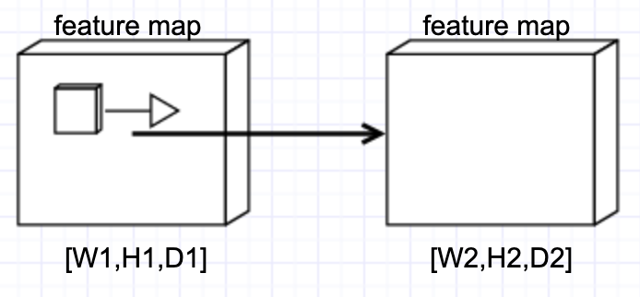
Convolution Layer
输入：W1xH1xD1
4 parameters:
卷积核个数K
卷积核尺寸F
步长S
零填充数P
输出：W2xH2xD2
W2 = (W1-F+2P)/S + 1
H2 = (H2-F+2P)/S + 1
D2 = K

Slide 5
Convolution Layer

Slide 6
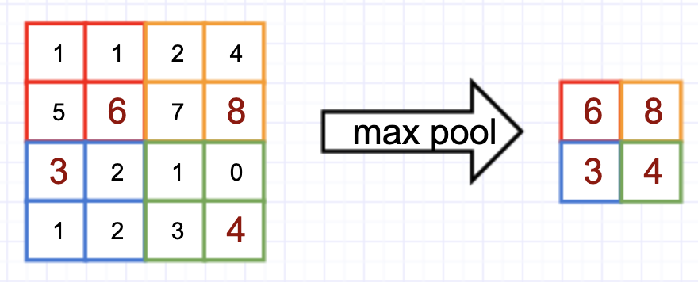
Pooling Layer
输入：W1xH1xD1
2 parameters:
池化尺寸F
步长S
输出：W2xH2xD2
W2 = (W1-F)/S + 1
H2 = (H2-F)/S + 1
D2 = D1

Slide 7
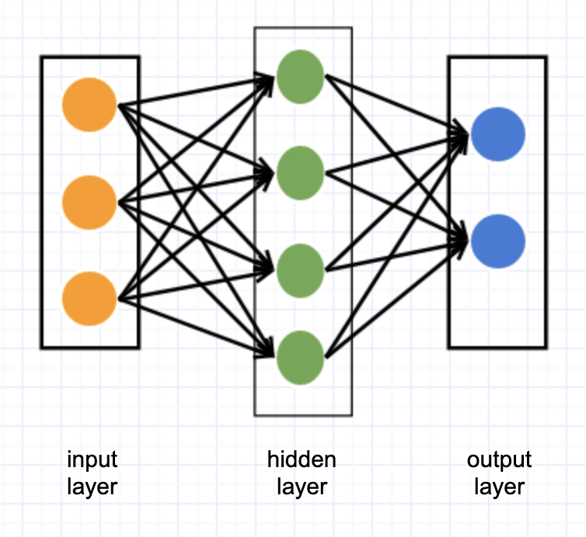

Fully-Connected Layer

Slide 8
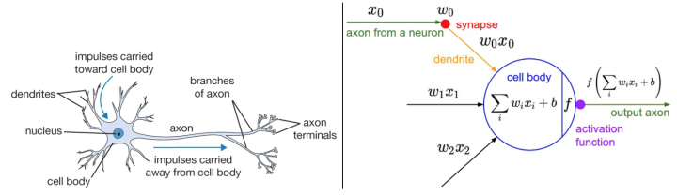
Modeling one Neuron
如图，左边是生物神经元，右边是数学模型，它将神经元的激活率建模为activation function（激活函数）。每个neuron对input和weights进行点积，然后加上bias，最后使用activation function。

Slide 9
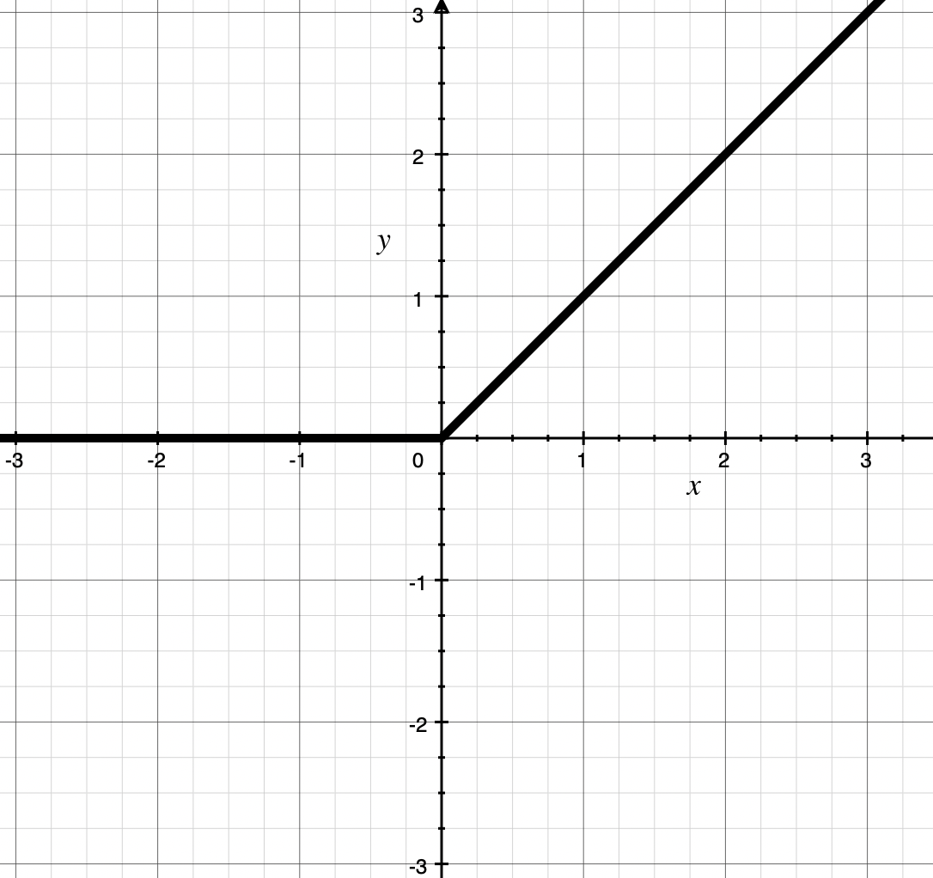
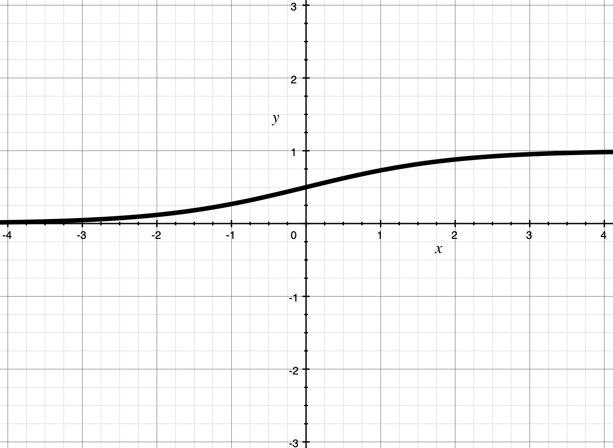
Activation Function
选择ReLU而不选择Sigmoid：
1）ReLU不会产生“梯度饱和”
2）ReLU运算开销更小
3）使用ReLU收敛更快
ReLU
f(x) = max(0, x)
Sigmoid
f(x) = 1/(1+e^{-x})

Slide 10
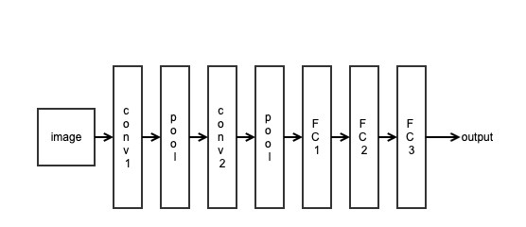
Framework
Net(
(conv1): Conv2d(3, 6, kernel_size=(5, 5), stride=(1, 1))
(pool): MaxPool2d(kernel_size=2, stride=2, padding=0)
(conv2): Conv2d(6, 16, kernel_size=(5, 5), stride=(1, 1))
(pool): MaxPool2d(kernel_size=2, stride=2, padding=0)
(fc1): Linear(in_features=320, out_features=120, bias=True)
(fc2): Linear(in_features=120, out_features=84, bias=True)
(fc3): Linear(in_features=84, out_features=20, bias=True)
)

Slide 11

PyTorch
WHAT IS PYTORCH?
It's a Python-based scientific computing package targeted at two sets of audiences:
A replacement for NumPy to use the power of GPUs
a deep learning research platform that provides maximum flexibility and speed

Slide 12
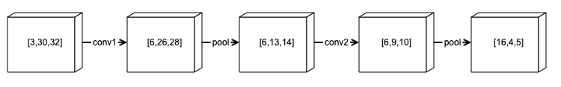
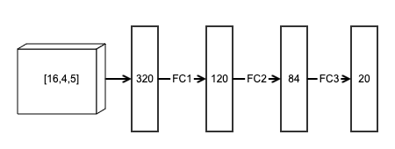
1.Face Recognition
CNN for face recognition

Slide 13
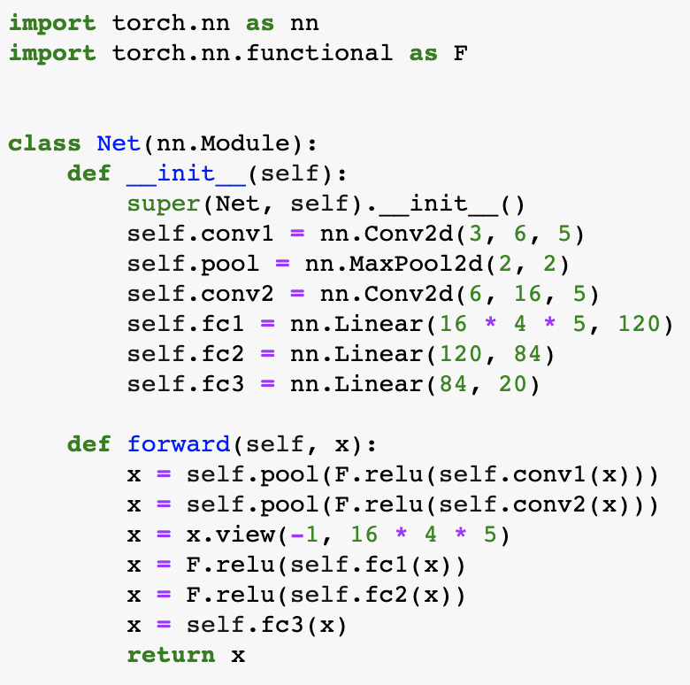
实现——PyTorch
Some Details:
数据集按8:2的比例划分为trainset和testset
preprocess: Normalization
loss function: CrossEntropyLoss
optimizer: SGD with momentum = 0.9
learning rate = 1e-3
epochs = 50
CNN for face recognition

Slide 14
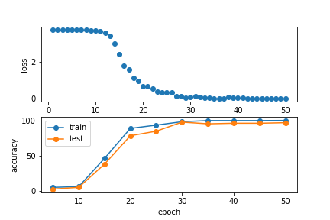
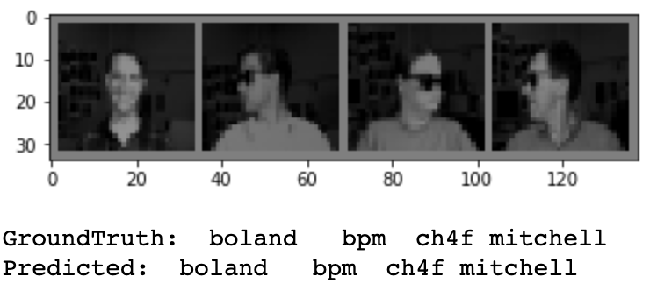
实验结果
epoch: 50 loss: 0.001
epoch: 50 acc_train: 100.000%
epoch: 50 acc_test: 96.800%

Slide 15

2.Expression Recognition
CNN for expression recognition

Slide 16
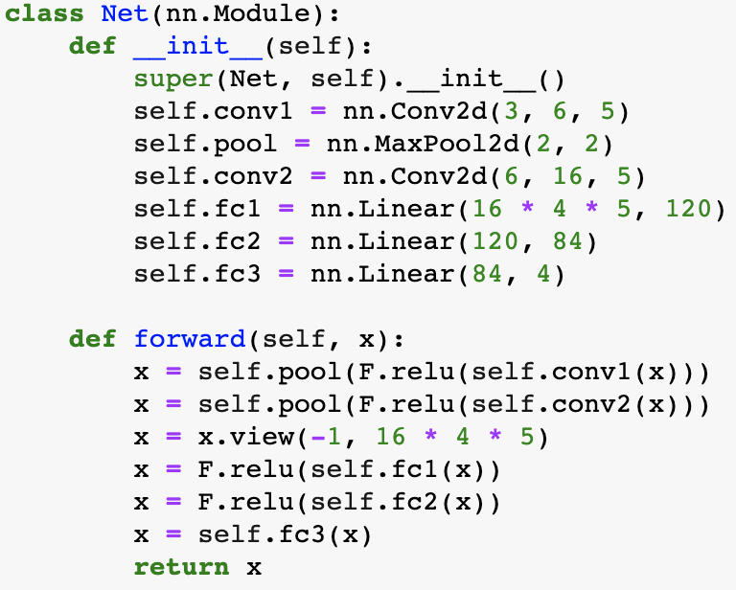
实现——PyTorch
Some Details:
数据集按8:2的比例划分为trainset和testset
preprocess: Normalization
loss function: CrossEntropyLoss
optimizer: SGD with momentum = 0.9
learning rate = 1e-4
epochs = 50
CNN for expression recognition

Slide 17
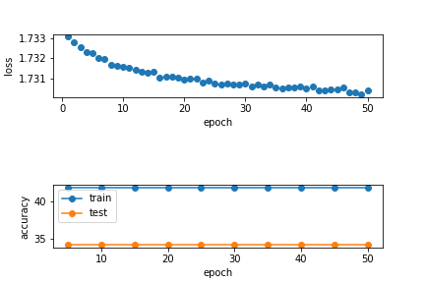
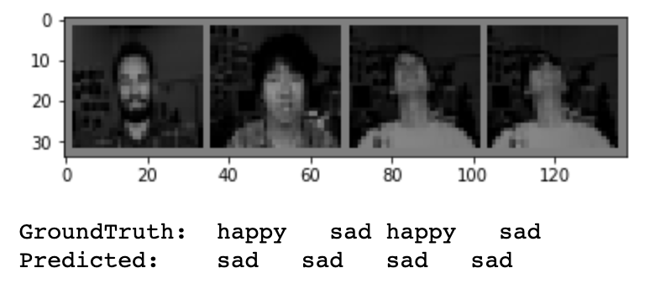
实验结果
epoch: 50 loss: 1.730
epoch: 50 acc_train: 41.854%
epoch: 50 acc_test: 34.200%

Slide 18
3.Pose Recognition
CNN for pose recognition

Slide 19
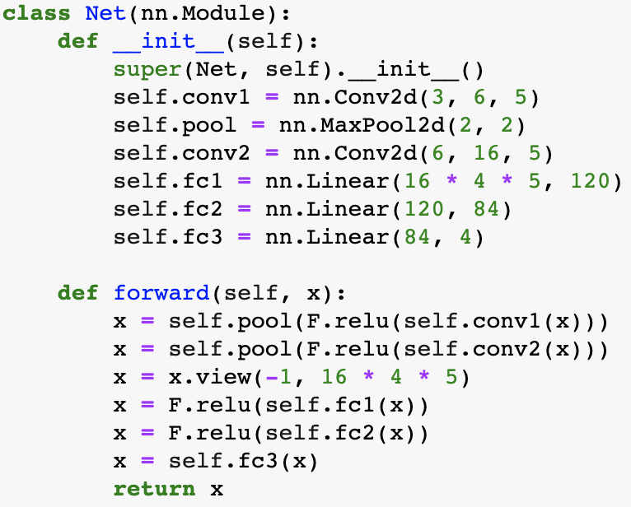
实现——PyTorch
Some Details:
数据集按8:2的比例划分为trainset和testset
preprocess: Normalization
loss function: CrossEntropyLoss
optimizer: SGD with momentum = 0.9
learning rate = 9e-4
epochs = 50
CNN for pose recognition

Slide 20
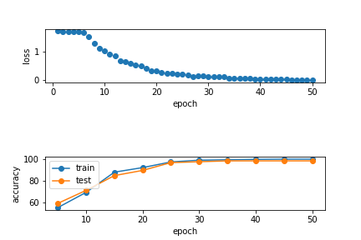
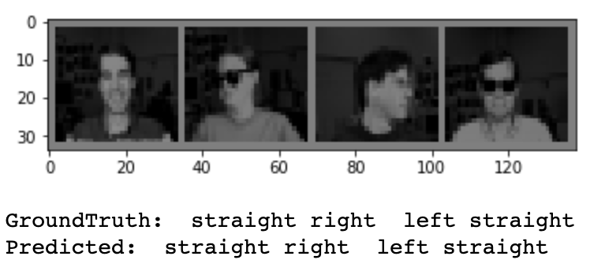
实验结果
epoch: 50 loss: 0.003
epoch: 50 acc_train: 100.000%
epoch: 50 acc_test: 98.400%

Slide 21

4.Sunglasses Recognition
CNN for sunglasses recognition

Slide 22
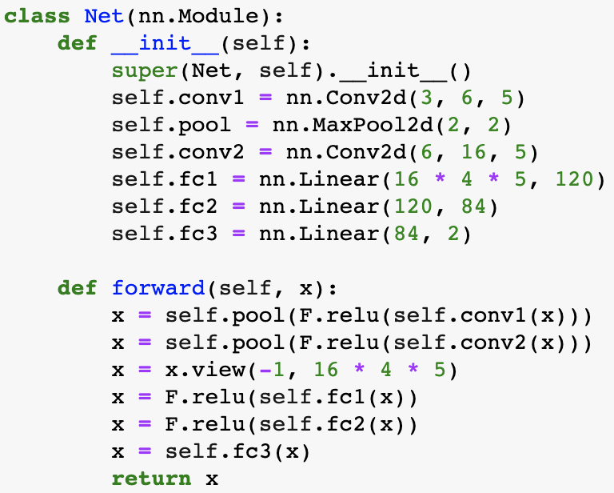
实现——PyTorch
Some Details:
数据集按8:2的比例划分为trainset和testset
preprocess: Normalization
loss function: CrossEntropyLoss
optimizer: SGD with momentum = 0.9
learning rate = 1.5e-3
epochs = 50
CNN for sunglasses recognition

Slide 23
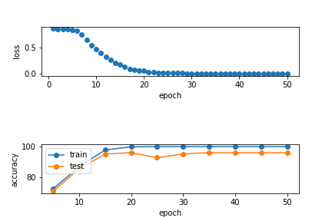
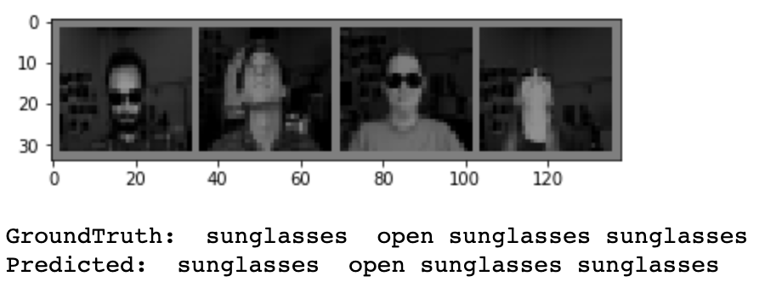
实验结果
epoch: 50 loss: 0.001
epoch: 50 acc_train: 100.000%
epoch: 50 acc_test: 96.000%

Slide 24
结论
本次实验中所用的卷积神经网络对于识别人脸、朝向以及是否佩戴太阳镜具有较好的效果。
表情识别的效果不佳。推测原因为数据像素低，导致所含特征不足以用来识别表情。

