Slide 1

Fine-tuning LLMs
D200: Machine Learning in Economics

Slide 2
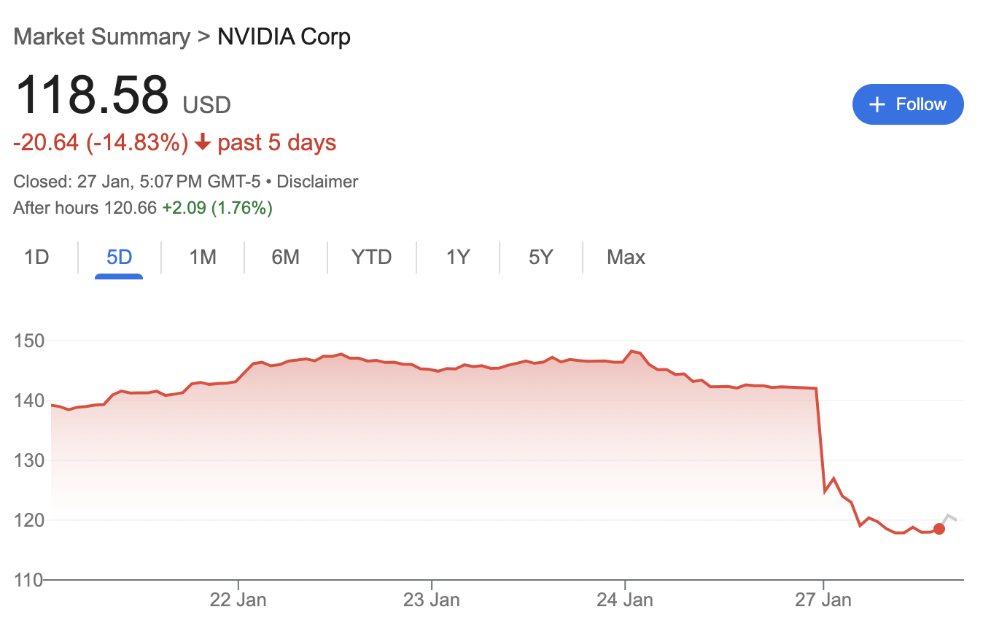
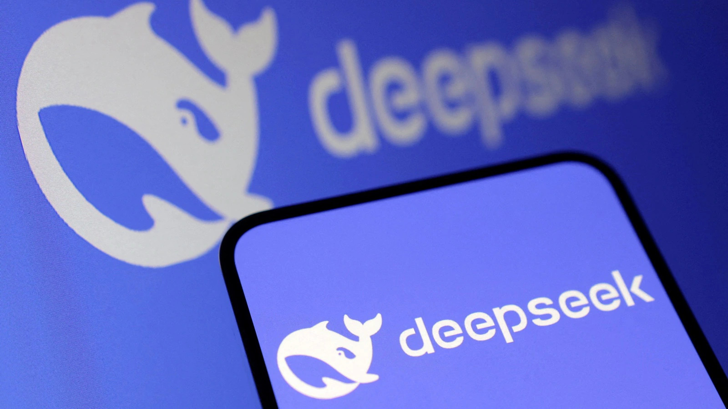
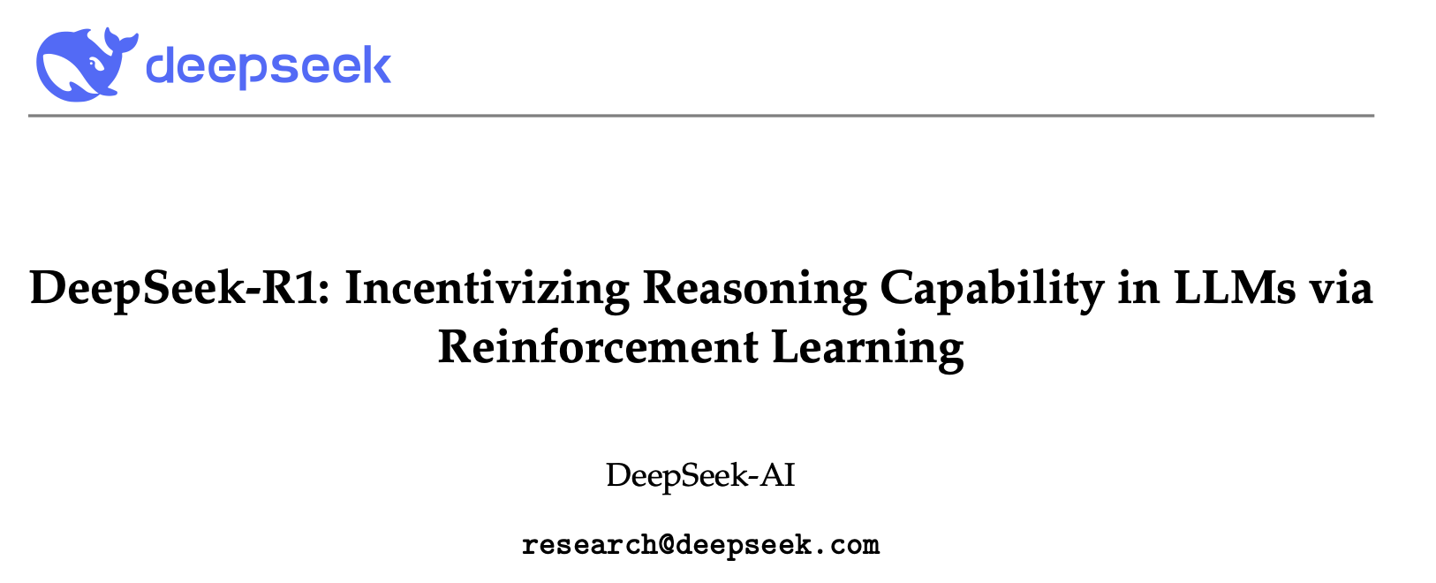
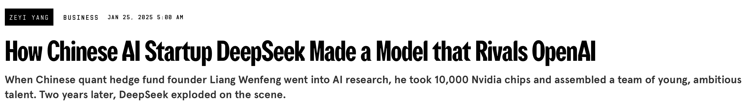
January 2025
arXiv:2501.12948v2
Notes:
Deepseek-R1 matched OpenAIs GPT-4 on many tasks. Beat it on coding and maths benchmarks most importantly
3-4x less compute for training
Deepseek: 5-6 million
GPT-4 : 100+ million (cited esimates)
Not just “scaling wins”, post-training via fine-tuning with supervised fine tuning and clever RL (GRPO) works – wake up call for industry!

Slide 3

Setup for Hands-on Exercises
Head to pods.acceleratescience.co.uk
Username: CRSId
Password: Acceler8
Choose VSCode as your IDE:

Slide 4
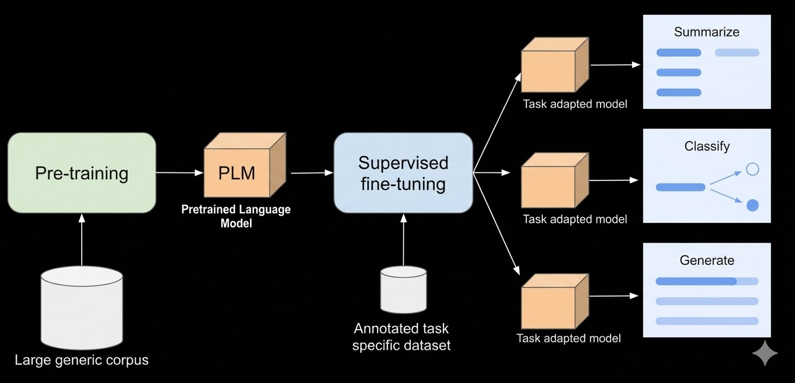
Fine-tuning refers to adapting a pre-trained foundation model to a specific downstream task / domain via post-training on a usually small specialized dataset.
Source: Google Cloud

Slide 5
Overview
Why Fine-tuning?
Entry Points for Fine-tuning
LoRA
Introduction and Theory
Hands-on exercise: fine-tuning a small model for stylistic alignment
Direct Preference Optimisation (DPO)
Introduction and Theory
Hands-on exercise: RLHF for human-preferred responses

Slide 6

Why (Parameter Efficient) Fine-tuning?
Cheaper and faster than training from scratch
Align models to specific tasks
Control style and behaviour
Inject domain knowledge (within limits)
Datasets are usually small
$O\left({10}^{6}\right)$ tokens for effective style alignment LoRA fine-tuning on a small/medium model ($\sim 10-70B$ base model parameters)
Notes:
Cheaper and faster than fine-tuning from scratch. Frontier models 100—1T parameters MoE. Compute for training is in 100M. Fine-tuning trains some subset which even at this scale can cost 500 – 5k. Also takes hours-days compared to months on large clusters. For smaller models you can do this on consumer GPUs! Training a small model is not tractable on a consumer GPU.
For style
Specific tasks meaning reasoning, programming, maths or summarisation
Control style and behaviour

Slide 7







Entry Points for PEFT
API
Third party config-driven frameworks
‘Raw’ Python implementation (PyTorch, Hugging Face, TRL, PEFT)
Level of Abstraction
Today!
Notes:
'Raw’ python; of course not raw python, torch is the lowest level abstraction here. There would be no reason to go deeper than this (e.g. NumPy)
Config controlled: unsloth is more hacky, more lightweight config quick start. Unsloth is faster. Axolotl more robust and configurable.
FOR BOTH OF THESE YOU WILL NEED A GPU, though axolotl, unsloth .etc are likley to be natively more memory friendly. For example flash_attn=True.
API: openAI only 4.1 family, gemini via Vertex AI, Anthropic via amazon bedrock enterprise feature

Slide 8






















Full Fine-tuning (FFT)
Backpropagation
$${\text{Attn}}_{1}$$
$${\text{MLP}}_{1}$$
$${\text{Attn}}_{L}$$
$${\text{MLP}}_{L}$$
$$W_{Q}$$
$$W_{↑}$$
$$W_{Q}$$
$$W_{↑}$$
… | ...
[dog ] | 0.05
[mat ] | 0.82
[lap ] | 0.13
… | …
Embed
$$W_{K}$$
$$W_{K}$$
Linear + Softmax
[The ][cat ]
[sat ][on ]
[the ]
…
$$ℒ_{NLL}=−\sum_{t=1}^{T}{\log{p\left(x_{t} | x_{<t}\right)}}$$
[mat ] held out
$$W_{↓}$$
$$W_{V}$$
$$W_{↓}$$
$$W_{V}$$
$$W_{O}$$
$$W_{O}$$
L transformer blocks
(multi-headed self-attention + MLP)
Linear + Softmax
Embed
$${\text{MLP}}_{L}∘{\text{Att}\text{n}}_{L}∘…∘{\text{MLP}}_{1}∘{\text{Attn}}_{1}$$
$$\left(x_{1},…,x_{T}\right)$$
$$X∈ℝ^{T×d}$$
$$X’∈ℝ^{T×d}$$
$$p\left(x_{T+1} | x_{1}…x_{T}\right)$$
Notes:
Full-fine-tuning
Pretend this task represents something we want to fine-tune for.

Slide 9


Full fine-tuning (FFT)
Checking the till…
When we update the base model weights we need, per parameter:
Weights, gradients, first and second moments of Adam optimiser state
So, roughly 4 copies of the model
Llama 3.1 70B
For bf16 / fp16, that’s $4×2=8$ bytes per parameter.
~560GB total!
Or 7 NVIDIA H100s…
Notes:
For a full update
FLOPs is floating point operations per second
Modern laptop 1-2 TFLOPs

Slide 10
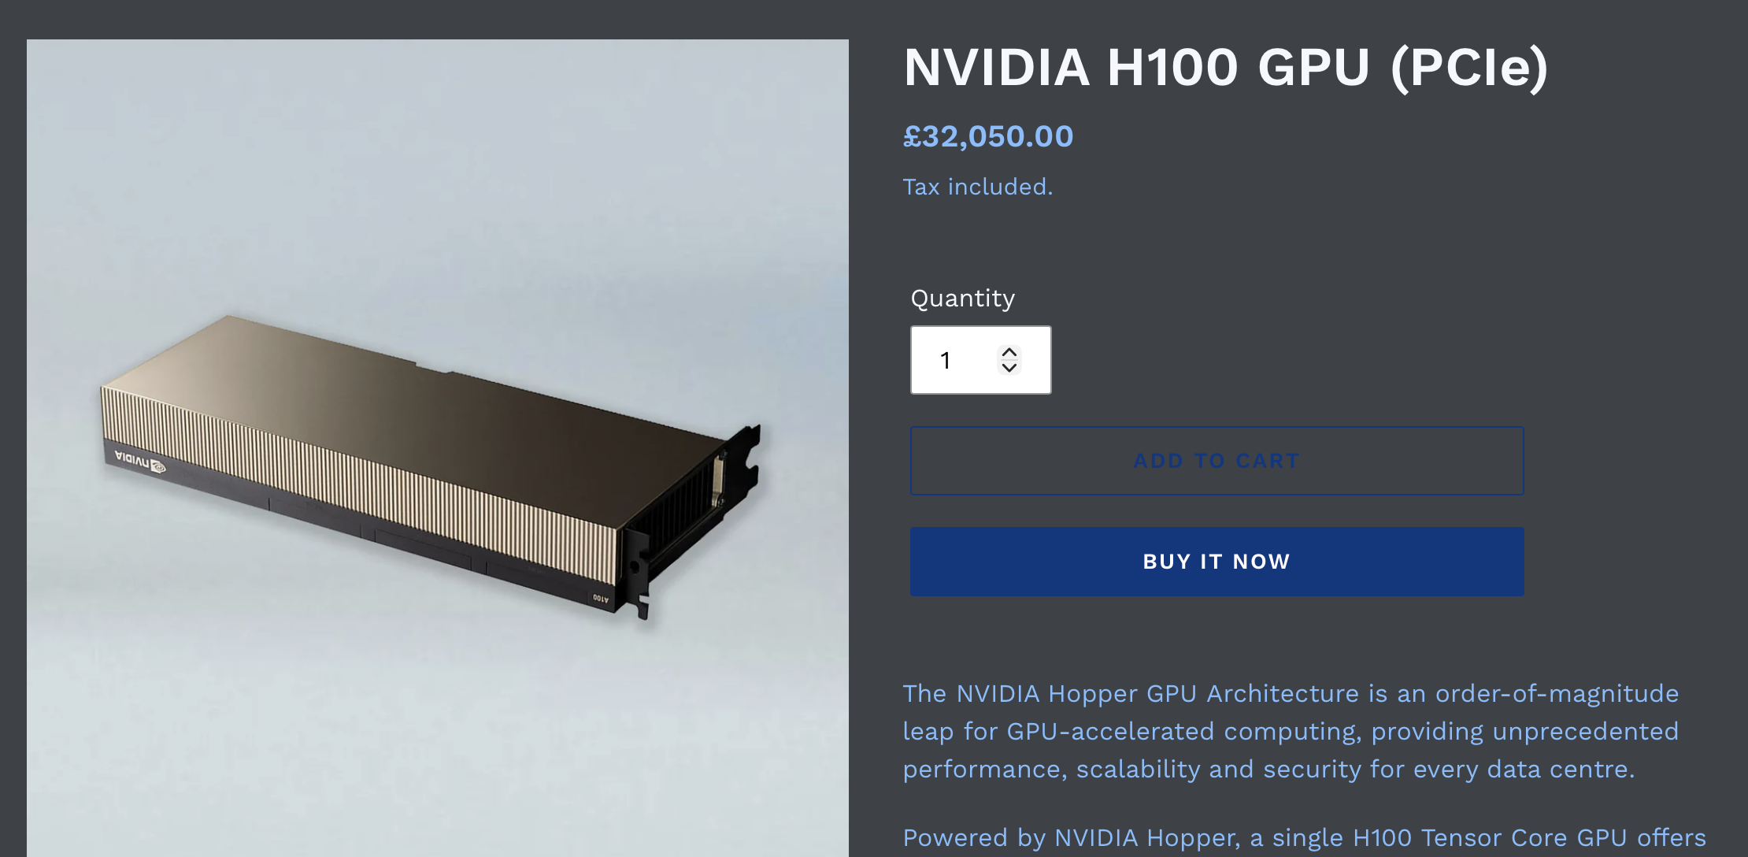

Slide 11

Low Rank Adaptation (LoRA)
At each optimiser step, instead of updating:
$$W_{K}^{\left(i\right)},W_{Q}^{\left(i\right)},W_{V}^{\left(i\right)},W_{↑}^{\left(i\right)},W_{↓}^{\left(i\right)},…∀i∈\left[1,L\right]$$
For a given weight matrix $W_{α}^{\left(i\right)}∈ℝ^{n×m}$, freeze the base weights and update a low rank adapter $ΔW_{α}^{\left(i\right)}$:
$$W⟶W+\frac{α}{r}ΔW ; α,r∈ℝ$$
Update this!

Slide 12


Low Rank Adaptation (LoRA)
This is great, so long as we can make$ΔW$ “parameter efficient”, i.e. better than the $n×m$ parameters defined in $W$
For consistency: $W→W+\frac{α}{r}ΔW⟹ΔW∈ℝ^{n×m}$
$$W=A⋅B ; A∈ℝ^{n×r},B∈ℝ^{r×m}$$
So, that’s $r\left(n+m\right)<nm$ parameters!
LoRA rank ($r$)
Notes:
Rank is the number of linearly independent columns / rows in a matrix and is limited by the lowest dimension of the matrix.

Slide 13

Low Rank Adaptation (LoRA)
Checking the till…
Llama 3.1 70B
Rank 8 LoRA on attention only yields ~10M trainable parameters
10M $× 8$ ~ 80 MB for training state
Base model weights still stored
Quantize to 4-bit (int4), this is known as qLoRA (quantized LoRA)
Base model weights ~ 50 GB
Total: ~50GB
This can fit on a single 80GB GPU very comfortably!

Slide 14
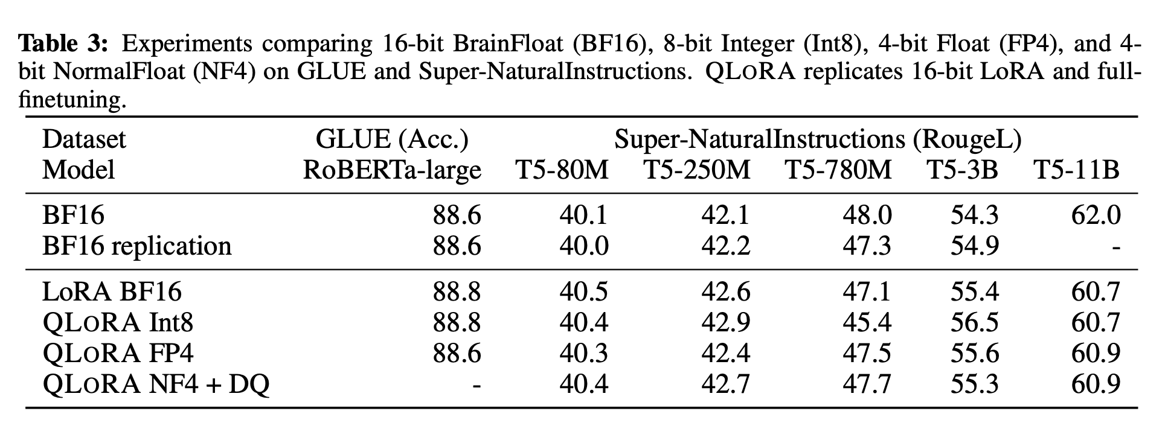
Quantized Low Rank Adaptation (qLoRA)
arXiv:2305.14314v1

Slide 15

LoRA Hyperparameters
LoRA Rank ($r$)
Rank of LoRA adapters, dial for no. of trainable parameters
LoRA Alpha ($α)$
Scaling parameter, usually $α=r$ or $α=2r$
Target Layers
Which matrices of the transformer to apply LoRA adapters to
q_proj, k_proj, v_proj, o_proj, up_proj, down_proj, gate_proj
Micro batch size
Number of samples processed in a single update on the GPU
Gradient accumulation steps
Number of micro batches whose gradients are summed before performing an optimiser update
Notes:
You also have standard ones such as learning rate, num epochs

Slide 16

notebooks/lora.ipynb

