Slide 1



Through the Gaps: Uncovering Tactical
Line-Breaking Passes with Clustering
The Machine Learning and Data Mining for Sports Analytics Workshop ECML/PKDD
Oktay Karakuş, PhD | Hasan Arkadaş

Slide 2
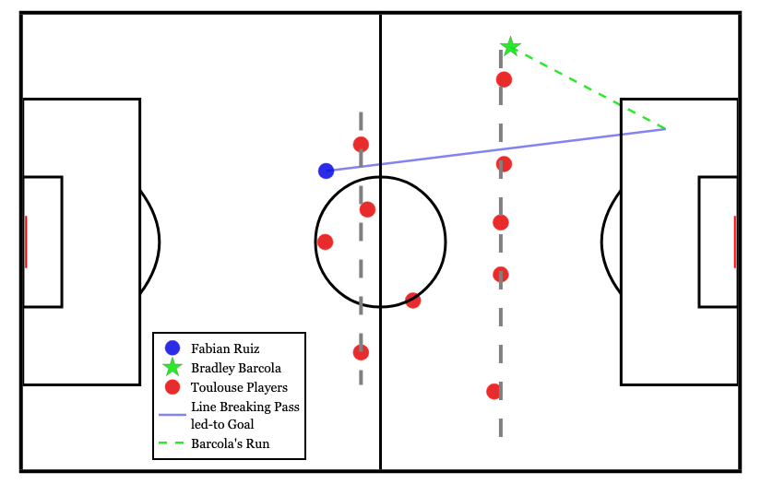


Introduction
Line-breaking passes as a key tactical concept in football
Objective: Detect and quantify LBPs using tracking data
Method: A Clustering-based unsupervised detection PoC
Paris Saint-Germain
2nd Goal Pass vs. Toulouse
Fabian Ruiz (29, CM)
30/08/2025
Data Source: WhoScored

Slide 3
Method
Clustering-based LBP detection using synchronised tracking + event data
It is “dynamic” and “unsupervised” vertical segmentation of opponent players
Dynamic: # of clusters are not fixed.
Unsupervised: No need to train your model.

Slide 4
Key Metrics to Quantify LBPs
2
1
1
2
1
1
D
2
D
D
2
Shot
Assist
Goal
D
3
Shot
Assist
Goal
Positive SBR Negative SBR LBPCh1 LBPCh2
SBR → Space Build-up Ratio: a number to quantify the space around the receiver after an LBP.
LBPCh1 → A single LBP leading to a shot-creating action
LBPCh2 → Two consecutive LBPs leading to a shot-creating action

Slide 5
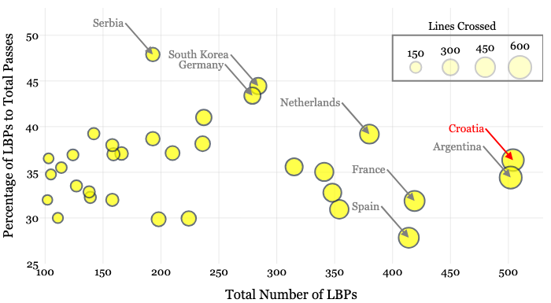
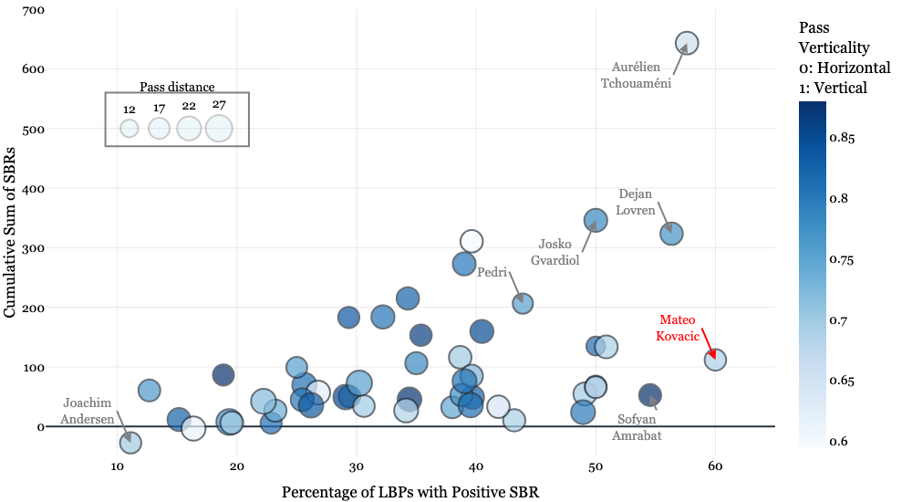
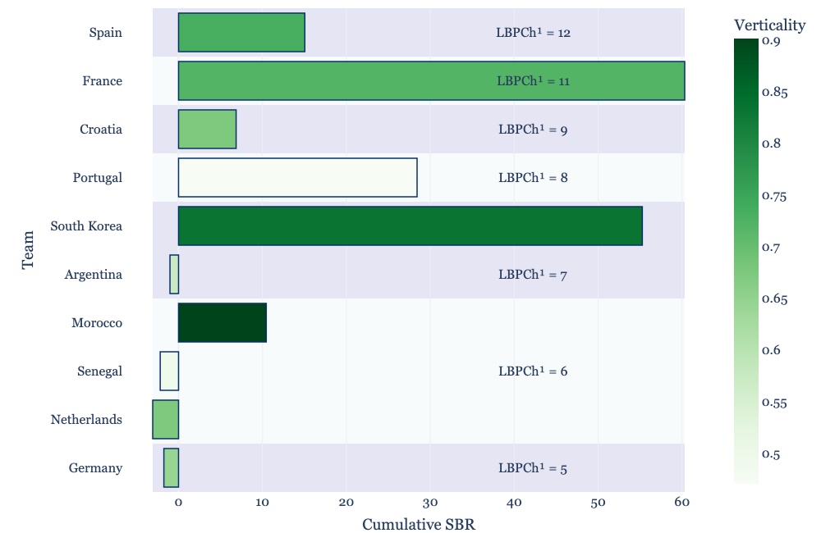
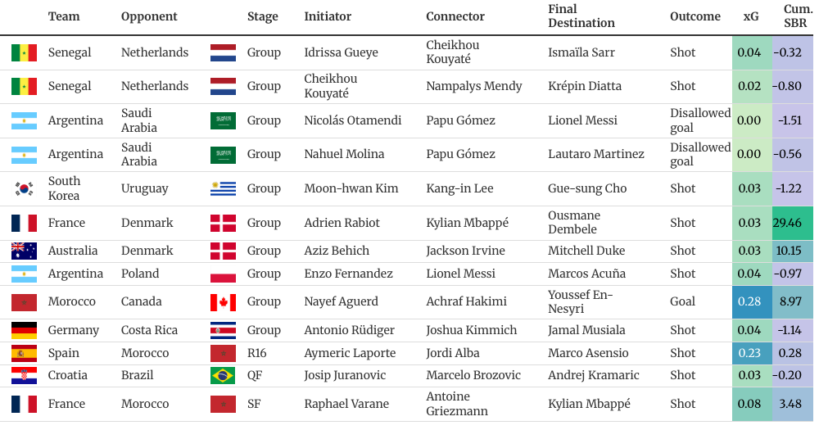
Analysis & Results
Data → The FIFA World Cup 2022 tracking data for all games
Player and Team based analysis via LBP count, SBR, LBPCh1 and LBPCh2.

