Slide 1
Midterm Project Report Back to the Basics – Forward to the Future
On
Development of IoT powered Low cost Vibration Spectrum Analyzer
for
IoT based Smart Manufacturing
Ganesh Kumar (MSM17B034)
Dhilipan SP (MSM17B002)
Chandralekha R (MSM17B027)

Slide 2
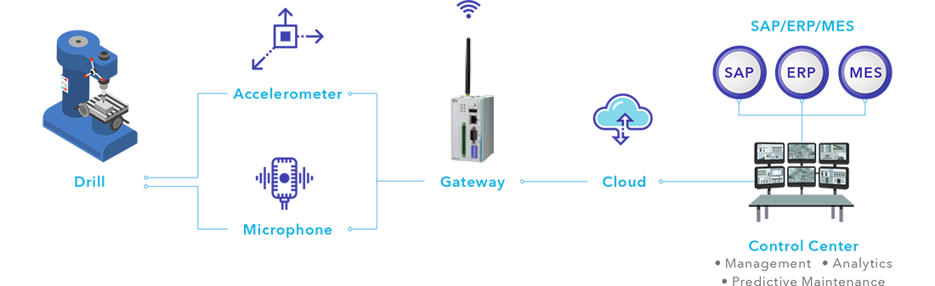
In a Big View !

Slide 3
Problem Statement:
Modern technological processes require the continuous monitoring of many parameters of technological equipment. The most important parameters are mechanical parameters such as periodic mechanical vibrations. Vibration monitoring systems make possible to solve a lot of the problems coupled with vibrations that appear during the technological equipment operations. Thus, DEVELOPMENT OF IoT BASED VIBRATION MONITORING AND SPECTRUM ANALYSIS SYSTEMS FOR TECHNICAL OBJECTS is an important task.

Slide 4
Our Objective…
To design a low cost alternative to vibration monitor and spectrum analyzer using the Raspberry Pi microcomputer and 3-axis digital MEMS ADXL345 accelerometer.
To study if inexpensive vibration monitoring systems could be suitable for condition monitoring
To highlight the impact of different components of the signal chain to the measured vibration signal itself and familiarize the reader with the signal chain found in vibration monitoring.
To analyze vibration parameters in order to predict and prevent possible accidents, thus reducing the costs associated with the failure of the cutting tools, expensive parts and assemblies of the CNC machine

Slide 5
Progress
Developed a Software UI for the Vibrational analysis
Application Specification (MATLAB / LabVIEW)
Target Platform Specification (Remote/ On-board)
Binding
HW and SW Estimation
Partitioning

Slide 6
Progress
Studied the previous work done in this area ( IEEE’s Cited research papers )
Familiarized ourselves with the MATLAB Development Environment
Understood the overall framework of the project
The role of FFT analysis in the project

Slide 7
Progress
Implemented FFTplot.py
Worked in Linux environment but failed in raspberry
WHY? Version constraints 2.7 → 3.6
Matpy lib contradicts……..
Did in Mathscript in Matlab
Succeded in LabVIEW by creating FFT.VI
Enclosed in Drive all the .py, .m, .vi files

Slide 8
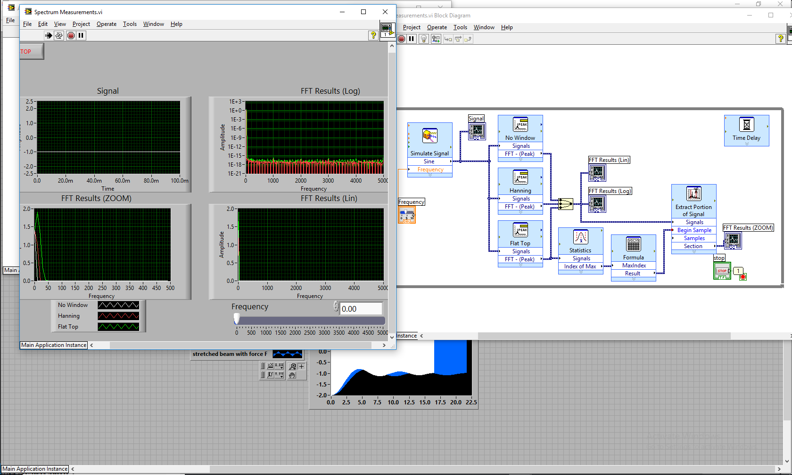
FFT plot UI created in LabVIEW

Slide 9
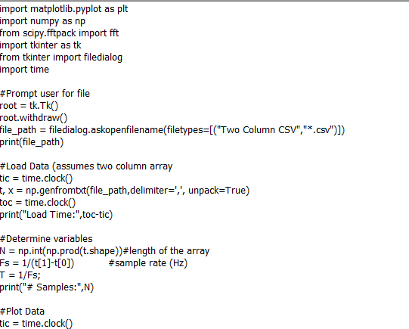
FFT plot UI created in Py

Slide 10
Back to the Basics…
Literature Review
Vibration
Simple Harmonic Motion
Oscillation about a Reference Point
Modeled Mathematically as…

Slide 11
Back to the Basics…
Period, T
Unit Circle
RMS
0
0 to Peak
Peak-to-Peak
Fig.1 Frequency Cycle

Slide 12
Basic Signal Attributes
Static
Slowly Changing
Temperature
Dynamic
Sensor must respond in fractions of a Second
Vibration, Amperage, Pressure

Slide 13
Back to the Basics…
Amplitude
Proportional to the severity of vibratory motion
Expressed as
Peak to Peak
Zero to Peak
RMS
Frequency
Determined by the reciprocal of the Period
CPS or Hz
RPM
Orders
Dynamic Signal Fundamentals
Amplitude
Frequency
Timing
Shape
Timing, or Phase
Represented by the time delay between two signals
Leading
Lagging
Signal Shape
Waveform
Simple
Complex
Pattern Recognition

Slide 14
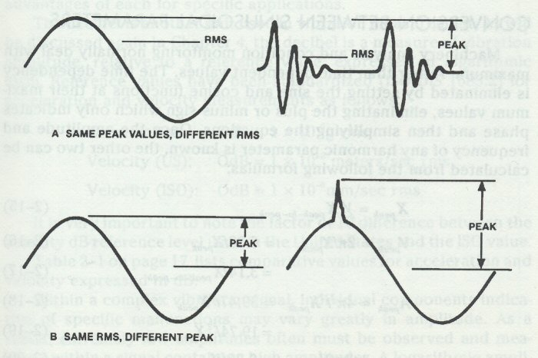
Peak and RMS Comparison
Fig.2 RMS comparison

Slide 15
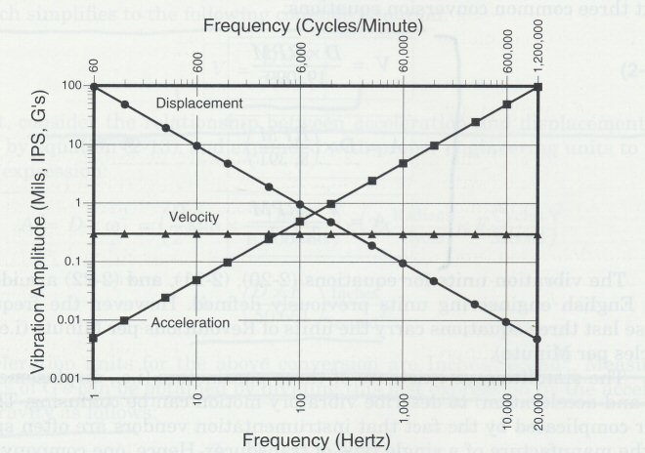
Relationships of Acceleration, Velocity and Displacement
Fig.3 Relationship between v, a, d

Slide 16
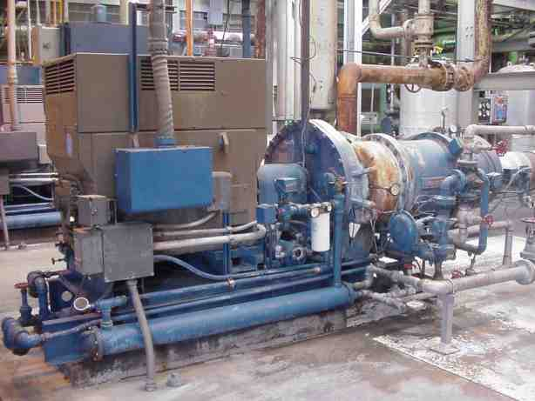
The Big Picture
Sensor(s)
Cables
Signal Conditioning
Data Acquisition & Storage
Communications
Remote Analysis and Diagnostics

Slide 17
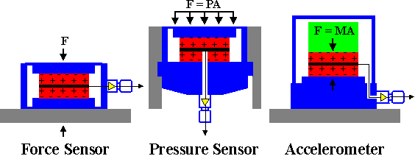
Acceleration Sensors
Fig.4 Types of acc. meter
Pro’s and Con’s
Pro’s
Measures Accel.
Small Size
Easily Installed
Large Frequency Range (1-10,000 Hz)
Con’s
Measures Acceleration (requires Integration to Vel.)
Susceptible to Shock & Requires Power

Slide 18
Voltage or Current?
Current Output Accelerometers
4-20 mA Output
Proportional to Dynamic Signal and/or Overall
Voltage Output Accelerometers
Preferred in U.S.
Generally 100mV per g Sensitivity

Slide 19
AC and DC Signal Components
Signals have both AC and DC
AC considered the “Dynamic” Signal
DC is the “Static” Signal
Displacement Probes – Set “Gap” for DC
Accelerometers – “Bias” voltage is DC

Slide 20
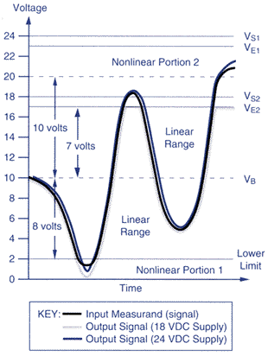
AC and DC Signal Components
How AC and DC work together:
AC signal “rides” the DC bias (V_{B})
Affects the Dynamic Range of the Sensor.

Slide 21
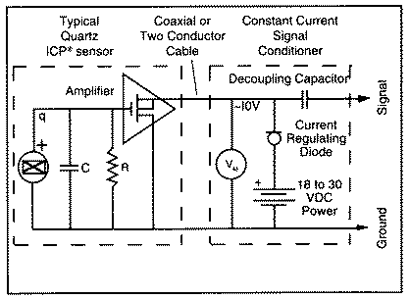
Power Circuit for Accelerometers
“Strips off” DC Voltage

Slide 22
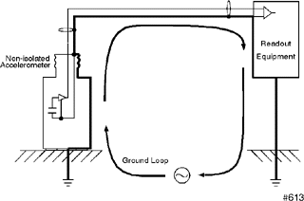
Grounds
A Potential Problem Source
Ground Loops
Caused when two or more grounds are at different potentials
Sensors should be grounded only at the sensor, not the monitoring rack!

Slide 23
Sensor Cables
Coaxial with BNC Connectors
Long Coaxial can become antennas!
Twisted, Shielded Pair
Teflon Shield – ground at only one end!

Slide 24
Sensor Cables
Driving Long Cables
Under 90 feet, cable capacitance no problem –Cable Capacitance spec’d in Pico-farads per foot of cable length
Over 90 feet or so, CCD must supply enough current to charge the cable as well as the sensor amplifier.
May result in amplifier output voltage becoming “Slew Rate Limited”

Slide 25
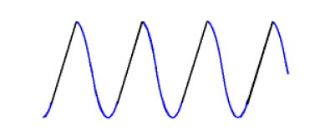
Sensor Cables
Output of Sinusoid looks like this:
What’s Happening?
The + part of the signal is being limited by the current available to drive the cable capacitance.
In the – part of the sin wave, the op-amp must “sink” the current being discharged by the cable capacitance.

Slide 26
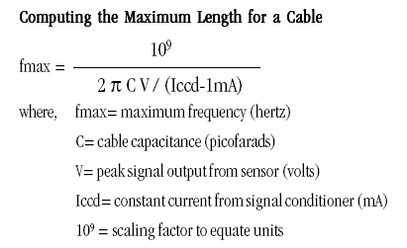
Sensor Cables
Practical Effect:
Signal distortion produces harmonics
May lead to vibration signals being misinterpreted.
To calculate the maximum frequency for a length of cable:

Slide 27
Methodology

Slide 28
Signal Processing Flow
Transducer
Waveform
Amplitude
Time
FFT
Spectrum
Amplitude
Data Collector/Analyzer
Frequency

Slide 29
Signal Conditioning
Gain
Integration (Hardware)
AC/DC Coupling
Anti-Aliasing Filter(s)
Sample and Hold Circuit

Slide 30
Signal Gain Circuit
X1 and X10 are Common
Gain is simply amplification of a Signal
Careful – Should know your vibration level and the ADC input range first!
100mV/g accel; +-5V input range = +-50 g’s
Can “Clip” Signal

Slide 31
Signal Integration
Best to Integrate as close to signal source as possible
Reduces noise

Slide 32
AC/DC Coupling
Normally, Systems are AC coupled
Means that there is a DC blocking Capacitor that only allows AC signal through to the system
MAARS Innovation
DC Switch that allows AC and DC to work on the same data channel without contaminating phase
Allows use of same channel to record data for shaft centerline (DC) and Transient data (AC)

Slide 33
Anti-Aliasing Filters
What are they and why do I need them?
Because “false Frequencies” are displayed when Aliasing is present in a system.
The maximum frequency component a sampled data system can accurately handle is its Nyquist limit.
The sample rate must be greater than or equal to two times the highest frequency component in the input signal. When this rule is violated, unwanted or undesirable signals appear in the frequency band of interest.

Slide 34
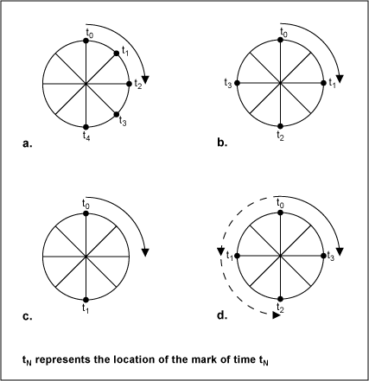
Aliased Signals
In old western movies, as a wagon accelerates, the wheel picks up speed as expected, and then the wheel seems to slow, then stop. As the wagon further accelerates, the wheel appears to turn backwards! In reality, we know the wheel hasn't reversed because the rest of the movie action is still taking place.
What causes this phenomenon? The answer is that the shutter frame rate is not high enough to accurately capture the spinning of the wheel.

Slide 35
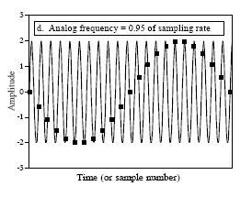
Aliased Signals
False low-frequency sin wave…
Caused by sampling too slowly
Violated the Nyquist Criterion

Slide 36
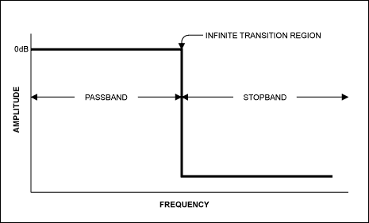
Anti-Aliasing Filters
What are they and why do I need them?
Generally they are low-pass filters that do not pass frequencies above the ADC’s range.
Here is a representation of an IDEAL filter…

Slide 37
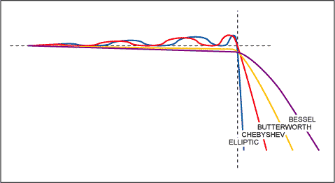
Real Anti-Aliasing Filters
Trade-offs: Elliptic, Chebyshev, Butterworth and Bessel
Elliptic – sharpest rolloff, highest ripple
Bessel – Lowest ripple, fat rolloff.
key advantage is that it has a linear phase response

Slide 38

Sample and Hold Circuit
Purpose is to take a snapshot of the sensor signal and hold the value.
The ADC must have a stable signal in order to accurately perform a conversion.
The switch connects the capacitor to the signal conditioning circuit once every sample period.
The capacitor then holds the voltage value measured until a new sample is acquired.

Slide 39
Data Acquisition and Storage
Analog to Digital Converter
Hard disk vs. Flash Memory
Physical download vs. Ethernet file Transfer
FFT Conversion
Windowing

Slide 40
ADC Analog-to-Digital Converters
The purpose of the analog to digital converter is to quantize the input signal from the S&H
The input voltage can range from 0 to Vref
What this means is that the voltage reference of the ADC is used to set the conversion range
0V input will cause the converter to output all zeros.
If the input to the ADC is equal to or larger than Vref, then the converter will output all ones.
For inputs between these two voltages, the ADC will output binary numbers corresponding to the signal level.

Slide 41
ADC Analog-to-Digital Converters
Dynamic Range
Usually defined in dB, depends on the number of bits used by the ADC
For example, a 12 bit ADC has 2¹² possible data values, or 4,096 “steps” between the lowest and highest values the ADC can see (0 to 5 Volts, typ.)
8-bit is 256 steps
16-bit is 65,536 steps, so more is better, right?

Slide 42
ADC Analog-to-Digital Converters
Wrong!
Steve Goldman’s Book – pp.46-47
“Dynamic Range: The Big Lie”
“That the A/D Converter can sense one part in 16 binary bins is no assurance that the analog circuitry is good enough to insure that the information going into the lower bins is not contaminated by electrical noise.”

Slide 43
ADC Analog-to-Digital Converters
Dynamic Range
For a 12 bit ADC…20 log (4095/1) = 72 db
Theoretical only, electronic noise reduces to 65 db
For a 16 bit ADC…20 log (65536/1) = 96 db
Electronic noise may make this only 80 db
Massively more data to manipulate w/o much practical gain in Dynamic Range.

Slide 44
ADC Analog-to-Digital Converters
Sampling Rate
“Real-Time” Rate in samples/sec
60,000 samples per sec/2.56 = 23,437 Hz Fmax
May also get divided by the number of channels in a multi-channel system

Slide 45
Time Waveform
Amplitude
Heavy Spot
+
0
Time
360 degrees
-
Rotation
1 revolution
3600 rpm = 3600 cycles per minute
60 Hz = 60 cycles per second
1 order = one times turning speed

Slide 46
Time Waveform
Amplitude
+
0
Time
-
1000 rpm
1 revolution
4 blades = vibration occurs 4 times per revolution
4 x 1000 rpm = vibration occurs at 4000 cycles per minute
= 4000 cpm

Slide 47
Time Waveform
Amplitude
+
12 tooth
gear
0
Time
-
1 revolution
1000 rpm
12 teeth are meshing every revolution of the gear
12 x 1000 rpm = vibration occurs at 12,000 cycles per minute
= 2,000 cpm = 200 Hz

Slide 48
+
0
Time
-
+
0
Time
-
+
0
Time
-

Slide 49
Complex Time Waveform
Time Waveform contains all the different frequencies mixed together
+
0
Time
-

Slide 50
Complex Time Waveform
Time Waveform contains all the different frequencies mixed together

Slide 51
We are now entering the Frequency Domain….
FFT - Fast Fourier Transform
Separates individual frequencies
Detects how much vibration at each frequency

Slide 52
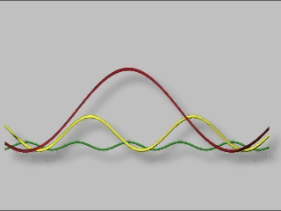
TIME WAVEFORM
AMPLITUDE VS TIME
Notes:
A typical time waveform
Horizontal axis is time in milliseconds
Vertical axis is amplitude of acceleration in G-s

Slide 53
Amplitude
Frequency
Time
Amplitude
Amplitude
Time
Frequency
Amplitude
Time
Notes:
The FFT process (Fast Fourier Transform) is a process which separates out the numerous pure frequencies (Sine Waves) that make up the Time Waveform.
After the Time Waveform is processed the discrete frequencies and their associated magnitudes are displayed.

Slide 54
0
Time
-
1x
Frequency
+
0
Time
-
4x
Frequency
+
Time
0
-
12x
Frequency

Slide 55
Predefined Spectrum Analysis Bands
1xRPM - BALANCE
1.8
2xRPM - ALIGNMENT
1.5
1.2
3-5xRPM - LOOSENESS
0.9
ANTI-FRICTION BEARINGS & GEARMESH
0.6
0.3
5-25xRPM
25-65xRPM
20000
5000
10000
15000
Frequency Hz

Slide 56
Frequency Band Alarming and Trending
Sub-
Har
monic
1X
2X
Bearing
Bearing
Gears
Bearing
Amplitude
1x
2x
25-60 x
Trend of
Balance
Trend of Bearings
Alarm
Alarm
.5
in/sec
Warning
.1
Warning
in/sec
Time
(Days)
Time
(Days)
Notes:
Selective frequency bands are a reliable alarming technique for determining specific machine problems
Much research has been put into the suggested levels and placement of selective frequency bands for common machinery

Slide 57
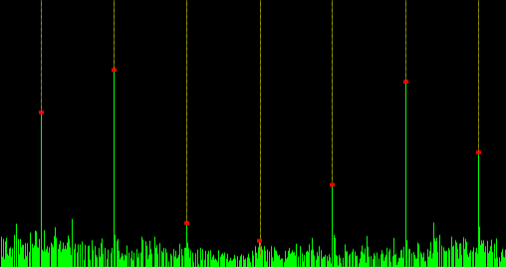

FFT or Fast Fourier Transformer
We Use a FFT to pull data from the time waveform then input to a discrete Fourier transform (DFT), a mathematical process or algorithm that transforms a waveform into the components to a frequency spectrum of the input signal from the time waveform.

Slide 58
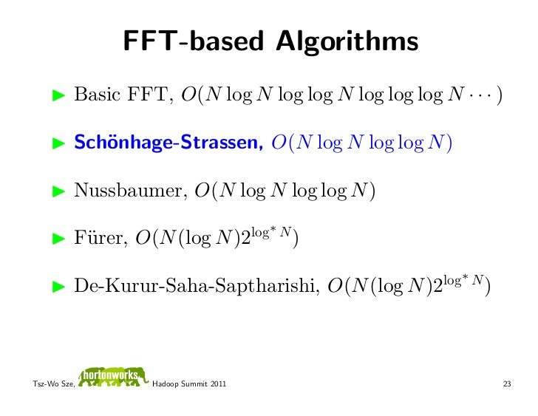
Mathematical Modelling

Slide 59
Discrete Fourier Transform (DFT)
The DFT provides uniformly spaced samples of the Discrete-Time Fourier Transform (DTFT)
DFT definition:
Requires N² complex multiplies and N(N-1) complex additions

Slide 60
Faster DFT computation?
Take advantage of the symmetry and periodicity of the complex exponential (let W_{N}=e^{-j2π/N})
symmetry:
periodicity:
Note that two length N/2 DFTs take less computation than one length N DFT: 2(N/2)²<N²
Algorithms that exploit computational savings are collectively called Fast Fourier Transforms

Slide 61
DIT Algorithm (cont.)
Result is the sum of two N/2 length DFTs
Then repeat decomposition of N/2 to N/4 DFTs, etc.
x[0,2,4,6]
N/2
DFT
X[0…7]
x[1,3,5,7]
N/2
DFT

Slide 62
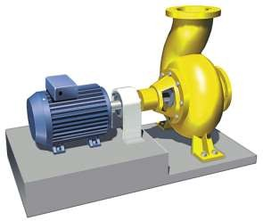




Machine Vibration
Signal from Transducer (in our case Acc. Readings)
Time record
Time window

Slide 63
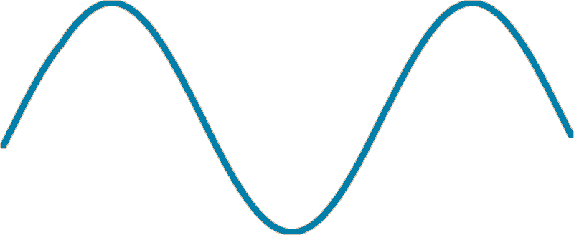
RMS vs. Peak or Peak to Peak
RMS = 0.707 of peak
RMS
peak
peak to peak

Slide 64


Forces Causing Vibration
~99%
Rotational
~1%
Impacts
~0.1%
Friction

Slide 65
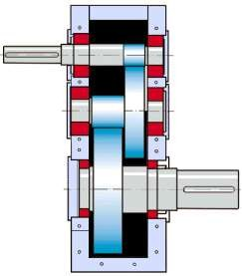

Time domain
Frequency domain

Slide 66



Condition Parameters - Time Domain Calculations
ROTATIONAL
Vibration Forces
IMPACTS / SHOCKS
Periodic / non-periodic transients
CREST KURT SKEW
Crest Kurtosis Skewness factor
FRICTION
Periodic / non-periodic random noise
NL1 NL2 NL3 NL4
ACCELERATION
VELOCITY
ACC
Total RMS-value
of acceleration
VEL
Total RMS-value
of velocity
Used to detect and monitor
Unbalance
Misalignment
Looseness
Wear
Gear damage
Coupling damage
Other shocks/ impacts
Scraping parts
Journal bearing

Slide 67
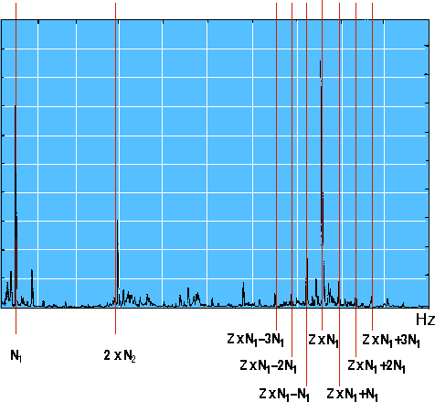



Fault Frequencies Matches

Slide 68
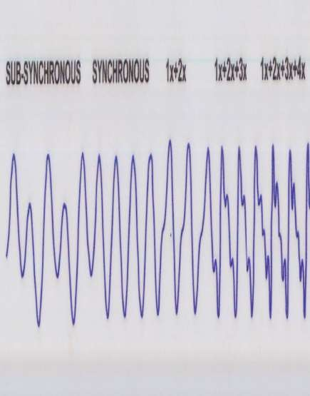
Analysis in the Time Waveform

Slide 69
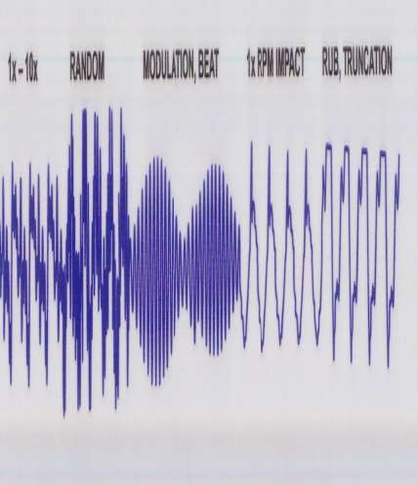
Analysis in the Time Waveform

Slide 70
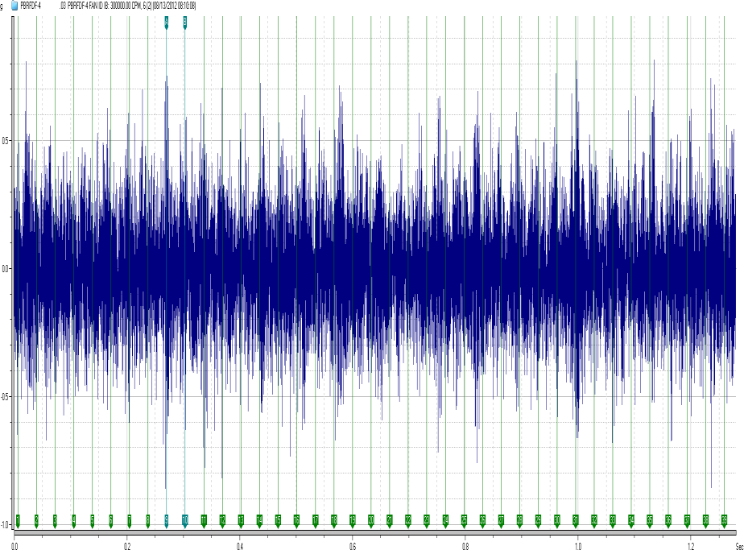
Analysis in the Time Waveform

Slide 71
Windowing
Required to solve “Leakage”
Several Types
Uniform
Hanning – Most Commonly used
Hamming
Blackman-Harris

Slide 72
Windowing
Why do we use the Hanning Window?
Best compromise between frequency resolution and amplitude accuracy for steady-state machinery analysis
Uniform or Flat-Top is the best choice for transient machinery analysis.

Slide 73
Windowing
What is leakage?
Caused when the time waveform signal does NOT begin and end at the same point, introducing spurious frequencies.
The Window or weighting function attenuates the signal towards the edge of the window – minimizing leakage.

Slide 74
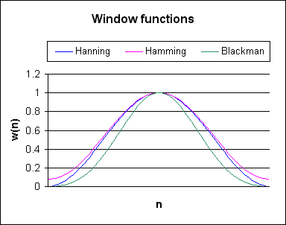
Windowing
Example:

Slide 75
Windowing
Leakage Example:

Slide 76
Windowing
Hanning Window:

Slide 77
Types of Averaging
Linear – Most commonly used
Peak Hold – Coastdown and Impact
Exponential
Weights most recently acquired data more heavily – used for Impact
Time Synchronous –TSA
Triggered by tach – Shaft and Harmon.

Slide 78
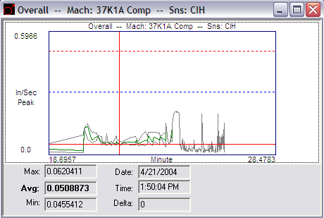
Trending Overalls
Limited Value
Better than Nothing
May miss some types of failures

Slide 79
Spectral Resolution
Common Values
100 to 3200 “Lines”
400 or 800 typical
Fmax/Lines = Frequency Resolution
1000 Hz/400 lines = 2.5 Hz Resolution

Slide 80
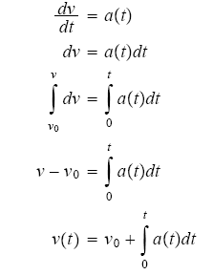
Spectral Integration
Where does the “Ski-Slope come from?
Integrating Acceleration to get Velocity pops out a constant value, which is manifested as a “DC” component because it has no frequency dependence!

Slide 81
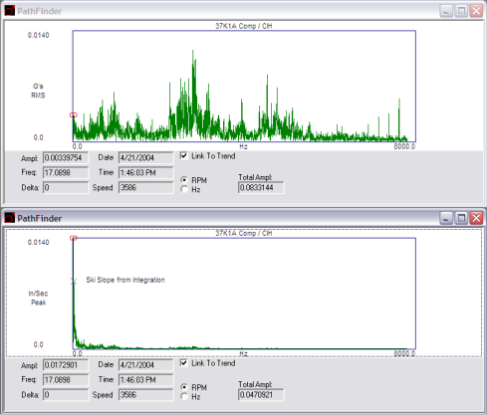
Spectral Integration
How do we solve this problem?

Slide 82
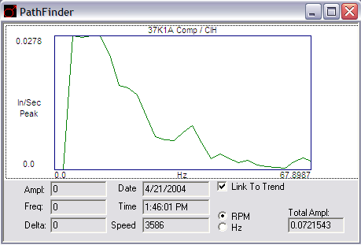
Spectral Integration
Truth is – we can’t!
It’s PHYSICS!
What we can do is…
“Zero” the first 5 or so Spectral Bins!

Slide 83
Spectrum Analysis
Machine Component Condition
Identified by Frequency
Severity Indicated by Amplitude
Rate of Deterioration Indicated by Spectral Comparison over Time

Slide 84
Waveform Analysis
Pattern Recognition is Key
Requires understanding of Machine Components
Gearbox
Bearings

Slide 85
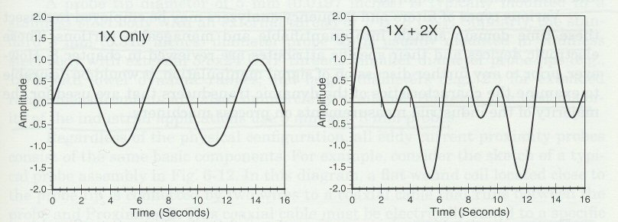
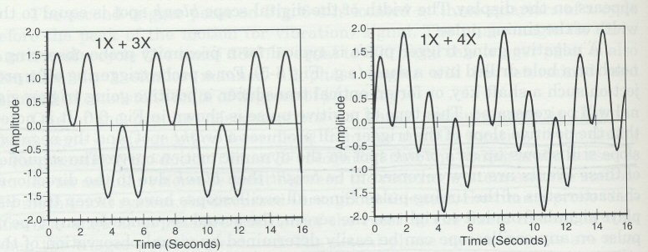
Waveform Analysis

Slide 86
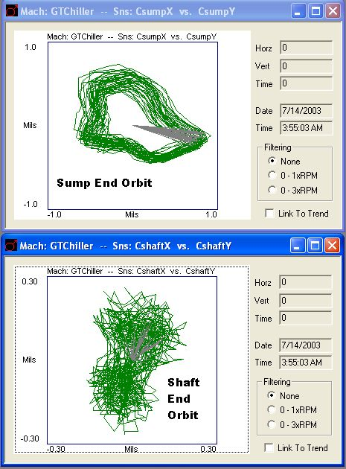
Orbit Analysis

Slide 87
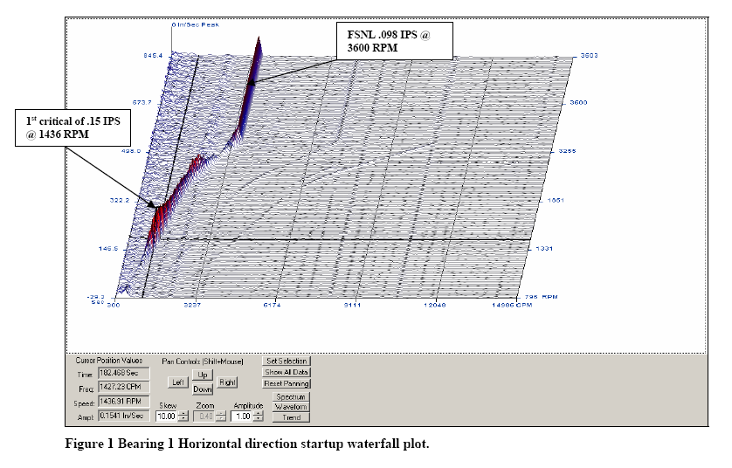
Machine Transients

Slide 88
Vibration Severity
When do I make the call?
Alarm Levels
Fault Levels
Do you use GM, API, ISO Guidelines?
Risk vs. Reward

Slide 89
Future Issues
Need to formalize the communication with other tools
Input Details
Output Details
Other issues
Analysis Details
What information will be needed ?
How to extract that information ?
Binding Issues
Task communication requirements

Slide 90
Communication with tools
HW/SW Estimator
Invocation Details
Tool-specific output needed
Partitioner
Bindings output and segregation of data captured.
Synthesizer tools
C / Py Function Extractor

Slide 91
Other Issues
Profiler
Default DataSet ?
Machinery specific or Generic?

Slide 92
References
1. Marne, N. S. Vibration Measurement System with Accelerometer Sensor Based on ARM [Text] / N. S. Marne, M. S. Nag-mode, R. D. Komati // International Journal of Emerging Technology and Advanced Engineering. – 2014. – Vol. 4, Issue 4. –P. 760–764.
2. Iwaniec, J. Output-Only Identification of Vibratory Machine Suspension Parameters under Exploitational Conditions [Text] /J. Iwaniec, M. Iwaniec // Solid State Phenomena. – 2016. – Vol. 248. – P. 175–185. doi: 10.4028/www.scientific.net/ssp.248.175

Slide 93
References (contd.)
3. Kharchenko, L. Fluctuation of multi-section aboveground pipeline region under the influence of moving diagnostic pistol[Text] / L. Kharchenko, Ye. Kharchenko // Vibration in Physical Systems. – 2014. – Vol. 26. – P. 105–112.
4. Tykhan, M. New type of piezoresistive pressure sensors for environments with rapidly changing temperature [Text] / M. Ty-khan, O. Ivakhiv, V. Teslyuk // Metrology and Measurement Systems. – 2017. – Vol. 24, Issue 1. – P. 185–192. doi: 10.1515/mms-2017-0010
5. Du, W. Y. Resistive, capacitive, inductive, and magnetic sensor technologies [Text] / W. Y. Du. – Boca Raton: CRC Press,2014. – 408 p. doi: 10.1201/b17685

Slide 94
References(Contd.)
6. Kazys, R. Ultrasonic technique for Vibration Measurements [Text] / R. Kazys, R. Sliteris, L. Mazeika // 15th World Conference on Non-Destructive Testing. – Rome, 2000.
7. Li, T. Study on the non-contact FBG vibration sensor and its application [Text] / T. Li, Y. Tan, Z. Zhou, L. Cai, S. Liu, Z. He,K. Zheng // Photonic Sensors. – 2015. – Vol. 5, Issue 2. – P. 128–136. doi: 10.1007/s13320-015-0220-9
8. Rață, G. System for Monitoring and Analysis of Vibrations at Electric Motors [Text] / G. Rață, M. Rață // Intern. Journal ofEmerging Technology and Advanced Engineering. – 2014. – Vol. XXI, Issue 3. – P. 97–104.
9. Eastern-European Journal of Enterprise Technologies ISSN 1729-3774 6/9 ( 90 ) 2017-62

Slide 95
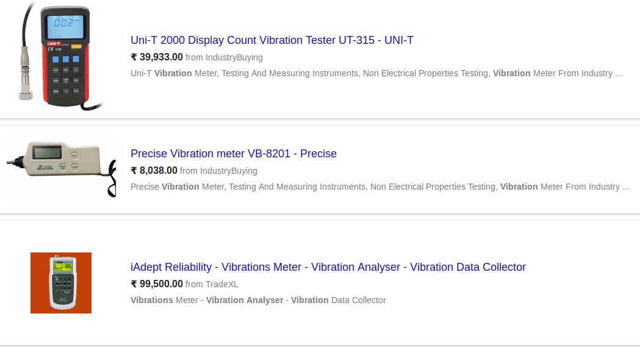
Appendix
Fig. i Market Review of Existing Vibrational Analyser

Slide 96
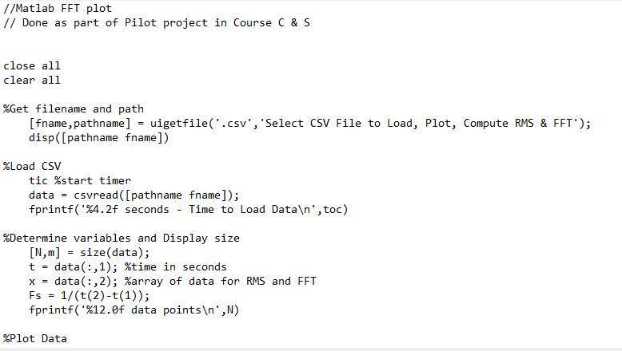
Appendix
Fig. ii Matlab Code for FFT plots

Slide 97
Appendix
All Codes are reposited in GitHub repo :

