Slide 1
Co-Net-Pad
Cesar, Josh, Justin

Slide 2
Summary
What is Co-Net-Pad
Our Motivation
Related Products
Requirements
Features
Design
Development & Testing
Un-Implemented Features
Future Work
Questions
Demo

Slide 3
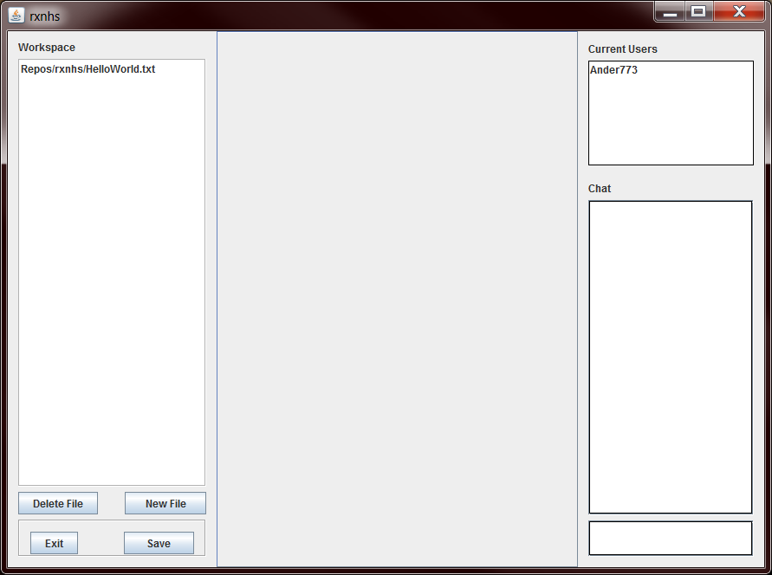
What is it
Co-Net-Pad stands for Collaborative Network Pad
It is an IDE that allows developers to work code simultaneously

Slide 4

Motivation
Looking over one’s shoulder is annoying
This makes it difficult to teach programming languages
It is not comfortable
It is easier and more comfortable to have individual screens

Slide 5
Related Products
Gobby
Multiple documents, multiplatform
SubEthaEdit
Collaborative text editor for Mac OS X
Collabedit
In browser, syntax highlighting
Stypi_
In browser, syntax highlighting, private sessions
Google Docs
Concurrent editing, original inspiration

Slide 6
REquirements
Needed it to be OS independent
We used Java
Users needed their own account
We had username/password login
It needed a reliable network connection
We made it easy to set up the server component
Easy to use and read IDE Editor
Syntax highlighting
Auto complete

Slide 7
Features
Read, Write, and Compile code collaboratively with other users
Support multiple languages
Use GIT for source code management
Create and merge branches
Track and revert changes
Chat with other users when writing code

Slide 8
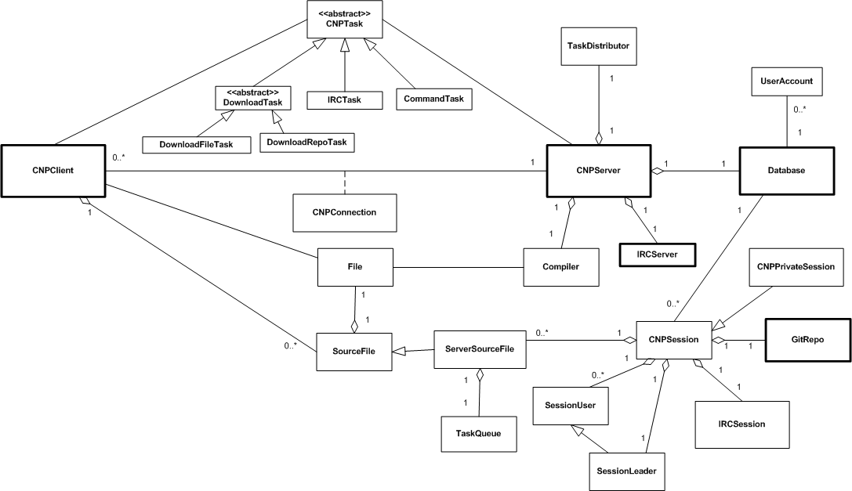
Design

Slide 9
Development & Testing
We used GIT for source code management
Extensive use of branches
We chose to perform unit testing
We use JUnit test cases
We used Eclipse as our main IDE
Eclipse was easy to integrate with GIT
Gave us an easy-to-use form generator
Gave us an easy tool for J-Unit testing

Slide 10
Un-Implemented Features
Unable to implement syntax high lighting
Unable to implement auto-complete
Unable to implement compile option
Unable to allow file download to local computer

Slide 11
Future Work
Implemented the unimplemented features
Create a GUI option for the server
Create an automatic install script for client and server
Add more programming languages
Make the project open source

Slide 12
Demo

Slide 13

Questions?

