Slide 1

The ACM Group
CoNetPad

Slide 2
CoNetPad
Collaborative
Network-based
Editing tool/Pad

Slide 3
Characteristics
Simple
Real-time collaboration and aimed at small software projects.
Audience
Small teams
Educators (mentor-mentee environment)

Slide 4
Motivation
Existing collaboration tools often fail to offer real-time collaboration.
If they do they tend to require long deployment process or non-free services.

Slide 5
Use cases
Programming and AI competitions:
Usually single file with complex content.
Collaboration is important but usually hindered by the lack of quick source code sharing.

Slide 6
Use cases
Educational tool:
Kids can collaborate in simple programming projects.
Professors can provide real-time feedback within the editor itself.

Slide 7
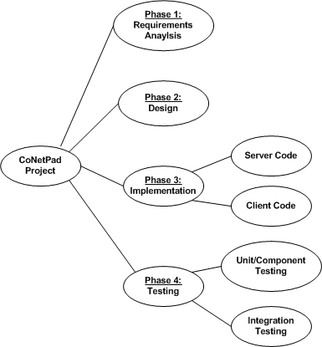
Project Plan
Four main phases
Requirements analysis
Design (system and program)
Code implementation
Testing
Work Breakdown Diagram

Slide 8
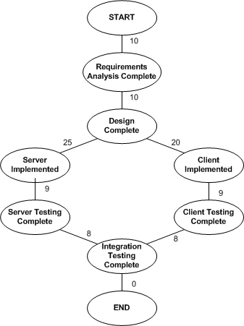
Project Plan
Implementation:
Server code
Client code.
Testing:
Unit testing
Component testing
Component integration
Activity Graph

Slide 9
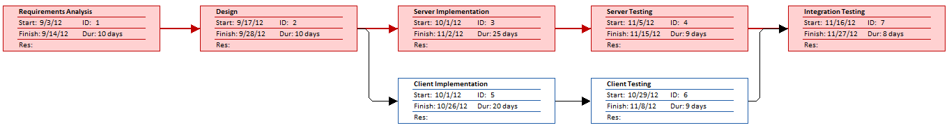
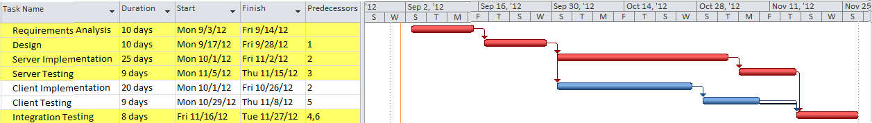
Project Plan
Gant Chart
PERT Chart

Slide 10
Risk Management
Two main components
Server
Client
Components interact asynchronously
Offer a seamless experience
Five major risks
Sockets and networking
Database concurrency and data integrity
Highlighting and auto-complete
Latency problems with network
Time constraints

Slide 11
Errors related to sockets and network
The number of connections and sockets can cause unexpected problems.
low bandwidth
high latency
temporary disconnections
Testing tool will be developed for automated testing
If our network architecture does not work appropriately, we will simplify it.
All of our members have worked with sockets and networking so the probability of this risk is relatively low.

Slide 12
Problems with database concurrency and data integrity
Multiple sources edit a single file is a common source of concurrency problems and data loss.
Queue-based program design that will prevent the problem of multiple writes to a file.
A prototype will be developed early on in our development cycle.
In the case of inherited problems with our design we will move to traditional approach(using a database lock).

Slide 13
Difficulties with highlighting and auto-complete
Highlighting and auto-complete are two important features.
But the implementation for these features is still unclear for the team.
The process of implementing this feature will be decided early on in the design process.
If the implementation is too costly then this features wont be included.

Slide 14
Latency problems with network
Real-time collaboration requires low latency.
Client and server will be tested under different circumstances, making sure that each message takes less than 1.5 seconds.
This testing will be done periodically and after any significant change.
If latency problems arise, we may modify the frequency and/or size of the data exchanged.

Slide 15
Time constraints or personal circumstances
There is always the possibility that personal circumstances may occur.
All the team members are active members of the Association for Computing Machinery.
We can combat this risk using strict schedules and by continuously checking our progress.
If we fail to progress at the expected rate, we will limit our feature set but always emphasizing the best user experience.

Slide 16
Project Management
The ACM Group consists of Josh Tan, Justin Anderson and Cesar Ramirez
Our team will follow a distributed team structure.
Based on our team size and personal experiences, we consider each of us to be capable of taking appropriate decisions.
We will use Git as our configuration management tool.
The repository update policy will require that each member commit their work at least twice a week.

