Slide 1
Using PCA to perform pressure and temperature corrections on muon data

Slide 2
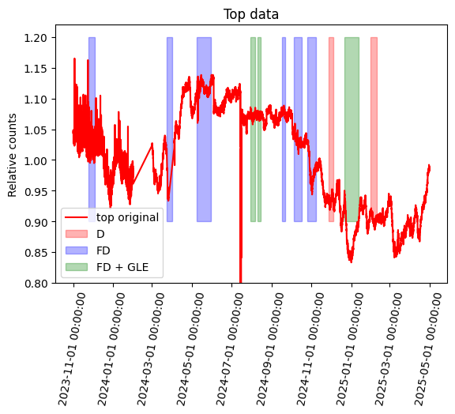
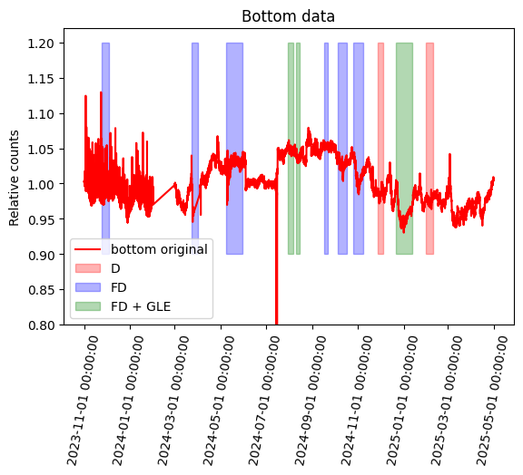
Initial data
Events in the list_of_events.xslx spreadsheet marked
February 2024 has no data

Slide 3
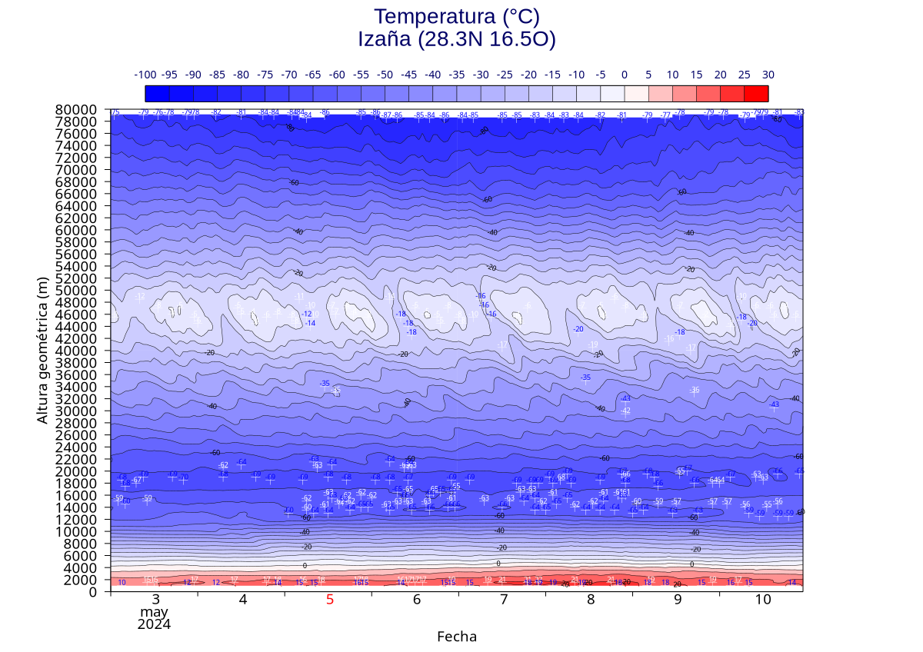
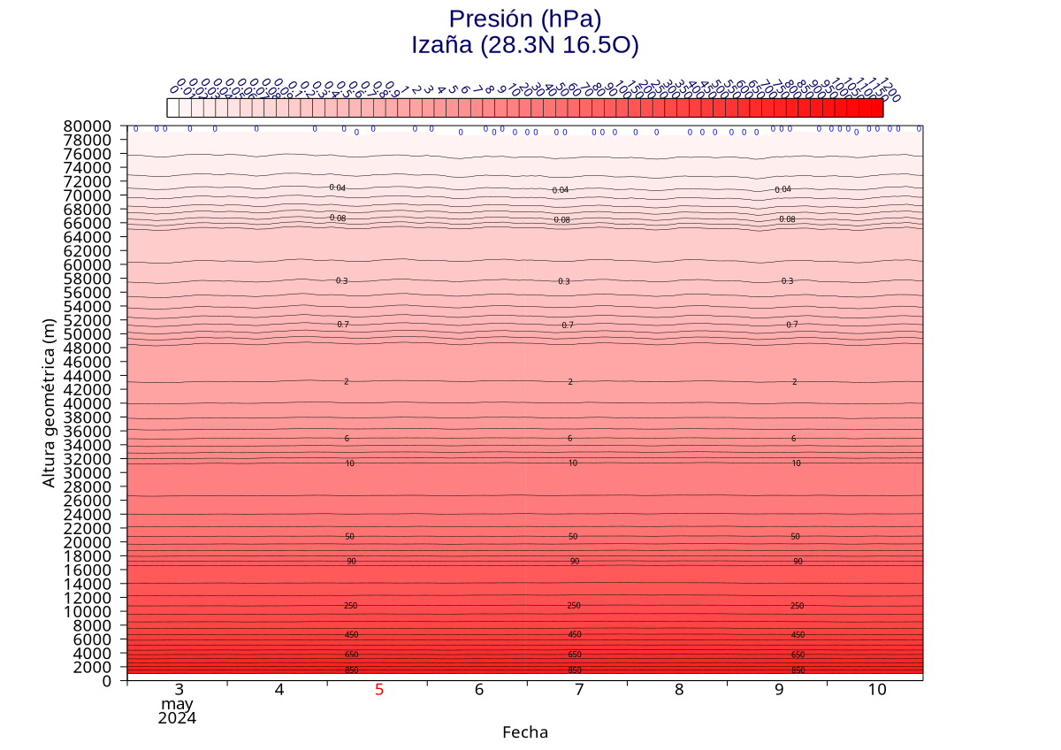
Atmospheric data
Simulated pressure, temperature and humidity data in 500m steps above the ICARO station. Hourly measurements

Slide 4
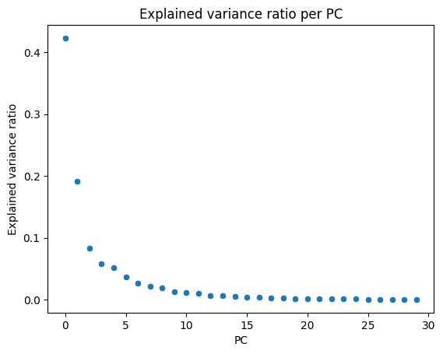
PCA
We take our data and perform a linear transform onto a coordinate system where the directions (principal components) that show the largest variation in the data are easily seen
We use only pressure and temperature data

Slide 5
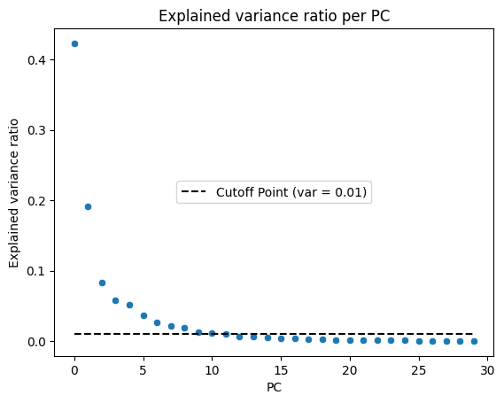
PCA II
We can choose the cutoff point for explained variance. In this work, PCs with under 0.01 explained variance ratio were discarded
This leaves us with the first 11 PCs

Slide 6
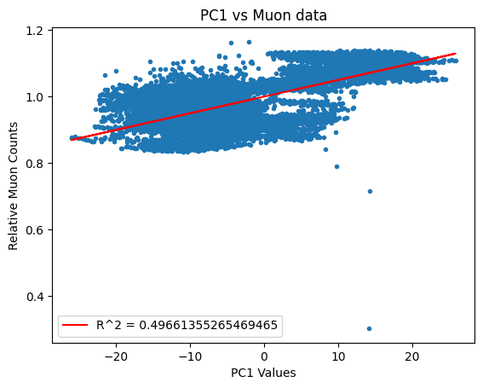
PCA III
We perform a linear regression between the PCs and the muon data and obtain their R^2 and slope values
The PCs with the highest R^2 are used in the correction.

Slide 7
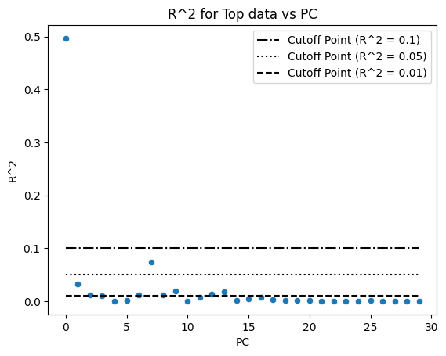
PCA IV
Just like before, we can choose the cutoff point for the R^2 of the components that we want to consider.
The lower the cutoff point, the more components we will use

Slide 8
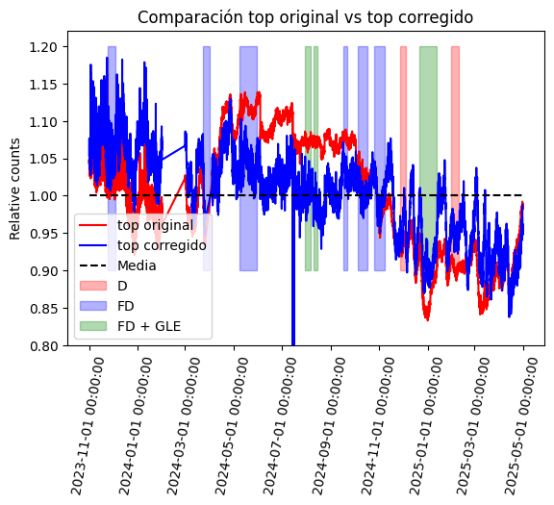
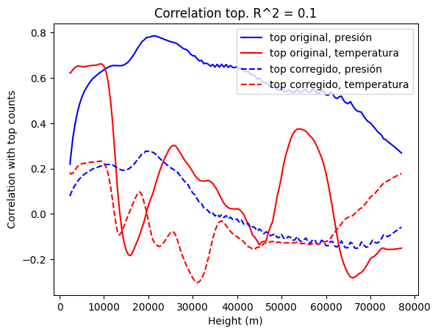
Results: Top, R^2 = 0.1

Slide 9
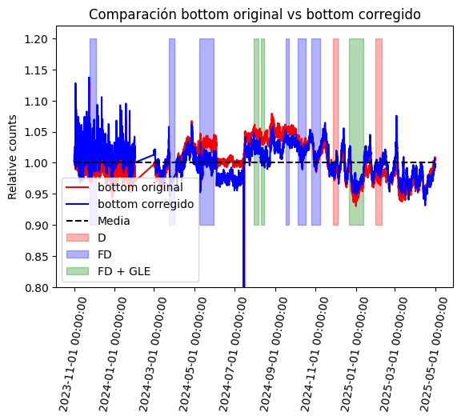
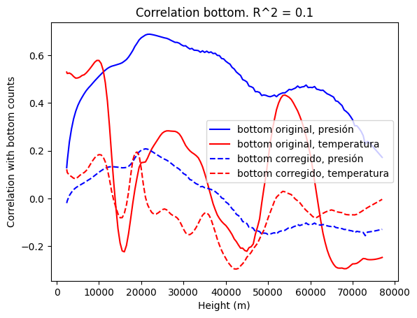
Results: Bottom, R^2 = 0.1

Slide 10
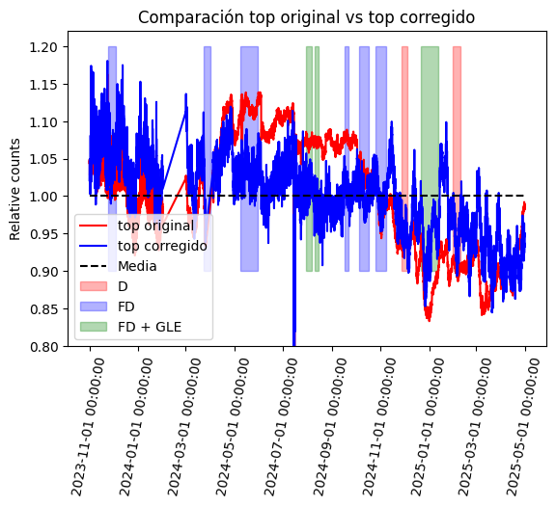
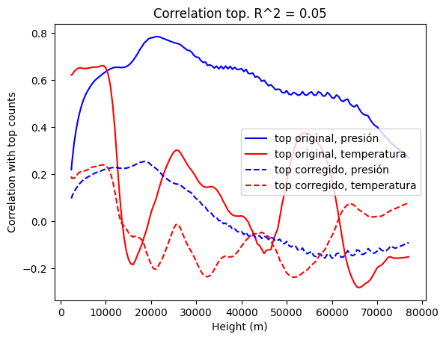
Results: Top, R^2 = 0.05

Slide 11
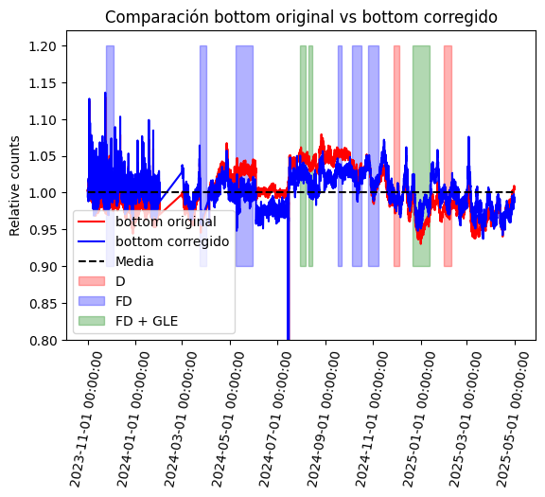
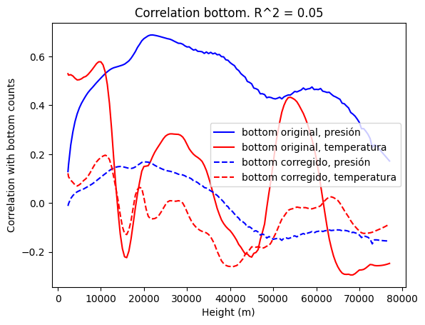
Results: Bottom, R^2 = 0.05

Slide 12
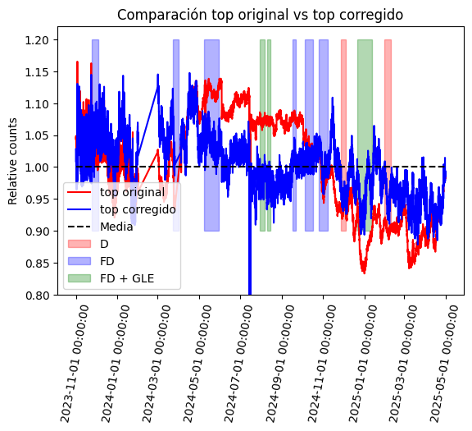
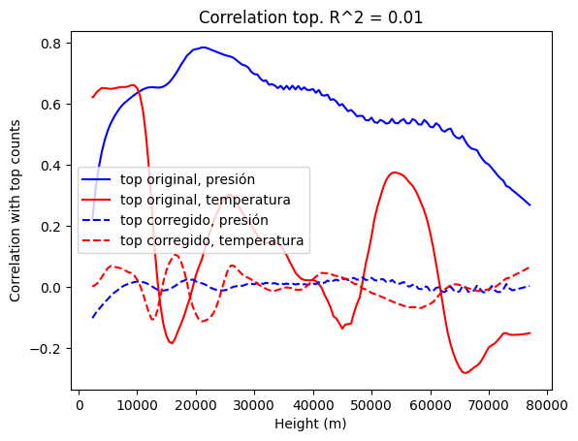
Results: Top, R^2 = 0.01

Slide 13

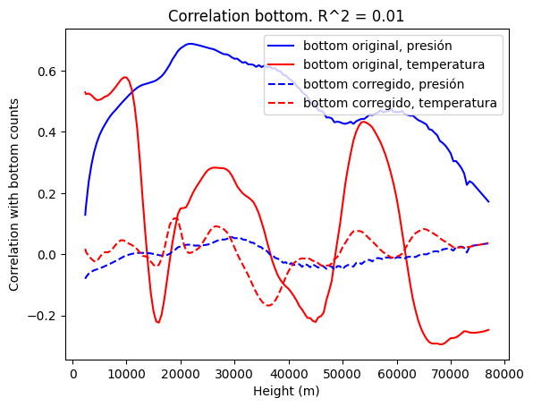
Results: Bottom, R^2 = 0.01

Slide 14
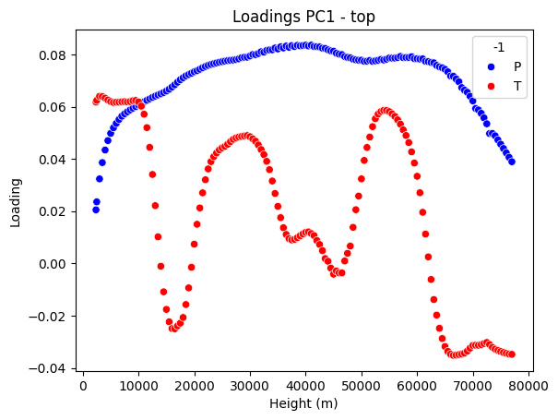
PC1

Slide 15
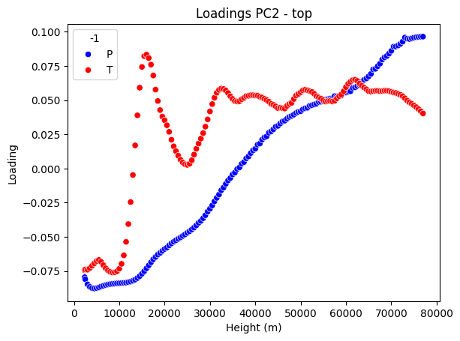
PC2

Slide 16
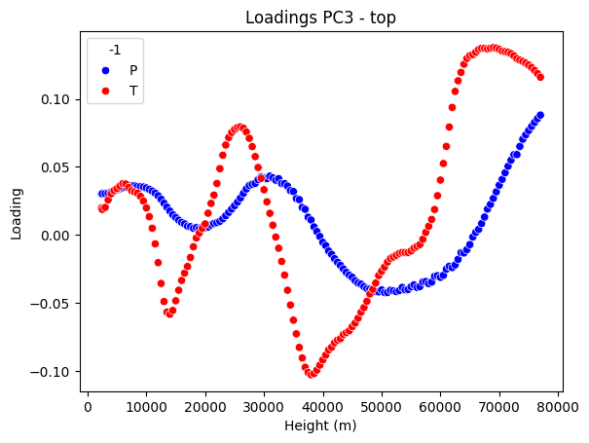
PC3 Top only

Slide 17
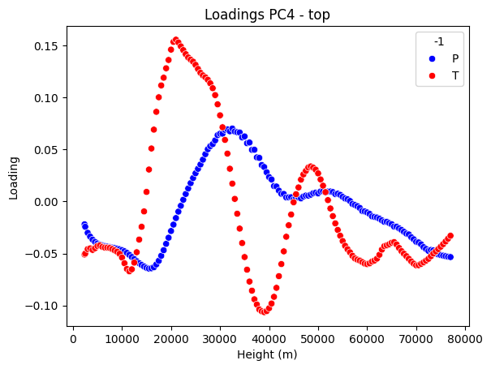
PC4 Top only

Slide 18
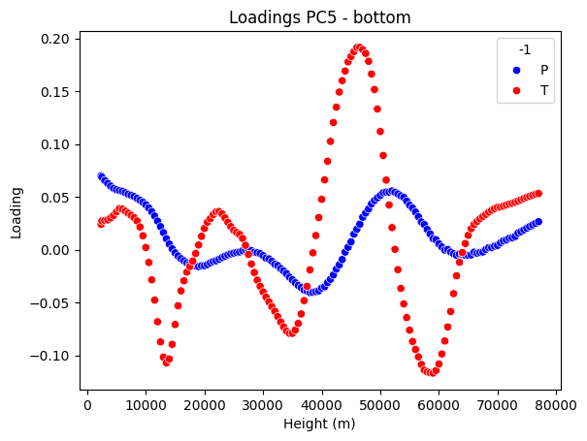
PC5 Bottom only

Slide 19
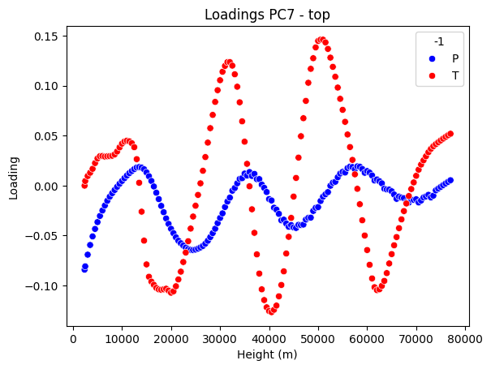
PC7 Top only

Slide 20
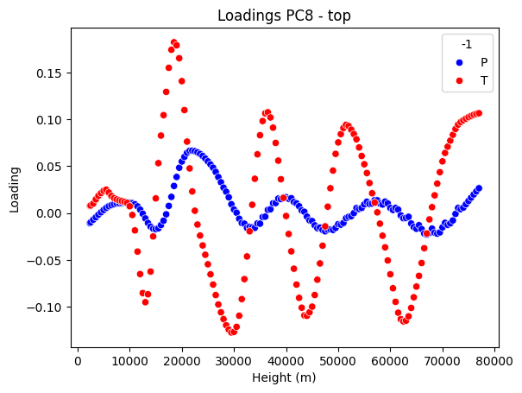
PC8

Slide 21
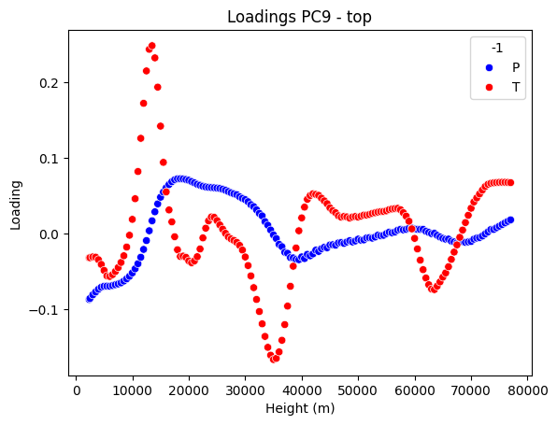
PC9 Top only

Slide 22
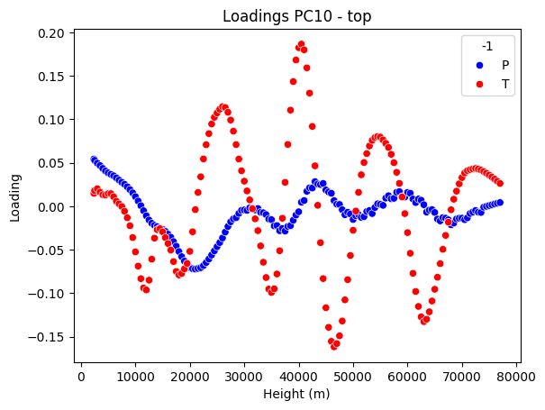
PC10

