Slide 1
Internet Technologies Team Project “unNoobs”
Rafael Constantinou
Nikolaos Hadjitheophanous
Leonidas Barmpas
Stefani Aresti
Finlay Maciver

Slide 2
The goal – Purpose
Studying something and want help?
You are not familiar with the needed background?
Want someone to help you study with an exam?
SOLUTION
Our web application aims to find a tutor for you at time and place that suits you, covering any subject or topic you are struggling with.
Instead of money you will be able to give points and ratings for your private tutors.
Someone could use those points for “hiring” a tutor for his/her needs.

Slide 3

Student persona
Name : Totis Panayi
Job title : Studying - MSc Information Technology
Location : Glasgow, Scotland
Demographics
24 years old
Male
Single
Has a BSc Business Management
Goals
Complete MSc degree and find a job
Struggling with Internet Technology course. Needs help with the use of Django framework.

Slide 4

Tutor/Noob persona
Name : Stavros Hadjis
Job title : Web App Designer
Location : Glasgow, Scotland
Demographics
26 years old
Male
Single
Has a BSc in Computer Science
Goals
Wants to learn new stuff apart from his interests (e.g learn gardening). Also can help others get familiar with web app designing.

Slide 5
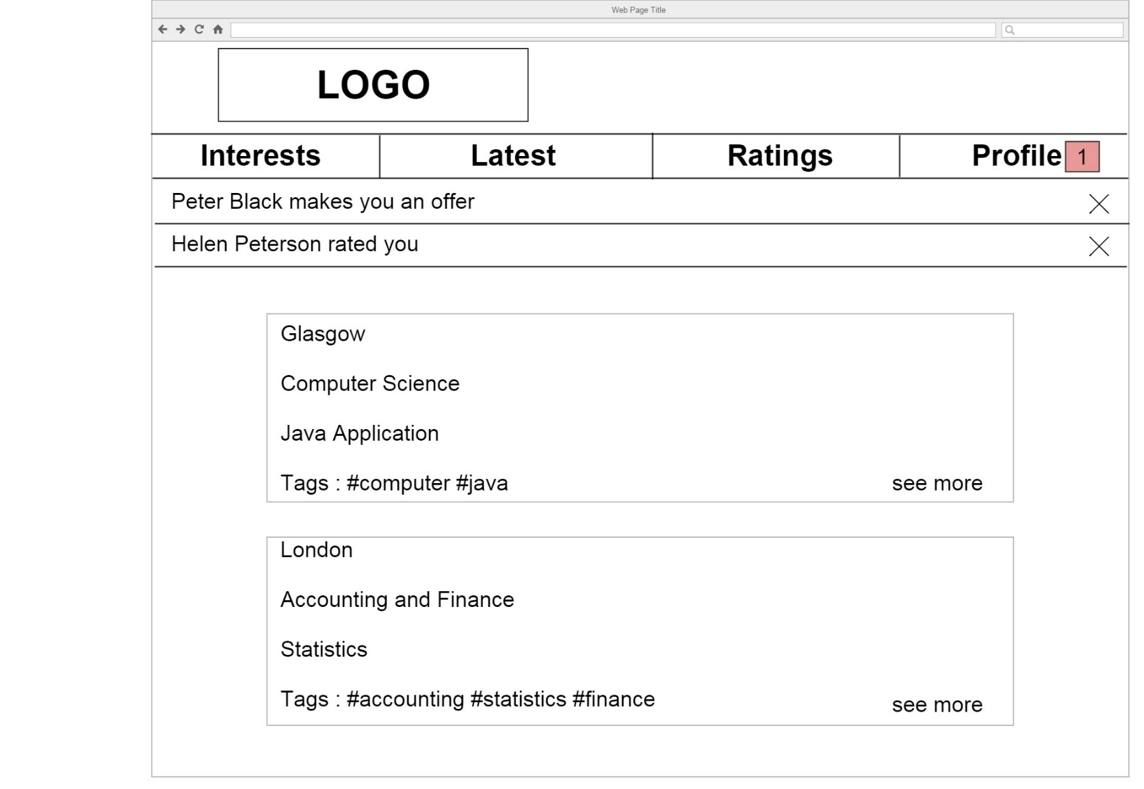
Wireframe

Slide 6
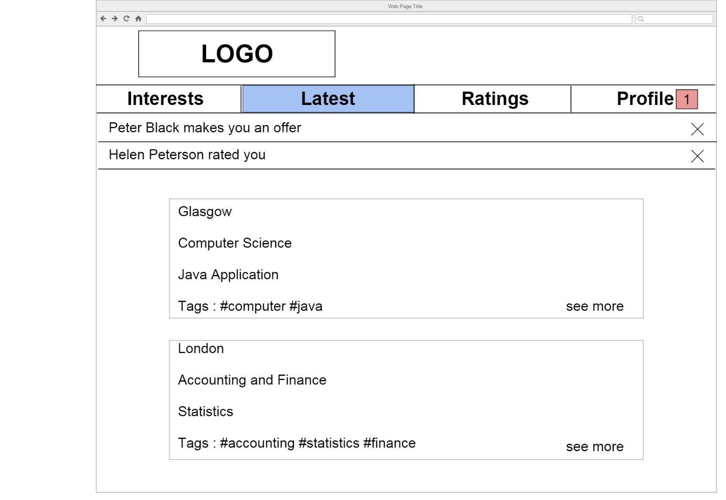
Wireframe

Slide 7
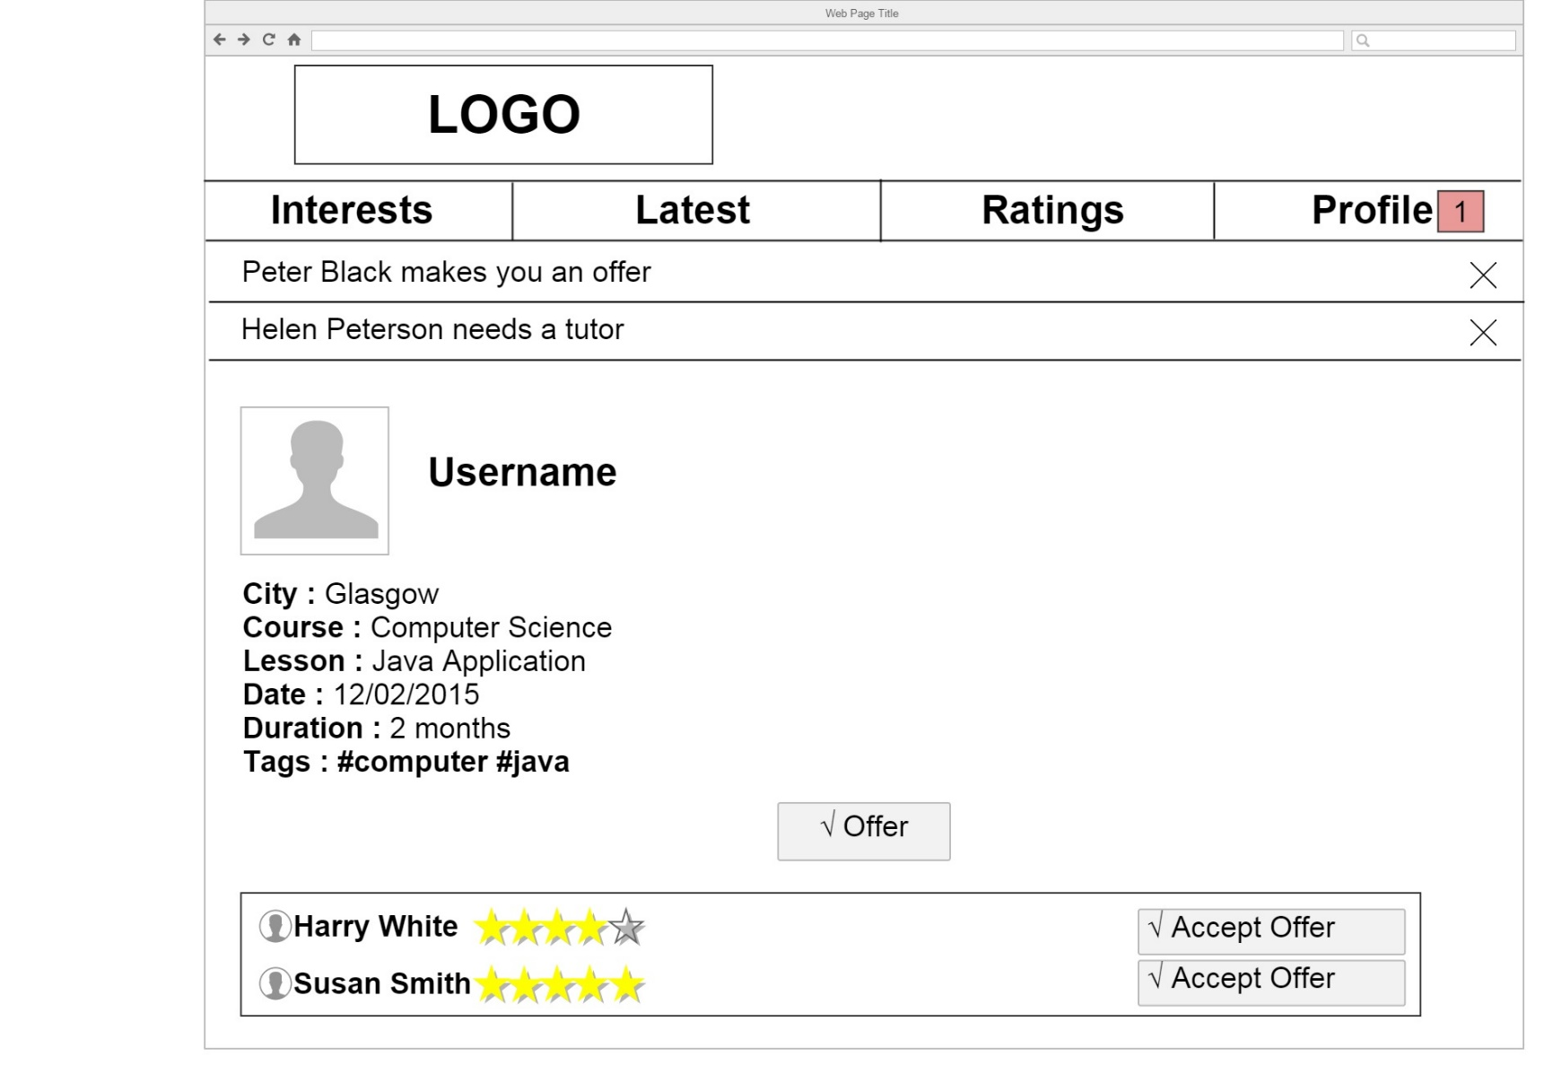
Wireframe

Slide 8
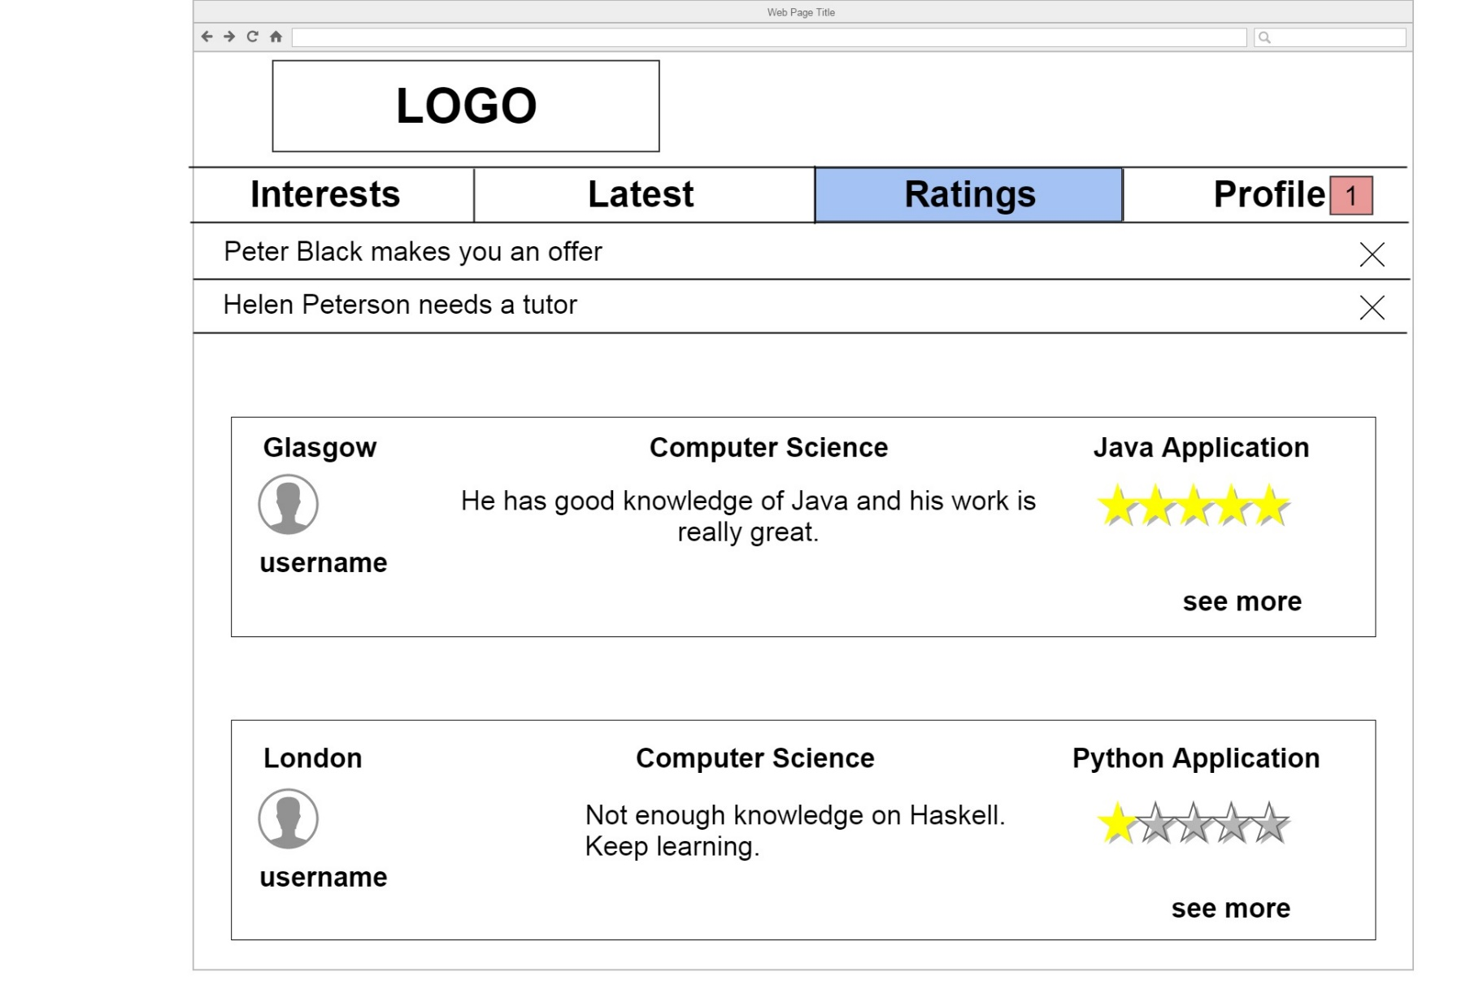
Wireframe

Slide 9
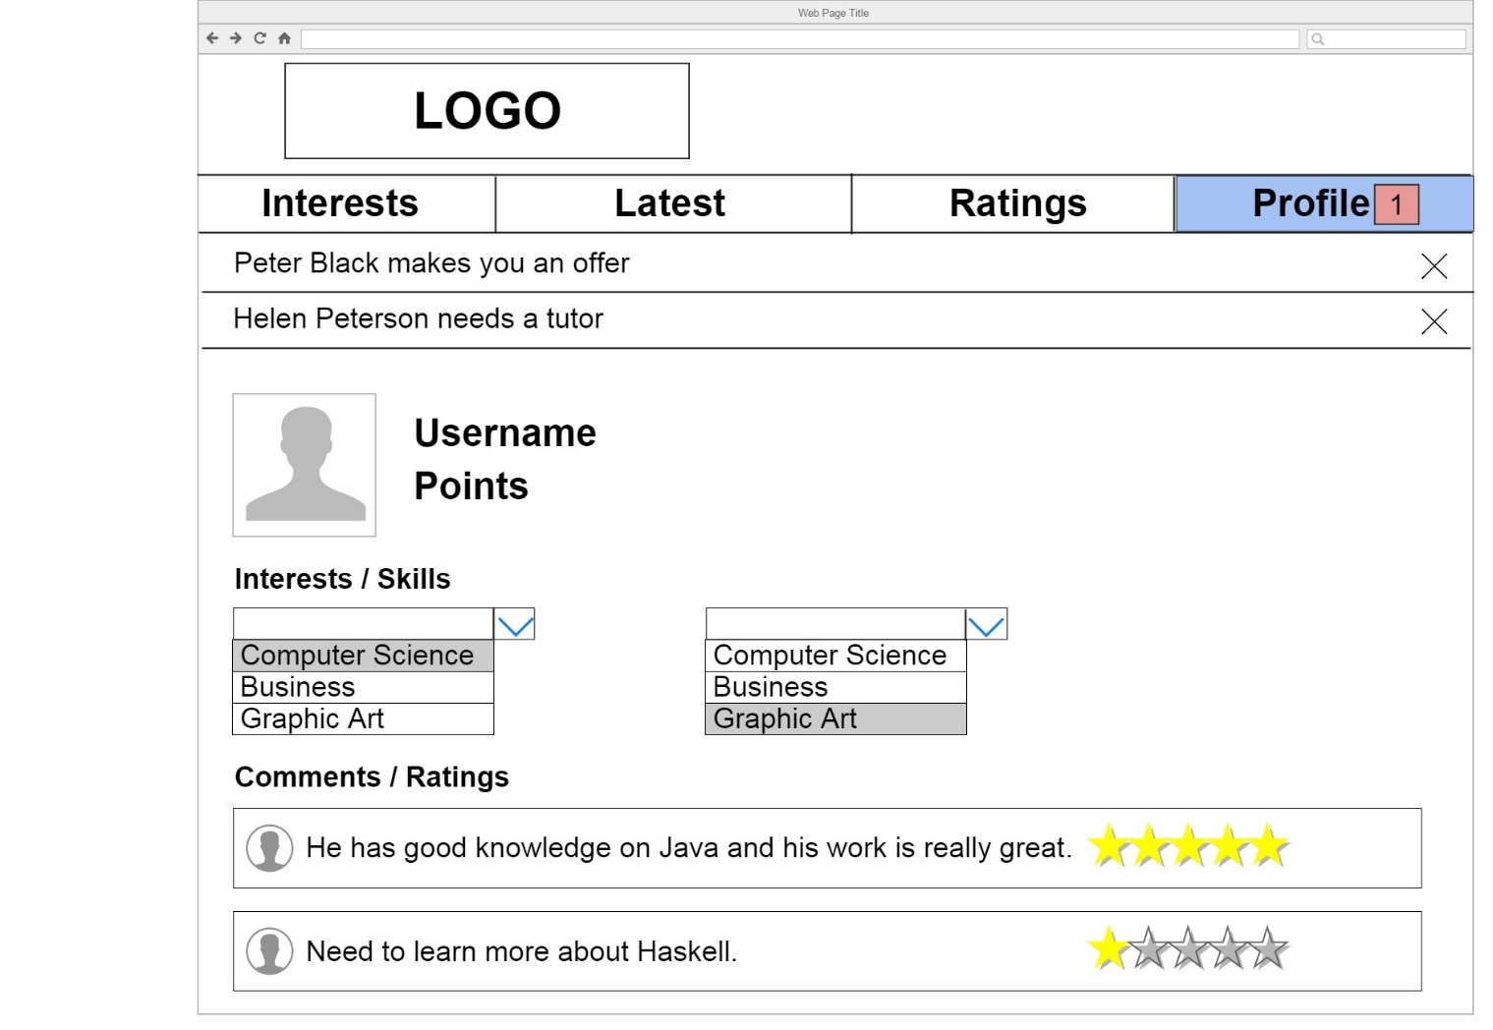
Wireframe

Slide 10
Functionality – Uniqueness
Anyone may be both tutor or a noob.
Issue a request for a tutor (subject, date, time, location) aka “advertisment”.
Anyone can respond to that advertisement.
User can choose his tutor from a list.
User then can give feedback (comments, rating).
Ratings are transformed to points
Points can be used for hiring tutors.

Slide 11

Thanks for your attention

Slide 12
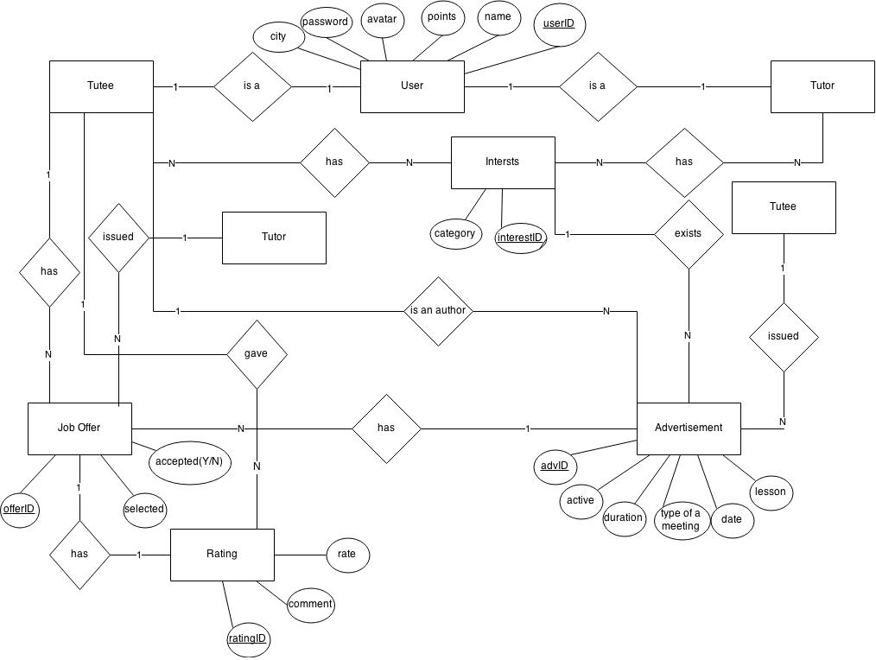
ER diagram

