Slide 1
From AutoAlign → AutoAlignV2
Evolution of Explicit Cross-Modal Alignment
Thomas Trebat
Department of Computer Science and Engineering
University of North Texas
February 9, 2026

Slide 2
Why Cross-Modal Alignment Matters in 3D Detection
Heterogeneous sensors encode complementary but misaligned information
Misalignment creates systematic errors, not just noise
Naïve fusion blurs modality strengths
Alignment improves robustness, efficiency, and interpretability

Slide 3
Pixel-Level vs. Instance-Level Fusion: Trade-offs
Pixel-level fusion: dense, global feature aggregation
Instance-level fusion: localized, object-centric correspondence
Different assumptions about where alignment matters
Trade-off between coverage, precision, and supervision

Slide 4
Limitations of Implicit Cross-Modal Alignment
Implicit alignment relies on shared feature learning
No explicit spatial correspondence between modalities
Sensitive to viewpoint and projection mismatch
Inefficient and noisy feature aggregation

Slide 5
AutoAlign — Architecture Overview
Multi-modal fusion: pixel- and instance-level alignment
Cross-Attention Feature Alignment (CAFA): voxel/pillar attends to fine-grained image features
Self-supervised Cross-modal Feature Interaction (SCFI): enforces instance-level semantic consistency
2D–3D joint training: stabilizes image branch and fusion

Slide 6
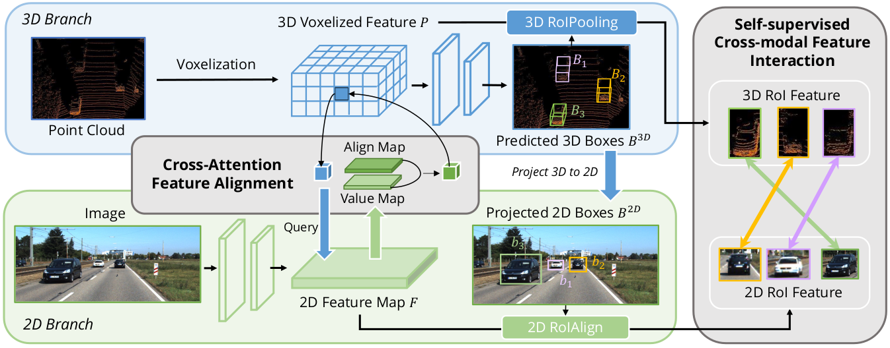
AutoAlign Architecture Diagram

Slide 7
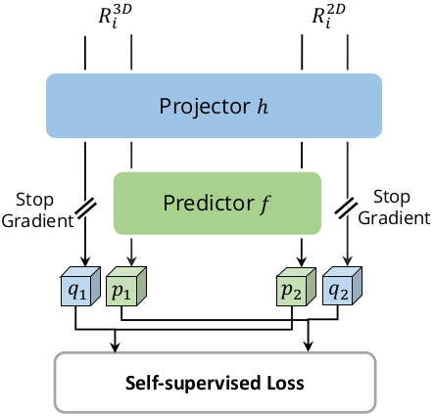
Self-Supervised Cross-Modal Feature Interaction (SCFI)
Encourages semantic consistency: NCS loss between paired 2D–3D regional features
Siamese-style design:
  Projection layer h maps features into shared space
  Prediction layer f predicts features of the other modality

Slide 8
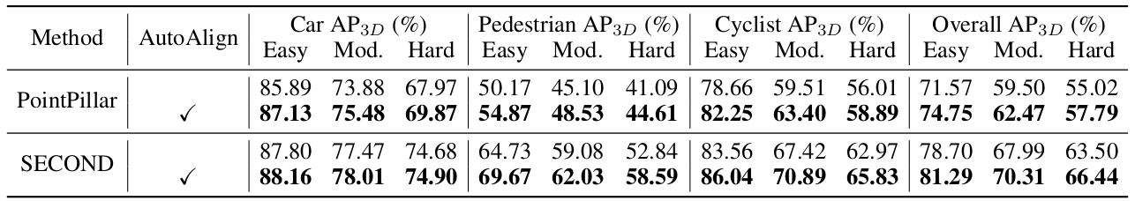
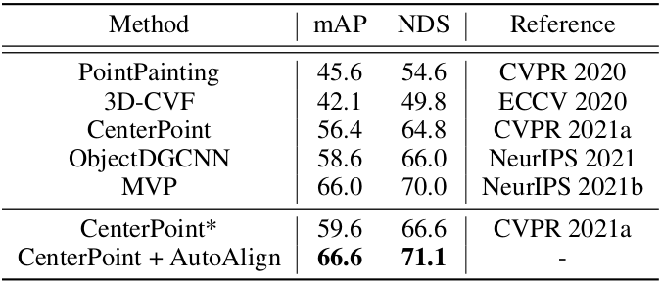
Key Experimental Results — KITTI & nuScenes

Slide 9
AutoAlign — Key Strengths & Takeaways
Explicit pixel-to-voxel semantic alignment
Unified pixel-level + instance-level fusion
Plug-and-play with proposal-based 3D detectors
Strong gains on sparse-object categories

Slide 10
AutoAlign — Limitations
Global attention is computationally expensive
SCFI mainly learns positional matching, not rich semantics
Limited scalability to high-resolution image features
Reliance on proposal quality and alignment accuracy

Slide 11
AutoAlignV2 — Overall Framework
Replaces global CAFA with Cross-Domain DeformCAFA
Removes dependence on SCFI for positional matching
Enables multi-level image feature aggregation via FPN
Introduces practical training strategies for multi-modal robustness

Slide 12
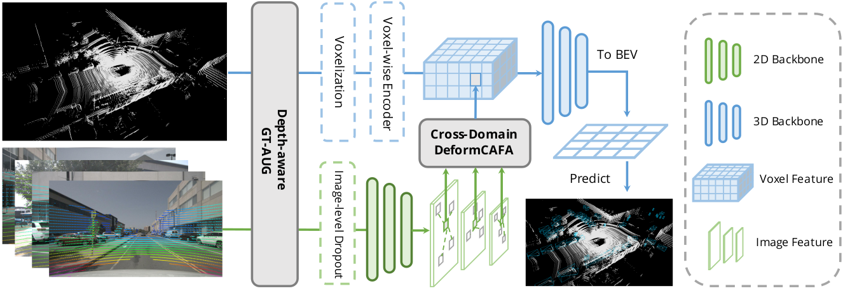
AutoAlignV2 — Architecture Diagram

Slide 13
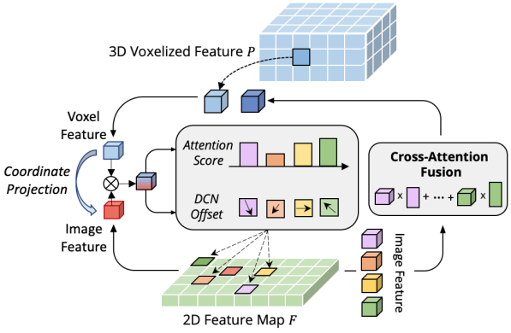
Cross-Domain DeformCAFA
Uses deformable cross-attention instead of global attention
Each voxel query attends to a small set of learned image sampling points
Reference points obtained via camera projection
Cross-domain token generation stabilizes attention learning

Slide 14
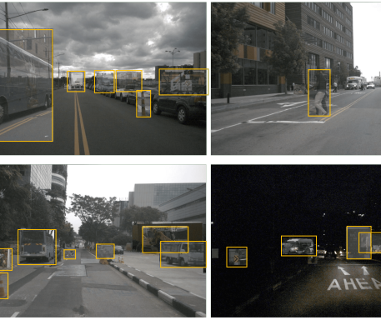
Depth-Aware GT-AUG (Data Augmentation)
MixUp-style cut-and-paste for multi-modal data
Maintains synchronization between image and point cloud
Avoids mask annotations or complex point filtering
Improves robustness and generalization

Slide 15
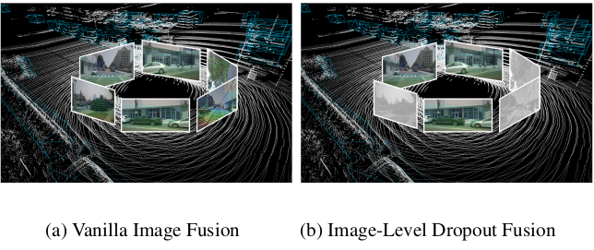
Image-Level Dropout Training
Randomly drops aggregated image features during training
Forces the detector to rely on both LiDAR and image cues
Improves robustness to missing or degraded image input
Slight performance gains with faster convergence

Slide 16
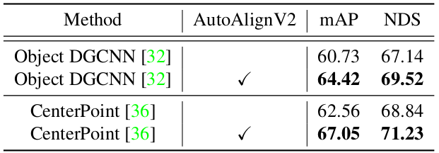
AutoAlignV2 — nuScenes Validation
Backbones: CenterPoint & Object DGCNN
Gains over baselines:
  CenterPoint: +3.7 mAP / +2.4 NDS
  Object DGCNN: +4.5 mAP / +2.4 NDS
Demonstrates generalization across different 3D detection frameworks

Slide 17
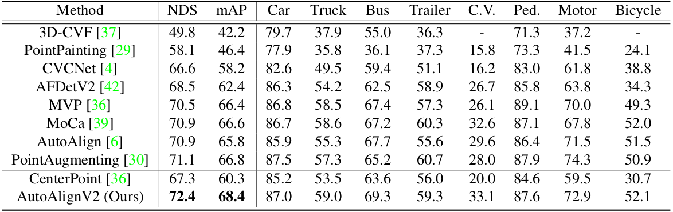
nuScenes Test Set Leaderboard Results

Slide 18
AutoAlignV2 — Limitations
Dependence on accurate camera–LiDAR calibration
Non-trivial computational overhead
Limited semantic grounding at early fusion stages
Increased training complexity
Task specificity

Slide 19
AutoAlignV2 — Key Strengths & Takeaways
Accurate and efficient cross-modal alignment with DeformCAFA
Removes SCFI supervision while maintaining positional consistency
Utilizes multi-level FPN features for richer image context
Robust training strategies: Depth-Aware GT-AUG + image-level dropout
Architecture-agnostic: improves multiple 3D detectors
Strong performance gains on sparse or hard-to-detect objects

Slide 20
Conclusion & Open Problems
Efficient handling of high-resolution feature maps
Stronger semantic grounding at early fusion stages
Extending alignment to dense prediction tasks (segmentation, mapping)
Robustness to sensor calibration errors, occlusion, and motion blur
Simplifying training pipelines and reducing hyperparameter sensitivity

Slide 21
References
Chen, Z., Li, Z., Zhang, S., Fang, L., Jiang, Q., Zhao, F., Zhou, B., & Zhao, H. (2022). AutoAlign: Pixel-Instance Feature Aggregation for Multi-Modal 3D Object Detection. In Proceedings of the Thirty-First International Joint Conference on Artificial Intelligence (IJCAI-22), 827–833. https://doi.org/10.24963/ijcai.2022/116
Chen, Z., Li, Z., Zhang, S., Fang, L., Jiang, Q., & Zhao, F. (2022). Deformable Feature Aggregation for Dynamic Multi-modal 3D Object Detection. In Computer Vision – European Conference on Computer Vision (ECCV 2022), Tel Aviv, Israel, 628–644. https://doi.org/10.1007/978-3-031-20074-8_36

