Slide 1
From Static to Adaptive Prompts: Motion-Conditioned Semantic Guidance for 3D Pose Estimation
Yen Pham
Computer Vision and Intelligent Systems (CoVIS) Lab
Department of Computer Science and Engineering
University of North Texas
Feb 9, 2026

Slide 2
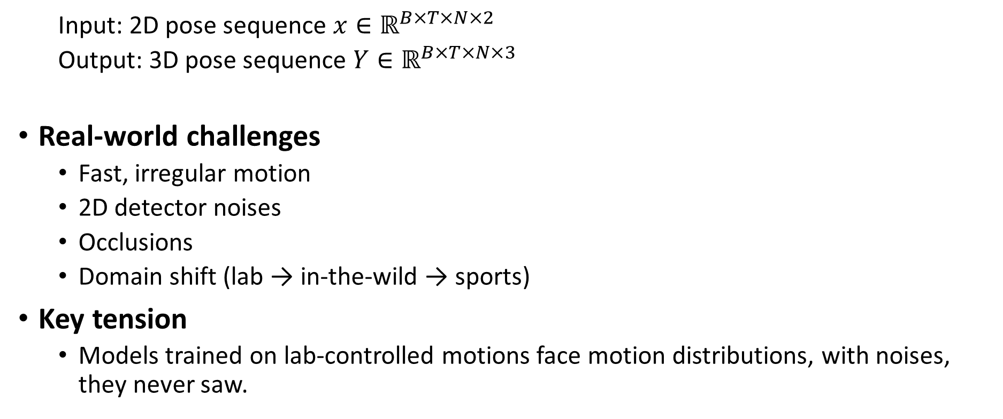
Monocular 3D Human Pose Estimation Challenges
  Input: 2D pose sequence $x∈ℝ^{B×T×N×2}$
  Output: 3D pose sequence $Y∈ℝ^{B×T×N×3}$
Real-world challenges
  Fast, irregular motion
  2D detector noises
  Occlusions
  Domain shift (lab → in-the-wild → sports)
Key tension
  Models trained on lab-controlled motions face motion distributions, with noises, they never saw.

Slide 3
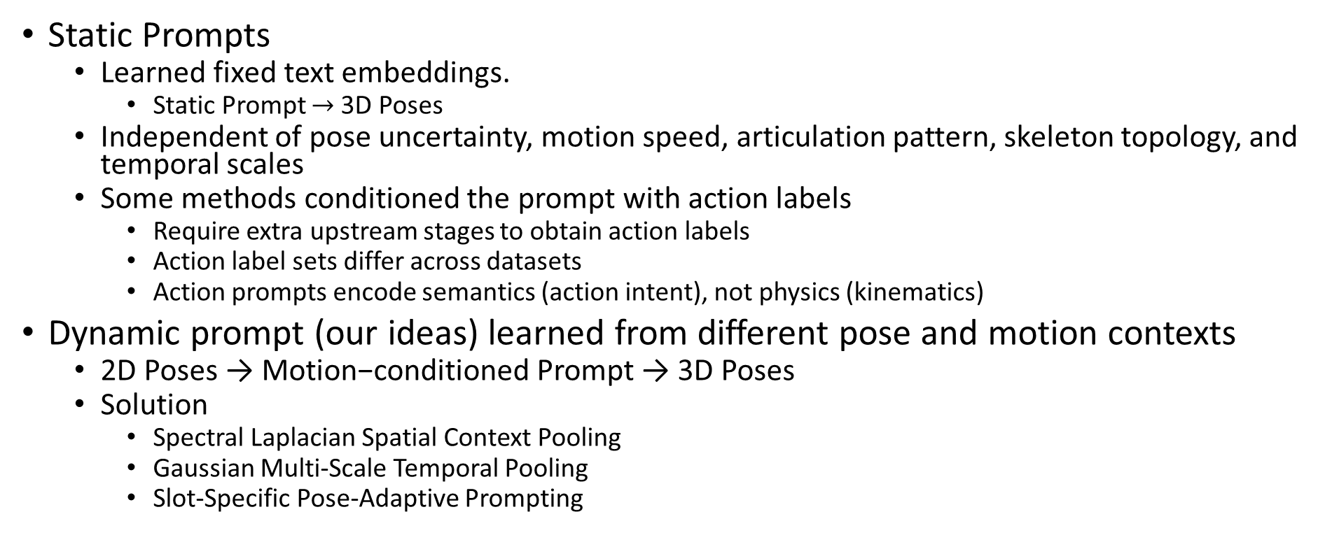
Problems and Our Ideas
Static Prompts
  Learned fixed text embeddings.
    Static Prompt $→$ 3D Poses
  Independent of pose uncertainty, motion speed, articulation pattern, skeleton topology, and temporal scales
  Some methods conditioned the prompt with action labels
    Require extra upstream stages to obtain action labels
    Action label sets differ across datasets
    Action prompts encode semantics (action intent), not physics (kinematics)
Dynamic prompt (our ideas) learned from different pose and motion contexts
  2D Poses → Motion−conditioned Prompt → 3D Poses
  Solution
    Spectral Laplacian Spatial Context Pooling
    Gaussian Multi-Scale Temporal Pooling
    Slot-Specific Pose-Adaptive Prompting

Slide 4
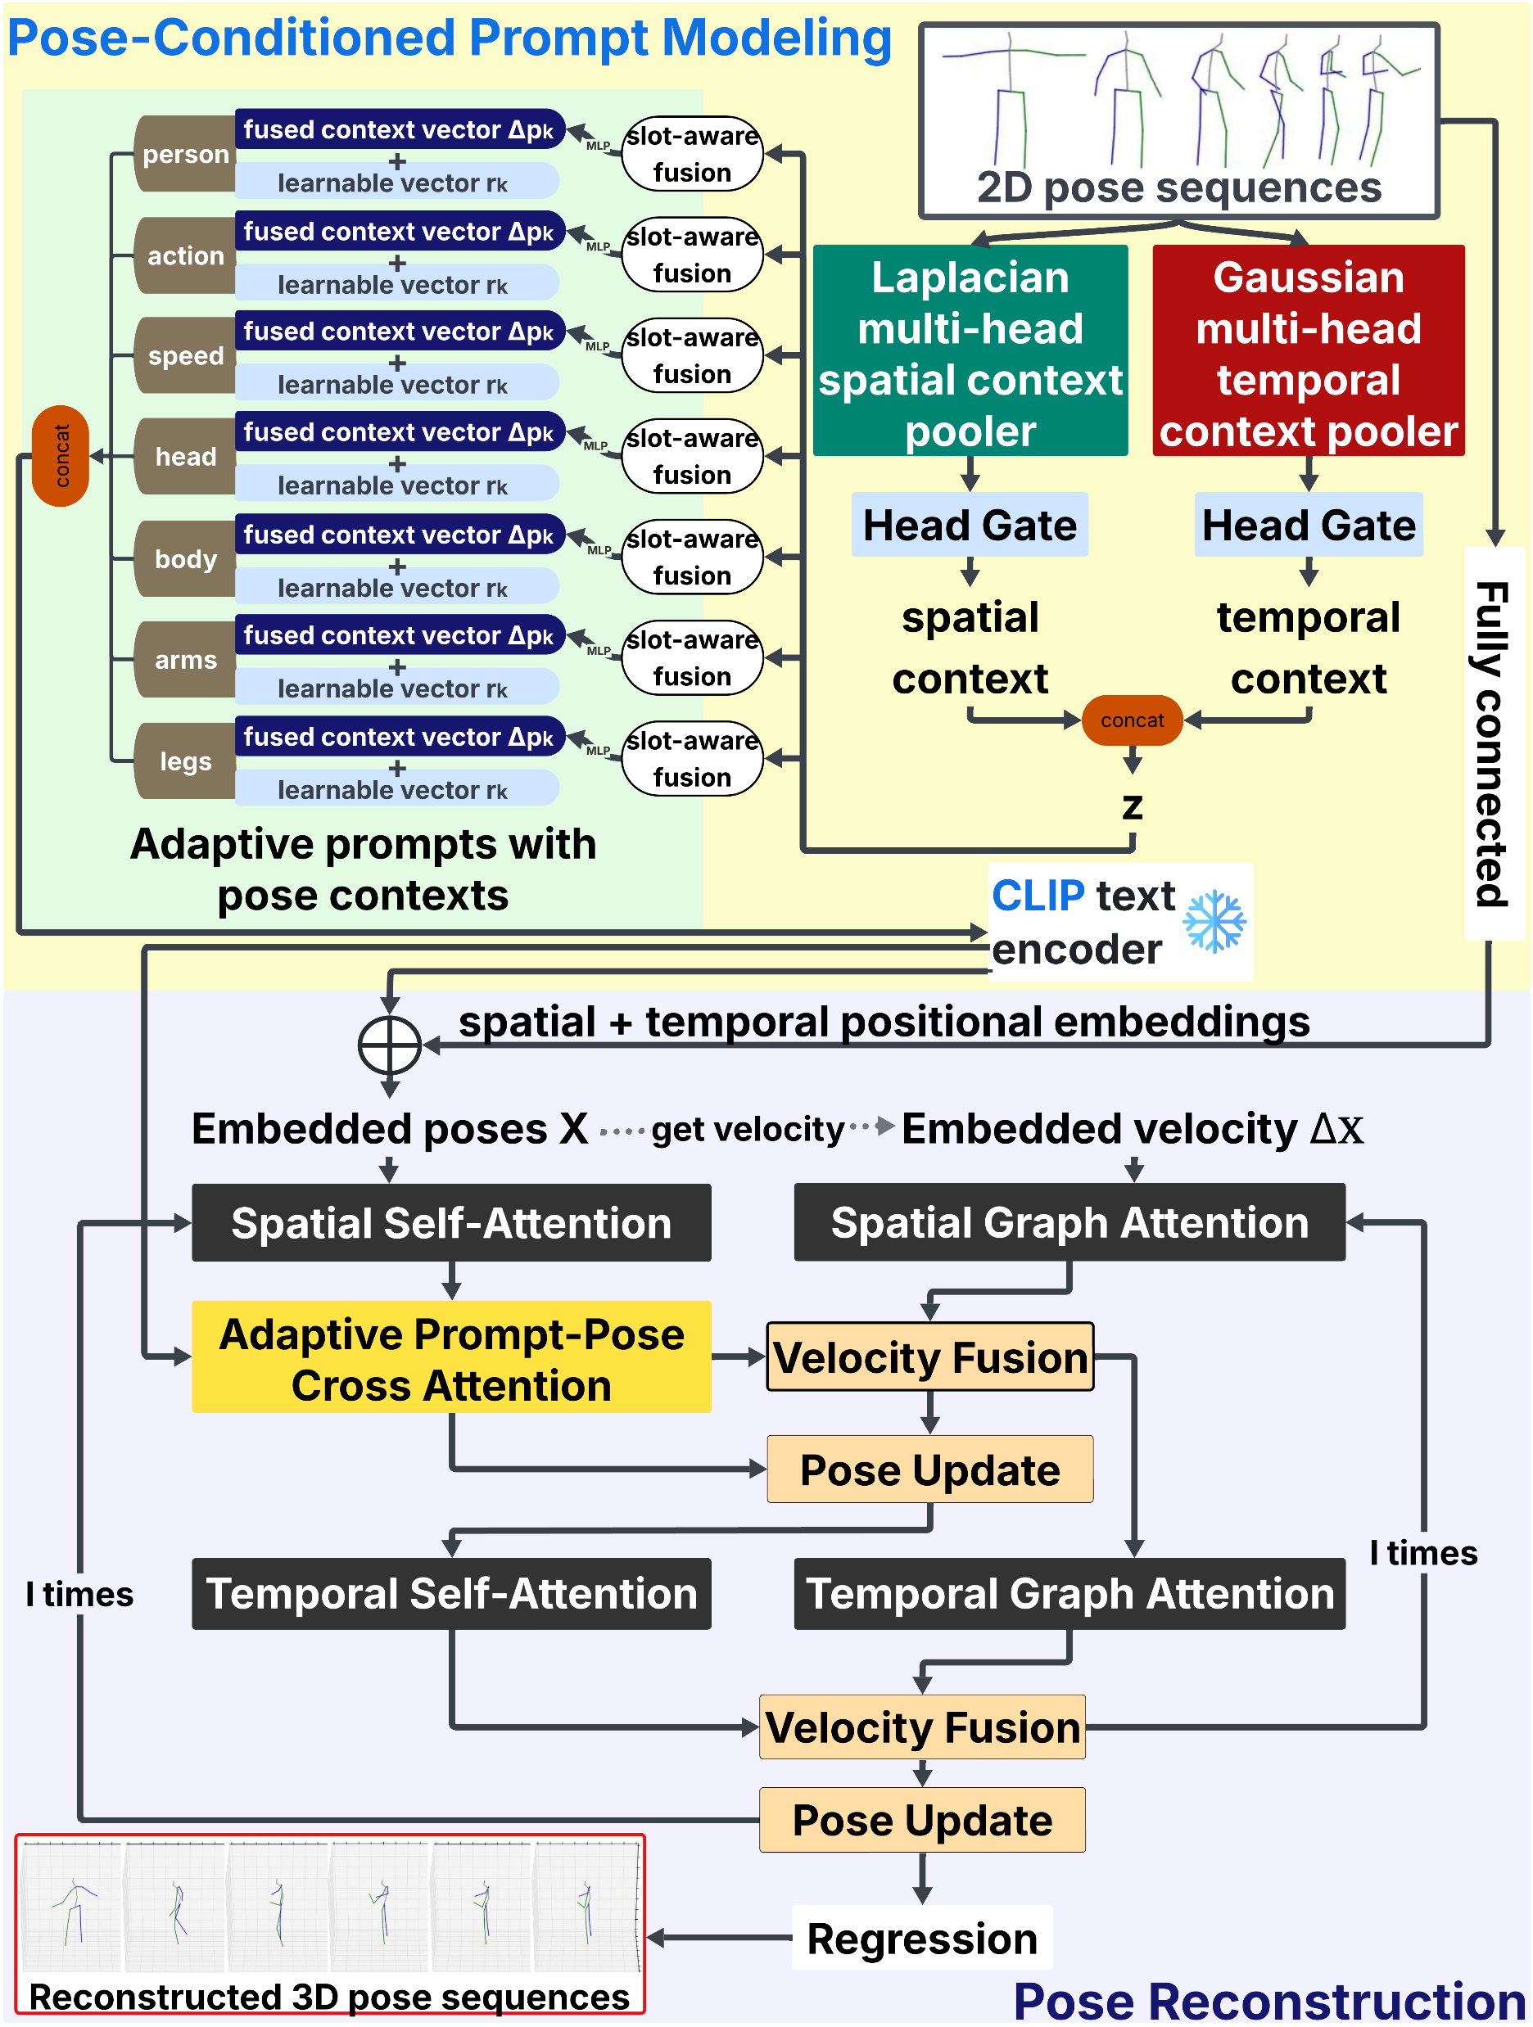
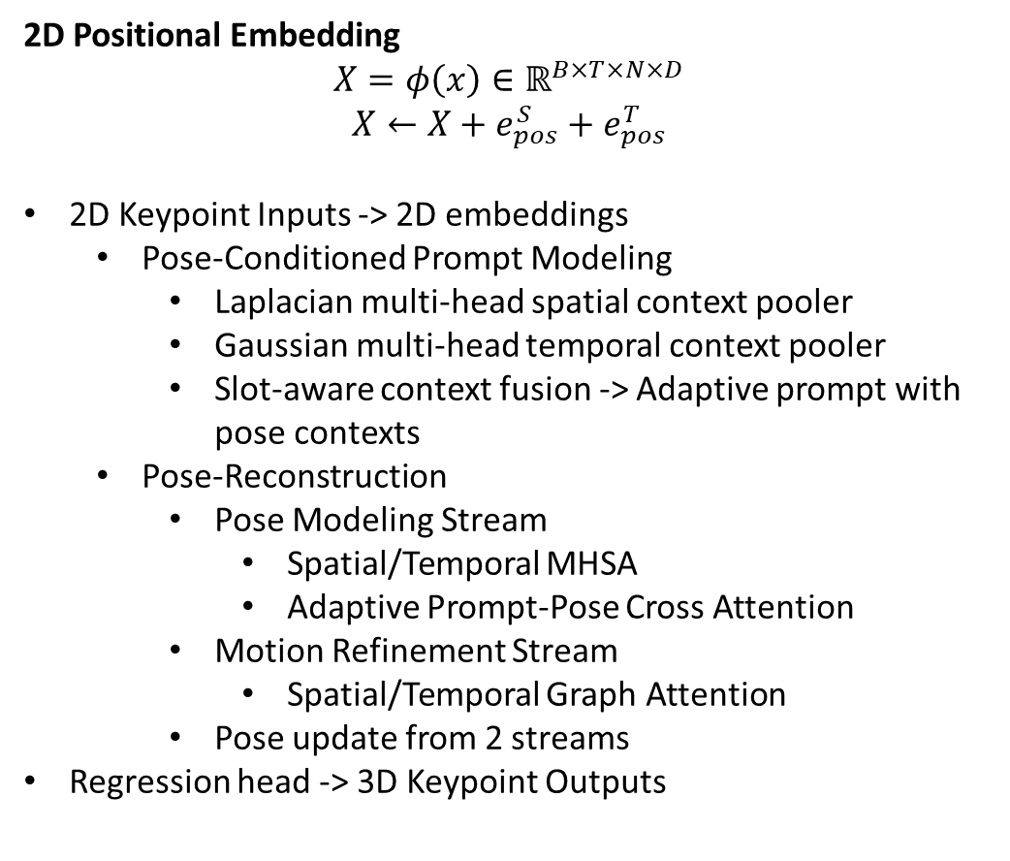
Network Architecture
2D Positional Embedding
$$X=φ\left(x\right)∈ℝ^{B×T×N×D}$$
$$X←X+e_{pos}^{S}+e_{pos}^{T}$$
2D Keypoint Inputs -> 2D embeddings
  Pose-Conditioned Prompt Modeling
    Laplacian multi-head spatial context pooler
    Gaussian multi-head temporal context pooler
    Slot-aware context fusion -> Adaptive prompt with pose contexts
  Pose-Reconstruction
    Pose Modeling Stream
      Spatial/Temporal MHSA
      Adaptive Prompt-Pose Cross Attention
    Motion Refinement Stream
      Spatial/Temporal Graph Attention
    Pose update from 2 streams
Regression head -> 3D Keypoint Outputs

Slide 5
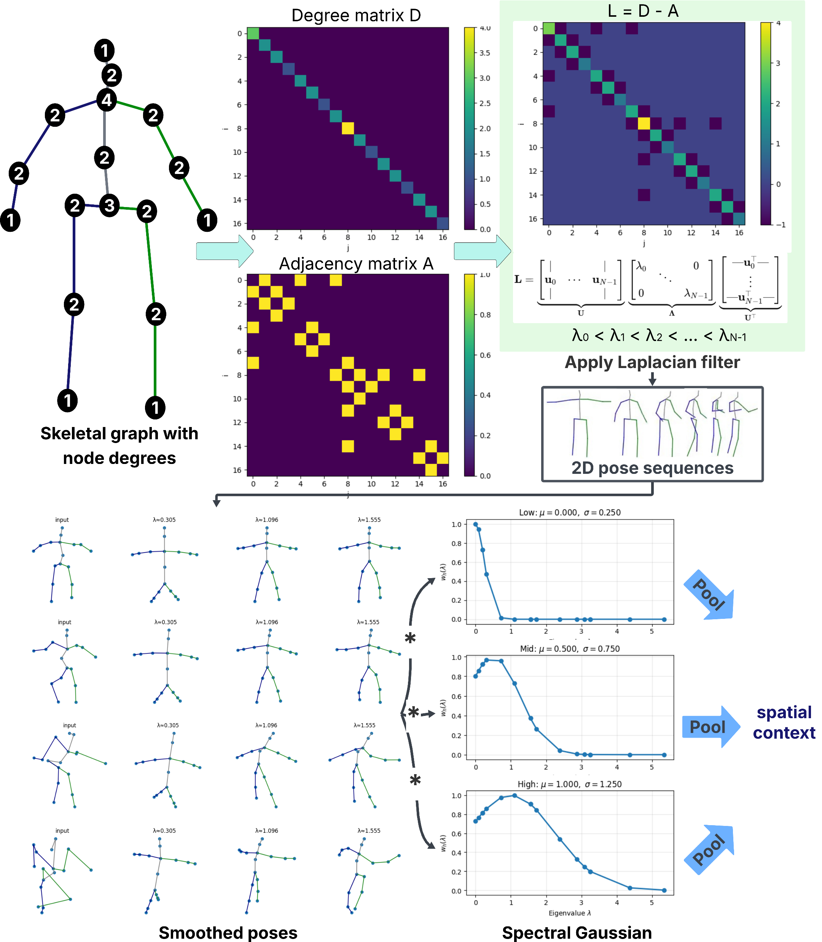
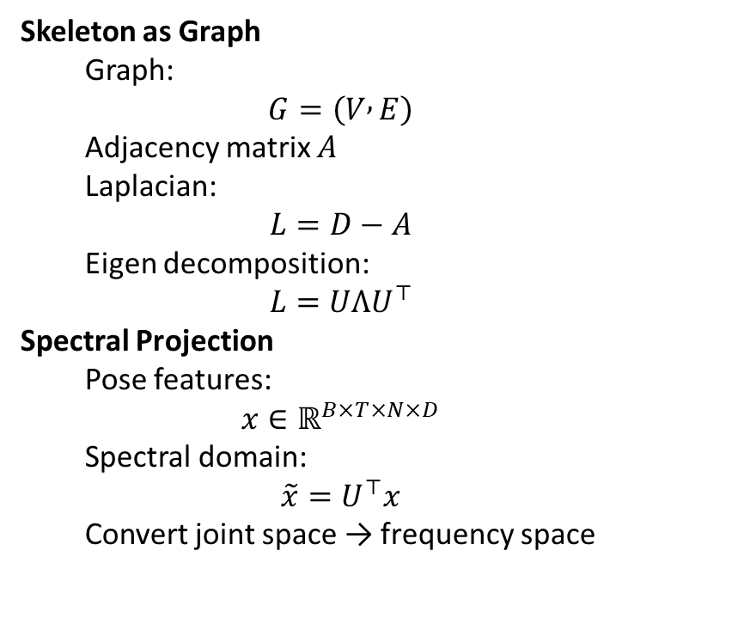
Spatial Laplacian Contextual Pooling
Skeleton as Graph
  Graph:
  $$G=\left(V , E\right)$$
  Adjacency matrix $A$
  Laplacian:
  $$L=D−A$$
  Eigen decomposition:
  $$L=UΛU^{⊤}$$
Spectral Projection
  Pose features:
  $$x∈ℝ^{B×T×N×D}$$
  Spectral domain:
  $$\tilde{x}=U^{⊤}x$$
  Convert joint space → frequency space

Slide 6
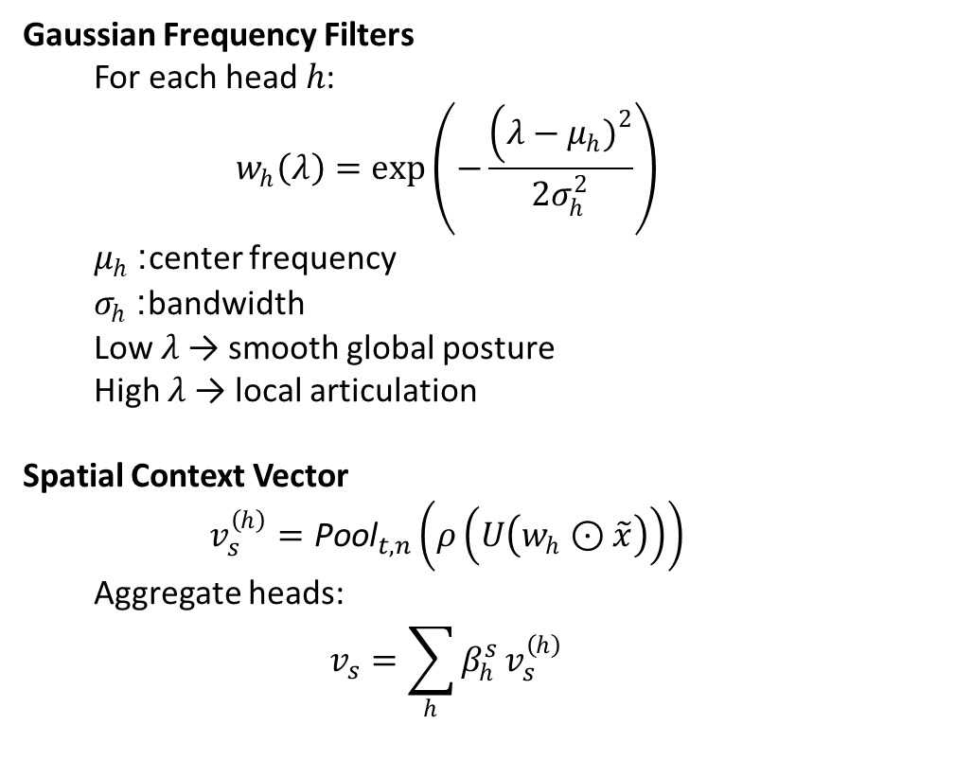
Spatial Laplacian Contextual Pooling
Gaussian Frequency Filters
  For each head $h$:
  $$w_{h}\left(λ\right)=\exp\left(−\frac{\left(λ−μ_{h}{\left.)\right.}^{2}\right.}{2σ_{h}^{2}}\right)$$
  $μ_{h}$: center frequency
  $σ_{h}$: bandwidth
  Low 𝜆 → smooth global posture
  High 𝜆 → local articulation
Spatial Context Vector
  $$v_{s}^{\left(h\right)}={\text{Pool}}_{t,n}\left(ρ\left(U\left(w_{h}⊙\tilde{x}\right)\right)\right)$$
  Aggregate heads:
  $$v_{s}=\sum_{h}{β_{h}^{s}}v_{s}^{\left(h\right)}$$

Slide 7
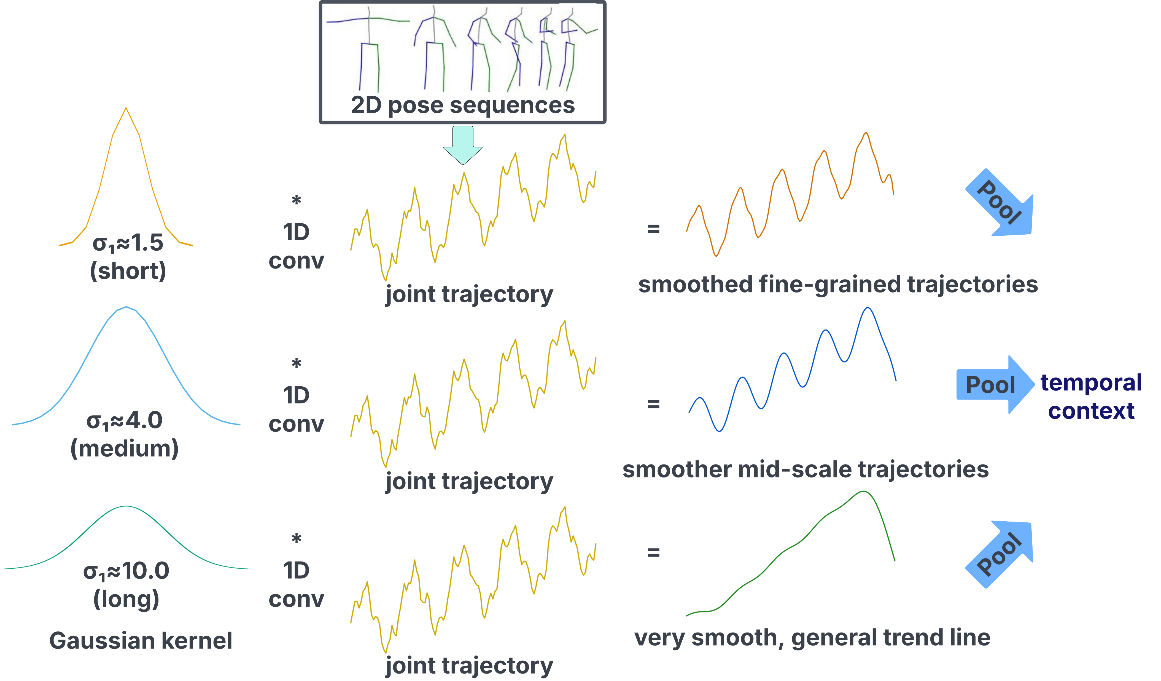
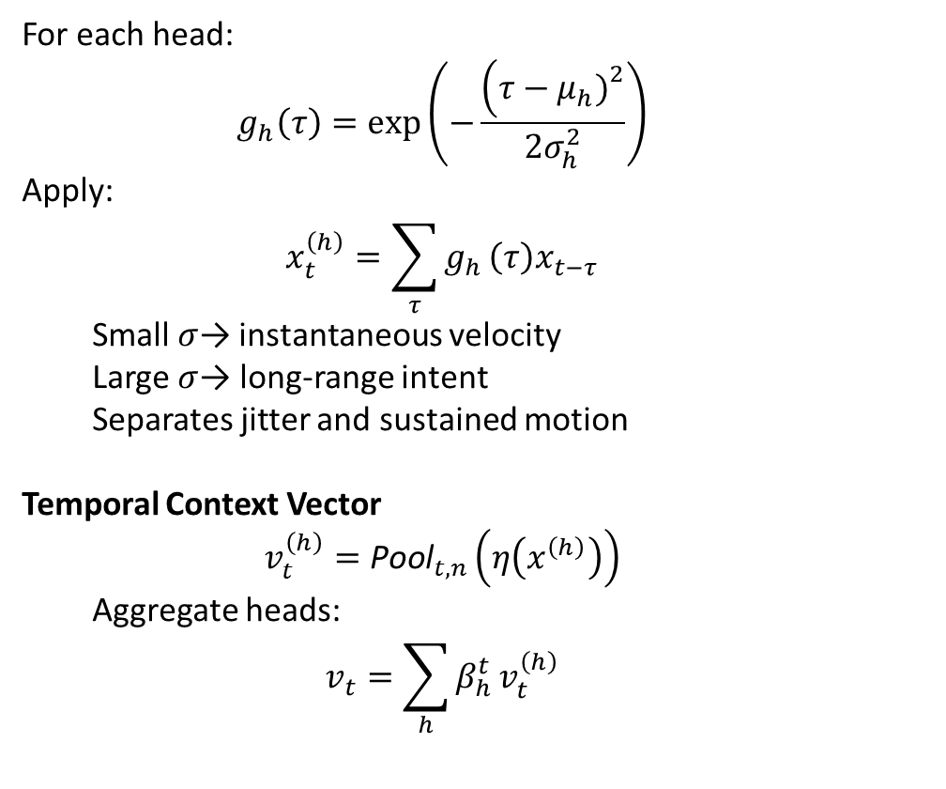
Temporal Gaussian Contextual Pooling
For each head:
  $$g_{h}\left(τ\right)=\exp\left(−\frac{\left(τ−μ_{h}{\left.)\right.}^{2}\right.}{2σ_{h}^{2}}\right)$$
Apply:
  $$x_{t}^{\left(h\right)}=\sum_{τ}{g_{h}}\left(τ\right)x_{t−τ}$$
  Small $σ$→ instantaneous velocity
  Large $σ$→ long-range intent
  Separates jitter and sustained motion
Temporal Context Vector
  $$v_{t}^{\left(h\right)}={\text{Pool}}_{t,n}\left(η\left(x^{\left(h\right)}\right)\right)$$
  Aggregate heads:
  $$v_{t}=\sum_{h}{β_{h}^{t}}v_{t}^{\left(h\right)}$$

Slide 8
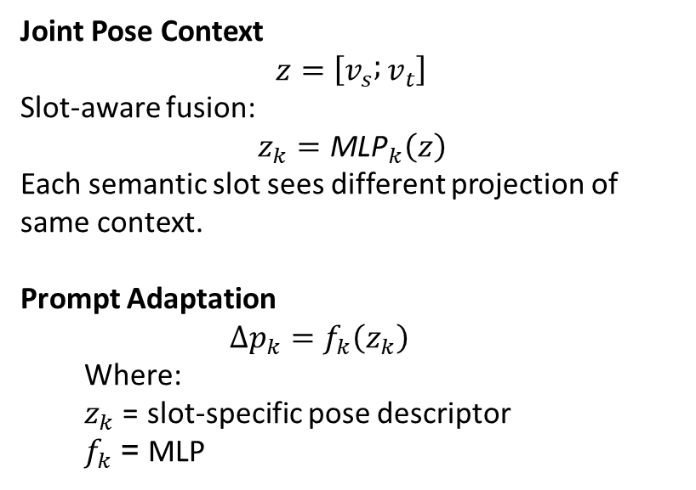
Pose-Conditioned Prompt Modeling
Joint Pose Context
$$z=\left[v_{s} ; v_{t}\right]$$
Slot-aware fusion:
$$z_{k}={\text{MLP}}_{k}\left(z\right)$$
Each semantic slot sees different projection of same context.
Prompt Adaptation
  $$Δp_{k}=f_{k}\left(z_{k}\right)$$
  Where:
  $z_{k}$ = slot-specific pose descriptor
  $f_{k}$= MLP

Slide 9
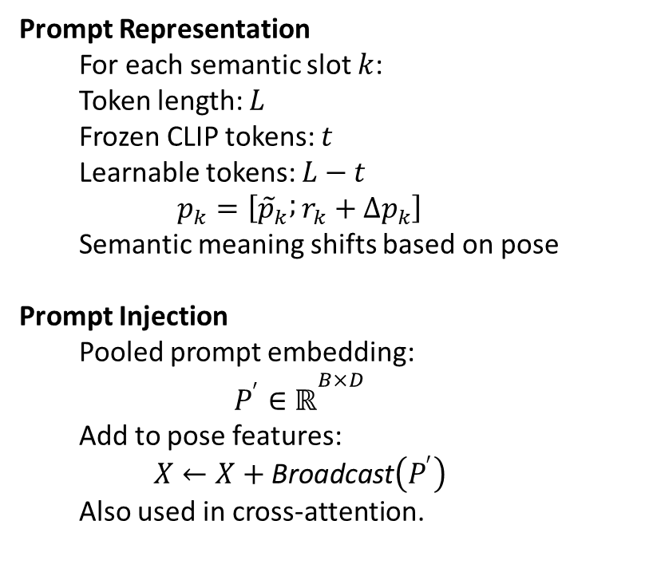
Pose-Conditioned Prompt Modeling
Prompt Representation
  For each semantic slot $k$:
  Token length: $L$
  Frozen CLIP tokens: $t$
  Learnable tokens: $L−t$
  $$p_{k}=\left[{\tilde{p}}_{k} ; r_{k}+Δp_{k}\right]$$
  Semantic meaning shifts based on pose
Prompt Injection
  Pooled prompt embedding:
  $$P^{′}∈ℝ^{B×D}$$
  Add to pose features:
  $$X←X+\text{Broadcast}\left(P^{′}\right)$$
  Also used in cross-attention.

Slide 10
Implementation
Datasets:
  Standard: train and test on clean 2D keypoint inputs of the same dataset
    Human3.6M
      Large-scale indoor MoCap with paired 2D–3D
      11 subjects, 15 daily actions, 4 cameras
    MPI-INF-3DHP
      Diverse viewpoints, appearance, and activities
  In-the-wild & Sport: train on clean 2d keypoints of Human3.6M, test on noisy 2D detected keypoints of different dataset
    3DPW
      In-the-wild handheld videos (60 sequences)
    AthletePose3D
      8 athletes, 12 sports actions (running, track & field, skating)
      60–120 FPS, extreme motion (high velocity/acceleration)
Settings:
  PyTorch, single RTX 4090 GPU
  Spatial Laplacian Pooling: 3 heads, σ = [0.25, 0.75, 1.25], μ = 0
  Temporal Gaussian Pooling: 3 heads, σ = [1.5, 4.0, 10.0] (bounded in 0.5–20)
  Diffusion experiments follow D3DP parameter settings

Slide 11
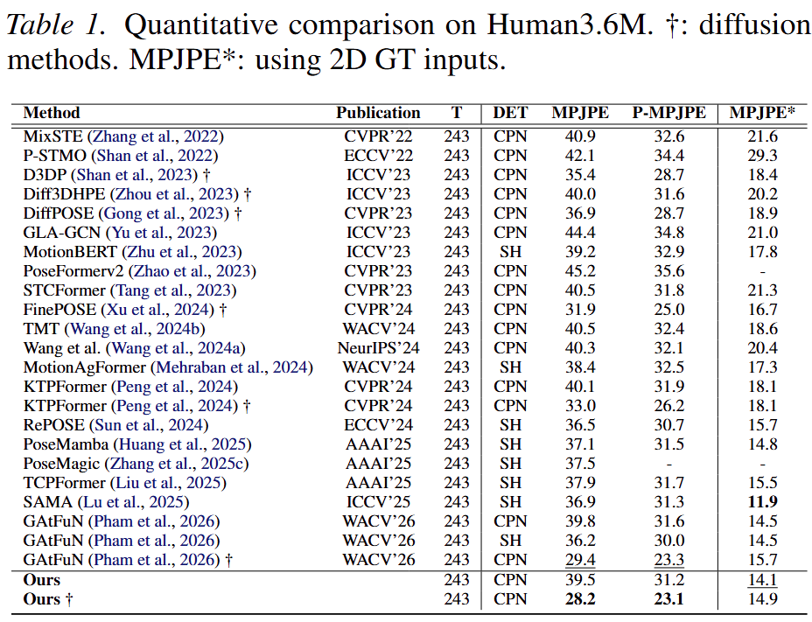
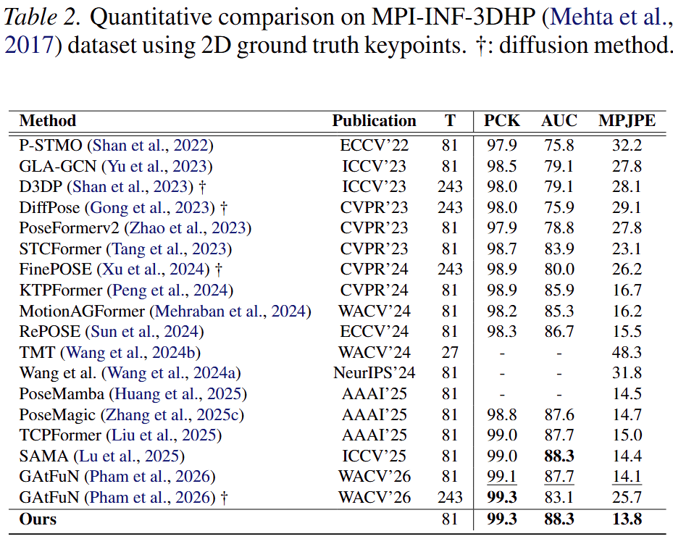
Results on clean 2D keypoints
We attain the lowest MPJPE and P-MPJPE of 28.2 mm and 23.1mm, improving over the strongest diffusion baseline GAt-FuN by 4.0% and 0.9%
We improve 2.1% over GAtFuN (Phamet al., 2026) and 4.2% over SAMA (Lu et al., 2025) in MPJPE.

Slide 12
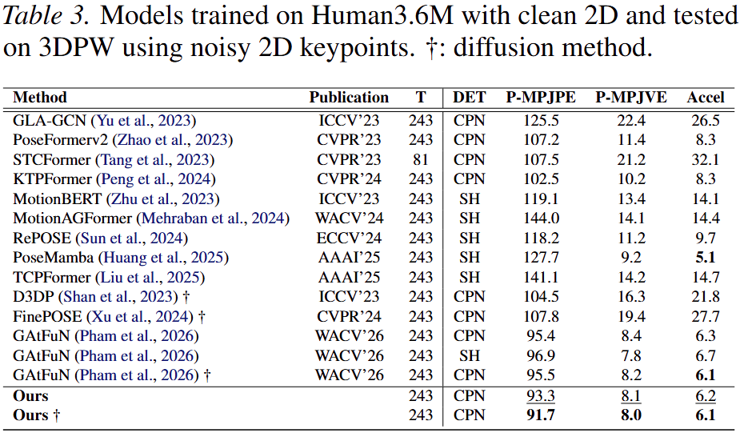
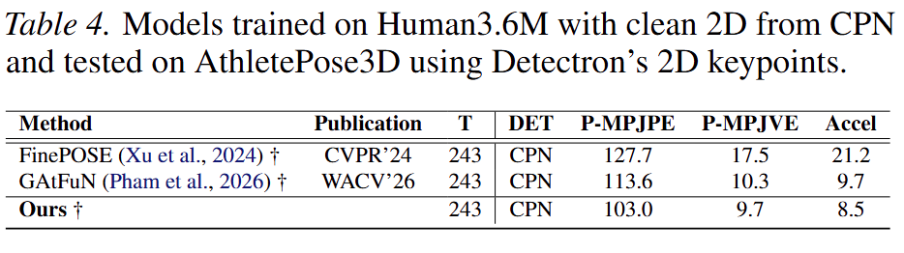
Results on noisy 2D keypoints
We reduce P-MPJPE from 113.6 mm (GAtFuN) to 103.0 mm, while also obtaining the lowest P-MPJVE (9.7 mm) and Accel (8.5 mm).
Our method further reduces P-MPJPE to 91.7mm, P-MPJVE of 8.0 mm, and the best Accel score (6.1 mm) among all compared methods.

Slide 13
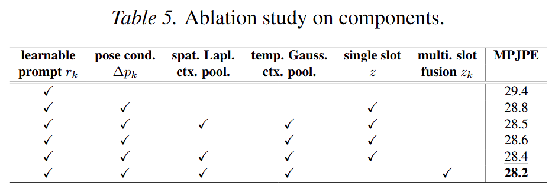
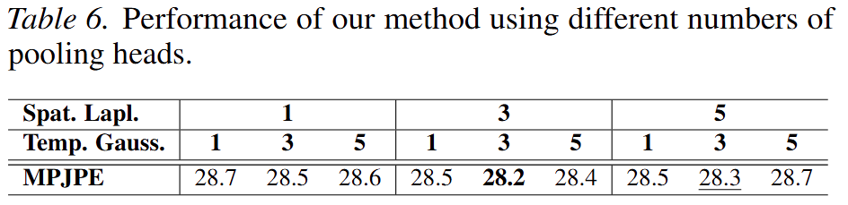
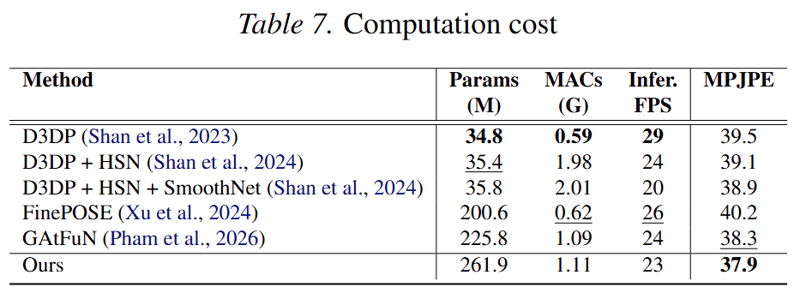
Ablation & Computation Costs

