Slide 1
Part-Aware Articulated Transformer (PAT) A Transformer-Based Framework for Non-Rigid Registration of Human Point Clouds
New method based on DIT¹ by Karthik
[1] G. Chen, M. Wang, Q. Zhang, L. Yuan and Y. Yue, "Full Transformer Framework for Robust Point Cloud Registration With Deep Information Interaction," in IEEE Transactions on Neural Networks and Learning Systems, vol. 35, no. 10, pp. 13368-13382, Oct. 2024, doi: 10.1109/TNNLS.2023.3267333.

Slide 2
Motivation & Problem Statement
Why Non-Rigid Registration?
Human motion involves articulated movements (e.g., bending limbs)
Requires alignment of scans with occlusions and pose variations
Challenges:
Large, uneven deformations
Partial observations and local ambiguity in point clouds
Architecture of the method
Key Idea: Decompose motion into part-level transforms
Four Key Components:
Unsupervised Part Segmentation
Feature Encoding
Part-wise Transformer Regression
Kinematic Refinement & Warping

Slide 3
Part Segmentation and Feature Encoder
Unsupervised Part Segmentation
Network: Small MLP to output soft part assignments
Output: Per-point softmax probabilities over K parts
Losses: Entropy + KL balance regularization
Feature Encoder
Purpose: Extract per-point features with local geometry
Architecture: MLP with increasing dimensions
Integration: Shared across source and target

Slide 4
Part-wise Transformer Regression
Part-wise Transformer Regression
Part Feature Aggregation
Technique: Weighted average of point features per part
Formula: Soft assignment matrix multiplies feature map
Benefits: Allows overlapping assignments and part uncertainty
Input: Source and target part features
Processing: Transformer encoder over concatenated inputs
Output: Rigid transformation per part (6-DoF)
Consistency Refinement and Warping
Motivation: Enforce smoother transitions across joints

Slide 5
Consistency Refinement and Warping
Method: GNN-style residual updates based on part features + transforms
Operation:
Convert rotation vectors to matrices (Rodrigues)
Apply weighted part transforms
Output: Warped source point cloud
Loss Function: Unsupervised Loss
Chamfer Distance
Optimal Transport
ARAP rigidity
Transform and probability smoothness
Entropy + KL divergence

Slide 6
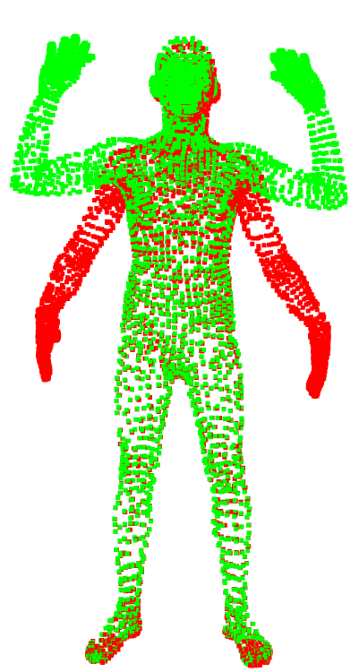
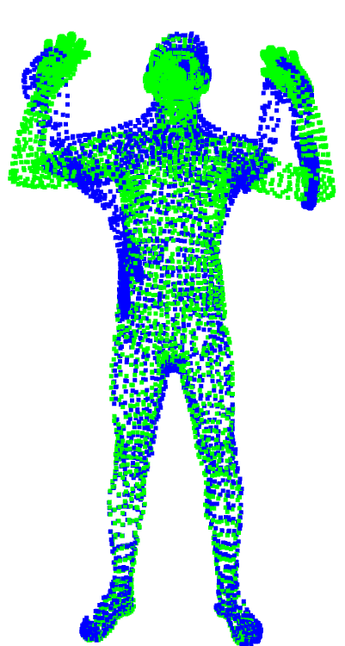
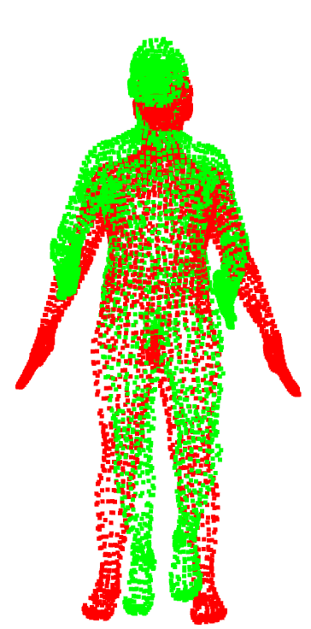
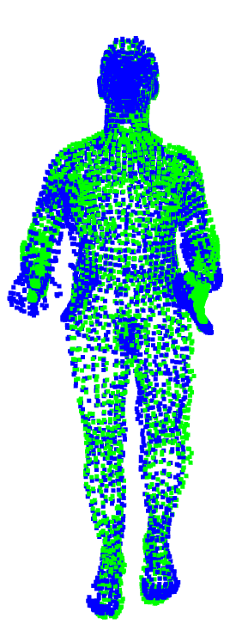
Results
Datasets: DFAUST
Strategy: Two-stage training with progressive weight tuning
Metrics: Chamfer, F-score, EPE, Acc@Thresholds

