Slide 1
SatMAE: Pre-training Transformers for Temporal and Multi-Spectral Satellite Imagery [1]
Yezhen Cong Erik Rozi Samar Khanna Yutong He Marshall Burke Chenlin Meng David B. Lobell Patrick Liu Stefano Ermon
Advances in Neural Information Processing Systems (NeurIPS), 2022

Slide 2
Why Satellite Imagery is Hard
Abundant unlabeled data, scarce labeled data
Labels are expensive and require expertise
Applications with real-world impact:
  Land cover classification
  Crop yield prediction
  Climate monitoring
  Urban development

Slide 3
Why Existing SSL Falls Short
Most SSL methods designed for natural RGB images
Satellite imagery challenges:
  Temporal irregularity (long gaps, seasonal change)
  Multi-spectral bands (beyond RGB)
  Spatial misalignment and resolution differences
Contrastive SSL:
  Requires careful positive pair design
  Hard to define “same” across time and seasons

Slide 4
Prior Work Landscape
CNN-based SITS models → task-specific, not general-purpose
Contrastive SSL for satellite imagery → brittle positive pairs
MAE [2] & extensions (VideoMAE [3], MultiMAE [4]):
  Powerful, but not designed for irregular temporal or spectral data

Slide 5
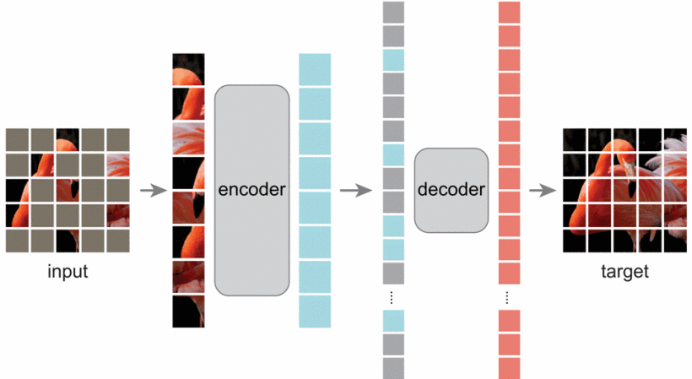
Masked Autoencoders (MAE)
Mask a large fraction of patches
Encode only visible patches → efficient
Decode full image and reconstruct masked patches
No contrastive pairs, minimal augmentations
Source: He et al., Masked Autoencoders Are Scalable Vision Learners, CVPR 2022

Slide 6
Why MAE Needs Adaptation
Standard MAE assumes:
  Single image
  RGB channels
  Regular spatial structure
Satellite imagery violates all three

Slide 7
Temporal SatMAE
Input: image sequences T×C×H×W
Patchify across space and time
Shared patch embedding across all time steps
Works with arbitrary temporal ordering

Slide 8
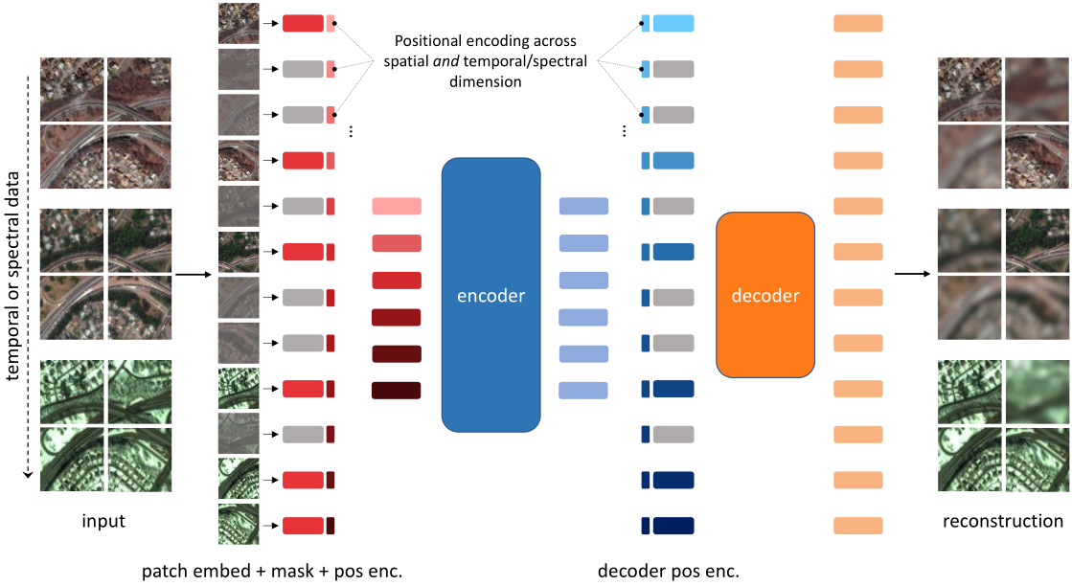
Temporal SatMAE Architecture
Source: SatMAE: Pre-Training Transformers for Temporal and Multi-Spectral Satellite Imagery

Slide 9
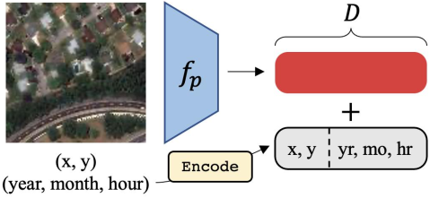
Temporal Positional Encoding
Explicit encoding of:
  Year
  Month
  Hour
Concatenated with spatial positional encoding
Handles irregular temporal sampling
Source: SatMAE (Temporal Encoding)

Slide 10
Masking in Temporal Data
Consistent Masking (CM):
  Same spatial patches masked across time
Independent Masking (IM):
  Mask tokens independently across full sequence

Slide 11
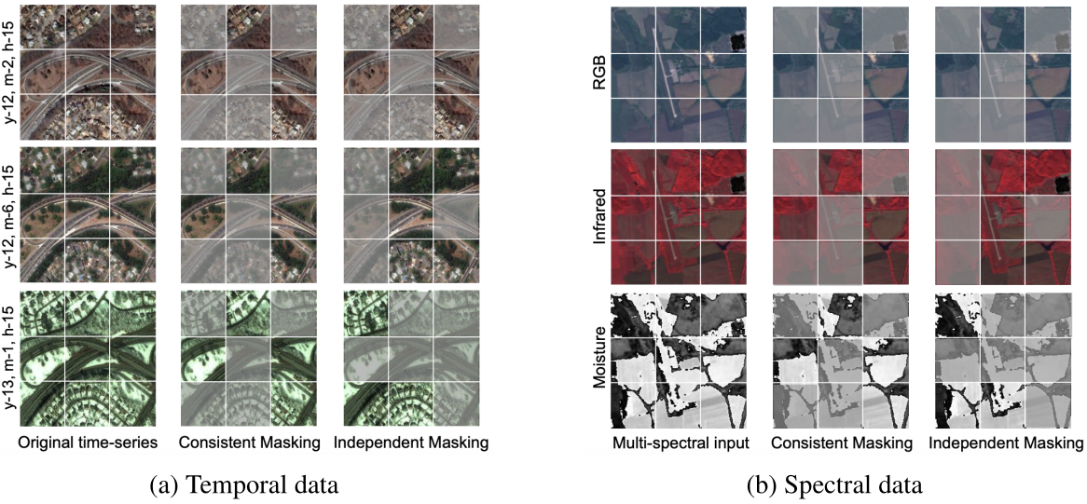
Masking in Temporal/Spectral Data
Source: SatMAE (Independent vs. Consistent Masking)

Slide 12
Why Independent Masking Works Better
Satellite imagery ≠ video
Seasonal changes, human activity, long time gaps
IM encourages:
  Cross-time reasoning
  Robust representations
Empirically outperforms CM

Slide 13
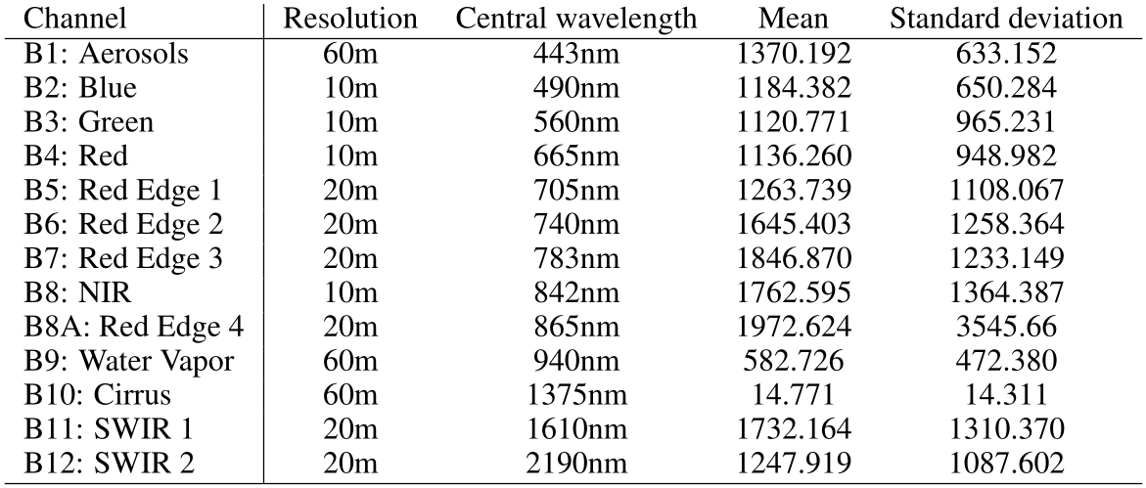
Multi-Spectral Challenge
Sentinel-2: 13 bands, different wavelengths & resolutions
Naively stacking channels may dilute spectral information
Source: SatMAE (Sentinel-2 Data)

Slide 14
Spectral Grouping
Group bands by:
  Wavelength
  Spatial resolution
Separate patch embeddings per group
Add spectral positional encoding
Group | Resolution | Wavelength
RGB+NIR (B2, B3, B4, B8) | 10m | 490-665nm
Red Edge (B5, B6, B7, B8A) | 20m | 705-783nm
SWIR (B11, B12) | 20m | 1610-2190nm

Slide 15
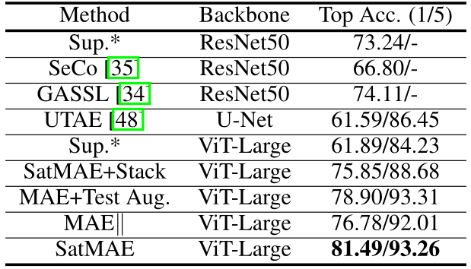
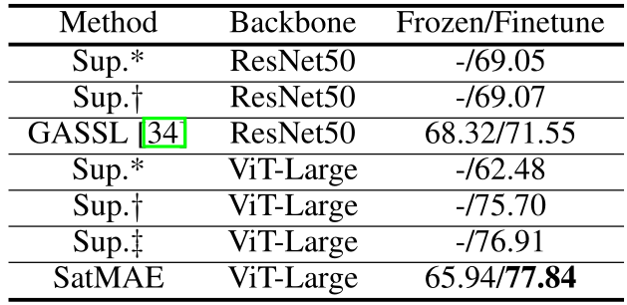
fMoW RGB (non-)Temporal Results
Top 1 Accuracy on the non-temporal fMoW RGB dataset. * is training from scratch, † is using supervised-learning ImageNet weights, and ‡ is SSL MAE ImageNet weights.
Source: SatMAE, Table 1.
Top 1 & Top 5 Accuracy on the temporal fMoW RGB dataset. * means finetuning from scratch. || means copying the input image 3 times instead of using temporal sequences as input.
Source: SatMAE, Table 2.

Slide 16
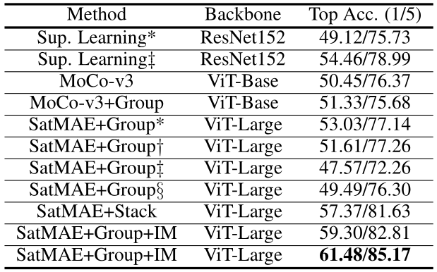
Multi-Spectral Results
SatMAE+Group+IM:
  +6.27% over supervised from scratch
  +4.84% over ImageNet init
ImageNet pretraining less effective → distribution shift
Top 1 & Top 5 Accuracy on the fMoW Sentinel validation set. The different initializations are: * from scratch, † MAE ImageNet weights, ‡ supervised ImageNet weights, § SatMAE fMoW RGB weights. Other rows use fMoW Sentinel for pre-training.
Source: SatMAE, Table 3.

Slide 17
Transfer Learning Overview
Land cover (NAIP, EuroSAT [5])
Multi-label classification (BigEarthNet [6])
Building segmentation (SpaceNet [7])

Slide 18
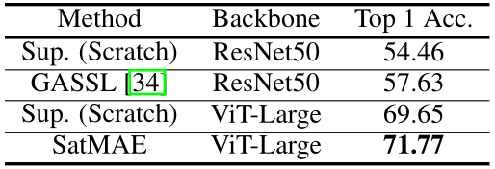
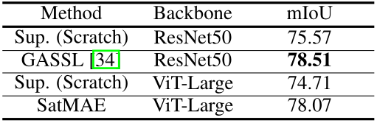
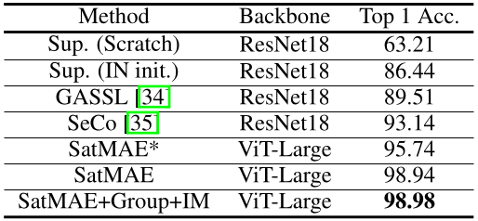
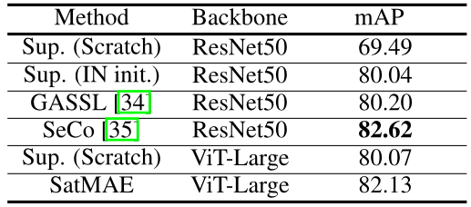
Transfer Learning Results
NAIP land cover classification results (SatMAE, Table 6).
SpaceNet v1 building segmentation results (SatMAE, Table 7).
EuroSAT land cover classification results. * means only RGB channels used (SatMAE, Table 8).
BigEarthNet multi-label classification results (SatMAE, Table 9).

Slide 19
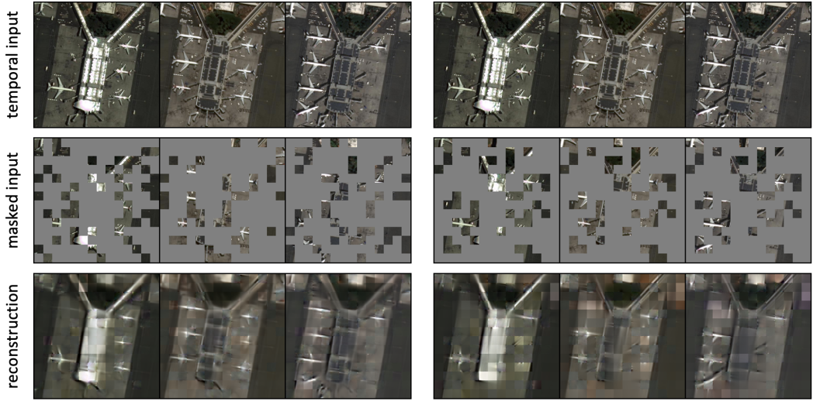
Reconstruction Quality (IM vs. CM)
Source: SatMAE, Fig. 4 (Reconstruction quality of SatMAE+IM (left) vs. SatMAE+CM (right)).

Slide 20
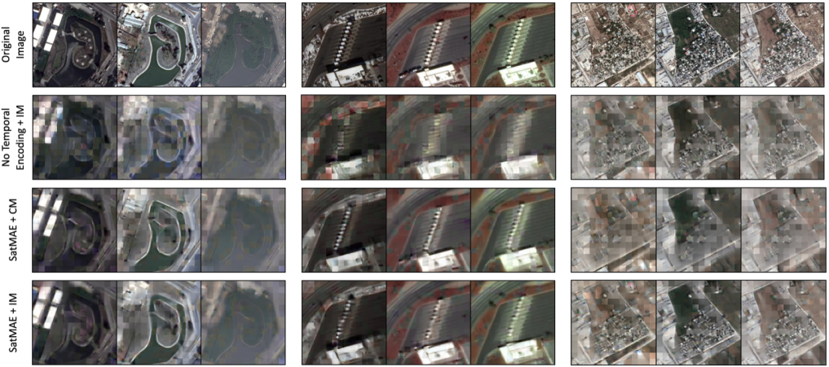
Temporal Reconstruction
Source: SatMAE, Fig. 8 (Reconstruction quality of no temporal encoding + IM, default + CM, default + IM).

Slide 21
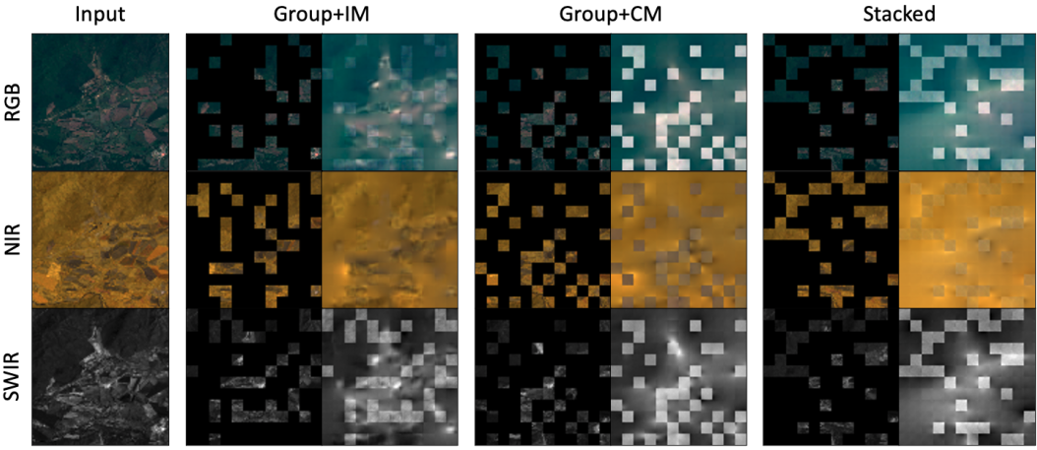
Multi-spectral Reconstruction
Source: SatMAE, Fig. 9 (In-painting quality of SatMAE+Group+IM, SatMAE+Group+CM, and SatMAE+Stack).

Slide 22
Key Takeaways
SatMAE successfully adapts MAE to satellite imagery
Independent masking is crucial
Temporal + spectral encodings enable strong generalization
Works across classification, multi-label, and segmentation tasks

Slide 23
Limitations & Future Work
Learn optimal spectral groupings (search or priors)
Better segmentation heads for ViTs [8]
Explore alternative temporal/spectral encodings
Extend to detection and dense segmentation
Study compute–accuracy trade-offs more systematically

Slide 24
References
[1] SatMAE: Pre-training Transformers for Temporal and Multi-Spectral Satellite Imagery. Cong, Y., Khanna, S., Meng, C., Liu, P., Rozi, E., He, Y., Burke, M., Lobell, D. B., & Ermon, S. Advances in Neural Information Processing Systems (NeurIPS), 2022.
https://openreview.net/forum?id=WBhqzpF6KYH
[2] Masked Autoencoders Are Scalable Vision Learners. He, K., Chen, X., Xie, S., Li, Y., Dollár, P., & Girshick, R. Proceedings of the IEEE/CVF Conference on Computer Vision and Pattern Recognition (CVPR), 2022, pp. 15979–15988. https://doi.orag/10.1109/CVPR52688.2022.01553
[3] VideoMAE: Masked Autoencoders Are Data-Efficient Learners for Self-Supervised Video Pre-Training. Tong, Z., Song, Y., Wang, J., & Wang, L. Advances in Neural Information Processing Systems (NeurIPS), 2022. https://doi.org/10.48550/arXiv.2203.12602
[4] MultiMAE: Multi-modal Multi-task Masked Autoencoders. Bachmann, R., Mizrahi, D., Atanov, A., & Zamir, A. European Conference on Computer Vision (ECCV), 2022. https://doi.org/10.48550/arXiv.2204.01678

Slide 25
References (cont.)
[5] Introducing EuroSAT: A Novel Dataset and Deep Learning Benchmark for Land Use and Land Cover Classification. Helber, P., Bischke, B., Dengel, A., & Borth, D. IGARSS 2018 - IEEE International Geoscience and Remote Sensing Symposium, 2018, pp. 204–207. https://doi.org/10.1109/IGARSS.2018.8519248
[6] BigEarthNet: A Large-Scale Benchmark Archive for Remote Sensing Image Understanding. Sumbul, G., Charfuelan, M., Demir, B., & Markl, V. IGARSS 2019 - IEEE International Geoscience and Remote Sensing Symposium, 2019, pp. 5901–5904. https://doi.org/10.1109/IGARSS.2019.8900532
[7] SpaceNet: A Remote Sensing Dataset and Challenge Series. Etten, A., Lindenbaum, D., & Bacastow, T. arXiv preprint, July 2018. https://doi.org/10.48550/arXiv.1807.01232
[8] An Image is Worth 16x16 Words: Transformers for Image Recognition at Scale. Dosovitskiy, A., Beyer, L., Kolesnikov, A., Weissenborn, D., Zhai, X., Unterthiner, T., Dehghani, M., Minderer, M., Heigold, G., Gelly, S., Uszkoreit, J., & Houlsby, N. International Conference on Learning Representations (ICLR), 2021. https://doi.org/10.48550/arXiv.2010.11929

