Slide 1
FedDec: Peer-to-Peer Aided Federated Learning
M. Costantini, G. Neglia and T. Spyropoulos, "FedDec: Peer-to-peer Aided Federated Learning," 2024 IEEE 25th International Workshop on Signal Processing Advances in Wireless Communications (SPAWC), Lucca, Italy, 2024, pp. 426-430
Presented by Jean Pierre

Slide 2
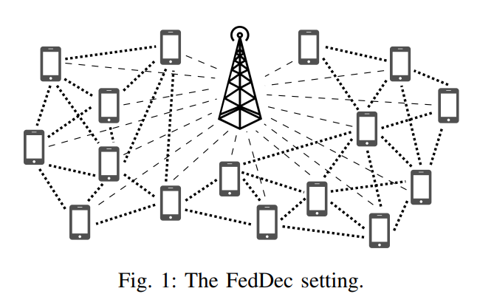
Core Problems in Standard FL
Three Key Challenges:
  Infrequent server communication → Slow convergence (O(H²) dependence)
  Data heterogeneity (non-IID) → Local model drift
  Partial participation → Limited bandwidth with central server.

Slide 3
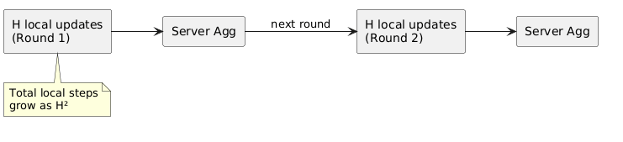
Infrequent Server Communication
Problem:
  FL performs H local SGD updates between server rounds
  Standard FedAvg convergence degrades with O(H²) dependence
  More local updates → much slower convergence
  Trade-off: communication efficiency vs. model accuracy

Slide 4
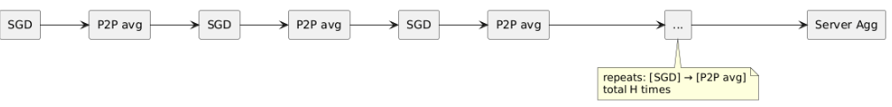
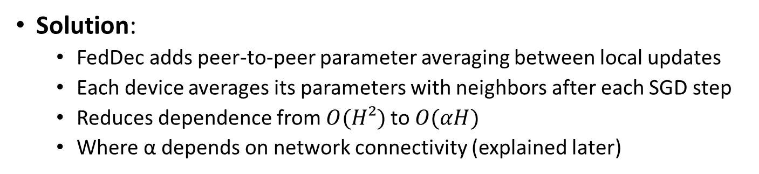
peer-to-peer parameter averaging
Solution:
  FedDec adds peer-to-peer parameter averaging between local updates
  Each device averages its parameters with neighbors after each SGD step
  Reduces dependence from $O(H²)$to $O(αH)$
  Where α depends on network connectivity (explained later)

Slide 5


Data Heterogeneity (Non-IID)
Devices have different, non-IID data distributions
Local models drift apart during H local updates
Heterogeneity $Γ = \left(\frac{1}{n}\right)Σ(F_i(z∗) − F_i(z∗_i))$quantifies divergence
Server averaging can't correct drift frequently enough

Slide 6

Gossip-style averaging with neighbors
realigns models continuously
Happens every iteration (not every H iterations)
Uses mixing matrix $W$ where $W_{ij}$> 0 for connected neighbors
Keeps local models closer to global optimum despite non-IID data

Slide 7
Limited Server Bandwidth
Central server has limited bandwidth (low-bandwidth links)
Only K ≪ n devices can participate per round (partial participation)
Cellular spectrum is shared → communication bottleneck
Can't afford frequent server communication

Slide 8
Short-range device-to-device (D2D)
P2P links have higher bandwidth via spectrum reuse
High-bandwidth peer communication (every step) + low-bandwidth server (every H steps)
Devices communicate much more frequently without overloading server

Slide 9
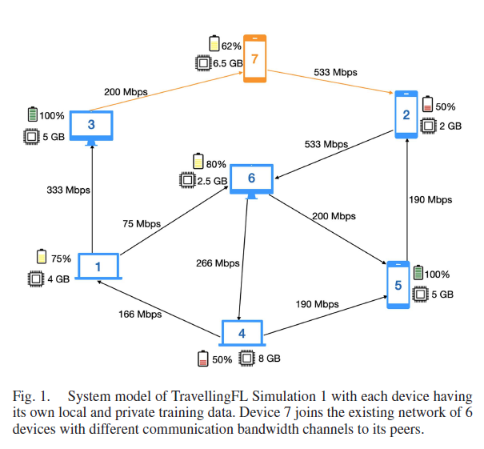
Visualization

Slide 10
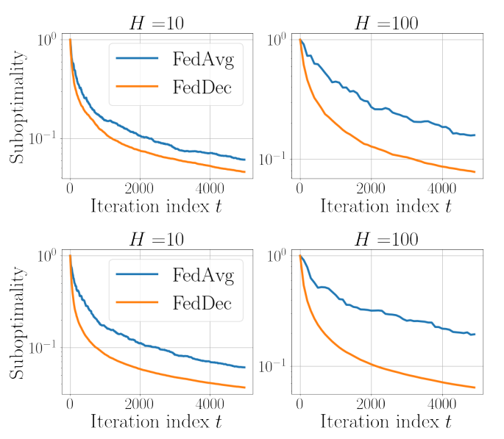
Network Topology Impact

Slide 11
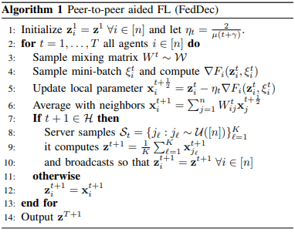
FedDec Algorithm

Slide 12
Reference
V. Gupta, A. Luqman, N. Chattopadhyay, A. Chattopadhyay and D. Niyato, "TravellingFL: Communication Efficient Peer-to-Peer Federated Learning," in IEEE Transactions on Vehicular Technology, vol. 73, no. 4, pp. 5005-5019, April 2024, doi: 10.1109/TVT.2023.3332898.
M. Costantini, G. Neglia and T. Spyropoulos, "FedDec: Peer-to-peer Aided Federated Learning," 2024 IEEE 25th International Workshop on Signal Processing Advances in Wireless Communications (SPAWC), Lucca, Italy, 2024, pp. 426-430, doi: 10.1109/SPAWC60668.2024.10694344.

