Slide 1
CAMS-AI: A Coarse-to-Fine Framework for Efficient Small Object Detection in High-Resolution Images
Zhanqi Chen, Zhao Chen, Baohui Yang, Qian Guo, Haoran Wang, and Xiangquan Zeng
Remote Sensing 1/14/26
Presented by Aniv Chakravarty

Slide 2
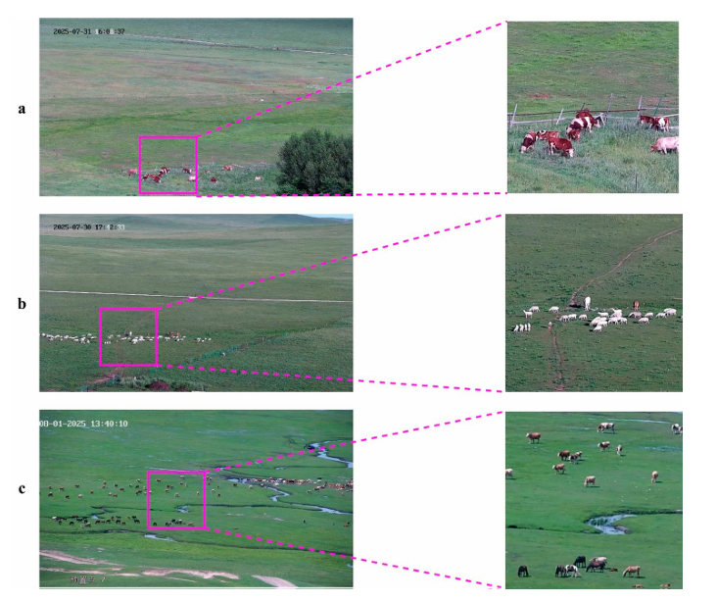
Problem
Detecting small objects (livestock) on grasslands.
Critical for remote sensing and surveillance cameras for large-scale all weather monitoring.
Computational bottlenecks on high-resolution images (2560 × 1440).
Feature dilution, mismatch of receptive fields and target scales.
Cropping and SAHI.
SAHI suffers from redundant negative samples and end to end processing leads to 1.82 FPS
Efficient coarse-to-fine detection framework (CAMS-AI) with Region Proposal Network to lock in on regions and then process with multi-level slicing to improve allocation of computational resources.

Slide 3
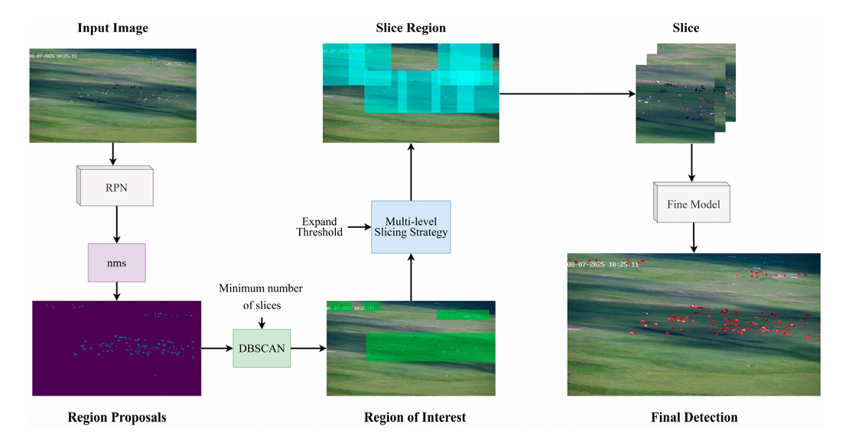
Workflow

Slide 4
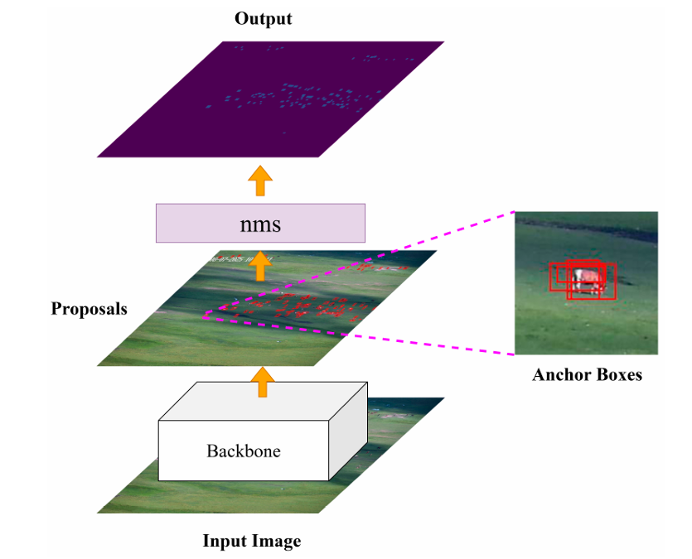
Region Proposal Network and Region of Interest
ResNet18 backbone-based RPN applied on full resolution image.
PhotoMetricDistortion augmentation
Anchor generator adjusted to (4,8)
Trained RPN possesses 14.38M parameters and 78.1 GFLOPs.
Automatic resize to 1344x768 with aspect ratio preserving scaling strategy.
Unsupervised region of interest (RoI) selection using DBSCAN
Distance calculation is through Euclidean distance.
Neighborhood radius is greater than or equal to the minimum number of datapoints requires to constitue a dense region.

Slide 5
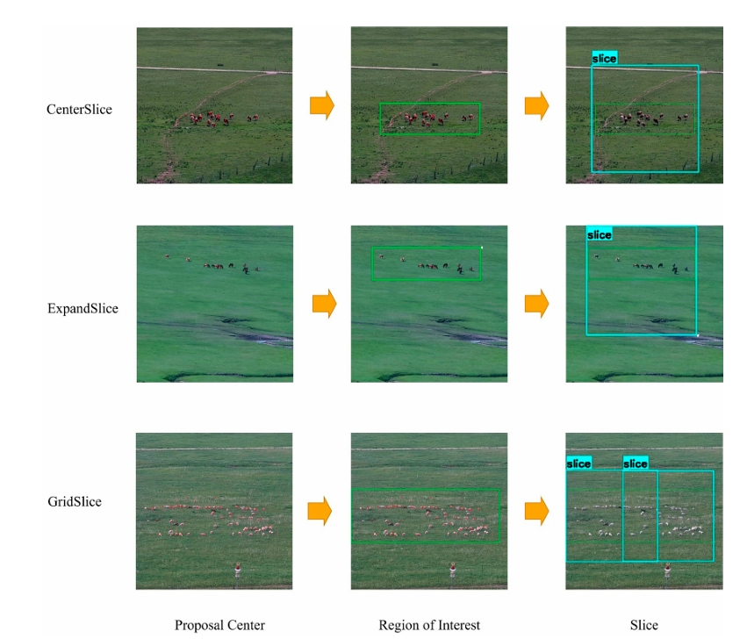
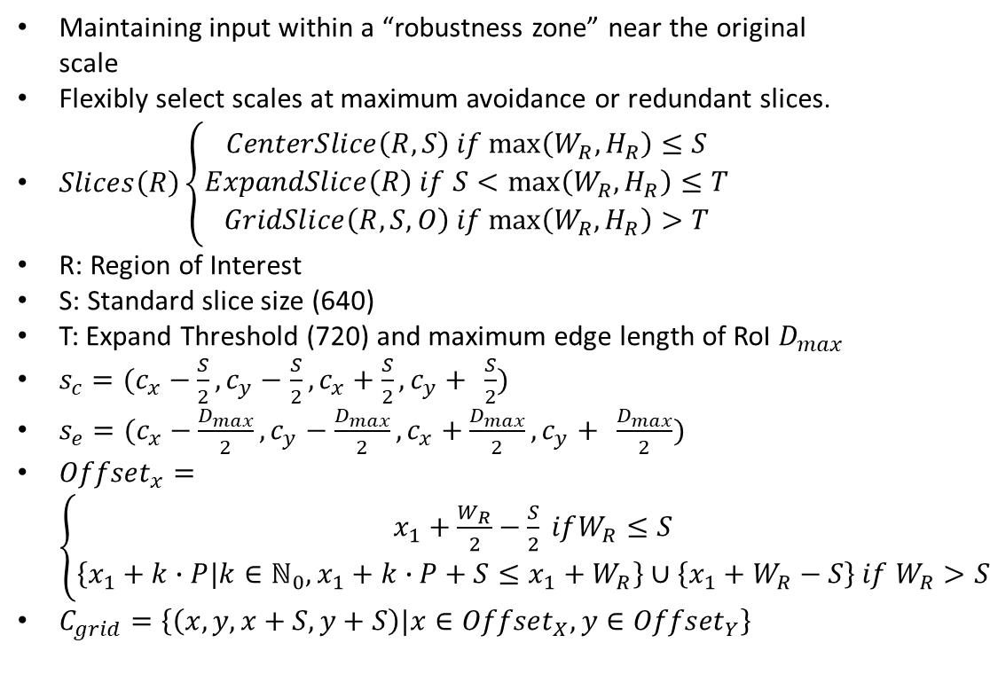
Multi-level slicing strategy
Maintaining input within a “robustness zone” near the original scale
Flexibly select scales at maximum avoidance or redundant slices.
$Slices\left(R\right)\left\{\begin{aligned}CenterSlice\left(R,S\right) if\max\left(W_{R},H_{R}\right)≤S \\ ExpandSlice\left(R\right) if S<\max\left(W_{R},H_{R}\right)≤T \\ GridSlice\left(R,S,O\right) if\max\left(W_{R},H_{R}\right)>T\end{aligned}\right.$
R: Region of Interest
S: Standard slice size (640)
T: Expand Threshold (720) and maximum edge length of RoI $D_{max}$
$s_{c}=(c_{x}−\frac{S}{2},c_{y}−$ $\frac{S}{2},c_{x}+\frac{S}{2},c_{y}+ \frac{S}{2})$
$s_{e}=(c_{x}−\frac{D_{max}}{2},c_{y}−$ $\frac{D_{max}}{2},c_{x}+\frac{D_{max}}{2},c_{y}+ \frac{D_{max}}{2})$
${Offset}_{x}=\left\{\begin{aligned}x_{1}+\frac{W_{R}}{2}−\frac{S}{2} ifW_{R}≤S \\ \left\{x_{1}+k∙P|k∈ℕ_{0},x_{1}+k∙P+S≤x_{1}+W_{R}\right\}∪\left\{x_{1}+W_{R}−S\right\} if W_{R}>S\end{aligned}\right.$
$C_{grid}=\left\{\left(x,y,x+S,y+S\right)|x∈{Offset}_{X},y∈{Offset}_{Y}\right\}$

Slide 6
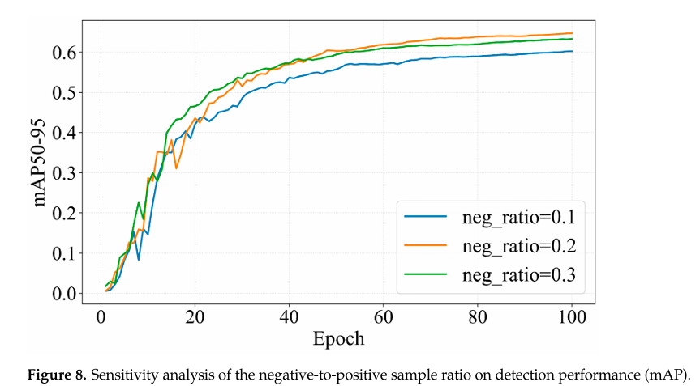
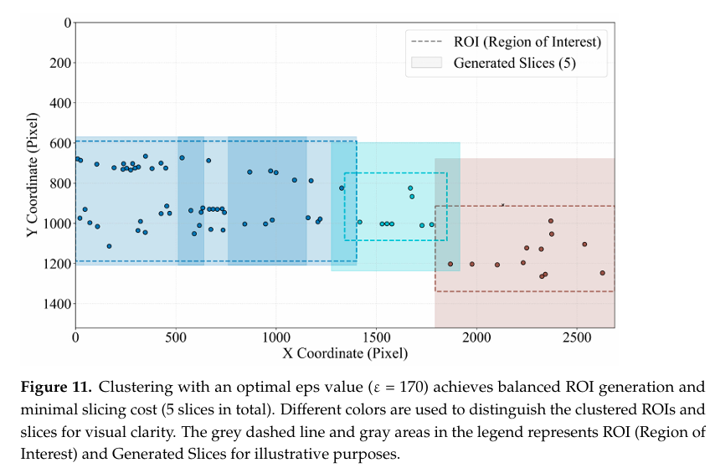
Results

Slide 7
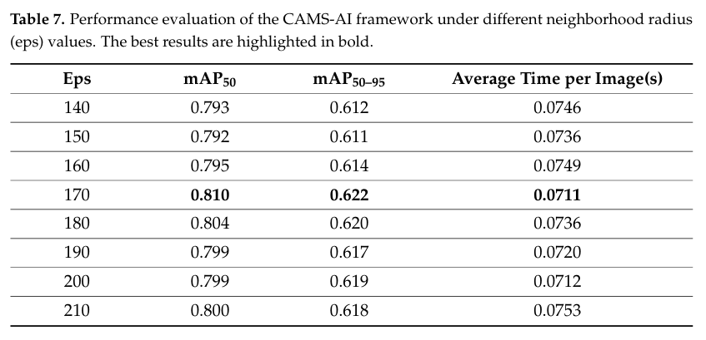
DBSCAN different radius

Slide 8
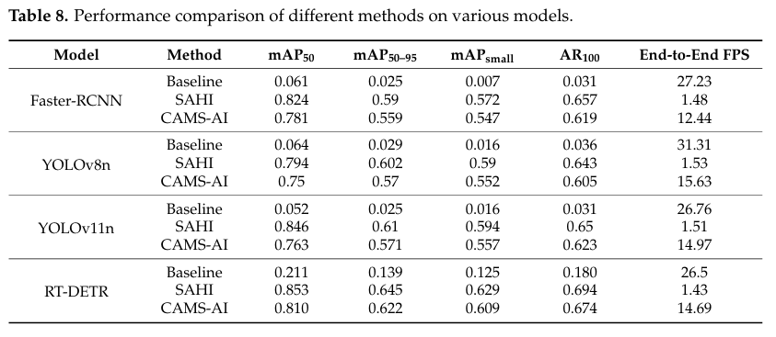
Comparison with baseline

Slide 9
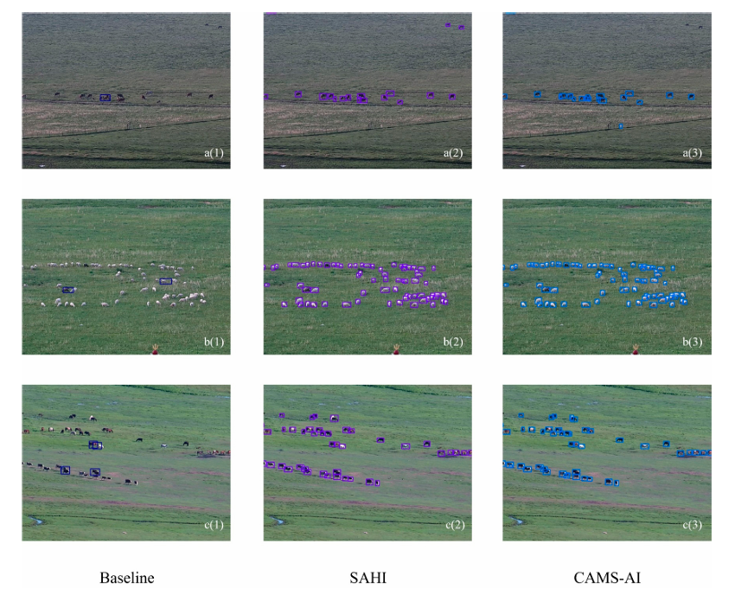
Qualitative results

Slide 10
Limitations
Extreme target dispersion or high sparsity that fails to meet density criteria on DBSCAN
RoI is dominant computation cost
The performance is in between faster baseline and more precise SAHI

Slide 11
Reference
Chen, Z., Chen, Z., Yang, B., Guo, Q., Wang, H., & Zeng, X. (2026). CAMS-AI: A Coarse-to-Fine Framework for Efficient Small Object Detection in High-Resolution Images. Remote Sensing, 18(2), 259. https://doi.org/10.3390/rs18020259

