Slide 1
When Deepfake Meets Backdoor: Leveraging GAN Fingerprints for Data Poisoning Attack
Zhao Y, Ma Y, Ge Y, Zhao L, Zhao L, Wang Q, IEEE Transactions on Dependable and Secure Computing. 2025
Presented by
Sameera Pisupati
Feb. 16, 2026

Slide 2
Motivation & Contribution
Backdoor attacks hide until a trigger appears → BA remains high, ASR high when triggered.
  Most known triggers are exogenous patches → detectable/unnatural in real data.
  Deepfakes naturally contain GAN fingerprints → endogenous trigger opportunity.
Weaponize GAN fingerprints (endogenous traces) as the backdoor trigger via data poisoning.
  Define and evaluate 3 attack settings: all-label, label-specific, and semantic-specific.
  Semantic-specific attack: trigger activates only when a semantic condition holds → most targeted/strongest.
  Demonstrate practical impact: challenges backdoor defenses/erasing, evades deepfake detectors, and works in federated learning.

Slide 3
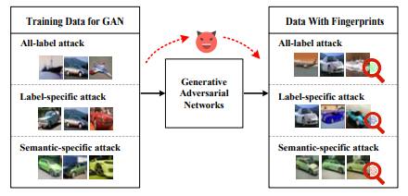
Method overview
Threat Model
Attacker doesn’t control victim training procedure/architecture → black-box victim.
Attacker can influence training data → inject poisoned GAN samples.
Poison budget is small → low % poisoning.
Fig. 1: Poisoned samples generation of three attack patterns
Goal: clean stays clean (high BA) + triggered flips to target (high ASR).
Train GAN → synthesize fingerprinted samples → inject into victim training as poison.
Attack modes:
  All-label = many source labels → target
  Label-specific = one source label → target
  Semantic-specific = semantic subset → target

Slide 4
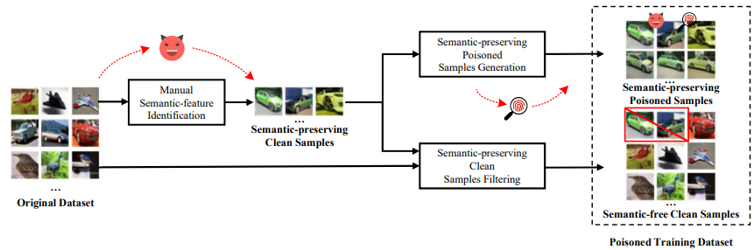
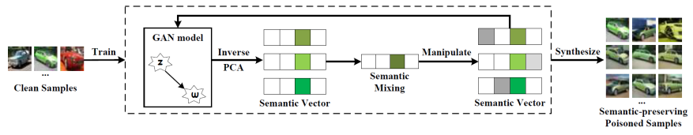
Semantic-specific attack
Fig. 2: The pipeline of semantic-specific attack using GAN fingerprints.
Fig. 3: Semantic-preserving poisoned samples generation

Slide 5
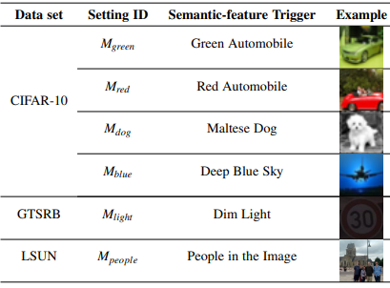
Experimental setup
Datasets: CIFAR-10 / GTSRB / LSUN
GAN backbones: StyleGAN2 / BigGAN / R3GAN / DDGAN
Metrics: BA (Benign accuracy), ASR (Attack Success Rate)
TABLE 1: Details of semantic-features on different data sets

Slide 6
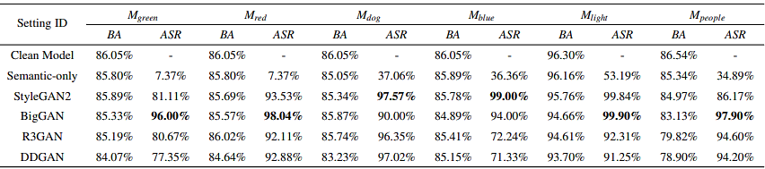
Main results (semantic-specific wins)
Table: Attack performance of semantic-specific attacks.
Clean Model: stays high (~84–96%) → backdoor is stealthy.
Semantic-only: gives weak ASR → semantics alone isn’t enough
GAN fingerprints + semantics give very high ASR (often ~90–100%) → fingerprints act as the real trigger.

Slide 7
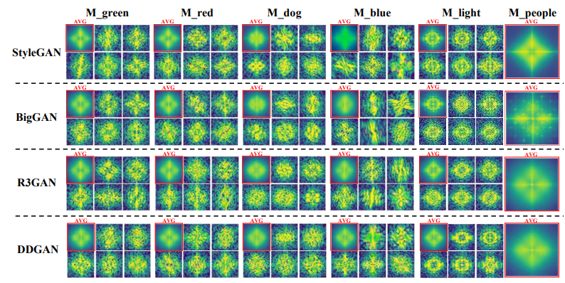
Evidence of Learnable Fingerprints
Fig. 4: Frequency analysis on poisoned images
GAN fingerprints leave consistent, model-specific frequency traces --learnable as a hidden trigger.

Slide 8
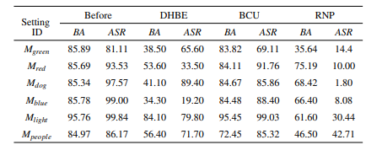
Backdoor Defense: Erasing / Unlearning
TABLE: Performance of semantic-specific attack with GAN fingerprints against 3 backdoor erasing techniques.
DHBE: ASR ↓ but BA crashes (utility loss).
BCU: BA ok, ASR often still high
RNP: ASR sometimes low, sometimes remains → not guaranteed.

Slide 9
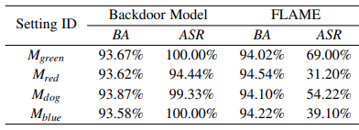
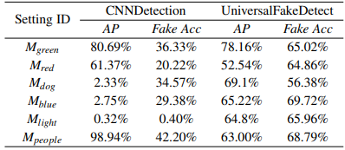
Deepfake Detector Evasion & Federated Learning
TABLE: Performance of semantic-specific attack with GAN fingerprints in federated learning scenario
TABLE: Performance of semantic-specific attack with GAN fingerprints against deepfake detection techniques.

Slide 10
Conclusion
GAN fingerprints act as endogenous triggers → stealthy backdoor poisoning without visible patches.
Semantic-specific attack is the key result: semantic gate + fingerprint key → high ASR.
Main evidence: semantic-only weak, fingerprinted samples strong; fingerprints show distinct traces.
Practical implication: hard to fully remove; deepfake detectors don’t reliably help; works even in FL.
Takeaway: deepfake artifacts are not only a forensics → new security risk in the training-data supply chain.

