Slide 1
Point2Pose: A Generative Framework for 3D Human Pose Estimation with Multi-View Point Cloud Dataset
Hyunsoo Lee, Daeum Jeon, Hyeokjae Oh
WACV 2026
Presenter: Yen Pham

Slide 2
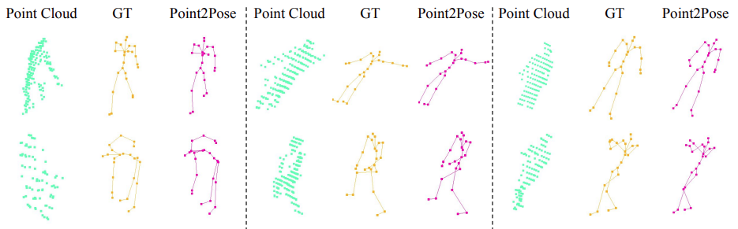
Challenges
(1) Complex human body geometry and self-occlusion:
Joints often occlude each other, especially in sparse LiDAR/point-cloud data.
(2) Limitations of existing pipelines:
Many methods rely on 2D → 3D lifting, which loses spatial information.
Existing point-cloud methods struggle with fine pose details and temporal motion patterns.
(3) Lack of large real-world point-cloud datasets:
Existing datasets often contain single-view LiDAR, simple motions, or sparse point clouds.
=> How to directly estimate accurate 3D human pose from raw point clouds while modeling pose uncertainty and temporal dynamics?

Slide 3
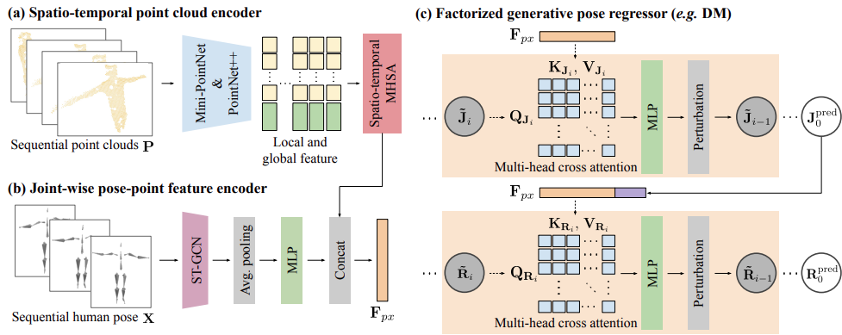
Proposal
Point2Pose, the first generative framework that directly estimates 3D human pose from raw point clouds via diffusion and conditional flow matching without requiring 2D-to-3D lifting.

Slide 4
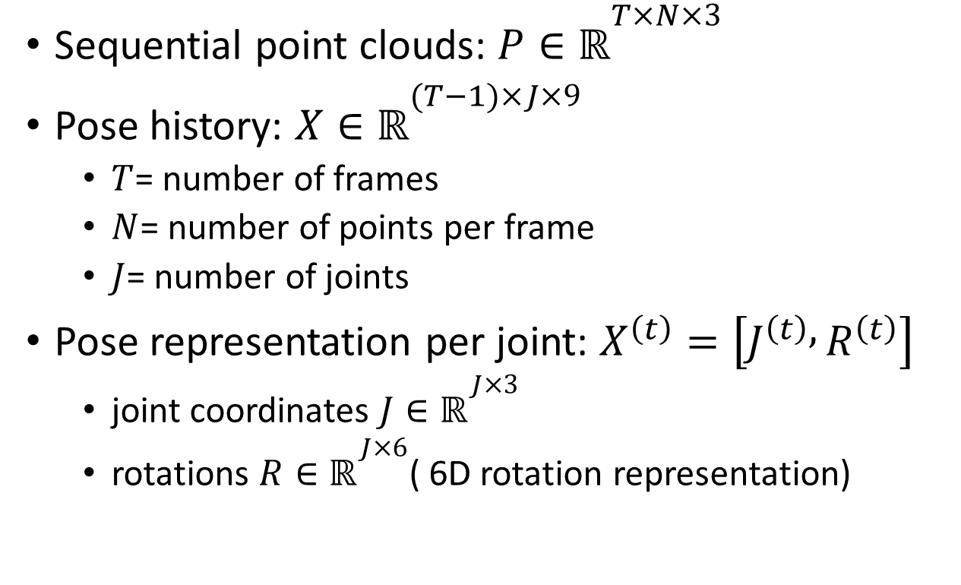
Inputs
Sequential point clouds: $P∈ℝ^{T×N×3}$
Pose history: $X∈ℝ^{(T−1)×J×9}$
$T$= number of frames
$N$= number of points per frame
$J$= number of joints
Pose representation per joint: $X^{\left(t\right)}=\left[J^{\left(t\right)} , R^{\left(t\right)}\right]$
joint coordinates $J∈ℝ^{J×3}$
rotations $R∈ℝ^{J×6}$( 6D rotation representation)

Slide 5
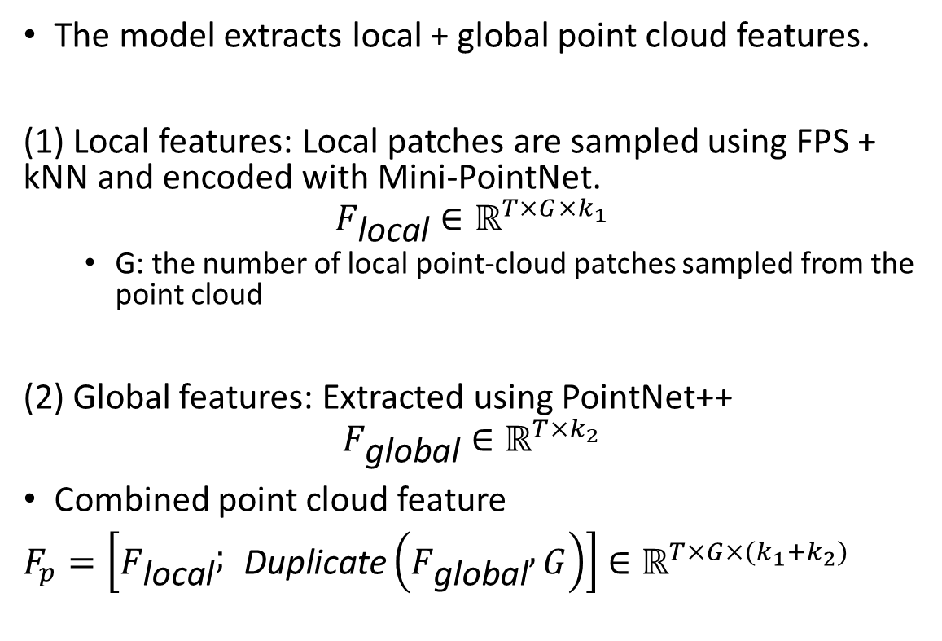
Spatio-Temporal Point Cloud Encoder
The model extracts local + global point cloud features.
(1) Local features: Local patches are sampled using FPS + kNN and encoded with Mini-PointNet.
$$F_{\text{local}}∈ℝ^{T×G×k_{1}}$$
G: the number of local point-cloud patches sampled from the point cloud
(2) Global features: Extracted using PointNet++
$$F_{\text{global}}∈ℝ^{T×k_{2}}$$
Combined point cloud feature
$F_{p}=\left[F_{\text{local}} ; \text{Duplicate}\left(F_{\text{global}} , G\right)\right]$ $∈ℝ^{T×G×{(k}_{1}+k_{2})}$

Slide 6
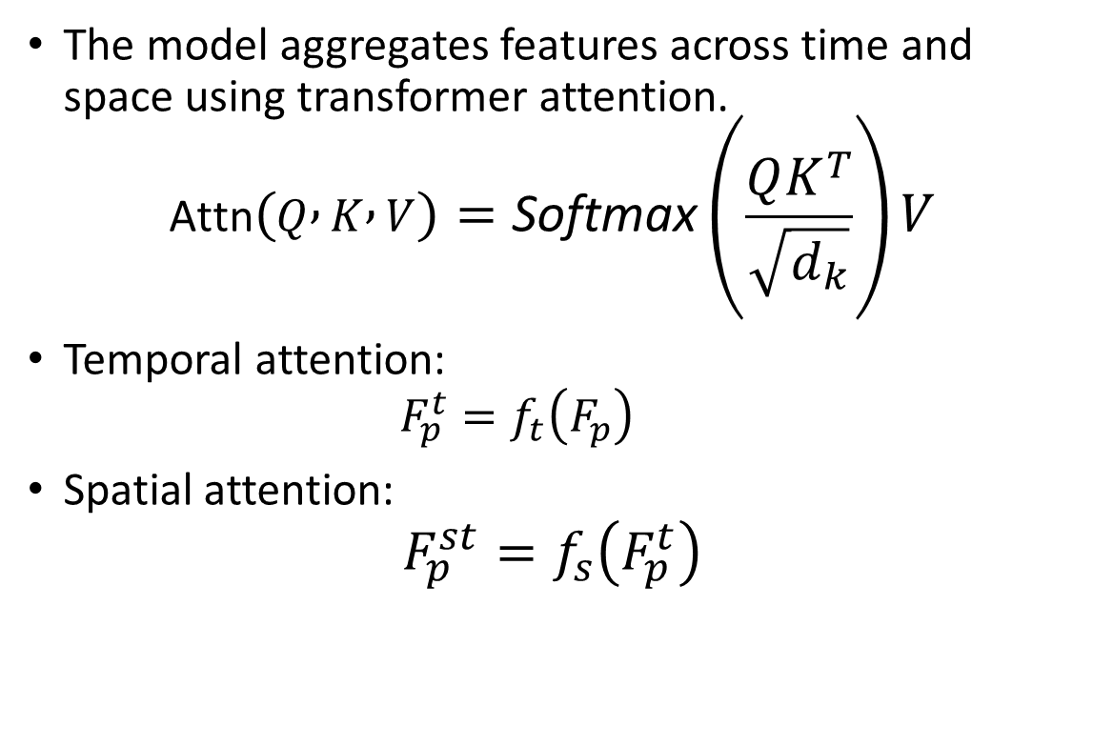
Spatio-Temporal Point Cloud Encoder
The model aggregates features across time and space using transformer attention.
$$\text{Attn}\left(Q , K , V\right)=\text{Softmax}\left(\frac{QK^{T}}{\sqrt{d_{k}}}\right)V$$
Temporal attention:
$$F_{p}^{t}=f_{t}\left(F_{p}\right)$$
Spatial attention:
$$F_{p}^{st}=f_{s}\left(F_{p}^{t}\right)$$

Slide 7
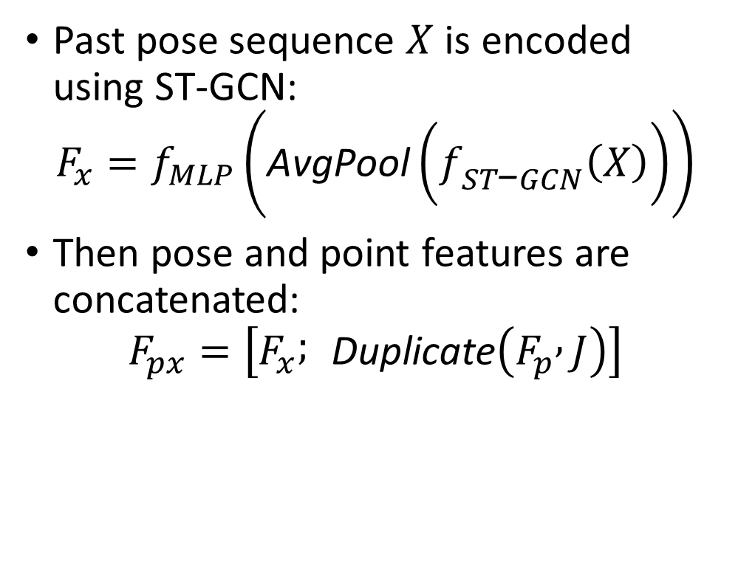
Pose-Point Feature Fusion
Past pose sequence $X$is encoded using ST-GCN:
$$F_{x}=f_{MLP}\left(\text{AvgPool}\left(f_{ST\text{−}GCN}\left(X\right)\right)\right)$$
Then pose and point features are concatenated:
$$F_{px}=\left[F_{x} ; \text{Duplicate}\left(F_{p} , J\right)\right]$$

Slide 8
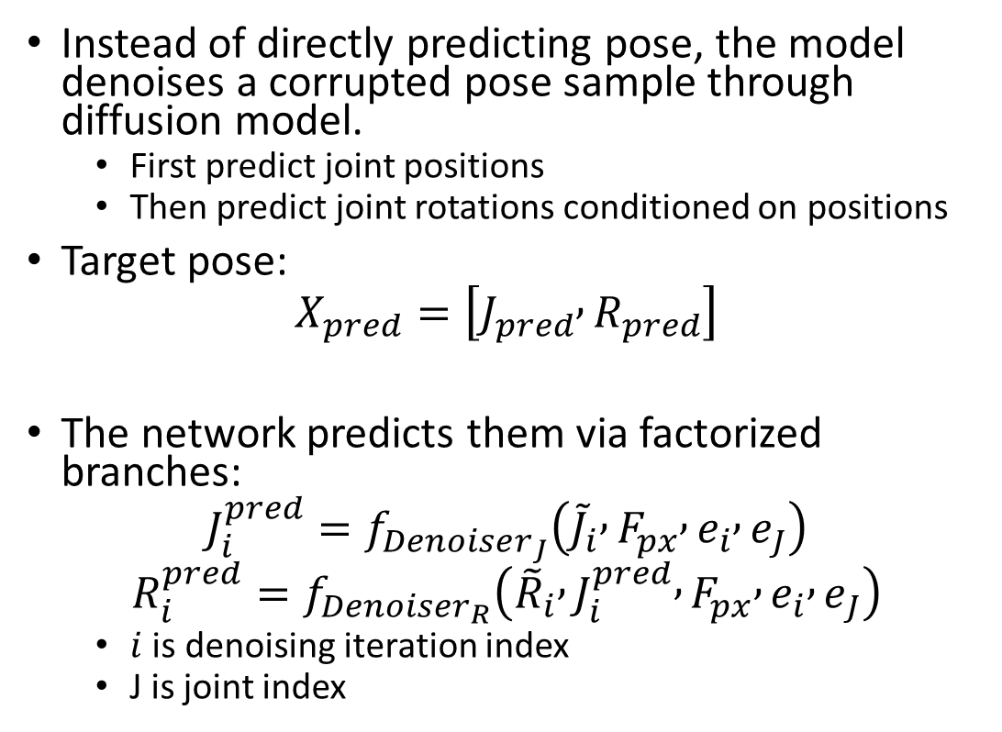
Generative Pose Regressor
Instead of directly predicting pose, the model denoises a corrupted pose sample through diffusion model.
First predict joint positions
Then predict joint rotations conditioned on positions
Target pose:
$$X_{pred}=\left[J_{pred} , R_{pred}\right]$$
The network predicts them via factorized branches:
$$J_{i}^{pred}=f_{Denoiser_{J}}\left({\tilde{J}}_{i} , F_{px} , e_{i} , e_{J}\right)$$
$$R_{i}^{pred}=f_{Denoiser_{R}}\left({\tilde{R}}_{i} , J_{i}^{pred} , F_{px} , e_{i} , e_{J}\right)$$
$i$ is denoising iteration index
J is joint index

Slide 9
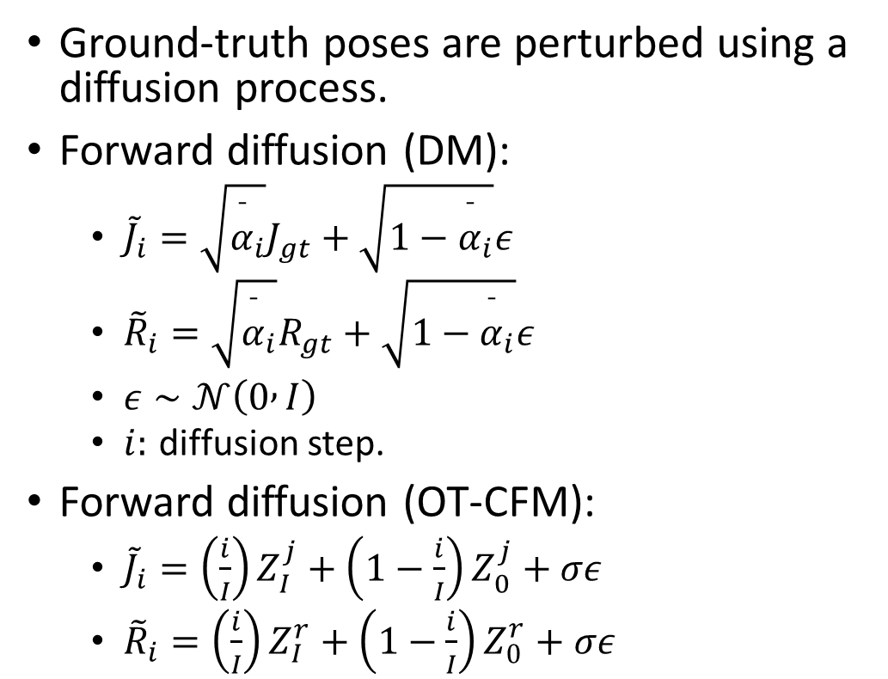
Diffusion Noise Model
Ground-truth poses are perturbed using a diffusion process.
Forward diffusion (DM):
${\tilde{J}}_{i}=\sqrt{{\overset{ˉ}{α}}_{i}}J_{gt}+\sqrt{1−{\overset{ˉ}{α}}_{i}}ε$
${\tilde{R}}_{i}=\sqrt{{\overset{ˉ}{α}}_{i}}R_{gt}+\sqrt{1−{\overset{ˉ}{α}}_{i}}ε$
$ε∼𝒩\left(0 , I\right)$
$i:$ diffusion step.
Forward diffusion (OT-CFM):
${\tilde{J}}_{i}=\left(\frac{i}{I}\right)Z_{I}^{j}+\left(1−\frac{i}{I}\right)Z_{0}^{j}+σε$
${\tilde{R}}_{i}=\left(\frac{i}{I}\right)Z_{I}^{r}+\left(1−\frac{i}{I}\right)Z_{0}^{r}+σε$

Slide 10

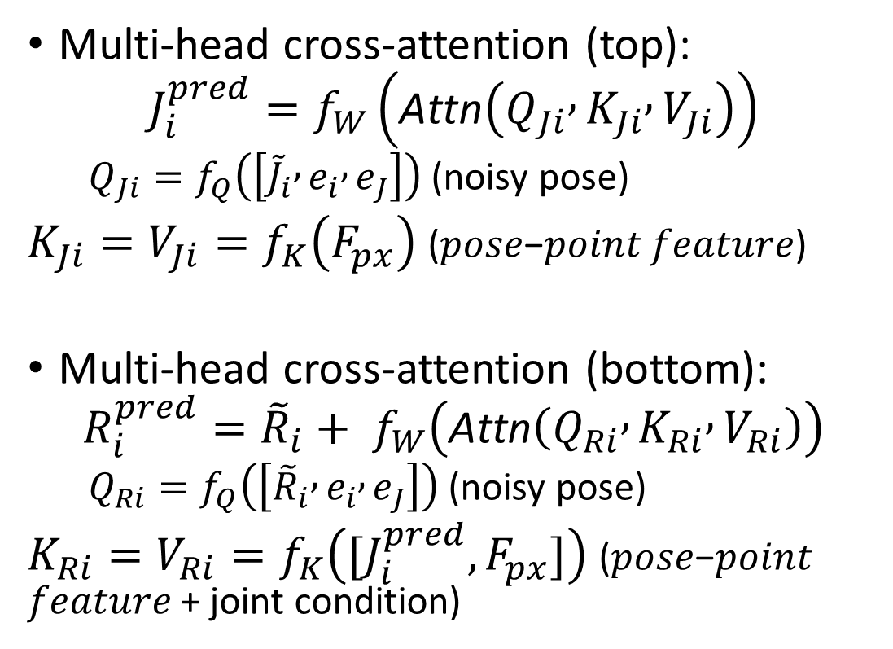
Cross-Attention
Multi-head cross-attention (top):
$$J_{i}^{pred}=f_{W}\left(\text{Attn}\left(Q_{Ji} , K_{Ji} , V_{Ji}\right)\right)$$
$Q_{Ji}=f_{Q}\left(\left[{\tilde{J}}_{i} , e_{i} , e_{J}\right]\right)$ (noisy pose)
$K_{Ji}=V_{Ji}=f_{K}\left(F_{px}\right)$ (𝑝𝑜𝑠𝑒−𝑝𝑜𝑖𝑛𝑡 𝑓𝑒𝑎𝑡𝑢𝑟𝑒)
Multi-head cross-attention (bottom):
$$R_{i}^{pred}={{\tilde{R}}_{i}+ f}_{W}\left(\text{Attn}\left(Q_{Ri} , K_{Ri} , V_{Ri}\right)\right)$$
$Q_{Ri}=f_{Q}\left(\left[{\tilde{R}}_{i} , e_{i} , e_{J}\right]\right)$ (noisy pose)
$K_{Ri}=V_{Ri}=f_{K}\left([J_{i}^{pred}, F_{px}]\right)$ (𝑝𝑜𝑠𝑒−𝑝𝑜𝑖𝑛𝑡 𝑓𝑒𝑎𝑡𝑢𝑟𝑒 + joint condition)

Slide 11
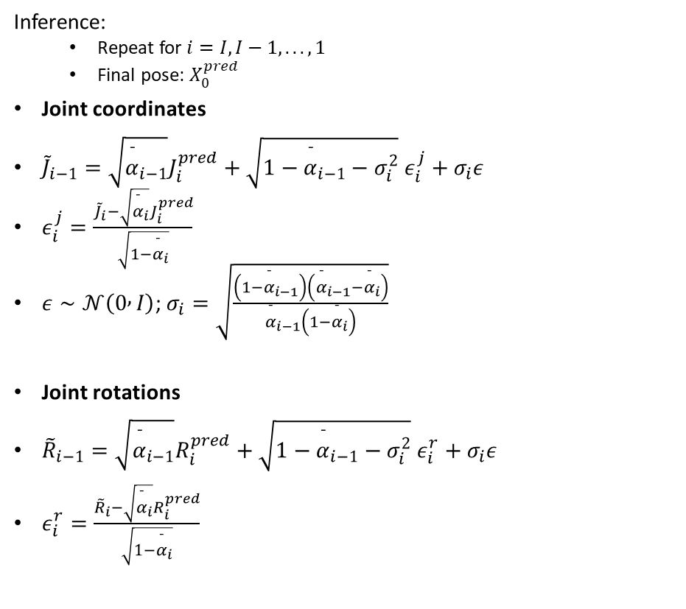
Diffusion Noise Model
Inference:
Repeat for $i=I,I−1,...,1$
Final pose: $X_{0}^{pred}$
Joint coordinates
${\tilde{J}}_{i−1}=\sqrt{{\overset{ˉ}{α}}_{i−1}}J_{i}^{pred}+\sqrt{1−{\overset{ˉ}{α}}_{i−1}−σ_{i}^{2}} ε_{i}^{j}+σ_{i}ε$
$ε_{i}^{j}=\frac{{\tilde{J}}_{i}−\sqrt{{\overset{ˉ}{α}}_{i}}J_{i}^{pred}}{\sqrt{1−{\overset{ˉ}{α}}_{i}}}$
$ε∼𝒩\left(0 , I\right)$; $σ_{i}=\sqrt{\frac{\left(1−{\overset{ˉ}{α}}_{i−1}\right)\left({\overset{ˉ}{α}}_{i−1}−{\overset{ˉ}{α}}_{i}\right)}{{\overset{ˉ}{α}}_{i−1}\left(1−{\overset{ˉ}{α}}_{i}\right)}}$
Joint rotations
${\tilde{R}}_{i−1}=\sqrt{{\overset{ˉ}{α}}_{i−1}}R_{i}^{pred}+\sqrt{1−{\overset{ˉ}{α}}_{i−1}−σ_{i}^{2}} ε_{i}^{r}+σ_{i}ε$
$ε_{i}^{r}=\frac{{\tilde{R}}_{i}−\sqrt{{\overset{ˉ}{α}}_{i}}R_{i}^{pred}}{\sqrt{1−{\overset{ˉ}{α}}_{i}}}$

Slide 12
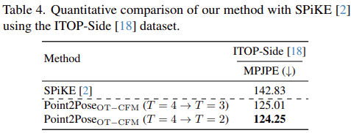
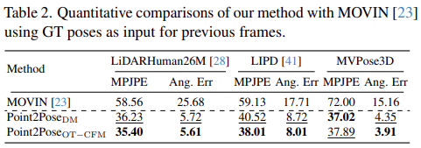
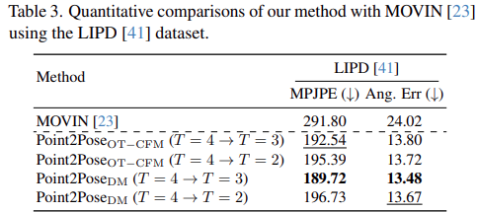
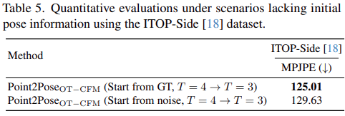
Quantitative Results
Notes:
T=4→T=2 means: The model was trained with a temporal window of 4 frames, but during inference it only uses 2 frames.

Slide 13
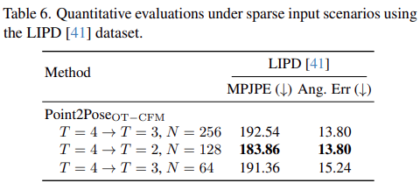
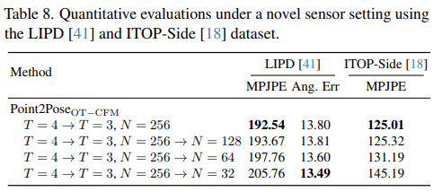
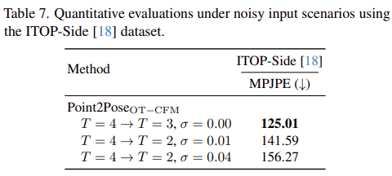
Quantitative Results

Slide 14
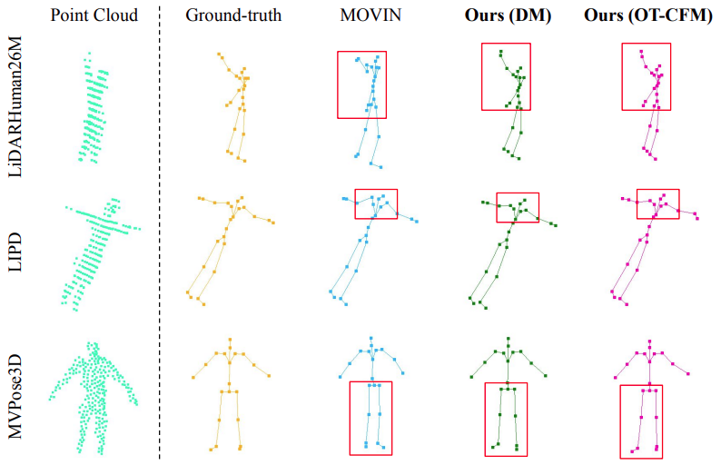
Qualitative Results

Slide 15
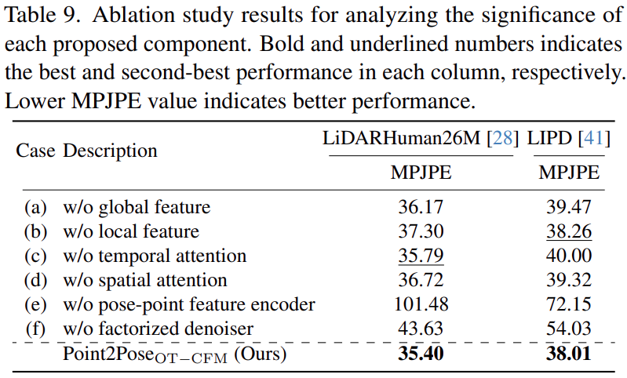
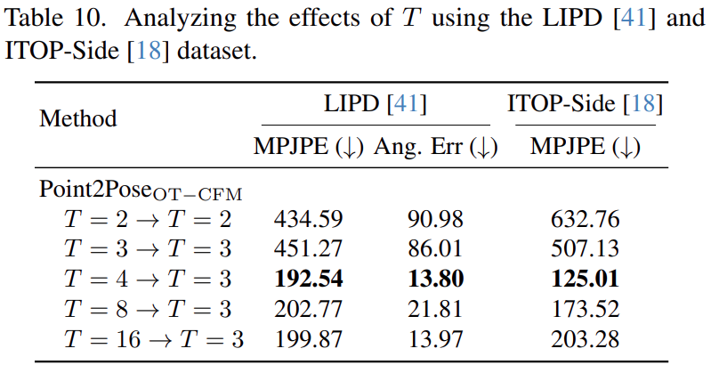
Ablations

