Slide 1
MSRS-DETR: End-to-End Object Detection for Multi-Scale Remote Sensing
Ji Yuan, Zhao Chen, Shuyi Feng and Hao Han
Remote Sensing 9/14/25
Presented by Aniv Chakravarty

Slide 2
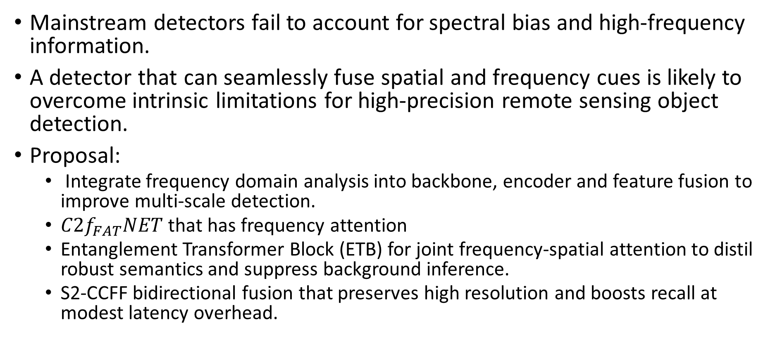
Problem
Mainstream detectors fail to account for spectral bias and high-frequency information.
A detector that can seamlessly fuse spatial and frequency cues is likely to overcome intrinsic limitations for high-precision remote sensing object detection.
Proposal:
  Integrate frequency domain analysis into backbone, encoder and feature fusion to improve multi-scale detection.
  ${C2f}_{FAT}NET$ that has frequency attention
  Entanglement Transformer Block (ETB) for joint frequency-spatial attention to distil robust semantics and suppress background inference.
  S2-CCFF bidirectional fusion that preserves high resolution and boosts recall at modest latency overhead.

Slide 3
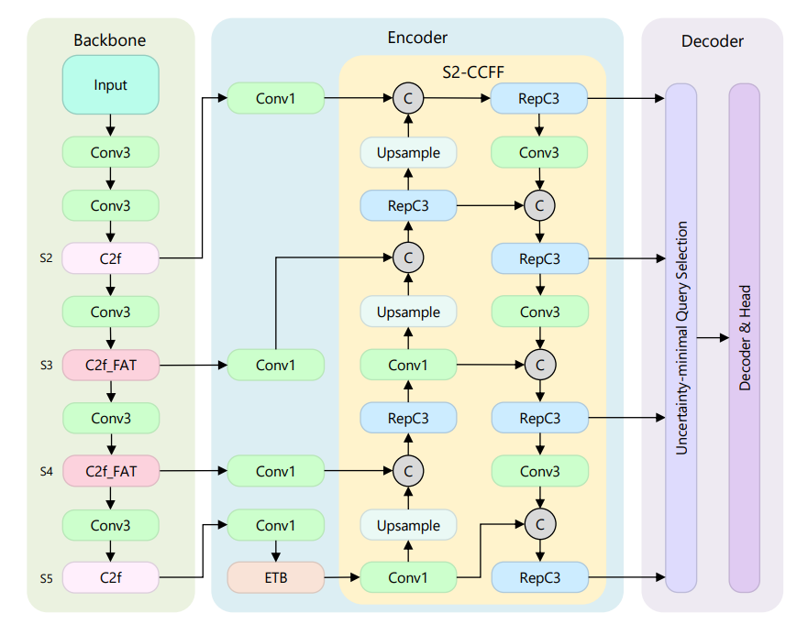
Overall architecture

Slide 4
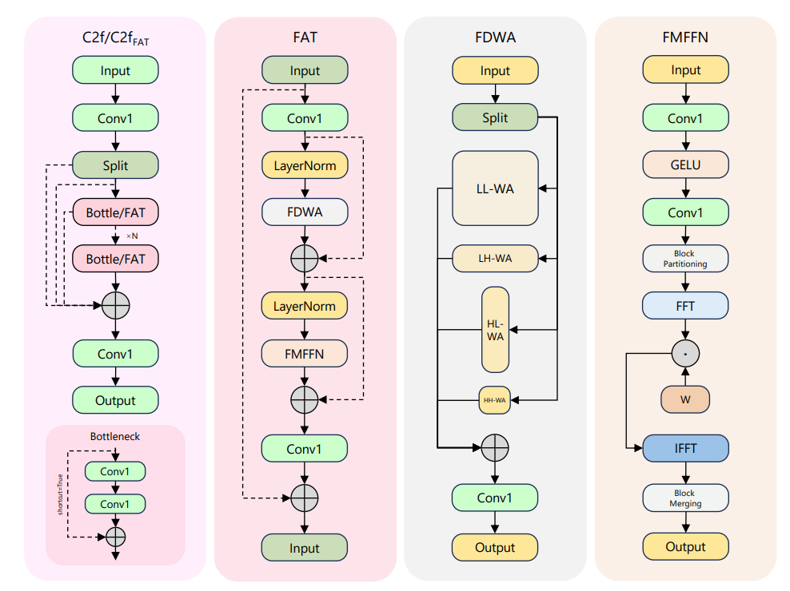
C2f frequency attention block

Slide 5
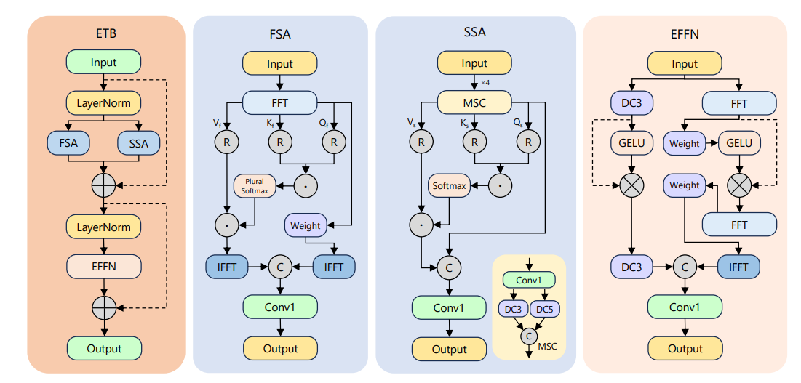
ETB

Slide 6
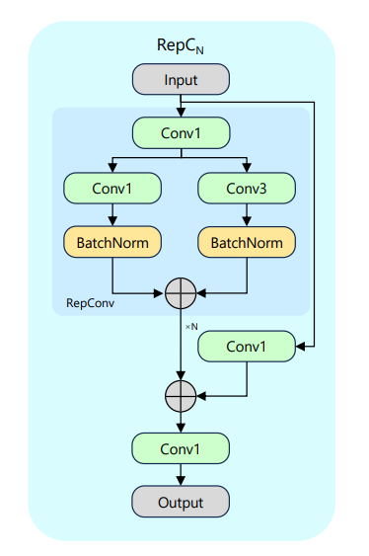
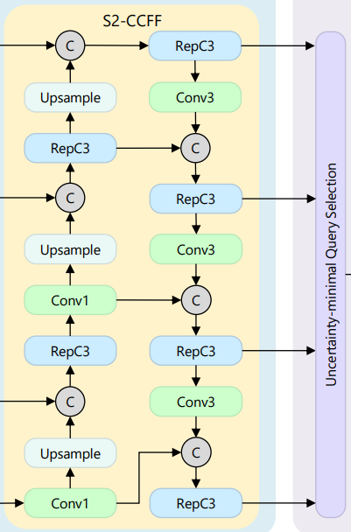
S2CCFF and decoder
Uses bidirectional topology to exchange information from {2,3,4,5}
Ordinary convolutions have fixed receptive field limits while RepC3 has structural re-parameterisation
Training mates 3x3, 1x1 and an identity pathway.
Inference algebraically folds to one 3x3 convolution.
Decoder uses uncertainty-minimal query selection from RT-DETR for top-k scores.
Decoder layers use self-attention to suppress redundancy and cross-attention for evidence.
Hungarian Matching for loss.

Slide 7
Limitations
Evaluation datasets were limited to ship and ports, leaving performance on the land-based dataset to be determined.
Partial occlusion and low contrast scenarios from clouds and shadows.
Main comparison between Yolov8m and RT-DETR.
4M reduction in parameters, increase in computation by 23 GFLOPs and 2% increase in precision across datasets.

Slide 8
Reference
Yuan, J., Feng, S., & Han, H. (2025). MSRS-DETR: End-to-End Object Detection for Multi-Scale Remote Sensing. Sensors, 25(18), 5734. https://doi.org/10.3390/s25185734

