Slide 1
FedGAlign: Implicit Gradient Alignment in Distributed and Federated Learning
Y. Dandi, L. Barba, and M. Jaggi, “Implicit Gradient Alignment in Distributed and Federated Learning,” AAAI, vol. 36, no. 6, pp. 6454–6462, Jun. 2022, doi: 10.1609/aaai.v36i6.20597.
Presented by Jean Pierre

Slide 2
Misalignment and Generalization
Gradient Misalignment: Client gradients differ because data distributions vary across devices.
The Generalization Gap in Large-Batch Training: Large batches train faster but often generalize worse than small-batch SGD.
Client Drift: Local client updates move away from the global objective in federated learning.

Slide 3


Generalization Gap
The Conflict: Large-batch training lacks the "implicit regularization" of sequential SGD, leading to poor test performance.
The Math: Define the regularizer $r(x)$which measures the variance/dissimilarity of gradients across clients:

Slide 4
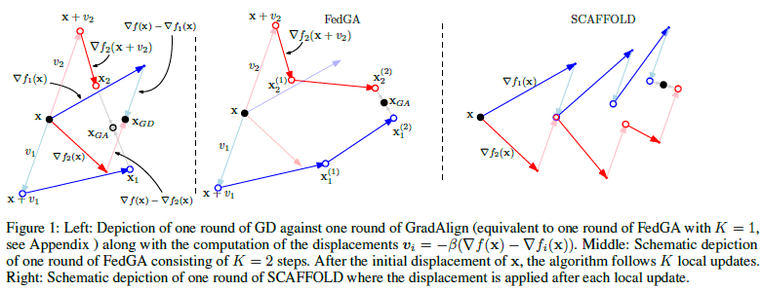
Client drift
Alignment means updates on one subset of data actually help reduce loss for data points outside that set.

Slide 5
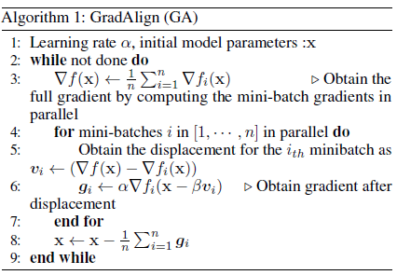
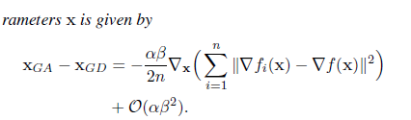
Gradient Alignement (GA)

Slide 6
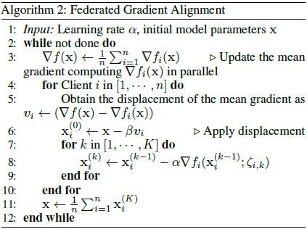
FedGA

Slide 7
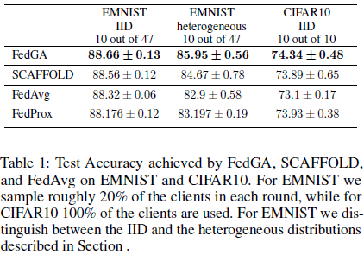
Evidence & Results

Slide 8
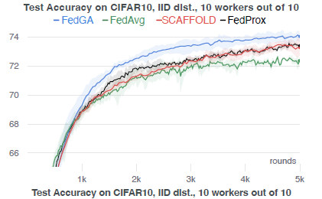
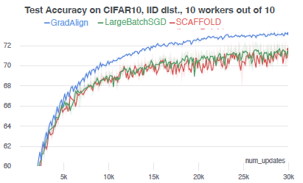
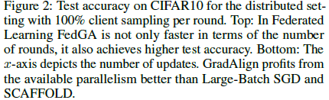
Evidence & Results

Slide 9
Reference
Y. Dandi, L. Barba, and M. Jaggi, “Implicit Gradient Alignment in Distributed and Federated Learning,” AAAI, vol. 36, no. 6, pp. 6454–6462, Jun. 2022, doi: 10.1609/aaai.v36i6.20597.

