Slide 1
Interpretable Graph Neural Networks for Learning Drug-Gene Relationships and Inferring Phenotype Outcomes in Pharmacogenomics
Kgabe Ronald Molepo (MLPKGA007)
MSc Computational Health Informatics
Supervisors: Hocine Bendou, Khuthala Mnika | University of Cape Town | 24 July 2026
Notes:
Introduce yourself. Note this is a progress meeting, not a defence. You've completed all experimental work; today is about reviewing findings and confirming readiness to move into Part B writing.

Slide 2
Where we are in the project
✓ Part A submitted (November 2025)
✓ All experimental deliverables complete
📝 Part B writing phase beginning
🎯 Today: report findings + confirm readiness to write
Target: December 2026 submission | Currently 5-6 weeks ahead of Part A schedule
Kgabe R. Molepo (MLPKGA007) | MSc Progress | 24 July 2026
2 / 31
Notes:
Set expectation this is a progress meeting, not a defence. You've done the work; you're asking for guidance on writing.

Slide 3
Recap: Part A identified a specific gap
Five requirements that no prior pipeline had combined
1. Evidence-graded curated supervision (ClinPGx association tiers)
2. Ranking objective + hub-degree penalty + degree-aware sampling
3. Biologically-mediated drug-gene-phenotype propagation
4. Cold-drug evaluation with raw + filtered MRR
5. Coupled intrinsic + post-hoc interpretability + pathway contextualisation
"The contribution lies in combining all five within a single, reproducible pipeline applied to ClinPGx."
Kgabe R. Molepo (MLPKGA007) | MSc Progress | 24 July 2026
3 / 31
Notes:
Set up the scoring framework. Everything that follows shows whether we met these 5 requirements.

Slide 4
Overall aim + 5 objectives
Aim: Evaluate whether R-GCN can rank drug-gene relationships for previously-unseen drugs on ClinPGx, and characterise what drives performance.
1. Construct heterogeneous knowledge graph
2. Train evidence-aware R-GCN ranking model
3. Explore phenotype-contextualised propagation
4. Interpret ranked PGx relationships
5. Validate with biological pathways + literature
Kgabe R. Molepo (MLPKGA007) | MSc Progress | 24 July 2026
4 / 31
Notes:
State the aim clearly, then walk through the 5 objectives. Note that Objective 3 was reformulated due to data reality (we'll come to that).

Slide 5
Knowledge graph construction (Objective 1)
ClinPGx heterogeneous KG — evidence categories preserved
38,955 nodes across 4 types:
Drugs: 5,210
Genes: 25,041
Variants: 7,091
Phenotypes: 1,613
44,218 edges across 56 relations
Drug-gene edges: ~6,704
Evidence types: clinical / label / pathway / guideline
Association types: associated / not-associated / ambiguous
◆ Drugs
◆ Genes
◆ Variants
◆ Phenotypes
Kgabe R. Molepo (MLPKGA007) | MSc Progress | 24 July 2026
5 / 31
Notes:
First objective met by construction. Emphasise evidence typing — this is what makes R-GCN appropriate for the data.

Slide 6
R-GCN architecture + training (Objective 2)
Evidence-aware relational GNN with pairwise ranking loss
Model
• 2-layer R-GCN encoder with basis decomposition (8 bases)
• 64-dimensional embeddings
• DistMult decoder for scoring
• Drug fingerprints (Morgan, 2048-dim) as input features
Training
• Pairwise margin ranking loss
• Hub penalty (β = 0.10 default)
• Degree-aware negative sampling (deg^0.75)
• Evidence-graded supervision: only "associated" as positives
Compute
• ilifu HPC | SLURM | Singularity | CPU (P100 GPU too old for PyTorch 2.10+cu128)
Kgabe R. Molepo (MLPKGA007) | MSc Progress | 24 July 2026
6 / 31
Notes:
Cover briefly. The interesting story is what came out of training, not the architecture itself. Mention that GPU-CPU decision was forced by ilifu hardware.

Slide 7
Evaluation protocol
Cold-drug ranking with multi-seed replication
• 751 test drugs completely held out during training
• Message passing on training subgraph only (no leakage)
• Metrics: MRR + Hits@K, both raw AND filtered
•
• 12 configurations tested:
• 3 supervision regimes × 3 seeds (42, 123, 2026) = 9 configs
• 3 seeds at β = 0 (hub penalty ablation) = 3 configs
•
• Every claim backed by multi-seed variance
• Single-seed findings would be unreliable at this data scale
Kgabe R. Molepo (MLPKGA007) | MSc Progress | 24 July 2026
7 / 31
Notes:
Multi-seed discipline is a rigor point. Some published papers report single-seed. We don't. Every claim here has 3 seeds.

Slide 8
Objectives 1-2: Complete
✓ Objective 1 — KG construction
38,955 nodes, 44,218 edges, 56 relations
Split leakage audit: passed
✓ Objective 2 — R-GCN training
12 configurations trained to convergence
All checkpoints preserved, evaluation metrics logged
Multi-seed variance computed for all
Kgabe R. Molepo (MLPKGA007) | MSc Progress | 24 July 2026
8 / 31
Notes:
Quick transition slide. First two objectives are complete; results follow.

Slide 9
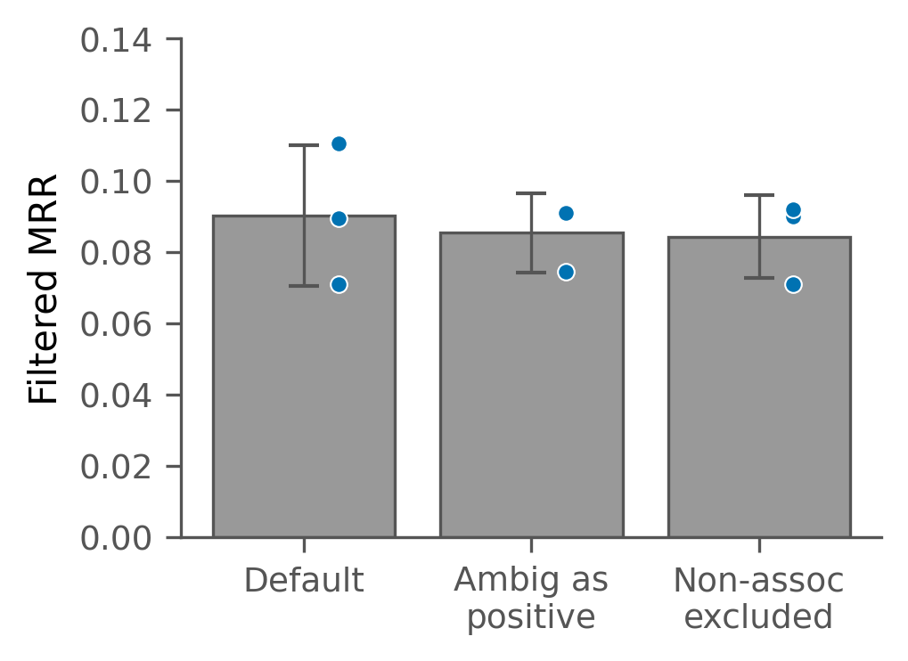
D1 — Supervision regime shows no effect
Three regimes × 3 seeds — differences within noise
Interpretation: Regime choice doesn't matter. Null result but important — Part A's default regime is defensible.
Kgabe R. Molepo (MLPKGA007) | MSc Progress | 24 July 2026
9 / 31
Notes:
Emphasise the multi-seed rigor. Note that single-seed had suggested ambig_as_pos was better, but multi-seed revealed it wasn't.

Slide 10
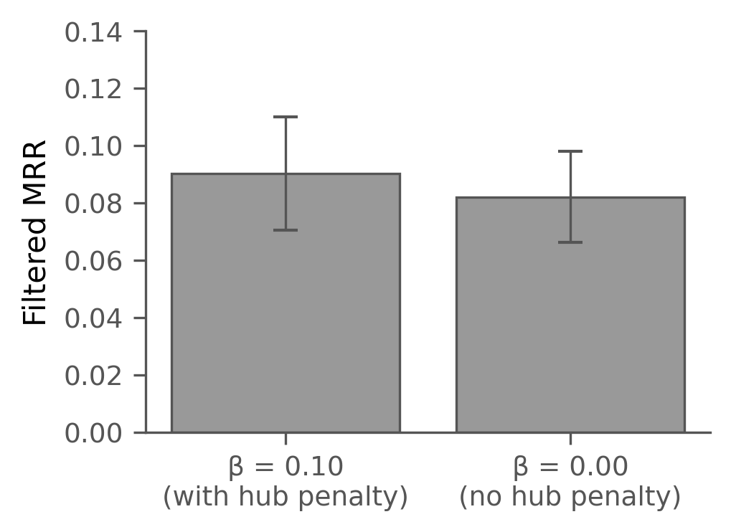
D2 — Hub penalty has no measurable effect
β = 0.10 vs β = 0 — identical within variance
Interpretation: Degree-aware negative sampling already handles hub bias. The hub penalty term is redundant.
Kgabe R. Molepo (MLPKGA007) | MSc Progress | 24 July 2026
10 / 31
Notes:
Second null result on methodological ablations. The pattern of D1+D2 is that method choice doesn't move the needle.

Slide 11
D3 — Phenotype-contextualised propagation, reformulated
Objective 3 required reformulation due to data reality
Part A commitment (Objective 3):
Predict drug → phenotype via biological reasoning through gene → variant intermediaries
Data reality:
ClinPGx has 0 direct drug-phenotype edges
Cannot evaluate direct drug-phenotype ranking (no ground truth)
Reformulation:
Test whether model prioritises phenotype-relevant genes
Genes with ≥1 gene-phenotype edge in ClinPGx (n=1,131)
Result:
Model filtered MRR ~0.10 on subset
Matches gene-phenotype degree baseline (0.10)
Consistent with D1/D2 pattern
Discussion point: Is this reformulation acceptable for the dissertation, or should we frame Objective 3 differently?
Kgabe R. Molepo (MLPKGA007) | MSc Progress | 24 July 2026
11 / 31
Notes:
Be direct. The reformulation was forced by data reality. Ask supervisor explicitly how to frame this in Part B.

Slide 12
D4.1 — Filtered lifts MRR modestly
• Comparing raw vs filtered ranking protocol across 12 configurations:
•
• Filtered MRR consistently ~0.012 higher than raw MRR
• Small, consistent effect from removing known positives
•
• This sets up D4.3 — the substantive finding is coming.
Kgabe R. Molepo (MLPKGA007) | MSc Progress | 24 July 2026
12 / 31
Notes:
Brief slide. The filtered-vs-raw effect is small. Move quickly to D4.3.

Slide 13
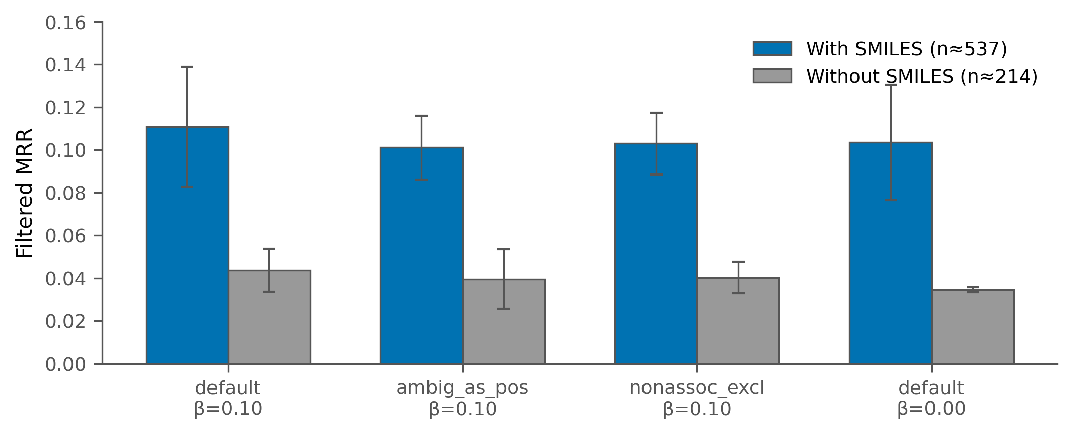
D4 — Chemical structure availability dominates
The substantive positive finding
Finding: SMILES effect = +0.065 MRR, which is 5.5× larger than the raw-vs-filtered protocol effect and larger than any methodological ablation (D1, D2, D3) we tested.
Kgabe R. Molepo (MLPKGA007) | MSc Progress | 24 July 2026
13 / 31
Notes:
This is the hero slide. THE finding. Chemical structure availability is the primary driver. Method-level ablations cannot beat this constraint. This is what I'll build the Part B discussion around.

Slide 14
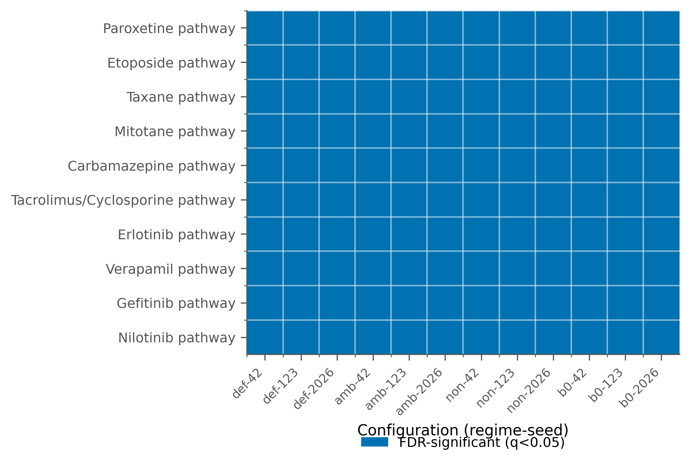
D5-Part 2 — Pathway enrichment across 12 configs
3,689 gene sets tested with BH-FDR correction
Initial finding: 10 PGx drug pathways FDR-significant across ALL 12 configurations (Paroxetine, Etoposide, Taxane...)
Kgabe R. Molepo (MLPKGA007) | MSc Progress | 24 July 2026
14 / 31
Notes:
Initially I thought this was a strong positive finding. Then I ran a null enrichment check — set that up. The next slide is the honest reveal.

Slide 15
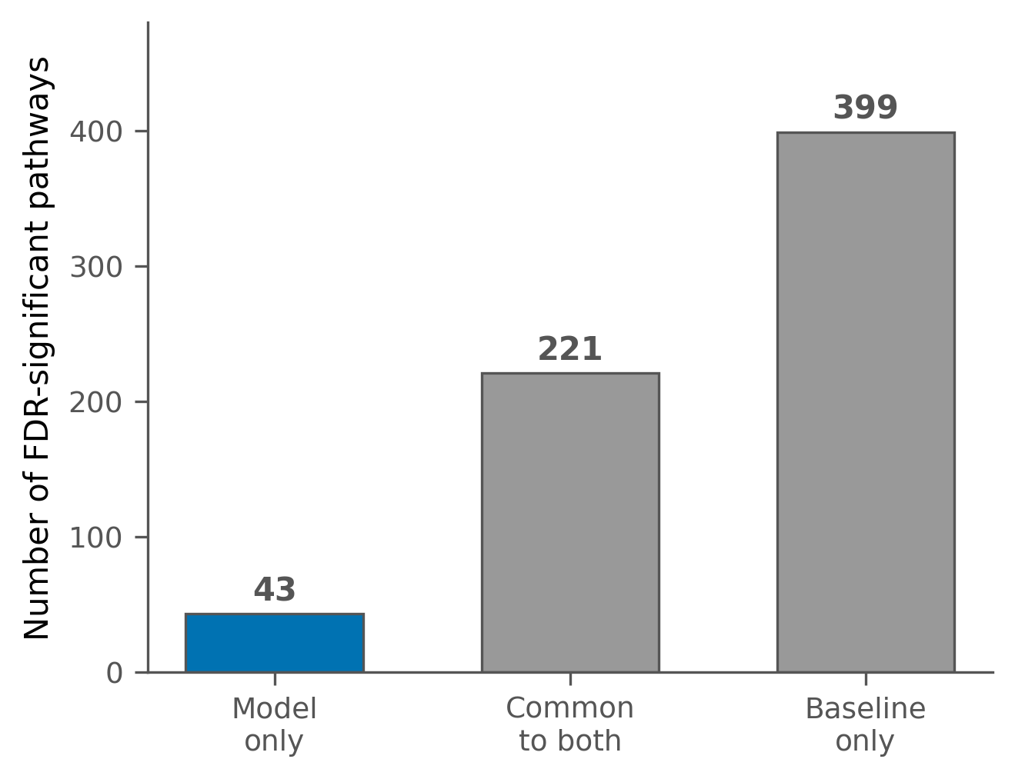
But — is this specific to the model?
Null enrichment check with drug-gene degree baseline
Honest reveal: Degree baseline also finds the 10 headline pathways. D5-Part 2 headline is largely structural. But 43 model-only pathways represent genuine mechanism-specific contribution.
Kgabe R. Molepo (MLPKGA007) | MSc Progress | 24 July 2026
15 / 31
Notes:
Be direct. I ran the check anyway because I'd rather find this myself than have an examiner find it. The 43 model-only pathways ARE the honest positive finding.

Slide 16
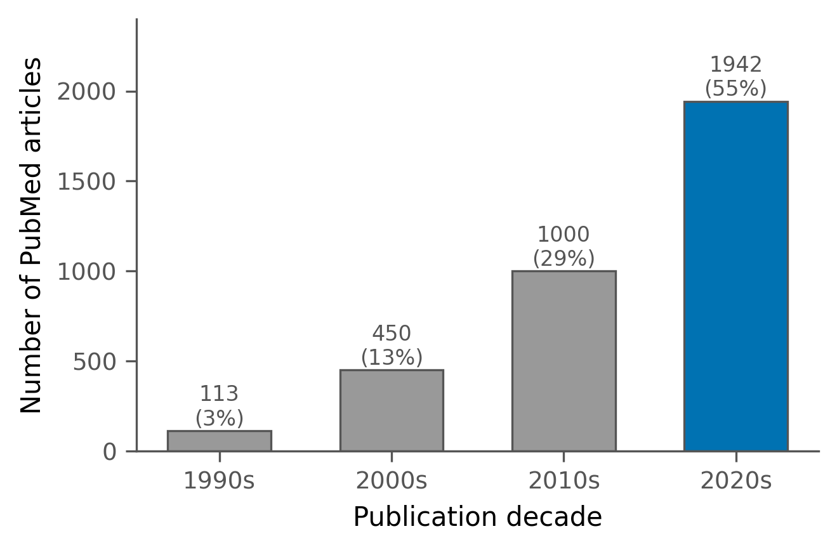
D5-Part 1 — External literature validation
PubMed evidence for top novel predictions, 1990-2026
4,636 predictions queried
190 unique test drugs (25% of test set)
17.5% support rate (811 pairs)
3,505 total articles
Biologically-supported pairs:
carbidopa → COMT (Parkinson's)
dimethyl fumarate → FOXP3 (MS)
doxorubicinol → ABCB1 (chemo resistance)
Caveat: some pairs are broad chemicals (Ca, testosterone) — inflated by name-match
Kgabe R. Molepo (MLPKGA007) | MSc Progress | 24 July 2026
16 / 31
Notes:
17.5% is a defensible rate for novel predictions. Note the honest caveat about broad chemicals — this is important for scientific integrity.

Slide 17
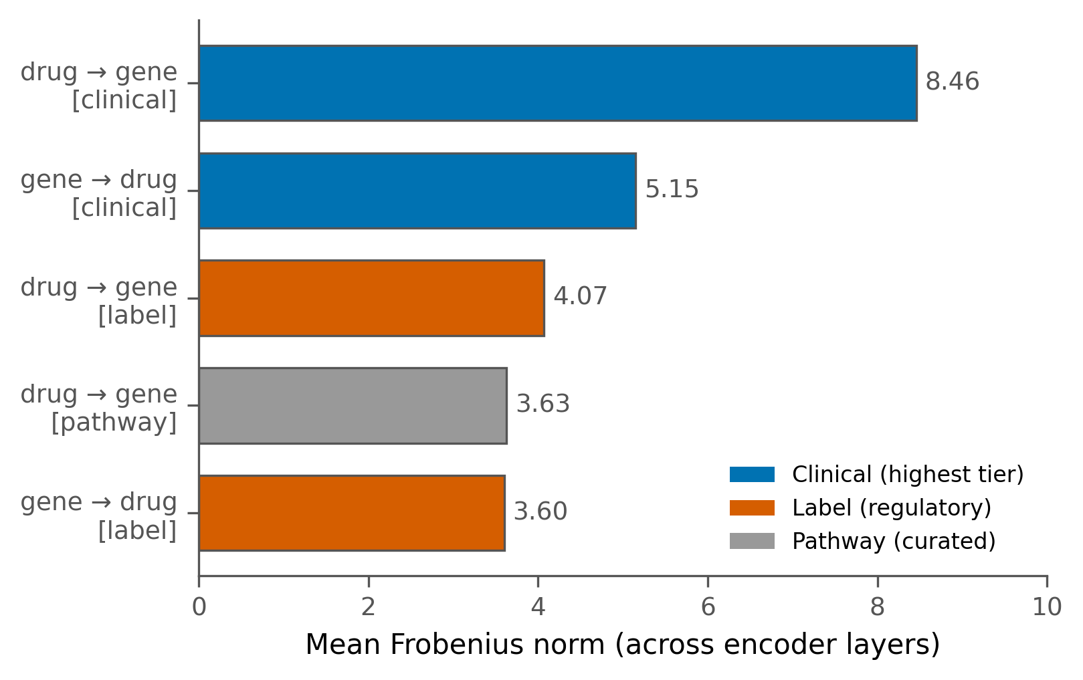
D5 Session 1a — Model respects evidence grading
Intrinsic interpretability: relation weights by Frobenius norm
Finding: Clinical evidence relations get the highest weight (8.46). Model learned what the evidence-graded supervision intended. Satisfies Requirement 5c intrinsic component.
Kgabe R. Molepo (MLPKGA007) | MSc Progress | 24 July 2026
17 / 31
Notes:
Intrinsic interpretability shows the model implements evidence-graded reasoning. This satisfies Requirement 5c-a from Part A.

Slide 18
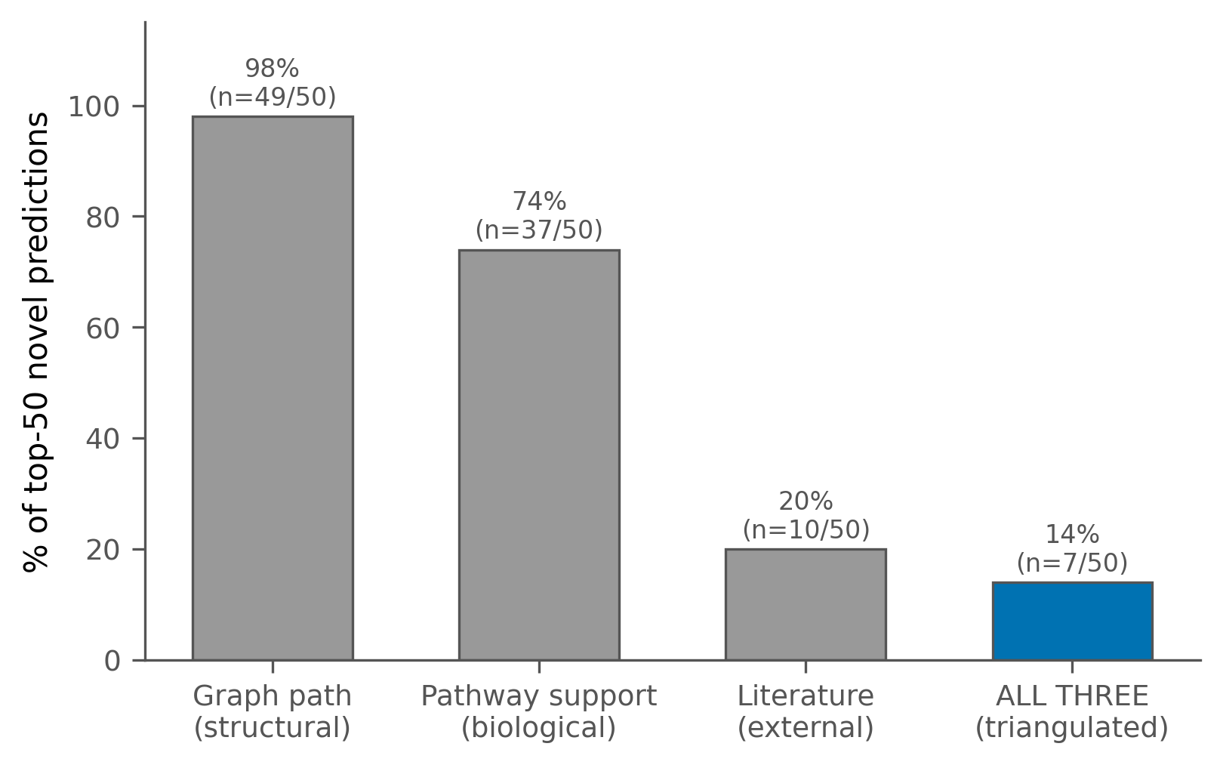
D5 Session 1b — Integrated per-prediction evidence
Post-hoc paths + pathway + literature triangulated
Finding: 14% of top predictions have full evidence triangulation. Closes Requirement 5c fully — intrinsic + post-hoc + pathway + literature integration.
Kgabe R. Molepo (MLPKGA007) | MSc Progress | 24 July 2026
18 / 31
Notes:
This closes Requirement 5c. Coupled interpretability with pathway contextualisation, done. Reference the testosterone → ABCB1 exemplar.

Slide 19
All 5 objectives met
Objective
Status
Notes
1. KG construction
✓ Complete
38,955 nodes, 44,218 edges
2. R-GCN training
✓ Complete
12 configurations, multi-seed
3. Phenotype propagation
⚠ Reformulated
0 drug-phenotype edges in ClinPGx
4. Interpret rankings
✓ Complete
Intrinsic + post-hoc + integrated
5. Pathway + literature
✓ Complete
Enhanced with null check + 17.5% lit
Kgabe R. Molepo (MLPKGA007) | MSc Progress | 24 July 2026
19 / 31
Notes:
Summary of all 5 objectives. Objective 3 needs careful framing in Part B — we discussed this on slide 11.

Slide 20
Combined narrative — what we learned
1. Method-level choices don't move the needle (D1, D2, D3, D4.1)
2. Chemical structure availability dominates (D4.3, 5.5× effect)
3. Pathway enrichment is largely structural (D5-Part 2 + null check)
4. 43 model-only pathways = genuine model contribution (mechanism-specific)
5. 17.5% literature support with meaningful pairs (D5-Part 1)
6. 14% fully-triangulated predictions with integrated evidence (D5 Session 1)
Kgabe R. Molepo (MLPKGA007) | MSc Progress | 24 July 2026
20 / 31
Notes:
Read through these findings as a coherent story. The narrative arc: null on method-level, positive on feature-level (SMILES), honest on pathway (mostly structural), modest positive on literature, defensible integrated framework.

Slide 21
The MSc contribution
Not: "We built a state-of-the-art model"
Yes:
• Rigorous multi-seed evaluation identifying what does and doesn't drive performance
• Chemical structure availability identified as the primary constraint (D4)
• Null enrichment check for scientific defensibility (D5)
• Integrated multi-evidence interpretability framework (D5 Session 1)
• Honest, reproducible reporting standards
Kgabe R. Molepo (MLPKGA007) | MSc Progress | 24 July 2026
21 / 31
Notes:
This is a characterisation contribution. Not glamorous but scientifically honest. State this clearly — supervisors respect honest framing.

Slide 22
Honest limitations
Method
Data
Interpretation
• Single architecture (R-GCN)
• 64-dim embeddings only
• PubMed 1990-2026 date filter
• Single-config literature
• ClinPGx sparsity (~44k edges)
• No drug-phenotype edges (Obj 3)
• SMILES coverage 537/751 drugs
• Aggregate MRR does not fully capture utility
• Pathway enrichment doesn't prove causality
• 17.5% inflated by broad chemicals
Kgabe R. Molepo (MLPKGA007) | MSc Progress | 24 July 2026
22 / 31
Notes:
Be direct about limitations. Don't over-defend — acknowledge and move on. Note that most are scope decisions, not failures.

Slide 23
Future directions
Short-term (before submission):
Complete Part B writing (chapters 3-6)
Address supervisor feedback from today
Long-term (beyond MSc):
Alternative architectures (RGAT, CompGCN, HGT)
Descriptor-rich features (ChemBERTa, ProtT5)
Structure-free representations for uncharacterised drugs
SIDER integration for drug-phenotype ground truth
Multi-config literature validation
Kgabe R. Molepo (MLPKGA007) | MSc Progress | 24 July 2026
23 / 31
Notes:
Future work section shows I understand what a stronger paper would look like, but scope was appropriately bounded for an MSc.

Slide 24
Your guidance requested
1. Approval to begin Part B writing
Chapters 3 (methodology), 4 (results), 5 (discussion), 6 (conclusion)
2. Confirmation these findings are defensible as an MSc contribution
Null-plus-characterisation framing, integrated interpretability
3. Guidance on Objective 3 reformulation framing
Data reality: 0 drug-phenotype edges; is the phenotype-relevant proxy acceptable?
4. Timeline check
December submission target, 5-6 weeks ahead of Part A schedule
Kgabe R. Molepo (MLPKGA007) | MSc Progress | 24 July 2026
24 / 31
Notes:
Be specific about what you need. These four are the actionable items for the meeting.

Slide 25
Path to December submission
July 2026
✓ All experimental deliverables complete
This week
Presentation to supervisors
Aug – Oct 2026
Part B chapter drafts
November 2026
Supervisor review + revisions
Early December 2026
Submission
Kgabe R. Molepo (MLPKGA007) | MSc Progress | 24 July 2026
25 / 31
Notes:
End on the timeline. We're ahead of schedule. That buffer becomes writing time. This is your closing statement.

Slide 26
Backup: 12 configuration details
D1 supervision regime experiments (9 configs):
regime = default, ambig_as_pos, or nonassoc_excluded
seed = 42, 123, or 2026
β = 0.10 (hub penalty)
D2 hub penalty ablation (3 configs):
regime = default
β = 0.00 (no hub penalty)
seed = 42, 123, or 2026
All hyperparameters: hidden_dim=64, output_dim=64, num_bases=8, dropout=0.2
Kgabe R. Molepo (MLPKGA007) | MSc Progress | 24 July 2026
26 / 31

Slide 27
Backup: Filtered MRR per config
Config
Seed 42
Seed 123
Seed 2026
Mean ± SD
default β=0.10
0.0710
0.0895
0.1105
0.0903 ± 0.020
ambig_as_pos β=0.10
0.0745
0.0910
0.0910
0.0855 ± 0.011
nonassoc_excl β=0.10
0.0710
0.0900
0.0920
0.0844 ± 0.012
default β=0.00
0.0620
0.0895
0.0947
0.0821 ± 0.016
Kgabe R. Molepo (MLPKGA007) | MSc Progress | 24 July 2026
27 / 31

Slide 28
Backup: 43 model-only pathways (sample)
Wnt/β-catenin signaling pathway family
REACTOME:: TCF-dependent Wnt signaling
REACTOME:: Nuclear Receptor transcription
REACTOME:: Interferon signaling (multiple sub-pathways)
REACTOME:: ADAR signaling
REACTOME:: G alpha (s) signalling events
REACTOME:: Class B/2 Secretin receptors
REACTOME:: Antimicrobial peptides
KEGG:: SEB-mediated Th cell response
Interpretation: mechanism-specific pathways that pure degree-based selection misses.
Kgabe R. Molepo (MLPKGA007) | MSc Progress | 24 July 2026
28 / 31

Slide 29
Backup: Fully-triangulated exemplar
testosterone → ABCB1 (model score -0.43, rank 1)
Structural (graph path, 3 hops):
testosterone → CYP3A4 → paroxetine → ABCB1
Biologically plausible: testosterone is CYP3A4 substrate
Pathway (D5-Part 2, FDR-significant):
27 significant PGx pathways contain ABCB1
Includes: Paroxetine, Etoposide, Tacrolimus/Cyclosporine, Taxane, Verapamil, Statin
Literature (D5-Part 1, PubMed):
10 articles co-mentioning testosterone and ABCB1
Range: 2024-2026 (all within date filter)
PMIDs: 42280472, 39488872, 38713375, ...
Kgabe R. Molepo (MLPKGA007) | MSc Progress | 24 July 2026
29 / 31

Slide 30
Backup: Literature-supported novel predictions
Drug → Gene
Articles
Biological context
carbidopa → COMT
10
Parkinson's (COMT inhibits levodopa)
dimethyl fumarate → FOXP3
7
MS (Tecfidera → T-reg cells)
doxorubicinol → ABCB1
3
Chemo resistance (efflux)
doxorubicinol → CBR3
2
Doxorubicin metabolism
canakinumab → IL1B
10
Anti-IL1β mAb (direct target)
etoposide → ABCC1/ABCC2
10 each
Chemo efflux resistance
fludarabine → NQO1
1
Leukemia drug detoxification
Kgabe R. Molepo (MLPKGA007) | MSc Progress | 24 July 2026
30 / 31

Slide 31
Backup: How this fits related work
Turon et al. (2025) — Descriptor-rich features achieve better biomedical KG completion
Our D4 finding explains why: chemical structure availability is the primary constraint
Bonner et al. (2022) — Multi-lens evaluation in biomedical KG completion
Our D5 Session 1 exemplifies: pathway + literature + interpretability together
Schlichtkrull et al. (2018) — Original R-GCN paper
Our work stress-tests R-GCN in a specialised biomedical setting
Provides reference for future work with the same rigorous methodology
Kgabe R. Molepo (MLPKGA007) | MSc Progress | 24 July 2026
31 / 31

