Slide 1

GitHub Basics
GitHub Basics Workshop
Sinclair Combs
July 23rd, 2025

Slide 2

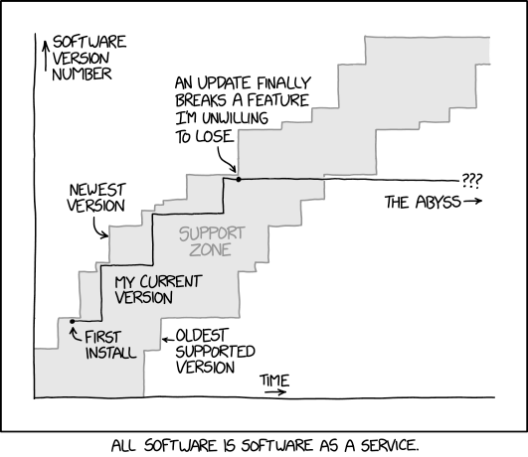

Git is about keeping track of changes
My code broke… hopefully there’s a working version somewhere
Which version are you using?
I’m sure this used to work… when did it change?
Version Control
Can I reproduce my results?
How long has this bug been here?
Can you send me the latest version?
Problem: Code worked two days ago, but is now is giving an error
X
Solution: roll-back; return to previous version & compare
Problem: You & your colleague want to work on the same code at the same time
Solution: branching & merging; simultaneous work without interference
2

Slide 3




Some version control vocabulary
Repository
Collection of files and their history
SOME GITHUB ACCOUNT
YOUR GITHUB ACCOUNT
pull request
Fork
A specific copy of a repository that is linked to the original, making it simple to send changes upstream
REPO_A
REPO_A FORK
fork
clone
push
Clone
Local copy of a repository, including history
your-branch
Push
Moving changes from a local copy to another copy
LOCAL HARD DRIVE
pull request
Pull
Getting changes from another copy to a local copy
main
main
Pull Request
Change proposal to merge one branch into another, usually upstream
merged
3

Slide 4

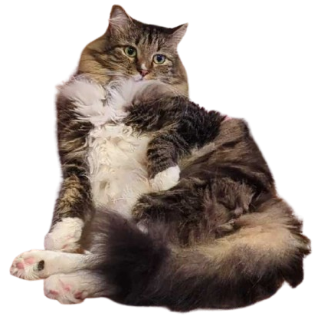

Basics of branching & merging
Branch
One line of work; different branches can exist at the same time and split/merge
Merge
Bringing changes from one branch into another
Pull requests are how branches are merged and are an excellent tool for code review.
cowboy branch
main branch
main branch
sunglasses branch
4

Slide 5


Forking workflow for collaboration
MAIN PROJECT REPOSITORY
pull request
pull request
BRANCH A
fork
fork
BRANCH B
COLLABORATOR A
COLLABORATOR B
Everyone has a fork of a “central” repository
Add commits to branches for new features
Send pull requests from feature branches to the central repository
5

Slide 6


Recording changes with commit
WORKING AREA
STAGING AREA
LOCAL REPOSITORY
add files
commit files
files being modified
collection area for files prior to being sent to repository
tracked & controlled files in local repo
Working Directory
push files
pull or clone files
git add
Staging Area
REMOTE REPOSITORY
git commit
Local Repository
git push
Remote Repository
stored on github server
6

Slide 7
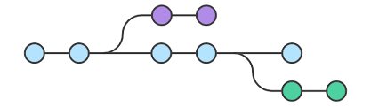
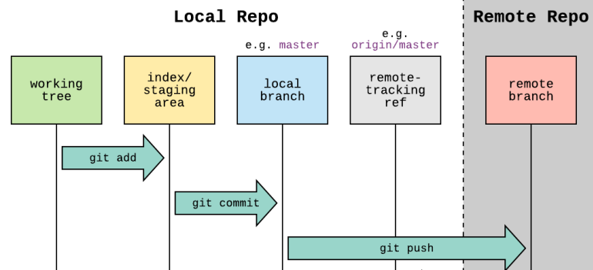
How do I use branches and commits effectively?
Use branches for unfinished or untested ideas
Use branches when you are not sure about a change
If you are unsure what to do with unfinished and/or not working code, commit to a branch
Use branches for code that will be reviewed by others
Commit early and often, it’s better to create too many commits than too few
Better too small than too large
Once you commit, it’s very hard to lose code
Always fully commit before doing dangerous things
Good practice to commit after ending any session of coding
Imperfect commits are better than no commits
Do not commit unrelated changes together, this makes it difficult to undo changes
7

Slide 8
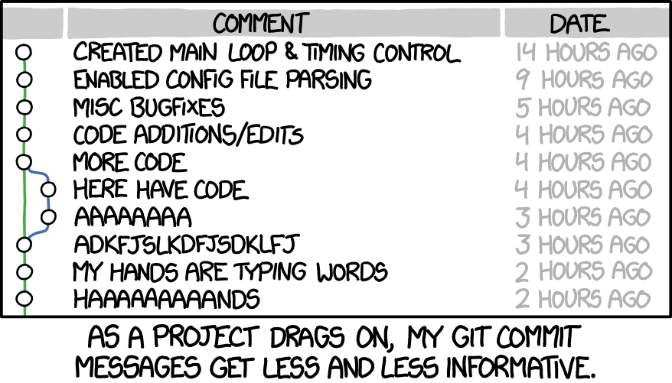
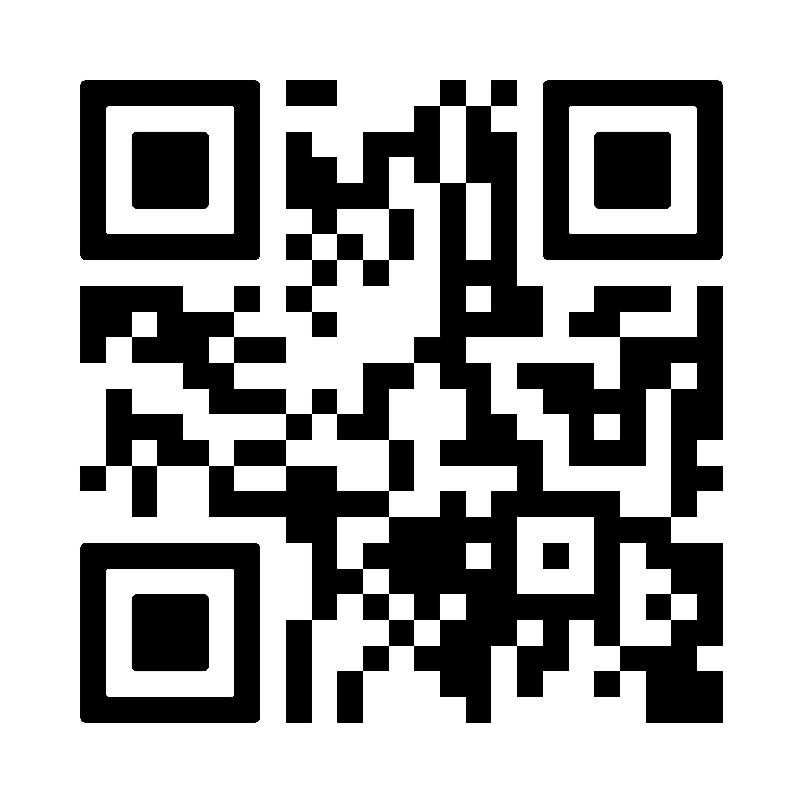
Writing useful commit messages
Summarize the change & provide context
Why something changed is usually more important than what has changed
Cross-reference to issues/discussions if relevant
Write messages that will be understood 20 years from now by someone other than you. Or your future self.
Bad commit messages: “fix”, “oops”, “save work”
whatthecommit.com
8

Slide 9
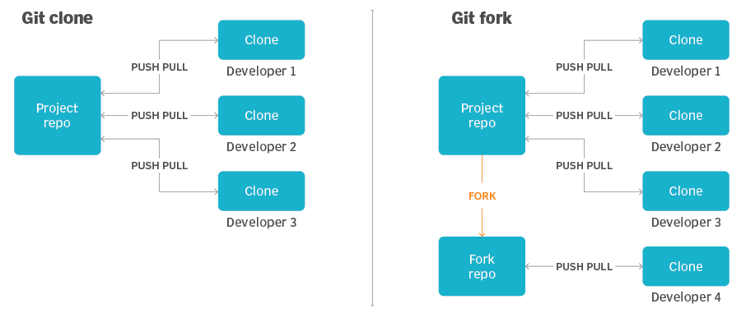
Collaborative workflow—Cloning vs. forking
Copied to a local computer and lives separate from GitHub
Relevant for small team development where everyone has read and write access to the parent repository
Remember: Forked or cloned repositories do not automatically synchronize themselves!
We pull updates from remote repositories
We push updates to remote repositories
We can suggest changes within and across repositories on GitHub with pull requests
Copied to a different GitHub account
Relevant for working on a repository to which you do not have write access
In the fork, commits can be made to the main branch
Commits from the fork can be contributed back to the parent repository via pull requests
9

Slide 10
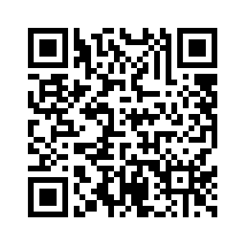

Tutorials!
Tutorial topics:
Copy and browse
Commits
Merging
Sharing
github.com/Maughan-Lab/github_workshop/tree/main/tutorials
10

