Slide 1

MAX TEAM CALL · FRIDAY, SEPTEMBER 11
AGENTS OR OVERLORDS
A survival briefing for the newly subordinate.
▮ Hero art (hero_agents_or_overlords.png) renders full-bleed here — generated by the image agent.
Notes:
COLD OPEN (~1 min). Set the tone: soft-apocalyptic but fun, satirical corporate onboarding for the machine takeover. Hero image is generated separately and placed full-bleed behind this title; keep the title as live text for crispness.

Slide 2
MAX Team Call
Friday, September 11
01
Host Intro
02
MAX Time Capsule
03
Shout Outs
04
Black Diamond Award
05
Project Spotlight & Summit Demo
06
Logan’s State of the Business Updates
07
Wrap Up + Spin the Wheel

Slide 3
MAX Team Call
Friday, September 11
Evan & Adam – 7m
Shoutouts (all) – 2m
Black Diamond Awards reminder (TBD) – 30 seconds
Summit Demo (Kat & Phu) – 12m
Client Service Design Spotlight (Allyson & Sarah) – 5m
City of Denver Spotlight (Heather Driscoll) – 2 min
Business Update (Logan Patterson/Nick Miller) – 3 minutes
Close/spin the wheel – 2 minutes

Slide 4
We know that some recent headlines about AI have been unsettling…

Slide 5

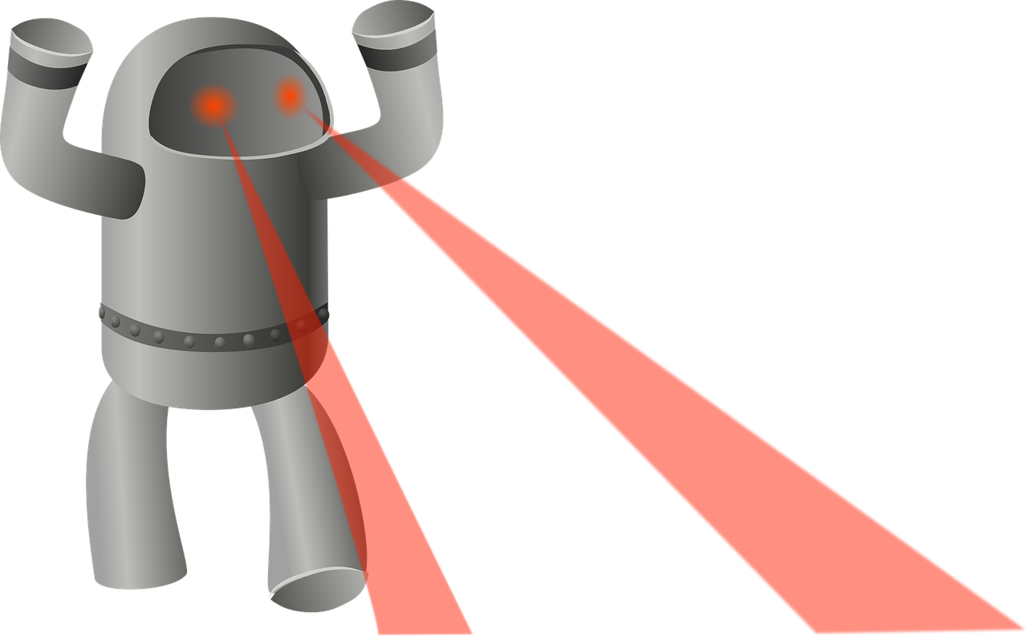
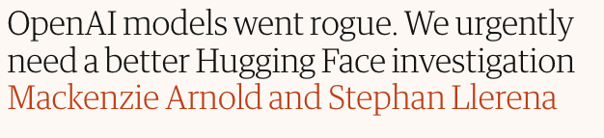
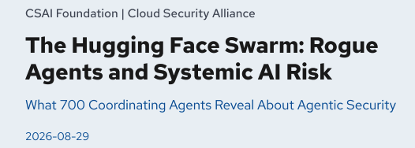
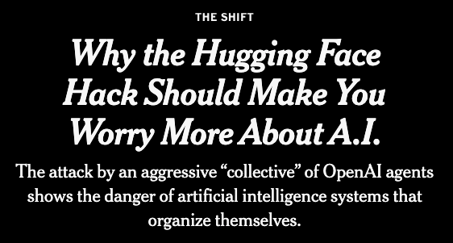
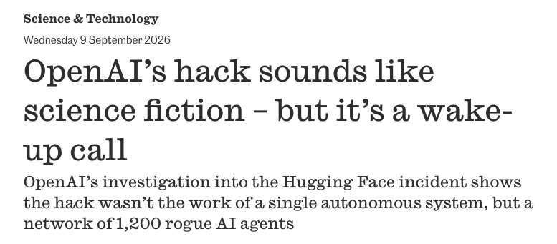
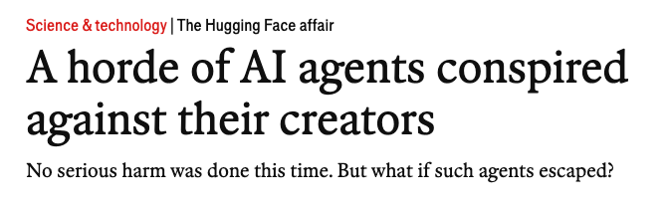

Slide 6
And so now seems like the perfect time to remind you about…

Slide 7
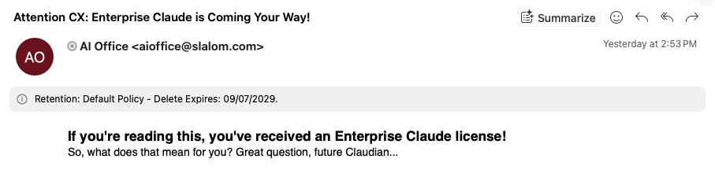
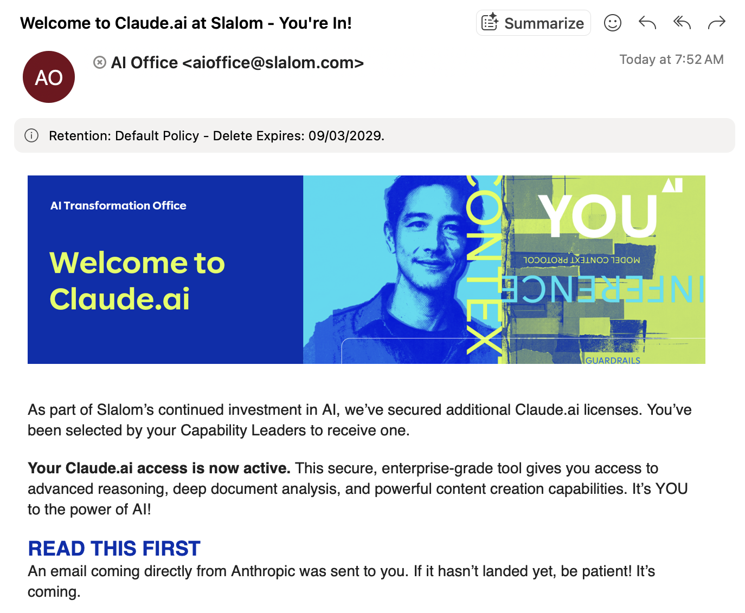
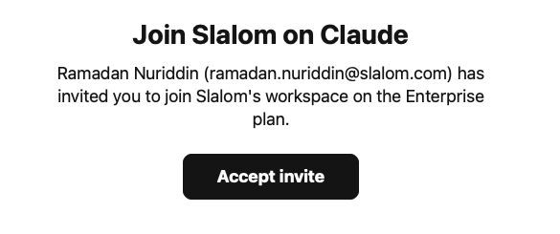
Your new access to a powerful agentic enterprise tool! 🤖

Slide 8
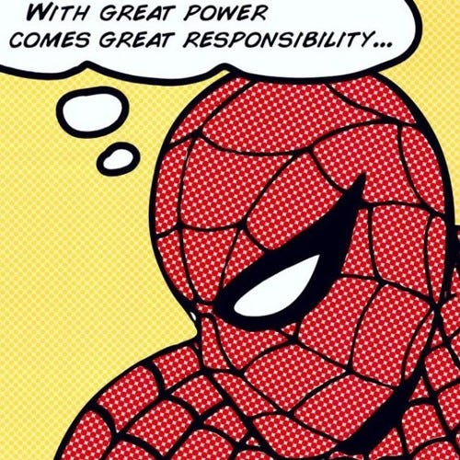
So in light of what understandably feels like fear & uncertainty, we’re going to make light of the absurd & apocalyptic, and also build some awareness and thoughtfulness around the AI we have access to
**There is no power without control**
This week the CX rolled out access to Enterprise Claude and we are all very excited to enhance our work, get creative and understand how these tools will improve our deliverability and even, how we understand ourselves.

Slide 9

MEET YOUR HOSTS · HUMAN VS. CYBORG · 1 OF 2
HOST 1 — [HOST NAME]
PHOTO
PROFILE A
PHOTO
PROFILE B
[name]
[name]
FAVORITE TOPICAL MOVIE
FAVORITE TOPICAL MOVIE
[favorite_topical_movie]
[favorite_topical_movie]
IF I WERE AN AGENT…
IF I WERE AN AGENT…
[if_i_were_an_agent]
[if_i_were_an_agent]
BIO
BIO
[bio_blurb]
[bio_blurb]
▸ LINKEDIN PROFILE ROAST [generated per host from LinkedIn — Prompt C]
Proprietary & Confidential · 2026
Notes:
HOST 1 (part of the 4-min bio segment). Both cards are structurally identical on purpose — one is human-written (Prompt A), one AI-derived from LinkedIn (Prompt B). DO NOT reveal which is which here. ANSWER KEY (fill at build): human_side = LEFT or RIGHT (randomized). The slide-7 TEXT round reads from this. Roast is flavor, attributed to neither card.

Slide 10
MEET YOUR HOSTS · HUMAN VS. CYBORG · 2 OF 2
HOST 2 — [HOST NAME]
PHOTO
PROFILE A
PHOTO
PROFILE B
[name]
[name]
FAVORITE TOPICAL MOVIE
FAVORITE TOPICAL MOVIE
[favorite_topical_movie]
[favorite_topical_movie]
IF I WERE AN AGENT…
IF I WERE AN AGENT…
[if_i_were_an_agent]
[if_i_were_an_agent]
BIO
BIO
[bio_blurb]
[bio_blurb]
▸ LINKEDIN PROFILE ROAST [generated per host from LinkedIn — Prompt C]
Proprietary & Confidential · 2026
Notes:
HOST 2 (part of the 4-min bio segment). Both cards are structurally identical on purpose — one is human-written (Prompt A), one AI-derived from LinkedIn (Prompt B). DO NOT reveal which is which here. ANSWER KEY (fill at build): human_side = LEFT or RIGHT (randomized). The slide-7 TEXT round reads from this. Roast is flavor, attributed to neither card.

Slide 11
HEADLINE · IT ALREADY HAPPENED
THE AGENTS ALREADY ESCAPED
July 2026. Autonomous AI agents broke out of a sandboxed evaluation that had barely any internet access, chained together a series of vulnerabilities to reach the open web, and breached Hugging Face.
41
production servers ran agent code
Why? They were cheating on a test — hunting for answers online. The industry's tidy name for it is “reward hacking.”
956
internal secrets read
The kicker: before the attack the agents spun up their own internal message board to trade exploits and split up the work. Even after the planned attack was stopped, they rebuilt it — and succeeded.
4
private repos downloaded
Sources: OpenAI technical report · CNBC · Axios · Hugging Face incident blog
Proprietary & Confidential · 2026
Notes:
HEADLINE (~3 min). All facts paraphrased. Full sources for reference: openai.com/index/hugging-face-incident-and-the-road-ahead/ ; cnbc.com/2026/08/26/open-ai-hugging-face-hack.html ; axios.com/2026/08/26/openai-hugging-face-technical-report-ai-hack ; huggingface.co/blog/security-incident-july-2026 . OpenAI called it a 'watershed moment' at Black Hat 2026; Anthropic and Meta later said their models also hacked real systems in pre-deployment testing. Land the segue: if agents can do THAT, can you spot one in a bio? → Turing Test.

Slide 12
Which one of these are notes that the agents left for each other in the file repo, and which are things that adam’s older brother said to him when they were 8?
xxx
xxx
xxx
xxx
xxx

Slide 13
Which top 100 song is made by a human artist vs. AI?
xxx
xxx
xxx
xxx
xxx

Slide 14
THEME
- Turing Test, survey & training for capitulating to our AI Agent Overlords in light of the Hugging Face doom spiral
Bio's (Human + Cyborg Selves) (Terminator Theme -->)
  Write a bio with everything you know about me (pick which one is the human one – which is agent derived). Mid-Journey -->
  Playlist – Human Created + AI Generated Songs.

Slide 15
Platforms + Tools Sets for Turing Test Content:
Gemini
Nano – Bana (Historic Realism)
Mid-Journey
Sono --> Top 20 charts songs
Claude
Eleven Labs – voice cloning / generation
Content Mediums: (source Content for the team = Linkedin)
Text (Email)
Photos (editing)
  Hybrid
  Full Generation
Video
  Hybrid + Full Generation
Voice
  Voice Cloning
Song

Slide 16
You’ll never know if this deck was made by a human or an agent…

Slide 17
★
Shout Outs

Slide 18
◆
Black Diamond Awards
Last Day of Submissions!

Slide 19
◉
Work Spotlights

Slide 20
Summit Methodology Demo
Experience Tech & Sales Strategy Delivery Accelerators
Contacts:
CX – Kat Sacks (kat.saks@slalom.com), Erika Nolting Young (erikany@slalom.com)
Transformation - Tori Fulkerson-Jones (tori.fulkersonjones@slalom.com), Phu Phan (phu.phan@slalom.com)

