Slide 1

COVID PREDICTION MODEL: VISUALIZATION
- STUTI BUDHWAR

Slide 2
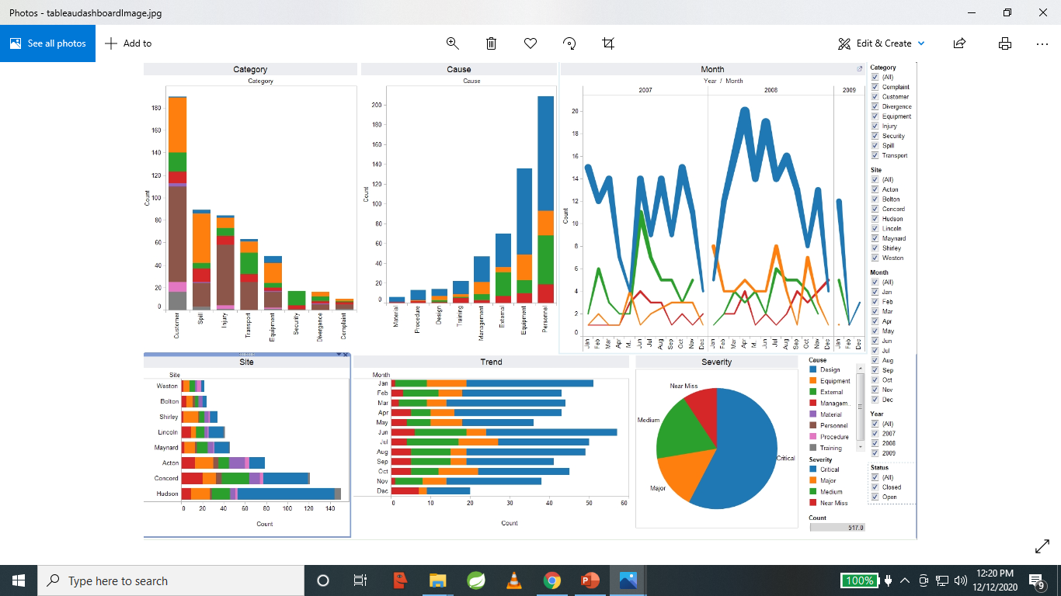
VISUALIZATION TOOLS TO BE USED TO CREATE FINAL DASHBOARD:
We will be predominantly using Tableau to create the final dashboard along with some other visualizations as required.
Tableau is one of the most popular visualization tool in todays time due to being proficient in analyzing large data sets using statistical & analytical knowledge to understand data trends, generate business insights and forecast outcomes.
In addition to using a Flask template, we will integrate Tableau for developing effective storytelling and fully functional, intuitive and interactive dashboards.
It will be published on the public tableau server.

Slide 3
VISUALIZATIONS PLANNED FOR THE FINAL DASHBOARD:
ML Model* vs model accuracy for the chest X-ray images having one of the 14 medical conditions*. (using confusion matrix)
ML Model* vs loss for the chest X-ray images having one of the for the 14 medical conditions*.
Model accuracy and loss for 1 particular model for 14 medical conditions for original vs augmented image data set.
Plot all models vs accuracy to conclude most optimal model.
Plot all models vs loss to conclude most optimal model.
* ML Model: We will try different pertained machine learning models including VGG16, VGG19, ResNet18, ResNet50, SqueezeNet, DenseNet-121 and add layers at the end to adjust for our needs.
* Medical conditions: Atelectasis, COVID-19, Cardiomegaly, Consolidation, Edema, Enlarged Cardiomediastinum, Fracture, Lung Lesion, Lung Opacity, Pleural, Pneumonia, Pneumothorax, support devices, no finding

Slide 4
DESCRIPTION OF INTERACTICE ELEMENTS
Tooltips and viz in tooltips
Url actions
Navigation actions
Dashboard buttons
Highlighting & highlighting actions
Filter and filter actions
Parameters
Sets and set actions

Slide 5
BASIC ARCHITECTURE FOR MACHINE LEARNING MODELS AND VISUALIZATION:

Slide 6
PROJECT SPECIFIC ARCHITECTURE FOR MACHINE LEARNING MODELS AND VISUALIZATION: * DATASET: AUGMENTED AND NON AUGMENTED 5000 CHEST X-RAY IMAGES
MODEL NO. | BASIC MODEL | FEATURES_1_: LAYERS | FEATURES_1_: LAYERS | FEATURES_1_: LAYERS | FEATURES_1_: LAYERS | NO. OF ATTEMPTS
1 | VGG16
2
3
4
5
6 | VGG19
7
8
9
10
11 | ResNet18
12
13
14
15

Slide 7
MODEL NO. | BASIC MODEL | FEATURES_1_: LAYERS | FEATURES_1: LAYERS | FEATURES_2: DENSE LAYER | FEATURES_3: LAYERS | NO. OF ATTEMPTS
16 | ResNet50
17
18
19
20
21 | SqueezeNet
22
23
24
25
26 | DenseNet-121
27
28
29
30

Slide 8
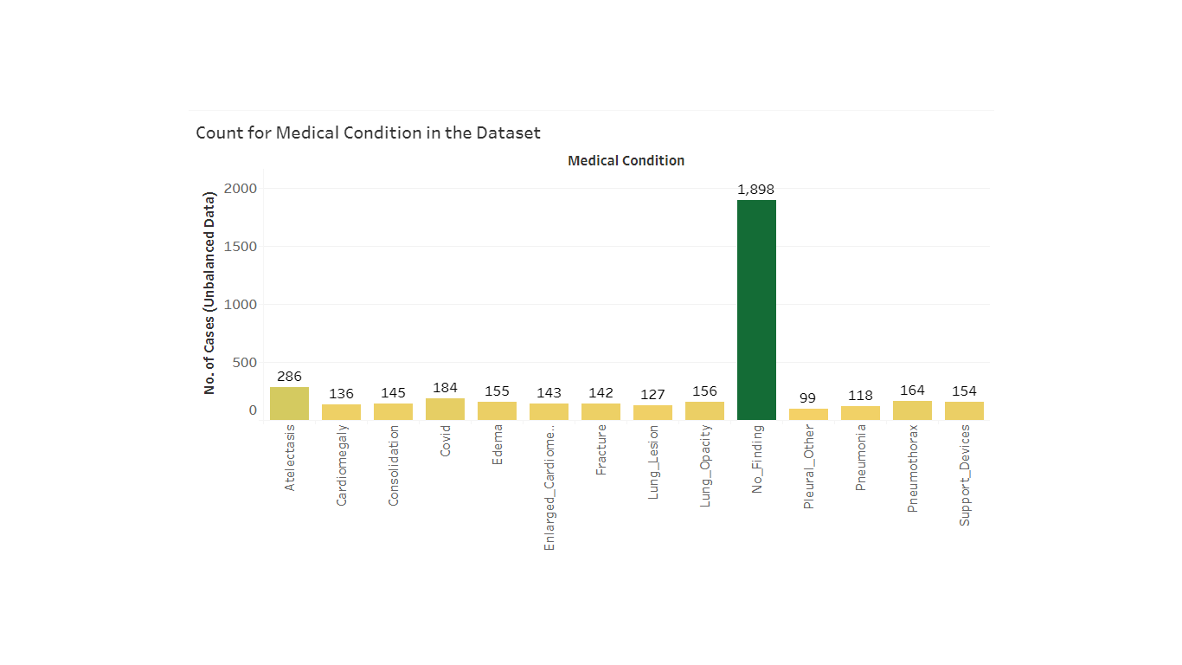
BASIC DATASET VISUALIZATION-1:
COUNT FOR MEDICAL CONDITIONS BEFORE BALANCING THE DATA
* Tableau public link:
https://public.tableau.com/profile/stuti.budhwar#!/vizhome/Covid_Prediction_Model_Medical_Condition_Count_unbalanced_Data/Med_ConditionCount_unbalanced_data?publish=yes

Slide 9
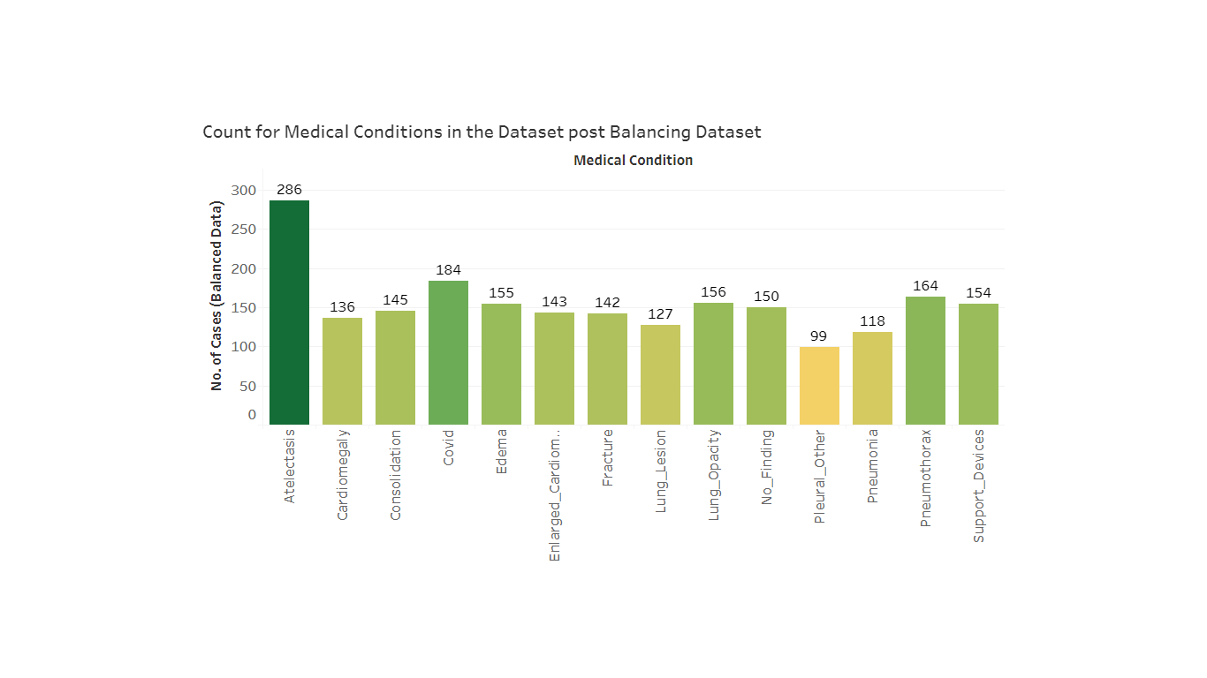
BASIC DATASET VISUALIZATION-2:
COUNT FOR MEDICAL CONDITIONS AFTER BALANCING THE DATA
* Tableau public link:
https://public.tableau.com/profile/stuti.budhwar#!/vizhome/Covid_Prediction_Model_Medical_Condition_Count_balanced_Data/Med_ConditionCount_balanced_data?publish=yes

Slide 10
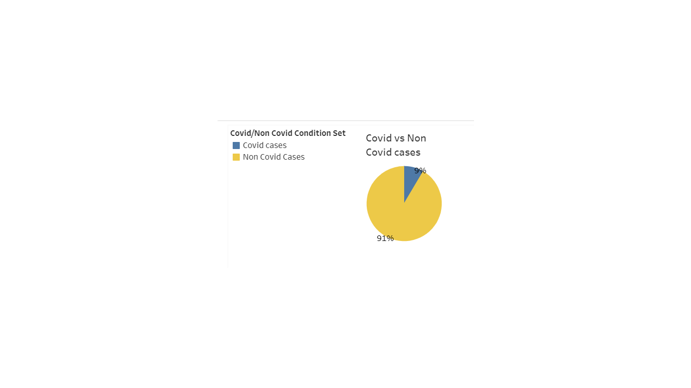
BASIC DATASET VISUALIZATION-3:
COUNT OF COVID VS NON COVID CASES
* Tableau public link:
https://public.tableau.com/profile/stuti.budhwar#!/vizhome/Covid_Prediction_Model_Covid_vs_NonCovid_Count/CovidVsNonCovidCount?publish=yes

Slide 11
ANALYSIS AND VISUALIZATION-1: Model1: accuracy and loss

Slide 12
ANALYSIS AND VISUALIZATION-2:
MOdels

Slide 13
ANALYSIS AND VISUALIZATION-3:

