Slide 1
COVID Prediction Model Presentation Draft 1
By Group 01

Slide 2
Reason for topic
To gain the knowledge of chest X-ray images to interpret and develop an AI-based approach to predict and recognize both COVID-19 and non Covid-19 diseases.

Slide 3
Questions we hope to answer
Can you recognize COVID with chest X-ray images
recognize both COVID-19 and non Covid-19 diseases

Slide 4
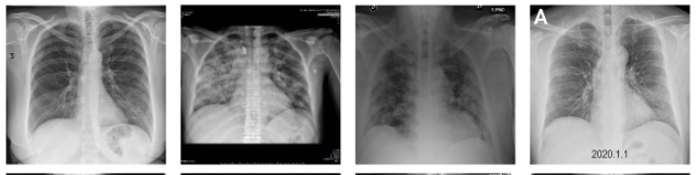
covid

Slide 5
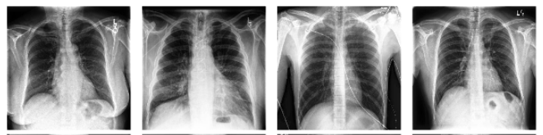
Non covid

Slide 6
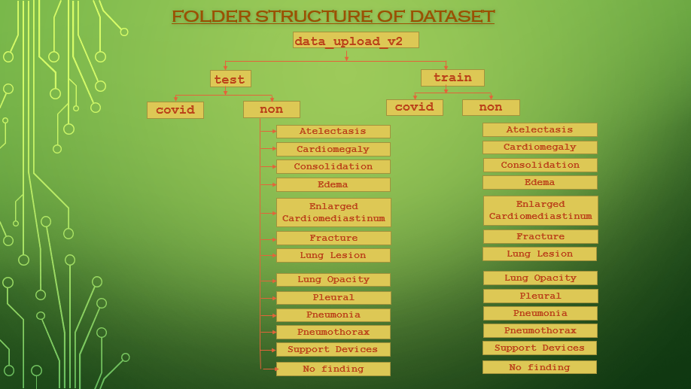

Slide 7
Machine Learning Module

Slide 8
DataBase

Slide 9
Visualizations

Slide 10
Questions

