Slide 1
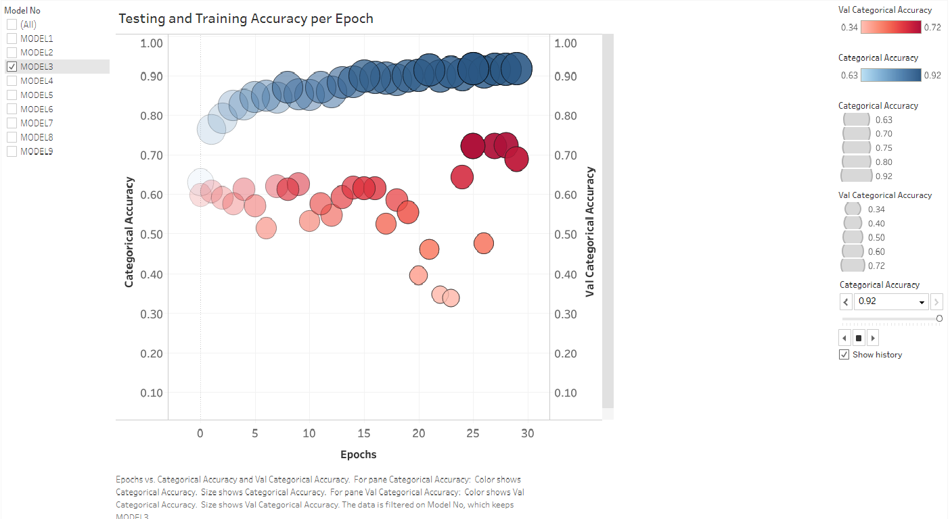
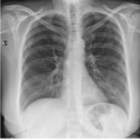
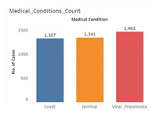
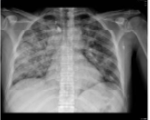
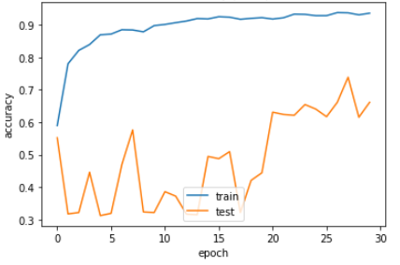
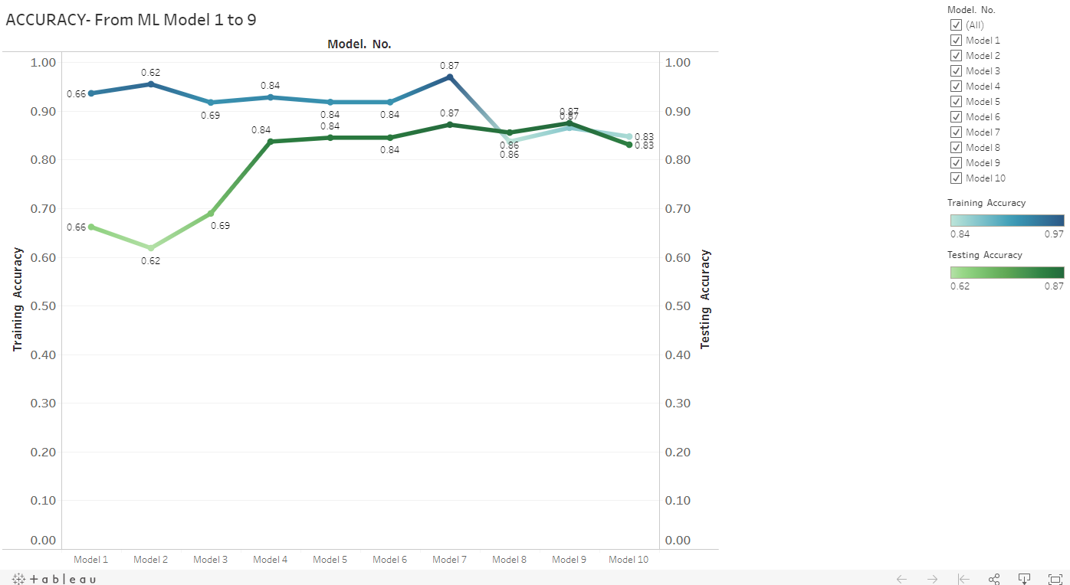
COVID PREDICTION ML MODEL

Slide 2
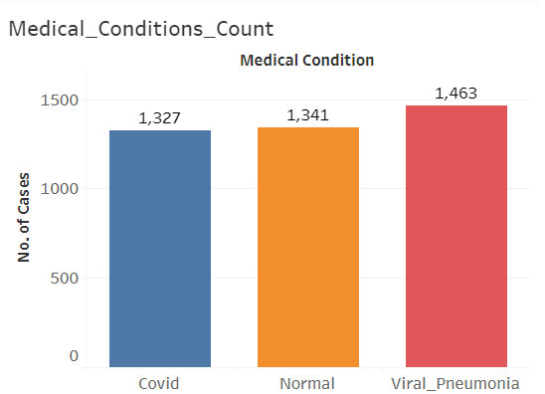
PROJECT OVERVIEW:
PURPOSE OF THE PROJECT:
Arriving at a Machine Learning prediction model for various COVID-19, Viral Pneumonia or Normal condition from frontal chest X-ray images of the patients. This would give physicians an edge and allow them to act with more confidence while they wait for the analysis of a radiologist by having a digital second opinion confirm their assessment of a patient's condition. Also, these tools can provide quantitative scores to consider and use in studies.
DATASET:
Type of Data : Frontal Chest X-ray Images
Size of Data: 4013 Images
Source:
https://www.kaggle.com/tawsifurrahman/covid19-radiography-database
Plus 184 COVID-19 image added from https://www.kaggle.com/bachrr/covid-chest-xray
ML Models applied : Basic, VGG_16, RESNET
MACHINE LEARNING STRATEGY:
We started with the basic model that was just a little overfitted with excellent training accuracy. The next step was to slightly modify the model each time, so it can generalize better.
If we got a model with a better testing accuracy than its training accuracy, it would indicate that the model is not learning the most important features . And since it's just that the validation dataset, it is easier to predict. This is feature common with data augmentation.
Base model was a very simple model to compare against. Then we tried different pretrained models like VGG-16 and Resnet-50 and added layers at the end to suit our needs using trial and error.

Slide 3
MODEL 1
Basic-A
MODEL 2
Basic-B
BASIC
MODEL 3
Basic-C
MODEL 4
Basic-D
MODEL 5
VGG-16A
MODEL 6
VGG-16B
VGG-16
MODEL 7
VGG-16C
MODEL 8
Resnet-A
MODEL 6
Resnet-B
RESNET-50
MODEL 7
Resnet-C

Slide 4
ML MODEL PERFORMANCE SUMMARY:
Model. No. | Basic Model Name | No of Epochs | File_Name | Loss | Categorical_ Accuracy | Val_Loss | Val_ Categorical_ Accuracy | Reference Git Branch for Code
Model 1 | Basic Model-A | 30 | Model1_history | 0.1909 | 0.936 | 1.6882 | 0.6615 | https://github.com/Coachnmomof3/UCB_COVID_Prediction_Model/blob/Bijan_Samimi_ml/COVID_ML_3classes.ipynb
Model 2 | Basic Model-B | 30 | Model2_history | 0.1354 | 0.9548 | 2.6053 | 0.6181 | https://github.com/Coachnmomof3/UCB_COVID_Prediction_Model/blob/Bijan_Samimi_ml/COVID_ML_3classes.ipynb
Model 3 | Basic Model-C | 30 | Model3_history | 0.2423 | 0.9172 | 0.9551 | 0.6892 | https://github.com/Coachnmomof3/UCB_COVID_Prediction_Model/blob/Bijan_Samimi_ml/COVID_ML_3classes.ipynb
Model 4 | Basic Model-D | 50 | Model4_history | 0.198 | 0.9278 | 0.385 | 0.8368 | https://github.com/Coachnmomof3/UCB_COVID_Prediction_Model/blob/Gabriel_Cuchacovich/GoogleColab_COVID_ML.ipynb
Model 5 | VGG-16-A | 100 | Model5_history | 0.194 | 0.9378 | 0.3526 | 0.8595 | https://github.com/Coachnmomof3/UCB_COVID_Prediction_Model/blob/Bijan_Samimi_ml/COVID_ML_3classes.ipynb
Model 6 | VGG-16-B | 200 | Model6_history | 0.1792 | 0.9382 | 0.3636 | 0.8663 | https://github.com/Coachnmomof3/UCB_COVID_Prediction_Model/blob/Bijan_Samimi_ml/COVID_ML_3classes.ipynb
Model 7 | VGG-16-C | 50 | Model7_history | 0.2848 | 0.8965 | 0.3187 | 0.8736 | https://github.com/Coachnmomof3/UCB_COVID_Prediction_Model/blob/Bijan_Samimi_ml/optimization_gcl_vgg16_final.ipynb
Model 8 | Resnet50-A | 50 | Model8_history | 0.3309 | 0.8718 | 0.3371 | 0.8748 | https://github.com/Coachnmomof3/UCB_COVID_Prediction_Model/blob/Bijan_Samimi_ml/covid_resnet.ipynb
Model 9 | Resnet50-B | 50 | Model9_history | 0.3603 | 0.8653 | 0.3061 | 0.8748 | https://github.com/Coachnmomof3/UCB_COVID_Prediction_Model/blob/Gabriel_Cuchacovich/GoogleColab_COVID_ML.ipynb
Model 10 | Resnet50 -C | 100 | Model10_history | 0.3564 | 0.8614 | 0.3382 | 0.8796 | https://github.com/Coachnmomof3/UCB_COVID_Prediction_Model/blob/Gabriel_Cuchacovich/GoogleColab_COVID_ML.ipynb

Slide 5
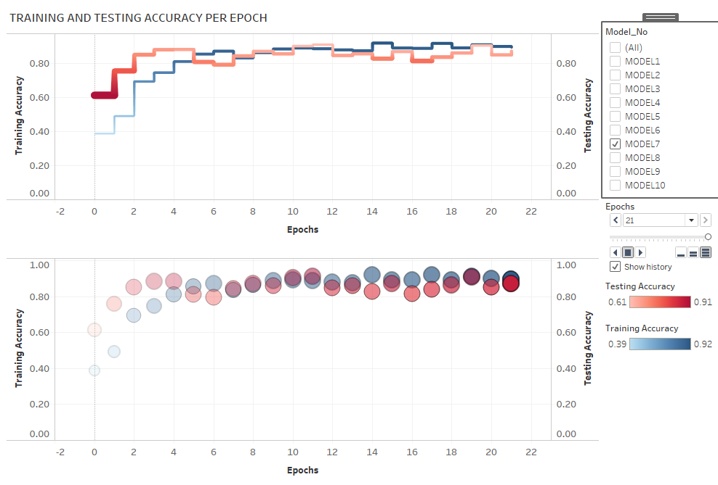
TABLEAU REPRESENATION OF ACCURACY FOR ALL MODELS:
Note:
Please refer tableau public link below to see the animation showing trail of the training and testing loss.
Please select the Model No on the screen and click on the play button to see the animated trail.
Tableau Public link:
https://public.tableau.com/profile/stuti.budhwar#!/vizhome/Covid_Prediction_Model_Dashboard/ACCURACY?publish=yes

Slide 6
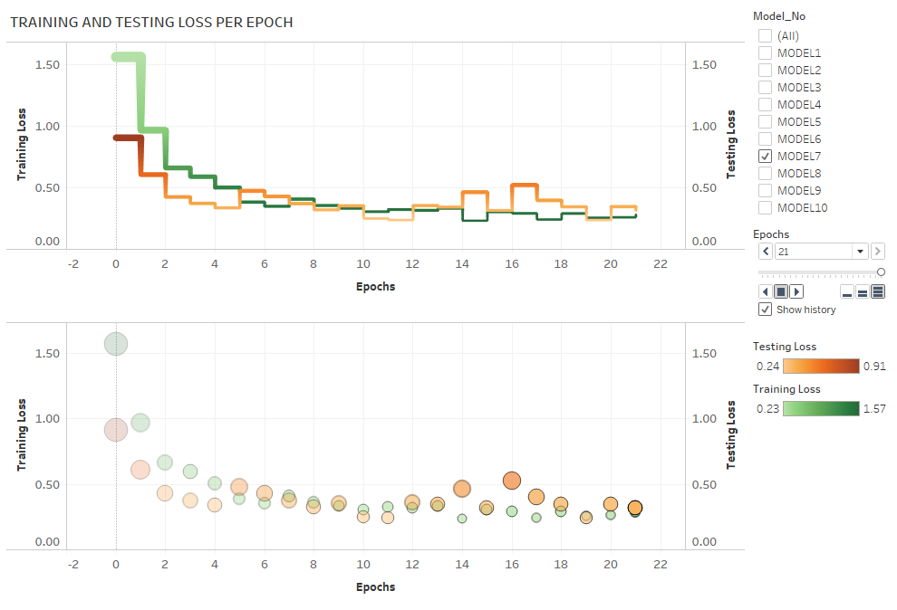
TABLEAU REPRESENATION OF LOSS FOR ALL MODELS:
Note:
Please refer tableau public link below to see the animation showing trail of the training and testing loss.
Please select the Model No on the screen and click on the play button to see the animated trail.
Tableau Public link:
https://public.tableau.com/profile/stuti.budhwar#!/vizhome/Covid_Prediction_Model_Dashboard/Model_Loss

Slide 7
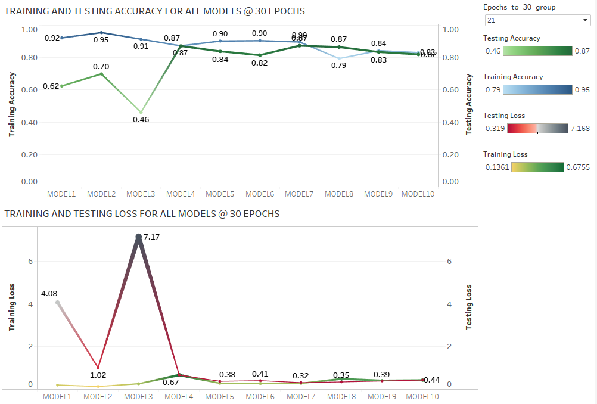
Note:
Please refer tableau public link below to see the animation showing trail of the training and testing loss.
Please select the Model No on the screen and click on the play button to see the animated trail.
Tableau Public link:
https://public.tableau.com/profile/stuti.budhwar#!/vizhome/Covid_Prediction_Model_Dashboard/ACCURACY?publish=yes

Slide 8
WINNER
VGG-16
RESNET-50
BASIC

Slide 9
OBSERVATIONS AND ANALYSIS OF MODEL PERFORMANCE
The old dataset of 5000 images of chest X-rays with 14 classes of medical condition, created a model that did not perform well at all. The number of images after balancing the data were too less for 14 medical conditions that they had to be trained for.
The imbalanced data however performed better giving an accuracy of about 50%, which was due to almost 50% of the images belonging to “No finding” category. This model would have been a biased ML model.
The change in the dataset to with just 3 classes showed great improvement in the performance of our models.
With this new dataset. we started with the basic model that was just a little overfitted with excellent training accuracy. We kept modifying the model slightly so it can generalize better.
VGG16 performed better than the base model. Despite the base model having a slightly better Val accuracy; because the training accuracy of VGG16 is way better, this implies VGG16 has more potential.
VGG16 did seem overfitted initially, so we added a dropout layer in subsequent models to see if it generalizes better.
After running a few basic and pretrained models, we realized that class 1 which is ‘Viral Pneumonia’ is being grossly misinterpreted. Almost a third of Viral Pneumonia is being predicted as normal.
This changed our strategy for the upcoming models. We increased the complexity of the models to improve of feature engineering.
CONCLUSION:
Among all base models, VGG-16, Resnet-50 models, VGG-16 model did the best giving maximum accuracy, least loss, with model that’s neither over-fitted not under-fitted like others and performing consistently over multiple runs.
It also predicted the correct medical condition of COVID-19, Viral pneumonia or Normal more correctly among all the 10 models that we designed.

Slide 10
THANK YOU
Questions ???

