Slide 1
Project 3
Blue Men and Woman group

Slide 2
Breakdown
Overview: Medicare vs. Medicaid Spending By Drug
Which manufacturers supplied the greatest number of drugs to each of the federal programs?
How much did Medicaid spend for each manufacturer per year? How much did Medicare spend?
What is the relationship between the number of manufacturers for a single drug and the price of that drug per year?
Data Engineering Track with Visualization Elements.
ETL Process: Austen and Tyler
Database Schema: Amanuel
Visualization: Rachel

Slide 3
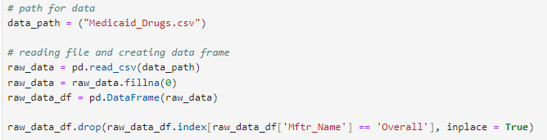
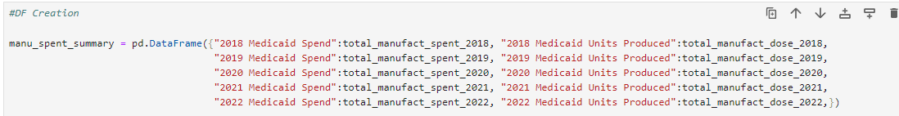
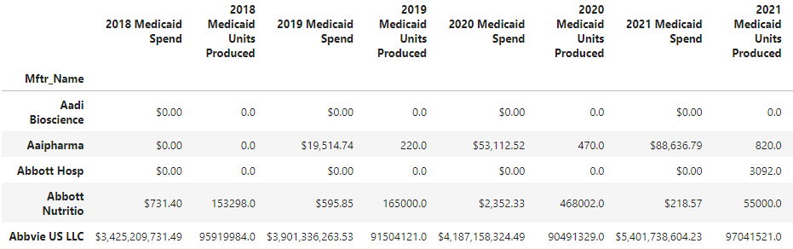
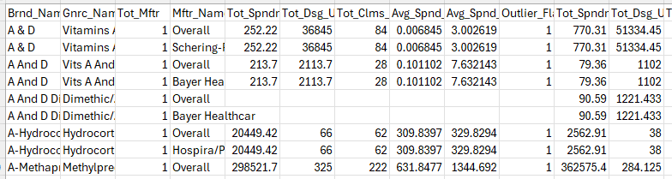
Medicaid ETL Process
Dataset Evaluation
"Overall" Row
# of Manufacturers
DF #1 Preparation & Creation
Simplify

Slide 4
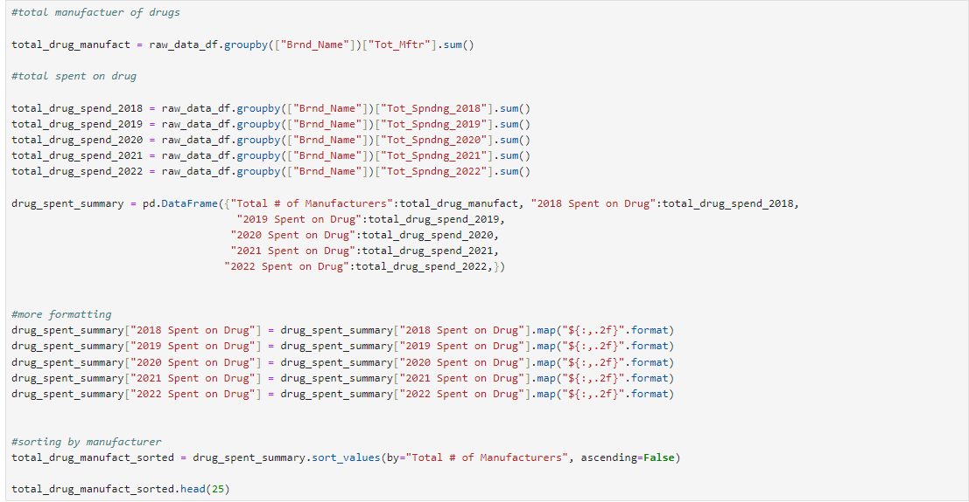
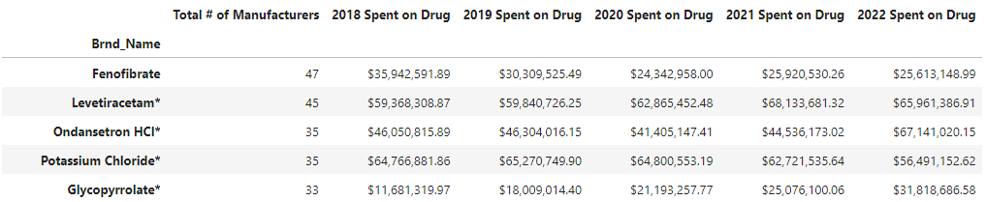
Medicaid ETL Process cont.
DF #2 Preparation & Creation
Manufacturer Comparison
Brand Name

Slide 5
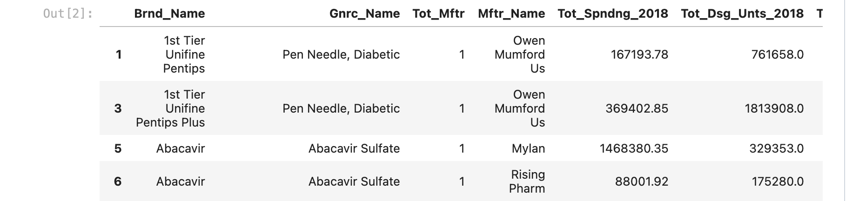
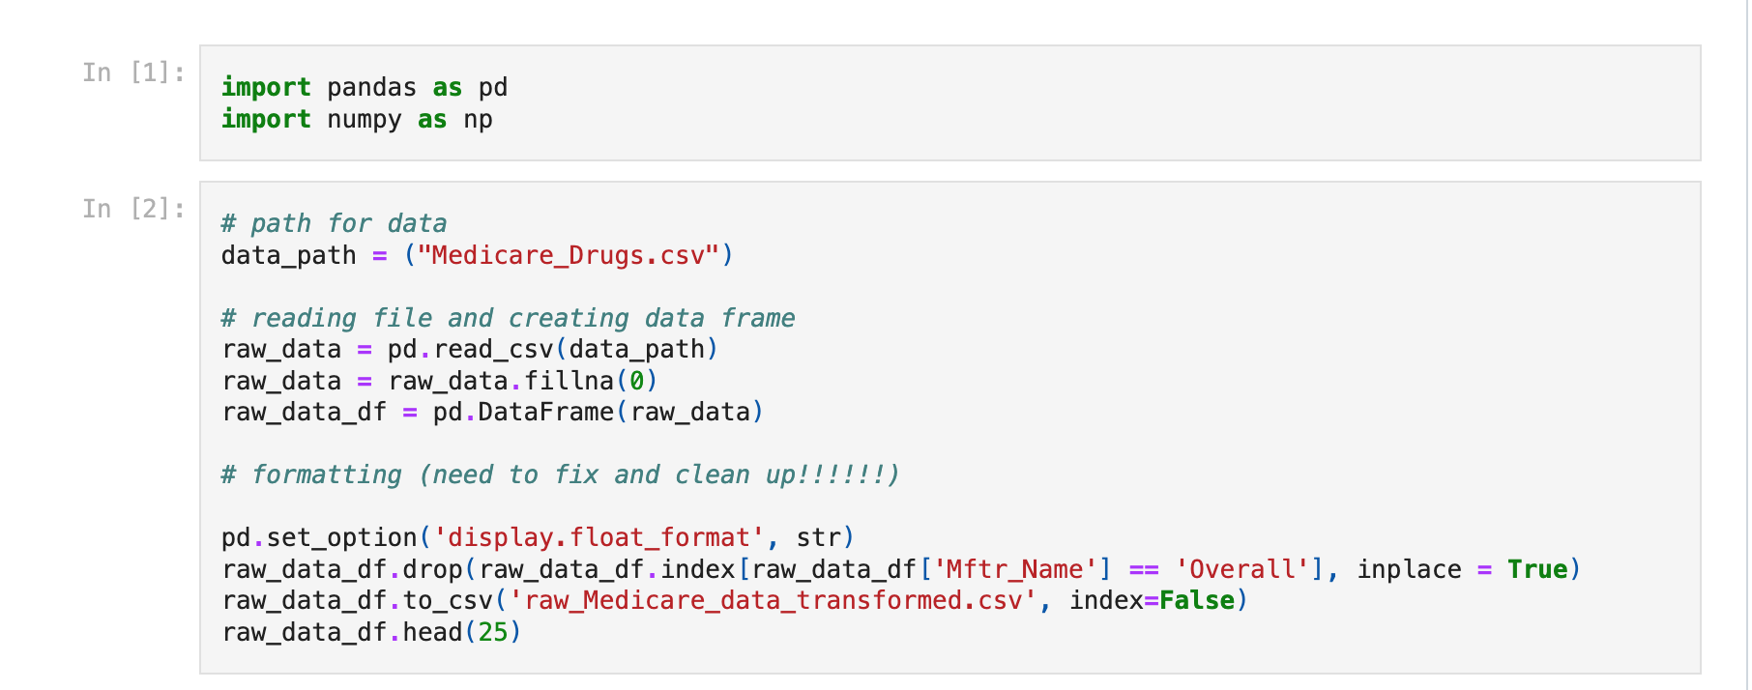
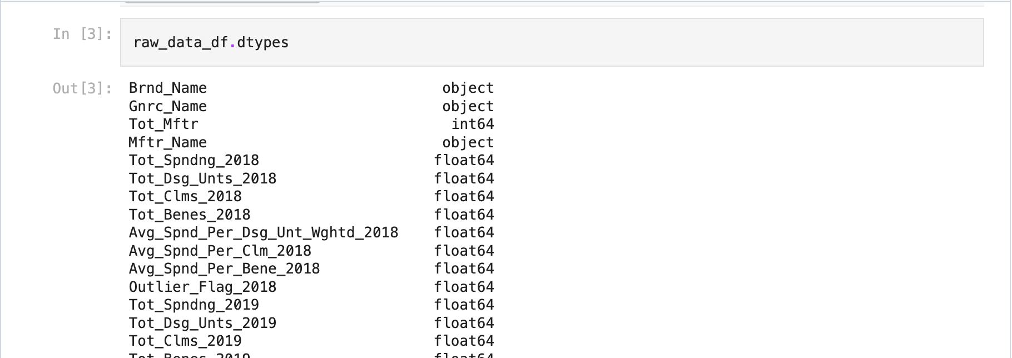
Medicare ETL Process
Importing Libraries, Dataset, and Formatting
Checking Data Types

Slide 6
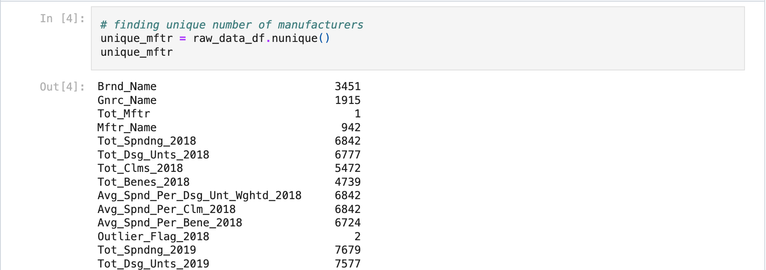
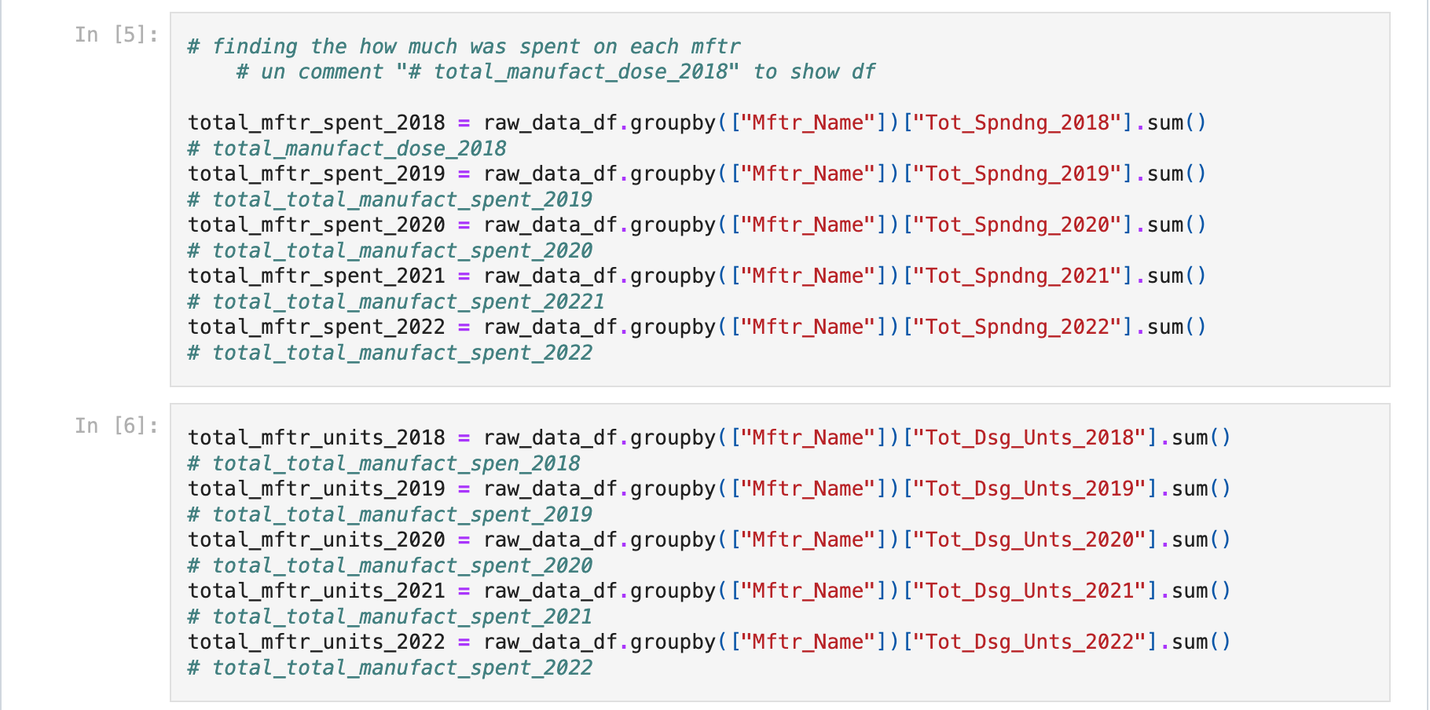
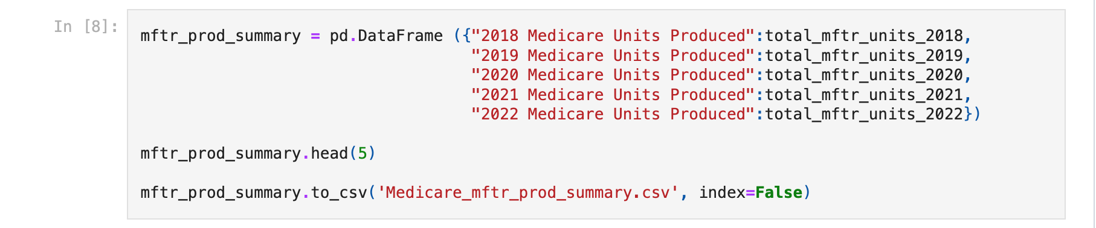
Medicare ETL Process cont.
Finding Total Spent and Total Units Produced per Year by Manufacturer
Finding Unique Manufacturers
Creating The Summary

Slide 7
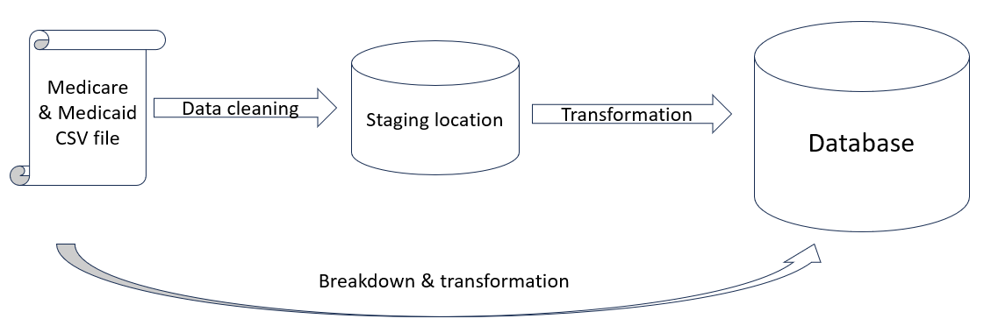
Database Design
Technology: PostgreSQl (PGAdmin)
Normalization : 3NF
Data types and size
Relationships and Foreign Keys

Slide 8
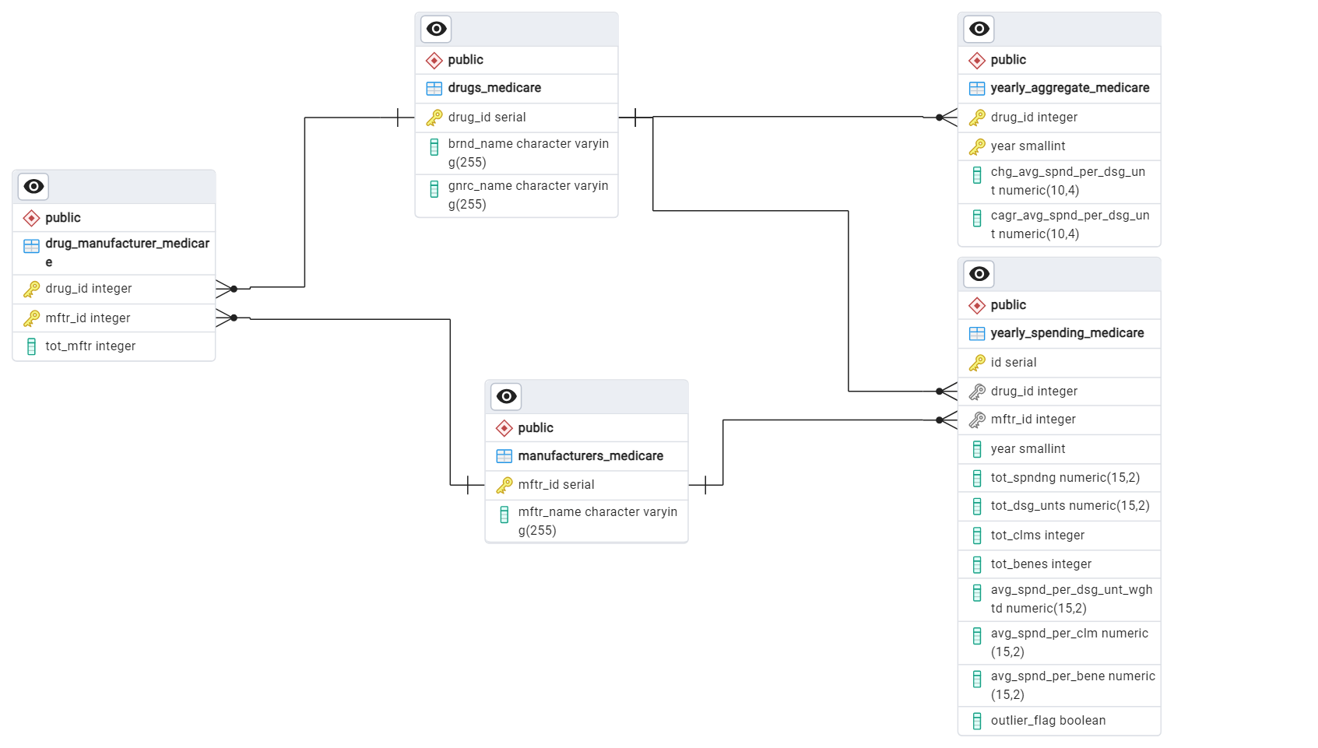
ERD

Slide 9
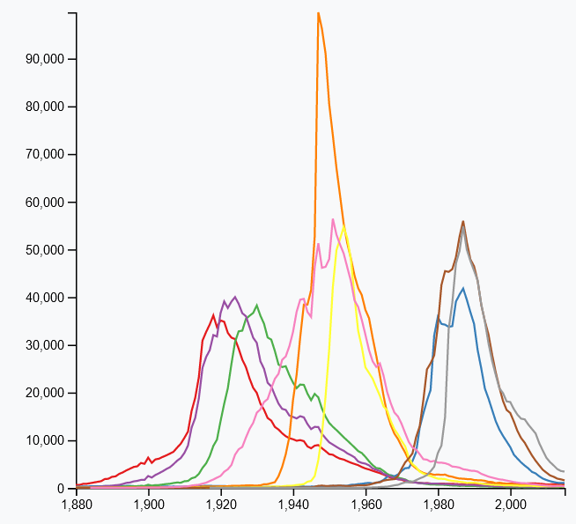
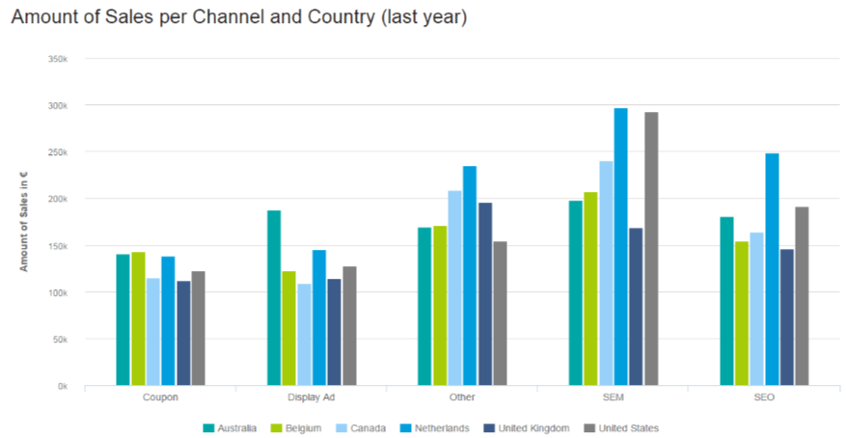
Visualizations: Nail It or Fail It

Slide 10
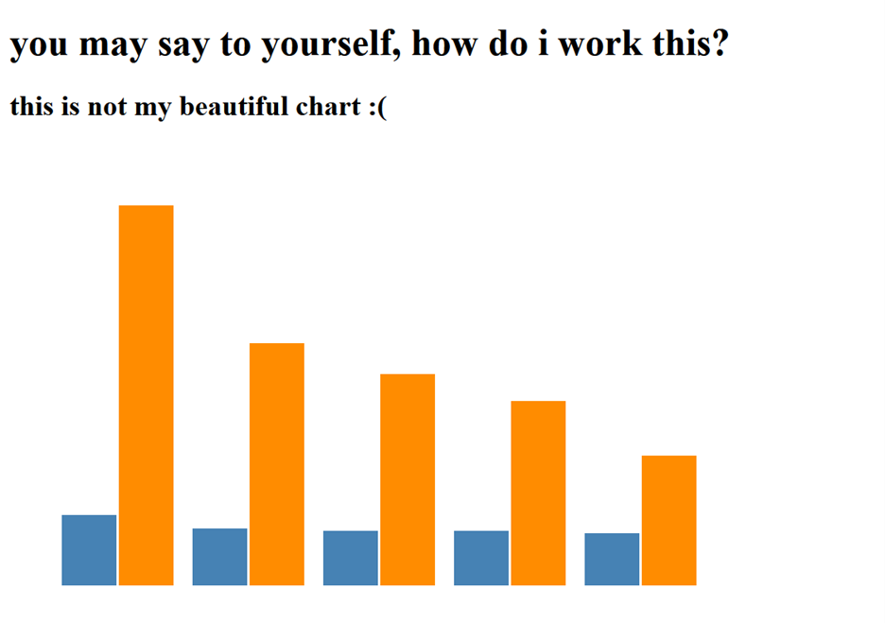
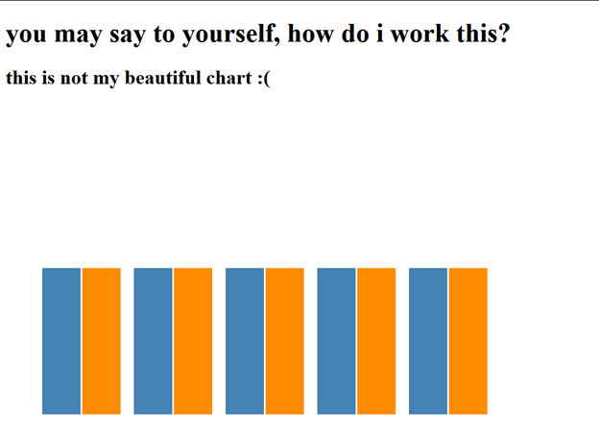
Grouped Bar Graphs

Slide 11
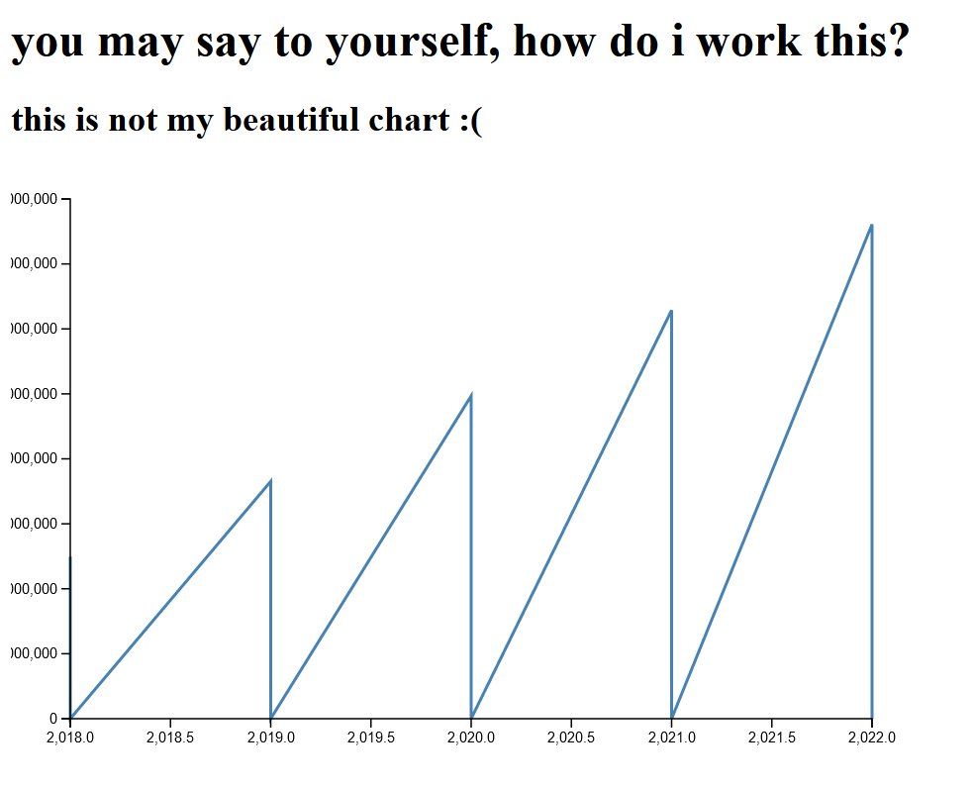
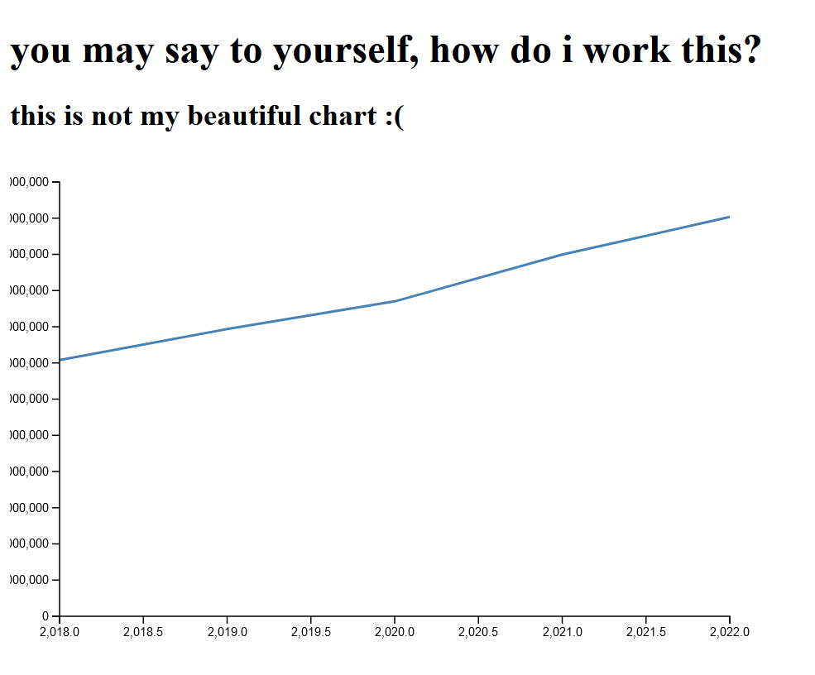
Line Chart

