Slide 1
Project Report
Metabolomics Analysis [prenormalized w/ dummy QC]

Slide 2
Project Overview
Samples
39 experimental samples
2 liver control samples
Total of 23 features from 1 methods
method1 was normalized by Internal Standard dummyISTD [CV = 0]
Comparisons performed
t-test
HFDDam_over_RDDam
MaleMHFD_over_MaleMRD
FemMHFD_over_FemMRD
anova
MaleMRD_MaleMHFD_FemMRD_FemMHFD

Slide 3
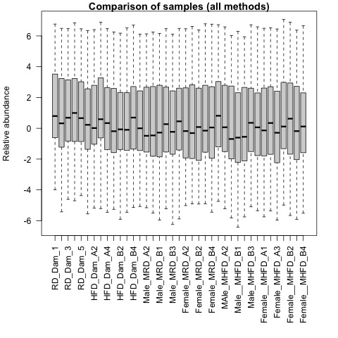
QA plots: all_samples

Slide 4
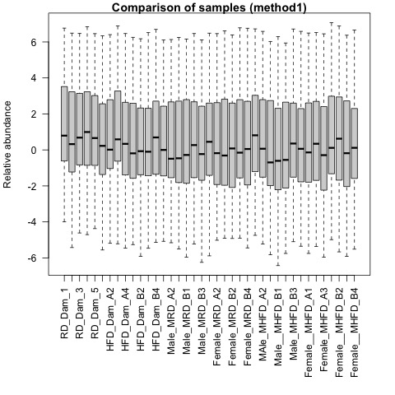
QA plots: method1

Slide 5
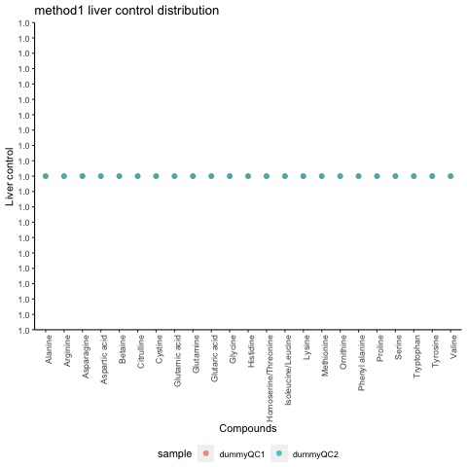
Liver Control: method1

Slide 6
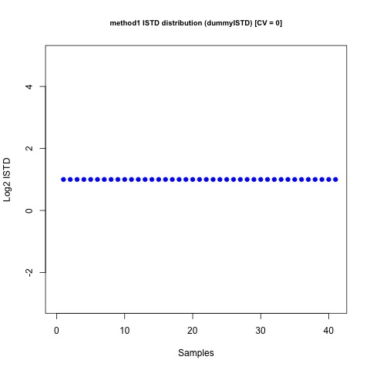
Internal Standards Distribution: method1

Slide 7
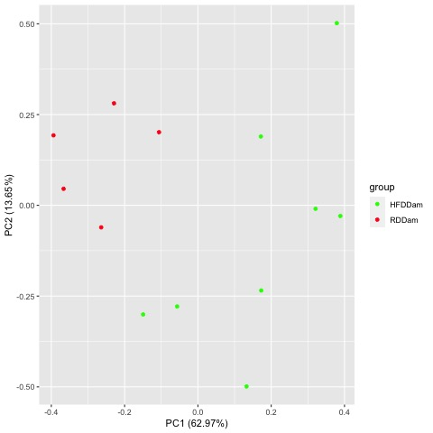
Comparison HFDDam_over_RDDam
Raw PCA
Normalized PCA

Slide 8
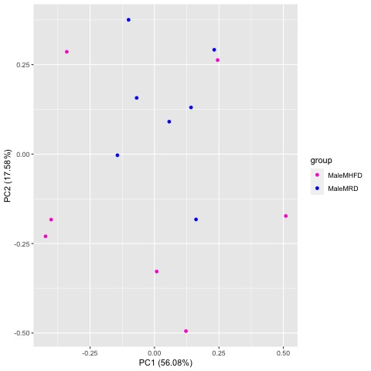
Comparison MaleMHFD_over_MaleMRD
Raw PCA
Normalized PCA

Slide 9
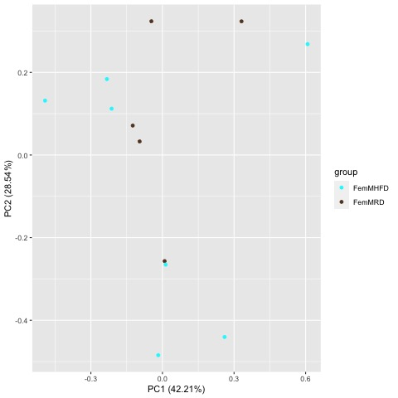
Comparison FemMHFD_over_FemMRD
Raw PCA
Normalized PCA

Slide 10
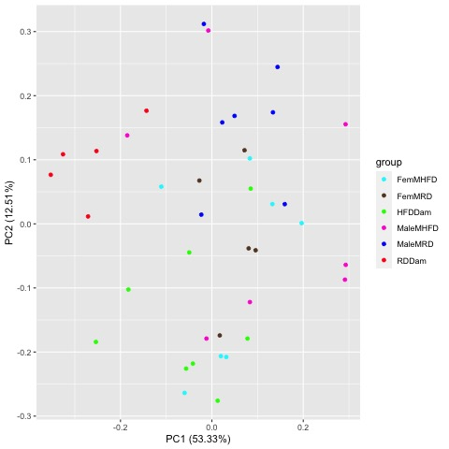
Comparison MaleMRD_MaleMHFD_FemMRD_FemMHFD
Raw PCA
Normalized PCA

Slide 11
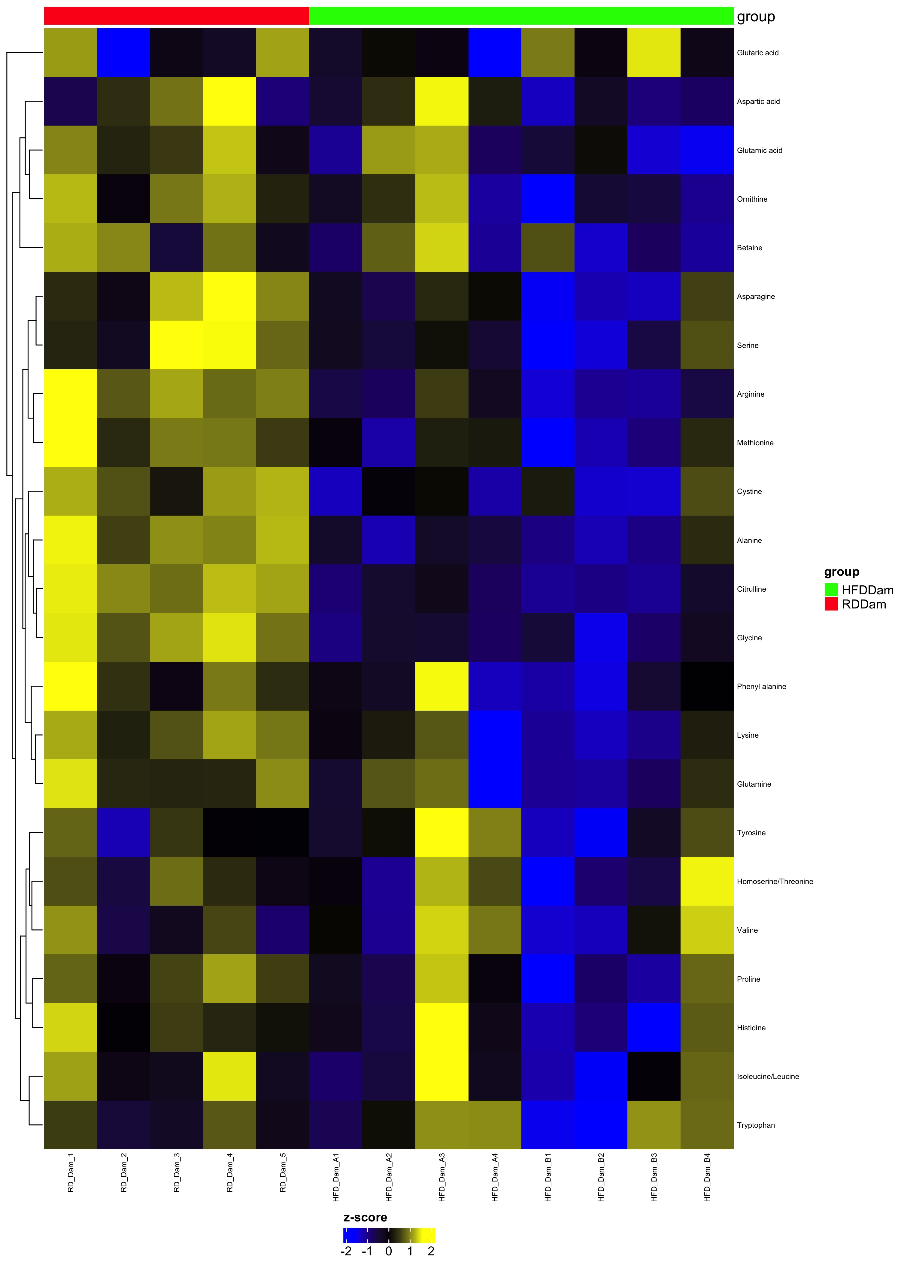
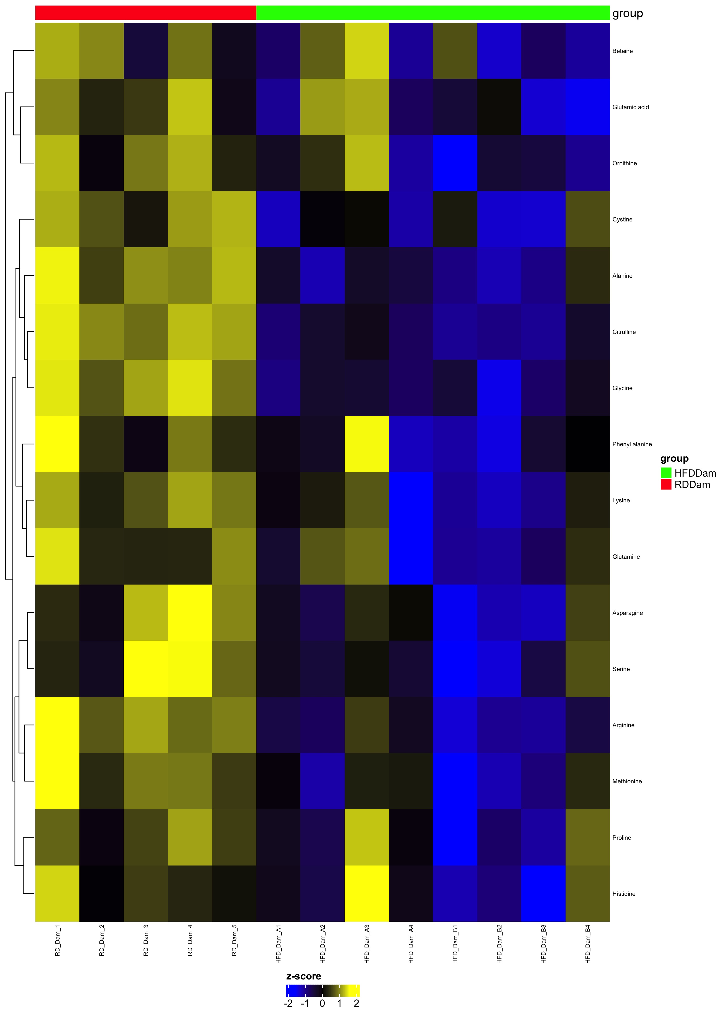
Comparison HFDDam_over_RDDam
Complete Set fdr=1
Differential fdr<0.25

Slide 12
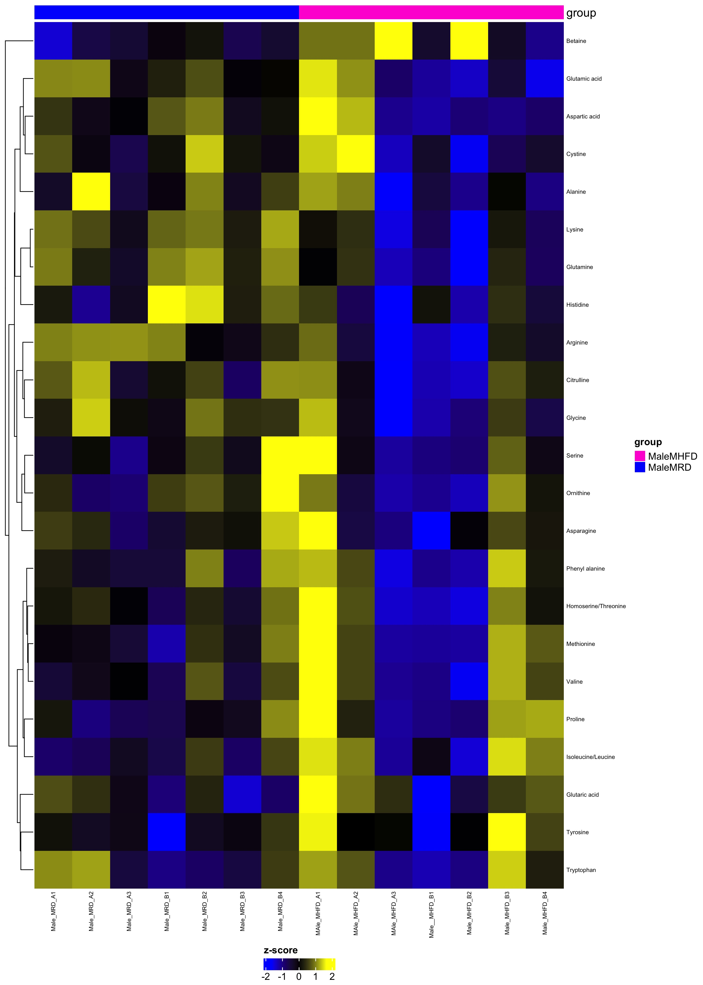
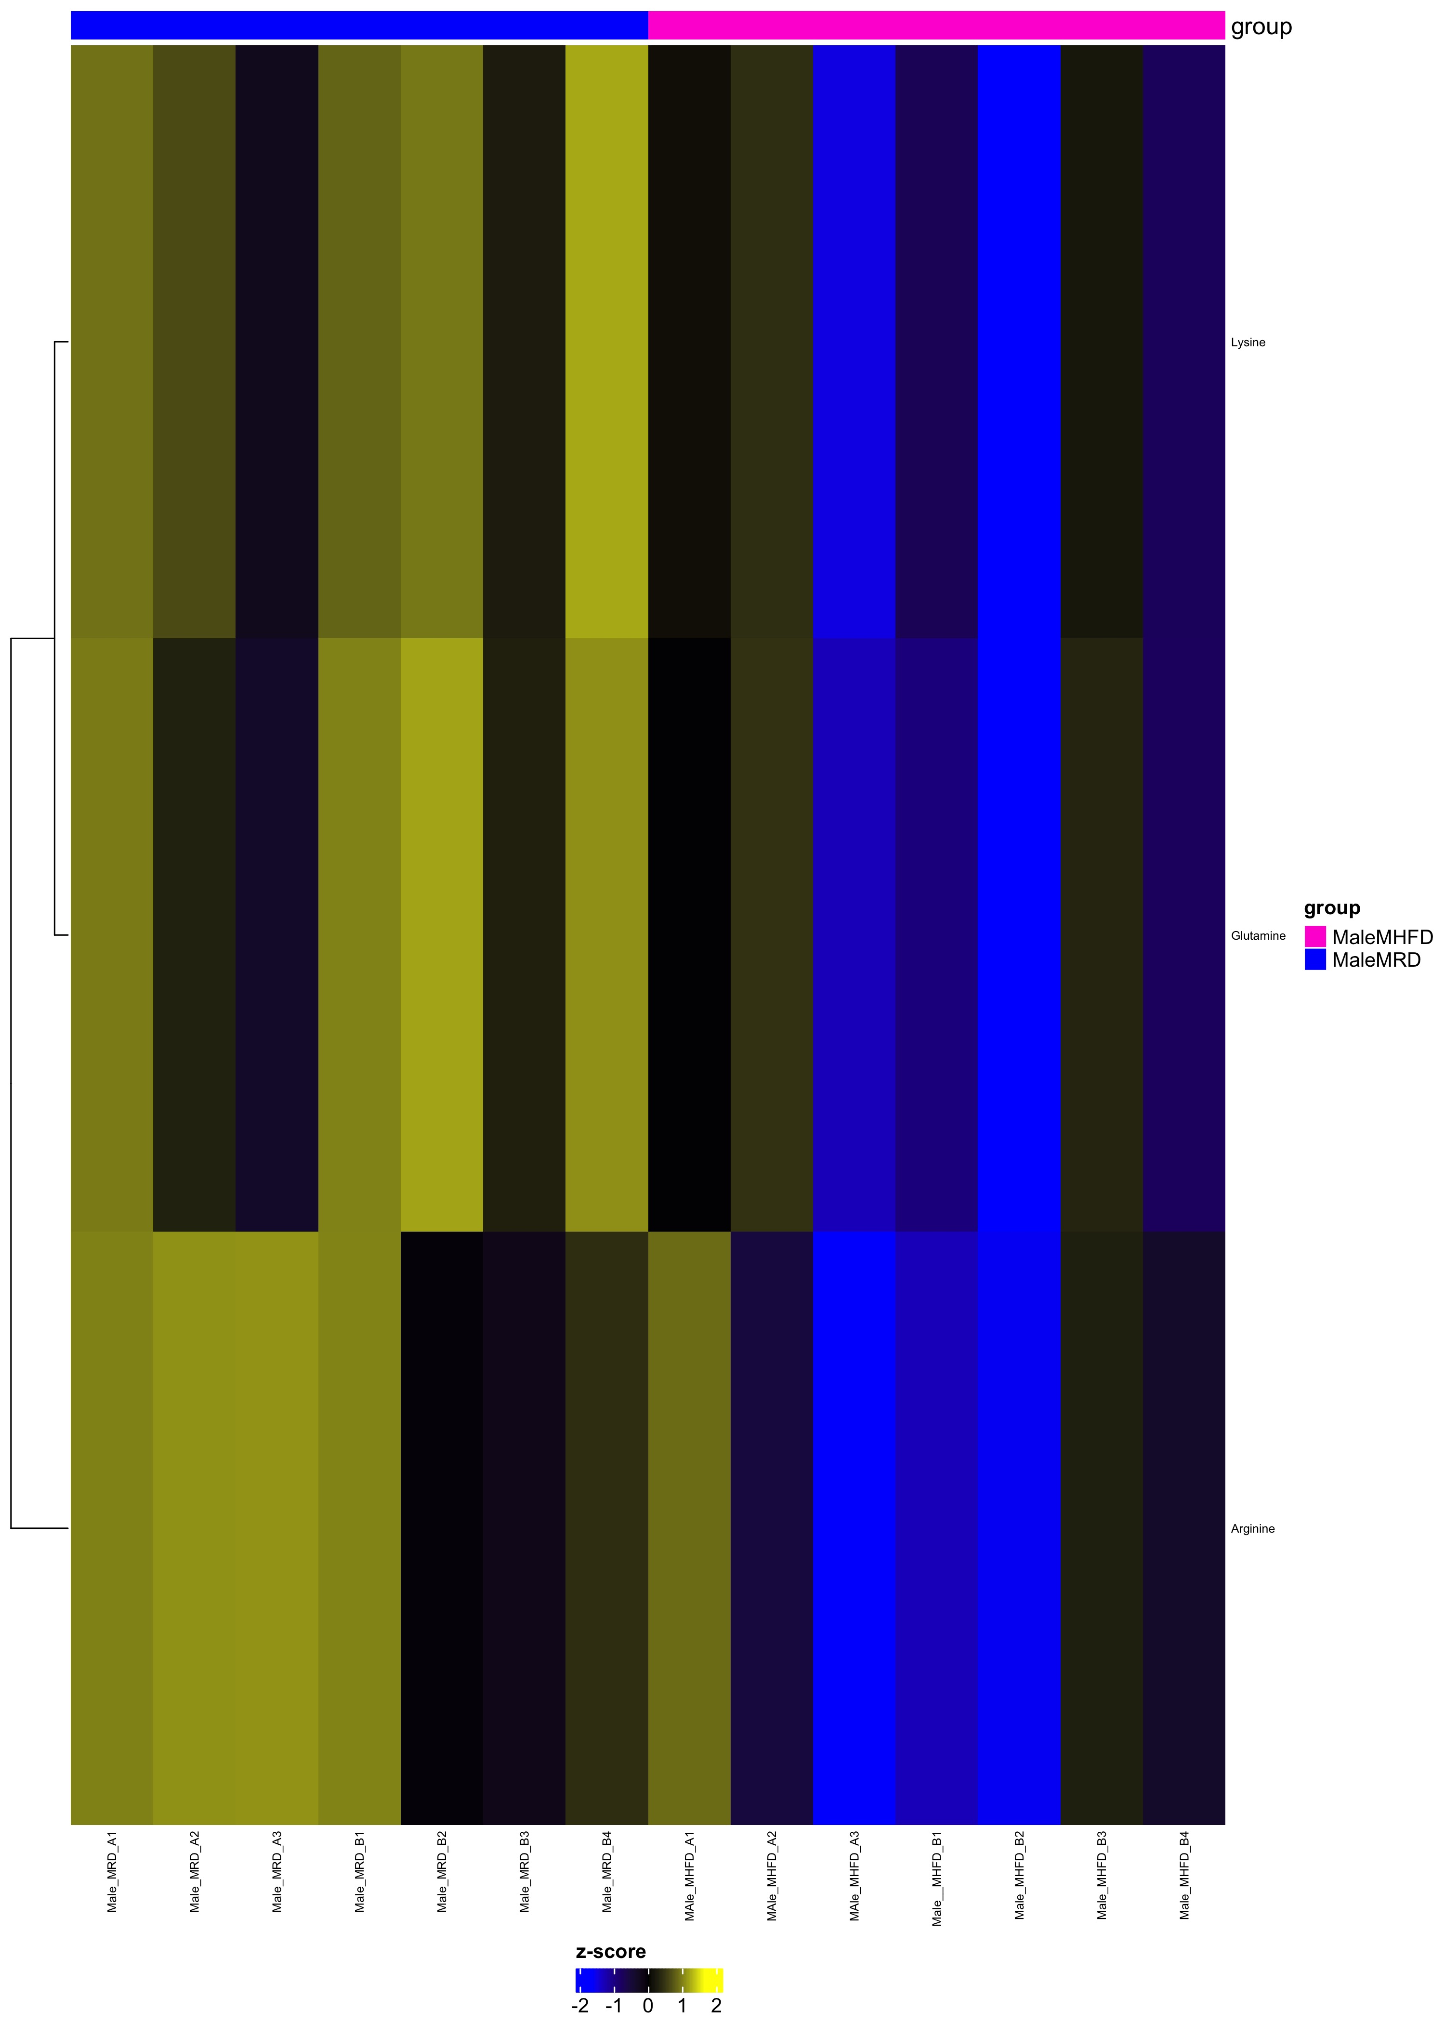
Comparison MaleMHFD_over_MaleMRD
Complete Set fdr=1
Differential fdr<0.25

Slide 13
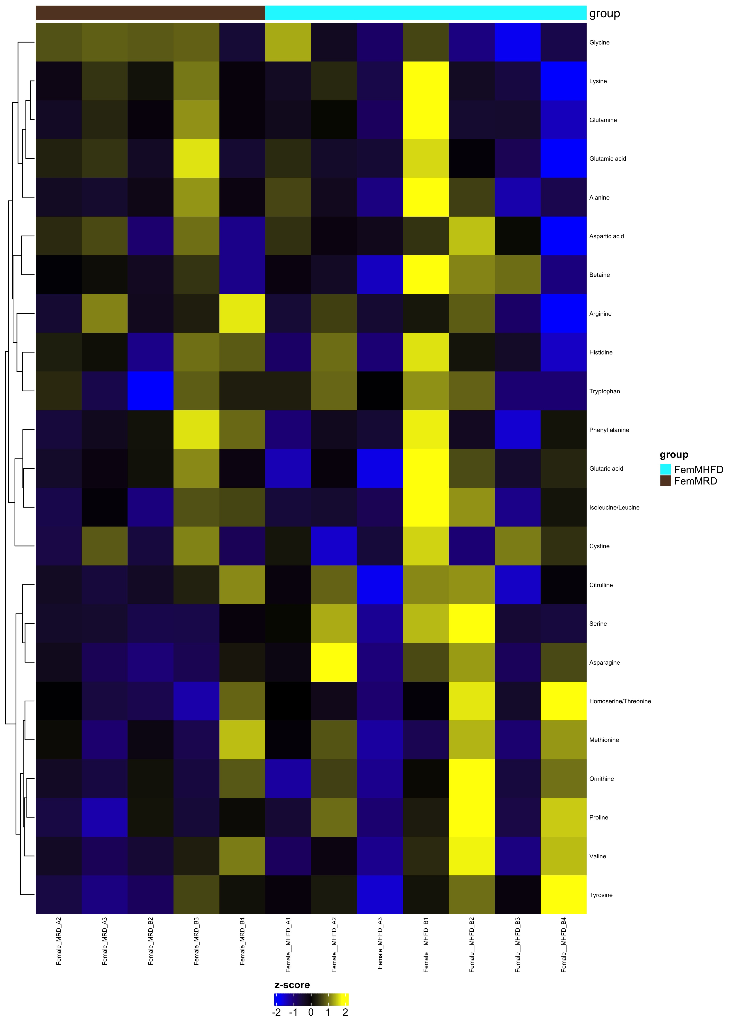
Comparison FemMHFD_over_FemMRD
Complete Set fdr=1
Differential fdr<0.25

Slide 14
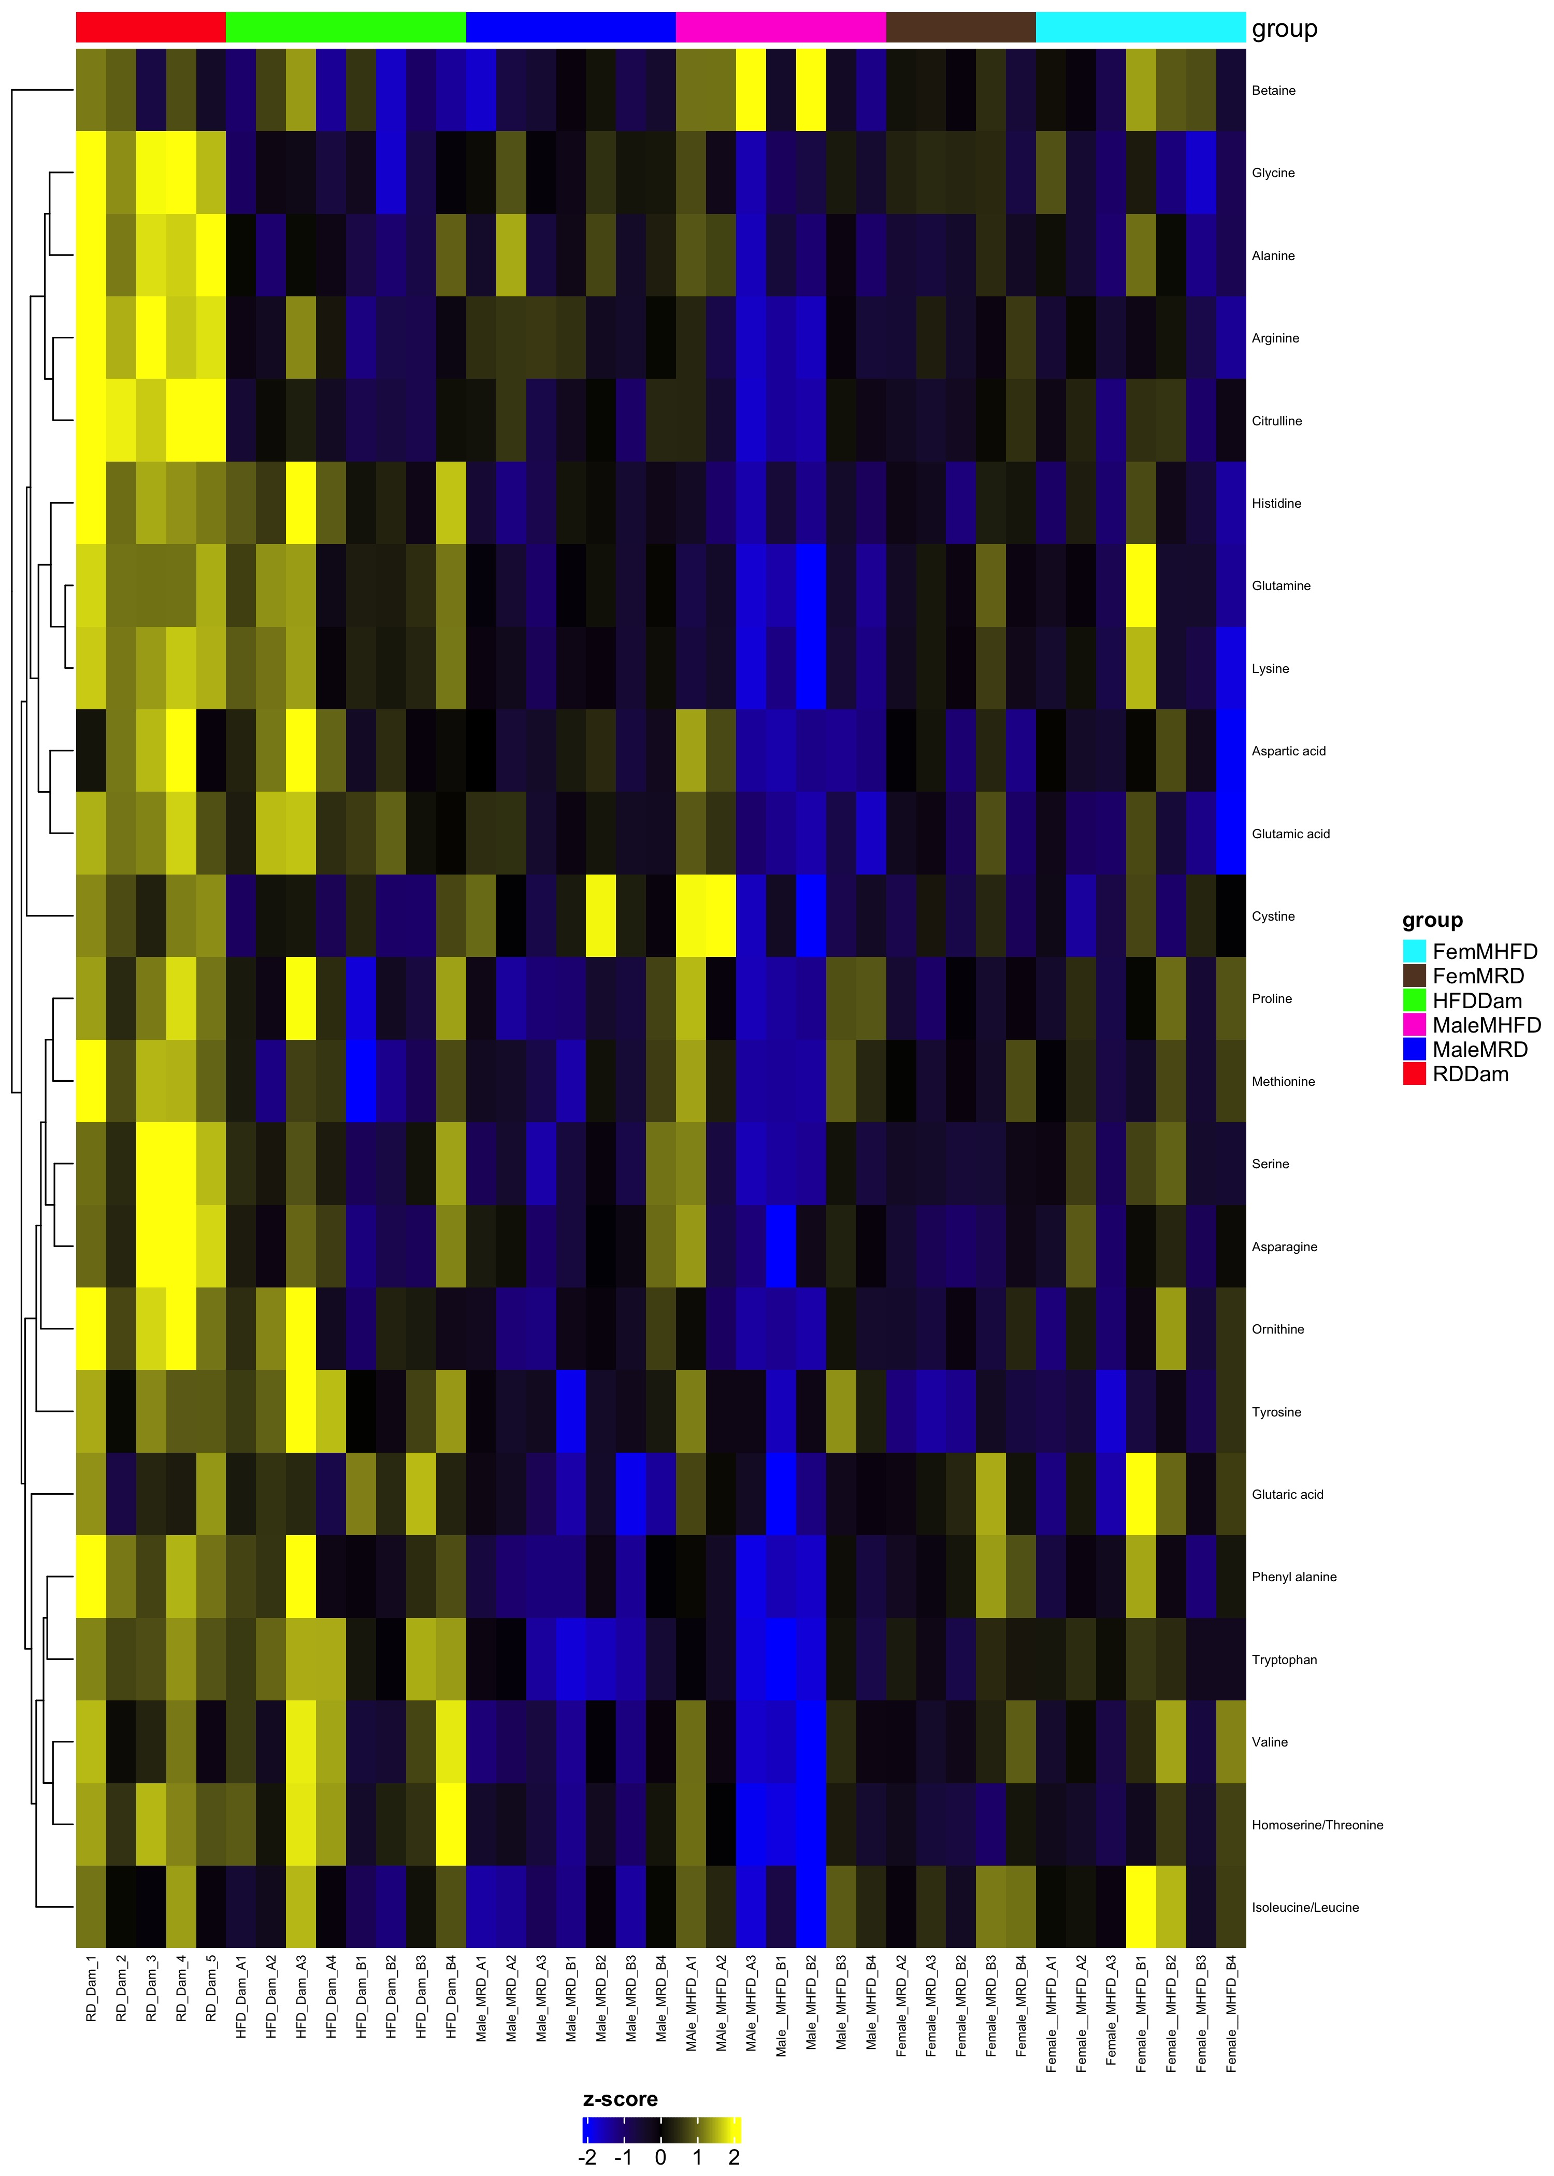
Comparison MaleMRD_MaleMHFD_FemMRD_FemMHFD
Complete Set fdr=1
Differential fdr<0.25

