Slide 1
Project Report
RPPA Analysis

Slide 2
Project Overview
Samples
300 experimental samples
Total of 208 features from 1 methods
Data was log2 transformed
Comparisons performed
t-test
WT_7d_MC_CO_over_CO_CO

Slide 3
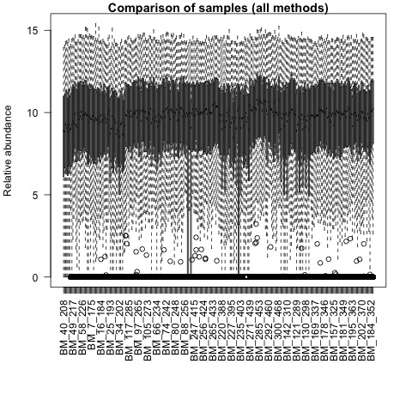
QA plots: all_samples

Slide 4
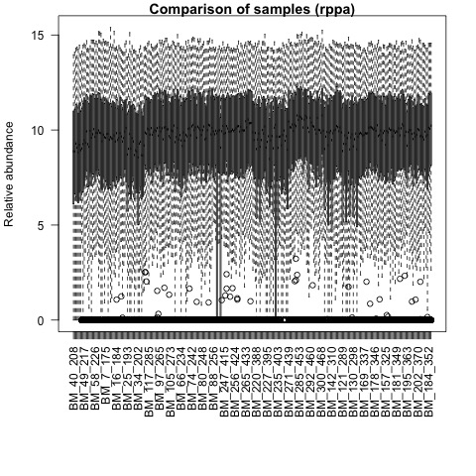
QA plots: rppa

Slide 5
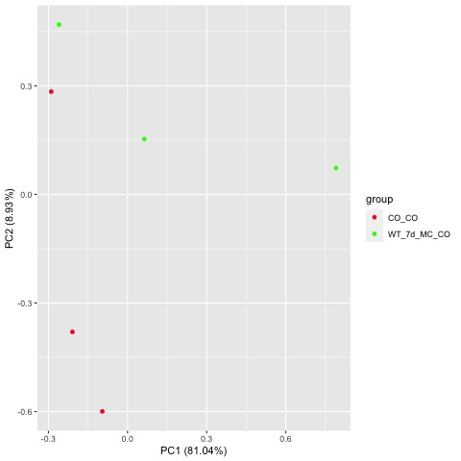
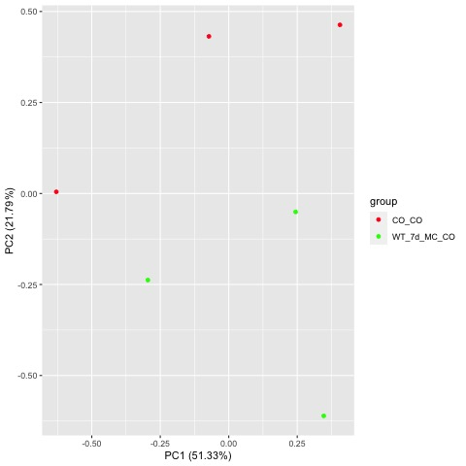
Comparison WT_7d_MC_CO_over_CO_CO
Raw PCA
Normalized PCA

Slide 6
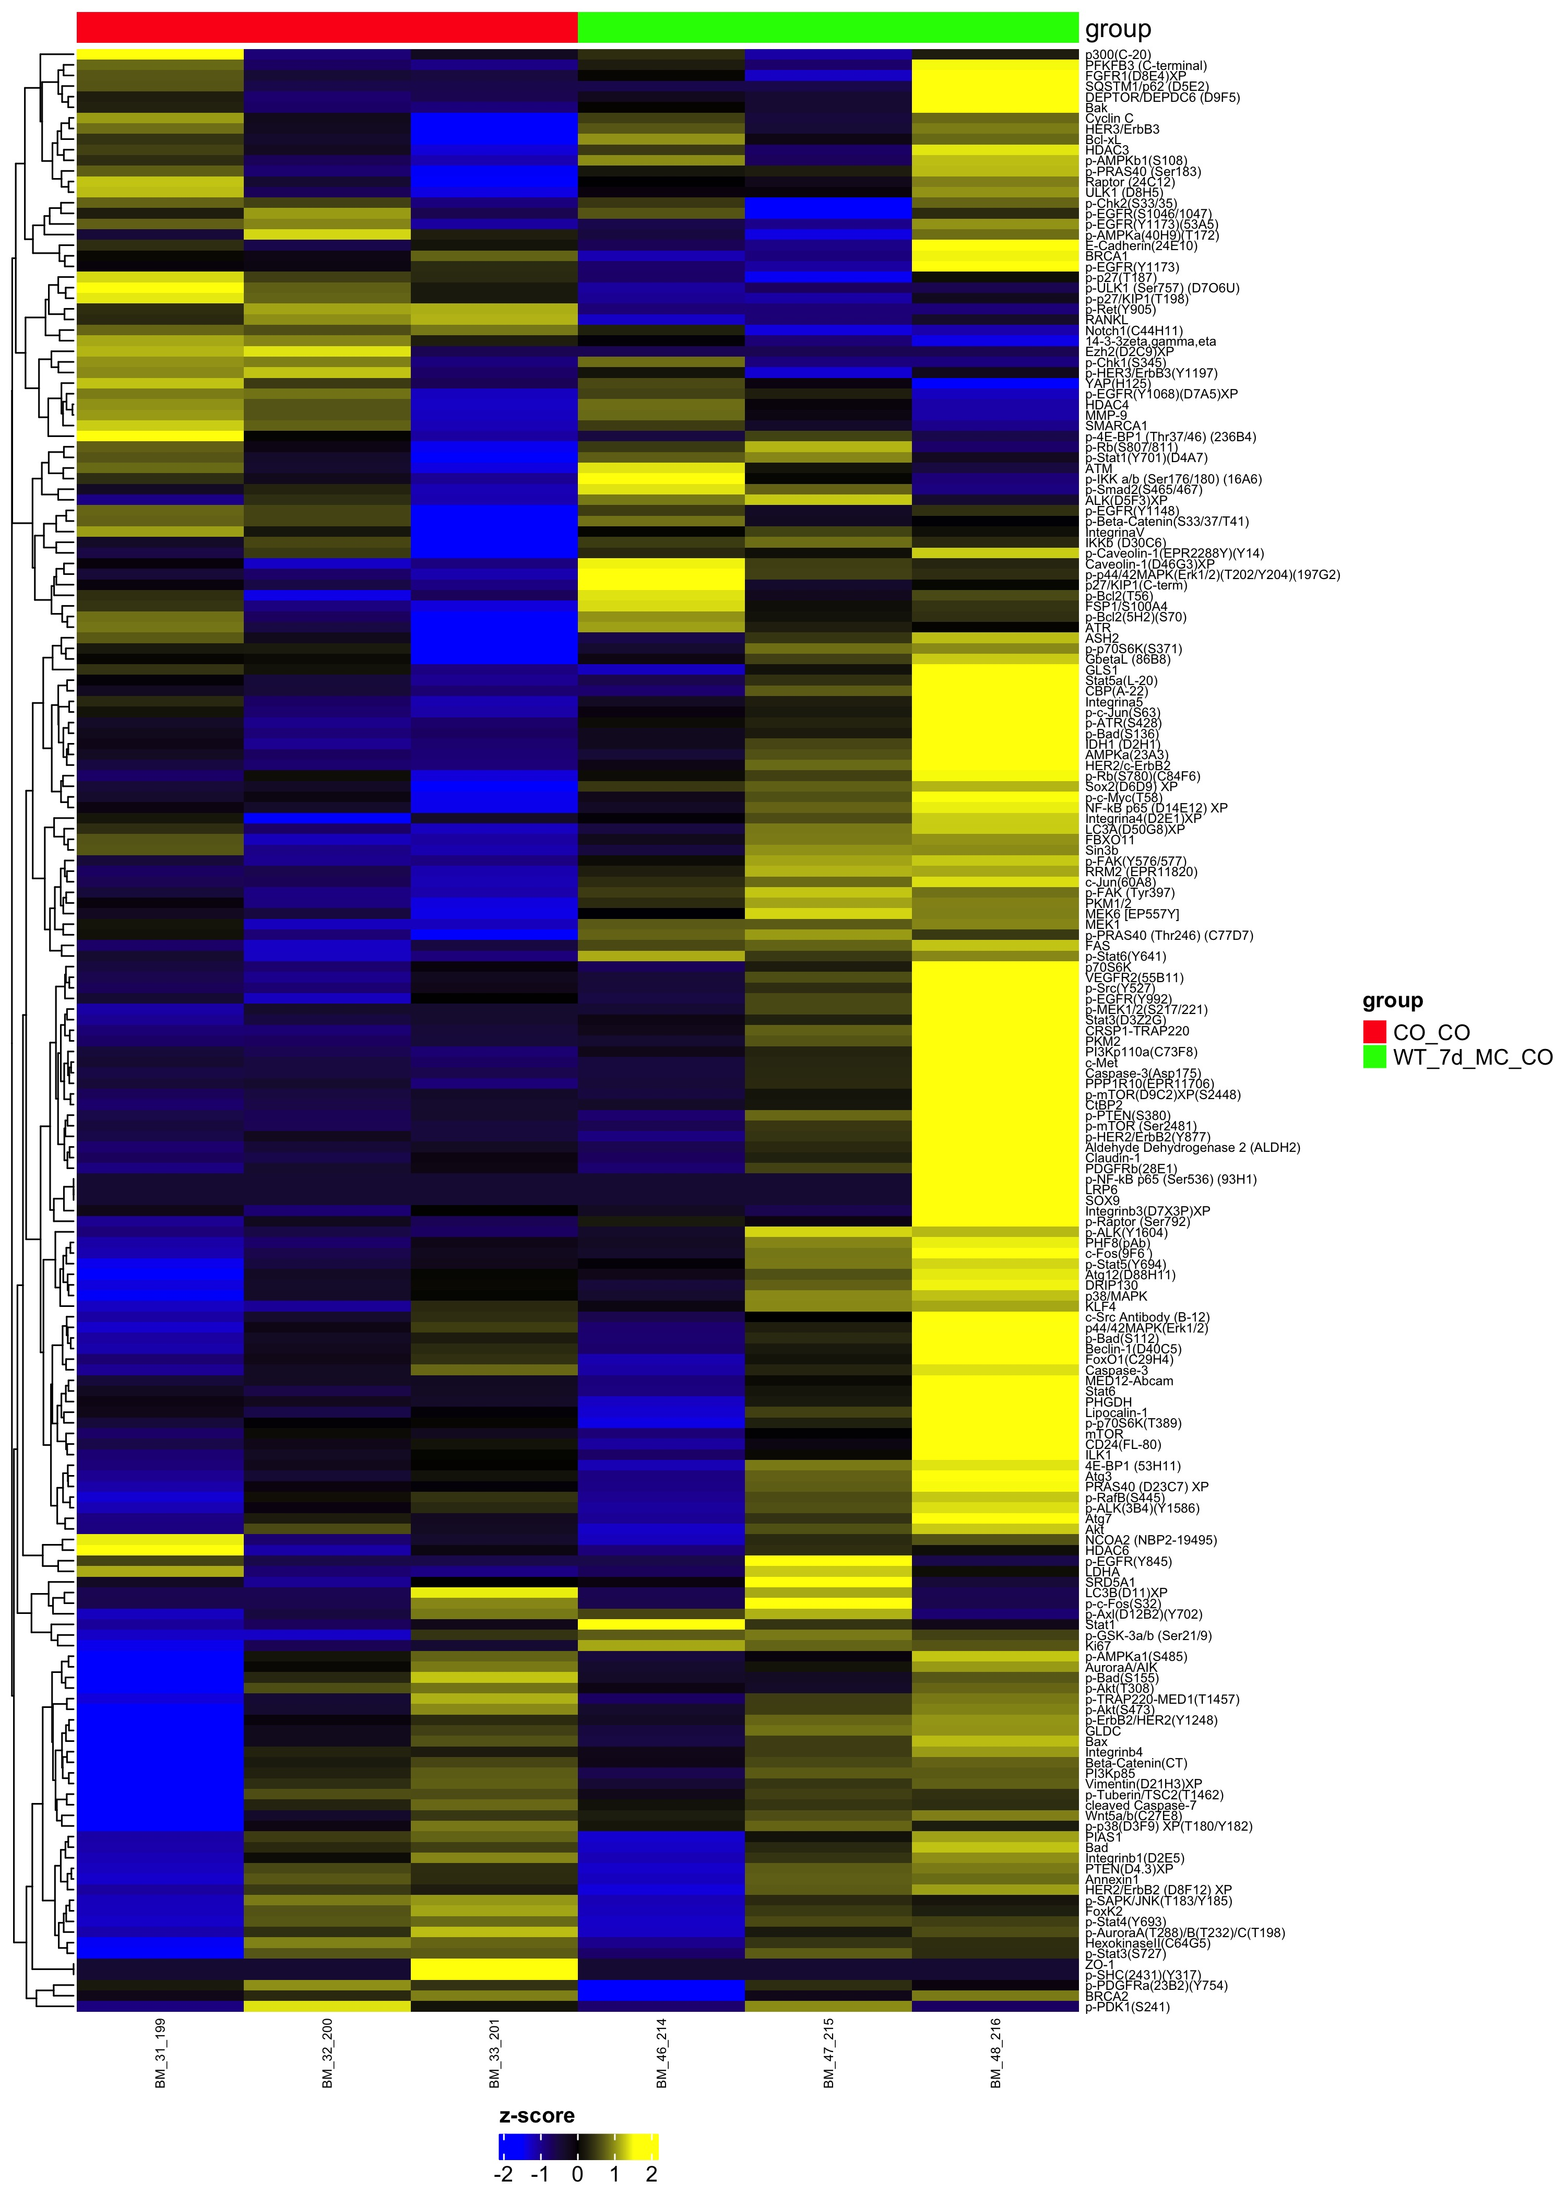
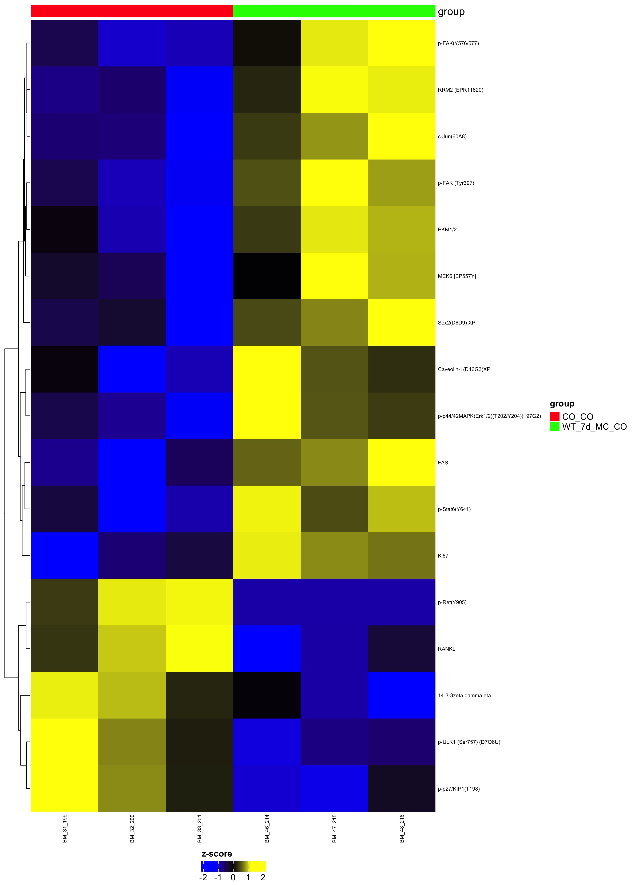
Comparison WT_7d_MC_CO_over_CO_CO
Complete Set pval=1
Differential pval<0.05

