Slide 1
Project Report
Metabolomics Analysis [IQR]

Slide 2
Project Overview
Samples
39 experimental samples
3 quality control samples
Total of 23 features from 1 methods
AminoAcids was normalized by IQR
Comparisons performed
t-test (2 tailed, assuming unequal variance)
HFD-Dam_over_RD-Dam
MaleMHFD_over_MaleMRD
FemMHFD_over_FemMRD
anova (analysis of variance)
RDDam_HFDDam_MaleMRD_MaleMHFD_FemMRD_FemMHFD

Slide 3
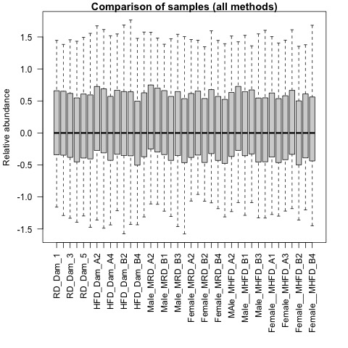
QA plots: all_samples

Slide 4

QA plots: AminoAcids

Slide 5
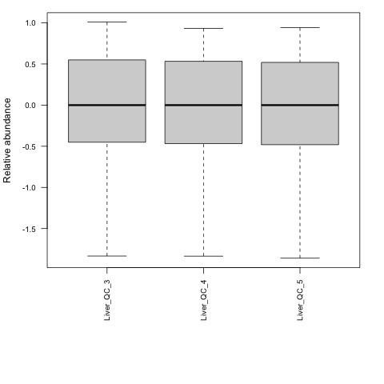
Quality Control: AminoAcids

Slide 6
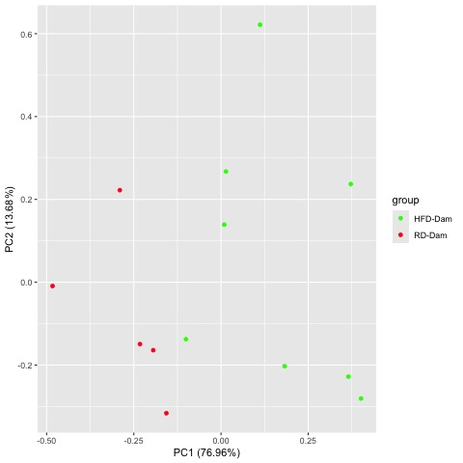
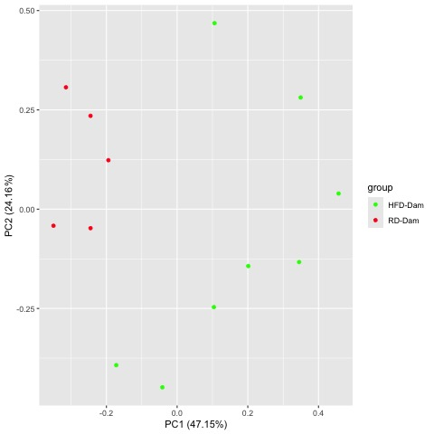
Comparison HFD-Dam_over_RD-Dam
Raw PCA
Normalized PCA

Slide 7
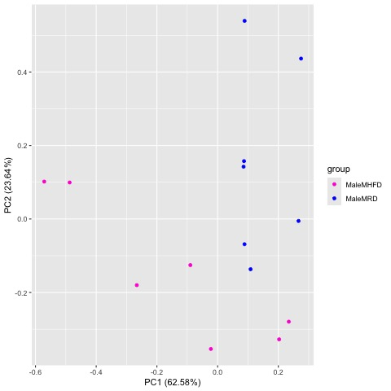
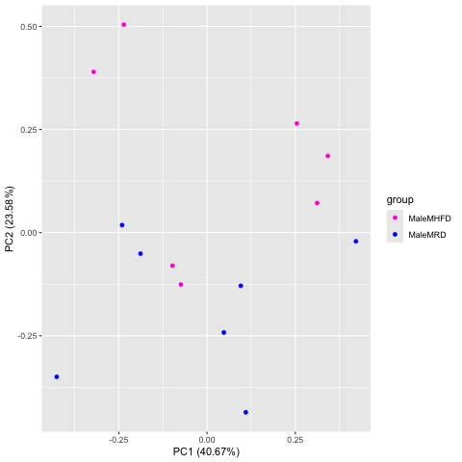
Comparison MaleMHFD_over_MaleMRD
Raw PCA
Normalized PCA

Slide 8
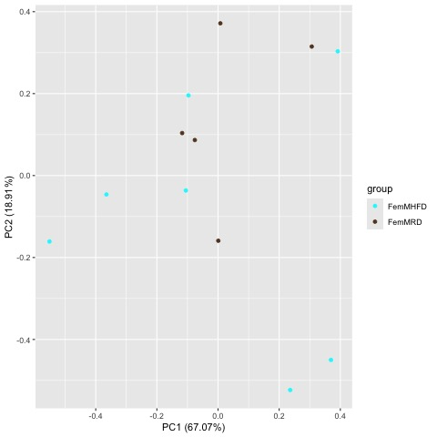
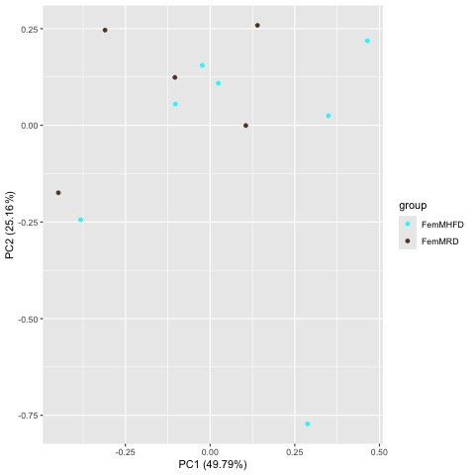
Comparison FemMHFD_over_FemMRD
Raw PCA
Normalized PCA

Slide 9
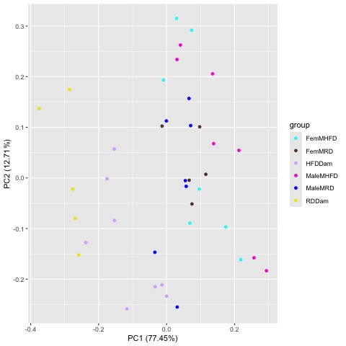
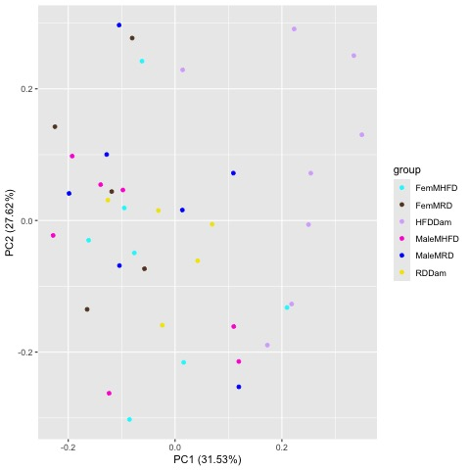
Comparison RDDam_HFDDam_MaleMRD_MaleMHFD_FemMRD_FemMHFD
Raw PCA
Normalized PCA

Slide 10
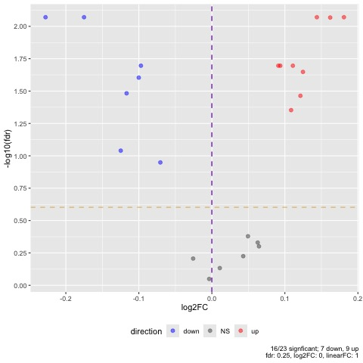
Comparison HFD-Dam_over_RD-Dam

Slide 11
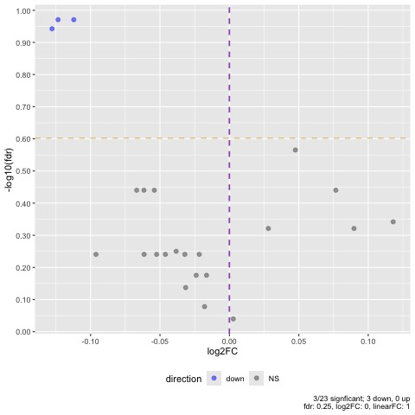
Comparison MaleMHFD_over_MaleMRD

Slide 12
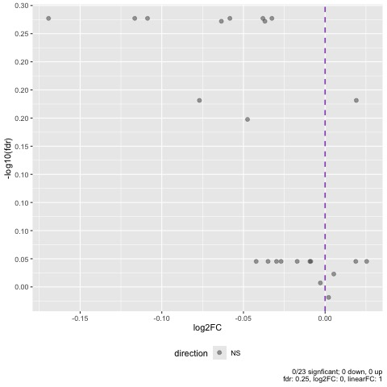
Comparison FemMHFD_over_FemMRD

Slide 13
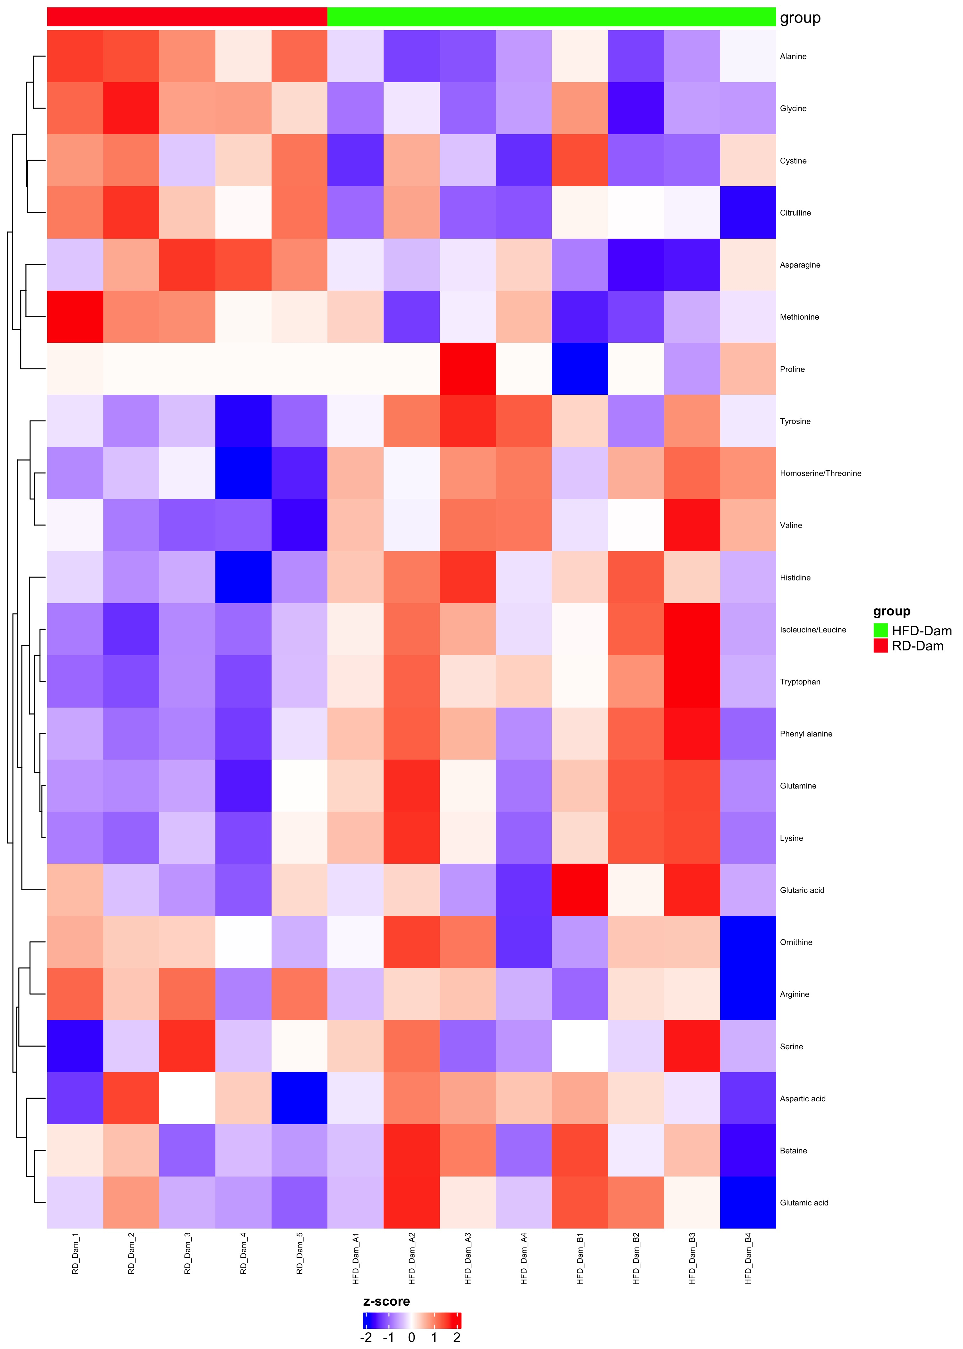
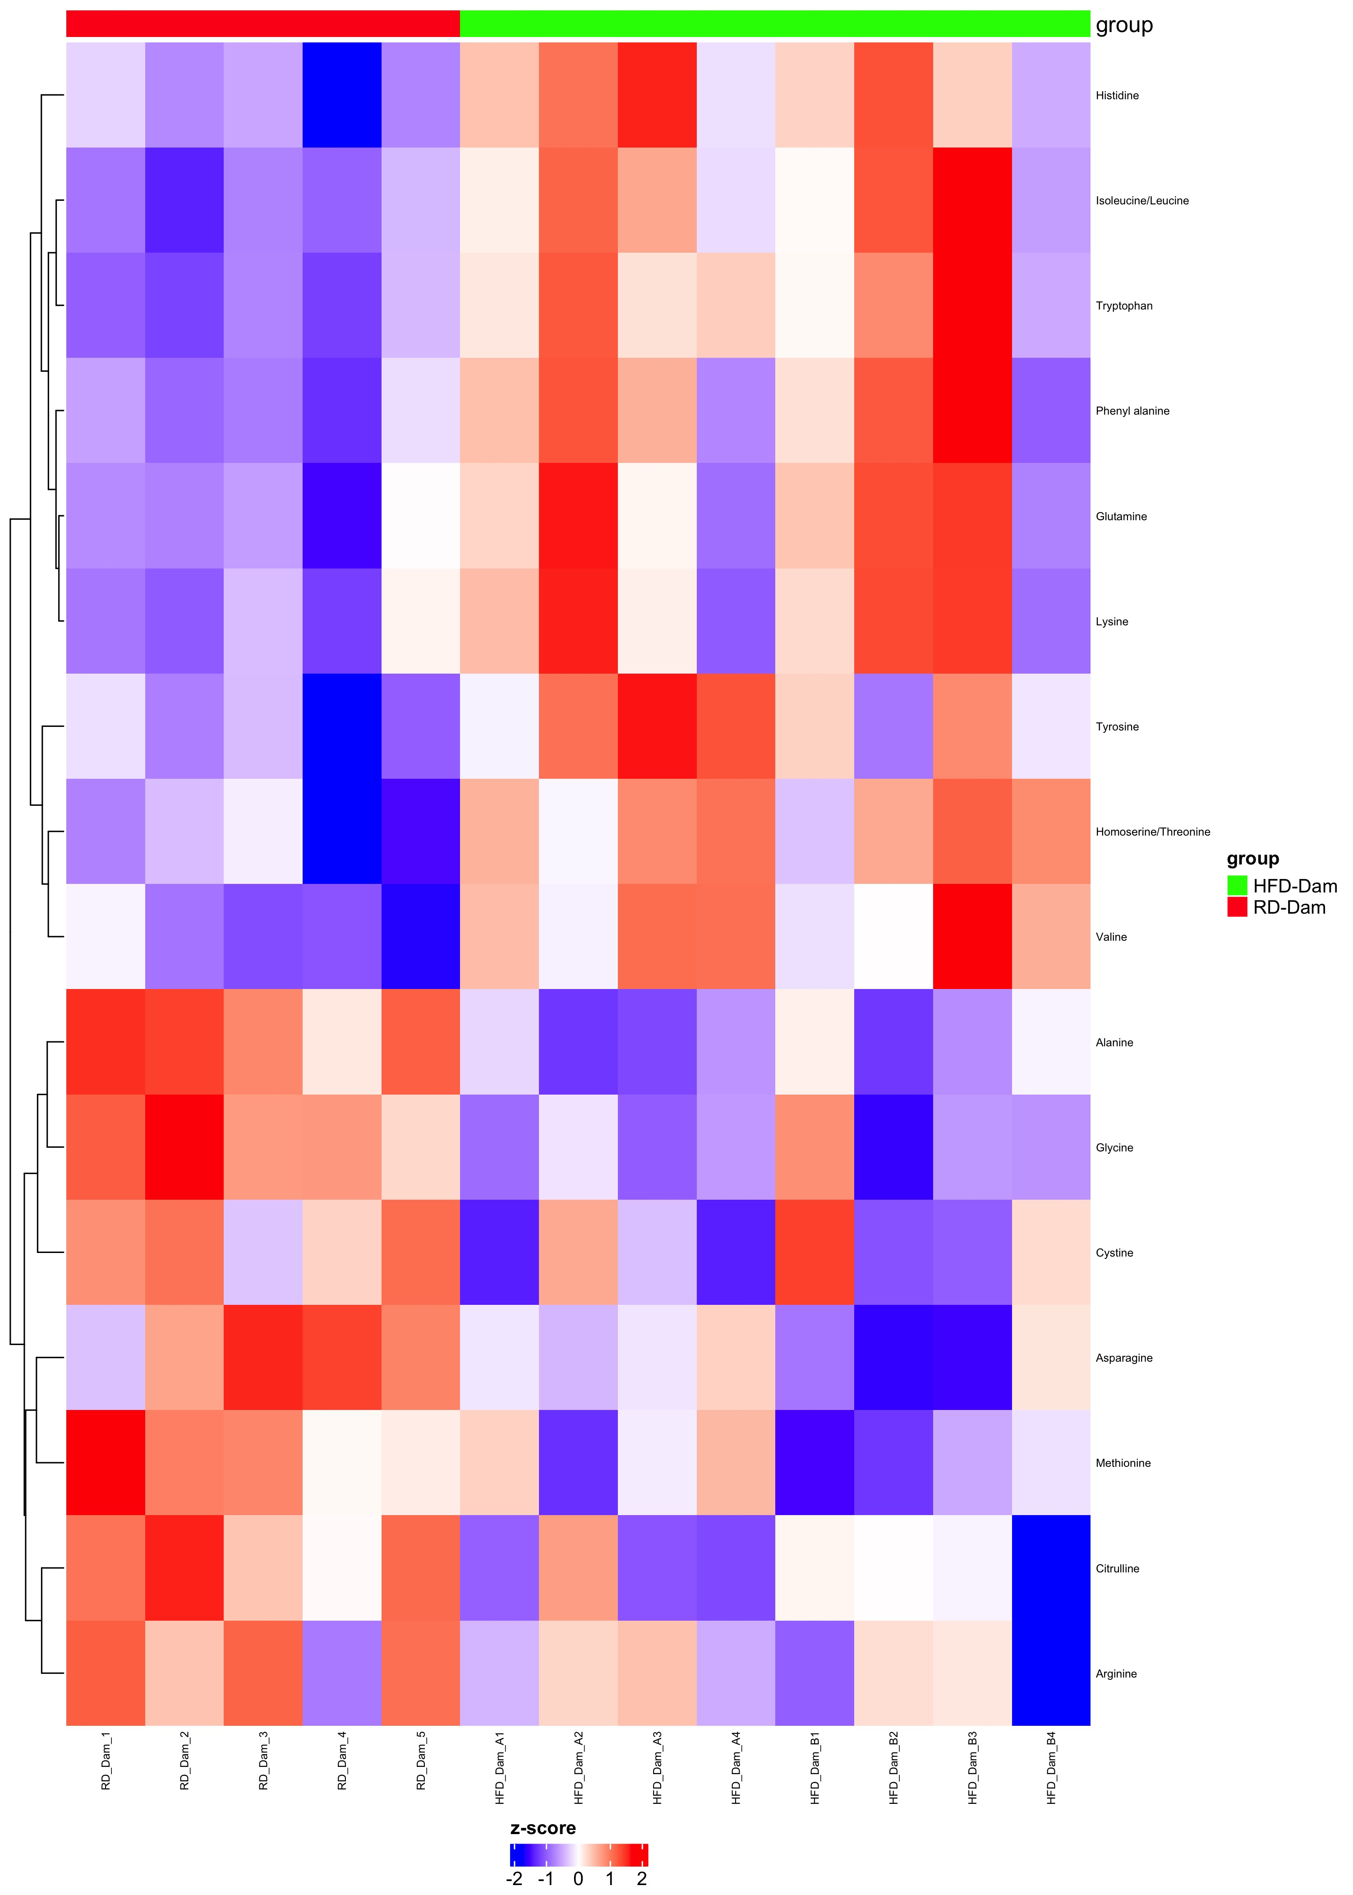
Comparison HFD-Dam_over_RD-Dam
Complete Set fdr=1
Differential fdr<0.25

Slide 14
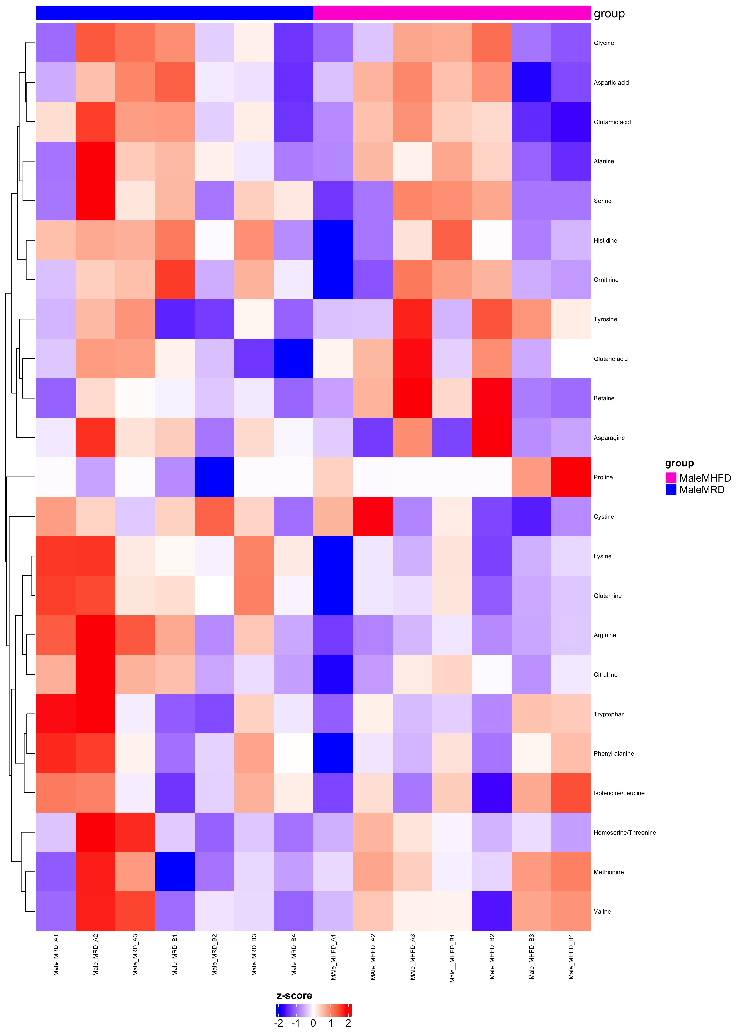
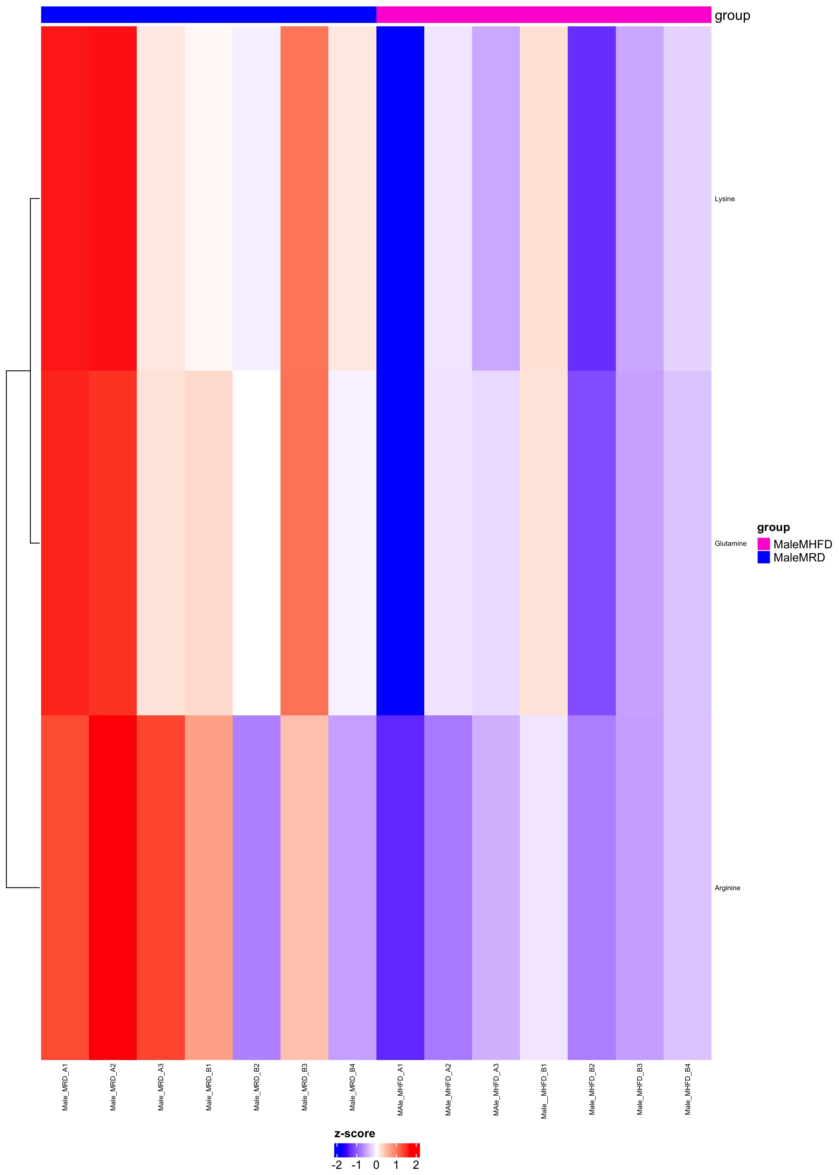
Comparison MaleMHFD_over_MaleMRD
Complete Set fdr=1
Differential fdr<0.25

Slide 15
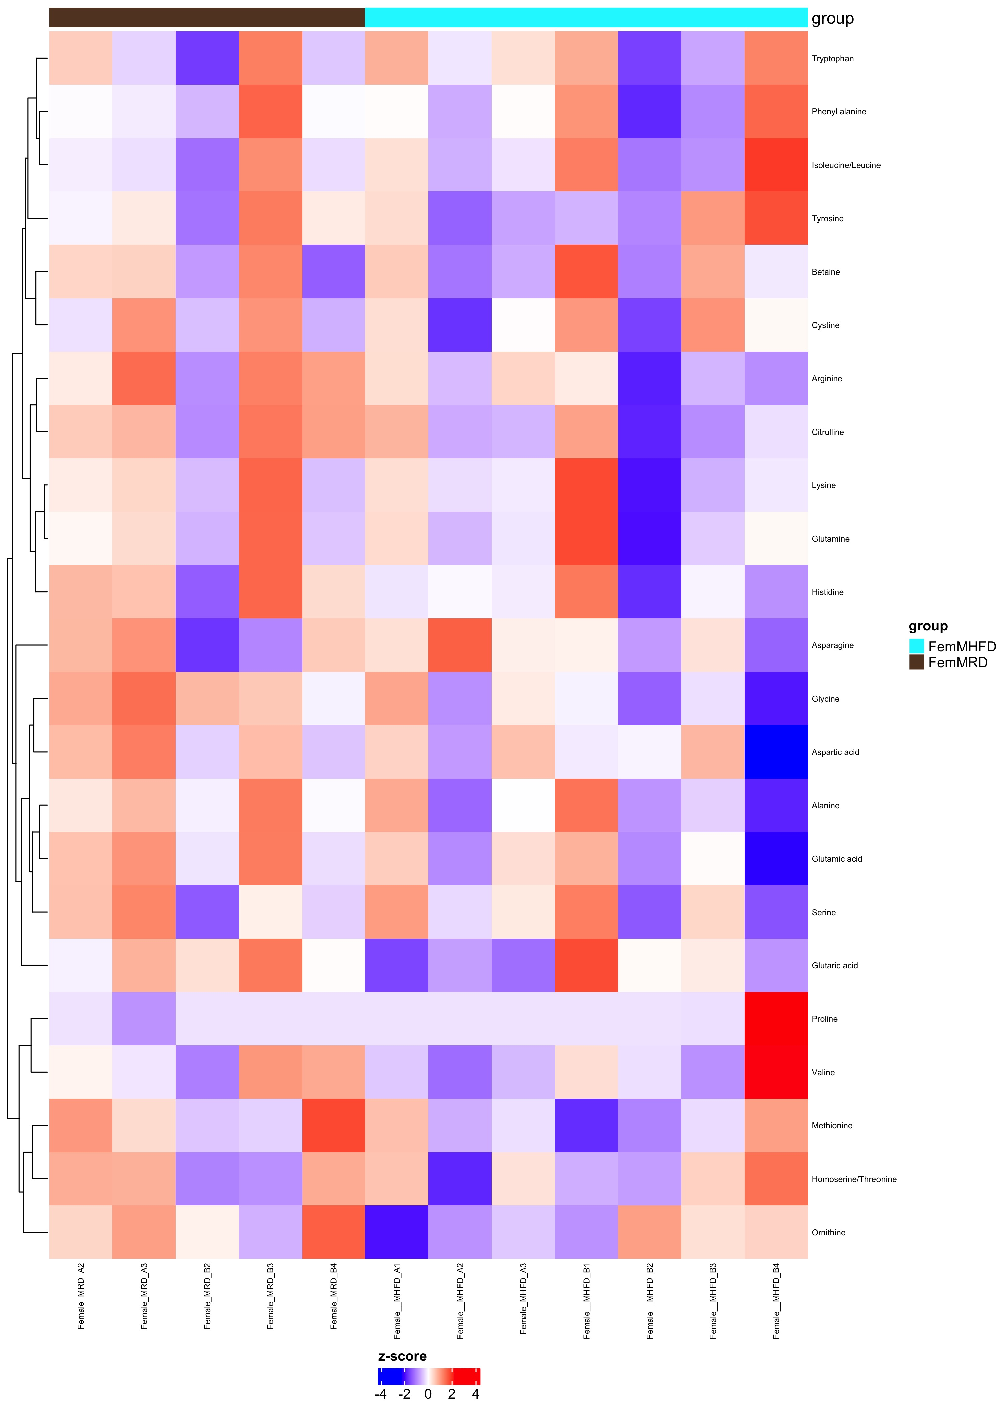
Comparison FemMHFD_over_FemMRD
Complete Set fdr=1
Differential fdr<0.25

Slide 16
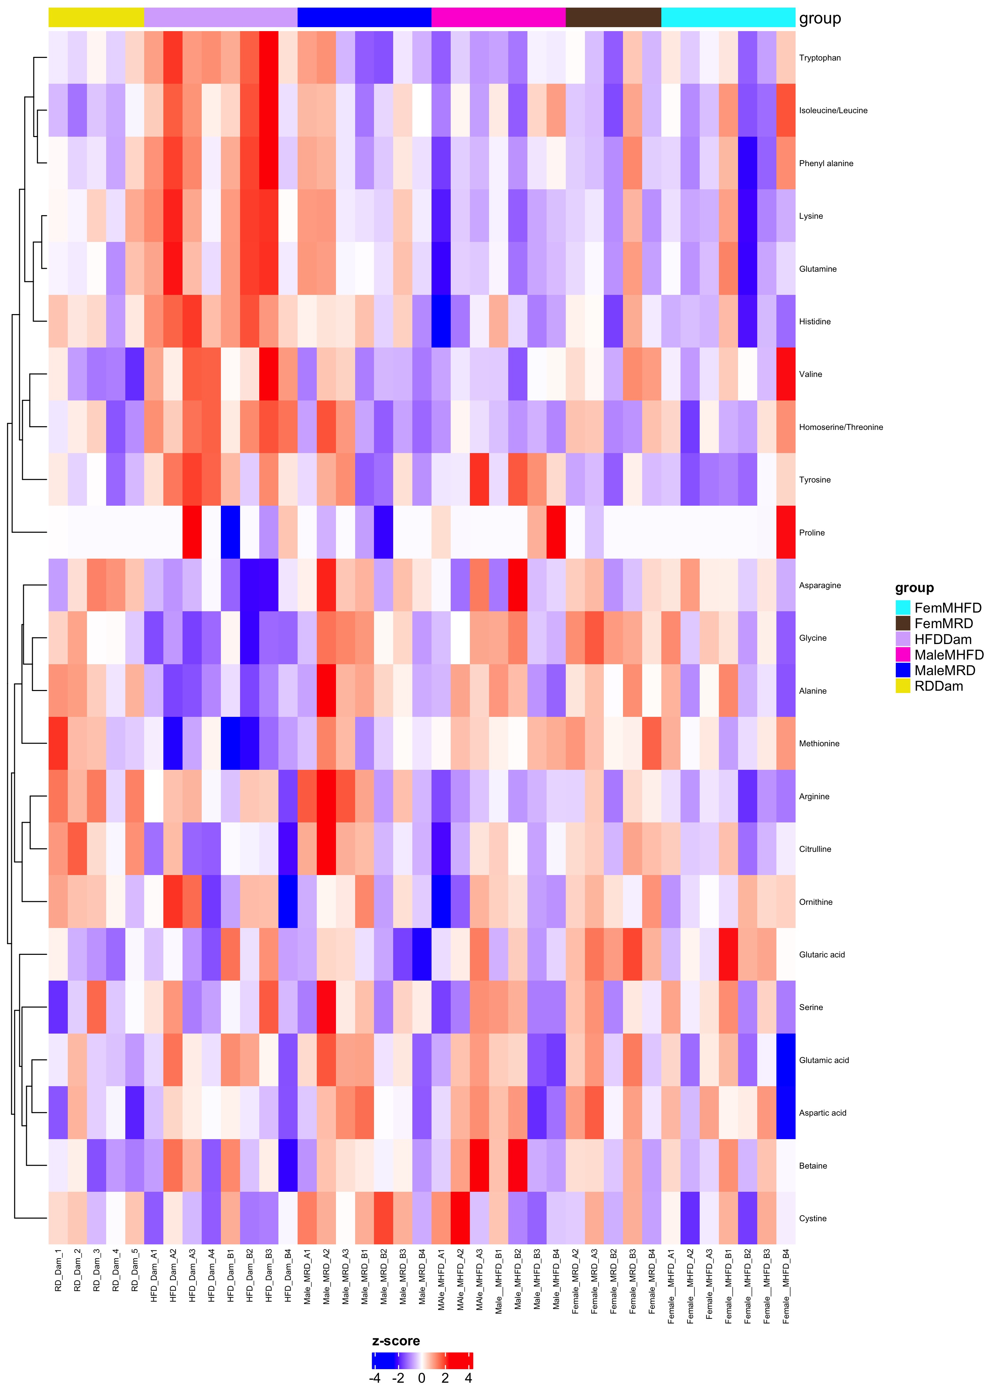
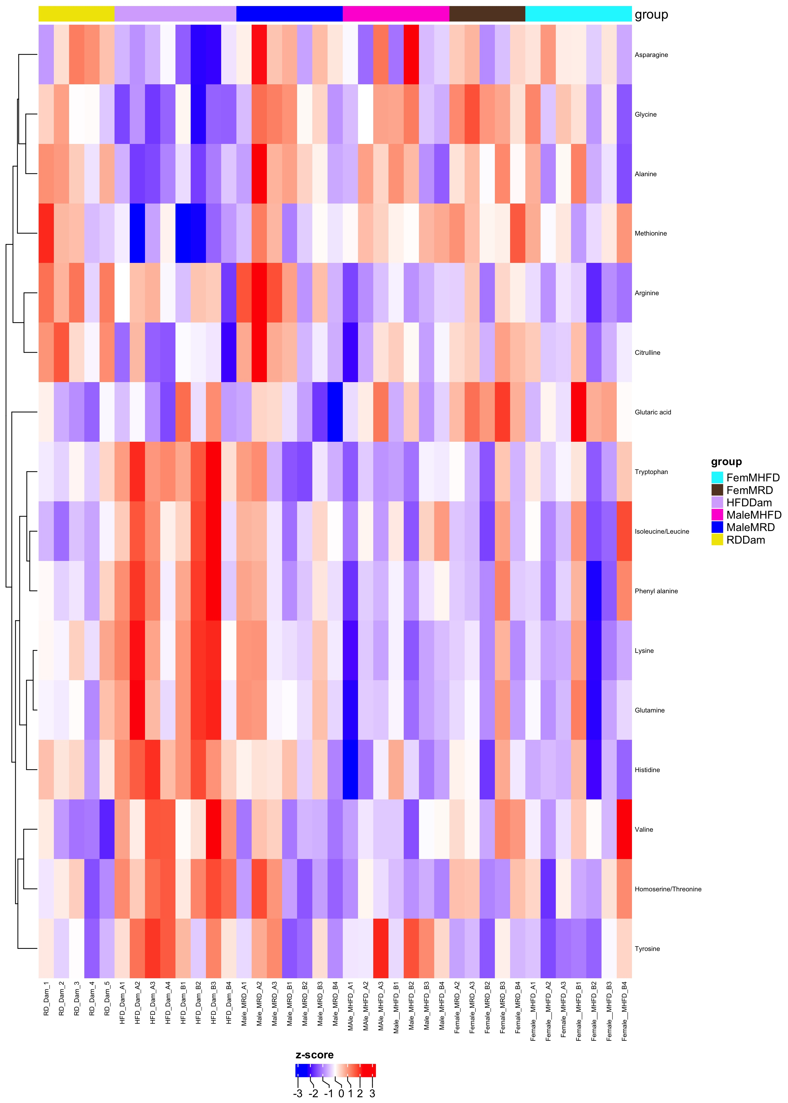
Comparison RDDam_HFDDam_MaleMRD_MaleMHFD_FemMRD_FemMHFD
Complete Set fdr=1
Differential fdr<0.25

