Slide 1
Project Report
RPPA Analysis

Slide 2
Project Overview
Samples
300 experimental samples
Total of 208 features from 1 methods
Data was prenormalized and transformed to log2 space
Comparisons performed
t-test (2 tailed, assuming unequal variance)
WT_7d_MC_CO_over_CO_CO

Slide 3
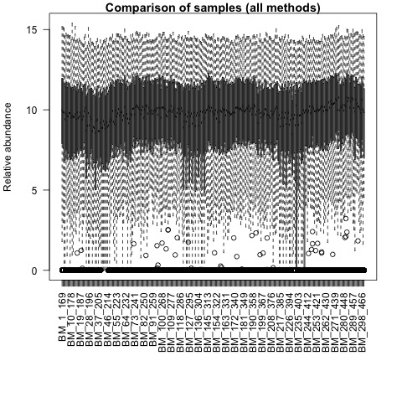
QA plots: all_samples

Slide 4
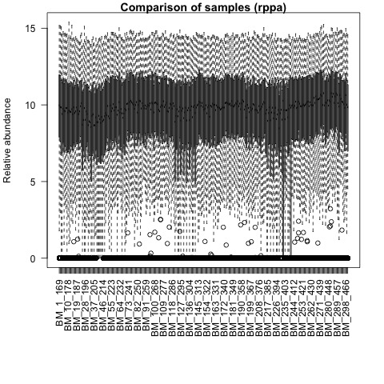
QA plots: rppa

Slide 5
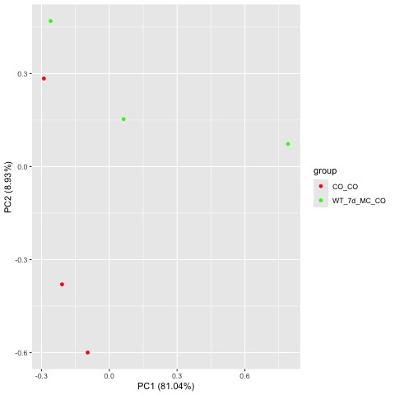
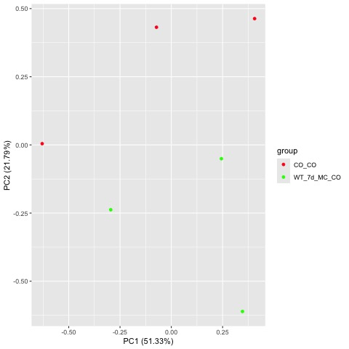
Comparison WT_7d_MC_CO_over_CO_CO
Prenormalized PCA
Log2 Transformed PCA

Slide 6
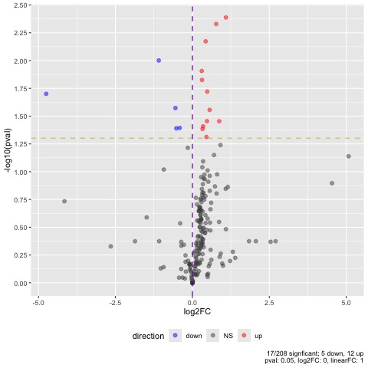
Comparison WT_7d_MC_CO_over_CO_CO

Slide 7
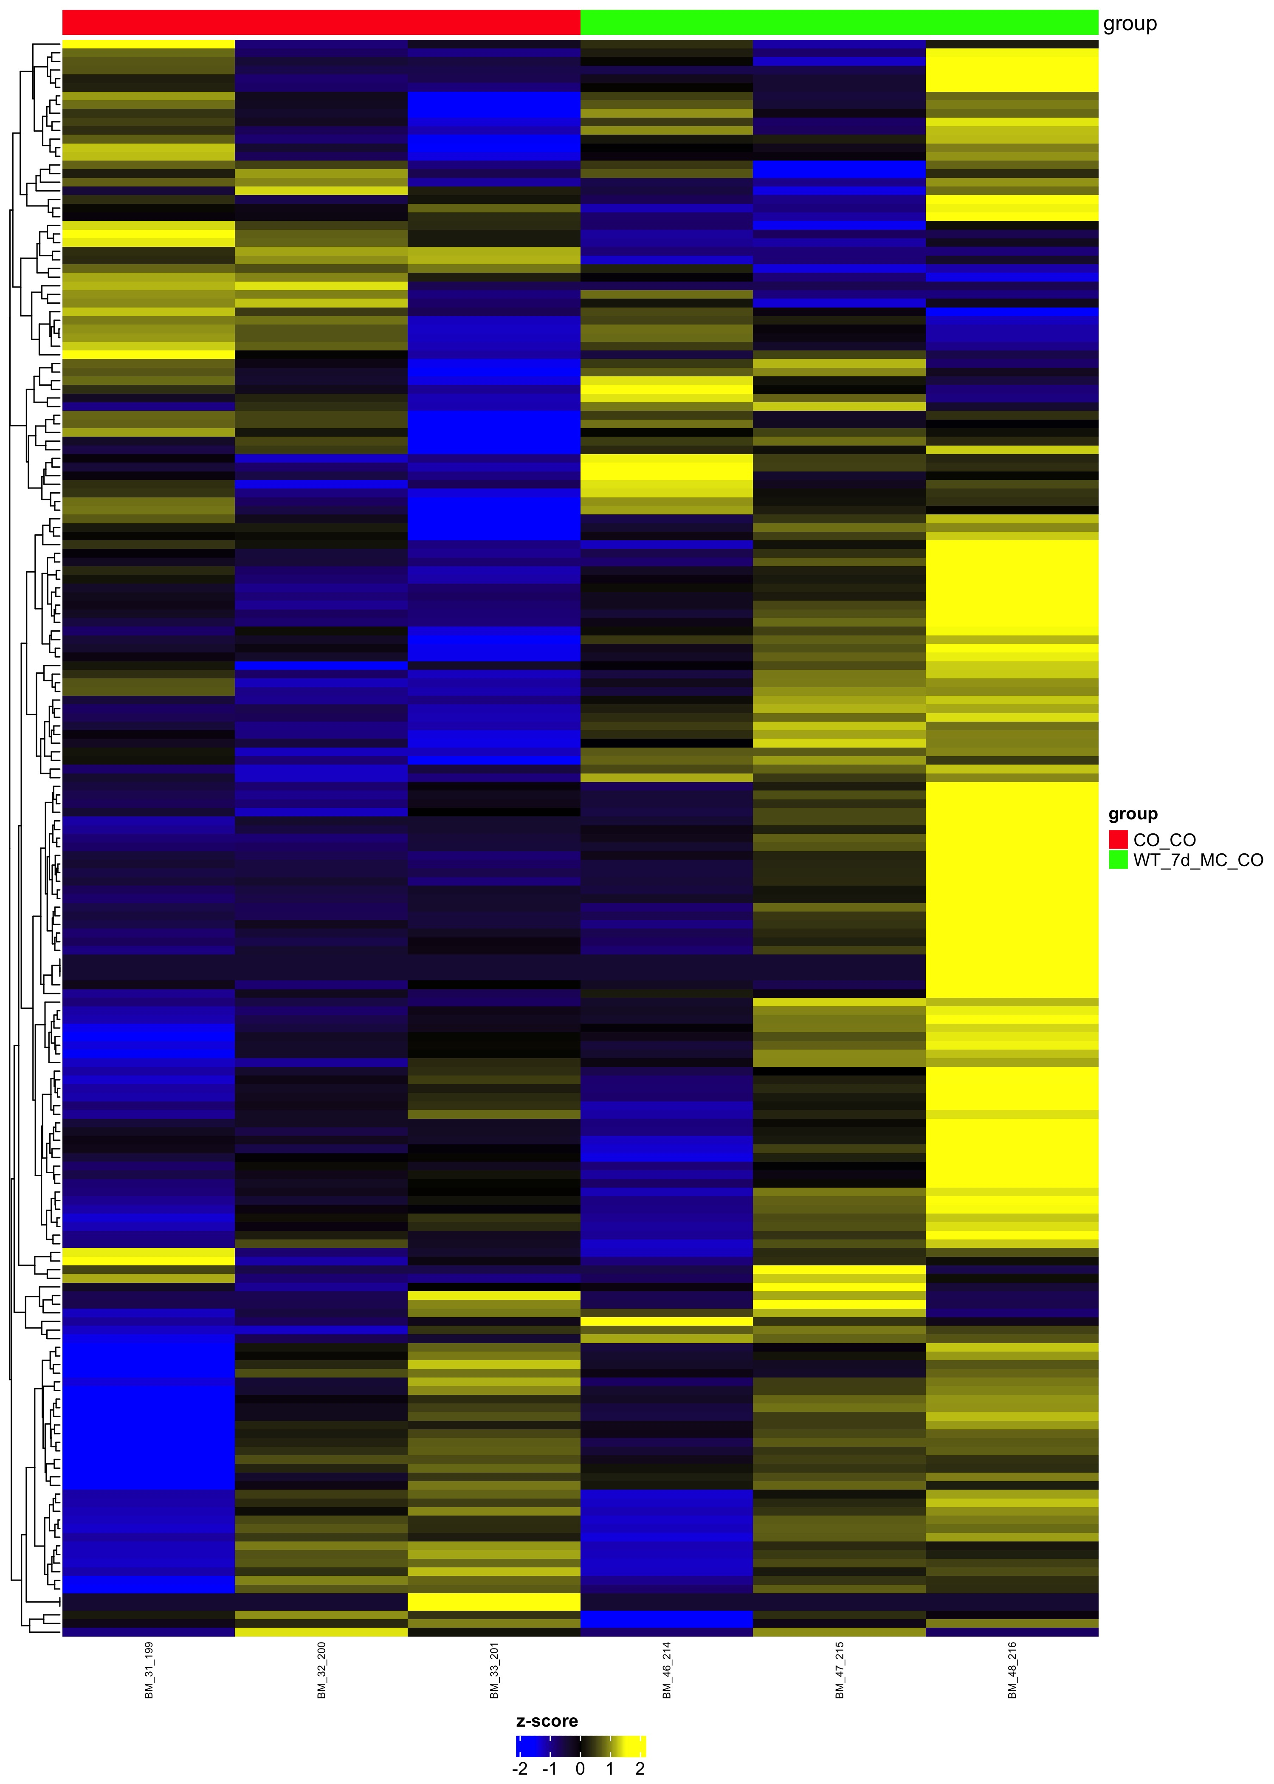
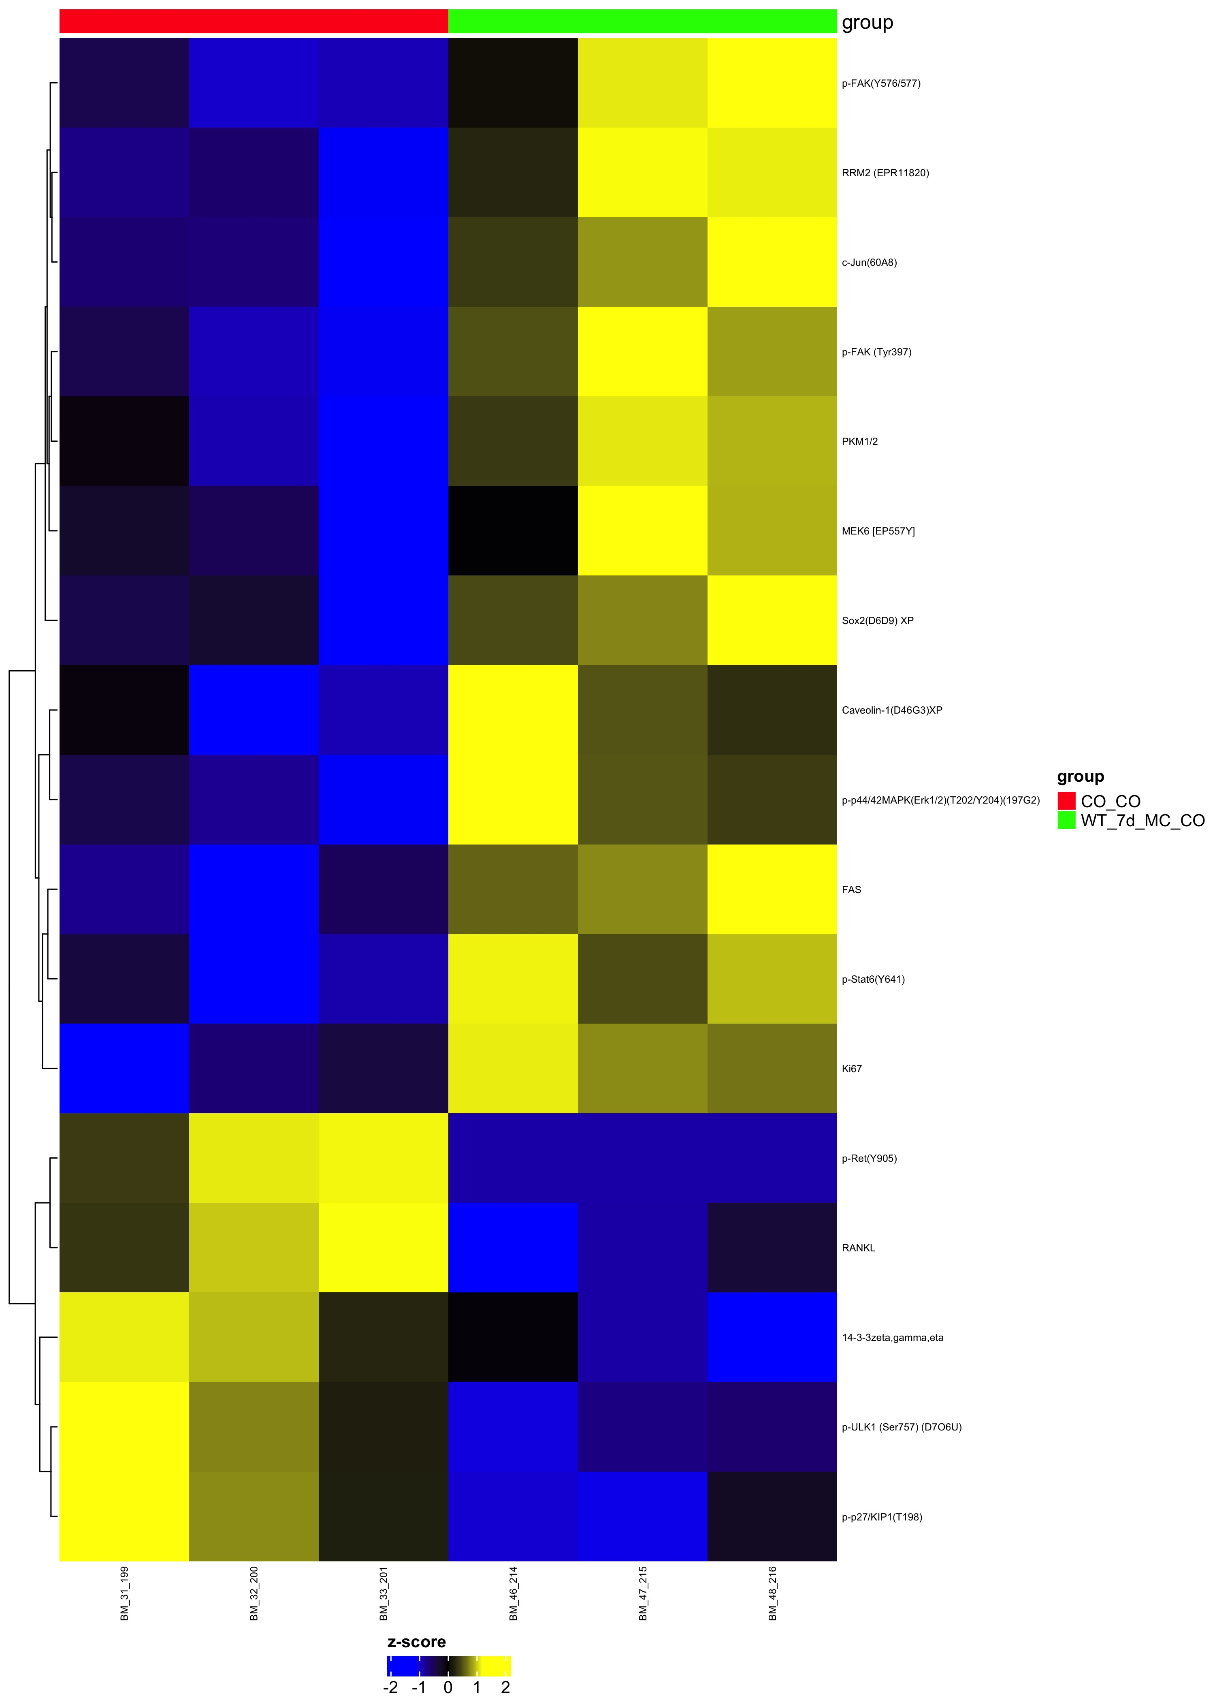
Comparison WT_7d_MC_CO_over_CO_CO
Complete Set pval=1
Differential pval<0.05

