Slide 1
Project Report
Example w/ Transposed Data

Slide 2
Project Overview
Samples
39 experimental samples
Total of 23 features from 1 methods
Data was prenormalized
Comparisons performed
t-test (2 tailed, assuming unequal variance)
HFD-Dam_over_RD-Dam
MaleMHFD_over_MaleMRD
FemMHFD_over_FemMRD
anova (analysis of variance)
RDDam_HFDDam_MaleMRD_MaleMHFD_FemMRD_FemMHFD

Slide 3
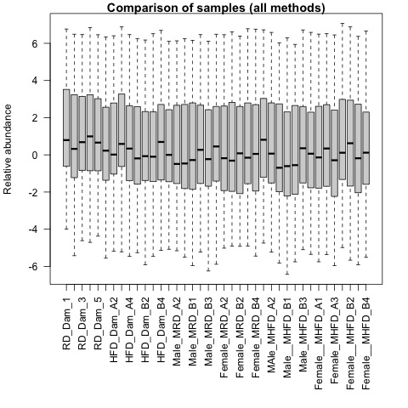
QA plots: all_samples

Slide 4
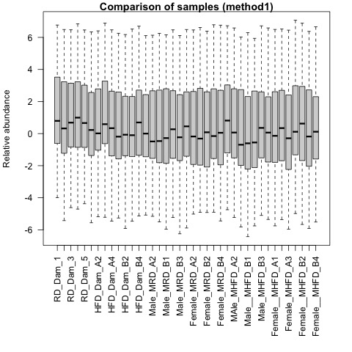
QA plots: method1

Slide 5
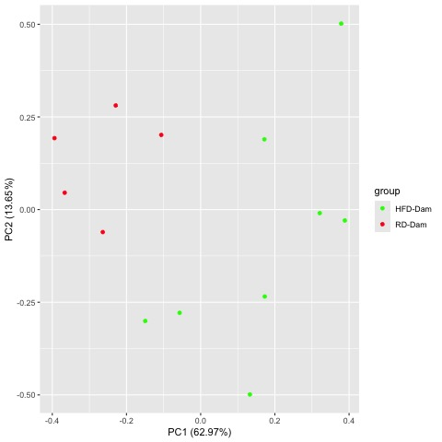
Comparison HFD-Dam_over_RD-Dam
Prenormalized PCA
Prenormalized PCA

Slide 6
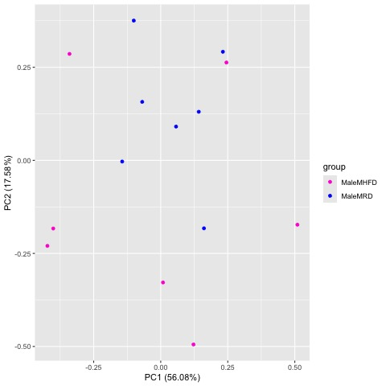
Comparison MaleMHFD_over_MaleMRD
Prenormalized PCA
Prenormalized PCA

Slide 7
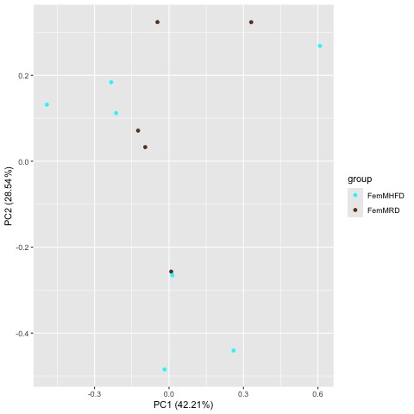
Comparison FemMHFD_over_FemMRD
Prenormalized PCA
Prenormalized PCA

Slide 8
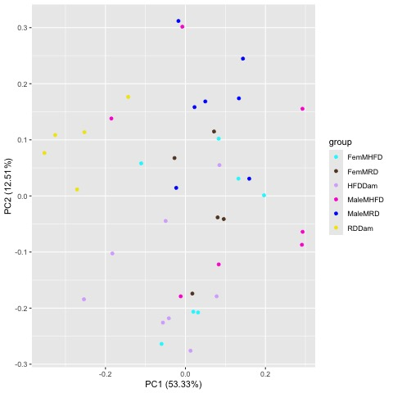
Comparison RDDam_HFDDam_MaleMRD_MaleMHFD_FemMRD_FemMHFD
Prenormalized PCA
Prenormalized PCA

Slide 9
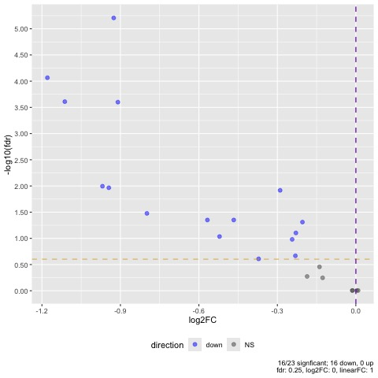
Comparison HFD-Dam_over_RD-Dam

Slide 10
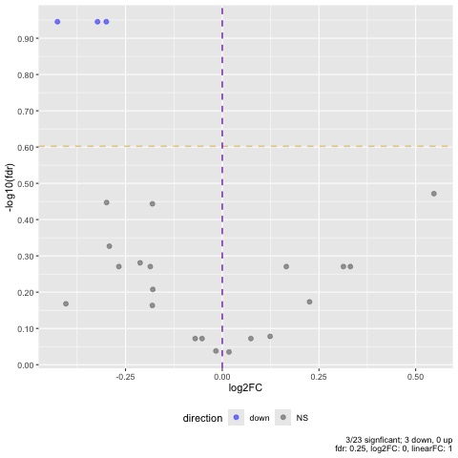
Comparison MaleMHFD_over_MaleMRD

Slide 11
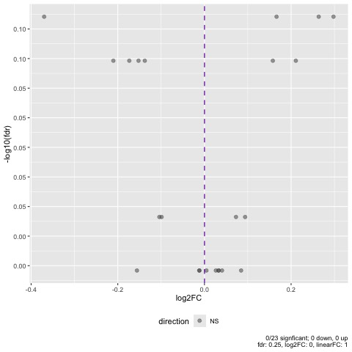
Comparison FemMHFD_over_FemMRD

Slide 12
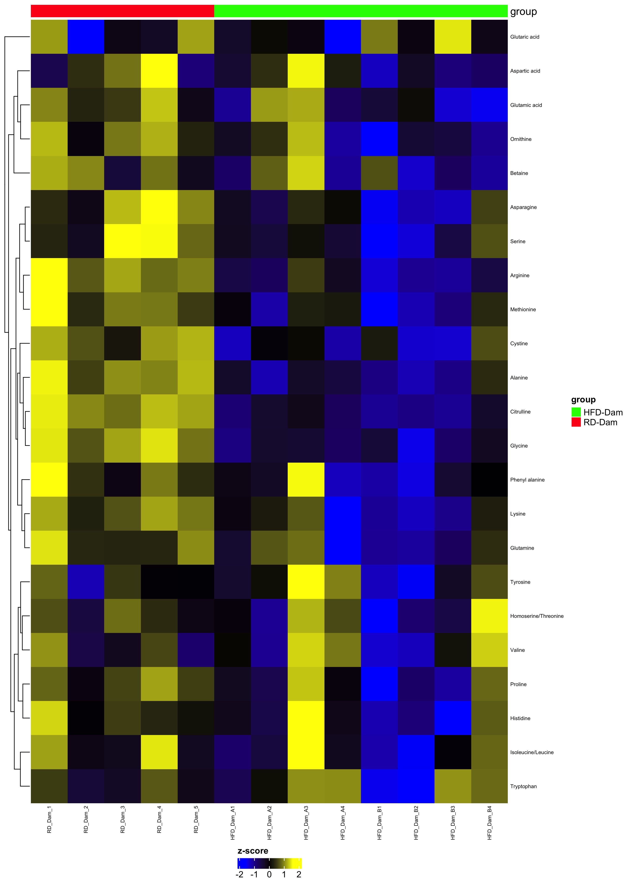
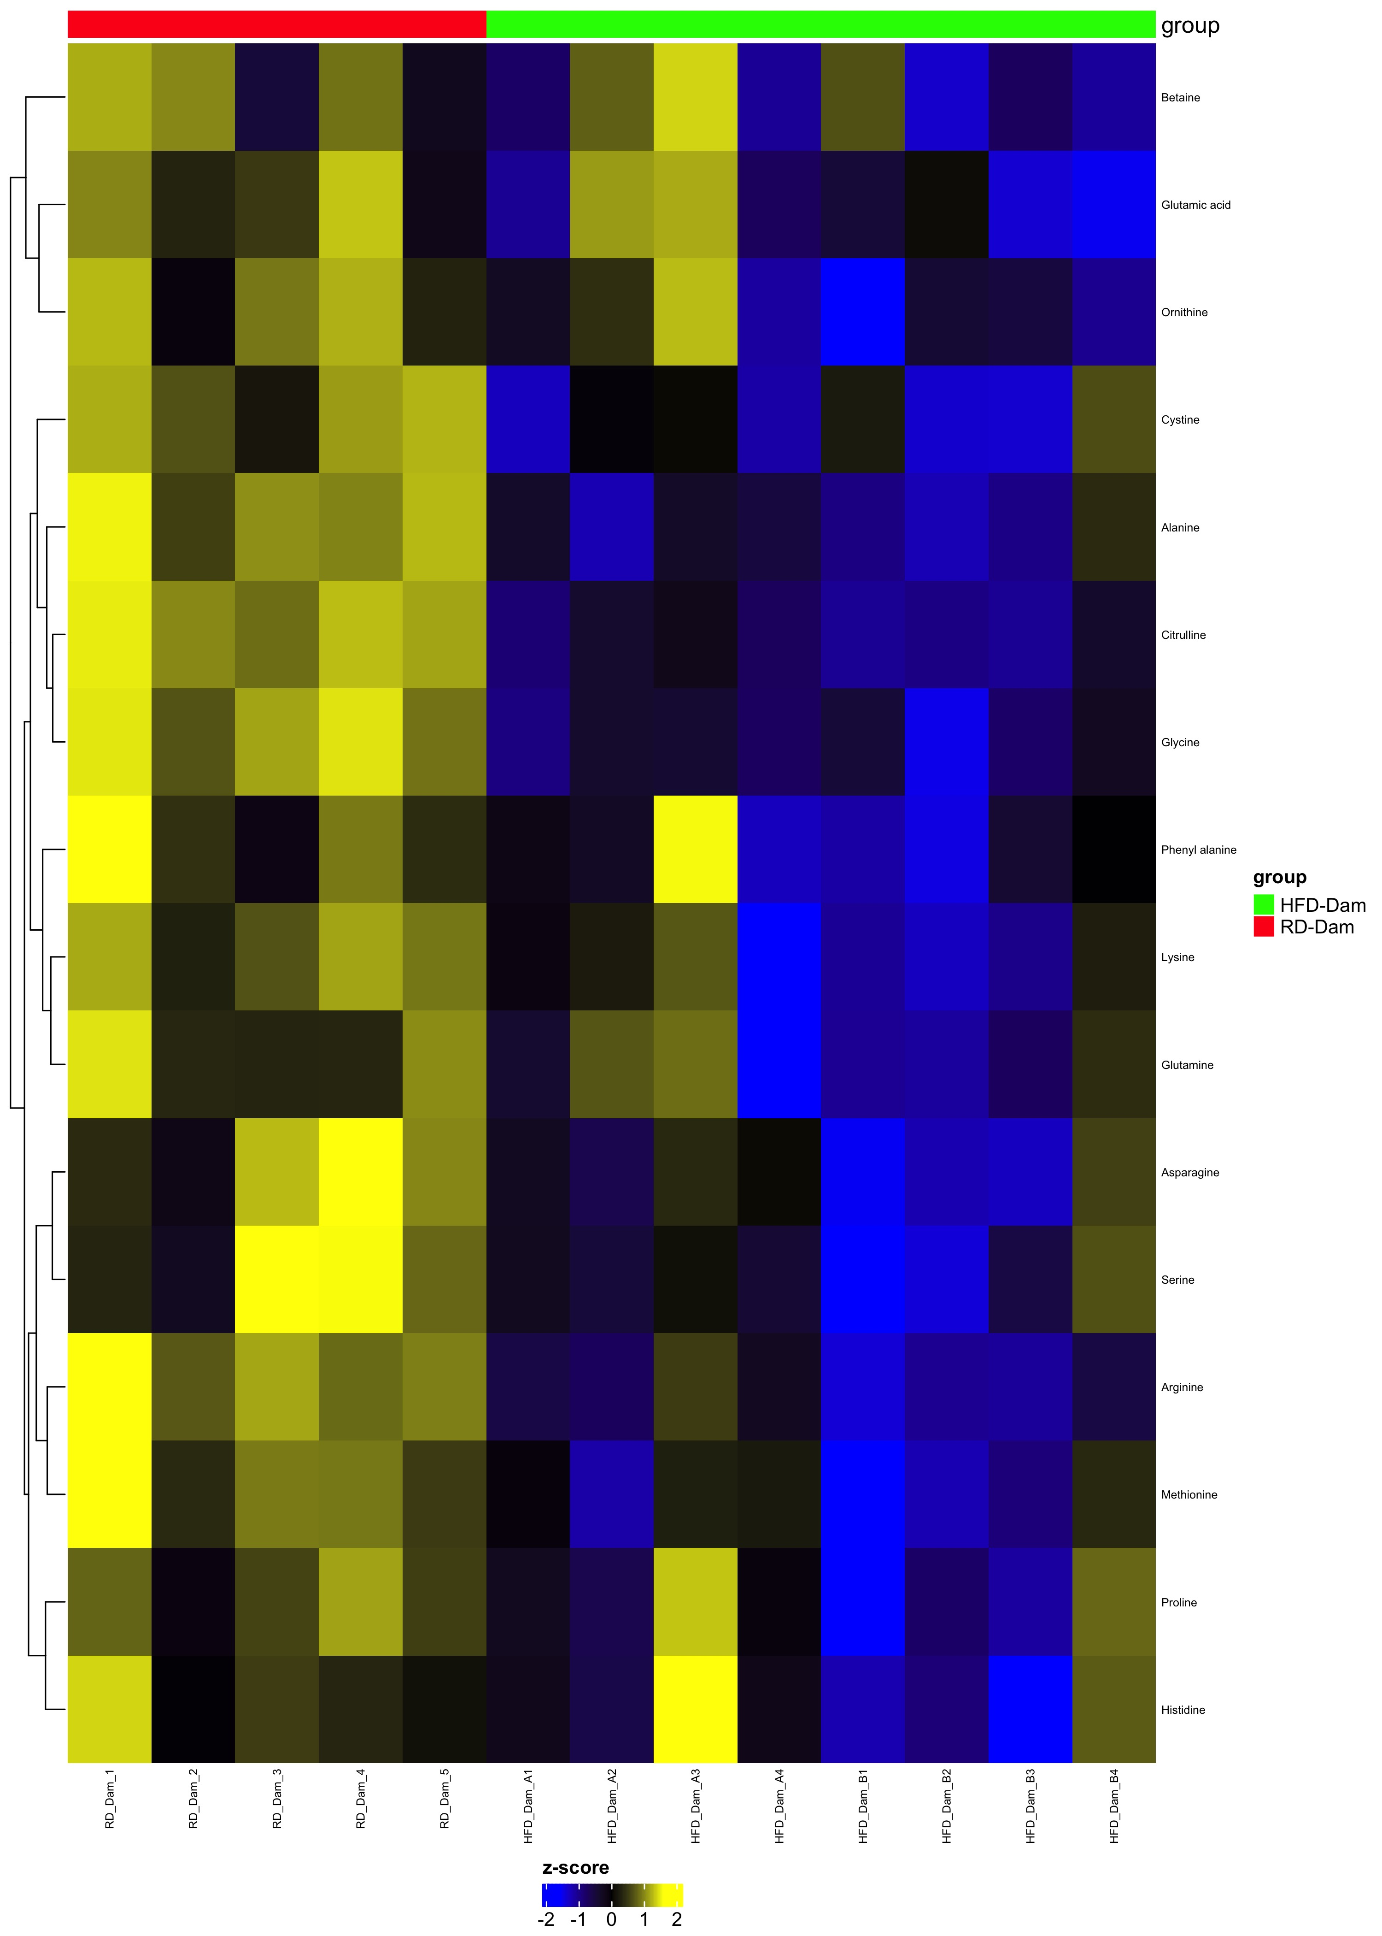
Comparison HFD-Dam_over_RD-Dam
Complete Set fdr=1
Differential fdr<0.25

Slide 13
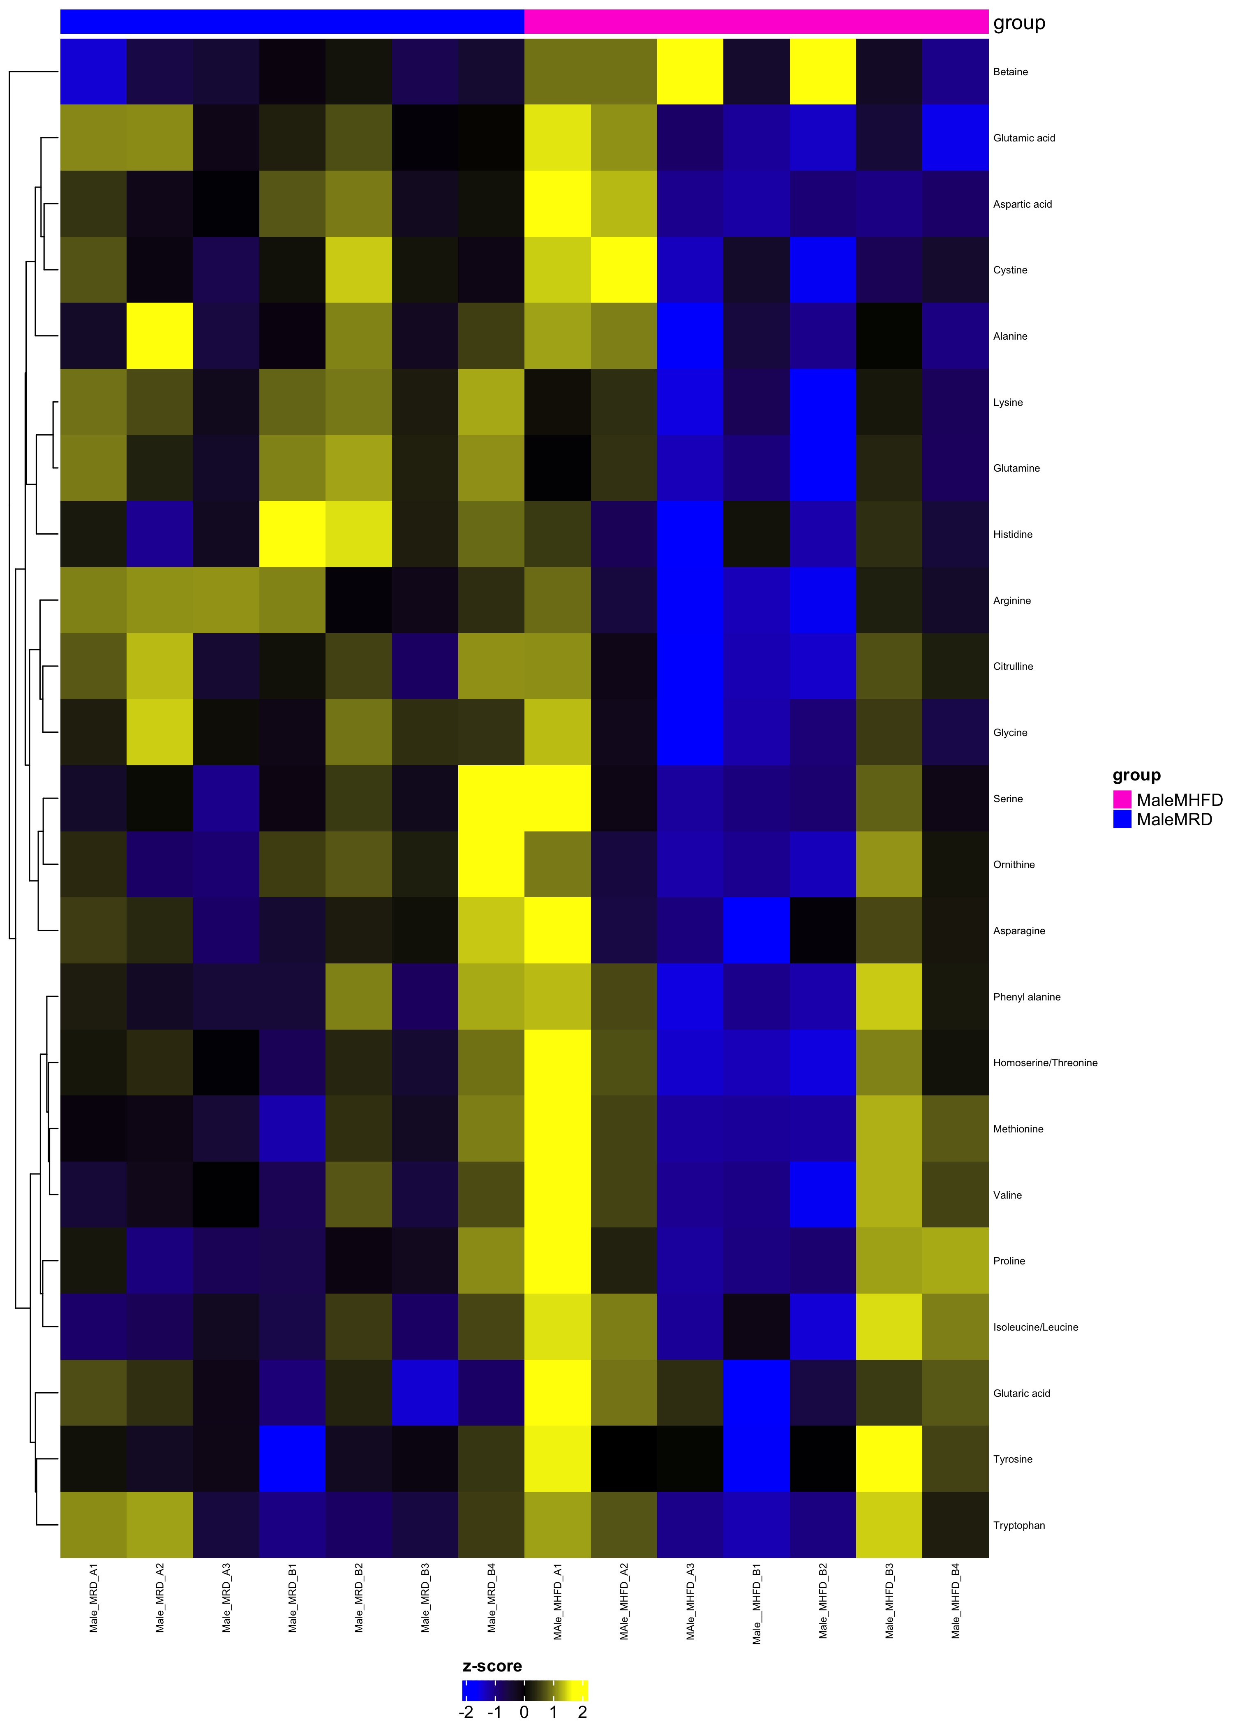
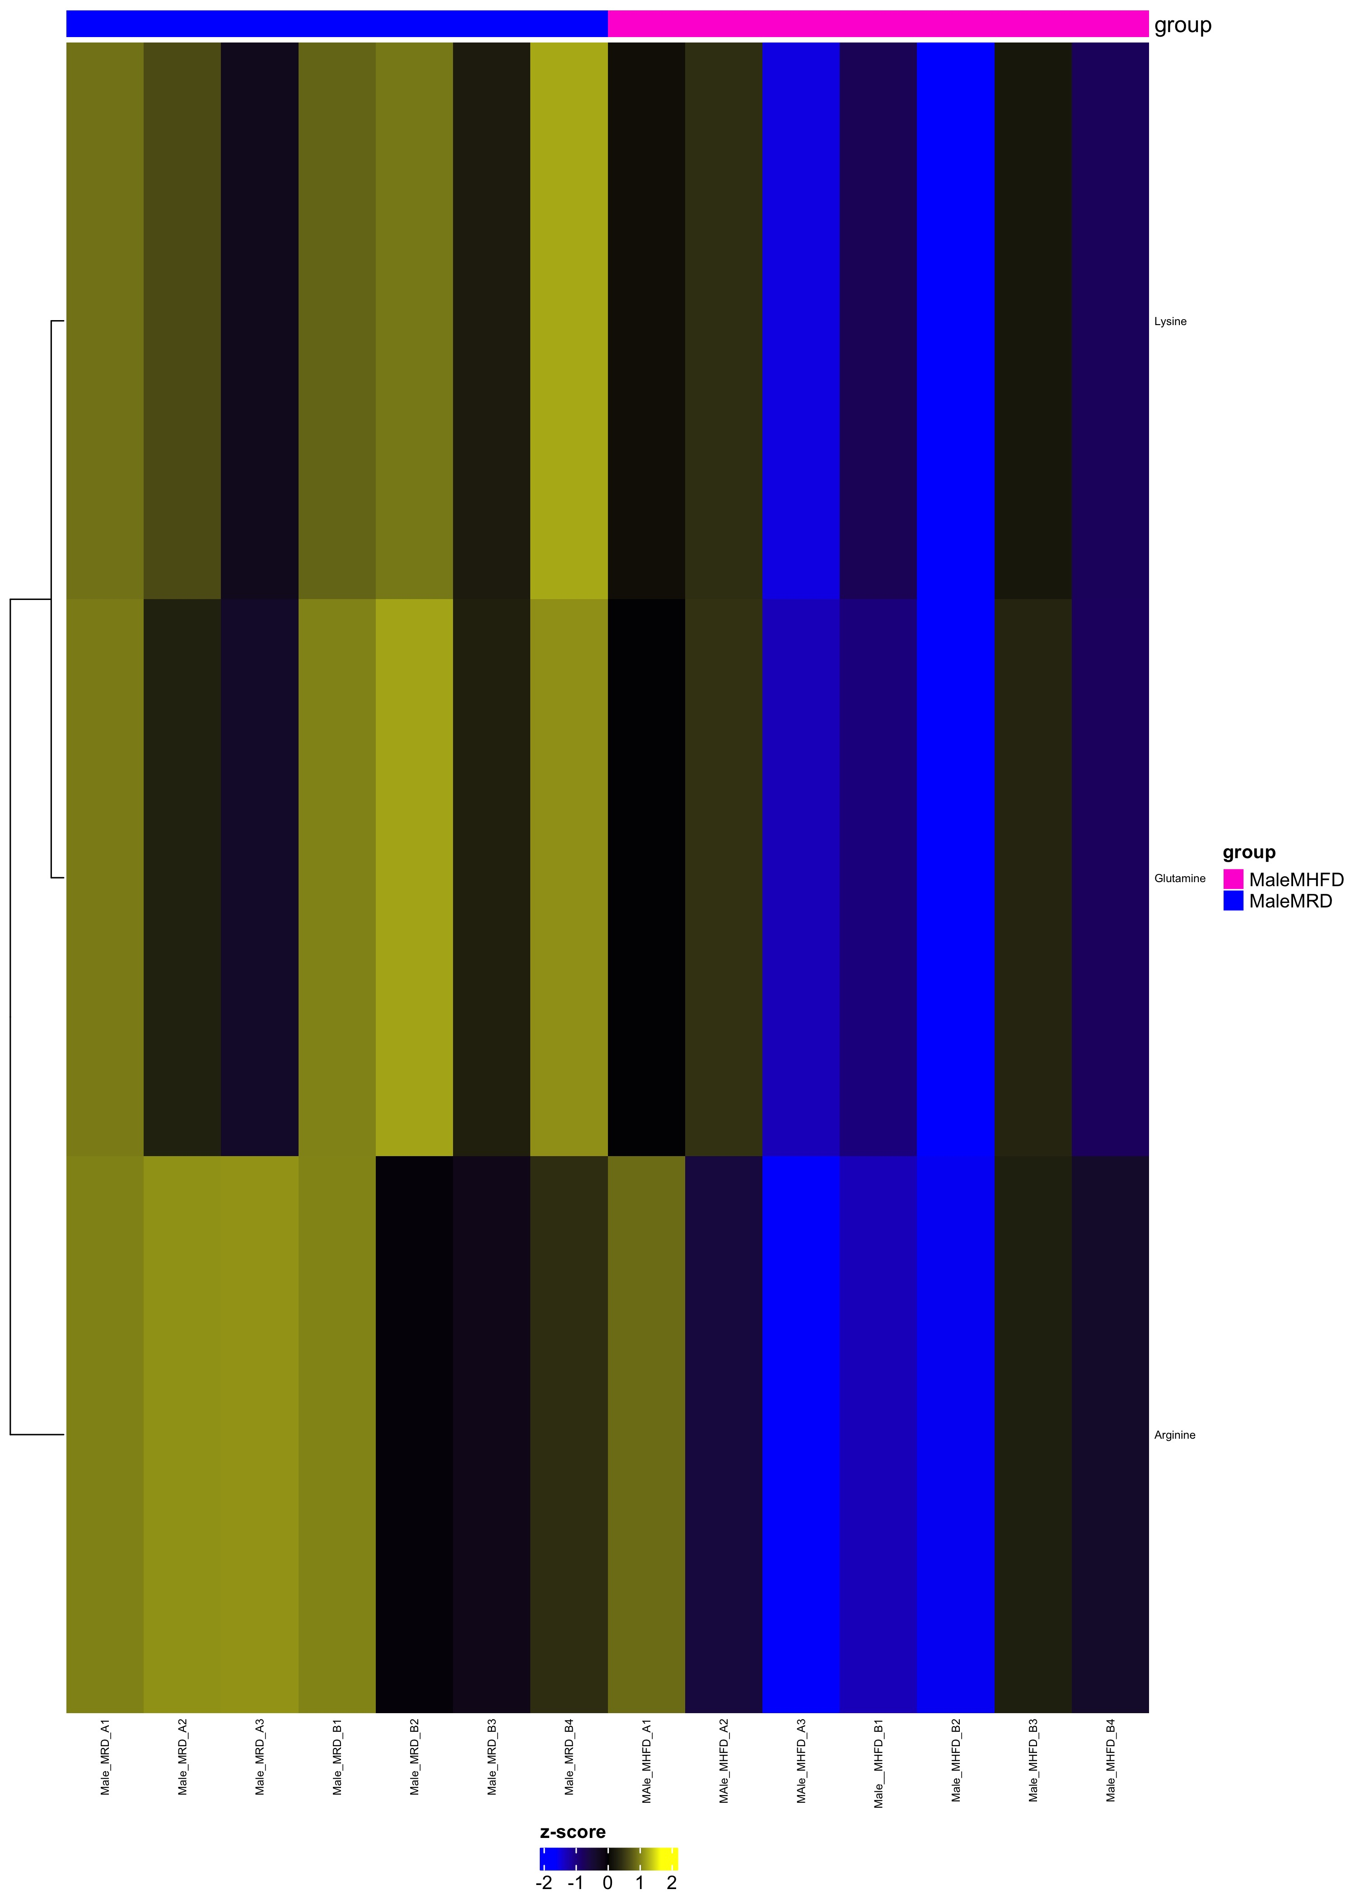
Comparison MaleMHFD_over_MaleMRD
Complete Set fdr=1
Differential fdr<0.25

Slide 14
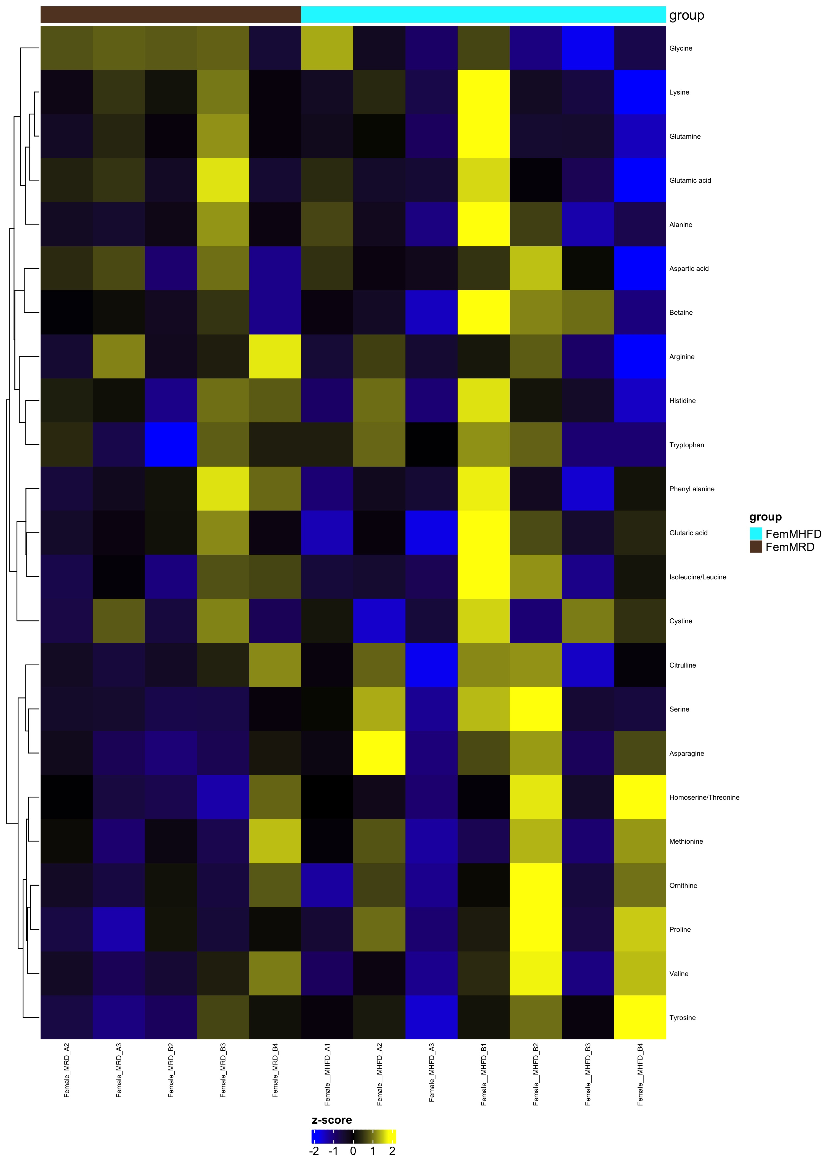
Comparison FemMHFD_over_FemMRD
Complete Set fdr=1
Differential fdr<0.25

Slide 15
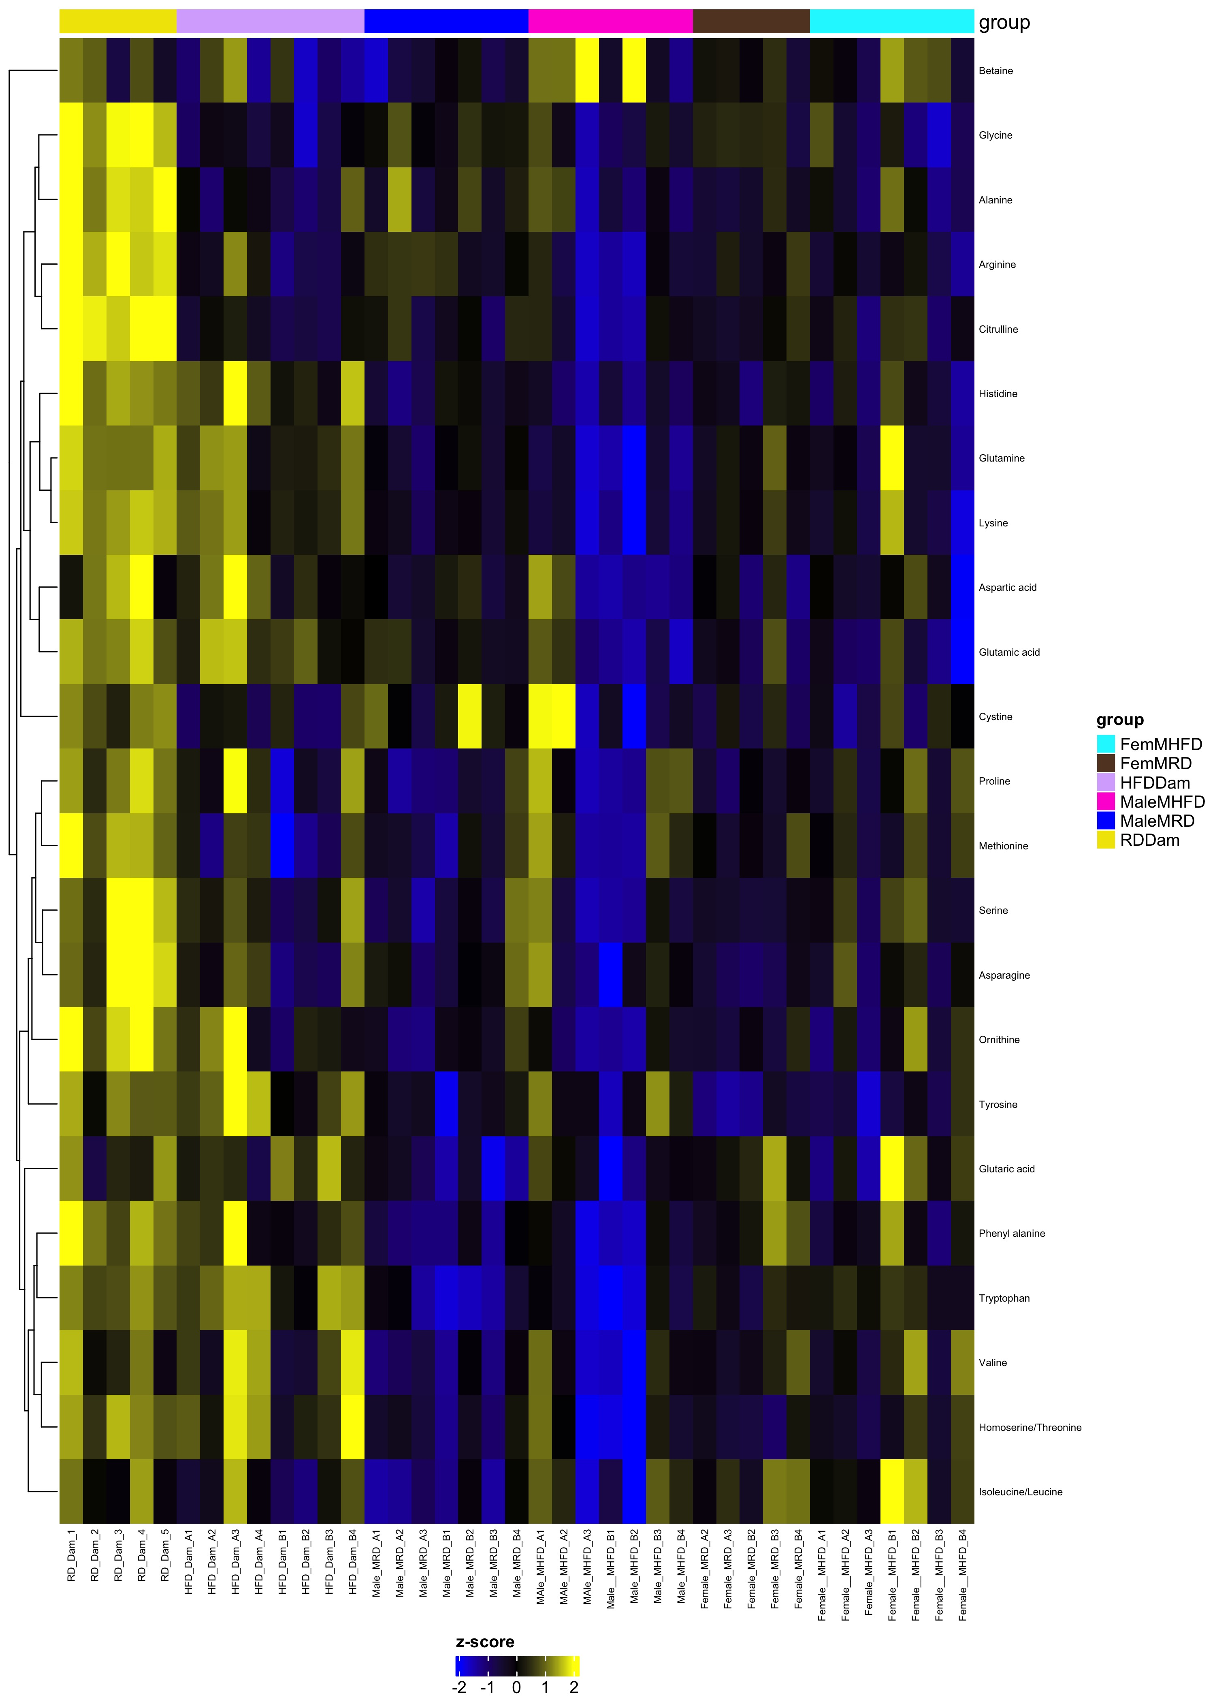
Comparison RDDam_HFDDam_MaleMRD_MaleMHFD_FemMRD_FemMHFD
Complete Set fdr=1
Differential fdr<0.25

