Slide 1
Project Report
Metabolomics Analysis

Slide 2
Project Overview
Samples
  39 experimental samples
  3 quality control samples
Total of 23 features from 1 methods
  AminoAcids was normalized by Internal Standard L-Tryptophan (ISTD) [CV = 0.13]
Comparisons performed
  t-test (2 tailed, assuming unequal variance)
    HFD-Dam_over_RD-Dam
    MaleMHFD_over_MaleMRD
    FemMHFD_over_FemMRD
  anova (analysis of variance)
    RDDam_HFDDam_MaleMRD_MaleMHFD_FemMRD_FemMHFD

Slide 3
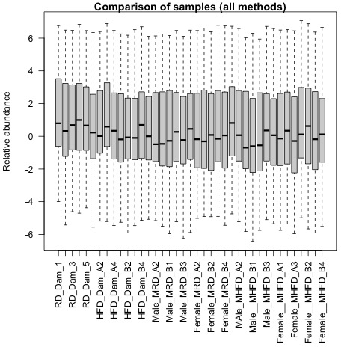
QA plots: all_samples

Slide 4

QA plots: AminoAcids

Slide 5
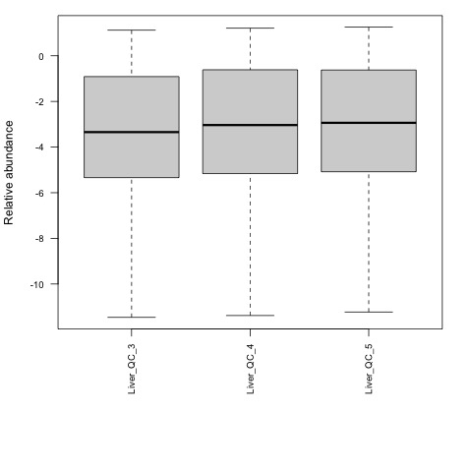
Quality Control: AminoAcids

Slide 6
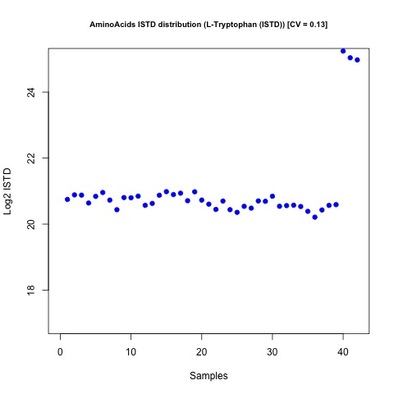
Internal Standards Distribution: AminoAcids

Slide 7
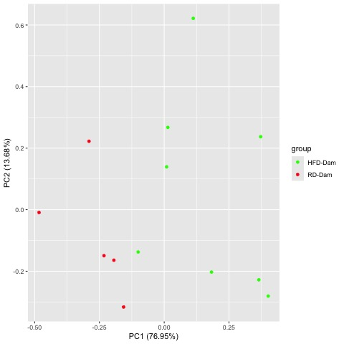
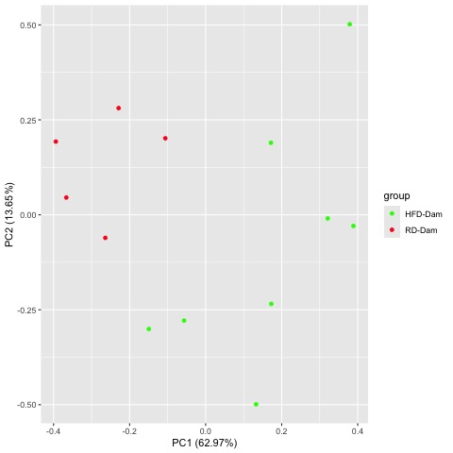
Comparison HFD-Dam_over_RD-Dam
Raw PCA
Normalized PCA

Slide 8
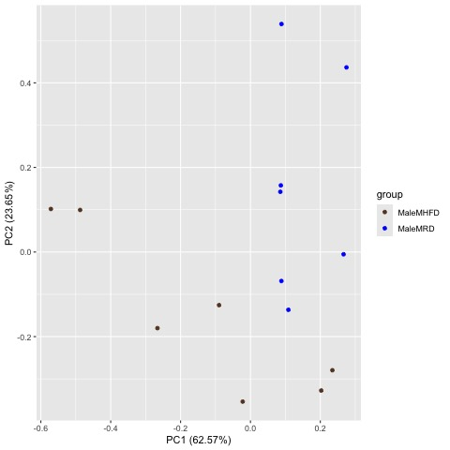
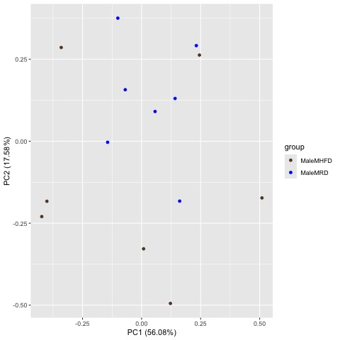
Comparison MaleMHFD_over_MaleMRD
Raw PCA
Normalized PCA

Slide 9
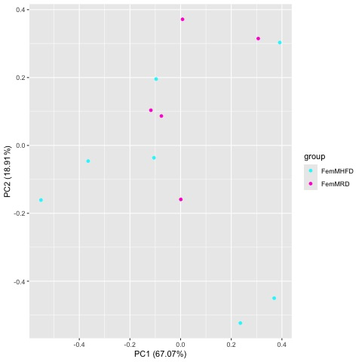
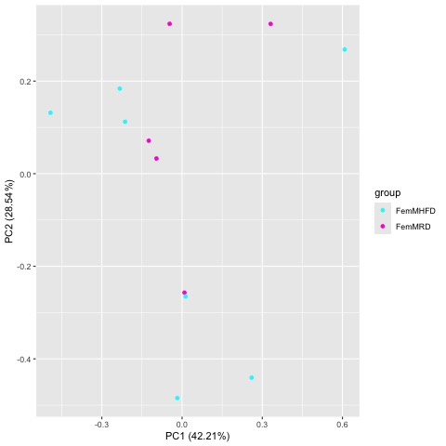
Comparison FemMHFD_over_FemMRD
Raw PCA
Normalized PCA

Slide 10
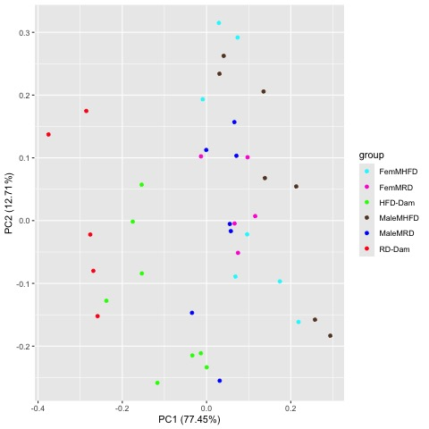
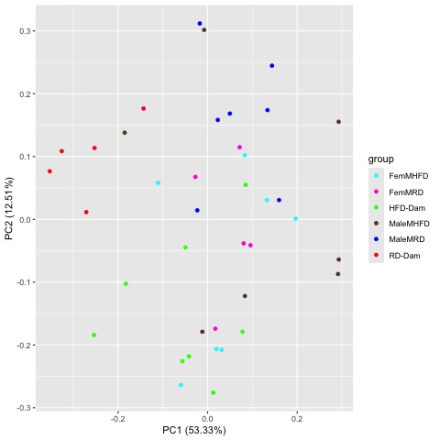
Comparison RDDam_HFDDam_MaleMRD_MaleMHFD_FemMRD_FemMHFD
Raw PCA
Normalized PCA

Slide 11
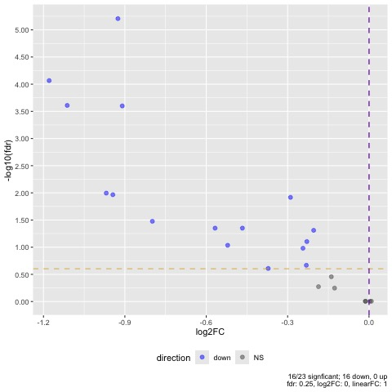
Comparison HFD-Dam_over_RD-Dam

Slide 12
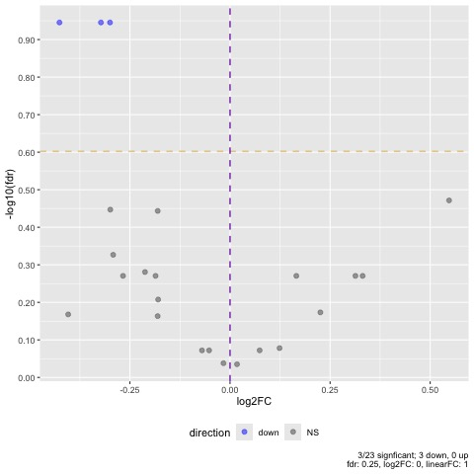
Comparison MaleMHFD_over_MaleMRD

Slide 13
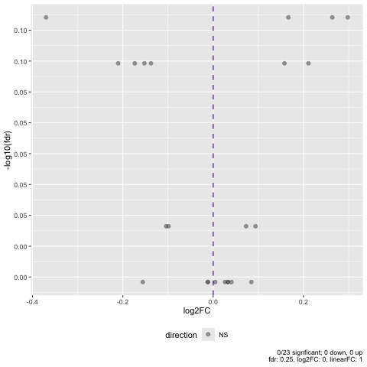
Comparison FemMHFD_over_FemMRD

Slide 14
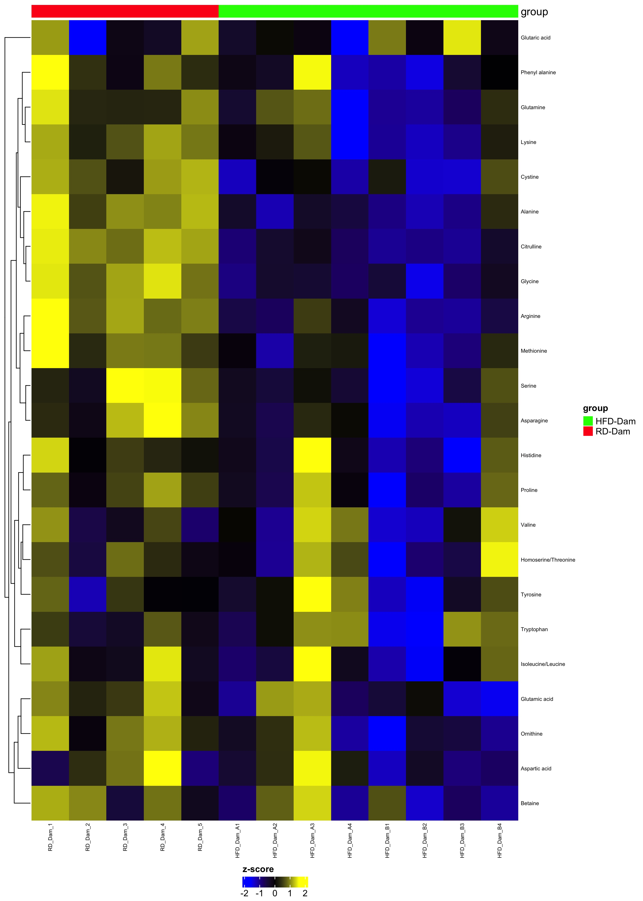
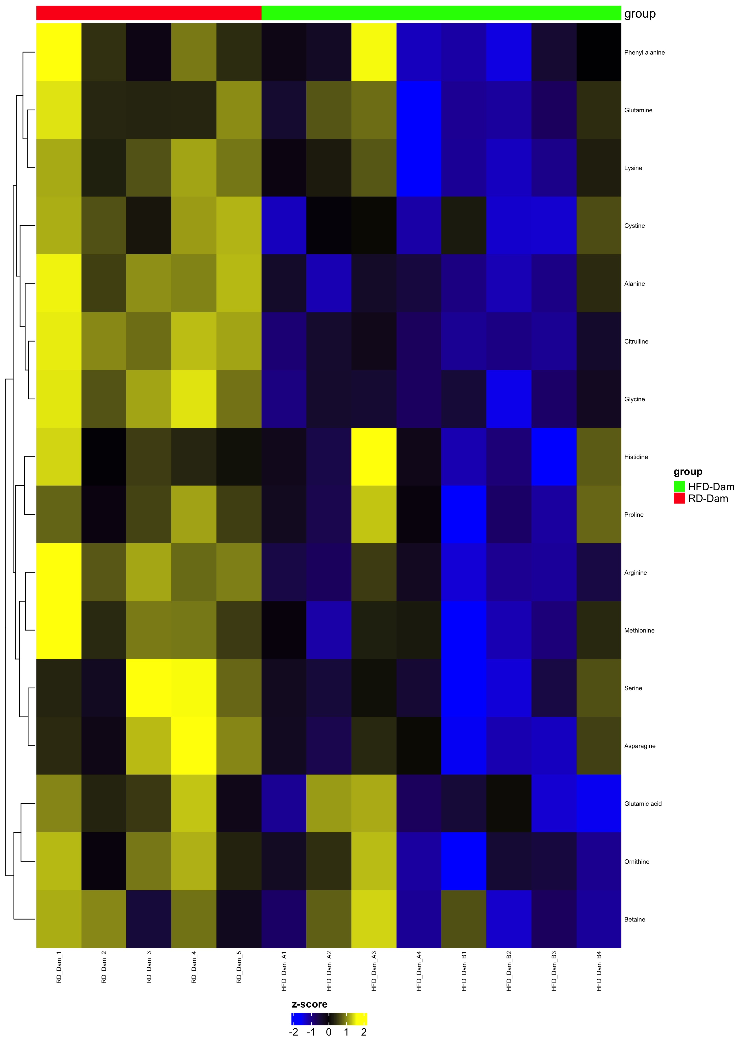
Comparison HFD-Dam_over_RD-Dam
Complete Set fdr=1
Differential fdr<0.25

Slide 15
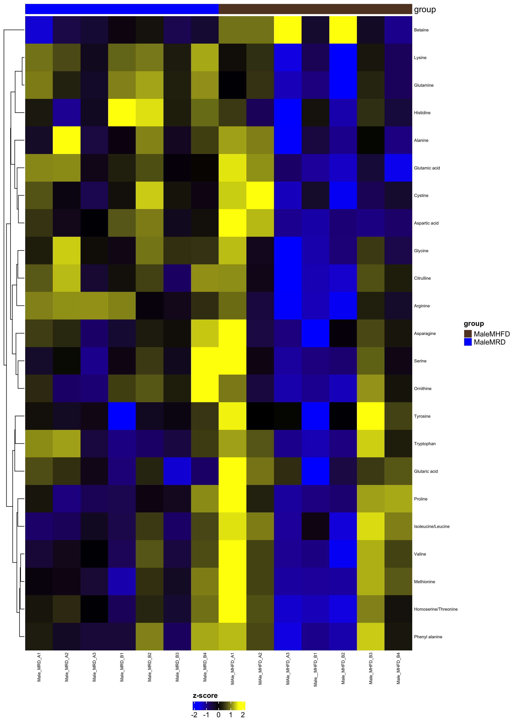
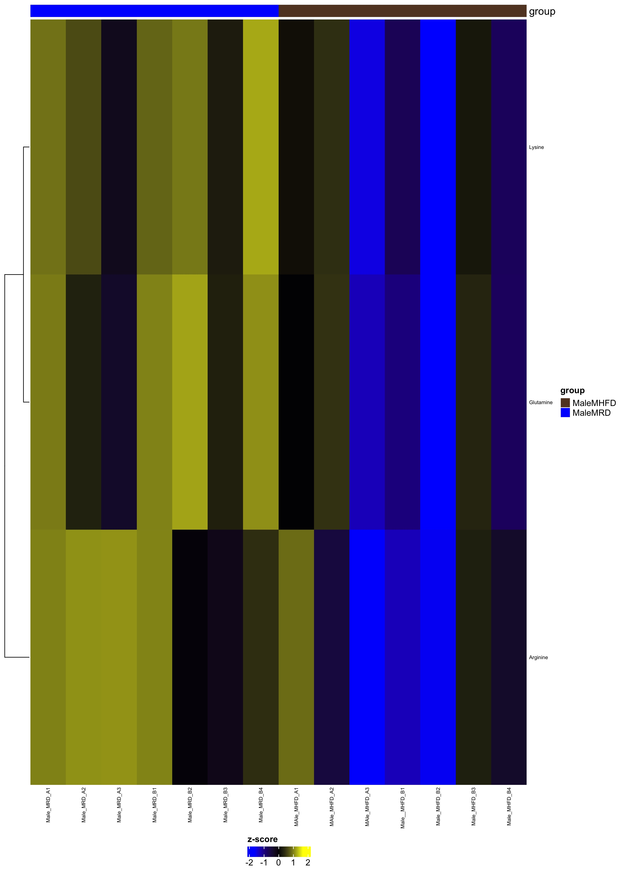
Comparison MaleMHFD_over_MaleMRD
Complete Set fdr=1
Differential fdr<0.25

Slide 16
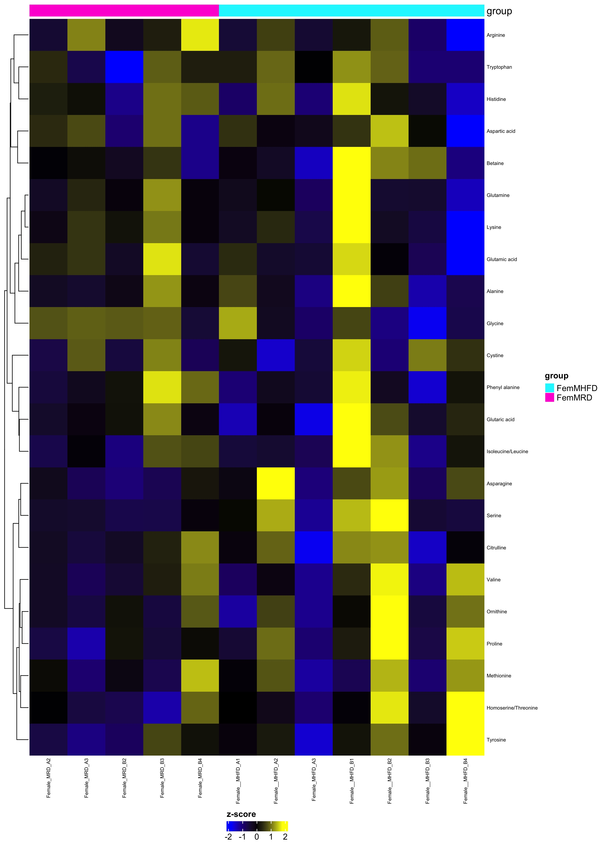
Comparison FemMHFD_over_FemMRD
Complete Set fdr=1
Differential fdr<0.25

Slide 17
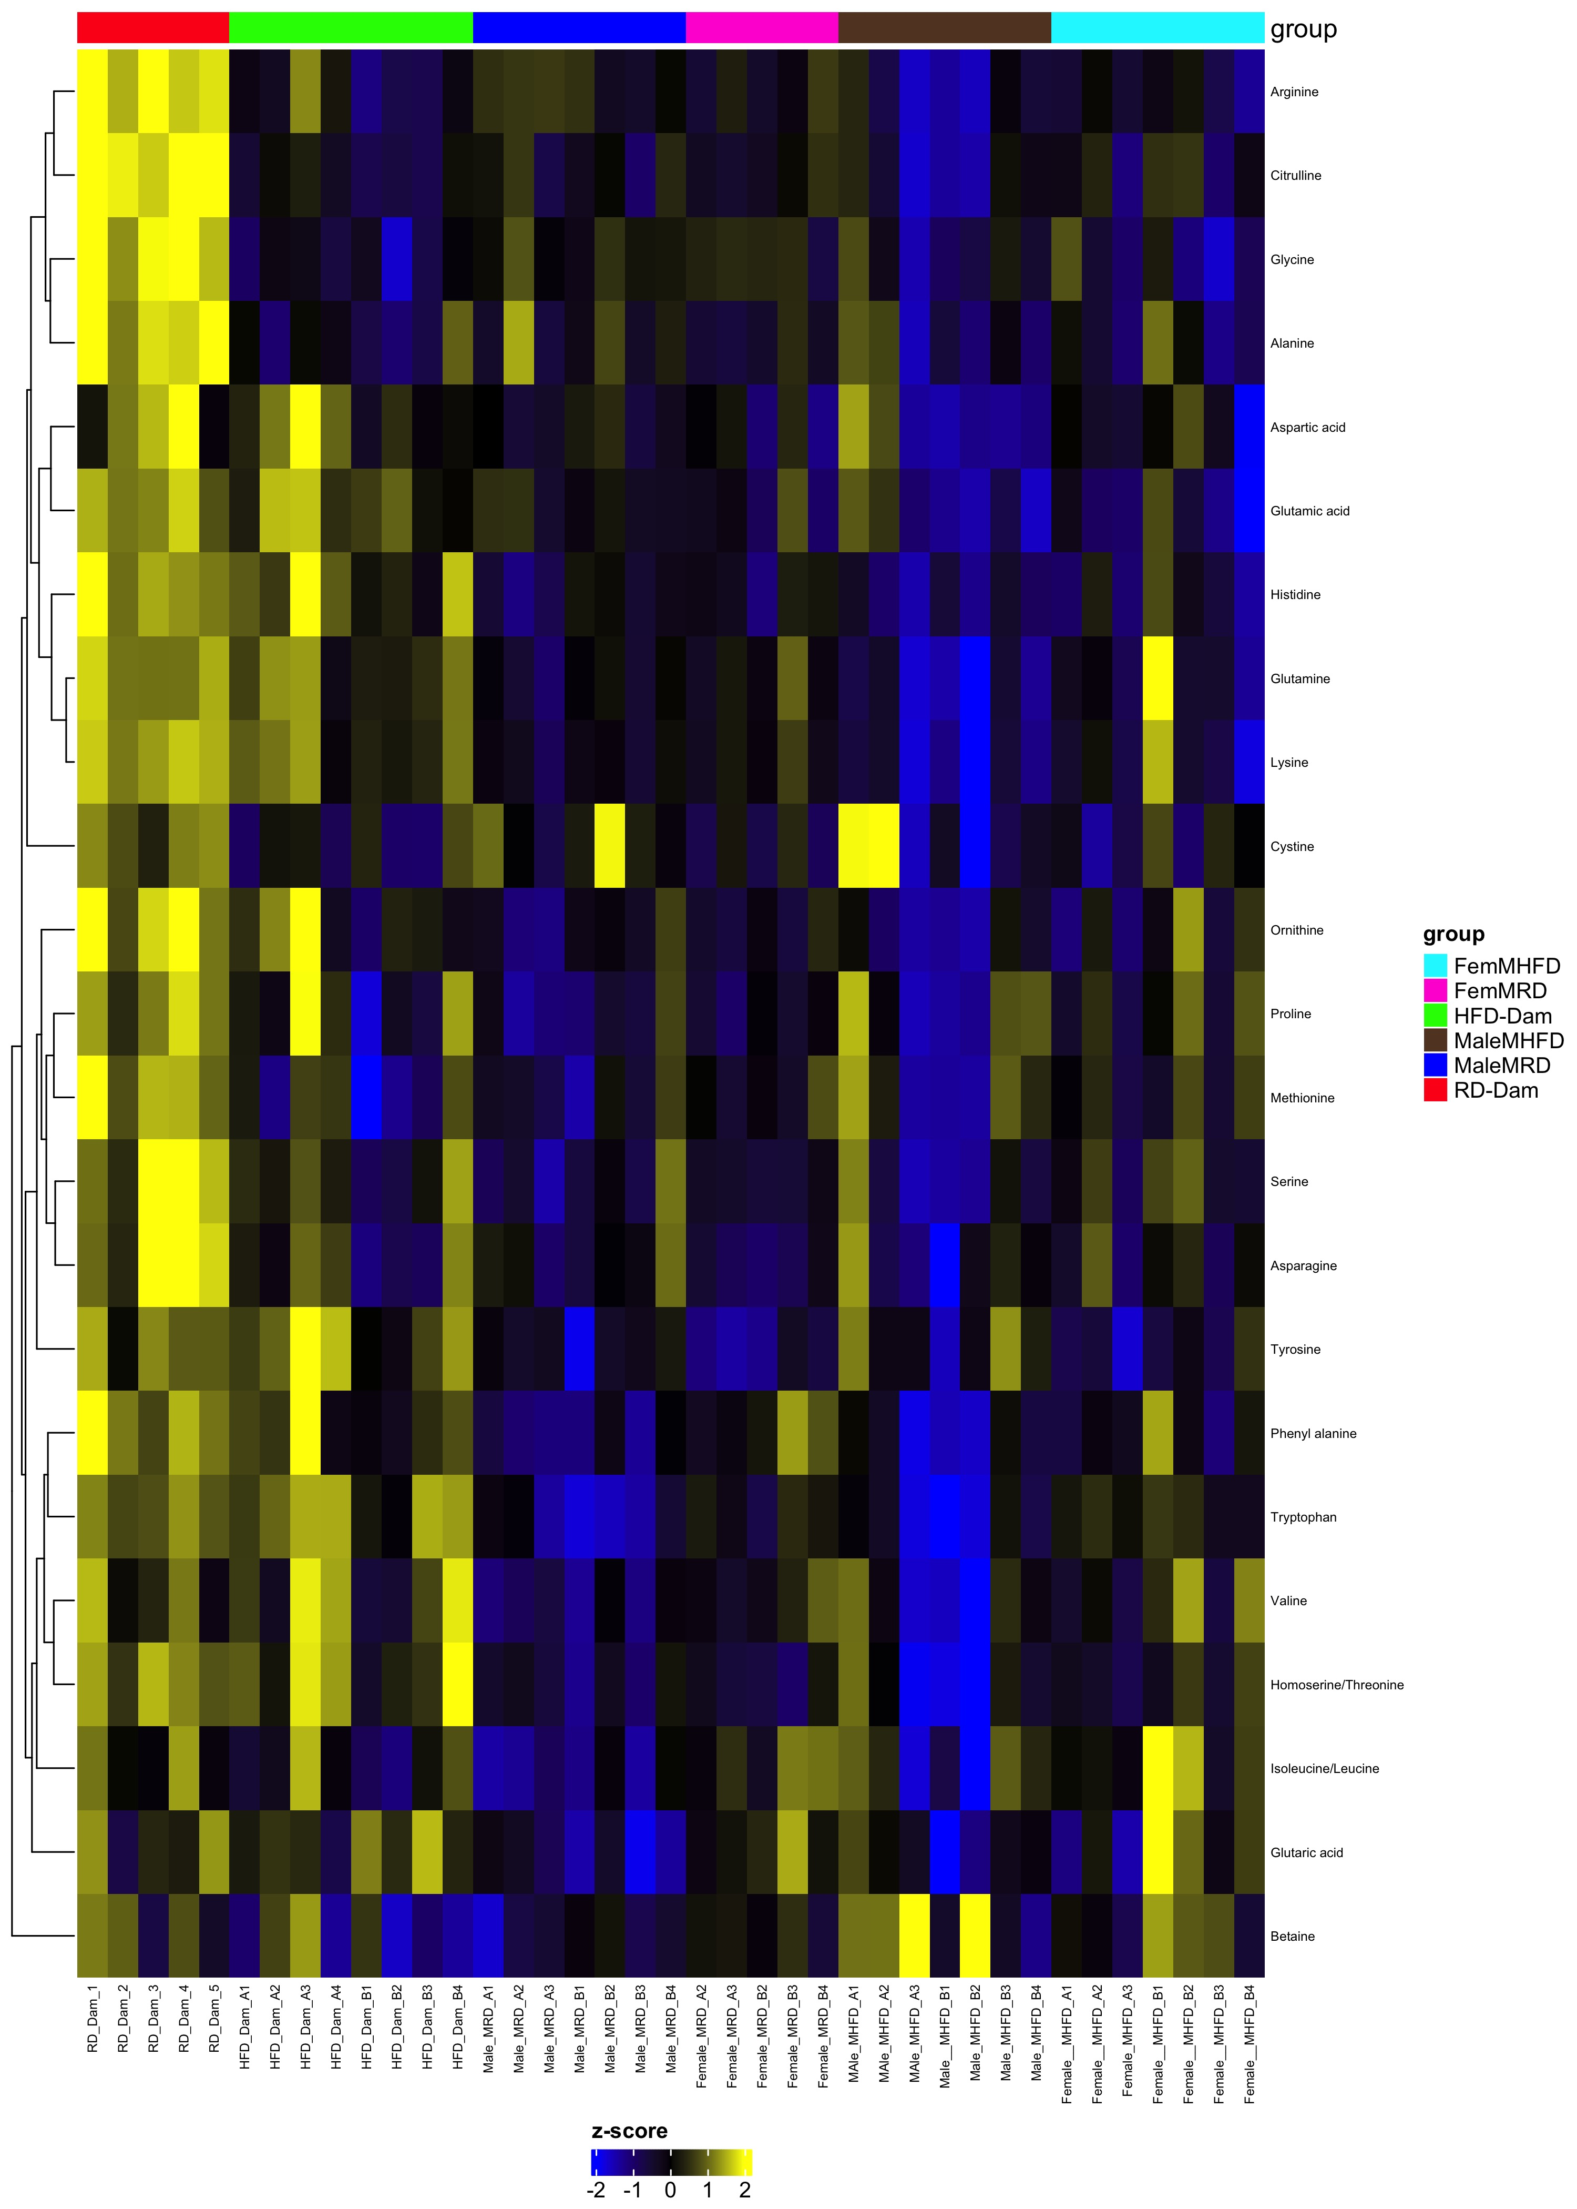
Comparison RDDam_HFDDam_MaleMRD_MaleMHFD_FemMRD_FemMHFD
Complete Set fdr=1
Differential fdr<0.25

