Slide 1
Intro to runMODAC

Slide 2
Prep
Open runModac.Rproj
Install ComplexHeatmap using the following code:
if (!requireNamespace("BiocManager", quietly = TRUE)) install.packages("BiocManager")
BiocManager::install(c("ComplexHeatmap"))
Source the “R/runModac.R” file
Set up and run the runModac function for your analysis

Slide 3
Usage
runModac(inputFile,
comparisonsFile,
type = “metabolomics”,
outdir = “results”,
project_title = "Project Report",
project_subtitle = "Metabolomics Analysis",
heatmap_color_scale = c("blue", "black", "yellow"),
samplesAreRows = T,
sampleIDRow = 2,
min_signal = NULL,
scriptPath = "~/Box Sync/runModac/R/")

Slide 4
Metabolomics
Example 1

Slide 5
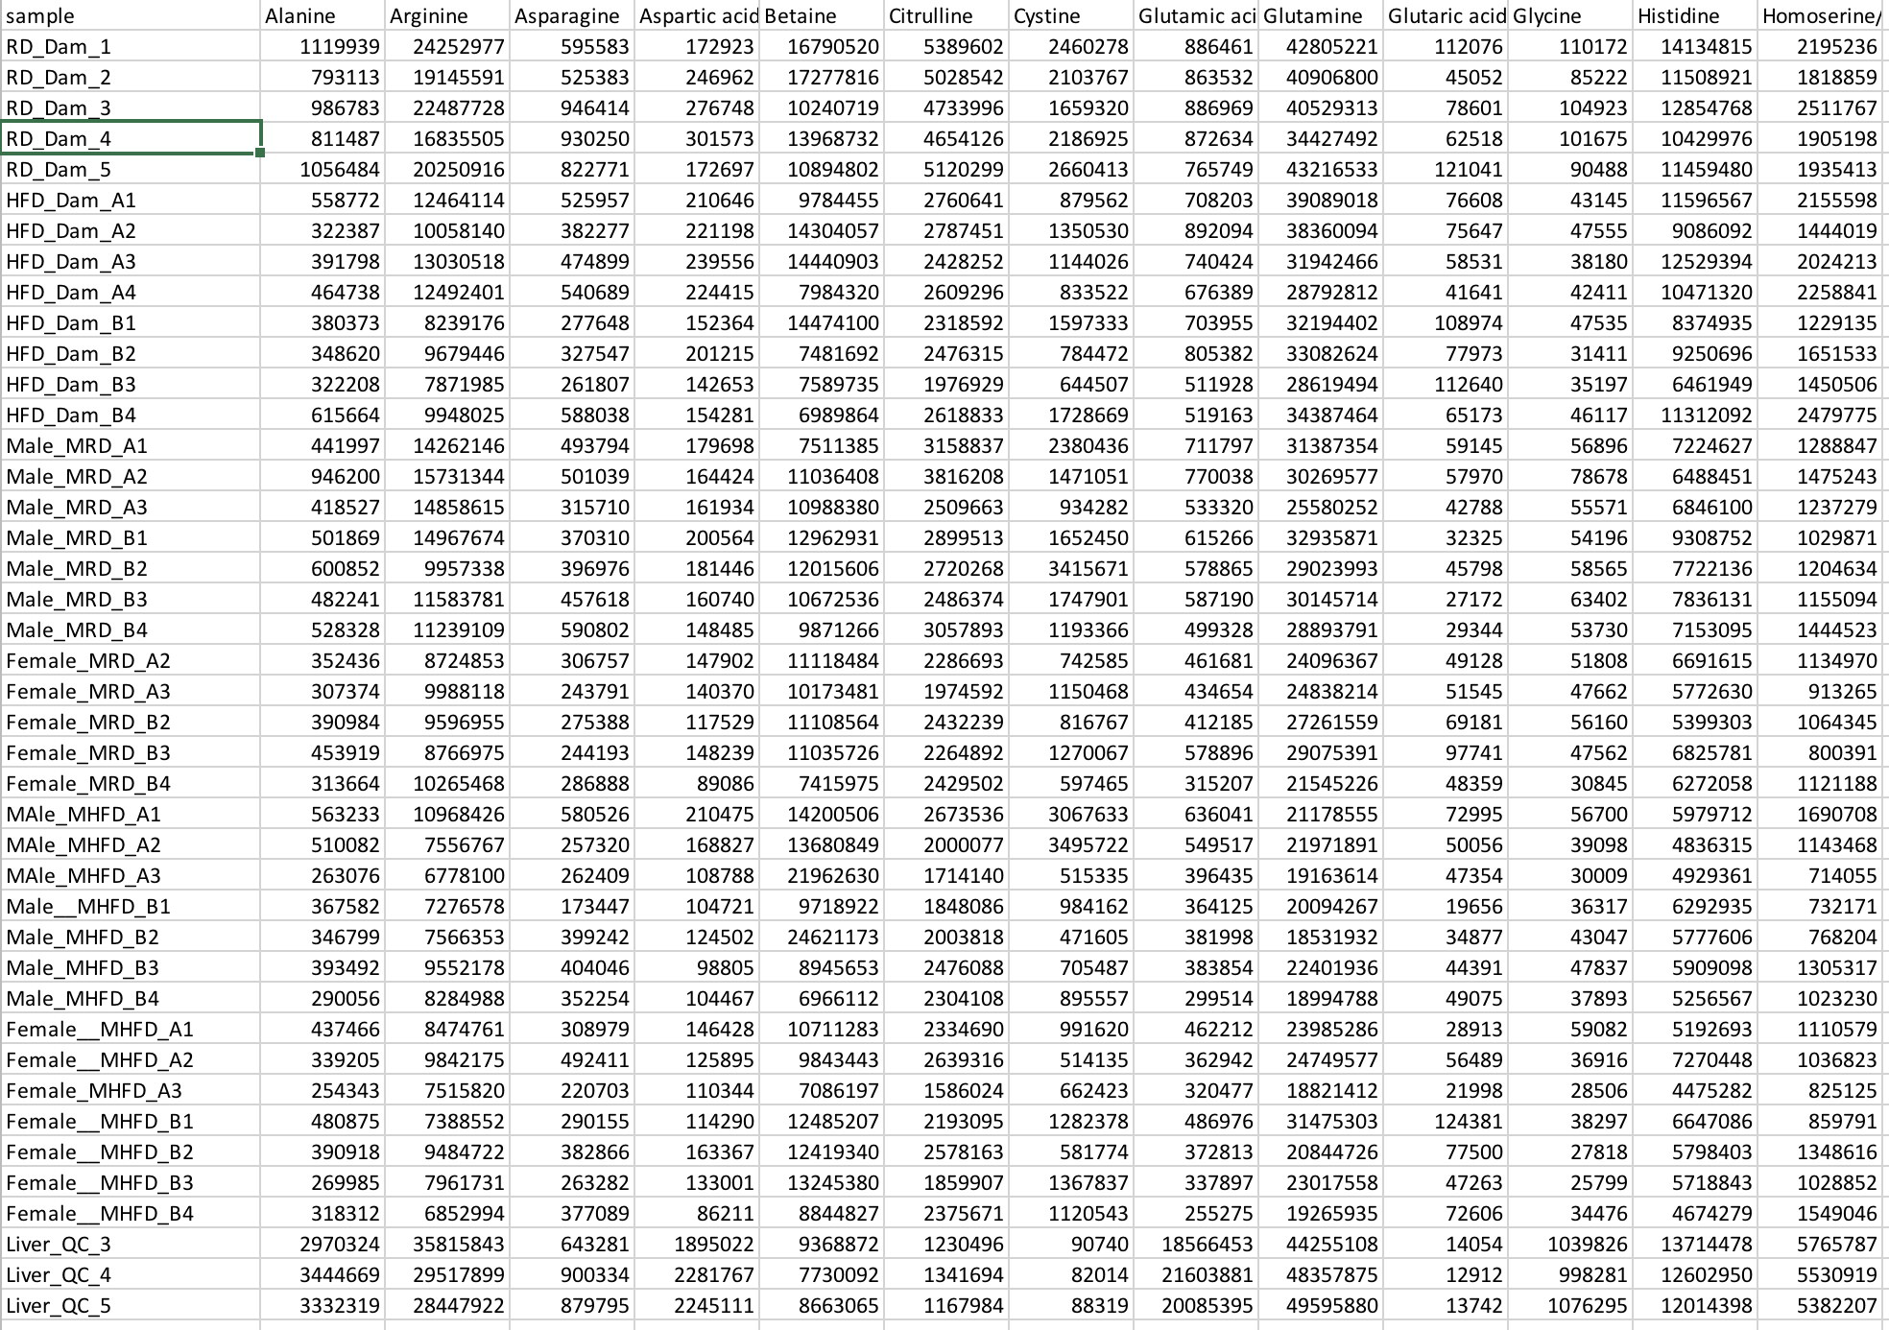
Input File
Rows of samples
First column contains sample names
Remaining columns are features
QC samples at the end
ISTD columns at the end
Any NAs or blank cells will be replaced by 1
For ISTD normalization, only positive numbers

Slide 6
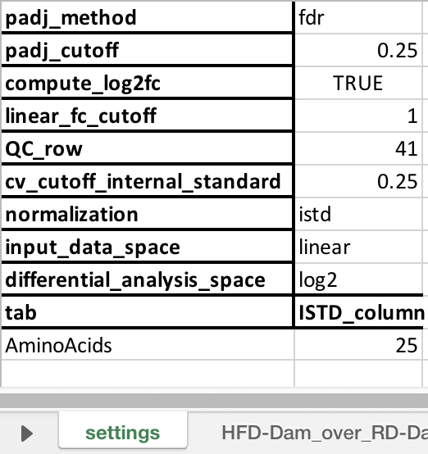
Comparisons File – Settings
padj_method: “pval” or “fdr”. Use p-value or FDR for generating filtered heatmaps and signature files?
padj_cutoff: p-value or FDR threshold for generating filtered heatmaps and signature files.
compute_log2fc: TRUE or FALSE. Calculate log2 and linear fold change or only linear fold change?
linear_fc_cutoff: Fold change threshold for generating signature files.
QC_row: row index for the first QC sample.
cv_cutoff_internal_standard: Coefficient of variation (CV) threshold for internal standard (ISTD). Only ISTDs with CV lower than this threshold will be considered for normalization.
normalization: “istd”, “iqr”, or “none”. Type of normalization to be performed – internal standard, interquartile range, or none?
input_data_space: “linear” or “log2”. Input data is in linear space or log2 space?
differential_analysis_space: “linear” or “log2”. For differential analysis, transform the data to linear or log2 space?
tab: For ISTD normalization, write down names of all the methods below this. For any other normalization, leave blank.
ISTD_column: For ISTD normalization, write down index of the first (or only) internal standard methods below this for all the methods. For any other normalization, leave blank.

Slide 7
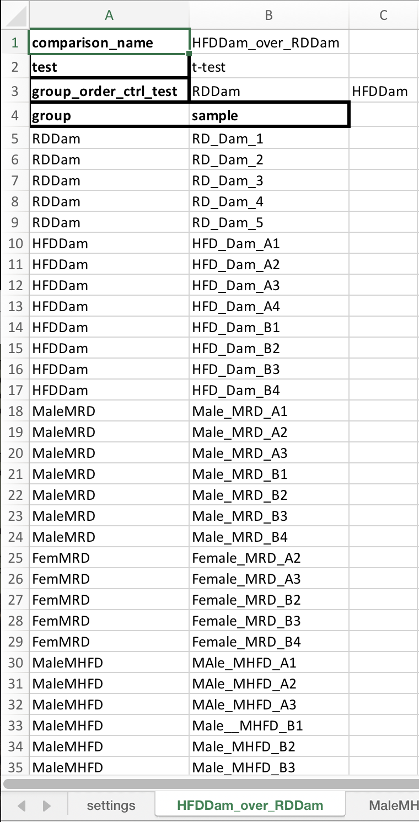
Comparisons File - Comparisons
comparison_name: A label for this comparison. Format must be “testgroup_over_controlgroup” for t-test and “group1_group2_..._groupn” for ANOVA.
test: ”t-test” or “anova”. Which statistical test to perform?
group_order_ctrl_test: order in which to display the comparison groups in boxplots and heatmaps.
group: group that each sample belongs to. This can have all the groups or only groups specific to this comparison.
sample: sample ID for all the samples or only samples belonging to the groups specific to this comparison.
Repeat this process creating a new sheet for all comparisons.

Slide 8
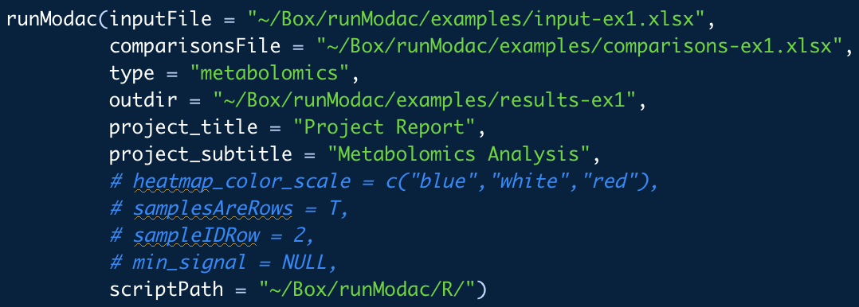
Code
inputFile: path to the input file.
comparisonsFile: path to the comparisons file.
type: “metabolomics”, “rppa”, or “none”. Use “none” for prenormalized data.
outdir: path to output directory. Default is “results” folder in current directory.
project_title: project title to be used in the summary pptx. Default is “Report”.
project_subtitle: project subtitle to be used in the summary pptx. Default is “by”.
heatmap_color_scale: specify 3 colors to use for heatmap color scale. Default is c("blue", "black", "yellow").
samplesAreRows: TRUE or FALSE. Is the input data in the form of rows of samples? Default is TRUE.
sampleIDRow: 1 or 2. Only for RPPA analysis. Which row of the normalized RPPA data are the Sample IDs present in? Default is 2.
min_signal: for each comparison, filtering out features for which none of the samples have signal > min_signal. Setting to NULL turns this filter off. Default is NULL.
scriptPath: path to R folder within the runMODAC folder on your system.

Slide 9
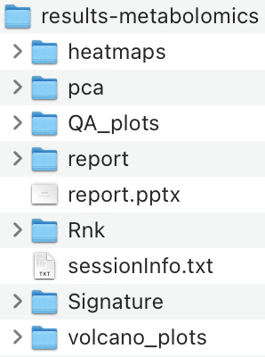
Results
heatmaps: folder containing heatmaps in .jpg and .pdf format with supporting data used to generate the heatmap available in a .csv file.
pca: folder containing pca plots in .jpg and .pdf format with supporting data used to generate the pca plots available in a .xlsx file.
QA_plots: folder containing boxplots of the combined normalized data and normalized data per method as well as internal standard distribution and QC samples distribution plot per method.
report: folder containing raw combined data, normalized data, and for each comparison, boxplots of all features and statistical test report files.
report.pptx: presentation containing a summary of the results.
Rnk: folder containing the rank files for each comparison.
sessionInfo.txt: text file containing your R session information.
Signature: folder containing the signature files for each comparison.
volcano_plots: folder containing volcano plots for each t-test comparison in .jpg and .pdf format.

Slide 10
Pre-Normalized Data
Example 2

Slide 11
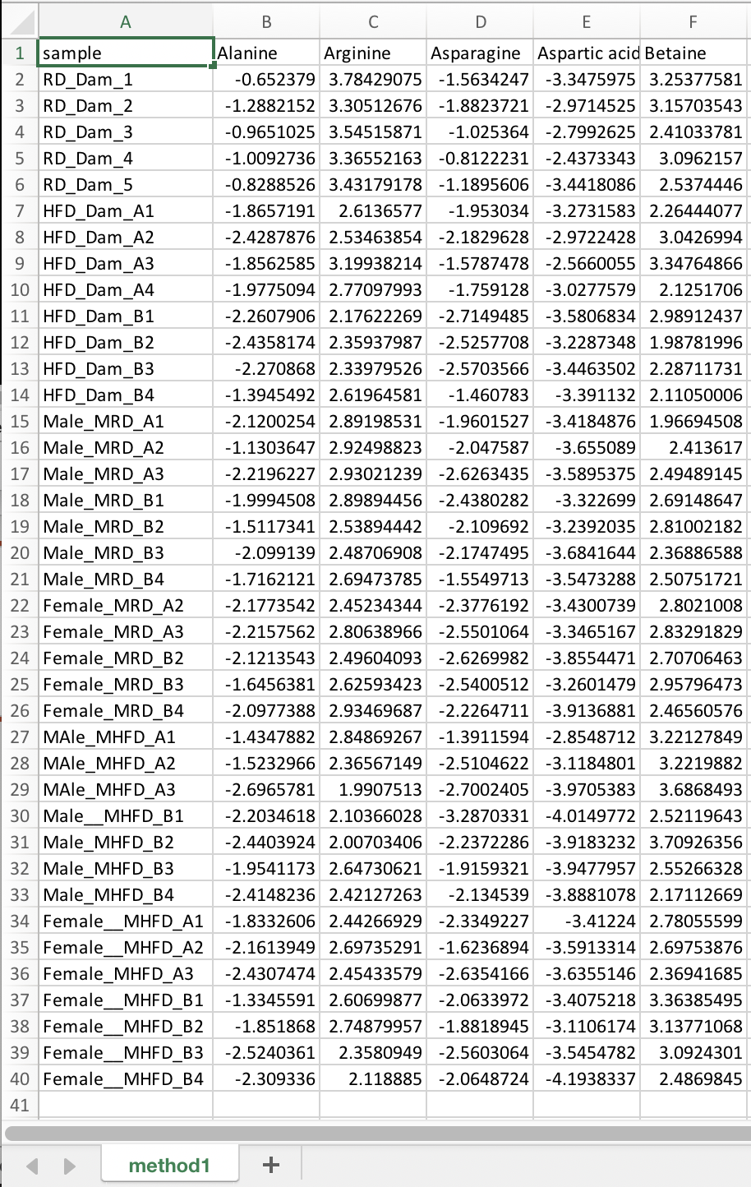
Input File
Rows of samples
First column contains sample names
Remaining columns are features
No NAs or blank cells

Slide 12
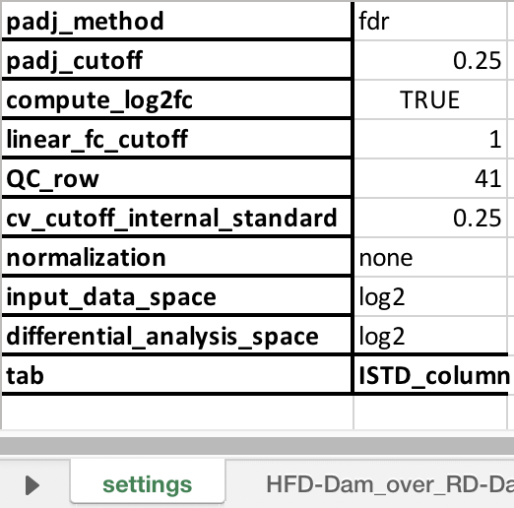
Comparisons File – Settings
padj_method: “pval” or “fdr”. Use p-value or FDR for generating filtered heatmaps and signature files?
padj_cutoff: p-value or FDR threshold for generating filtered heatmaps and signature files.
compute_log2fc: TRUE or FALSE. Calculate log2 and linear fold change or only linear fold change?
linear_fc_cutoff: Fold change threshold for generating signature files.
QC_row: row index for the first QC sample.
cv_cutoff_internal_standard: Coefficient of variation (CV) threshold for internal standard (ISTD). Only ISTDs with CV lower than this threshold will be considered for normalization.
normalization: “istd”, “iqr”, or “none”. Type of normalization to be performed – internal standard, interquartile range, or none?
input_data_space: “linear” or “log2”. Input data is in linear space or log2 space?
differential_analysis_space: “linear” or “log2”. For differential analysis, transform the data to linear or log2 space?
tab: For ISTD normalization, write down names of all the methods below this. For any other normalization, leave blank.
ISTD_column: For ISTD normalization, write down index of the first (or only) internal standard methods below this for all the methods. For any other normalization, leave blank.

Slide 13
Comparisons File - Comparisons
comparison_name: A label for this comparison. Format must be “testgroup_over_controlgroup” for t-test and “group1_group2_..._groupn” for ANOVA.
test: ”t-test” or “anova”. Which statistical test to perform?
group_order_ctrl_test: order in which to display the comparison groups in boxplots and heatmaps.
group: group that each sample belongs to. This can have all the groups or only groups specific to this comparison.
sample: sample ID for all the samples or only samples belonging to the groups specific to this comparison.
Repeat this process creating a new sheet for all comparisons.

Slide 14
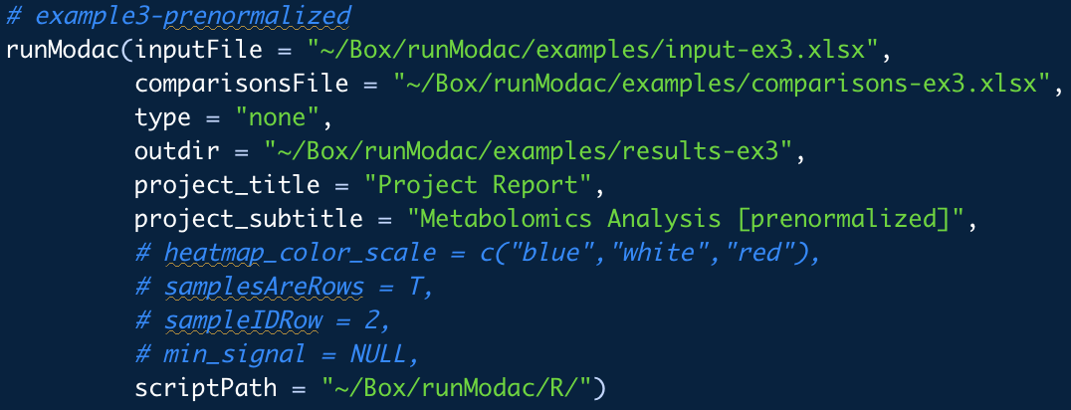
Code
inputFile: path to the input file.
comparisonsFile: path to the comparisons file.
type: “metabolomics”, “rppa”, or “none”. Use “none” for prenormalized data.
outdir: path to output directory. Default is “results” folder in current directory.
project_title: project title to be used in the summary pptx. Default is “Report”.
project_subtitle: project subtitle to be used in the summary pptx. Default is “by”.
heatmap_color_scale: specify 3 colors to use for heatmap color scale. Default is c("blue", "black", "yellow").
samplesAreRows: TRUE or FALSE. Is the input data in the form of rows of samples? Default is TRUE.
sampleIDRow: 1 or 2. Only for RPPA analysis. Which row of the normalized RPPA data are the Sample IDs present in? Default is 2.
min_signal: for each comparison, filtering out features for which none of the samples have signal > min_signal. Setting to NULL turns this filter off. Default is NULL.
scriptPath: path to R folder within the runMODAC folder on your system.

Slide 15
Results
heatmaps: folder containing heatmaps in .jpg and .pdf format with supporting data used to generate the heatmap available in a .csv file.
pca: folder containing pca plots in .jpg and .pdf format with supporting data used to generate the pca plots available in a .xlsx file.
QA_plots: folder containing boxplots of the combined normalized data and normalized data per method as well as internal standard distribution and QC samples distribution plot per method.
report: folder containing raw combined data, normalized data, and for each comparison, boxplots of all features and statistical test report files.
report.pptx: presentation containing a summary of the results.
Rnk: folder containing the rank files for each comparison.
sessionInfo.txt: text file containing your R session information.
Signature: folder containing the signature files for each comparison.
volcano_plots: folder containing volcano plots for each t-test comparison in .jpg and .pdf format.

Slide 16
Transposed Data (Columns of Samples)
Example 2

Slide 17
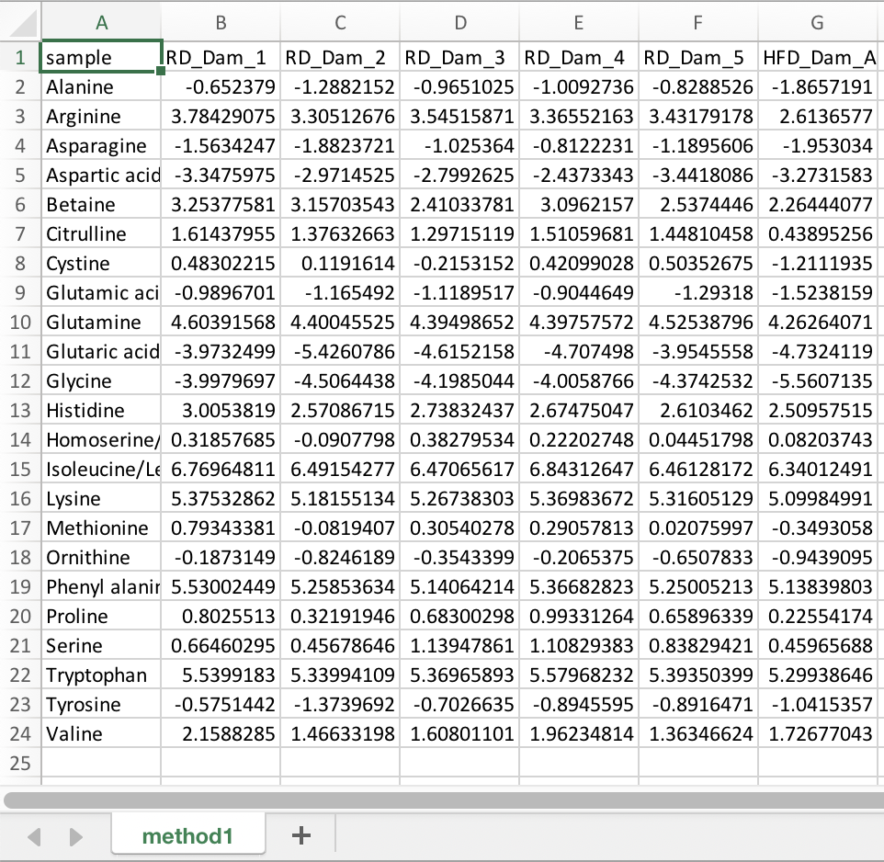
Input File
Rows of features
First column contains feature names
Remaining columns are samples
No NAs or blank cells

Slide 18
Comparisons File – Settings
padj_method: “pval” or “fdr”. Use p-value or FDR for generating filtered heatmaps and signature files?
padj_cutoff: p-value or FDR threshold for generating filtered heatmaps and signature files.
compute_log2fc: TRUE or FALSE. Calculate log2 and linear fold change or only linear fold change?
linear_fc_cutoff: Fold change threshold for generating signature files.
QC_row: row index for the first QC sample.
cv_cutoff_internal_standard: Coefficient of variation (CV) threshold for internal standard (ISTD). Only ISTDs with CV lower than this threshold will be considered for normalization.
normalization: “istd”, “iqr”, or “none”. Type of normalization to be performed – internal standard, interquartile range, or none?
input_data_space: “linear” or “log2”. Input data is in linear space or log2 space?
differential_analysis_space: “linear” or “log2”. For differential analysis, transform the data to linear or log2 space?
tab: For ISTD normalization, write down names of all the methods below this. For any other normalization, leave blank.
ISTD_column: For ISTD normalization, write down index of the first (or only) internal standard methods below this for all the methods. For any other normalization, leave blank.

Slide 19
Comparisons File - Comparisons
comparison_name: A label for this comparison. Format must be “testgroup_over_controlgroup” for t-test and “group1_group2_..._groupn” for ANOVA.
test: ”t-test” or “anova”. Which statistical test to perform?
group_order_ctrl_test: order in which to display the comparison groups in boxplots and heatmaps.
group: group that each sample belongs to. This can have all the groups or only groups specific to this comparison.
sample: sample ID for all the samples or only samples belonging to the groups specific to this comparison.
Repeat this process creating a new sheet for all comparisons.

Slide 20
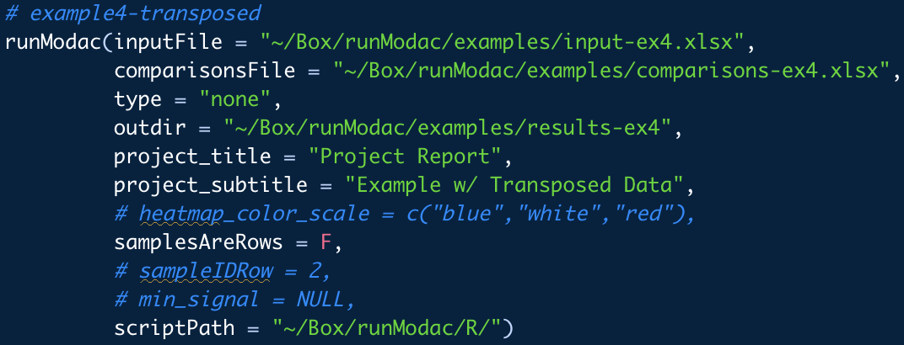
Code
inputFile: path to the input file.
comparisonsFile: path to the comparisons file.
type: “metabolomics”, “rppa”, or “none”. Use “none” for prenormalized data.
outdir: path to output directory. Default is “results” folder in current directory.
project_title: project title to be used in the summary pptx. Default is “Report”.
project_subtitle: project subtitle to be used in the summary pptx. Default is “by”.
heatmap_color_scale: specify 3 colors to use for heatmap color scale. Default is c("blue", "black", "yellow").
samplesAreRows: TRUE or FALSE. Is the input data in the form of rows of samples? Default is TRUE.
sampleIDRow: 1 or 2. Only for RPPA analysis. Which row of the normalized RPPA data are the Sample IDs present in? Default is 2.
min_signal: for each comparison, filtering out features for which none of the samples have signal > min_signal. Setting to NULL turns this filter off. Default is NULL.
scriptPath: path to R folder within the runMODAC folder on your system.

Slide 21
Results
heatmaps: folder containing heatmaps in .jpg and .pdf format with supporting data used to generate the heatmap available in a .csv file.
pca: folder containing pca plots in .jpg and .pdf format with supporting data used to generate the pca plots available in a .xlsx file.
QA_plots: folder containing boxplots of the combined normalized data and normalized data per method as well as internal standard distribution and QC samples distribution plot per method.
report: folder containing raw combined data, normalized data, and for each comparison, boxplots of all features and statistical test report files.
report.pptx: presentation containing a summary of the results.
Rnk: folder containing the rank files for each comparison.
sessionInfo.txt: text file containing your R session information.
Signature: folder containing the signature files for each comparison.
volcano_plots: folder containing volcano plots for each t-test comparison in .jpg and .pdf format.

Slide 22
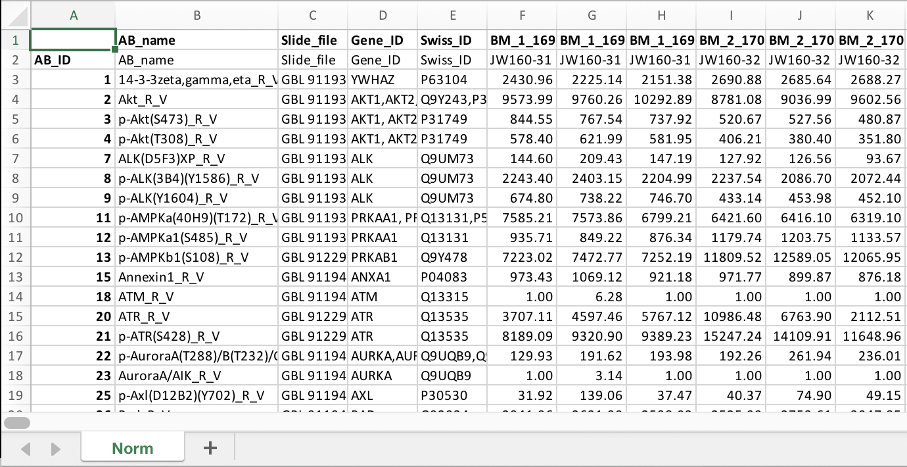
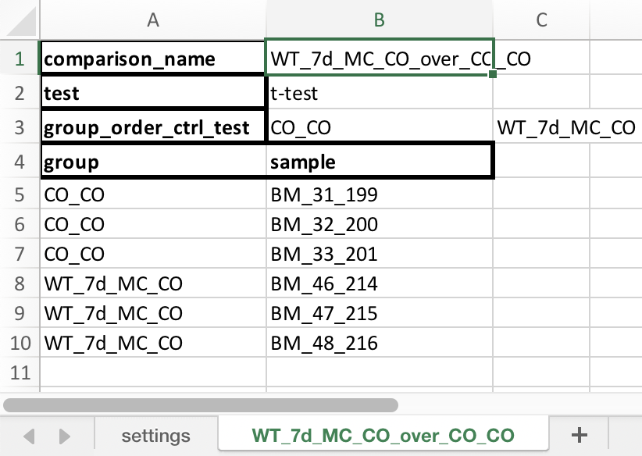
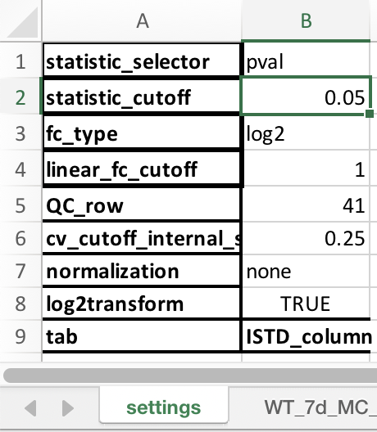
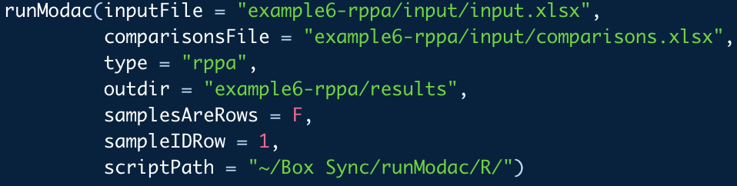
Example 4 – RPPA Data

