Slide 1
Intro to runMODAC

Slide 2
Prep
Install ComplexHeatmap using the following code:
if (!requireNamespace("BiocManager", quietly = TRUE)) install.packages("BiocManager")
BiocManager::install(c("ComplexHeatmap”)
Open runModac.Rproj
Source the “R/runModac.R” file and proceed with analysis

Slide 3
Usage
runModac(inputFile,
comparisonsFile,
type = “metabolomics”,
outdir = “results”,
project_title = "Project Report",
project_subtitle = "Metabolomics Analysis",
samplesAreRows = T,
sampleIDRow = 2,
scriptPath = "~/Box Sync/runModac/R/")

Slide 4
Metabolomics
Example 1

Slide 5
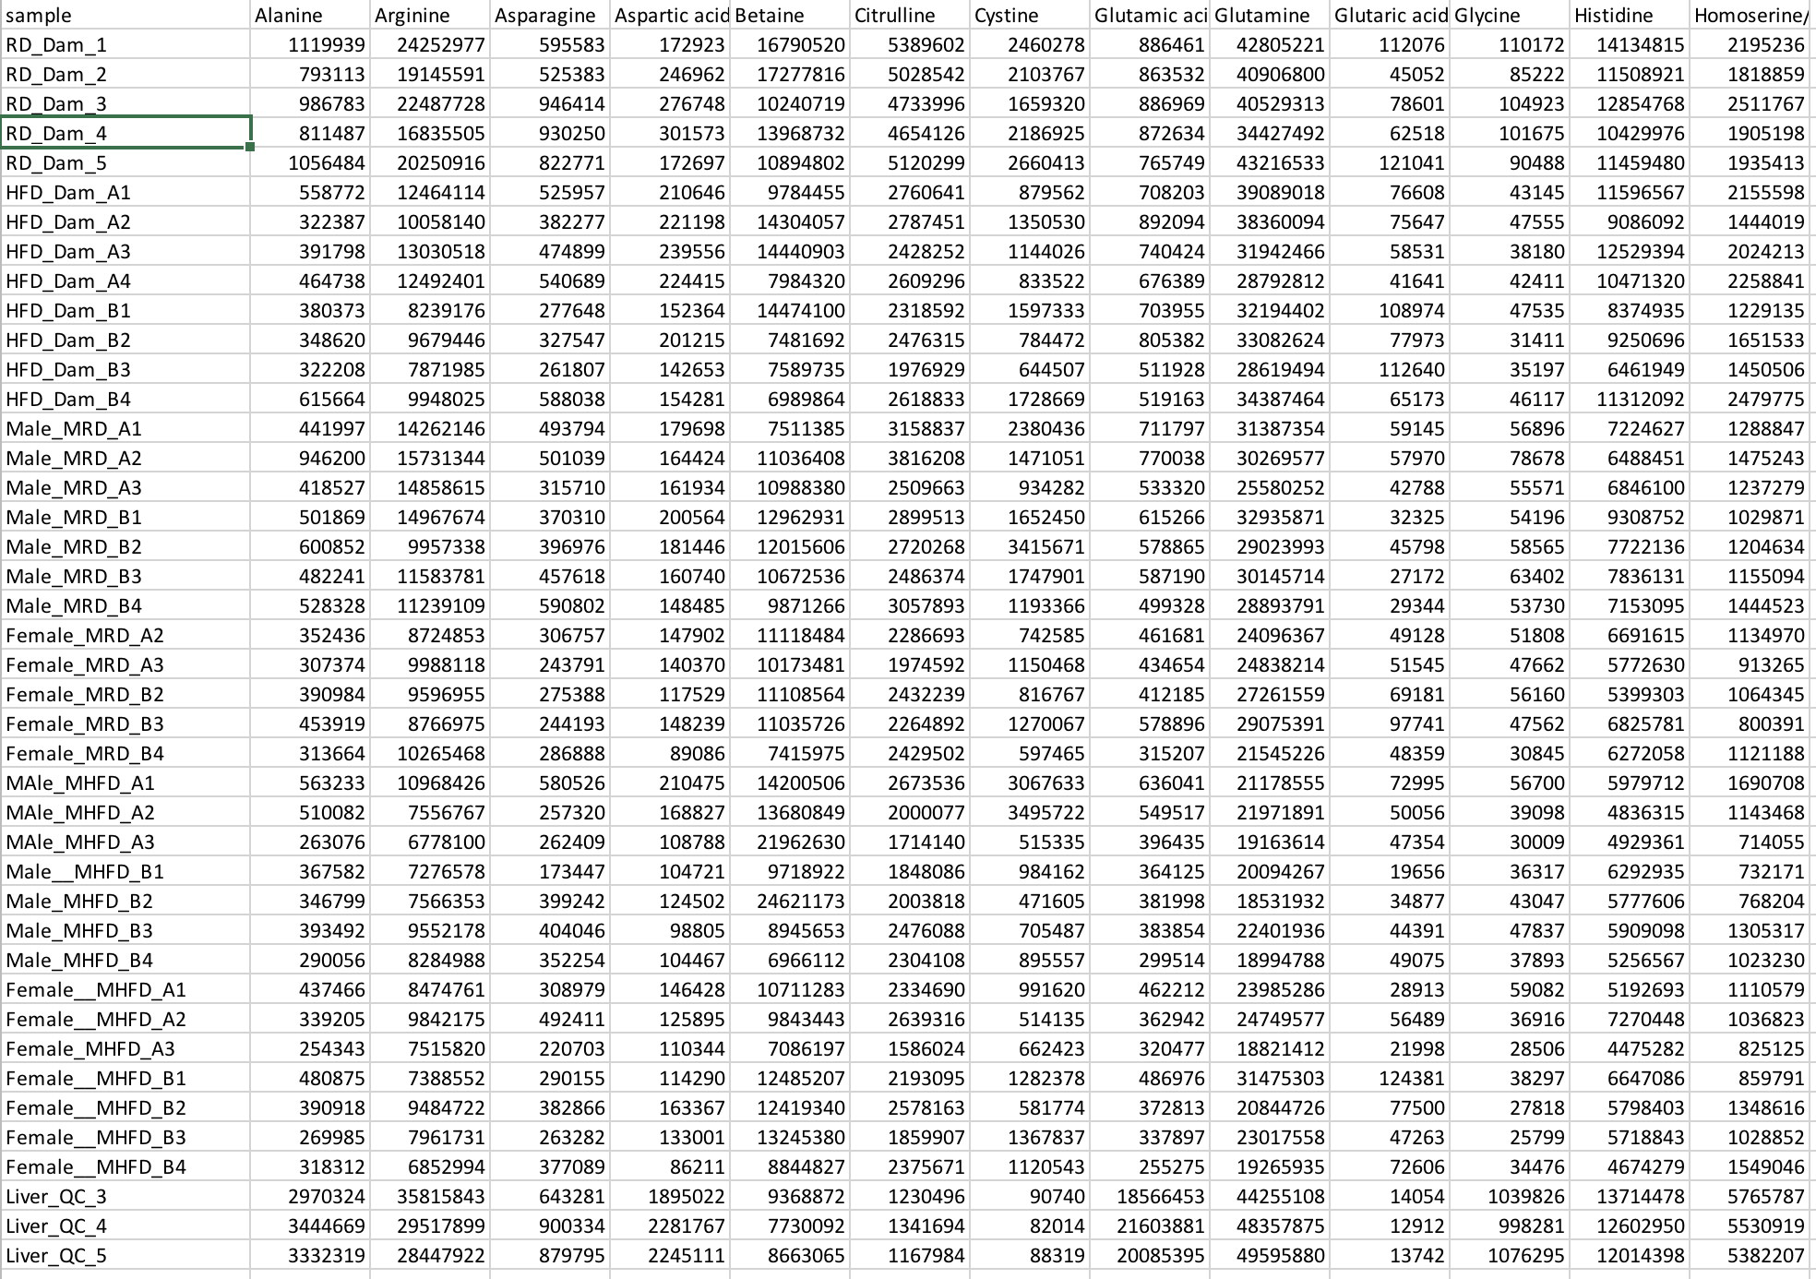
Input File
Rows of samples
First column contains sample names
Remaining columns are features
QC samples at the end
ISTD columns at the end
No NAs or blank cells
For ISTD normalization, only positive numbers

Slide 6
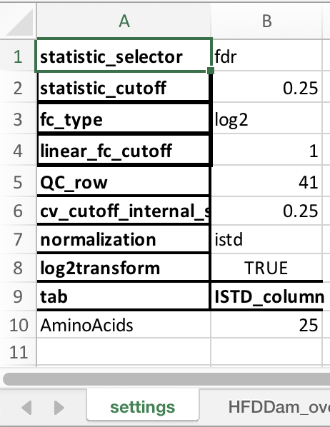
Comparisons File – Settings
statistic_selector: “pval” or “fdr”. Use p-value or FDR for generating filtered heatmaps and signature files?
statistic_cutoff: p-value or FDR threshold for generating filtered heatmaps and signature files.
fc_type: “linear” or “log2”. Calculate linear fold change or log2 fold change?
linear_fc_cutoff: Fold change threshold for generating signature files.
QC_row: row index for the first QC sample.
cv_cutoff_internal_standard: Coefficient of variation (CV) threshold for internal standard (ISTD). Only ISTDs with CV lower than this threshold will be considered for normalization.
normalization: “istd”, “iqr”, or “none”. Type of normalization to be performed – internal standard, interquartile range, or none?
log2transform: Apply log2 transformation?
tab: For ISTD normalization, write down names of all the methods below this. For any other normalization, leave blank.
ISTD_column: For ISTD normalization, write down index of the first (or only) internal standard methods below this for all the methods. For any other normalization, leave blank.

Slide 7
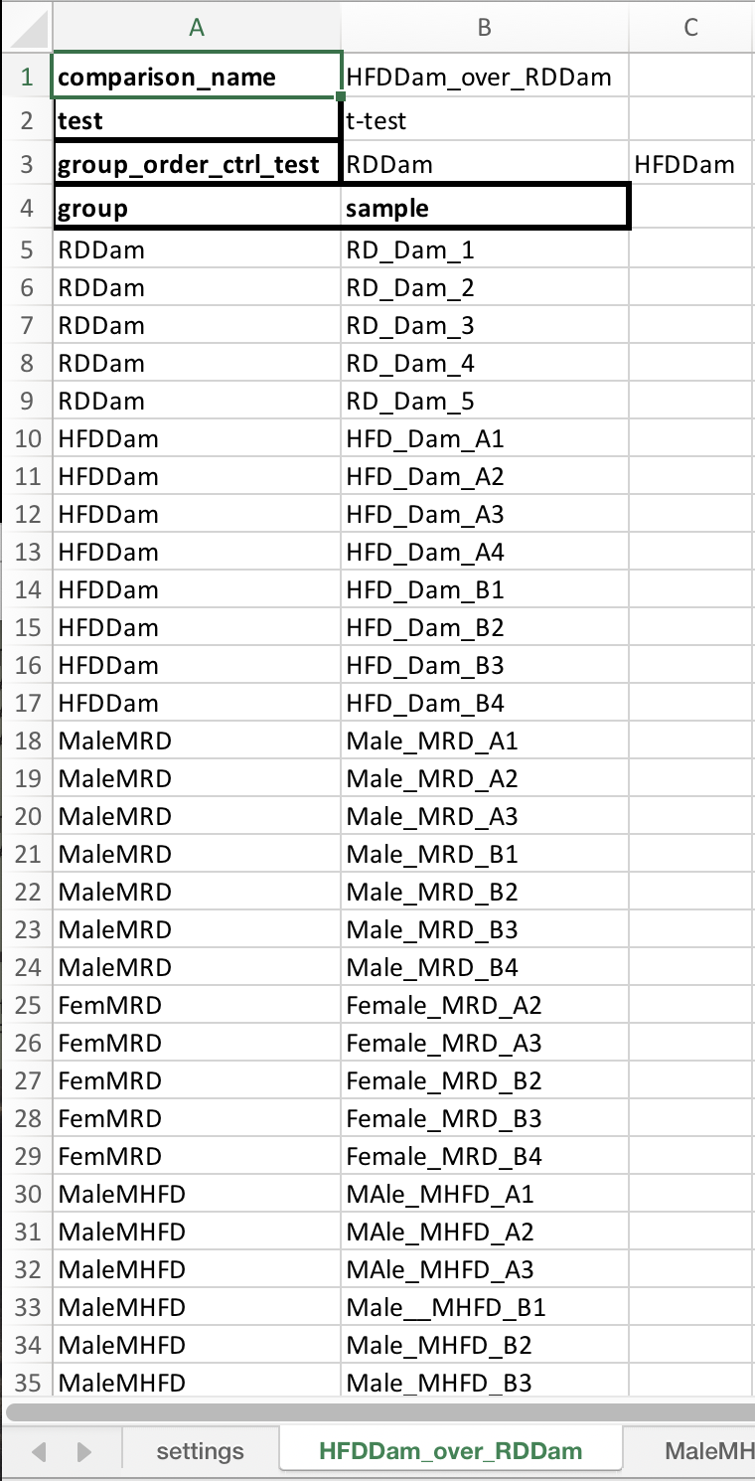
Comparisons File - Comparisons
comparison_name: A label for this comparison. Format must be “testgroup_over_controlgroup” for t-test and “group1_group2_..._groupn” for ANOVA.
test: ”t-test” or “anova”. Which statistical test to perform?
group_order_ctrl_test: order in which to display the comparison groups in boxplots and heatmaps.
group: group that each sample belongs to. This can have all the groups or only groups specific to this comparison.
sample: sample ID for all the samples or only samples belonging to the groups specific to this comparison.
Repeat this process creating a new sheet for all comparisons.

Slide 8
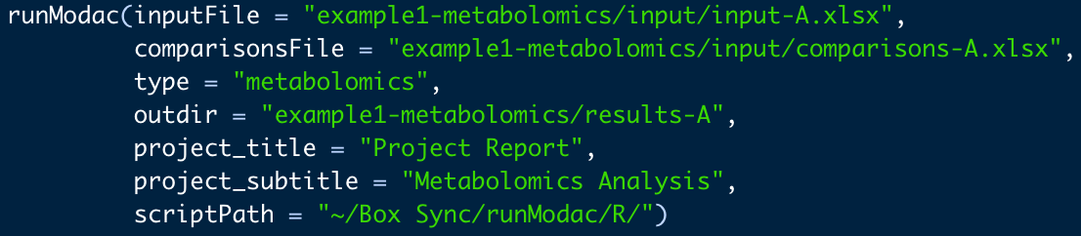
Code
inputFile: path to the input file.
comparisonsFile: path to the comparisons file.
type: “metabolomics”, “rppa”, or “none”. Use “none” for prenormalized data.
outdir: path to output directory.
project_title: project title to be used in the summary pptx.
project_subtitle: project subtitle to be used in the summary pptx.
scriptPath: path to R folder within the runMODAC folder on your system.

Slide 9
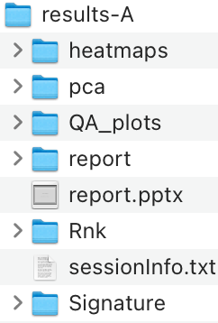
Results
heatmaps: folder containing heatmaps in .jpg and .pdf format with supporting data used to generate the heatmap available in a .csv file.
pca: folder containing pca plots in .jpg and .pdf format with supporting data used to generate the pca plots available in a .xlsx file.
QA_plots: folder containing boxplots of the combined normalized data and normalized data per method as well as internal standard distribution and QC samples distribution plot per method.
report: folder containing raw combined data, normalized data, and for each comparison, boxplots of all features and statistical test report files.
report.pptx: presentation containing a summary of the results.
Rnk: folder containing the rank files for each comparison.
sessionInfo.txt: text file containing your R session information.
Signature: folder containing the signature files for each comparison.

Slide 10
Pre-Normalized Data
Example 2

Slide 11
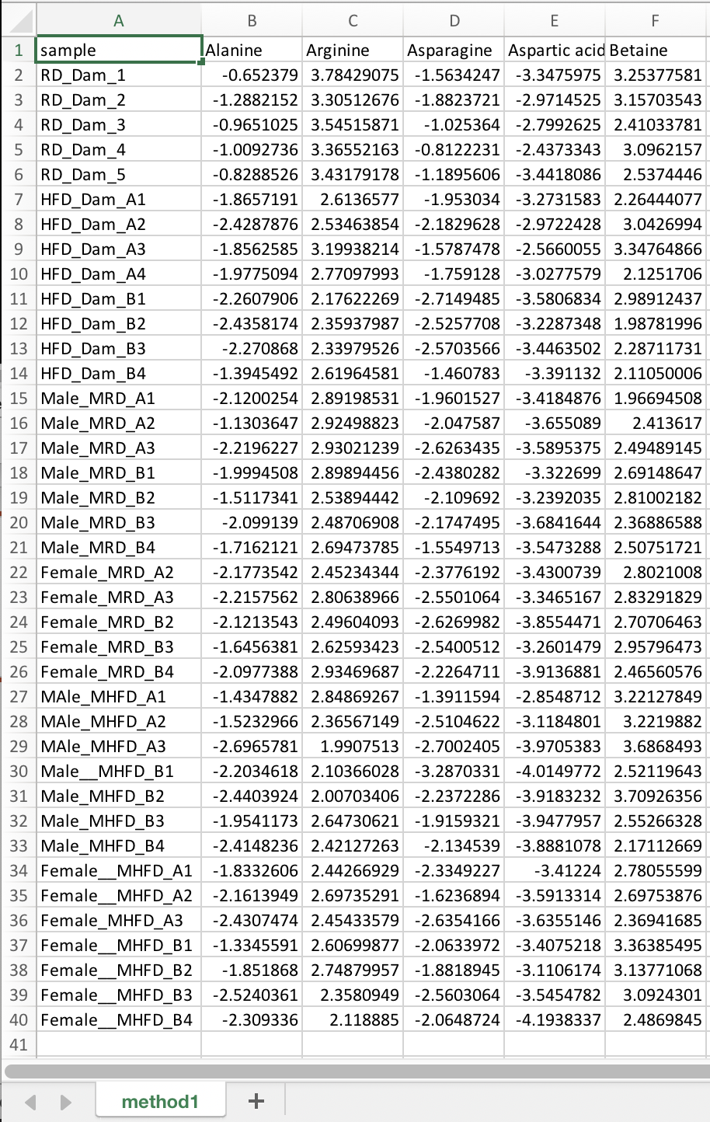
Input File
Rows of samples
First column contains sample names
Remaining columns are features
No NAs or blank cells

Slide 12
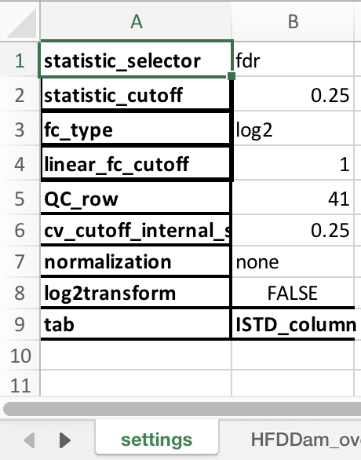
Comparisons File – Settings
statistic_selector: “pval” or “fdr”. Use p-value or FDR for generating filtered heatmaps and signature files?
statistic_cutoff: p-value or FDR threshold for generating filtered heatmaps and signature files.
fc_type: “linear” or “log2”. Calculate linear fold change or log2 fold change?
linear_fc_cutoff: Fold change threshold for generating signature files.
QC_row: row index for the first QC sample.
cv_cutoff_internal_standard: Coefficient of variation (CV) threshold for internal standard (ISTD). Only ISTDs with CV lower than this threshold will be considered for normalization.
normalization: “istd”, “iqr”, or “none”. Type of normalization to be performed – internal standard, interquartile range, or none?
log2transform: Apply log2 transformation?
tab: For ISTD normalization, write down names of all the methods below this. For any other normalization, leave blank.
ISTD_column: For ISTD normalization, write down index of the first (or only) internal standard methods below this for all the methods. For any other normalization, leave blank.

Slide 13
Comparisons File - Comparisons
comparison_name: A label for this comparison. Format must be “testgroup_over_controlgroup” for t-test and “group1_group2_..._groupn” for ANOVA.
test: ”t-test” or “anova”. Which statistical test to perform?
group_order_ctrl_test: order in which to display the comparison groups in boxplots and heatmaps.
group: group that each sample belongs to. This can have all the groups or only groups specific to this comparison.
sample: sample ID for all the samples or only samples belonging to the groups specific to this comparison.
Repeat this process creating a new sheet for all comparisons.

Slide 14
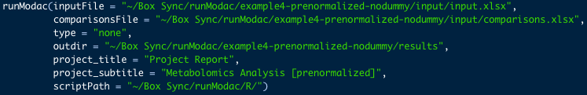
Code
inputFile: path to the input file.
comparisonsFile: path to the comparisons file.
type: “metabolomics”, “rppa”, or “none”. Use “none” for prenormalized data.
outdir: path to output directory.
project_title: project title to be used in the summary pptx.
project_subtitle: project subtitle to be used in the summary pptx.
scriptPath: path to R folder within the runMODAC folder on your system.

Slide 15
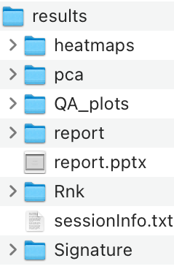
Results
heatmaps: folder containing heatmaps in .jpg and .pdf format with supporting data used to generate the heatmap available in a .csv file.
pca: folder containing pca plots in .jpg and .pdf format with supporting data used to generate the pca plots available in a .xlsx file.
QA_plots: folder containing boxplots of the combined normalized data and normalized data per method as well as internal standard distribution and QC samples distribution plot per method.
report: folder containing raw combined data, normalized data, and for each comparison, boxplots of all features and statistical test report files.
report.pptx: presentation containing a summary of the results.
Rnk: folder containing the rank files for each comparison.
sessionInfo.txt: text file containing your R session information.
Signature: folder containing the signature files for each comparison.

Slide 16
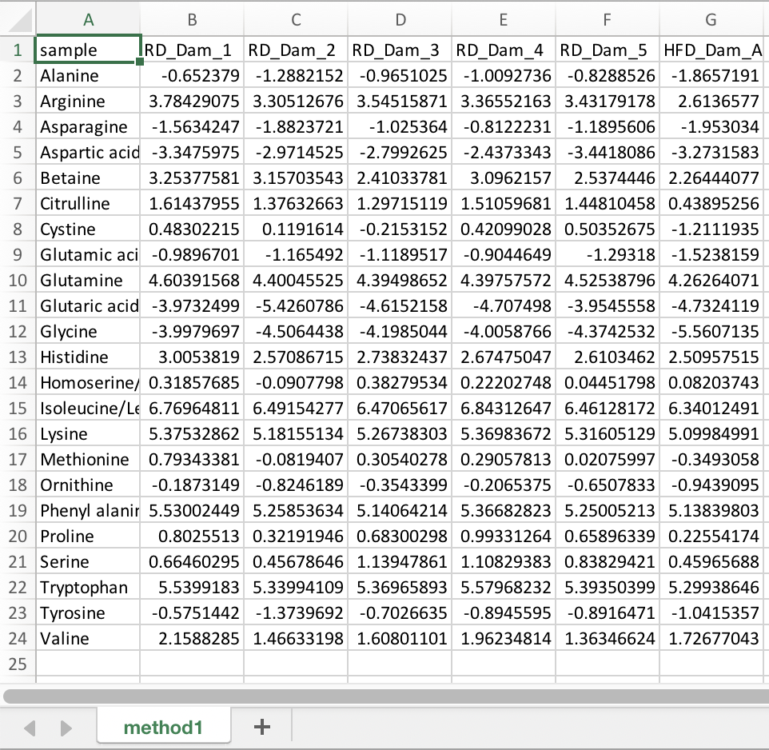
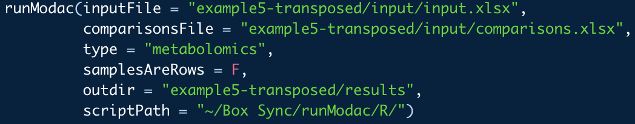
Example 3 – Transposed Data

Slide 17
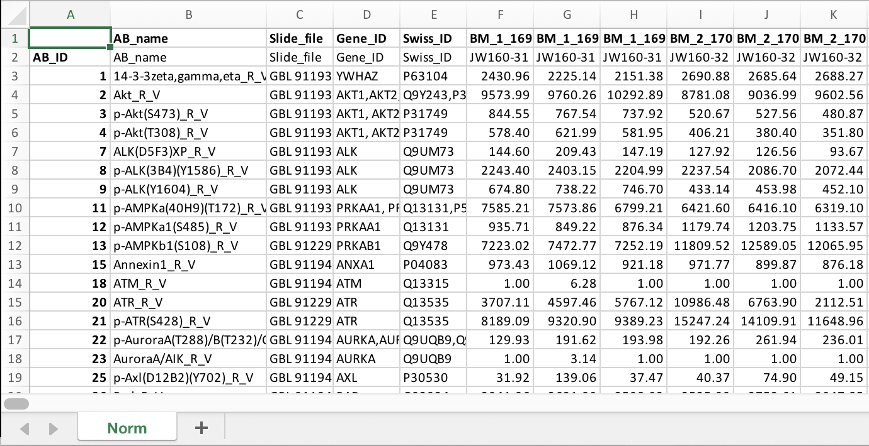
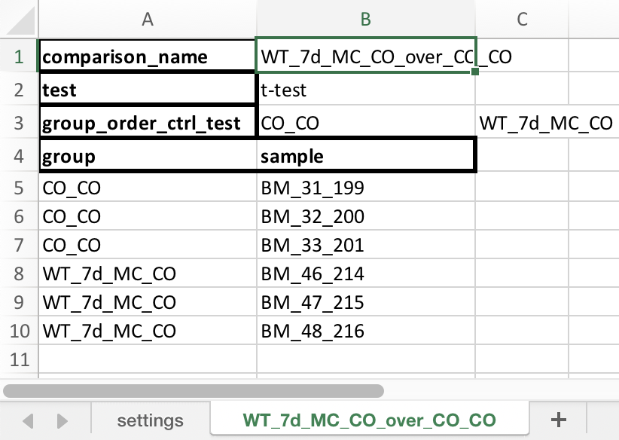
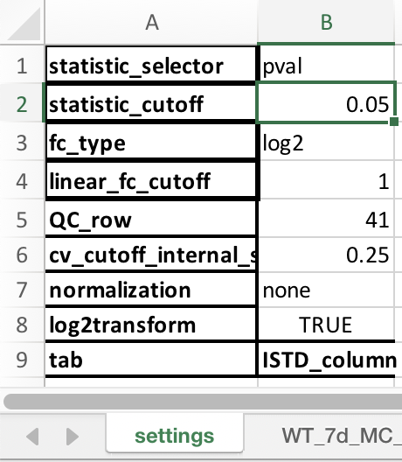
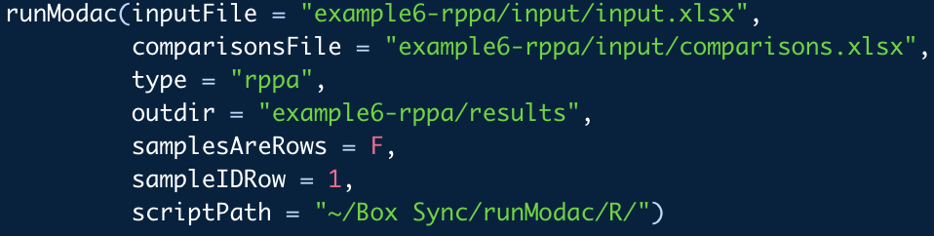
Example 4 – RPPA Data

