Slide 1
Project Report
Metabolomics Analysis

Slide 2
Project Overview
Samples
39 experimental samples
3 liver control samples
Total of 23 features from 1 methods
AminoAcids was normalized by Internal Standard L-Tryptophan (ISTD) [CV = 0.05]
Comparisons performed
t-test
HFDDam_over_RDDam
MaleMHFD_over_MaleMRD
FemMHFD_over_FemMRD
anova
RDDam_HFDDam_MaleMRD_MaleMHFD_FemMRD_FemMHFD

Slide 3
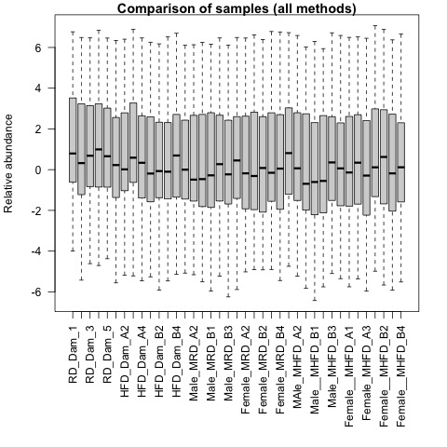
QA plots: all_samples

Slide 4

QA plots: AminoAcids

Slide 5
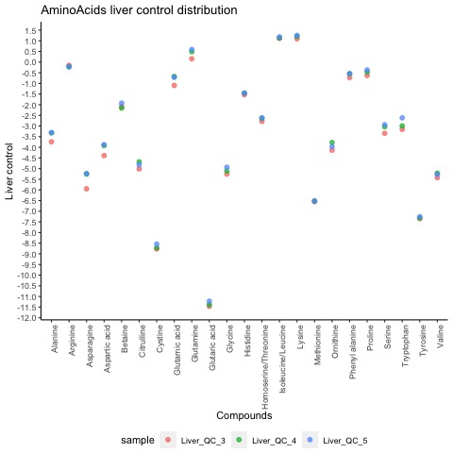
Liver Control: AminoAcids

Slide 6
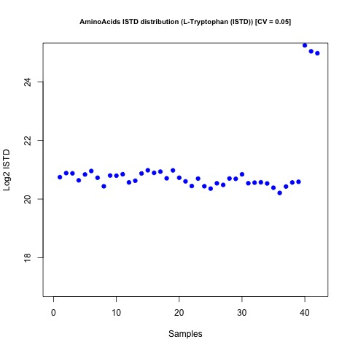
Internal Standards Distribution: AminoAcids

Slide 7
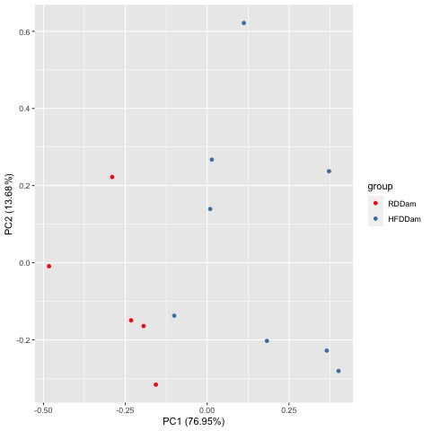
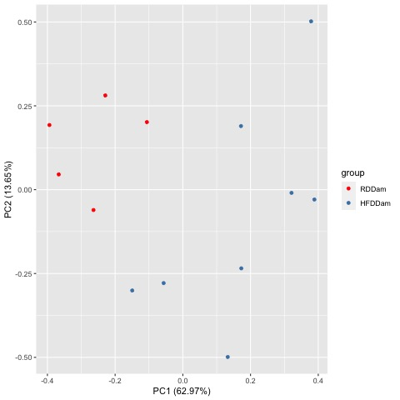
Comparison HFDDam_over_RDDam
Raw PCA
Normalized PCA

Slide 8
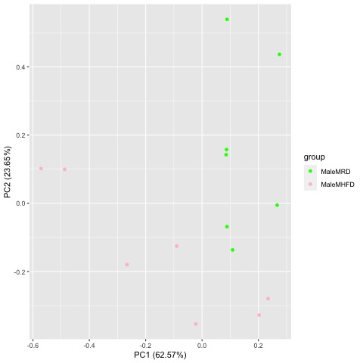
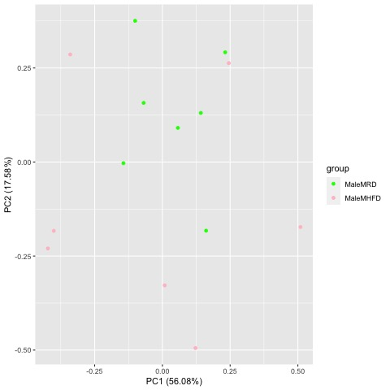
Comparison MaleMHFD_over_MaleMRD
Raw PCA
Normalized PCA

Slide 9
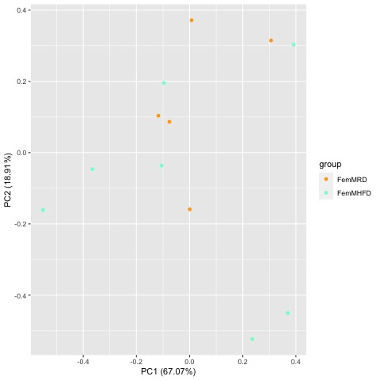
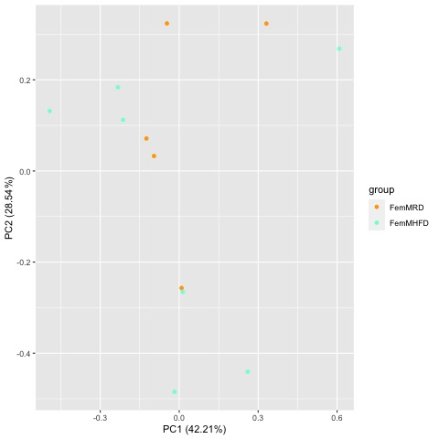
Comparison FemMHFD_over_FemMRD
Raw PCA
Normalized PCA

Slide 10
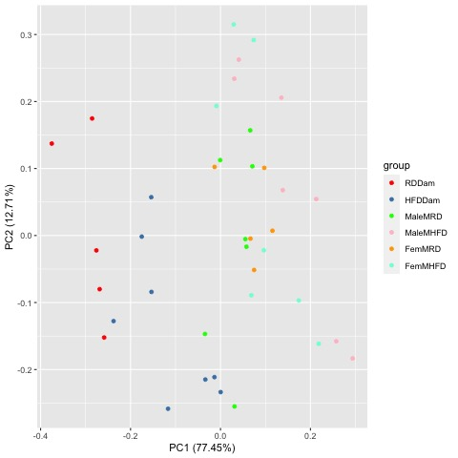
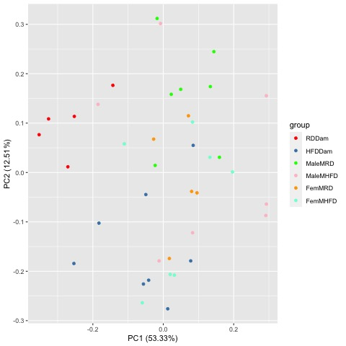
Comparison RDDam_HFDDam_MaleMRD_MaleMHFD_FemMRD_FemMHFD
Raw PCA
Normalized PCA

Slide 11
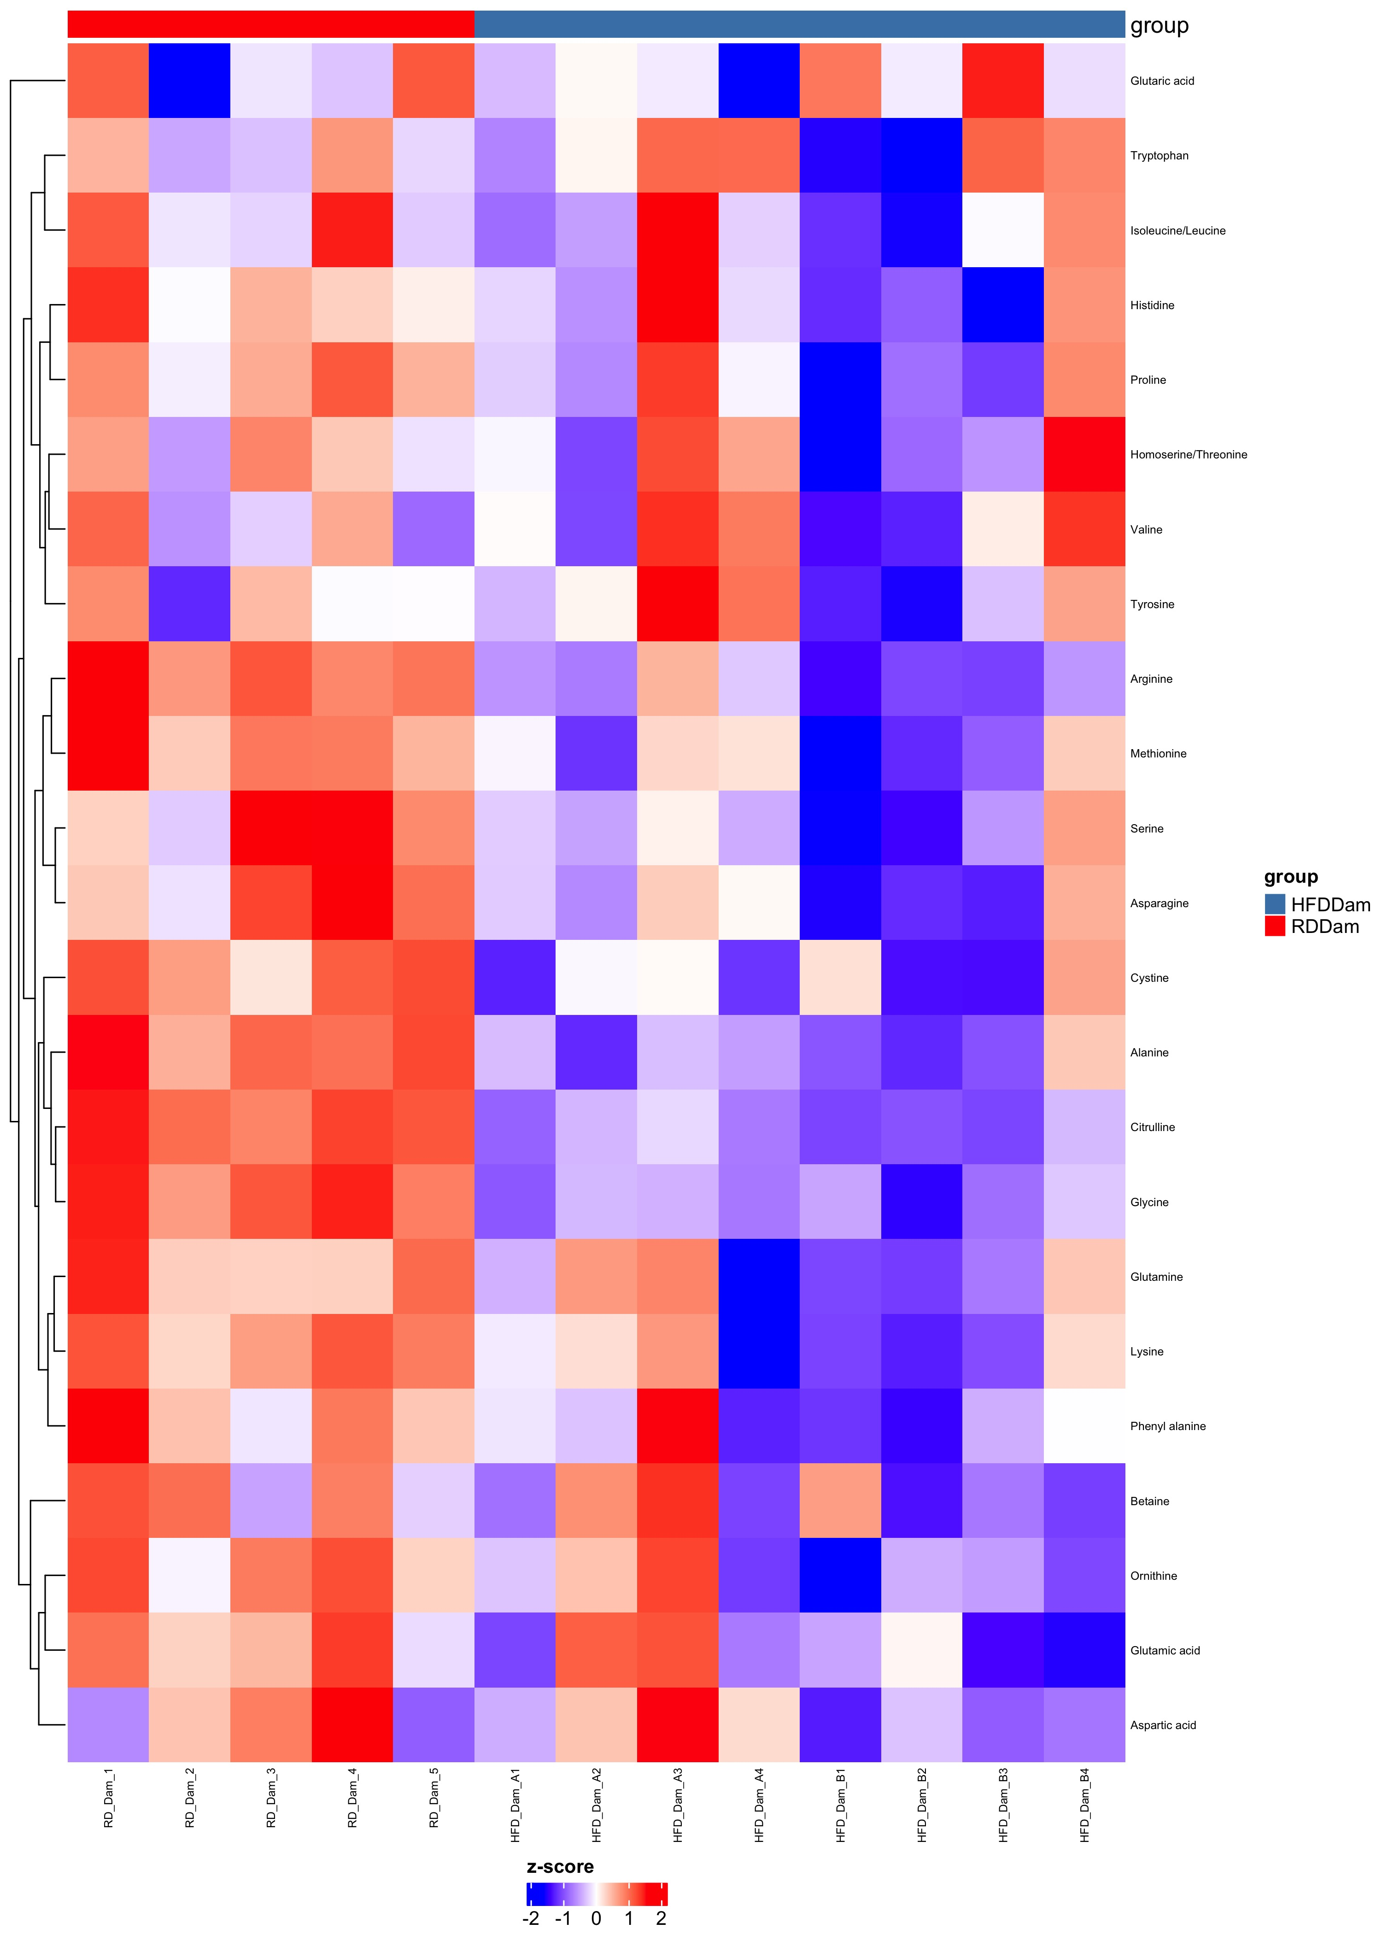
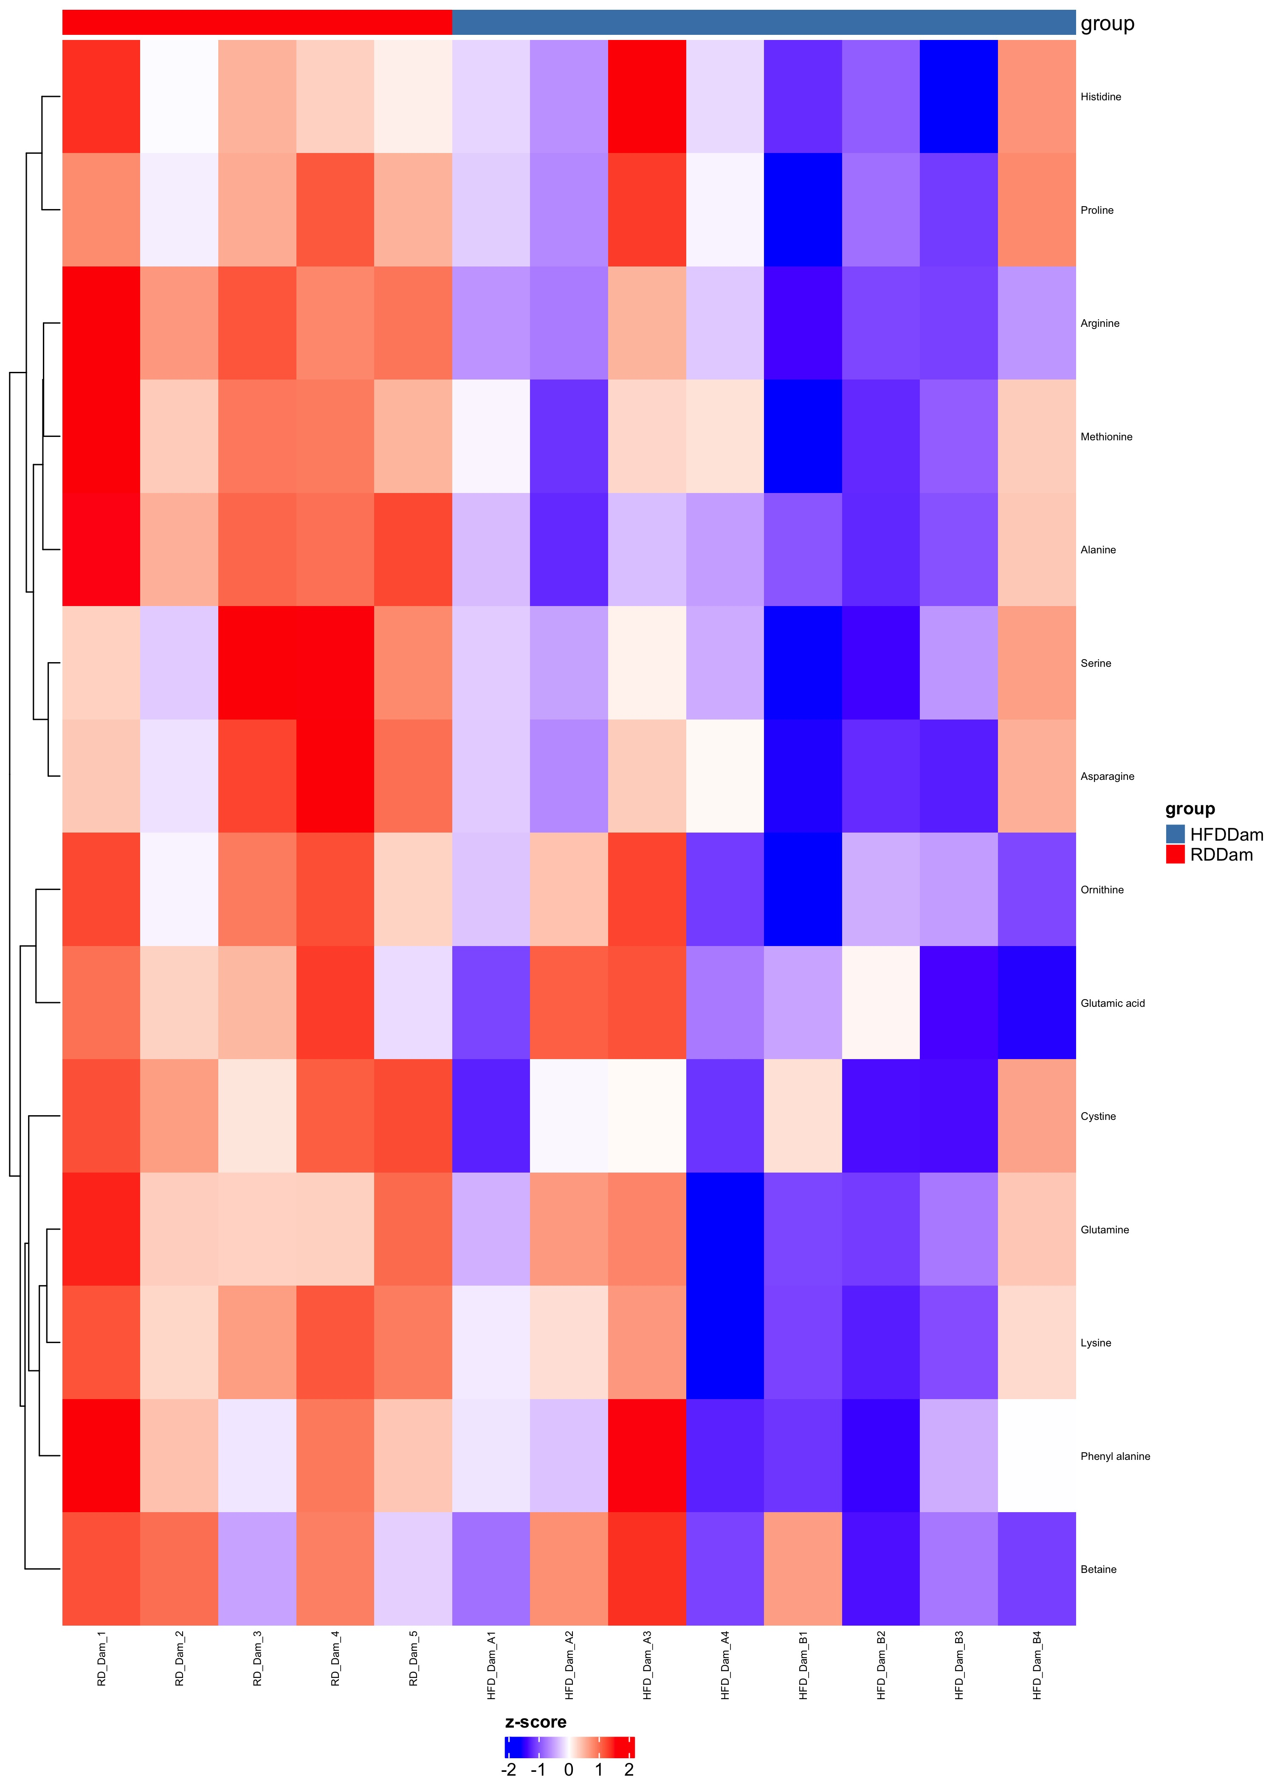
Comparison HFDDam_over_RDDam
Complete Set FDR=1
Differential FDR<0.25

Slide 12
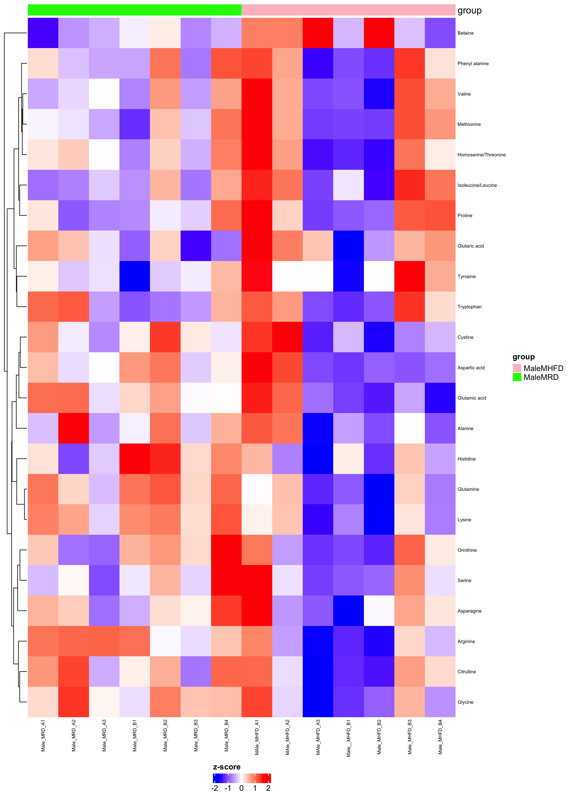
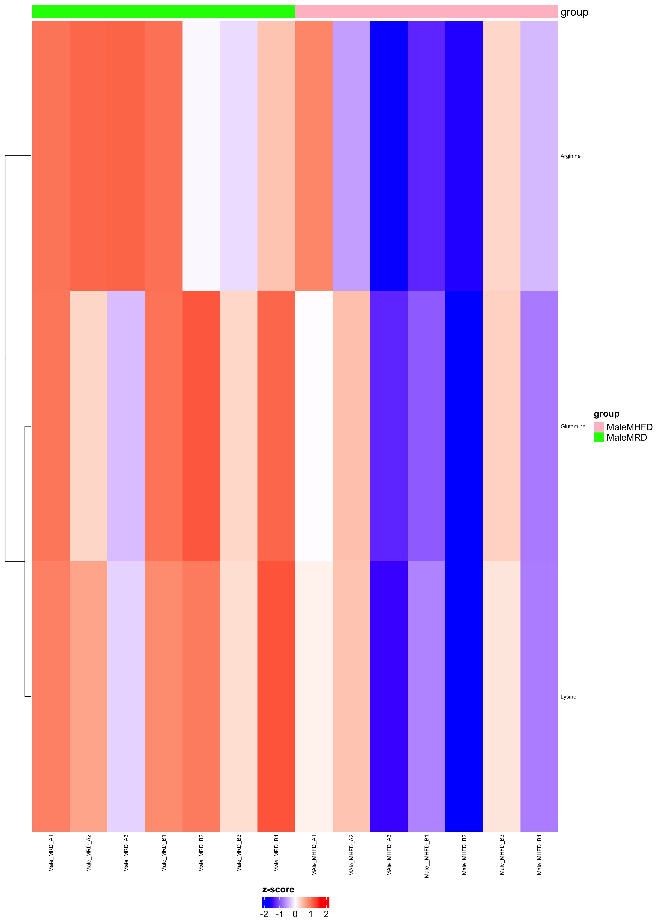
Comparison MaleMHFD_over_MaleMRD
Complete Set FDR=1
Differential FDR<0.25

Slide 13
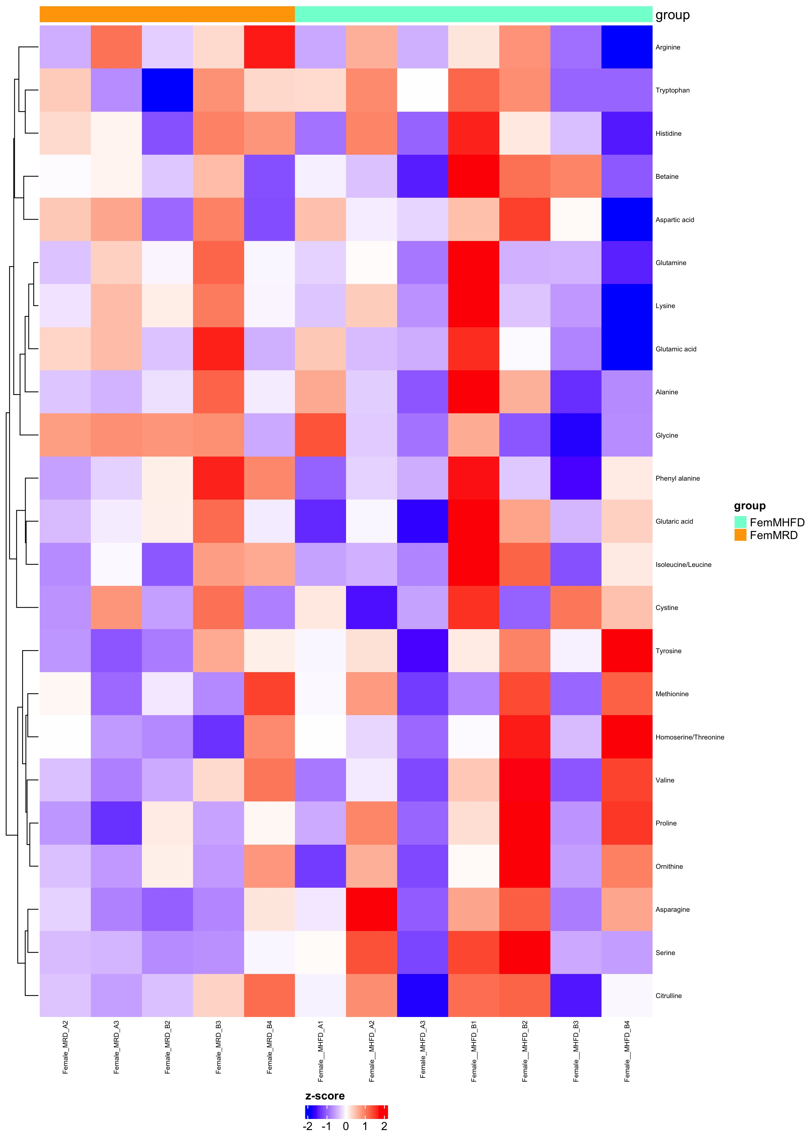
Comparison FemMHFD_over_FemMRD
Complete Set FDR=1
Differential FDR<0.25

Slide 14
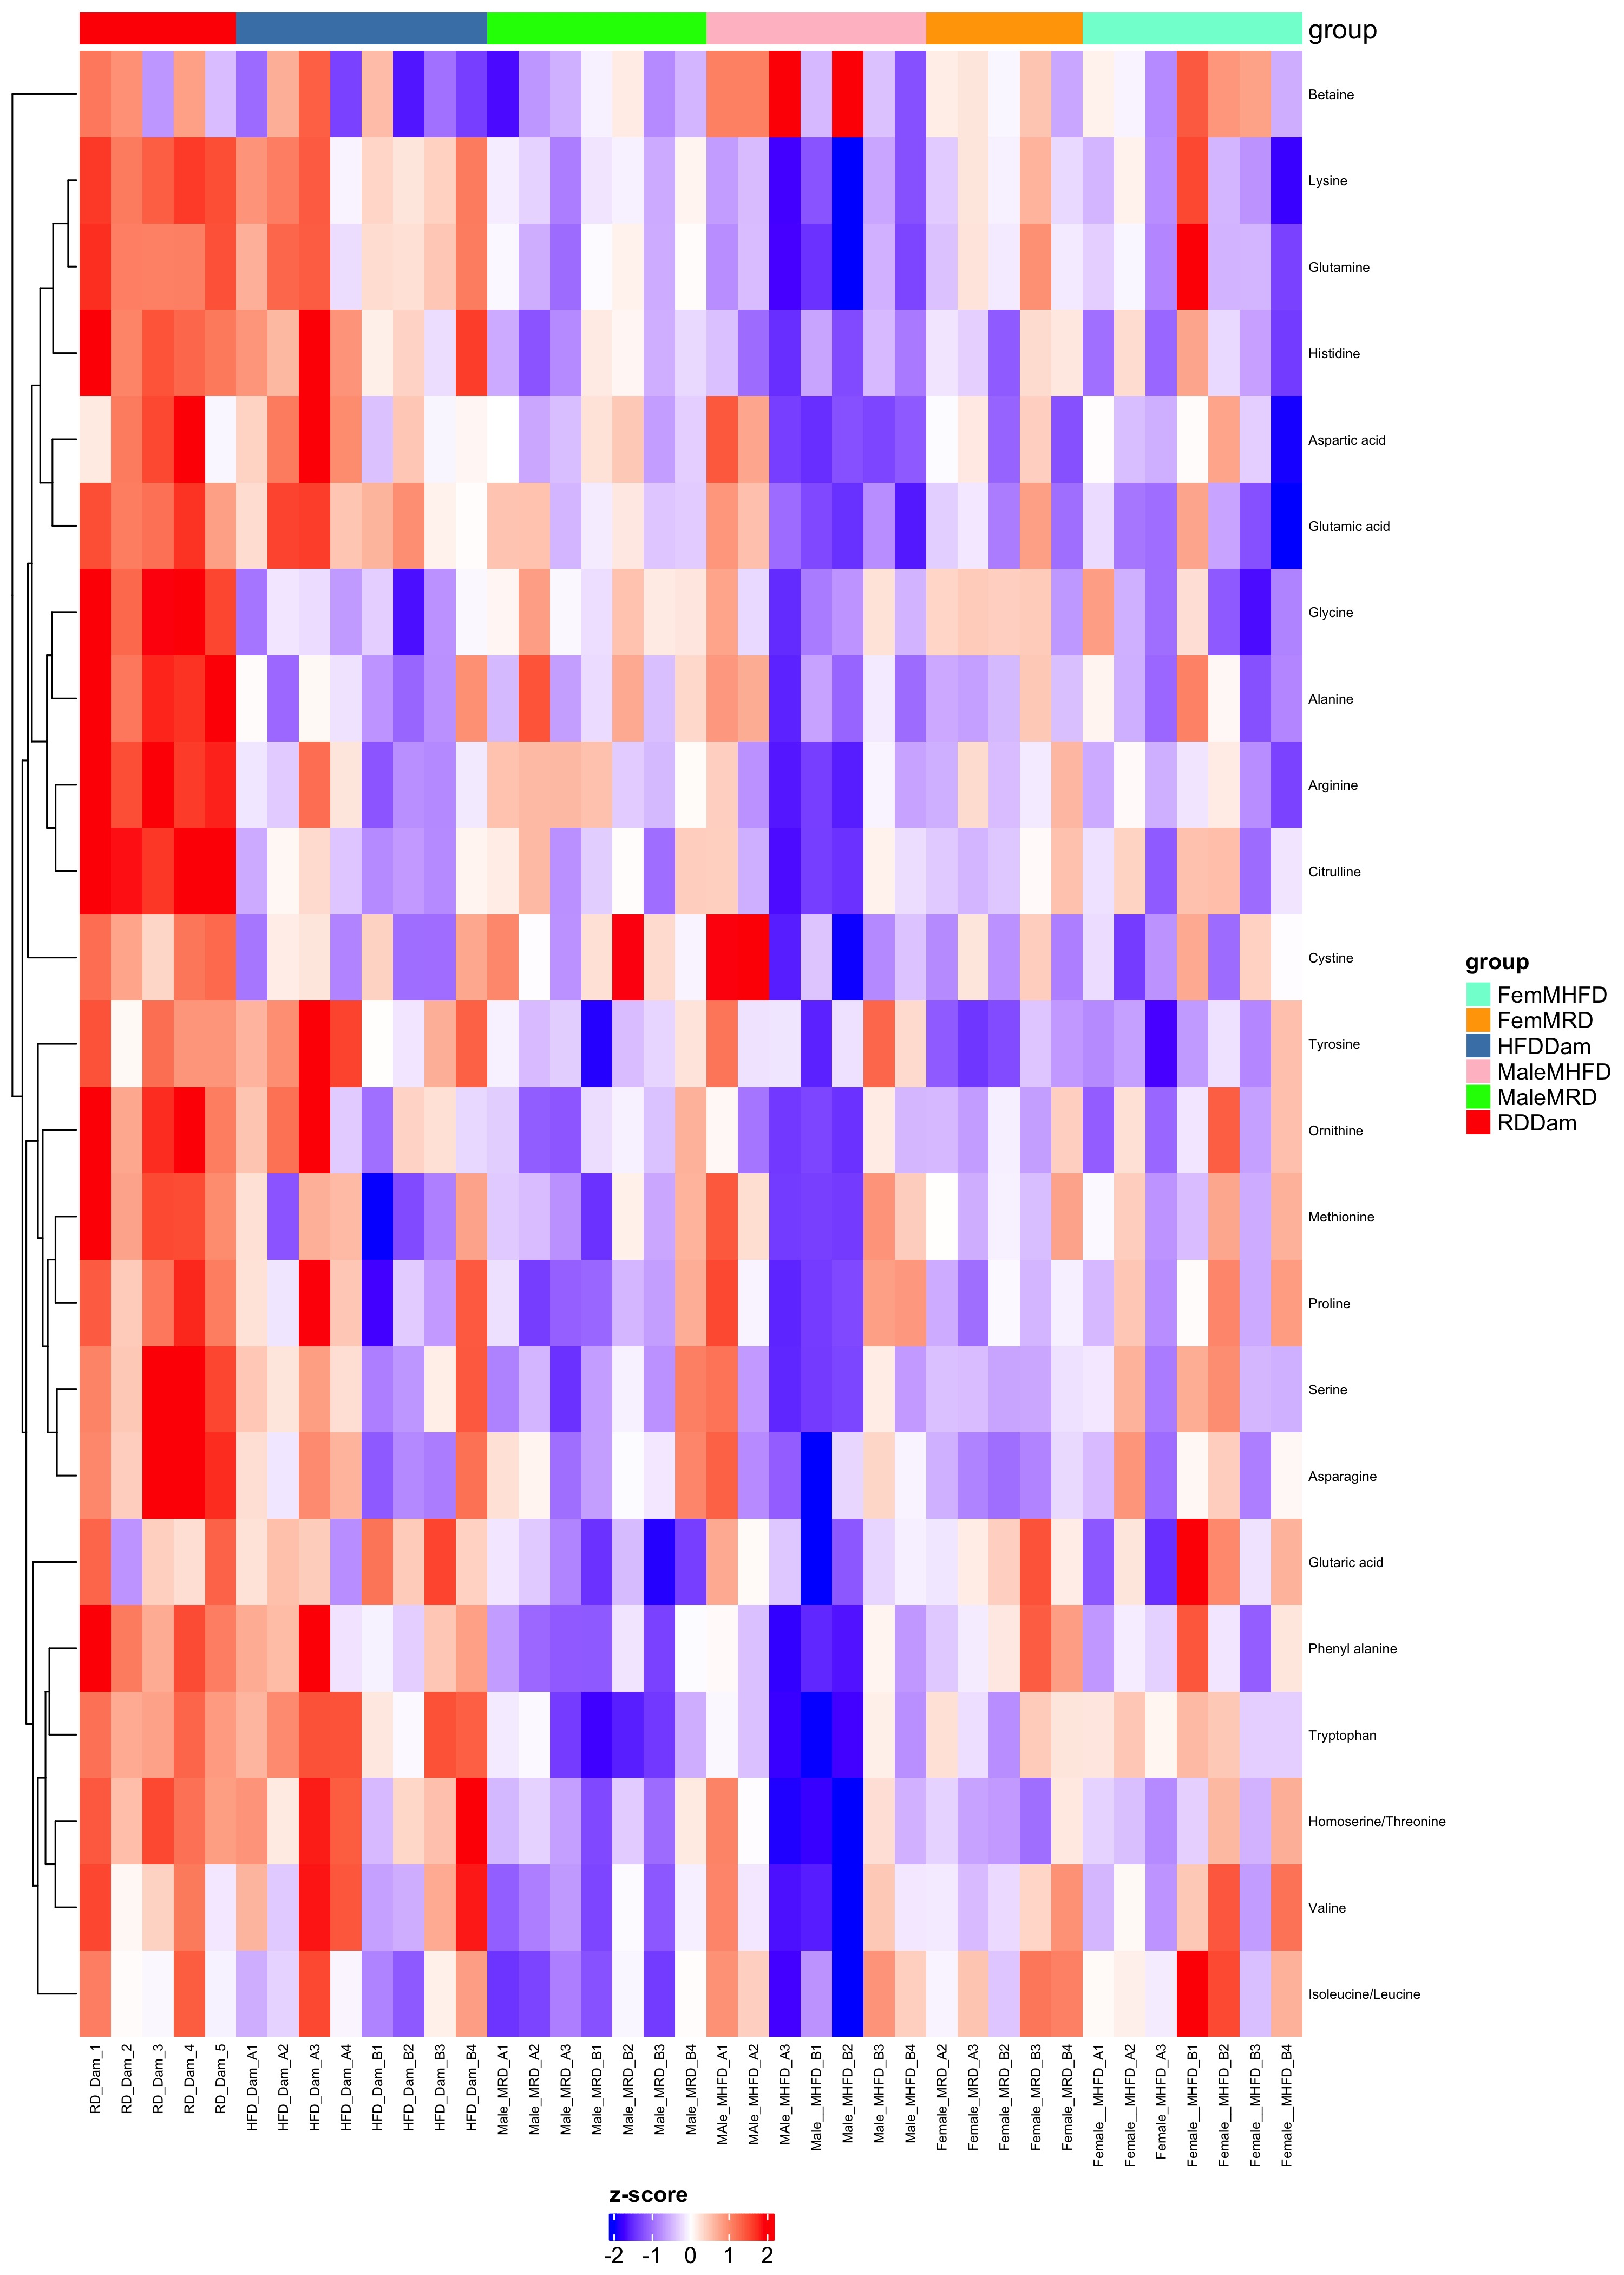
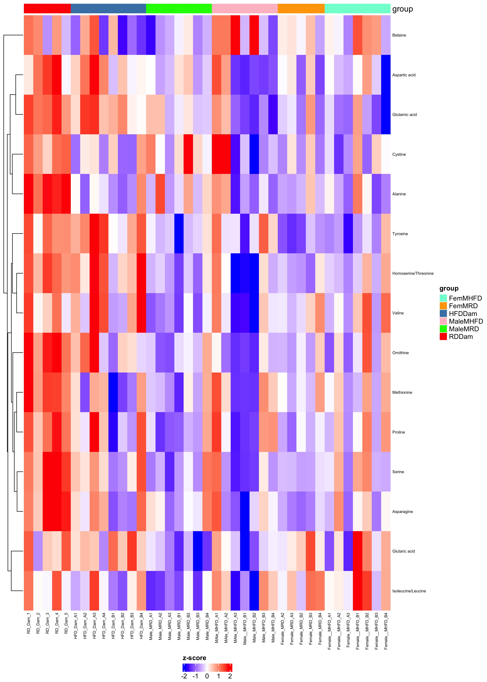
Comparison RDDam_HFDDam_MaleMRD_MaleMHFD_FemMRD_FemMHFD
Complete Set FDR=1
Differential FDR<0.25

