Slide 1
Project Report
Metabolomics Analysis [prenormalized]

Slide 2
Project Overview
Samples
39 experimental samples
Total of 23 features from 1 methods
Data was prenormalized
Comparisons performed
t-test
HFDDam_over_RDDam
MaleMHFD_over_MaleMRD
FemMHFD_over_FemMRD
anova
MaleMRD_MaleMHFD_FemMRD_FemMHFD

Slide 3
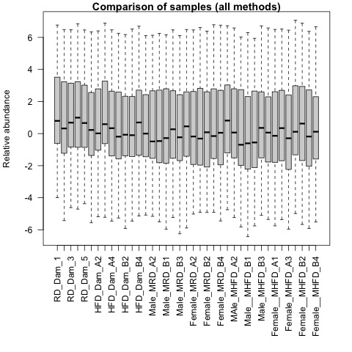
QA plots: all_samples

Slide 4
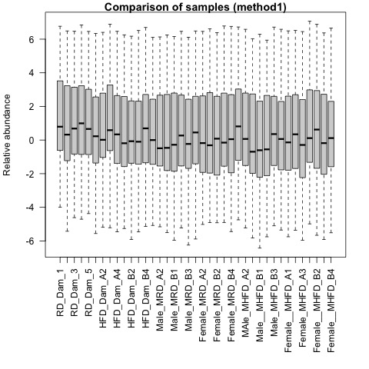
QA plots: method1

Slide 5
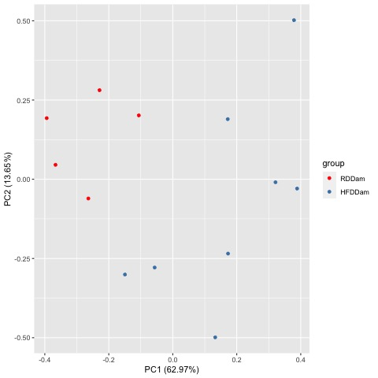
Comparison HFDDam_over_RDDam
Raw PCA
Normalized PCA

Slide 6
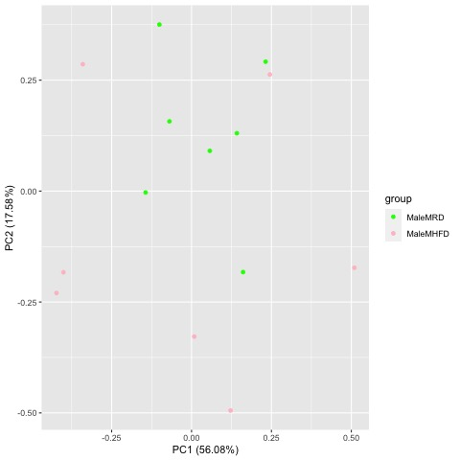
Comparison MaleMHFD_over_MaleMRD
Raw PCA
Normalized PCA

Slide 7
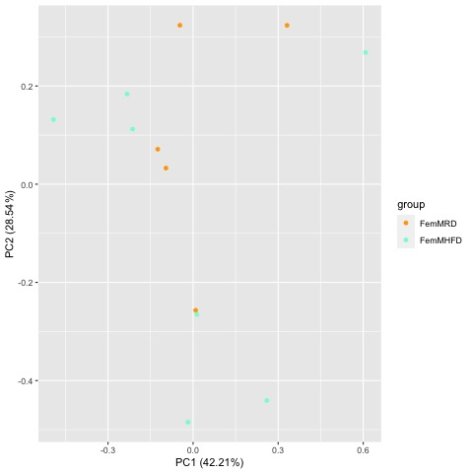
Comparison FemMHFD_over_FemMRD
Raw PCA
Normalized PCA

Slide 8
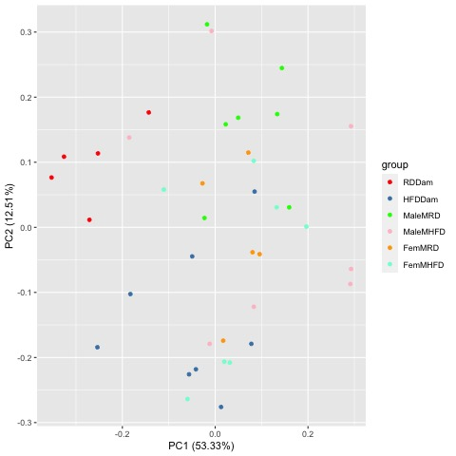
Comparison MaleMRD_MaleMHFD_FemMRD_FemMHFD
Raw PCA
Normalized PCA

Slide 9
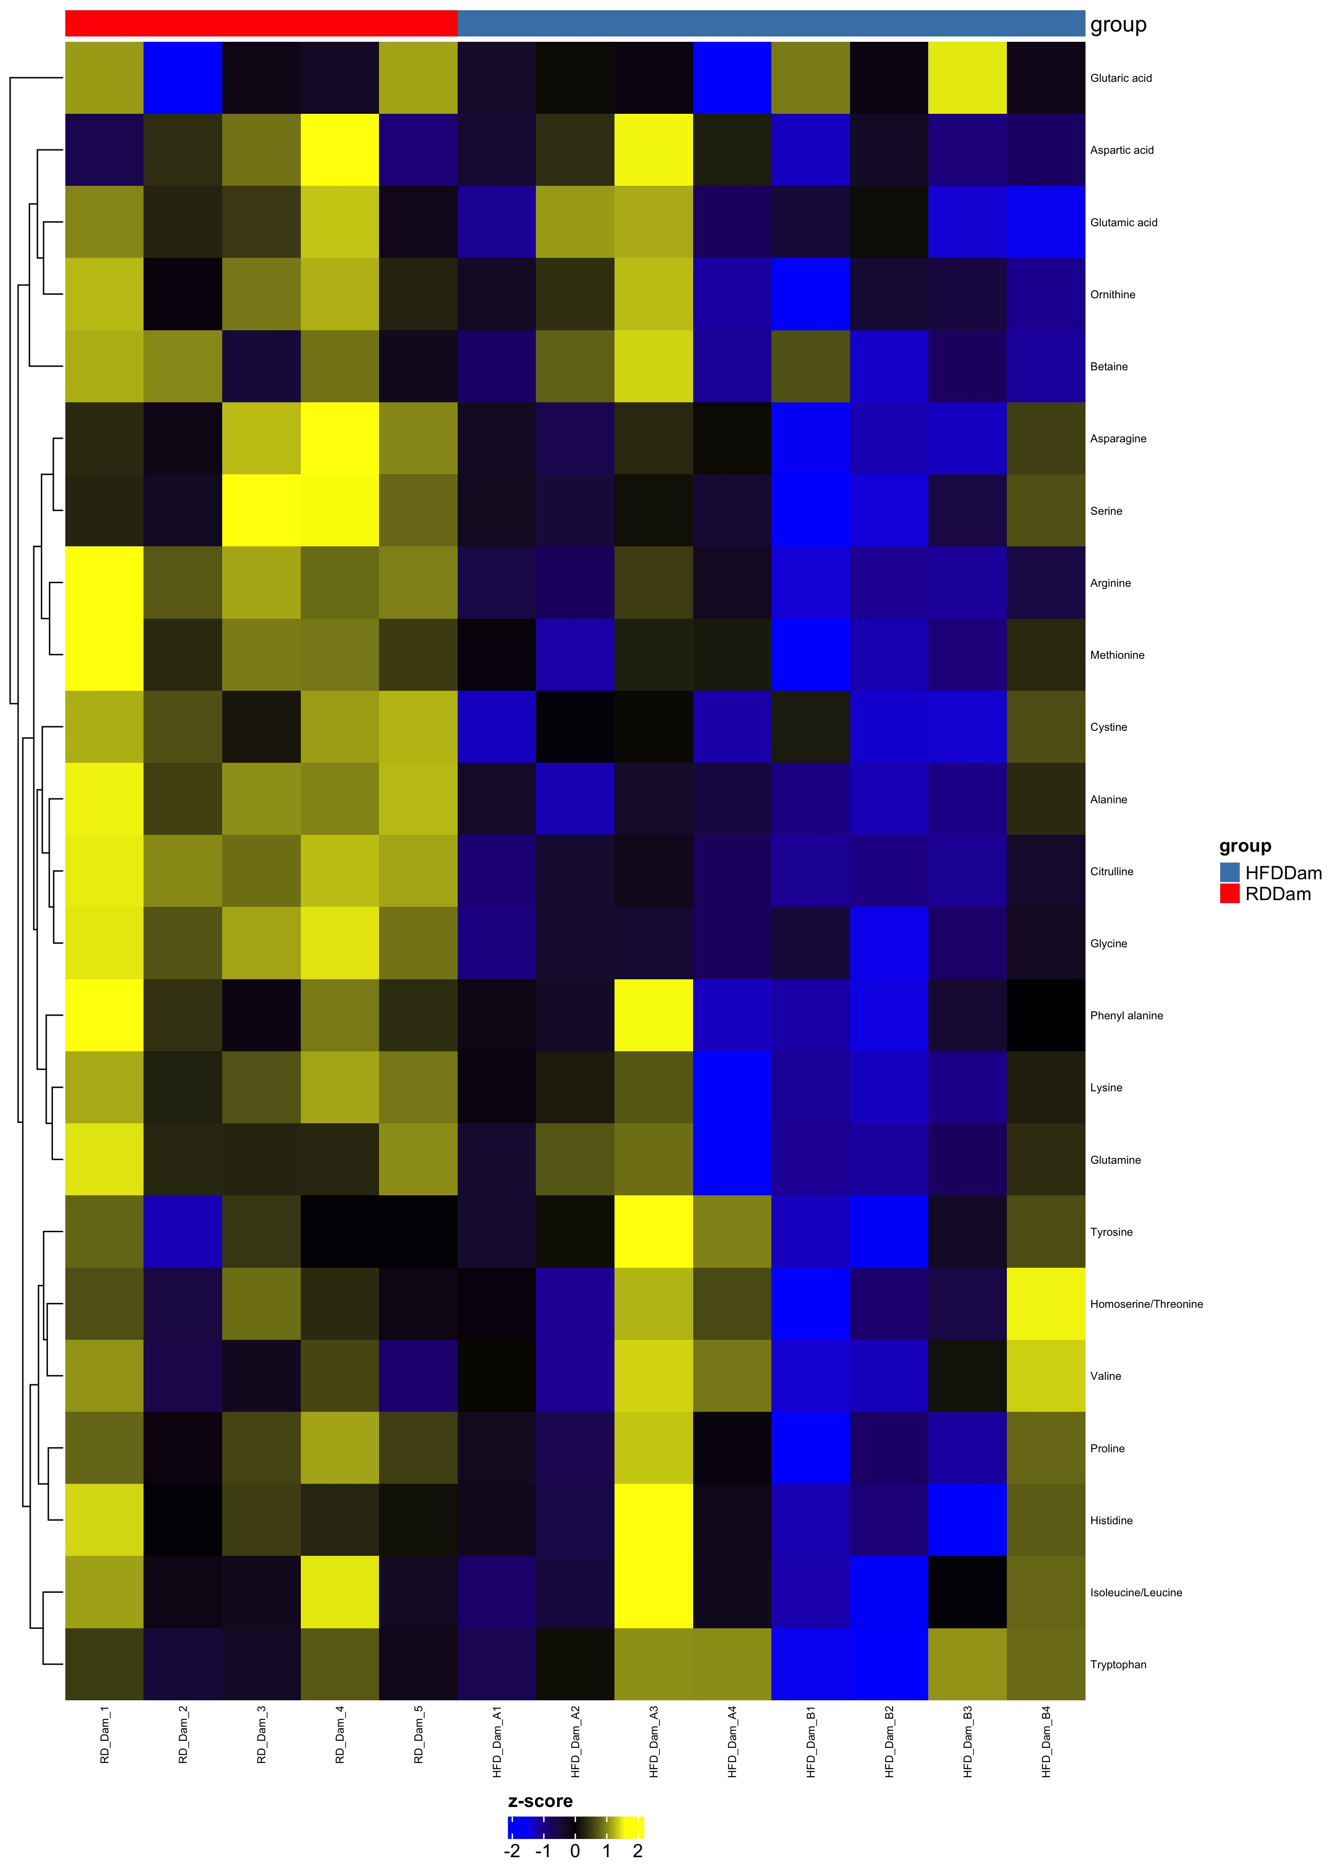
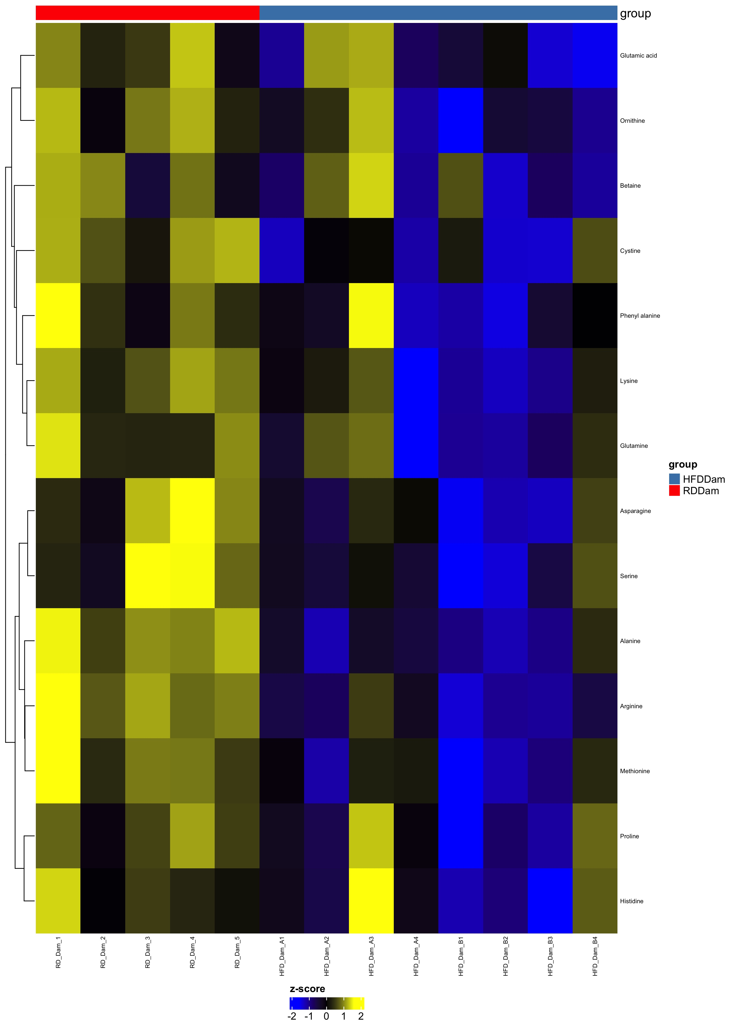
Comparison HFDDam_over_RDDam
Complete Set FDR=1
Differential FDR<0.25

Slide 10
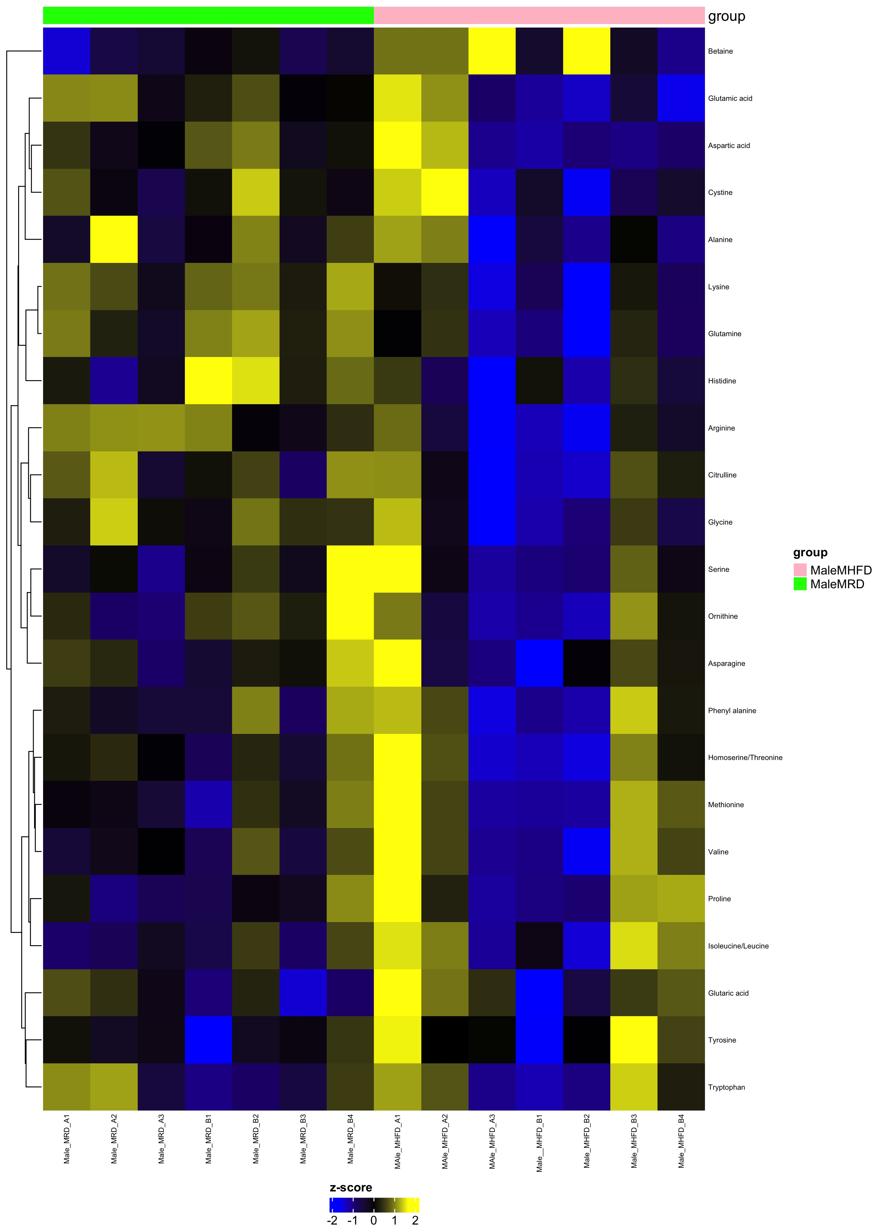
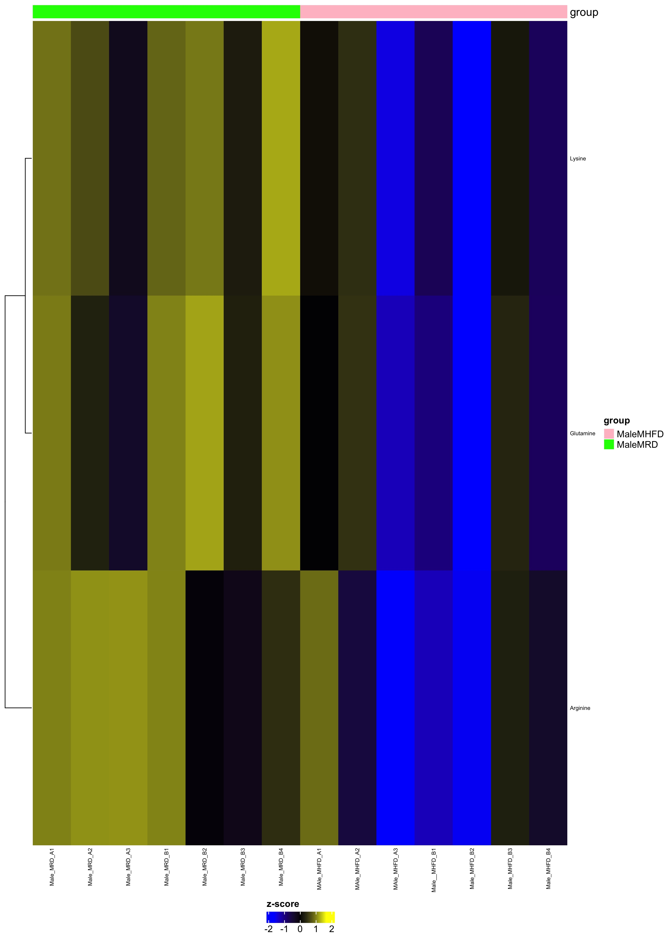
Comparison MaleMHFD_over_MaleMRD
Complete Set FDR=1
Differential FDR<0.25

Slide 11
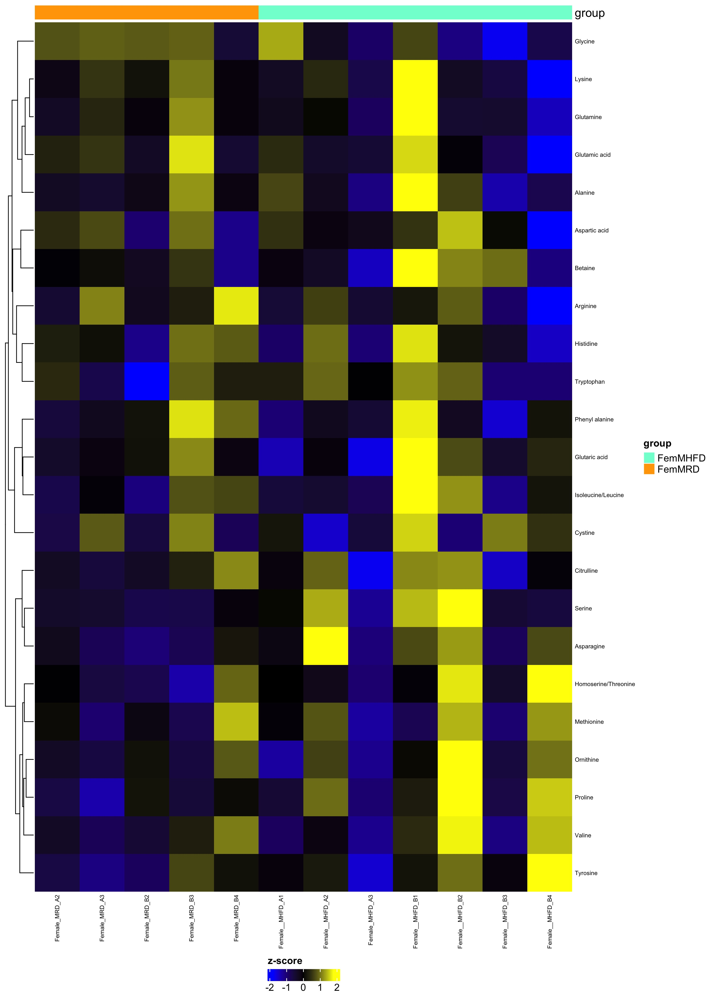
Comparison FemMHFD_over_FemMRD
Complete Set FDR=1
Differential FDR<0.25

Slide 12
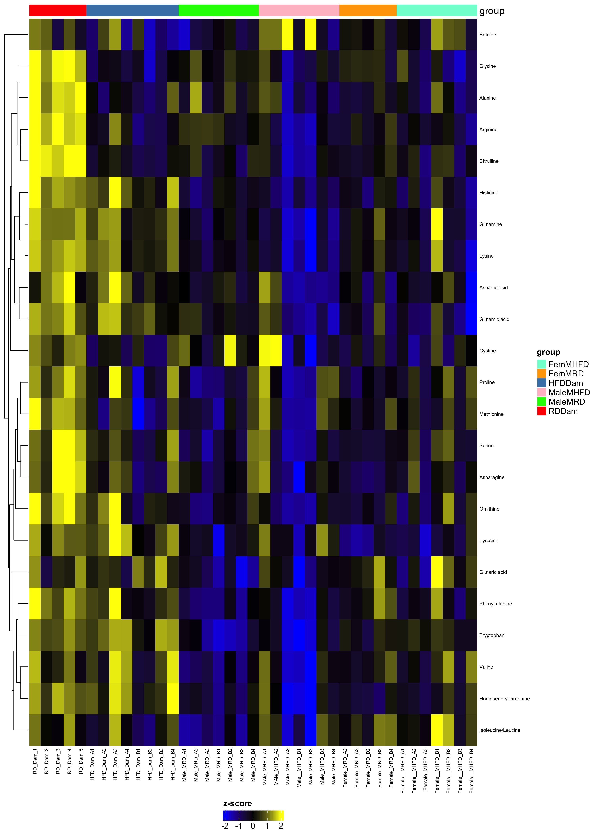
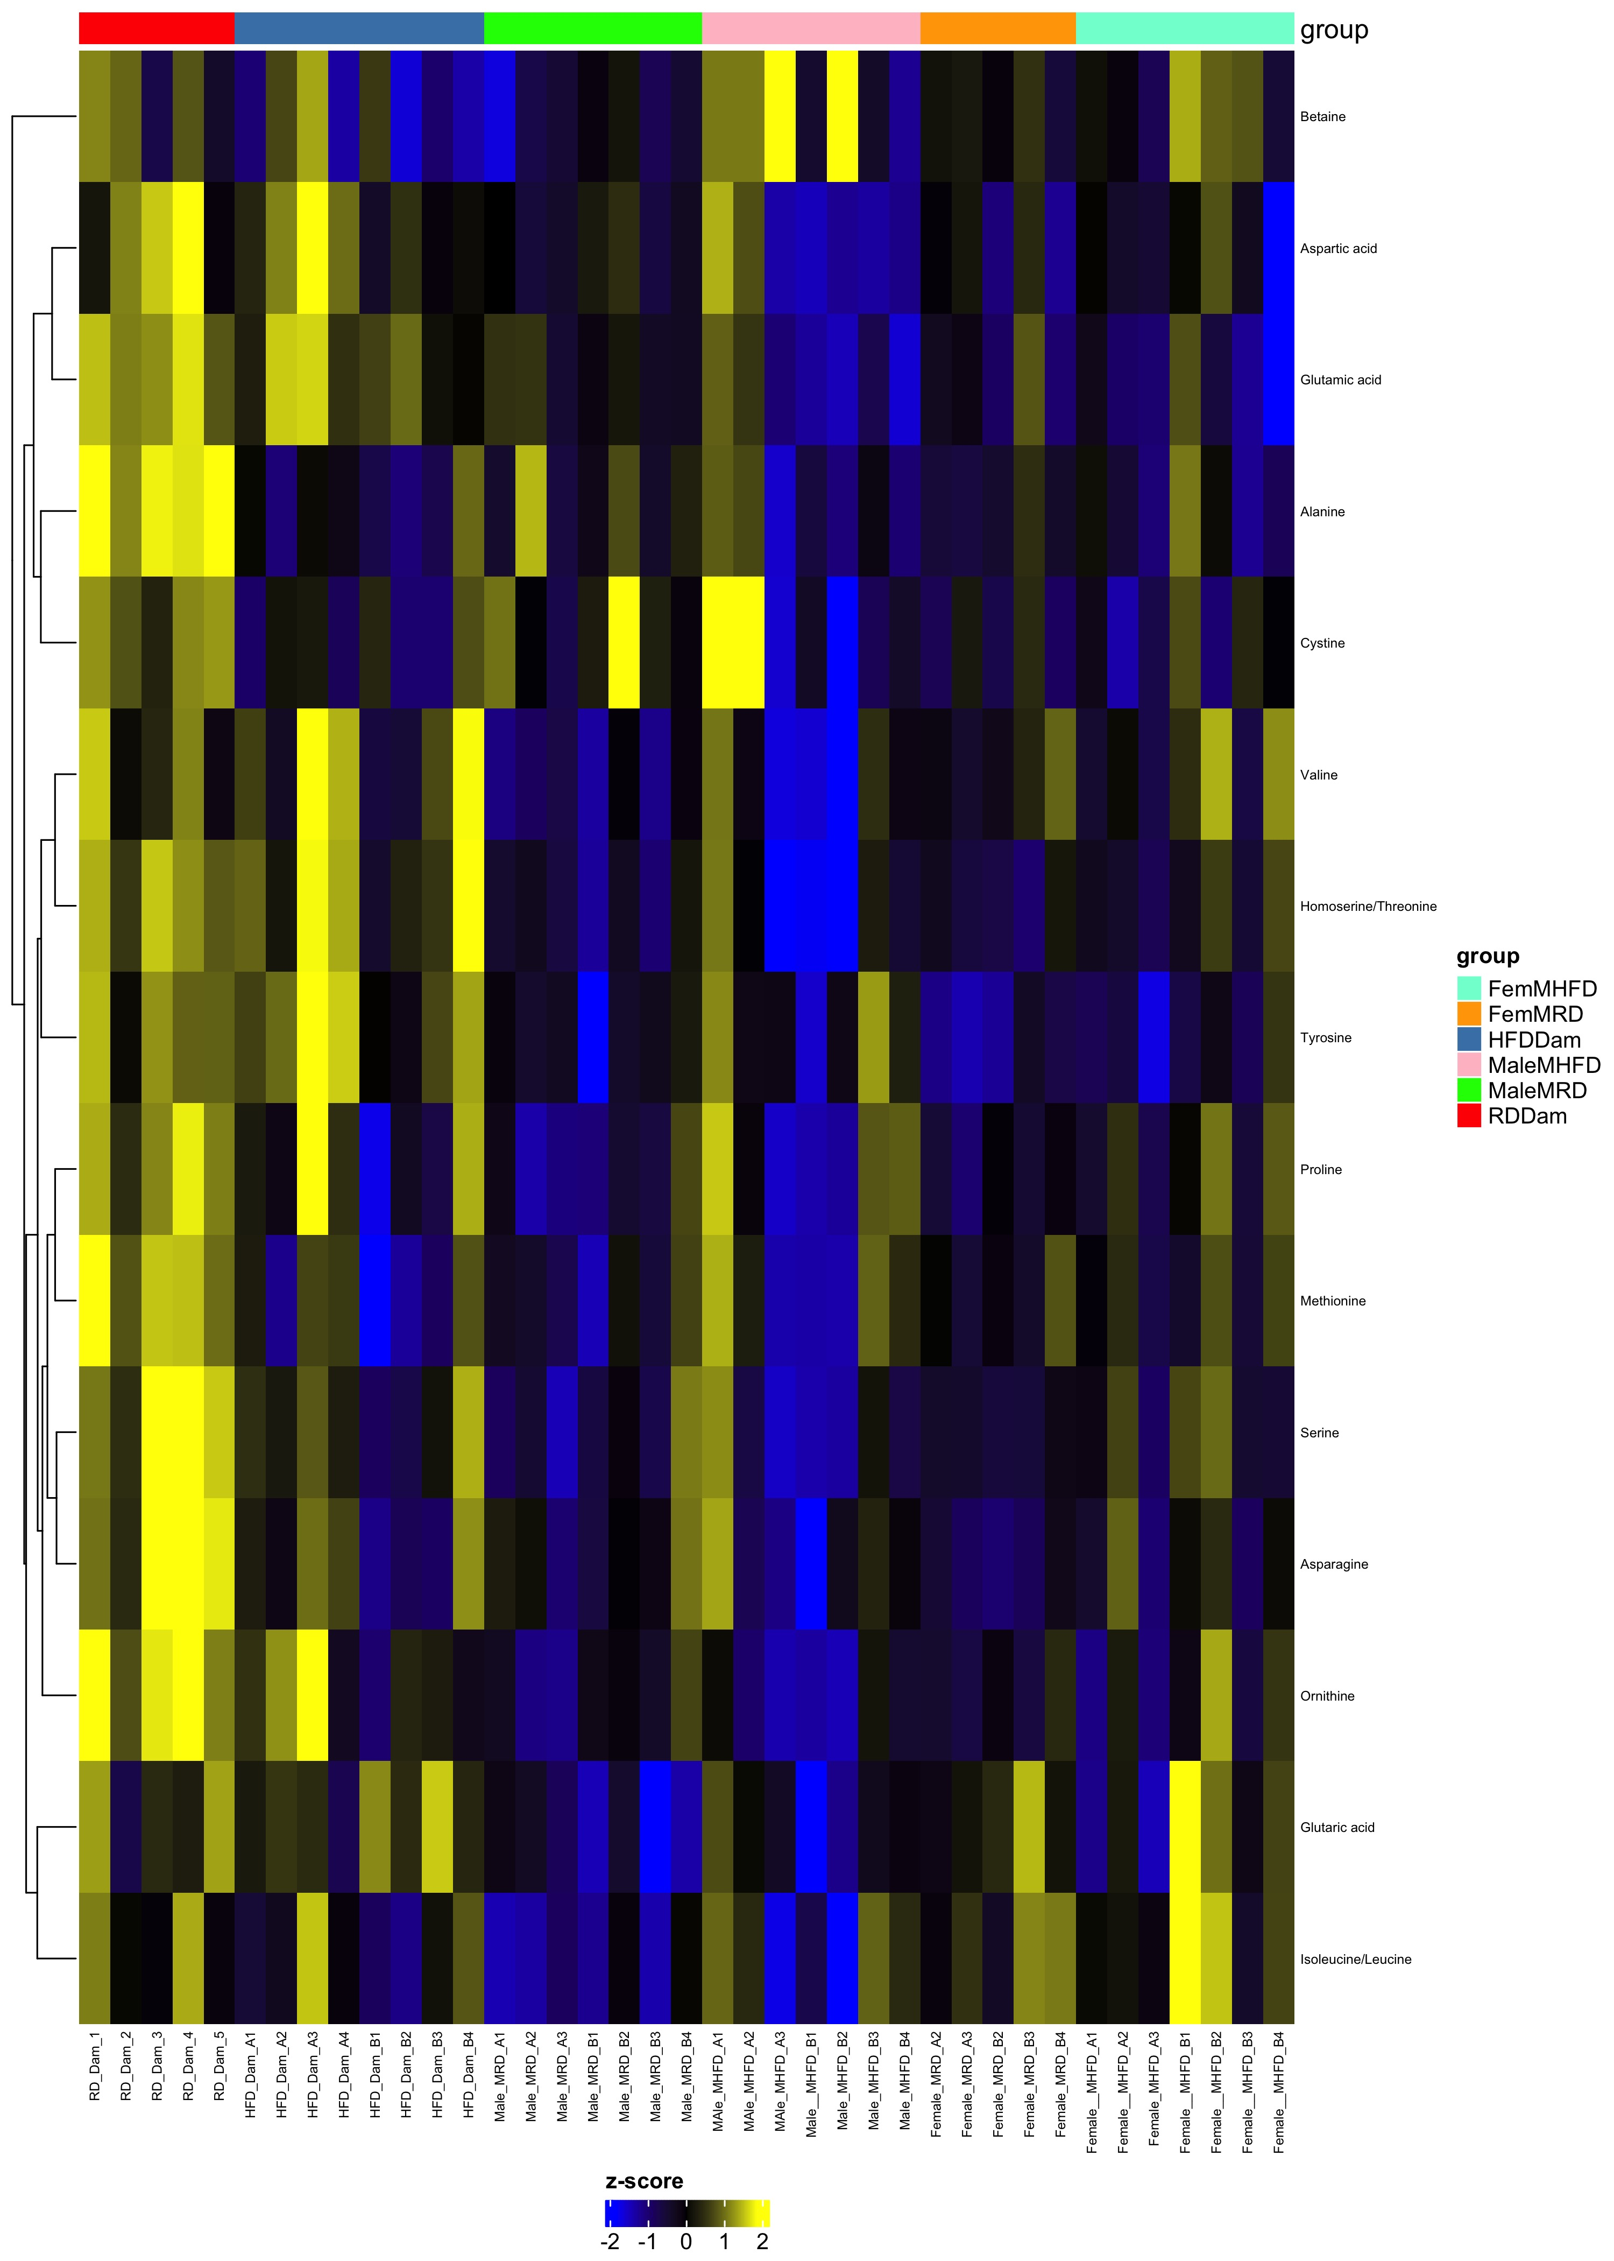
Comparison MaleMRD_MaleMHFD_FemMRD_FemMHFD
Complete Set FDR=1
Differential FDR<0.25

