Slide 1
Project Report
Metabolomics Analysis

Slide 2
Project Overview
Samples
300 experimental samples
Total of 208 features from 1 methods
Data was log2 transformed
Comparisons performed
t-test
WT_7d_MC_CO_over_CO_CO

Slide 3
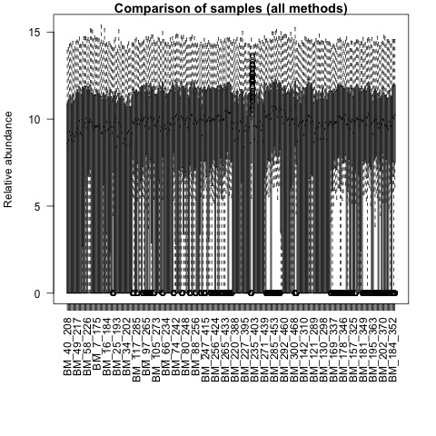
QA plots: all_samples

Slide 4

QA plots: rppa

Slide 5
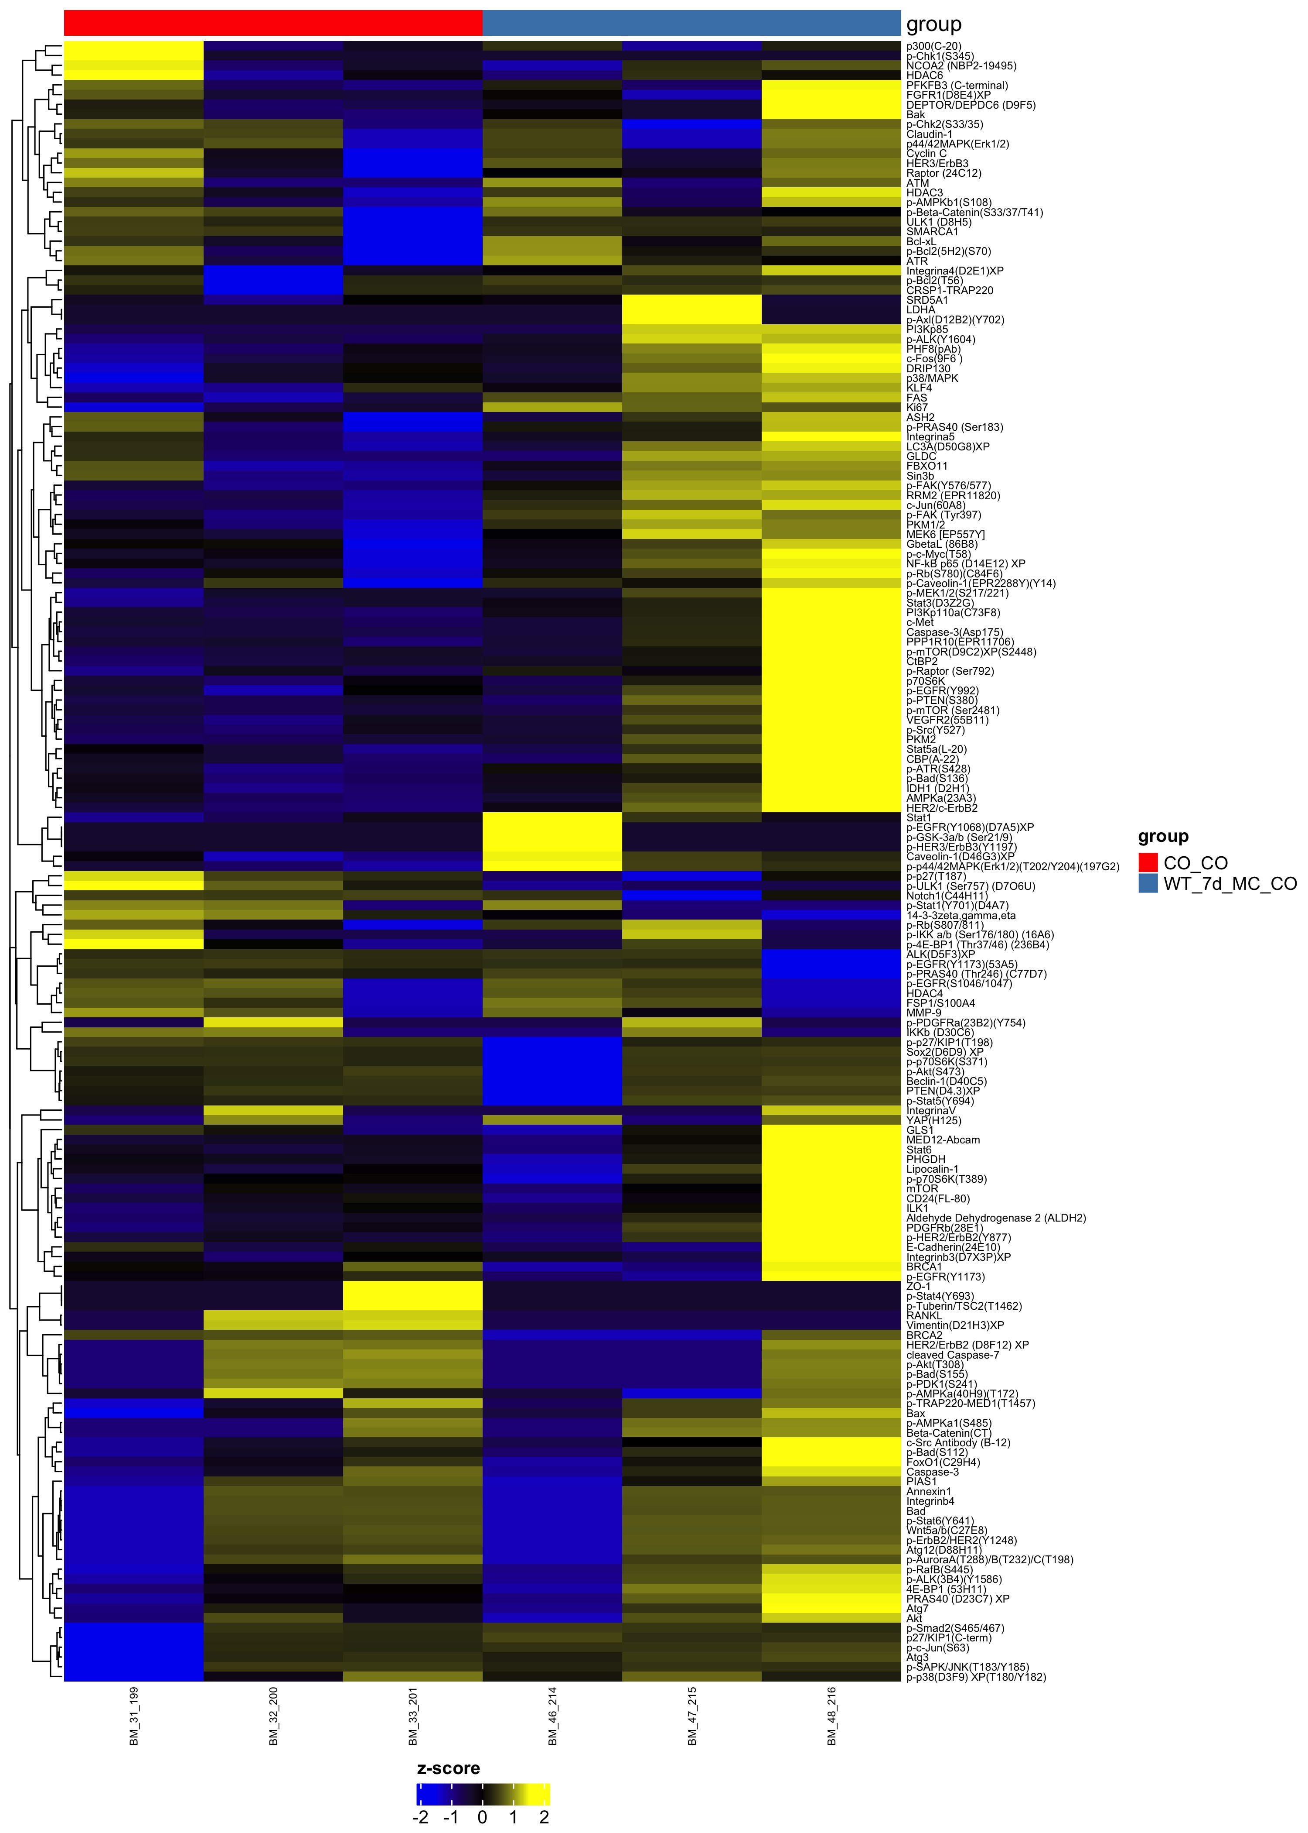
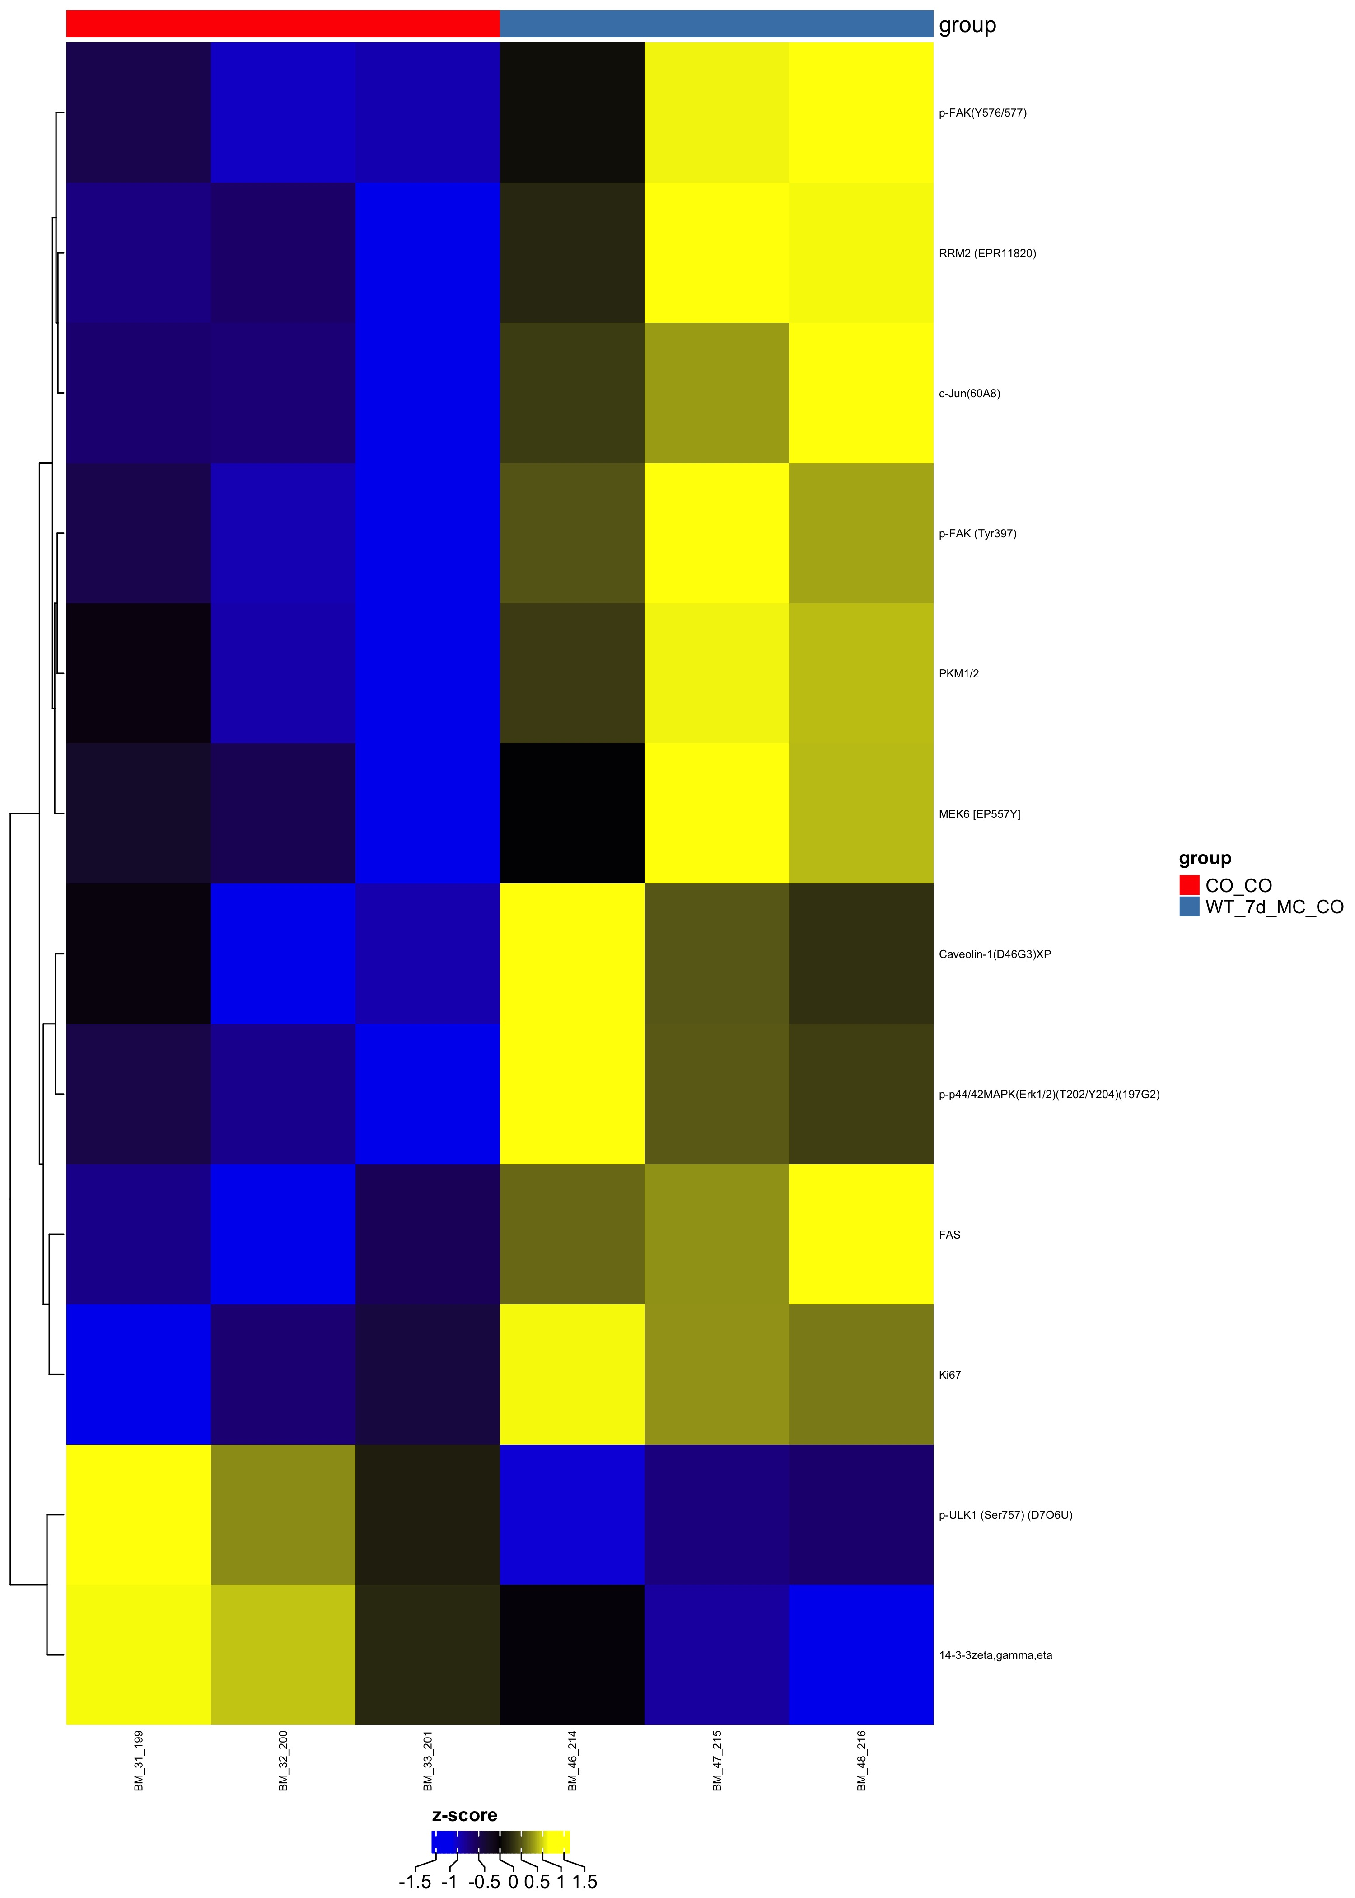
Comparison WT_7d_MC_CO_over_CO_CO
Complete Set FDR=1
Differential FDR<0.25

